Slide 1
T1C8L6 Opportunities to Respond (OTRs)
Tier 1 Effective Teaching & Learning Practices
(ETLPs) for the Classroom
Notes:
Trainer Notes:
To Know/To Say: This lesson describes strategies to enhance student engagement in instructional activities by increasing their opportunities to respond.

Slide 2
Lesson Description
Opportunities to Respond (OTRs) increase academic engagement.
OTRs improve academic and behavioral outcomes
A variety of strategies to provide OTRs will be described
Notes:
Trainer Notes:
To Know/To Say: This lesson explains how increasing students’ opportunities to Respond (OTRs) increase not only student academic engagement but also academic and behavioral success.
This lesson also provides opportunities to actively identify and plan for successful implementation of this effective teaching and learning practice (ETLP).

Slide 3
Working Agreements
Be Respectful
Be an active listener—open to new ideas
Use notes for side bar conversations
Be Responsible
Be on time for sessions
Silence cell phones—reply appropriately
Be a Problem Solver
Follow the decision making process
Work toward consensus and support decisions of the group
Notes:
Trainer Notes:
To Know/To Say: Here are the working agreements we will follow during our time together, today.

Slide 4
Introductions
Notes:
Trainer Notes:
To Know/To Say:

Slide 5
Attention Signal
Notes:
Trainer Notes:
To Know/To Say:

Slide 6
Handouts/Materials
MO SW-PBS Opportunities to Respond Teacher Tool
MO SW-PBS Opportunities to Respond Implementation Guide
Optional: Cards for Slide 24
Materials: Chart paper, markers
Notes:
Trainer Notes:
To Know/To Say: These are the handouts and materials that we will use during this lesson.

Slide 7
Pre-Requisites
Knowledge of The Science of Behavior
Function Based Thinking
Completion of the following ETLP Lessons:
Lesson 1: Classroom Expectations & Rules
Lesson 2: Classroom Procedures & Routines
Lesson 3: Encouraging Expected Behaviors
Lesson 4: Discouraging Unexpected Behaviors
Notes:
Trainer Notes:
To Know/To Say: Before beginning this lesson, it is helpful to have a knowledge of the science of Behavior/Function Based Thinking. You will also get more out of this lesson if you complete the following:
Lesson 1 - Classroom Expectations & Rules
Lesson 2 - Classroom Procedures & Routines
Lesson 3 - Classroom Encouraging Expected Behavior
Lesson 4 - Classroom Discouraging Unexpected Behavior

Slide 8
Lesson Outcomes
At the end of this session, you will be able to…
Understand why Opportunities to Respond improve student engagement.
Provide many, varied and frequent Opportunities to Respond for ALL students.
Notes:
Trainer Notes:
To Know/To Say: We have one lesson outcome for the day: By the end of this session, you will be able to provide many, varied, and frequent Opportunities to Respond to all students.

Slide 9
Rationale
Opportunities to respond (OTRs) keep students’ minds engaged in the lesson, increasing academic achievement and reducing unexpected behaviors.
Notes:
Trainer Notes:
To Know/To Say: When students are bored, disengaged, or not paying attention, not only will they not pick up what you are putting down, they may also engage in other activities that you may not want in your classroom. Therefore, teachers must utilize a variety of strategies that keep students actively thinking about the academic content of the lesson. One way to do this is to provide them with many and frequent opportunities to respond. Opportunities to respond require students to think through and respond to a teacher’s question about the content of the lesson. Opportunities to respond not only force students to remain focused on the lesson, they also provide quick and frequent checks for understanding so that the teacher can adjust the lesson, if necessary.

Slide 10
Reflective Questions
How can you ensure all students are actively engaged in every lesson?
How can you ensure all students understand the concepts discussed during every lesson?
How will you increase the number and frequency of Opportunities to Respond that you provide to your students?
Notes:
Trainer Notes:
To Know/To Say: As we go through this lesson, consider how you would answer each of these questions.

Slide 11
Key Terms
Opportunity to Respond (OTR) is “an instructional question, statement or gesture made by the teacher seeking an academic response from students.”
(Sprick, Knight, Reinke, & McKale 2006)
Notes:
Trainer Notes:
To Know/To Say: We have one key term that we will use during this lesson that it will be helpful for you to know. An Opportunity to Respond (OTR) “is an instructional question, statement or gesture made by the teacher seeking an academic response from students.”

Slide 12
The MO SW-PBS Opportunities to Respond Teacher Tool
Defines the practice,
Shares research supporting the use and effectiveness of the practice,
Indicates how the practice aligns to Missouri Teacher Standards,
Describes an example of the practice,
Provides steps and examples of how to implement the practice,
Lists research references for further study.
Includes a Self-Assessment
Includes a Practice Profile
Notes:
Trainer Notes: Make sure to have a copy of the Opportunities to Respond Teacher Tool handy during this lesson.
To Know/To Say: The focus of this lesson is on the development and use of the Opportunities to Respond strategies in the classrooms. The MO SW-PBS Opportunities to Respond Teacher Tool provides you with several resources to understand the importance of OTRs, provide tips to progress monitor your development of OTRs and use OTRs. Each Teacher Tool:
Defines the practice,
Shares research supporting the use and effectiveness of the practice,
Indicates how the practice aligns to Missouri Teacher Standards,
Describes an example of the practice,
Provides steps and examples of how to implement the practice,
Lists research references for further study.
Includes a Self-Assessment
Includes a Practice Profile

Slide 13
Opportunities to Respond (OTRs)
Strategies that engage all students to simultaneously think about about the content, usually in response to a teacher’s question.
The higher the number and frequency of OTRs, the greater the academic engagement time.
Notes:
Trainer Notes:
To Know/To Say: Opportunities to respond are the times in which students are required to think of a response to a teacher question. Students are held accountable for their response, either by responding simultaneously, or being called upon in a random/unpredictable manner following adequate wait time. The higher the number and frequency of opportunities to respond provided by the teacher, the greater the level of student engagement of all students in the academic content of the lesson.

Slide 14

The Value of OTRs
Builds positive relationships
Promotes expected behavior
Increases academic engagement
Provides formative assessment
Provides assessment of engagement
Elicits immediate feedback
Notes:
Trainer Notes:
To Know/To Say: Providing high rates of OTRs in the classroom build positive relationships, promote expected behaviors, increase academic engagement, provide the teacher with immediate formative assessment, and provides students with immediate feedback

Slide 15
Activity #1 How Many OTRs?
Shortly after science class started, the teacher announced, “We have a small block of ice and the same sized block of butter. Tell your neighbor which one would melt first.” A few seconds later the teacher said, “Please write down in one sentence an explanation for your answer.” A few minutes later, the teacher told students to share with their neighbor what they had written. Shortly thereafter, the teacher called on one student to tell the class her answer. The teacher then asked the class to raise their hand if they agreed with the answer. Then the teacher asked students to give a thumb down if anyone disagreed.
(source: Geoffrey Colvin)
Notes:
Trainer Notes: Provide copies of the scenario on this slide to participants.
To Know/To Say: The scenario on the slide is in Step 1 of the MO SW-PBS Classroom Opportunities to Respond Implementation Guide. The teacher in this scenario provides several opportunities to respond.
Underline each example of an opportunity to respond that you see in the scenario. If you can, identify the strategy. How many opportunities to respond do you see in this lesson?

Slide 16
How Many OTRs?
Shortly after science class started, the teacher announced, “We have a small block of ice and the same sized block of butter. Tell your neighbor which one would melt first.” A few seconds later the teacher said, “Please write down in one sentence an explanation for your answer.” A few minutes later, the teacher told students to share with their neighbor what they had written. Shortly thereafter, the teacher called on one student to tell the class her answer. The teacher then asked to the class to raise their hand if they agreed with the answer. Then the teacher asked students to give a thumb down if anyone disagreed. (Colvin)
Notes:
Trainer Notes: CHECK THE GROUP’S RESPONSES.
To Know/To Say: How many times during this scenario did the teacher give students an opportunity to respond? (six)
What were the various strategies that were used to get students to respond?
Talk to neighbor
“Tell your neighbor which one would melt first.” (verbal response)
Teacher told students to share with their neighbor what they had written. (verbal response)
Write
“Please write down in one sentence an explanation for your answer.” (write)
Oral responses
The teacher called on one student to tell the class her answer. (verbal response)
Non-verbal responses (raised hand, thumbs down)
The teacher then asked to the class to raise their hand if they agreed with the answer. (gesture)
Then the teacher asked students to give a thumb down if anyone disagreed. (gesture)

Slide 17
Elements to Consider when Using OTRs
Academically relevant questions.
Variety and unpredictability
Use OTRs to stimulate interest, challenge the class and avoid predictability
Brisk pace
Provide all students with OTRs
Monitor and adjust
Notes:
Trainer Notes:
To Know/To Say: There are a number of elements to consider when planning OTRs for your classroom. The Classroom Check-Up resource center sponsored by the Institute for Education Sciences (IES) recommends the following and are referenced on the next slides:
Ask academically relevant questions.
Incorporate variety and unpredictability into question asking
Use OTRs to stimulate interest, challenge the class and avoid predictability.
Ask group and individual OTRs at a brisk pace.
Ensure all students are provided OTRs.
Use the level of student accuracy OTRs to inform instruction.
We will take a closer look at each consideration and share research validated guidelines.
Source (for presenter’s info, you don’t have to share this with the participants)
https://classroomcheckup.org/increasing-opportunities-to-respond/

Slide 18

Relevant Questions
Notes:
Trainer Notes:
To Know/To Say: Ask academic questions that are relevant, meaning they are important and applicable to student experiences and the content, and are provided at the appropriate level of rigor.
Mix brief, fast-paced teacher-directed review of previous material into every lesson.
Break complex problems down into smaller chunks, providing opportunities for students to answer for each chunk of the problem.

Slide 19

Varied & Unpredictable Questions
Notes:
Trainer Notes:
To Know/To Say: Incorporate variety and unpredictability into question asking so students learn they can be called on at any time. Set the expectation that they can be called on at any time. Use unpredictability to force all students to formulate a response. Don’t use OTRs to try and catch inattentive students to punish or embarrass them. This can damage student-teacher relationships.
Consider that OTRs can take a variety of forms.
Question formats can and should vary from written, verbal and non-verbal
Ask questions that engage as many students as possible and across a variety of respondents…whole group, partners or single student.
And finally make sure you consider the depth of knowledge the question requires and the time needed to formulate answers.

Slide 20

Stimulating & Challenging Questions
Notes:
Trainer Notes:
To Know/To Say: Use OTRs to stimulate interest and challenge the class.

Slide 21

Brisk Pace and Group & Solo Questions
Brisk Pace of Questions
Group & Solo Questions
Notes:
Trainer Notes:
To Know/To Say: Ask group and individual students OTRs using a brisk pace.
Having a brisk pace and interspersing between whole class and individual OTRs keeps students engaged.

Slide 22

Provide ALL Students with OTR’s
Notes:
Trainer Notes:
To Know/To Say: Ensure all students are provided OTRs.
OTR’s should include all students by using discussion protocols, small group collaboration, etc.
Consider emotional safety and cultural awareness for all learners.
Consider reviewing concepts with students with special needs right before whole group activities to support their responding with accuracy.
Consider seating arrangement for “impromptu partners” with varying ability levels.

Slide 23
Level of Student Accuracy Informs Instruction
4-6
New material: a minimum of ____ responses per minute with ____ accuracy.
Review of previously learned material: ____ responses per minute with ____ accuracy.
80%
8-12
90%
Notes:
Trainer Notes: Optional activity to build in Participant OTR: provide participants with 4 cards (4-6, 80%, 8-12, 90%) and ask them to put their cards in the correct order to complete the information
To Know/To Say: Use the level of student accuracy to OTRs to inform instruction.
The general guideline has been 4-6 OTRs with 80% accuracy on new material
And
8-12 OTRs with 90% accuracy when reviewing previously learned content.
When students’ responses are below these metrics, they may benefit from additional instruction and practice before moving on to additional material.
https://classroomcheckup.org/increasing-opportunities-to-respond/

Slide 24
6 Components of OTRs
Tell students how they will respond and what the signal will be
Ask the question
Provide wait time
Give the response signal
Students respond
Provide feedback
Notes:
Trainer Notes:
To Know/To Say: There are 6 steps to providing opportunities to respond.
Tell students how they will respond and what the signal will be
Ask the question
Provide wait time
Teacher gives signal or cue to respond
Students respond to the cue, and
Teacher provides praise for correct response or provides corrective feedback for incorrect response
Use the MO SW-PBS classroom Opportunities to Respond Implementation Guide Step 2 to determine whether each step is an antecedent, behavior, or consequence strategy..

Slide 25
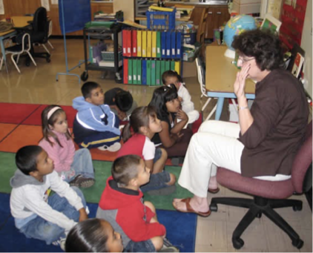
Questioning & Wait Time
Wait time refers to two specific practices where instructors deliberately pause.
  Wait time 1 constitutes a 3-5 second pause between asking a question and soliciting an answer.
  Wait time 2 is a 3-5 second pause after a student response. This provides students with time to think about the question and develop a response, either to the instructor’s question or a peer’s response.
https://www.kent.edu/ctl/wait-time-making-space-authentic-learning
Notes:
Trainer Notes:
To Know/To Say: Wait Time or Think Time – the time lapse when delivering a question before calling on a student or cueing a group response.
Engages all students in thinking.
Increases participation.
Increases quality of responses.
Results in fewer redirects of students and fewer discipline problems.
(Rowe, 1987)

Slide 26
Student Response
Verbal
  Choral
  Individual (random, unpredictable)
  With Partner or Small Group
Non-Verbal
  Written
  Gesture
  Movement
  Response Card
Notes:
Trainer Notes:
To Know/To Say: You can think of OTRs as being Verbal, or Non-Verbal. The key is all students must simultaneously think of a response to the question. For a choral response, the teacher gives a signal, then all students simultaneously state their answer. For an individual response, the teacher asks the question, provides wait time, then randomly calls on a student to respond, forcing all students to formulate a response. Other verbal strategies can include turn and talk or table talk.
Non-verbal strategies can include writing their response on a piece of paper or on a white board. A gesture could be a thumbs up or thumbs down. Movement could be to stand in a certain part of the room or by a sign that best aligns with their response. A response card could be a letter (as in multiple choice) or a True/False.

Slide 27
Activity #2 Think, Pair, Share
Describe a verbal response strategy you have used in your classroom.
Notes:
Trainer Notes: Share out as a whole group. Create a poster of strategies to hang (chart paper).
To Know/To Say: Find a partner. Take turns sharing a verbal strategy you have used in your classroom to provide students with an opportunity to respond.

Slide 28

Archer OTR video
Notes:
Trainer Notes:
To Know/To Say: This video is a high school geometry vocabulary lesson and highlights the idea that OTRs don’t need to be fussy or fancy… note that this teacher is using an overhead projector.
As we watch this video clip, keep track of the number and types of OTRs that you observe. This video playback should start on your click, and will start at the beginning and should end at the 3:00 mark. If it doesn’t stop automatically, stop it at 3:00.

Slide 29
Activity #3 Verbal Response Strategies
Reflection Questions
What routines were present?
How did the teacher positively reinforce students?
What was reinforced (behavior, academics…)?
How many students were engaged? (Approximately)
What was the impact on learning? Social Skills?
Notes:
Trainer Notes:
To Know/To Say: During the video:
What routines did the teacher use?
How did she provide positive reinforcement to the students?
What did she reinforce?
How many students were engaged during the lesson?
What was the impact on student learning?
What social skills did students learn or were reinforced?

Slide 30

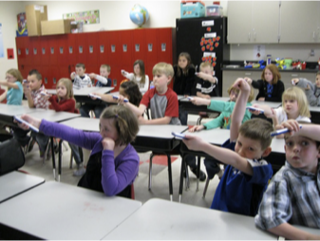
Common Non-Verbal Responding
Write a response on paper
Guided notes
White boards
Gestures (i.e., thumbs up/thumbs down)
Movement (stand by sign)
Technology
Notes:
Trainer Notes:
To Know/To Say: Non-Verbal Responding provides for more variety in response types, and possibly engagement levels.
Every student actively answering or responding to each question or problem posed by the teacher.
Same benefits as verbal response strategies.[Guided Notes]
Most common approaches: white boards, written response cards, signaling or movement responses, or technology.

Slide 31
Activity #4 Non-verbal Responses
On the walls, there are 4 charts labeled:
Gesture Responses
Movement Responses
Written Responses
Response Cards
Technology
Everyone needs a marker. For the next 5 minutes, move around between the charts and add as many examples as you can.
Notes:
Trainer Notes: Posters posted on the wall, labeled ahead of time, and make sure everyone has access to markers
To Know/To Say: Now we are going to crowd source some ideas of strategies for non-verbal responses where all students can respond simultaneously. There are four chart posters around the room with labels for gestures, movement, written, and response cards. You have 5 minutes. Jot down as many examples as you can for each of the types of response strategies.
(After 5-minutes) Now take 3 minutes to walk around the room and look at the ideas that you and your colleagues have generated.

Slide 32

Effective Teacher Feedback
Start with positive reinforcement
Specific
Actionable
Strengths-based
Focused on observable behaviors & responses
Clear
Non-judgmental
Offer support for improvement.
hyperlink to "tips for giving feedback".
Notes:
Trainer Notes:
To Know/To Say: What do you do when a student or students give an incorrect response. You have to provide them with performance feedback, but you must also do it in a way that is non-threatening. Start by reinforcing effort, direction following, or partially correct responses. Then provide performance feedback.
Effective teacher feedback should be specific, actionable, and strengths-based, focusing on observable behaviors & responses.
Key approaches include starting with positive reinforcement, providing clear, non-judgmental observations, and offering support for improvement.

Slide 33
Activity #5 Reflecting on Practice
Think about a lesson you recently taught:
How could you have increased students’ opportunities to respond?
What would you adjust?
  Discuss with your right shoulder partner.
  Be prepared to share with the larger group
Notes:
Trainer Notes:
To Know/To Say: Give participants 3-4 minutes to discuss and share out

Slide 34
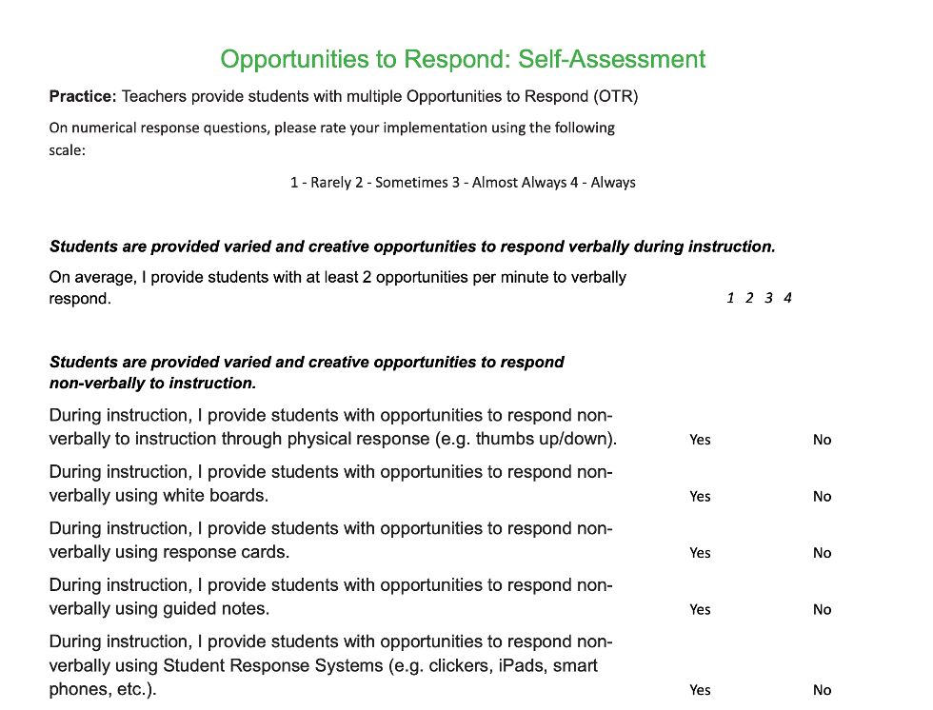
Pause & Reflect: Self Assessment
Complete the Self Assessment on page 3 of the Classroom Opportunities to Respond “Teacher Tool”
Notes:
Trainer Notes:
To Know/To Say: You began planning for delivering Opportunities to Respond by using Classroom Opportunities to Respond Planning & Implementation Guide. Now turn to the Self-Assessment section on the MO SW-PBS Classroom Opportunities to Respond Teacher Tool, to rate your current implementation of Opportunities to Respond.

Slide 35
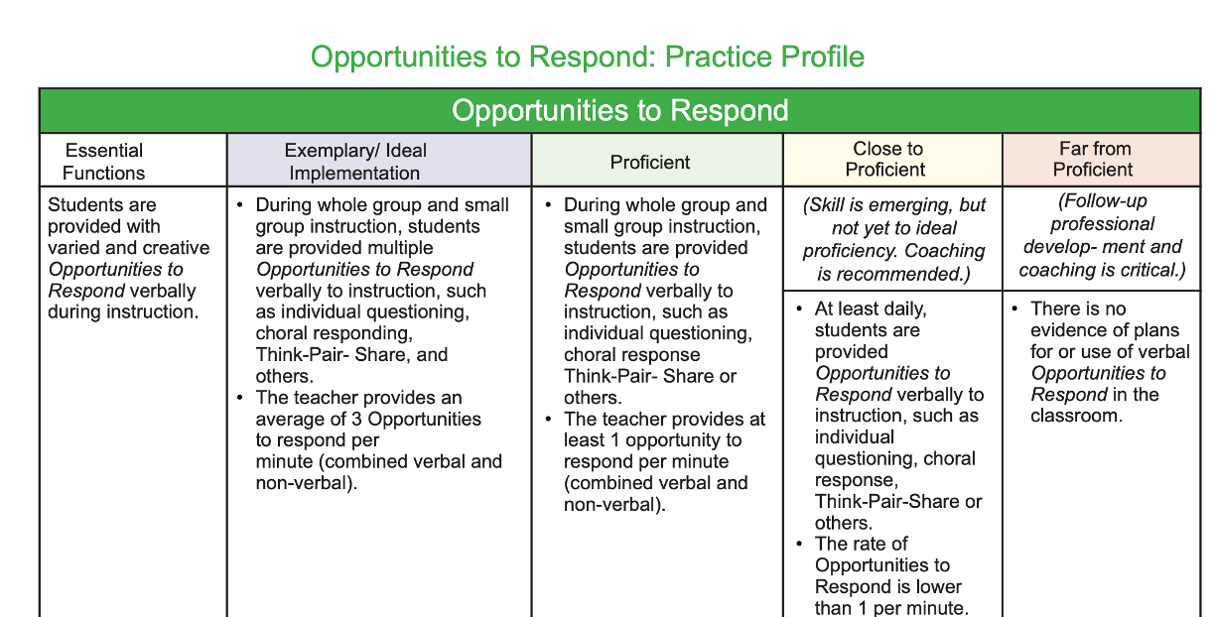
Pause & Reflect: Current Implementation
Turn to page 4 of the Classroom Opportunities to Respond “Teacher Tool”
Where does your current practice fit on the rubric?
Notes:
Trainer Notes:
To Know/To Say: Then, turn to the Practice Profile on the MO SW-PBS Classroom Opportunities to Respond Teacher Tool to consider where your current implementation falls on the rubric’s continuum from Exemplary or Ideal, through Proficient, Close to Proficient, or Far From Proficient

Slide 36

Next Steps
Notes:
Trainer Notes:
To Know/To Say: During this lesson You learned:​
How increasing opportunities to respond increase academic engagement and academic and behavioral outcomes for students
To identify opportunities and strategies to increase opportunities to respond
Learned key principles to consider when implementing increased opportunities to respond, and
Brainstormed a variety of ways to increase opportunities to respond in your classroom
Now, begin planning how you will increase opportunities to respond in your classroom, and how you will monitor the rate of opportunities to respond that you provide to your students.

Slide 37
References
Colvin, G. (2009). Managing noncompliance and defiance in the classroom: A road map for teachers, specialists, and behavior support teams. Thousand Oaks, CA: Corwin Press.
Haydon, T., MacSuga-Gage, A. S., Simonsen, B., & Hawkins, R. (2012). Opportunities to Respond: A Key Component of Effective Instruction. Beyond Behavior, 22(1), 23-31.
Council for Exceptional Children, (1987). Academy for effective instruction: working with mildly handicapped students. Reston, VA: Author.
Heward, W.L. & Wood, L. (2004). Good noise! Using choral responding to increase the effectiveness of group instruction. Ohio State University, Columbus.
Reinke, W., Herman, K., & Sprick, R. (2011). Motivational interviewing for effective classroom management: The classroom check-up. New York, NY: The Guilford Press.
Reinke, W. M., Herman, K. C., & Stormont, M. (2013). Classroom-level positive behavior supports in schools implementing SW-PBIS: Identifying areas for enhancement. Journal of Positive Behavior Interventions, 15(1), 39-50.
Reiser, R. A., & Dempsey, J. (2007). Trends and issues in instructional design and technology (2nd Ed., pp. 94-131). Upper Saddle River, NJ: Pearson Education
Rowe, M. (1987) Wait time: Slowing down may be a way of speeding up. American Educator, 11, 38-43.
Simonsen, B., & Myers, D. (2015). Classwide Positive Behavior Interventions and Supporets. New York: The Guilford Press.
Sprick, R. (2009). CHAMPS: A proactive and positive approach to classroom management. Eugene, OR: Pacific Northwest Publishing.
The Classroom Check-Up. (2025, July 24) Strategy: Increasing Opportunities to Respond.Hyperlink to classroom Checkuphttps://classroomcheckup.org/increasing-opportunities-to-respond/
Notes:
Trainer Notes:
To Know/To Say: Here are some of the sources that were used to inform this lesson.

Slide 38


Contact Information
Check Out MO SW-PBS on Social Media:
Facilitator Contact Information:
pbismissouri.org
List HERE
facebook.com/moswpbs
instagram.com/moswpbs/

