Slide 1
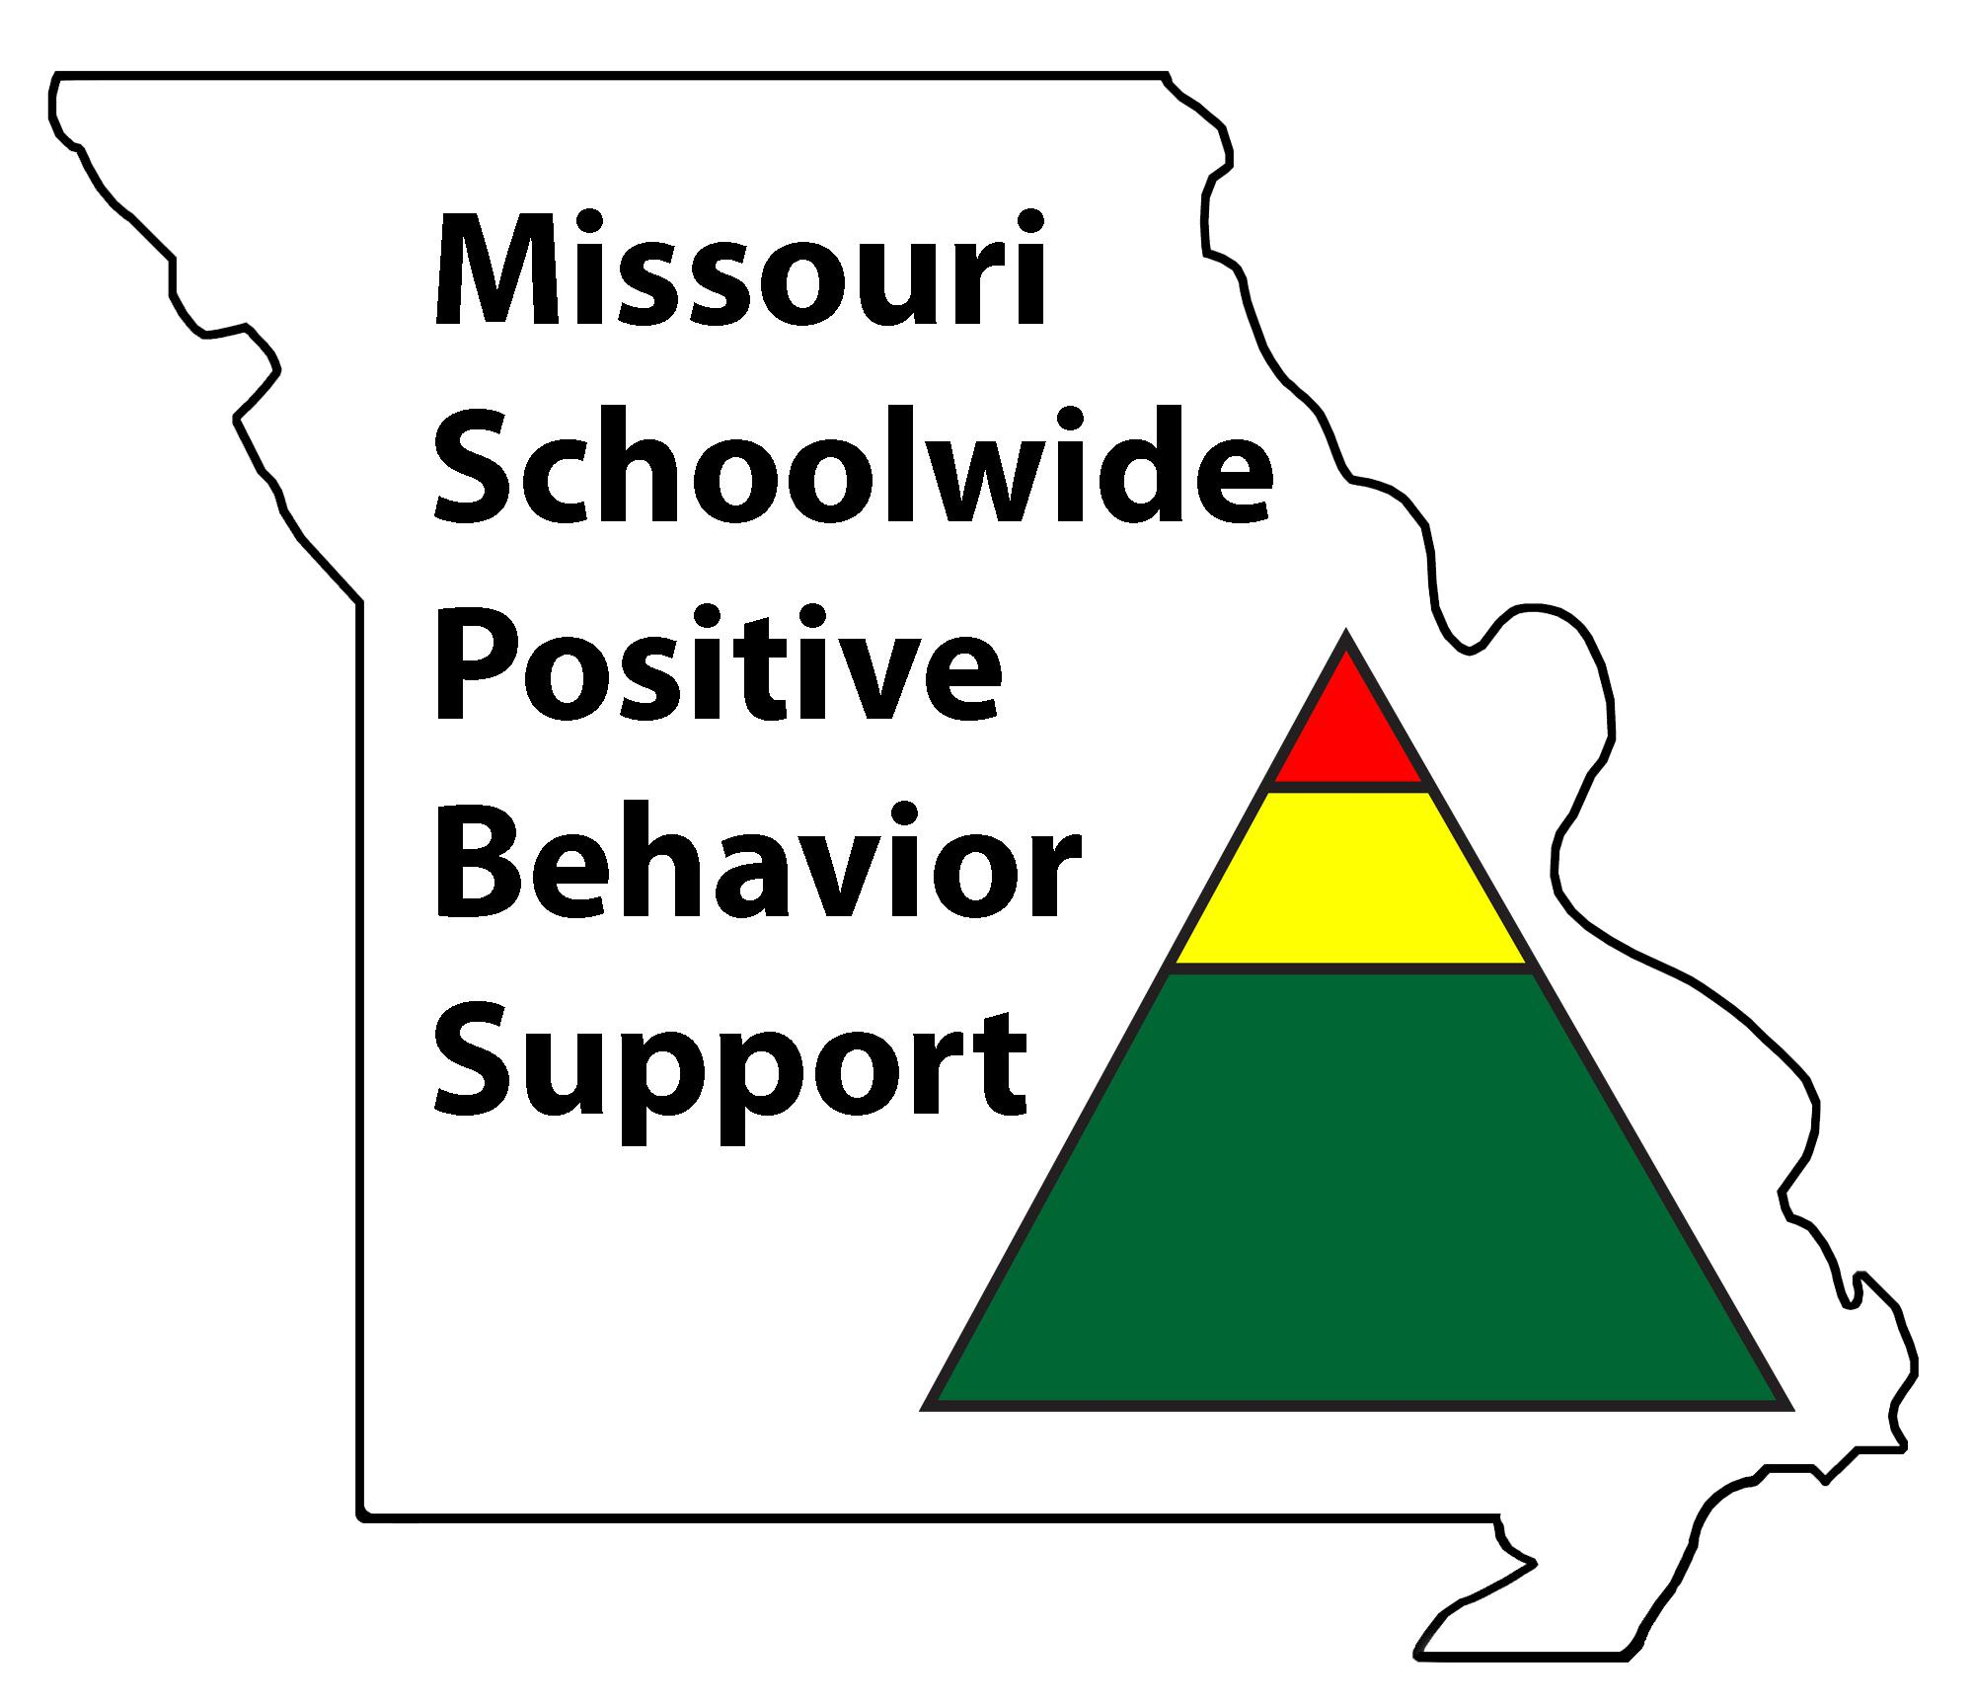
T1C8L3 Classroom
Encouraging Expected Behavior
Tier 1 Effective Teaching & Learning Practices
(ETLPs) for the Classroom
Notes:
Trainer Notes:
To Know/To Say: Welcome to Lesson 3 of the MO SW-PBS Effective Teaching & Learning (ETLP) series. This lesson describes the use of specific, positive feedback mirroring a schoolwide recognition system within the classroom environment to encourage expected behavior.

Slide 2
Working Agreements
Be Respectful
Be an active listener—open to new ideas
Use notes for side bar conversations
Be Responsible
Be on time for sessions
Silence cell phones—reply appropriately
Be a Problem Solver
Follow the decision making process
Work toward consensus and support decisions of the group
Notes:
Trainer Notes:
To Know/To Say: “These will be the Working Agreements for our time together.”

Slide 3
Attention Signal Practice
Select and teach an attention signal.
Notes:
Trainer Notes:
To Know/To Say: “One of our agreements is to follow the attention signal.”
“Your team will work with your school to develop an attention signal you will use in every setting.”
“In order to get all of you focused after discussions, activities or breaks, I will ________________________.”
(Insert your attention signal here.)
“Your task will be to finish your sentence, quiet your voice and ____________________________.”
(Insert what you want participants to do.)

Slide 4
Introductions
Insert an Introductions Activity.
Notes:
Trainer Notes: Choose an Introductions Activity/Ice Breaker appropriate for your context and audience
To Know/To Say:

Slide 5
Handouts
MO SW-PBS Teacher Tool: Classroom Encouraging Expected Behavior
MO SW-PBS Teacher Classroom Encouraging Planning & Implementation Guide
Notes:
Trainer Notes:
To Know/To Say: There two handouts that we will reference during this lesson.
MO SW-PBS Classroom Encouraging Expected Behavior Teacher Tool
MO SW-PBS Classroom Encouraging Planning & Implementation Guide
*If you have not downloaded them from the lesson website, please do so now.

Slide 6
Pre-requisites
Knowledge of The Science of Behavior
Function Based Thinking
Clarifying Expected Behavior
Teaching Expected Behavior
Completion of the following ETLP Lessons:
Lesson A: Overview of the 8 Classroom ETLP’s
Lesson 1 - Classroom Expectations & Rules
Lesson 2 - Classroom Procedures & Routines
Notes:
Trainer Notes:
To Know/To Say: There are several lessons that will build background knowledge that will be helpful to you for this lesson. We encourage you to review the Function Based Thinking, Clarifying Expected Behaviors, and Teaching Expected Behaviors lessons prior to beginning the current lesson. This information can be found in the MO SW-PBS Handbook, and the MO SW-PBS Tier 1 IMplementation Guide. In addition, this information is also available in the MO SW-PBS Tier 1 Courses. All of these resources are available on the pbismissouri.org Tier 1 Workbook and Resources page of our website
In addition, participants should also complete the Overview of the 8 Classroom ETLPs, (Lesson A) and Classroom Expectations & Rules (Lesson 1) and Classroom Procedures & Routines (Lesson 2) so that they can make a plan for what expectations and procedures they will be working to consistently and with fidelity be reinforcing in their classroom. This information is also available in the Tier 1 Implementation Guide located on the pbismissouri.org Tier 1 Workbook and Resources page of our website, and the Tier 1 courses page of the website.

Slide 7
Session Outcomes
At the end of the session, you will be able to…
Create a plan to leverage Preferred Adult Behaviors.
Explain the rationale for using specific, positive feedback to reinforce expected student behaviors within classrooms.
Develop a menu of reinforcers that includes social attention, activities and tangibles that appeal to all students, that are available frequently, intermittently and/or occasionally.
Establish and implement a process/strategy for self-monitoring the use of specific, positive feedback with fidelity, consistency and equity with all students.
Notes:
Trainer Notes:
To Know/To Say: “Here are the outcomes for this session.
Create a plan to leverage Preferred Adult Behaviors.
Explain the rationale for using specific, positive feedback to reinforce expected student behaviors within classrooms.
Develop a menu of reinforcers that includes social attention, activities and tangibles that appeal to all students, that are available frequently, intermittently and/or occasionally.
Establish and implement a process/strategy for self-monitoring the use of specific, positive feedback with fidelity, consistency and equity with all students.

Slide 8

Rationale
Teachers should use the same process to encourage expected behaviors as they use to encourage academic skills. Encouragement motivates students as they learn new skills, builds fluency, and creates a more positive classroom environment.
Notes:
Trainer Notes:
To know/To say: As you begin this lesson, it is important for you as a classroom teacher to reflect on your current implementation of specific, positive feedback:
How do you provide specific, positive feedback to students when they demonstrate expected academic, athletic, artistic or other behaviors?
How do you provide non-contingent and contingent feedback to your students?

Slide 9
Reflective Questions
How do you provide specific, positive feedback to students when they demonstrate expected behaviors?
How do you provide non-contingent and contingent feedback to your students?
How do you ensure you provide specific, positive feedback to all students in an equitably?
Notes:
Trainer Notes:
To Know/To Say:
Think about how you would give specific, positive feedback (SPF) to an athlete, or an artist, or for academics? This would be how you give SPF for behaviors.
How do you provide non-contingent and contingent feedback to your students? Non-contingent would be giving positive feedback that is not tied to a behavior. Examples: greetings, compliments,
How do you ensure you provide behavioral specific, positive feedback to all students equitably?
What is your ratio of positive to corrective feedback for expected academic behaviors? (How do you know?)
What is your ratio of positive to corrective feedback for expected social behaviors? (How do you know?)
How do you self-monitor your use of the evidence-based practice of specific, positive feedback?

Slide 10
Keywords
Reinforcement: Consequence contingent on behavior that increases the likelihood that the behavior will occur in the future.
Specific, Positive Feedback: Verbal feedback that tells the individual exactly what they did correctly. A type of social reinforcement that may increase the likelihood of future behavior.
Praise: A general positive statement directed to an individual or a group, usually contingent on preferred behavior.
Notes:
Trainer Notes:
To Know/To Say: There are a number of keywords to know and understand that are provided in the Pre-Requisite Resources just shared. These terms are repeated here as a brief primer to prepare you to apply the concepts in planning for encouragement of expected behaviors in your classroom.
Reinforcement: overarching term for a contingently delivered consequence associated with an increased likelihood of future behavior. Reinforcement can take many forms, most commonly general praise or specific, positive feedback (social reinforcement), but also tangible reinforcement (tickets, tokens, coupons, etc.), and activity reinforcers.
Specific, Positive Feedback: verbal statement delivered contingent upon successful performance of a task or behavior that provides information describing the successful behavior while reinforcing or increasing the likelihood that behavior will be repeated; combines social attention, instruction, and reinforcement.
Praise: a general positive statement directed to an individual or a group; an expression of admiration for performance that serves to reinforce the behavior; verbal recognition.

Slide 11
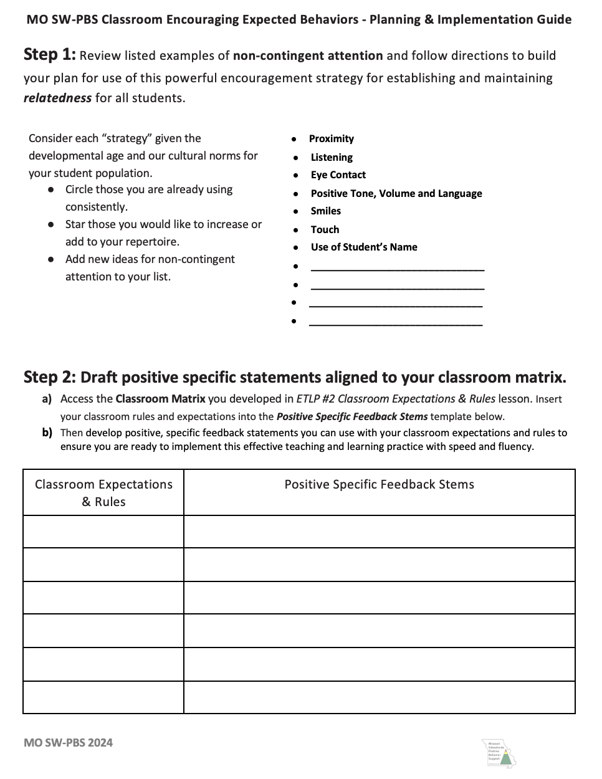
Classroom Encouraging Planning Guide
Non-Contingent Attention
specific, positive Feedback
Menu of Classroom Reinforcers
Classroom Continuum of Reinforcers
Teacher Self-monitoring Plan
Notes:
Trainer Notes:
To Know/To Say: Take out your MO SW-PBS Classroom Encouraging Planning & Implementation Guide handout and use it to document your reflections and ideas as you develop a plan to encourage expected behavior in your classroom. The following slides will walk you through
Non-Contingent Attention
Specific, Positive Feedback
Menu of Classroom Reinforcers
Classroom Continuum of Reinforcers, and finally a
Teacher Self-monitoring Plan

Slide 12

Classroom Encouraging Expected Behavior Teacher Tool
Notes:
Trainer Notes: Participants will need a copy of the MO SW-PBS Classroom Encouraging Expected Behavior Teacher Tool
To Know/To Say: Take out your copy of the MO SW-PBS Classroom Encouraging Expected Behavior Teacher Tool. The MO SW-PBS Classroom Encouraging Expected Behavior Teacher Tool provides you with resources to understand the importance of encouraging expected behavior, provide tips for developing a continuum for encouragement strategies, and identify ways to progress monitor your use of encouragement strategies, especially your use of specific, positive feedback.
The first 2 pages of each Teacher Tool defines the practice,
The section marked “Research States” shares the evidence base for the practice,
The section marked “Aligns to MO Teacher Standards” indicates how the practice aligns to Missouri Teacher Standards,
The section marked “What is it” provides a definition of the practice,
The section marked “Implementation” provides steps and examples of how to implement the practice,
and the section marked “Research” lists references for further study.
You will learn more about page 3 the Self-Assessment and page 4 the Practice Profile later in this course. Make sure to have a copy of the Classroom Encouraging Expected Behavior Teacher Tool handy during this lesson.

Slide 13
Adult Attention
Two types of adult attention:
Non-contingent – Attention provided regardless of performance
Contingent – Attention provided that is based on student performance of an expected behavior
MO SW-PBS
Notes:
Trainer Notes:
To Know/To Say: Both non-contingent and contingent attention have a positive impact on teacher-student and student-student interactions in schools. Together, both types of attention create a positive school climate and build rapport and relationships, and help students learn social behavioral expectations.
There is a growing body of research that indicates academic achievement and stu­dent behavior are both influenced by the quality of teacher-student relationship (Jones & Jones, 1998 and Algozzine, Wang, & Violette, 2010).
We sometimes call non-contingent teacher attention, Preferred Adult Behaviors because students should be able to have positive interactions with their teacher regardless of their performance. For students who struggle academically as well as behaviorally this may be the only interactions that makes the student feel safe or like they are a valued member of the classroom community.

Slide 14
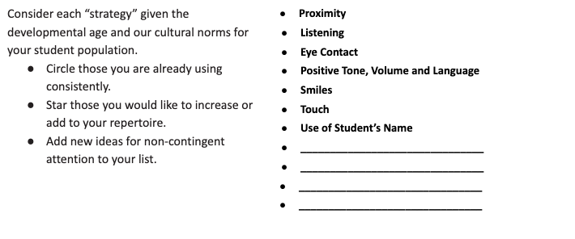
Non-Contingent Attention
Consider student age and culture in selecting strategies.
Circle those you use consistently
Star those you would like to increase or add
Add additional ideas for non-contingent attention
Notes:
Trainer Notes: Provide participants with a copy of the MO SW-PBS Classroom Encouraging Planning & Implementation Guide
To Know/To Say: Now take out your copy of the MO SW-PBS Classroom Encouraging Planning & Implementation Guide. Use the MO SW-PBS Classroom Encouraging Planning & Implementation Guide handout Step 1: Review listed examples of non-contingent attention and follow directions to build your plan for use of this powerful encouragement strategy for establishing and maintaining positive relationships with all students.
As you go through the exercise, consider the culture(s) of your students as well as their developmental level as you select strategies.
Circle those strategies that you use consistently
Put a star next to those that you would like to do increase your use of or add to your repertoire.
Write additional non-contingent strategies in the lines provided.

Slide 15
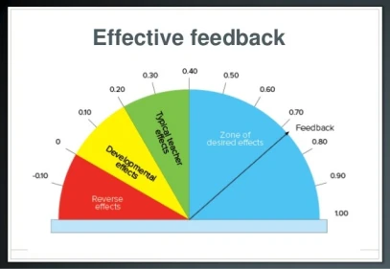

Contingent Attention: Effective Feedback
Notes:
Trainer Notes:
To Know/To Say: The other type of attention is contingent attention. This is attention given to a student contingent on their academic and/or behavioral performance. Contingent Attention is most effective when it provides performance feedback. Feedback provides the student with information about his or her performance, and can be positive or corrective.
There is strong scientific evidence that feedback is a powerful strategy for promoting student success (Brophy, 2006; Cameron & Pierce, 2002, Hattie, 2009). In a meta-analysis of 196 studies, John Hattie (2009) found feedback was among one of the 10 most influential practices on student achievement.
Despite strong evidence that teacher feedback is a highly effective instructional practice, a large scale study of over 6,700 classroom observations in 2017 (Scott, Hirn & Cooper, 2017) found that the rates and ratios of specific, positive feedback remain startlingly low, especially in middle and high school classrooms. Even in elementary classrooms, positive feedback only happens on average every 7 1/2 minutes. For most students this rate may be insufficient to sustain engagement, let alone learning.
Research consistently shows that a high ratio of positive feedback relative to reprimands or corrections not only improves student behavior, but also leads to increased student engagement and improved grades.

Slide 16
ABC Chart for Behavior
Antecedent | Behavior | Consequence
Event that signals or triggers the behavior | An observable act. What the student does. | Event that occurs immediately following the behavior. Often impacts future occurrence.
Notes:
Trainer Notes:
To Know/To Say: Recall from the Science of Behavior the Antecedent - Behavior - Consequence contingency. This describes a pattern in which an antecedent signals a behavior. The behavior is then followed by a consequence. Over time, the student learns that under certain antecedent conditions a behavior or type of behavior more often than not results in a certain kind of consequence. If this consequence results in an increase in the behavior in the future, it is reinforcing.
Keep in mind that a consequence is only reinforcing when it increases future use of the expected behavior, and what students find reinforcing may vary from student to student.A consequence that we as adults assume is universally reinforcing may not be reinforcing for some or even many students. There are no universal reinforcers!
Also, remember that all behavior is functional and the function of most human behavior falls within two broad categories: to OBTAIN access to attention, objects or experiences; or to AVOID attention, objects or experiences.
Therefore, a key to reinforcing expected behavior is to provide a consequence that meets the student’s need for a certain functional outcome. Put a pin in this idea because we will return to it later in this lesson.

Slide 17
Specific, Positive Feedback Defined
specific, positive Feedback: verbal reinforcement that provides specific information on why behavior was successful, while providing social reinforcement that is likely to increase the behavior in the future.
Notes:
Trainer Notes:
To Know/To Say:
This is the definition of specific, positive Feedback first introduced in the Keywords slide. Specific, positive feedback provides the student with performance feedback, while also providing positive adult attention which most students find reinforcing. Compare this to general praise, which does not provide the student with information about why his or her response was correct.
Going back to the ABC Chart we just reviewed, specific positive feedback is one of the more powerful forms of reinforcement that teachers can deliver for most students. Keep this definition in mind as we look more closely at why specific, positive feedback matters and how to deliver it effectively.

Slide 18
Specific, Positive Feedback: Core Components
Contingent on student performing behavioral expectation.
Delivered immediately following the behavior.
Specifically describes what the student did that met the expectation.
Notes:
Trainer Notes:
To Know/To Say: Specific, positive feedback has 3 core components:
It is delivered contingent on the student performing an expected behavior,
Delivered immediately following the expected behavior, or as soon after the expected behavior is observed as is possible.
It specifically describes what the student did that met the expectation.
“When I said it was time to begin, you cleared off your desk, got your materials out immediately, and began working quickly.”
specific, positive feedback also frequently includes a rationale of why the expected behavior is important.
“Getting started right away shows cooperation, and if we save time during directions, you will have more time to complete your work, and possibly less homework.”

Slide 19
Specific, Positive Feedback
Essential to change and sustain behavior.
Recognizes successes or efforts at tasks that are difficult for the child.
While general praise contributes to a pleasant classroom, it is insufficient to build and sustain desired behavior.
Students need clear, specific, positive feedback on the quality of their expectations following behavior.
Notes:
Trainer Notes:
To Know/To Say:
Specific Positive Feedback
Is essential to changing and sustaining behavior: It provides information about what the student is doing correctly, and reinforces the preferred behavior.
Recognizes effort or partial success at tasks that are difficult for the child: If we give students positive feedback for their effort when tasks are difficult, it will encourage students to persist. Sometimes we need to give positive feedback when students display expected behavior for a short time, or approximations of the desired behavior. For example, if you are teaching a student to throw, you could provide specific, positive feedback on an approximation of the desired behavior by saying, “You brought the ball back behind your ear, snapped your wrist, and followed through. Now try twisting your hips toward your target.” Similarly, you could say, “You raised your hand to talk That is excellent! Next, we will work on raising your hand and waiting until I call on you.”
While general praise contributes to a pleasant classroom, it is insufficient to build and sustain desired behavior: “Good job” is a phrase we hear staff say to students but general praise needs to be more specific to help students learn academic and social behavior.
Students need clear specific feedback on classroom expectations.

Slide 20
Effective Positive Feedback
1. Specifically describe the behavior.
  “Thank you for getting your materials out quickly and beginning your work.”
2. Provide a rationale by stating the expectation.
“You are being responsible.”
3. Optional: May include a tangible reinforcement.
“You have earned a Bulldog Buck.”
Notes:
Trainer Notes:
To Know/To Say: Now let’s talk about how to provide effective specific positive feedback. There are 2 things to keep in mind to make positive feedback effective to change behavior. First, teachers need to specifically describe the behavior. This helps students understand the exact behavior you want the student to continue. Think of a videotape replay, we need to simply describe what we saw the student do and tie it to classroom expectations. Then provide a rationale for for why the behavior is important. Optionally, you may conclude by providing the student with some sort of tangible reinforcer. The tangible reinforcer serves two purposes: 1) it reminds the adults to give specific, positive feedback, and 2) it can be reinforcing for the student, especially if it can be exchanged for something that is functionally motivating for the student. For example:
“Thank you for getting your materials out quickly and beginning your work.”
“You are being responsible.”
“You have earned a Bulldog Buck.”

Slide 21
Putting It All Together
  “Thank you for being responsible by getting your materials out quickly and getting to work.”
  “Thank you for getting out your materials and getting to work quickly. You are being responsible.”
Notes:
Trainer Notes:
To Know/To Say: Here are two examples of providing effective specific positive feedback that incorporate the two components we just shared. Notice that it tells the student what they did, and provides a rationale that is tied to the broader expectation. This may seem lengthy and awkward at first but with practice it will become more natural. See how specific this feedback is? There should be no doubt the student is told exactly what they did and why it was important.

Slide 22
Clean
Genuine
Avoid Sarcasm
Avoid backhanded compliments
Notes:
Trainer Notes:
To Know/To Say: In addition, make sure that the specific, positive feedback you provide to students is “clean.” This means that it is phrased in such a way that the student does not feel manipulated or that it is really a negative comment in disguise.
First, the feedback needs to be genuine. Kids can see through inauthentic feedback, and will view these as attempts at manipulation.
Second, avoid sarcasm. Sarcasm is not specific, positive feedback at all. To be sure, it can only be interpreted as the opposite. Think of the statement “Thank you for raising your hand” given legitimately. Now consider the same statement given sarcastically. The sarcastic statement is actually calling out the student for not raising her hand.
Third, we want to avoid backhanded compliments. This is any positive feedback, including specific, positive feedback, that is immediately withdrawn by the teacher’s next statement. For example, “Thank you for raising your hand. It’s about time.” In this case, the student actually raised her hand, but the teacher can’t resist shaming her for all of those times she did not.

Slide 23
Additional Considerations
Frequent
More positive than corrective feedback
Provide specific, positive Feedback to all students
Notes:
Trainer Notes:
To Know/To Say: Some additional considerations when providing specific, positive feedback is that it should be given frequently, especially as students are learning a new behavior. Specific, positive feedback is reinforcing the behavior you want to see, so the more frequently you reinforce it the quicker the students will add it to their repertoire. In addition to high frequency, you should give specific, positive feedback more often than you give corrective feedback. It is generally recommended that you strive to provide students a 4:1 ratio of positive to corrective feedback.
Third, provide specific, positive feedback to all students. It can sometimes feel difficult to provide specific, positive feedback to students with challenging behavior, but supporting expectation following behavior in these students will have an even bigger impact on the climate of your classroom than providing specific positive feedback only to the students who always follows directions.

Slide 24
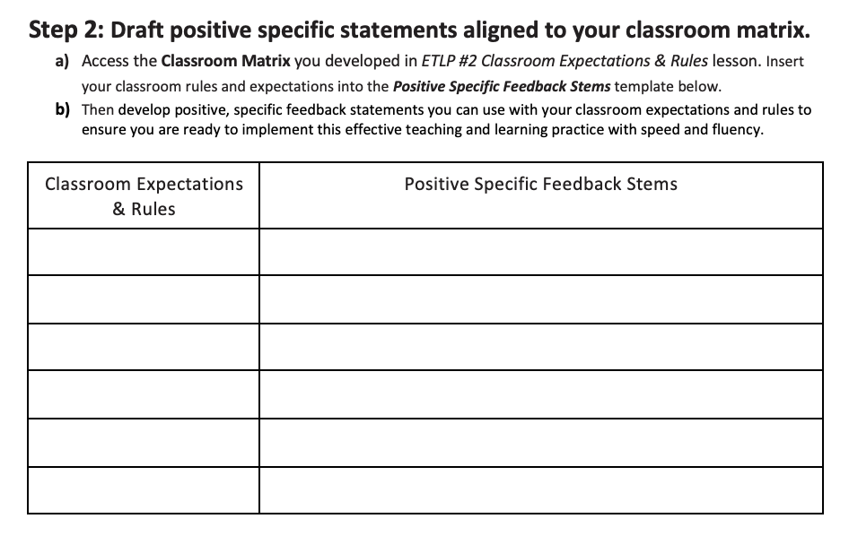
Write Feedback Statements
Notes:
Trainer Notes:
To Know/To Say: Turn back to your MO SW-PBS Classroom Encouraging Planning & Implementation Guide.Use the MO SW-PBS Classroom Encouraging Planning & Implementation Guide handout Step 2 to develop specific, positive feedback statements you can use with your classroom expectations and rules to ensure you are ready to implement this effective teaching and learning practice with speed and fluency.

Slide 25
Menu of Reinforcers
Social Attention
Seekers
Wink, thumbs up, smile
Positive Feedback
Work with a preferred friend
Time to visit or walk with a friend
etc.
Avoiders
Lunch in private area with preferred peer or staff
Extra computer time
Extra time to read
Pass out of assembly
Etc.
Notes:
Trainer Notes:
To Know/To Say: Remember back a few slides when we were reviewing the science of behavior and I asked you to put a pin in the idea that consequences were reinforcing when they helped the student achieve a desired function? One way to do this is to give the student a tangible item, say a ticket, that can be exchanged for an “item” on a menu of reinforcers that are selected to cover all of the common functions of behavior that occur in schools. Step 3 of the Classroom Encouraging Planning & Implementation Guide lists three different lists of activities, privileges or items that address the different functions of behaviors. The example on the slide is for Social Attention.
Remember that there are no universal reinforcers, and that within your classroom there will be students who are seeking attention, access to items or activities, and students who will actively avoid attention, activities or certain experiences. You will need a variety of options that can meet all functions.
On step 3 of the handout:
Circle those reinforcers you currently use.
Star those reinforcers that you would consider adding to your current menu of reinforcement.
Add one or two ideas specific to your classroom context.
.
Now with a working list, consider how to engage student and family voice in drafting your menu of reinforcers.
Consider what information about your menu of reinforcers you could leave for a substitute or consider a special menu when a substitute fills in for you.

Slide 26
Plan to Provide specific, positive Feedback Across a Continuum
Frequent
Reinforce frequently when trying to learn a new behavior.
Intermittent
Reinforce Unpredictably and intermittently once the skill or behavior has been learned, to maintain the behavior.
Occasional
Eventually fade to occasionally reinforcing to support long term use of expected behavior.
Notes:
Trainer Notes:
To Know/To Say: In addition, you want to build your reinforcement system along a continuum of scaffolded support, such that you gradually remove the supports, thereby assisting your students to become independent self-managers. This continuum involves providing frequent reinforcement early on as the students are learning the new behavior. This helps them to acquire and become fluent in the new behavior, so that the behavior becomes automatic. Gradually, you decrease the frequency and predictability of the reinforcement. A continuum of supports builds in this “fading” of reinforcement. The different steps along the continuum can be described as follows:
Frequent: Reinforce frequently when trying to learn a new behavior.
Intermittent: Reinforce Unpredictably and intermittently once the skill or behavior has been learned, to maintain the behavior.
Occasional: Eventually fade to occasionally reinforcing to support long term use of expected behavior.
Remember to be genuine, sincere, and appropriate for the situation and individual. Also, be creative and mix it up and keep it fresh.

Slide 27
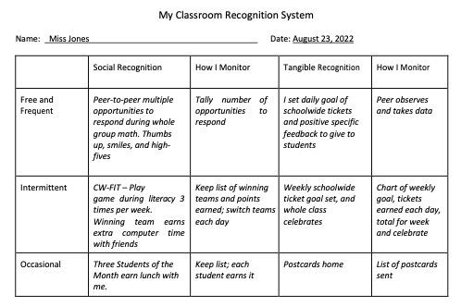
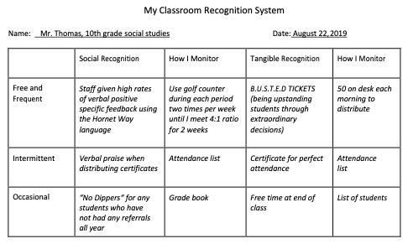
My Classroom Recognition System
Notes:
Trainer Notes:
To Know/To Say: Now that you have a menu of reinforcers that provide options for reinforcing all your students, consider when to use options that work in your classroom context.
Here are elementary and secondary classroom reinforcement continuums. Note in both the elementary and secondary examples they planned for encouragement delivered Frequently, Intermittently, and Occasionally. They also planned for a sufficient variety of both social and tangible reinforcers that students can receive as a consequence for demonstrating expected classroom behaviors. This kind of detail in planning increases the likelihood that they deliver feedback with fidelity, consistency, and equity.
Finally, as their plan was developed, they also considered how to monitor ongoing delivery of the planned reinforcement.

Slide 28
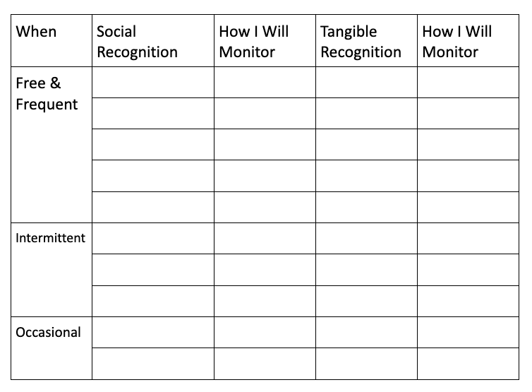
Classroom Continuum
Notes:
Trainer Notes:
To Know/To Say: Use the Classroom Encouraging Planning & Implementation Guide, items you circled and starred, and your additional ideas from step 3 to either create or update your classroom recognition continuum. Step 4 of the handout offers you a framework (as seen on the screen), which helps you consider if the reinforcement is something you will deliver frequently, intermittently or only occasionally.
How will engage student and family voice as you develop your encouraging continuum to ensure it is developmentally and culturally relevant for everyone?

Slide 29

Communication
COLLEAGUES
FAMILIES
STUDENTS
ADMINS
Notes:
Trainer Notes:
To Know/To Say: Once your encouraging continuum is completed, plan for how you will share it with
Students,
Families,
Grade level or departmental team,
and your building administrator.
What parts of this plan would be beneficial to share with substitute teachers?

Slide 30
Average teacher fails to take advantage of the power of attention.
Approval statements for academic responses far outweigh those for social behavior.
Highest rates of attention for social behavior occur in 2nd grade and decrease dramatically after that.
Teachers respond more frequently to inappropriate social behavior than to appropriate social behavior.
This attention inadvertently maintains or increases the misbehavior.
Why Monitor Your
Classroom Encouragement?
Notes:
Trainer Notes:
To Know/To Say: Many educators may think, “I already give kids non-contingent and contingent attention.”
But how do you know for sure?
Research has shown that the average teacher fails to take advantage of the power of positive attention to reinforce expectation following behavior.
In fact years of research has shown that teachers positively respond to student academic performance much more frequently than expected student social behavior. (Beaman & Wheldall, 2000).
In addition, teachers’ heightened attention to unexpected classroom behavior can in fact be reinforcing unwanted behavior rather than reducing it.
The good news is we can change this to help us improve the learning environment and to support student use of important social skills…which can benefit the student in the classroom and beyond..

Slide 31
Type of Feedback by School Level
 | Positive Feedback Rate | Negative Feedback Rate | Corrective Feedback | Positive to Negative Ratio
Elementary | 0.137/min., or once every 7 mins. 29 secs | 0.038/min., or once every 26 mins., 20 secs. | 0.007/min, or once every 142 mins., 48 secs. | 3 : 1
Middle | 0.061/min., or once every 16 mins, 23 secs. | 0.031/min., or once every 32 mins., 15 secs. | 0.0004/min, or once every 250 mins | 1.74 : 1
High | 0.033/min., or once every 30 mins., 18 secs. | 0.046/min, or once every 32 mins,44 secs | 0.0004/min, or once every 200 mins | 0.65 : 1
Scott, Him & Cooper, 2017
Notes:
Trainer Notes:
To Know/To Say: This table summarizes research on the current rates of feedback provided by classroom teachers in elementary, middle and high schools. The researchers counted as “Positive Feedback” any time the teacher gave the entire class or an individual student feedback on an academic or social behavior that was a correct response. “Negative Feedback” was defined as any time the teacher informed a student that his or her academic or social behavior was incorrect, but did not provide specific information about why the response was incorrect. For example, they might have said,”that’s wrong,” “stop that,” “turn around,” or “be quiet.”
Corrective feedback was defined as the teacher telling the student that their response was incorrect and telling them why the response was incorrect.
Take a moment to review what research says occurs in the average classroom at each level. Think about how increasing specific positive feedback even a little might make a huge difference in the academic and social behavior of students.

Slide 32
“...teacher reprimands did not decrease students’ future disruptive behavior or increase their engagement or vice versa.”
(Caldarella, Larsen, Williams, Wills, & Wehby, 2021)
Notes:
Trainer Notes:
To Know/To Say: It is critical to note, another recent study of over 149 teachers across 19 elementary schools in 3 states (including Missouri) that focused on 311 students at-risk for emotional and behavioral disorders, teacher reprimands did not decrease students’ future disruptive behavior or increase their academic engagement. Teachers may find that reprimands suppress misbehavior in the moment, but do not appear to decrease disruptive behavior or increase student engagement over time.
Caldarella, Larsen, Williams, Wills, & Wehby (2021)

Slide 33

Teacher in front of the classroom
Notes:
Trainer Notes:
To Know/To Say: The positive to corrective feedback ratio for high school classrooms has not been studied as widely as those for elementary and middle school students. In recent pilot and single subject studies, teachers were able to increase their behavior-specific praise rates and decrease their reprimand rates, resulting in increased on-task student behavior. One can hypothesize that if secondary teachers tend on average to deliver little if any positive feedback for behavior, simply increasing their positive to corrective feedback ratio to 1:1 for behavior would benefit all students both behaviorally as well as academically. (Caldarella, Richards, Williams, & Warburton, 2023; Speight, Kucharczyk, & Whitby, 2022).

Slide 34
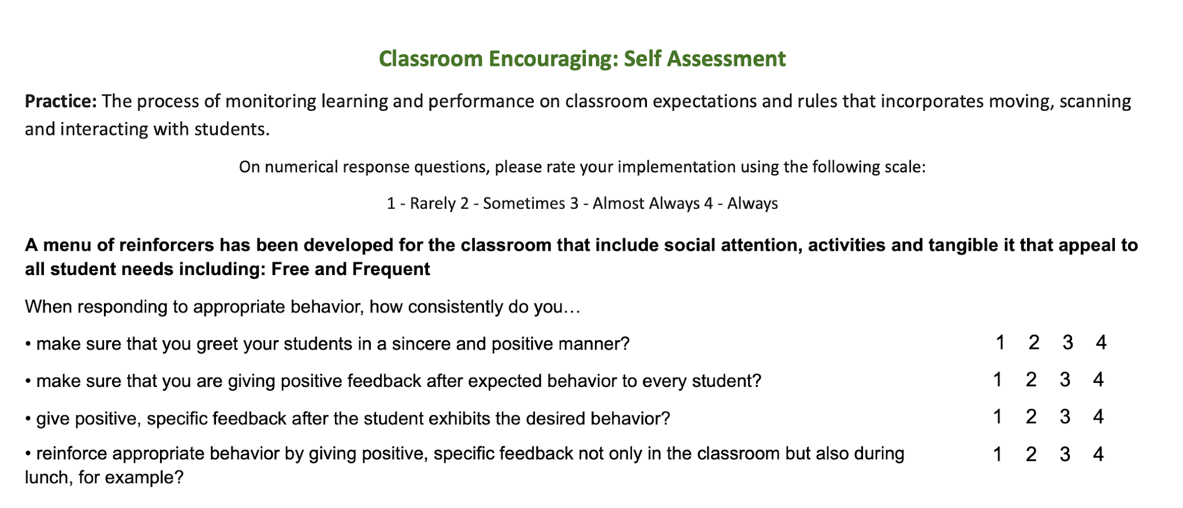
Self Assessment
Turn to page 3 of the Classroom Encouraging Expected Behavior “Teacher Tool”
Complete the Self Assessment
Notes:
Trainer Notes:
To Know/To Say: Now turn to the Self-Assessment section on the MO SW-PBS Classroom Encouraging Teacher Tool. Rate your current implementation of encouragement for expected classroom behavior.

Slide 35
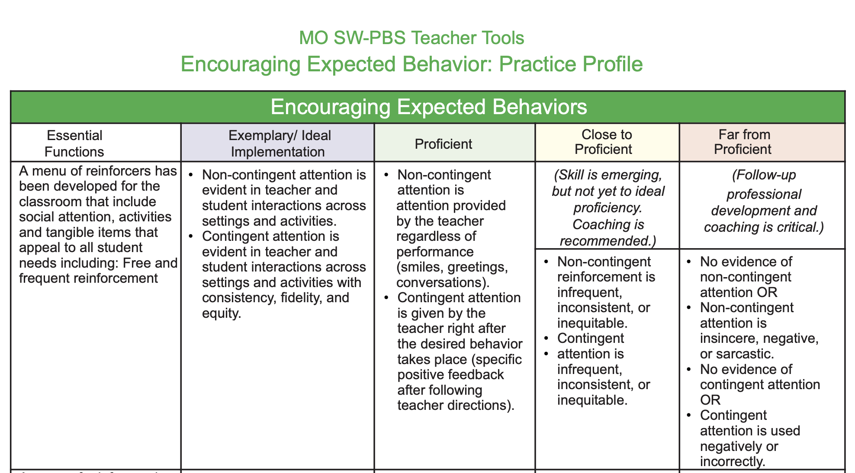
Identify Current Implementation
Turn to page 4 of the Classroom Encouraging Expected Behavior “Teacher Tool”
Where does your current practice fit on the rubric?
Notes:
Trainer Notes:
To Know/To Say: Then, turn to the Practice Profile on the MO SW-PBS Classroom Encouraging Expected Behavior Teacher Tool. Where does your current level of encouragement of expected behavior fall on the practice profile rubric?

Slide 36

Monitor Frequency
Notes:
Trainer Notes:
To Know/To Say: In addition to self assessments, you can also monitor your classroom behavior. Consider the following strategies to self-monitor the frequency that you deliver specific, positive feedback:
move a paper clip from your one pocket to another,
add a tick mark on a post-it note, or
use a golf stroke counter to keep track.
Then, divide the total number by the number of minutes that you self-monitored your feedback.

Slide 37

Monitor Ratio
Positive
IIII
Corrective
I
Notes:
Trainer Notes:
To Know/To Say: What procedure can you use to self-monitor your RATIO of specific, positive feedback to corrective feedback?
You could use tick marks on a post-it note to count specific, positive feedback and corrective feedback statements.
Consider having a colleague conduct a 5-minute classroom observation
or record yourself using audio or video during part or all of a lesson.

Slide 38
Next Steps
Use the Classroom Encouraging Planning & Implementation Guide to
  Draft a classroom encouragement system
    plan to engage student and family voice in the final review.
  Consistently provide specific, positive feedback to students.
Use the Classroom Encouraging Expected Behavior Teacher Tool to monitor your development and use of encouraging expected behavior in your classroom.
Notes:
Trainer Notes:
To Know/To Say: Next steps include:
Use the Classroom Encouraging Planning & Implementation Guide to
Develop a draft for classroom encouragement systems and resources; plan to engage student and family voice in the final review and editing.
Consistently provide specific, positive feedback to students on classroom expectations & rules and procedures as needed.
Use the Teacher Tool - Procedures and Routines Self-Assessment and Practice Profile and the Teacher ETLP Self-Monitoring Plan to monitor your development and use of classroom expectations and rules. to monitor your development and use encouraging expected behavior in your classroom.

Slide 39
References
Beaman, R., & Wheldall, K. (2000). Teachers' use of approval and disapproval in the classroom. Educational Psychology, 20(4), 431–446.
Brophy, J. (1998). Motivating students to learn. Boston: McGraw Hill.
Brophy, J. (2006). History of research on classroom management. Handbook of classroom management: Research, practice, and contemporary issues, 17-43.
Caldarella, P., Richards, E.J., Williams, L. et al. Improving Behavior in an Alternative High School Summer Program Using Class-Wide Function-Related Intervention Teams: A Pilot Study. Educ. Treat. Child. 46, 351–365 (2023).
Caldarella, P., Larsen, R. A., Williams, L., Wills, H. P., & Wehby, J. H. (2019). Teacher Praise-to-Reprimand Ratios. Education and Treatment of Children, 42(4), 447-468
Caldarella, P., Larsen, R. A. A., Williams, L., & Wills, H. P. (2023). Effects of Middle School Teachers’ Praise-to-Reprimand Ratios on Students’ Classroom Behavior. Journal of Positive Behavior Interventions, 25(1), 28-40.
Cameron, J., & Pierce, W. D. (1994). Reinforcement, reward, and intrinsic motivation: A meta-analysis. Review of Educational research, 64(3), 363-423.
Everston, C. M., & Emmer, E. T. (1982). Preventive classroom management. Alexandria, VA: Association for Supervision and Curriculum Development.
Evertson, C. M., Emmer, E. T., & Worsham, M. E. (2003). Classroom management for secondary teachers. Allyn and Bacon.
Flora, S. R. (2000). Praise’s magic reinforcement ratio: Five to one gets the job done. The Behavior Analyst Today, 1, 64 – 69. doi:10.1037 /h0099898
Notes:
Trainer Notes:
To Know/To Say: Here are the references used to develop this material. If you need more information, see the MO SW-PBS tier 1 Workbook available online at pbismissouri.org

Slide 40
References Continued
Good, T. L., & Brophy, J. E. (2003). Looking in classrooms (9th ed.). Boston: Allyn & Bacon.
Hattie, J., & Yates, G. C. (2013). Visible learning and the science of how we learn. Routledge.
Kern, L., & Clemens, N.H. (2007). Antecedent strategies to promote appropriate classroom behavior. Psychology in the Schools, 44(1), 65-75.
Missouri Schoolwide Positive Behavior Support (2019). Missouri Schoolwide Positive Behavior Support Handbook.
Missouri Schoolwide Positive Behavior Support (2019). Missouri Schoolwide Positive Behavior Support Tier 1 Implementation Guide.
Scott, T., Hirn., R. and Cooper, J. (2017). Teacher and student behaviors: Keys to success in classroom instruction. Rowman & Littlefield.
Shores, R. E., Gunter, P. L., & Jack, S. L. (1993). Classroom management strategies: Are they setting events for coercion? Behavioral Disorders, 18, 92 – 102. doi:10.1177/019874299301800207
Soar, R., & Soar, R. (1979). Emotional climate and management. In P.L. Peterson & H. J. Walberg (Eds.), Research on teaching. Berkeley, CA: McCutchan.
Speight, R., Kucharczyk, S., & Whitby, P. (2022). Effects of a behavior management strategy, CW-FIT, on high school student and teacher behavior. Journal of Behavioral Education, 31(4), 751-770.
Trussell, R. P. (2008). Classroom universals to prevent problem behaviors. Intervention in School and Clinic, 43, 179 – 185. doi:10.1177 /1053451207311678
Notes:
Trainer Notes:
To Know/To Say: Here are the references used to develop this material. If you need more information, see the MO SW-PBS tier 1 Workbook available online at pbismissouri.org

Slide 41


Contact Information
Check Out MO SW-PBS on Social Media:
Facilitator Contact Information:
pbismissouri.org
List HERE
facebook.com/moswpbs
instagram.com/moswpbs/
Notes:
Trainer Notes:
To Know/To Say: This lesson was made possible with funds from the Missouri Department of Elementary and Secondary Education, Division of Special Education; the Center on Positive Behavior Interventions and Supports and the University of Missouri Center for Schoolwide Positive Behavior Support. This lesson was made possible with funds from the Missouri Department of Elementary and Secondary Education, Division of Special Education; the Center on Positive Behavior Interventions and Supports and the University of Missouri Center for Schoolwide Positive Behavior Support.

