Slide 1
T1C8L2 Classroom
Procedures and Routines
Tier 1 Effective Teaching & Learning Practices ​
(ETLPs) for the Classroom
Notes:
Trainer Notes:
To Know/To Say: Welcome to Lesson 2 of the MO SW-PBS Effective Teaching & Learning or ETLP series. This lesson describes the process to develop and teach efficient and effective classroom procedures, which when taught to fluency become routines that all students can follow. ​
This lesson was made possible with funds from the Missouri Department of Elementary and Secondary Education, Division of Special Education; the Center on Positive Behavior Interventions and Supports and the University of Missouri Center for Schoolwide Positive Behavior Support.​
​

Slide 2
Lesson Description
This session focuses on the importance of explicitly teaching classroom procedures and routines to maximize instructional time and support positive student behavior.
Participants will reflect on their current practices, identify key routines, and explore strategies for modeling, practicing, and reinforcing expectations, so students can perform them independently and consistently.
Notes:
Trainer Notes:
To Know/To Say:

Slide 3
Working Agreements
Be Respectful
Be an active listener—open to new ideas
Use notes for side bar conversations
Be Responsible
Be on time for sessions
Silence cell phones—reply appropriately
Be a Problem Solver
Follow the decision making process
Work toward consensus and support decisions of the group
Notes:
Trainer Notes:
To Know/To Say: These will be the Working Agreements for our time together

Slide 4
Attention Signal Practice
Select and teach an attention signal.
Notes:
Trainer Notes:
To Know/To Say: One of our agreements is to follow the attention signal. ​
Your team will work with your school to develop an attention signal you will use in every setting.
​
In order to get all of you focused after discussions, activities or breaks, I will ________________________.
(Insert your attention signal here.)​
Your task will be to finish your sentence, quiet your voice and ____________________________.
(Insert what you want participant to do here.)

Slide 5
Handouts
MO SW-PBS Classroom Procedures and Routines Teacher Tool​
MO SW-PBS Classroom Procedures-Routines Plan Implementation Guide​
Notes:
Trainer Notes:
To Know/To Say: There are several handouts associated with this lesson.

Slide 6
Pre-Requisites
Knowledge of The Science of Behavior
Function Based Thinking
Clarifying Expected Behavior
Teaching Expected Behavior
Notes:
Trainer Notes: ​
To Know/To Say: There are several lessons that will be beneficial for you to complete before you begin this lesson. We highly encourage any​
one who is engaging in this lesson on Classroom Procedures & Routines to first engage with at least one of the Science of Behavior resources listed prior to taking this lesson. Doing so will provide critical background information necessary to be able to understand and apply the concepts shared here for classroom implementation of encouraging expected behaviors with fidelity, consistency and equity. ​
​
In addition, participants should also complete the Overview of the 8 Classroom ETLPs, (Lesson A) and Classroom Expectations & Rules (Lesson 1) to better align all components into a single classroom management plan.​
​
If you are a member of a building or district leadership team we encourage you to FIRST complete the Systems to Support Implementation of ETLPs (Lesson B) and establish building or district systems to support all instructional staff in the delivery of all 8 ETLPs.​
​
All of these resources can be found on the MO SW-PBS website located at pbismissouri.org .​
​
​
​
​

Slide 7
Lesson Outcomes
At the end of this session, you will be able to…
Identify and develop classroom procedures.​
Plan for implementation of procedures to create routines.
Develop a way to teach, model, and practice ​routines.
Deliver effective feedback to students to reinforce expected behaviors and correct unexpected behaviors. ​
Notes:
Trainer Notes: Identify 2–3 key classroom procedures that need to be explicitly taught
Develop a plan to teach, model, and practice one routine to fluently
Evaluate current routines for consistency and alignment with schoolwide expectations
Create one actionable step to improve student independence through routines.
To Know/To Say:

Slide 8
Rationale
“When students can predict the events throughout their school day, they are more likely to be engaged and less likely to display problem behavior. One way to increase predictability in a classroom is to establish routines, particularly early in the school year.”
Notes:
Trainer Notes:
To Know/To Say: When students can predict the events throughout their school day, they are more likely to be engaged and less likely to display problem behavior. One way to increase predictability in a classroom is to establish routines, particularly early in the school year” ~ Kern & Clemens, 2007​
​

Slide 9
Reflective Questions
Where do you currently lose the most instructional time, and which routines need the most clarity?
How explicitly do you teach, model, and practice your procedures so students reach fluency?
How consistent are your expectations and routines across the entire day, including transitions?
Notes:
Trainer Notes:
To Know/To Say:

Slide 10
Key Terms
Procedures: methods or process for how things are done in non-classroom
settings and each classroom. ​
Routines: the regular process of enacting procedures. Once students know
how things are done, they can perform them with confidence and fluency.
Notes:
Trainer Notes:
To Know/To Say: Here are key terms and acronyms that will be used in this lesson.​
Procedures: methods or process for how things are done in non-classroom settings and each classroom. Procedures make it clear how things operate in your classroom as opposed to other classrooms, such as where and how to turn in work, where and how to get needed materials, where and how to store personal items in the classroom, etc.​
​
Routine: a regular course of procedure; habitual performance of a procedure. Routines are the regular process of enacting procedures. Once students know how things are done, they can perform them with confidence and fluency.​

Slide 11
Introductions
Insert an Introductions Activity.
Notes:
Trainer Notes: Choose an Introductions Activity/Ice Breaker appropriate for your context and audience
To Know/To Say:

Slide 12
Classroom Procedures and Routines Teacher Tool
First two pages:
Define the practice, ​
share research regarding the practice, ​
indicate how the practice aligns to Missouri Teacher Standards, ​
describe an example of the practice, ​
provide steps and examples of how to implement the practice, ​
and list research references for further study. ​
Notes:
Trainer Notes:
To Know/To Say: The focus of this lesson is on the development and use of the Encouragement strategies in the classrooms. The MO SW-PBS Procedures & Routines Teacher Tool 2023 provides you with several resources to understand the importance of, provide tips for drafting and metrics to progress monitor your development and use of procedures and routines. ​
The first 2 pages of each Teacher Tool defines the practice, ​
shares research regarding the practice, ​
indicates how the practice aligns to Missouri Teacher Standards, ​
describes an example of the practice, ​
provides steps and examples of how to implement the practice, ​
and lists research references for further study. ​
​
You will learn more about page 3 the Self-Assessment and page 4 the Practice Profile later in this course. Make sure to have a copy of the Classroom Encouraging Expected Behavior Teacher Tool handy during this lesson. ​

Slide 13
Making Procedures Routine
Clarify
Directly teach
Prompt or pre-correct
Reinforce
Notes:
Trainer Notes:
To Know/To Say: When procedures are clarified, directly taught, prompted or pre-corrected before the students will need to use the procedure, and when the procedure is demonstrated as expected the teacher consistently reinforces with positive, specific feedback, the procedures become classroom routines. ​
​
​

Slide 14
Supporting Student Needs
Turn and Talk: How might having clear and consistent classroom procedures and routines support a student’s sense of competence, autonomy, or relatedness in your classroom?
Notes:
Trainer Notes:
To Know/To Say: As you learn more about ETLPs in the classroom, keep these needs in mind. How might having clear and consistent classroom procedures and routines support a student’s sense of competence, autonomy or relatedness in your classroom?​ Be prepared to share out.
​
Note to Trainer: Possible answers:
Predictability empowers all students to demonstrate expected behavior, thereby increasing the likelihood that they will have access to positive, reinforcing interactions with the adults. For many students, receiving this contingent reinforcement for following classroom procedures helps them to grow :
confidence and competence to be a successful classroom participant. ​
a sense of relatedness to the teacher and their classmates ​
sense of autonomy to work independently within the classroom setting.​
The predictability of the classroom is a key to fostering student self-determination. ​
​
​

Slide 15
Procedures Increase Instructional Time
Because students know what to do, procedures…
Decrease unexpected behaviors
Decrease classroom distractions and disruption
Decrease transition times
Notes:
Trainer Notes:
To Know/To Say: Having classroom procedures…​
Increases instructional time by preventing unexpected behavior. Procedures show students how to behave, minimizing the amount of non-academic time while increasing time for academic instruction.​
​
​

Slide 16
Shifts Teacher Focus
From correcting unexpected behavior
To reinforcing expected behavior
and classroom instruction
Notes:
Trainer Notes:
To Know/To Say: Frees teachers from correcting repeated unexpected misbehavior. When students perform routines smoothly, teachers can focus on recognizing the expected behavior, and are freed to take care of instructional tasks and review student work, while having to provide less correction.

Slide 17
Effective Procedures and Routines
Improve class climate
Create shared ownership
Develop self-management
Tellsstudents what to do!
Notes:
Trainer Notes:
To Know/To Say:
Improves classroom climate. When you take time to explain how things are to be done, you appear fair and concerned. Students then experience higher rates of success and satisfaction, ensuring a positive learning environment.​
​
Creates shared ownership of the classroom. Involving students in management of the learning environment empowers them, helping them to feel a partnership for their success and that of others.​
​
Develops self-management. Procedures provide students with productive work habits that lead to personal accountability and effectiveness later in life.​
​
Effective procedures should provide students with the information about what TO do. Positively stated procedures leave little room for confusion. When procedures are clear and simple, there is a higher likelihood of success. ​

Slide 18
Self-Regulation
Students know what to expect
Students know what to do
Creates consistency
Creates predictable environment
Notes:
Trainer Notes:
To Know/To Say: Perhaps even more importantly procedures and routines provide critical structure in the classroom for students who struggle with self-regulation. When all students know the expectations and rules as well as the procedures and routines for daily classroom processes such as lining up, or working independently, it helps students to know what to expect because the classroom is consistent and most importantly, predictable.

Slide 19
Steps to Creating Procedures and Routines
Identify problem areas and times
Determine the desired outcome
Write the steps needed to complete the task
Write steps and behaviors that follow OMPUA
Create signage
Directly teach, Reeteach, and Reinforce
Notes:
Trainer Notes:
To Know/To Say: Creating effective classroom procedures is a straightforward process. ​
Teachers identify common procedures needed in their classroom context. ​
Then the teacher identifies the desired outcome of the procedure.​
Next the teacher writes the out the steps of the procedure to ensure it follows the OMPUA guidelines​
Remember to describe what to do, when to do and how to do it.​
Think of the errors students typically make before, during and after an activity when identifying the steps to include in the procedure.​
Create signs in student friendly language that list steps and serve as visual cues
Directly teach, reteach, and reinforce the procedures
Take a look at the procedures listed on the Classroom Procedures & Routines Teacher Tool and consider how these examples might be adapted for your instructional context. ​
​

Slide 20
Example: Lining Up to Exit the Classroom
1
2
3
4
5
At the signal, put materials away and clear your desk
When your row is called, push in your chair and move quietly, walking to the doorway
Line up facing the door, keeping one space between each person
Keep hands and feet to self
Listen to the teacher and wait for the signal to depart
Notes:
Trainer Notes:
To Know/To Say: This is an example of the steps in a procedure for lining up to exit the classroom.
​

Slide 21
Independent Seatwork
1
At the signal, put materials away and clear your desk
5
2
Listen to the teacher and wait for the signal to depart​
When your row is called, push in your chair and move quietly, walking to the doorway
4
3
Keep hands and feet to self
Line up facing the door, keeping one space between each person
Notes:
Trainer Notes:
To Know/To Say: This is an example of the steps to a procedure for completing independent seatwork.

Slide 22
Creating Procedures and Routine: Examples
Elementary: Learning Position
Secondary: Class discussion
Sit with your bottom on your chair
Sit with legs under your desk
Keep both feet on the floor
Look at the teacher when they talk to the class
Keep your materials on top of your desk
Prepare for engagement by reading the required assignment in advance
Wait until the other person is finished speaking before you talk
Stay on topic
Respect others’ opinions and contributions
Disagree appropriately
Notes:
Trainer Notes:
To Know/To Say:

Slide 23
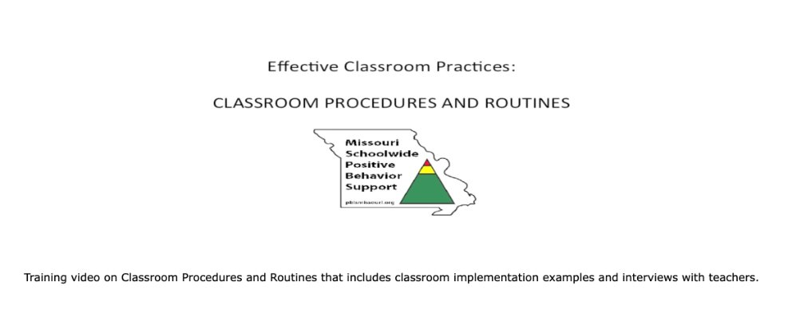
Activity: Classroom Procedures &
Routines in Practice
​
Procedures and Routines Training Video (9-minutes)​
Notes:
Trainer Notes: ​(Vimeo Link - https://vimeo.com/174282791 and linked to the picture)
To Know/To Say: Watch the video which includes classroom implementation examples and interviews with teachers about having clear classroom procedures and routines. Consider how establishing clear classroom procedures and routines that align with schoolwide expectations could benefit your classroom. ​
​
While the examples in this video are primarily in elementary and middle school classrooms, pause and consider all the examples that would apply in high school classrooms? What about lab based classes including art, music/band, FACs, biology, CAD LAB, chemistry, etc?

Slide 24
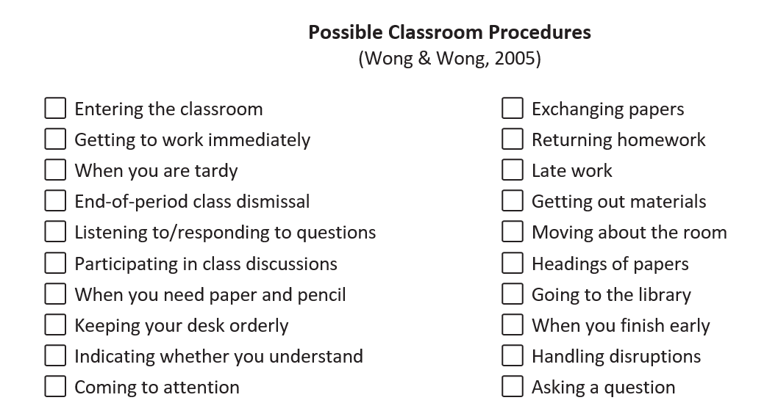
Step 1: Review Draft List
Notes:
Trainer Notes: Handout - MO SW-PBS Classroom Procedures & Routines - Planning & Implementation Guide ​
To Know/To Say: These are some common activities for which you may want to develop procedures. They are listed in step 1 of your handout the MO SW-PBS Classroom Procedures & Routines - Planning & Implementation Guide .

Slide 25
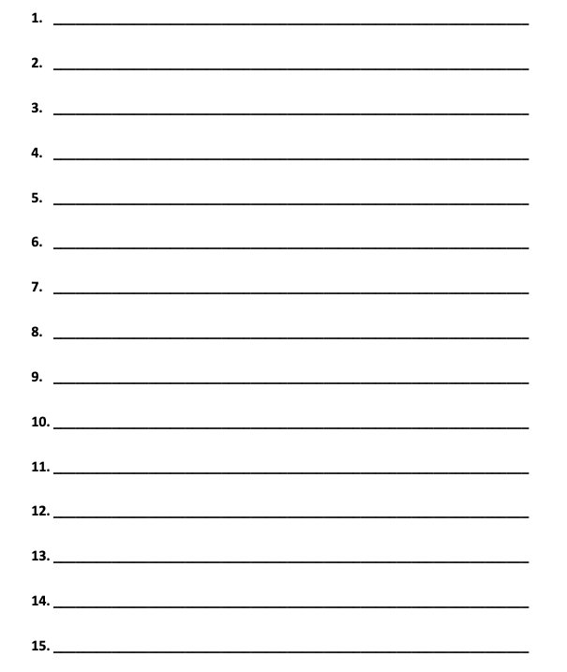
Step 2: Draft a list of YOUR procedures
My Classroom Procedures:
Notes:
Trainer Notes:
To Know/To Say: Complete step 2 on the MO SW-PBS Classroom Procedures & Routines - Planning & Implementation Guide​
Create a list of potential classroom procedures you will want to define from the un-checked items from the list in step 1 above on the back of this paper.​
Consider if there are procedures not listed that would apply to your instructional context and need to be added.​
Run through a typical day in your classroom in your mind and cross reference a typical day with the procedures needed to help you ensure your classroom is predictable.​

Slide 26

Write a Draft Procedure
Activity the need to do first thing
Activity they need to do every day
Notes:
Trainer Notes:
To Know/To Say: Step 3: Write a draft of one of your procedures. Begin by selecting the procedure that students will need to follow first thing when they enter the classroom, or a procedure they need to follow every day.​
​

Slide 27
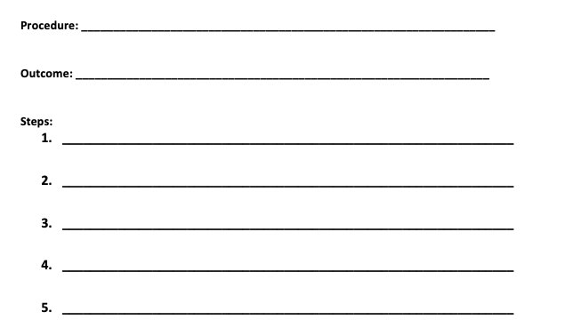
Step 3: Draft ONE of YOUR procedures
Notes:
Trainer Notes:
To Know/To Say: Complete step 3 on the MO SW-PBS Classroom Procedures & Routines - Planning & Implementation Guide​
​Identify the desired outcome of the procedure.​
​Sequentially list each step required to complete. an activity (each step must contain an observable action to be performed by the student).​
​Describe what to do, when to do and how to do it.​
​Think of the errors students typically make before, during, and after the current procedure ​when identifying the steps to include. ​
.​

Slide 28
Step 4: Check for OMPUA
Step 4: Conduct an OMPUA review of your Classroom Procedures
Observable - Behaviors we can see.
Measurable - We can count occurrences.
Positively Stated - What we do to be successful.
Understandable - Student friendly language.
Always Applicable - No exceptions.
Notes:
Trainer Notes:
To Know/To Say: Complete step 4 on the MO SW-PBS Classroom Procedures & Routines - Planning & Implementation Guide​​
​
Conduct an OMPUA review of your classroom procedures:​
Observable – Behaviors we can see.​
Measurable – Behaviors we can count.​
Positively Stated – What we do to be successful.​
Understandable – Student-friendly language.​
Always Applicable – No exceptions

Slide 29
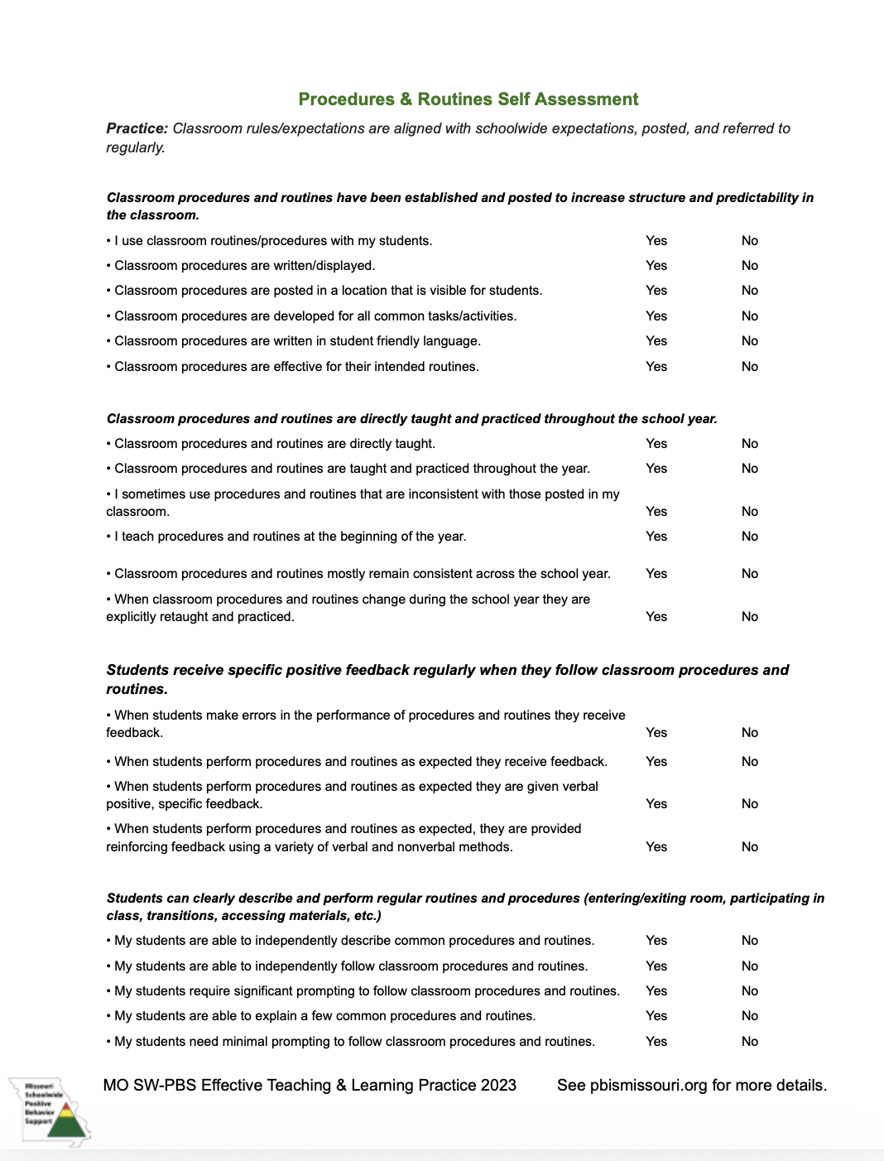
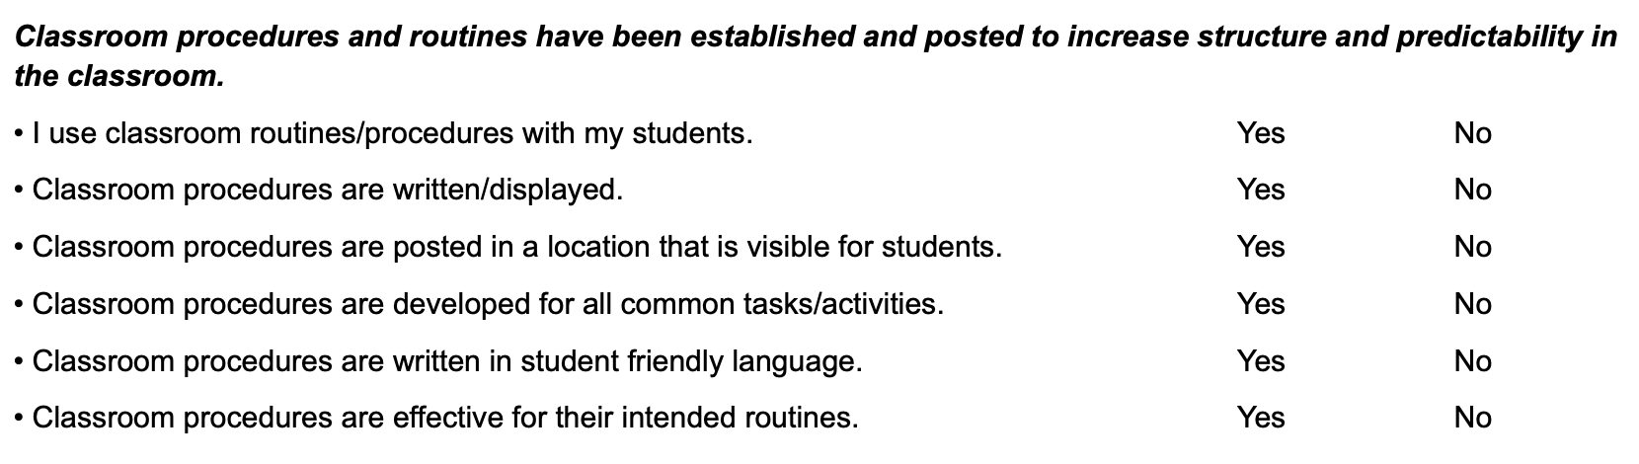
Procedures & Routines Self-Assessment
Notes:
Trainer Notes: Has animation
To Know/To Say: ​Take a moment and go to page 3 of the Classroom Procedures and Routines Teacher Tool and refer to the Self-Assessment Practice Profile as you plan for using your procedures and routines to support expected student behavior. Which steps have you taken today to establish and post your procedures to increase classroom structure and predictability?
​

Slide 30

Step 5: Draft ALL of YOUR procedures
Notes:
Trainer Notes:
To Know/To Say: Complete step 5 on the MO SW-PBS Classroom Procedures & Routines - Planning & Implementation Guide​
​Drafting all Classroom Procedures​
When will you take time to fully draft each of your classroom procedures?​
The more detailed and operational your procedures are the more you structure your classroom for student success.​
Remember to use OMPUA as a process for reviewing your drafted procedures.​
Where will you save a complete document of your classroom procedures?
.​

Slide 31

Step 6: Engaging All Voices & Communicating Procedures
Notes:
Trainer Notes:
To Know/To Say: Complete of the MO SW-PBS Classroom Procedures & Routines - Planning & Implementation Guide Step 6​: Engaging ALL Voices & Communicating Classroom Procedures​
Including student and family input into your classroom procedures can ensure that they are culturally relevant
How will you engage student and family voice in a review and updating of your classroom procedures?​
How will you clearly communicate your “final” list of classroom procedures to family and community?​

Slide 32
Step 7: Teaching & Delivering Feedback
Plan for:
Directly teaching procedures
  Re-teach when students forget
  Re-teach following breaks
Provide Specific Positive Feedback
Respond to errors
Notes:
Trainer Notes: Has animation
To Know/To Say: Complete the MO SW-PBS Classroom Procedures & Routines - Planning & Implementation Guide Step 7: Teaching and Delivering Feedback on Classroom Procedures​
​What is your plan to directly teach each and every procedure at the start of the school year? after breaks? And/or when student behavior indicates all students need a booster or refresher?
What is your plan to deliver consistent and effect positive, specific feedback when students demonstrate expected Classroom Procedures? See lesson 3 for more on classroom encouraging.
What is your plan to deliver consistent and effective corrective feedback when students demonstrate unexpected Classroom Procedures? See lesson 4 for more on classroom discouraging

Slide 33
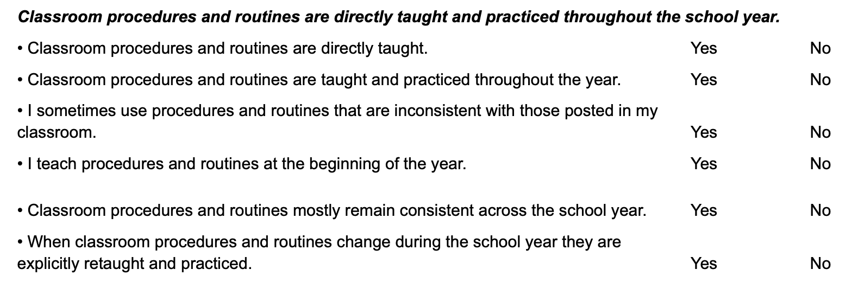
Self Assessment: Teach and Reifnorce
Notes:
Trainer Notes: Has animation
To Know/To Say: ​Use the Classroom Procedures and Routines Teacher Tool to assess your plans
​What is your plan to directly teach each and every procedure at the start of the school year? after breaks? And/or when student behavior indicates all students need a booster or refresher?
What is your plan to deliver consistent and effect positive, specific feedback when students demonstrate expected Classroom Procedures? See lesson 3 for more on classroom encouraging.
What is your plan to deliver consistent and effective corrective feedback when students demonstrate unexpected Classroom Procedures? See lesson 4 for more on classroom discouraging

Slide 34
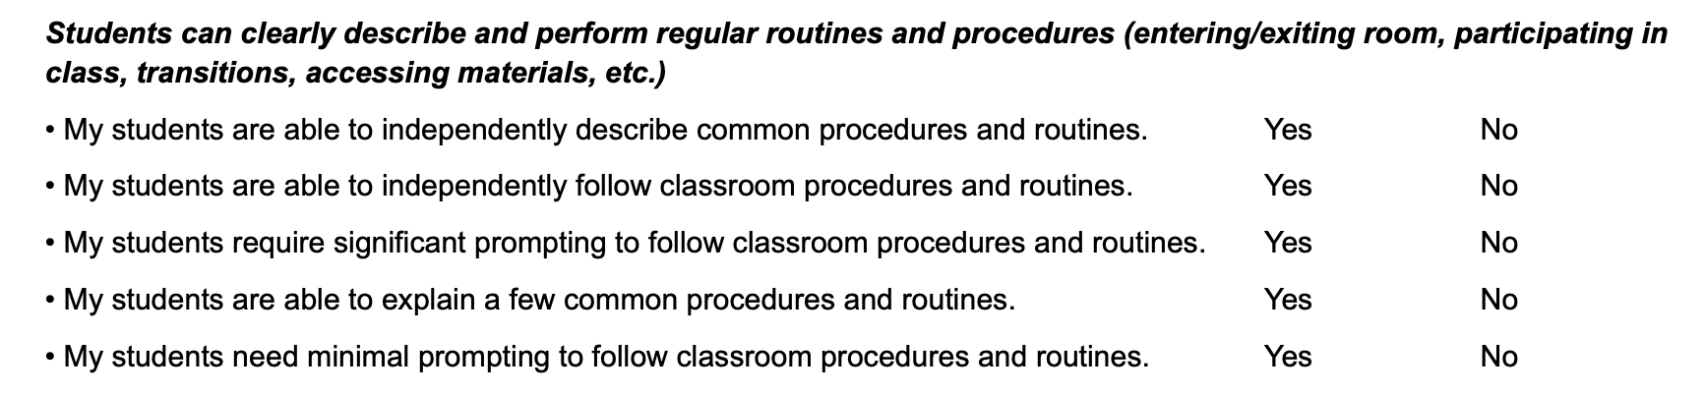
Procedures & Routines
Notes:
Trainer Notes: Has animation
To Know/To Say: Perhaps the best measure of your fidelity of planning for and implementing classroom procedures and routines is assessing students’ knowledge of and fluency with your procedures. The final section on the Classroom Procedures and Routines Teacher Tool’s Self-Assessment Practice Profile helps you do just that.
​

Slide 35
Action Planning
Classroom Procedures & Routines Planning & Implementation Guide​
Draft Procedures
  How will you engage student and family voice to review & edit
Directly teach & reteach
Provide feedback ​
Use the Procedures and Routines Self-Assessment and Practice Profile to monitor your development and use of classroom expectations and rules.
Notes:
Trainer Notes:
To Know/To Say: Next steps include: ​
Use the Classroom Procedures & Routines Planning & Implementation Guide​
Develop a draft of classroom procedures and routines; make a plan to engage student and family voice in the final review and editing.​
Consistently teach and provide feedback to students on classroom procedures as needed for fluency of expected procedures to​
become routine.​
Use the Teacher Tool - Procedures and Routines Self-Assessment and Practice Profile and the Teacher ETLP Self-Monitoring Plan to monitor your development and use of classroom expectations and rules. ​
​
Additional information about developing and implementing classroom expectations and rules can be found in the MO SW-PBS Handbook and the Tier 1 Implementation Guide.

Slide 36

Next Steps
Notes:
Trainer Notes:
To Know/To Say: During this lesson You learned to:​
Identify and develop classroom procedures.​
Plan for implementation of procedures to create routines.​
Deliver effective feedback to students to reinforce expected behaviors and correct unexpected behaviors. ​
Establish a process to self monitor the implementation of classroom procedures and routines with fidelity, consistency and equity

Slide 37
References
Brophy, J. (2006). History of research on classroom management. Handbook of classroom management: Research, practice, and contemporary issues, 17-43.​
​
Brophy, J. (1998). Motivating students to learn. Boston: McGraw Hill.​
Brophy, J. & Evertson, C. (1976). Learning from teaching: A developmental perspective. Boston, MA: Allyn and Bacon.​
​
Everston, C. M., & Emmer, E. T. (1982). Preventive classroom management. Alexandria, VA: Association for Supervision and Curriculum Development.​
​
Evertson, C. M., Emmer, E. T., & Worsham, M. E. (2003). Classroom management for secondary teachers. Allyn and Bacon. ​
​
Good, T. J., & Brophy, J. (2000). Looking into classrooms (8th Ed.) New York, NY: Longman Press. ​
​
Good, T. L., & Brophy, J. E. (2003). Looking in classrooms (9th ed.). Boston: Allyn & Bacon.​
​
Johnson, T. C., Stoner, G. & Green, S. K. (1996). Demonstrating the experimenting society model with classwide behavior management interventions. School Psychology Review, 25(2), 199-214.​
​
Kern, L., & Clemens, N.H. (2007). Antecedent strategies to promote appropriate classroom behavior. Psychology in the Schools, 44(1), 65-75. ​
​
Missouri Schoolwide Positive Behavior Support (2019). Missouri Schoolwide Positive Behavior Support Handbook. ​
​
Missouri Schoolwide Positive Behavior Support (2019). Missouri Schoolwide Positive Behavior Support Tier 1 Implementation Guide. ​
​
Scott, T., Hirn., R. and Cooper, J. (2017). Teacher and student behaviors: Keys to success in classroom instruction. Rowman& Littlefield.​
​
Soar, R., & Soar, R. (1979). Emotional climate and management. In P.L. Peterson & H. J. Walberg (Eds.), Research on teaching. Berkeley, CA: McCutchan.
Notes:
Trainer Notes:
To Know/To Say: Here are some of the references used in this lesson.

Slide 38


Contact Information
Check Out MO SW-PBS on Social Media:
Facilitator Contact Information:
pbismissouri.org
List HERE
facebook.com/moswpbs
instagram.com/moswpbs/
Notes:
Trainer Notes:
To Know/To Say: This lesson was made possible with funds from the Missouri Department of Elementary and Secondary Education, Division of Special Education; the Center on Positive Behavior Interventions and Supports and the University of Missouri Center for Schoolwide Positive Behavior Support.

