Slide 1
T1C8L1 Classroom Expectations
& Rules
Tier 1 Effective Teaching & Learning Practices
(ETLPs) for the Classroom
Notes:
Trainer Notes:
To Know/To Say: Welcome to Lesson 1 MO SW-PBS of the Effective Teaching & Learning or ETLP series. This lesson describes the value of having classroom expectations and rules clarified and aligned to schoolwide and/or districtwide expectations. The key to successful classroom management is preventing problems before they occur. Clarifying specific expected rules for the classroom is essential, and the same rules that reduce classroom disruptions are clearly associated with increased student learning.

Slide 2
Lesson Description & Rationale
Defining, teaching & reinforcing expectations and rules form the foundation for a positive, predictable, and supportive classroom environment.
Notes:
Trainer Notes:
To Know/To Say: This Course introduces educators to the Missouri Schoolwide Positive Behavior Support (MO‑SWPBS) framework with a focus on Tier 1 universal systems. Participants learn how to define, teach, and acknowledge expected behaviors for all students using equitable practices and consistent systems. This course establishes the foundation for a positive, predictable, and supportive classroom environment.

Slide 3
Working Agreements
Be Respectful
Be an active listener—open to new ideas
Use notes for side bar conversations
Be Responsible
Be on time for sessions
Silence cell phones—reply appropriately
Be a Problem Solver
Follow the decision making process
Work toward consensus and support decisions of the group
Notes:
Trainer Notes:
To Know/To Say: “These will be the Working Agreements we will honor during all our training sessions this year.”

Slide 4
Attention Signal
Notes:
Trainer Notes: Select an attention signal.
To Know/To Say: “One of our agreements is to follow the attention signal.”
“Your team will work with your school to develop an attention signal you will use in every setting.”
“In order to get all of you focused after discussions, activities or breaks,
I will ________________________________________.”
(Insert your attention signal here.)
“Your task will be to finish your sentence, quiet your voice and ____________________________.”
(Insert what you want participants to do.)

Slide 5
Introductions
Notes:
Trainer Notes Select an introductions activity.
To Know/To Say:

Slide 6
Handouts
Classroom Expectations and Rules Teacher Tool
MO SW-PBS Classroom Expectations & Rules - Planning & Implementation Guide
Notes:
Trainer Notes:
To Know/To Say: There are two handouts that are used in this lesson, and can help you to define, teach and reinforce expectations and rules in your classroom.

Slide 7
Lesson Outcomes
At the end of this session, you will be able to…
Explain why students need to know expectations and rules
Develop a draft of classroom expectations and rules.
Begin developing a system to consistently teach and reinforce these expectations and rules.
Consider a process to self monitor the implementation of classroom expectations and rules with fidelity, consistency and equity.
Notes:
Trainer Notes:
To Know/To Say: Read slide.

Slide 8
Essential Questions
How does knowing expectations and rules create a consistent learning environment for students?
Think of a time when you made a social error because at work or somewhere else because you did not know expectations: How would knowing the expectations in advance have helped you to avoid making that error?
Notes:
Trainer Notes:
To Know/To Say: Read slide.

Slide 9
Pre-Requisites
Knowledge of The Science of Behavior
Function Based Thinking
Clarifying Expected Behavior
Teaching Expected Behavior
Notes:
Trainer Notes:
To Know/To Say: There are are several courses and lessons that will be beneficial for you to complete before you begin this lesson. We highly encourage anyone who is engaging in this lesson on Classroom Expectations & Rules to first engage with at least one of the Science of Behavior resources listed prior to taking this lesson. Doing so will provide critical background information necessary to be able to understand and apply the concepts shared here for classroom implementation of encouraging expected behaviors with fidelity, consistency and equity.
In addition, participants should also complete the Overview of the 8 Classroom ETLPs, (Lesson A)
Note: ETLP Lessons 1-8 will primarily focus on the 8 Classroom ETLPs through the lens of INDIVIDUAL classroom educators. All of these resources can be found on the MO SW-PBS website located at pbismissouri.org.

Slide 10

Keywords
Expectations: three to five words/phrases that define the kind of people you want your students to be, which are a direct outgrowth of your beliefs, vision and mission.
Rules: discrete, positively stated behaviors that operationally define the expectations
Notes:
Trainer Notes:
To Know/To Say: Here are key terms and acronyms that will be used in this lesson.
Expectations: three to five words/phrases that define the kind of people you want your students to be, which are a direct outgrowth of your beliefs, vision and mission. Typically, the schoolwide expectations may be set by a BUILDING LEADERSHIP TEAM ( BLT) or the DISTRICT LEADERSHIP TEAM (DLT).
Behaviors/Rules: the specific tasks students are to do to demonstrate the schoolwide expectations. For the remainder of this lesson we will use the term RULES to mean the specific tasks that demonstrate the expectation.

Slide 11
Quote
“Although expectations used by effective educators may vary from teacher to teacher and school to school, we do not find effectively managed schools and classrooms operating without them.”
~ Carolyn Evertson, PhD – Peabody College, Vanderbilt University
Notes:
Trainer Notes:
To Know/To Say: Possible engagement strategy: Turn and talk to a neighbor. What do you notice? What do you wonder?

Slide 12
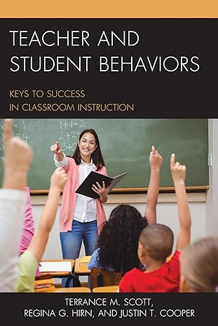
Overview of Classroom Expectations & Rules
Large scale study of over 6,500 classrooms
Consistently indicates that clarifying specific expected behaviors and rules for the classroom is essential
Consistent expectations reduce classroom disruptions and are clearly associated with increased student learning.
Notes:
Trainer Notes:
To know/To say: The current need for clear and consistent classroom rules is evident. In a large-scale study in over 6,500 classrooms in the late-2010’s, Scott, Hirn and Cooper found the commonality across all classrooms was the generally low level of implementation of teaching and learning practices with large effect sizes.
The work of Scoot and colleagues is undergirded by research spanning more than 40 years which consistently indicates that clarifying specific expected behaviors and rules for the classroom is essential, and the same behaviors and rules that reduce classroom disruptions are clearly associated with increased student learning.
In addition we know from research that
A dependable system of rules and procedures provides structure for students and helps them to be engaged with instructional tasks.⁴
Teaching rules and routines to students at the beginning of the year and enforcing them consistently across time increases student academic achievement and task engagement. ^{5,6}
Clearly established classroom expectations and rules provide language for teaching and feedback for students, staff and parents.⁷
For further research on this topic, see the citations at the end of this lesson.

Slide 13
Activity : Classroom Rules and Expectations in Practice
How can it benefit your classroom to align your classroom expectations to the schoolwide expectations.
How did teachers in the video:
  Teach expected behaviors
  Precorrect/Prompt or review expected behaviors
  Reteach expected behaviors
  Reinforce students for following expected behaviors
Expectations & Rules Training Video (12-minutes)
(Embed Vimeo Link) - https://vimeo.com/174282584
Notes:
Trainer Notes: This slide and video are optional; Suggested activity: For the video activity, assign each table/group/pairing one of the four takeaways from the video and have them listen for and jot down any examples they hear tied to their assigned takeaway. After the video, have each group share out what they found. Giving trainees a specific, narrower task should keep them more accountable and engaged through the full video.
To Know/To Say: Watch this 12-minute video that includes classroom implementation examples and interviews with teachers about having clear classroom expectations & rules.
How did teachers in this video teach expected behaviors?
How did teachers in this video precorrect or prompt students to use expected behaviors?
How did teachers in this video reteach expected behaviors?
How did teachers in this video reinforce students who followed the behavior expectations

Slide 14
Before We Zoom in on the Classroom…
District Expectations
Be Respectful
Be Responsible
Be a Learner
Schoolwide Expectations
Be Respectful
Be Responsible
Be a Learner
Classroom Expectations
Be Respectful
Be Responsible
Be a Learner
Notes:
Trainer Notes: This shows alignment of classroom matrix with building expectations.
To Know/To Say: Most SW-PBS schools and many SW-PBS districts have already selected expectations. If so, you will want to align your classroom expectations and rules to the district or schoolwide expectations. Alignment provides consistency and common language for the adults and students. It makes the environment predictable for students.
The easiest way to align your classroom expectations and rules to the district or school expectations is to simply use the same 3-5 expectations selected by district or school, but operationally define them for your specific classroom setting.

Slide 15
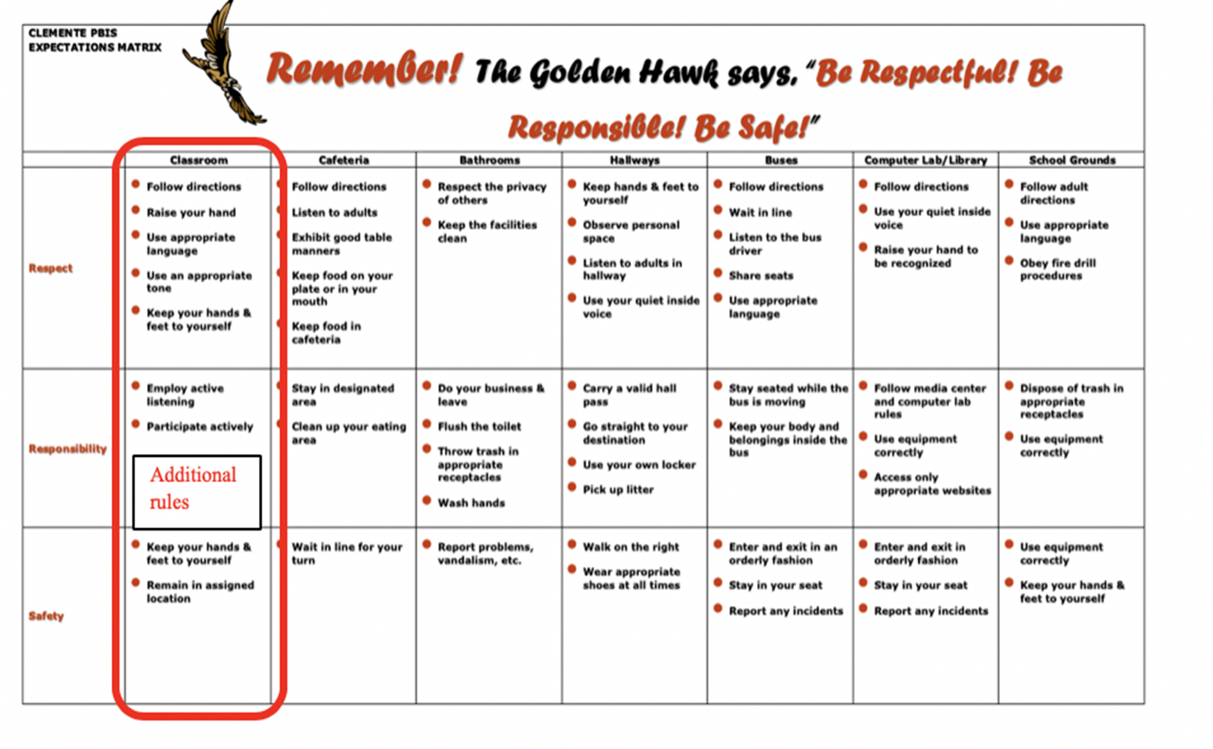
Schoolwide Matrix Including Classroom Setting
Notes:
Trainer Notes: This shows alignment of classroom matrix with building expectations.
To Know/To Say: You will need to know what the schoolwide Expectations are and which if any Rules have been established by the leadership team for ALL classroom settings. In the example schoolwide matrix the building leadership team opted to create certain rules that apply in all classrooms.

Slide 16
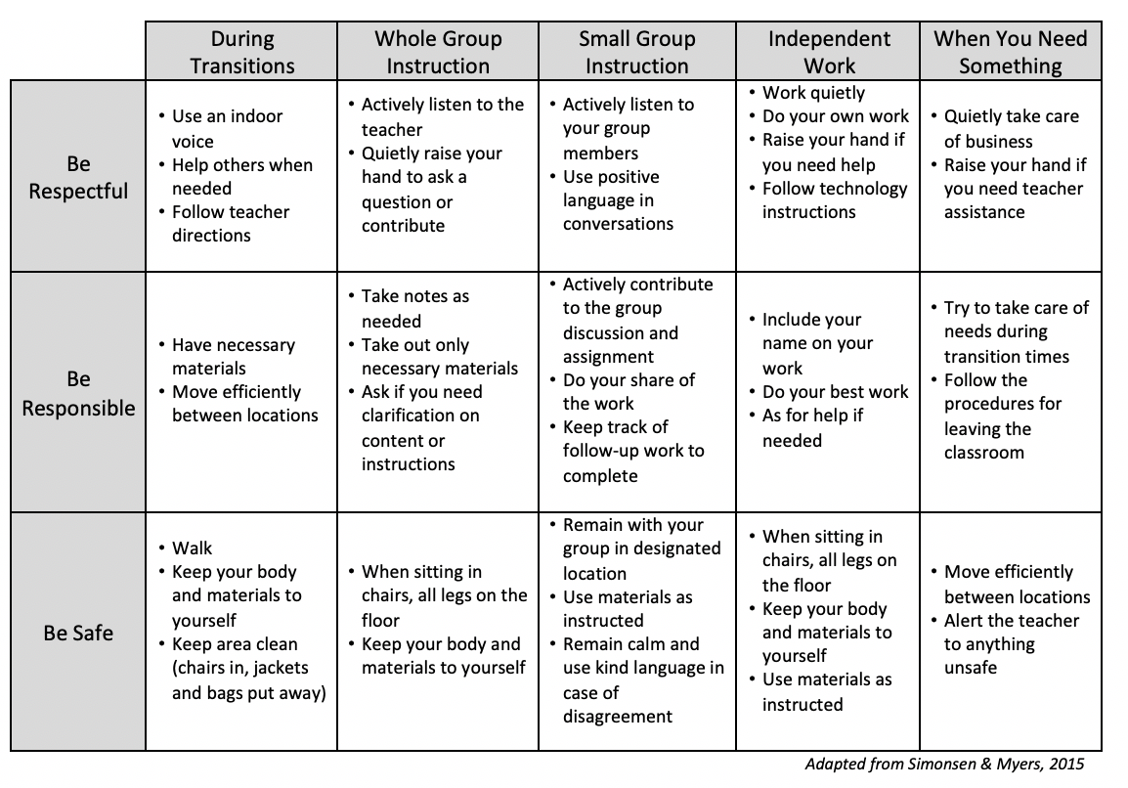
Where are we going?
Notes:
Trainer Notes: This shows how the classroom matrix can be personalized.
To know/To say: A classroom matrix describes the expectations for successful learning in all classroom activities. The rules describe how to demonstrate successful learning behavior.
This sample matrix describes the expectations and rules in a middle school classroom. image adapted from Simonsen & Myers 2015
This lesson will walk you through the process of drafting classroom rules aligned to schoolwide expectations, developing a classroom matrix, creating a plan to teach and reinforce your classroom rules, and finally self-assess your implementation of classroom expectations and rules.

Slide 17
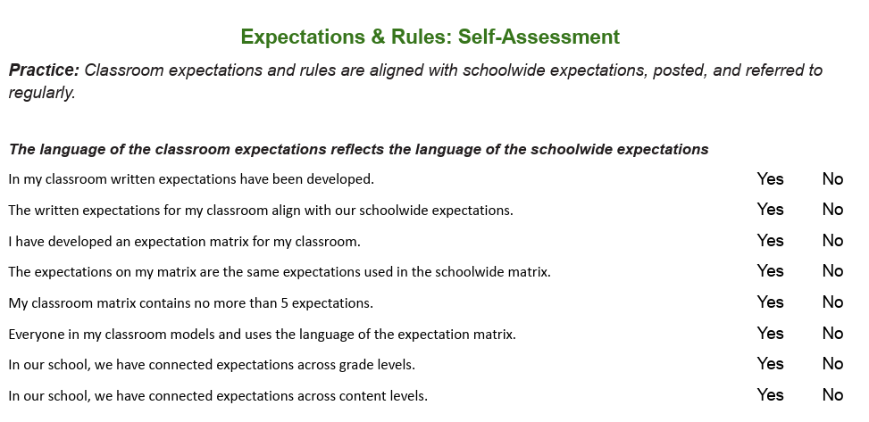
Where am I right now?
Notes:
Trainer Notes: Possible adult engagement strategy is to take the self assessment on the back of the teacher tool.
To know/To say: This slide is just here as a reference to remind you to pull out the handout!
The MO SW-PBS Classroom Expectations and Rules Teacher Tool provides you with several resources to understand the importance of, provide tips for drafting and metrics to progress monitor your development and use of classroom procedures and routines.
1. The first 2 pages of each Teacher Tool defines the practice,
2. shares research regarding the practice,
3. indicates how the practice aligns to Missouri Teacher Standards,
4. describes an example of the practice,
5. provides steps and examples of how to implement the practice,
6. and lists research references for further study.
You will learn more about page 3 Self-Assessment and page 4 Practice Profile later in this course. Make sure to have a copy of the Classroom Expectations & Rules Teacher Tool handy during this
lesson.

Slide 18
How Do I Get There?
Be Safe
During Transitions
Use walking feet
At My Desk
Keep all four feet of your chair on the floor
Small Groups
Use center materials as directed
Notes:
Trainer Notes:
To Know/To Say: Which brings us to how to make the expectations meaningful for students. Expectations are a small number of character traits or values that we want our students to demonstrate. But what do they look like? If you ask 5 teachers and 5 students in your school what “respect” looks like, you are likely to get 10 different answers! “Rules” are the behaviors that operationally define the expectations; they identify what the students should do to demonstrate the expectations. So, in this school, “Being Safe” in the hall is operationally defined as walking. If you are walking, you are being safe.
Furthermore, what expectations look like may vary from one place to the next, and one activity to the next. Here are some obvious examples: we may define being safe in the hall with the behavior, “walk.” However, “walk” is not always appropriate in the gym. We sometimes want students to run in the gym, but we want them to do so safely. So we might have a behavior of “maintain personal space.” Furthermore, students would never have a need to use a push stick in the gym or the hall, but it will keep their hands safe in Shop Class.
So, the challenge is to operationally define the expectations with the behaviors that we want to see in a particular setting.

Slide 19
Drafting Classroom Rules That Are OMPUA
• Observable – Behaviors we can see
• Measurable – We can count occurrences
• Positively Stated – What we do to be successful
• Understandable – Student-friendly language
• Always Applicable – No exceptions in this setting
Notes:
Trainer Notes: Drafting Classroom Rules that are OMPUA
To Know/To Say: No matter which option your LEADERSHIP TEAM chooses, it is important that all YOUR classroom rules that are selected to define the expectations follow the same OMPUA Guidelines used for development of the rules that define the expectations at the building level in schoolwide settings (think hallway, cafeteria, commons or on the playground).
Specifically Identified behaviors should be:
• Observable – Behaviors we can see
• Measurable – We can count occurrences
• Positively Stated – What we do to be successful
• Understandable – Student-friendly language
• Always Applicable – No exceptions in this setting
For instance, being respectful means different things to different people. We have to define what respect looks like for our students at our school and in our classrooms. It may mean ‘Eyes on the speaker,’ ‘Sitting quietly with hands to self,’ or ‘Asking for your partner’s opinion,’ depending on the context or routine.

Slide 20
Activity: OMPUA or Not?
Guideline | This Means | Example | Non-Example
Observable | I can see it | Raise your hand | Be your best
Measureable | I can count it | Bring materials | Be ready to learn
Positively Stated | It describes what to do. | Keep hands to self | No fighting!
Understandable | Age/Grade appropriate | Keep hands to self | Maintain spatial awareness
Always Applicable | No exceptions | Stay in assigned area | Remain in seat at all times
Notes:
Possible adult engagement strategy: At posters around the room, choose a non-example to edit and make it OMPUA
Trainer Notes: Recall the video shared earlier < https://vimeo.com/174282584>.
To Know/To Say: Take a moment to review the examples and non-examples of rules and the ratings each has been given in regard to a specific OMPUA guideline.
This OMPUA checklist is part of the Teacher Tool collection, see MO SW-PBS Classroom Expectations & Rules handout.

Slide 21
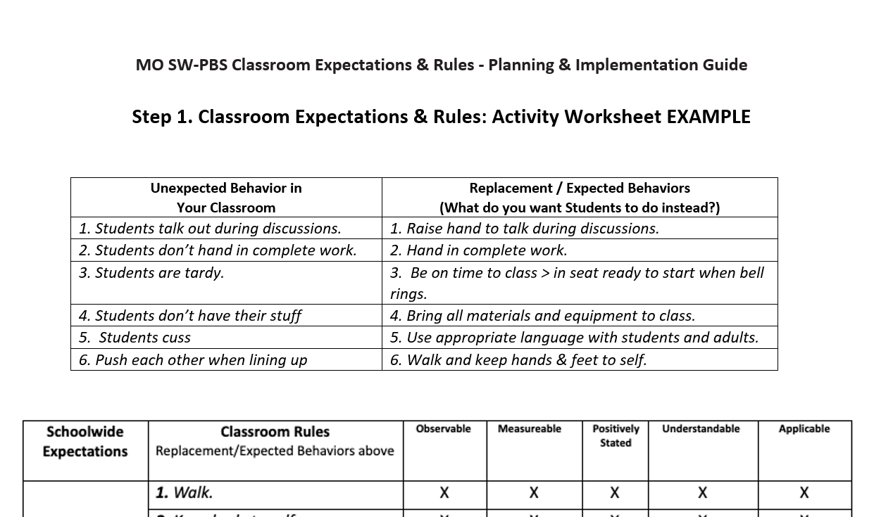
Activity: Evaluate an Example
Notes:
Trainer Notes: This slide only serves as a reminder to pull out the handout “MO SW-PBS Classroom Expectations & Rules - Planning & Implementation Guide” and complete the Step 1 Activity.
To Know/To Say: Now it is time to practice writing classroom rules that are aligned with your schoolwide expectations, your instructional contexts and follow the OMPUA Guidelines. First, review step 1 on the handout, “MO SW-PBS Classroom Expectations & Rules - Planning & Implementation Guide.” This is a completed example with some discussion questions. Review the example and formulate your thoughts.
What were the unexpected behaviors this teacher observed?
What were the possible replacement behaviors this teacher listed?
Consider if you agree that this teacher’s brainstormed list of behaviors and rules meet the OMPUA guidelines.

Slide 22
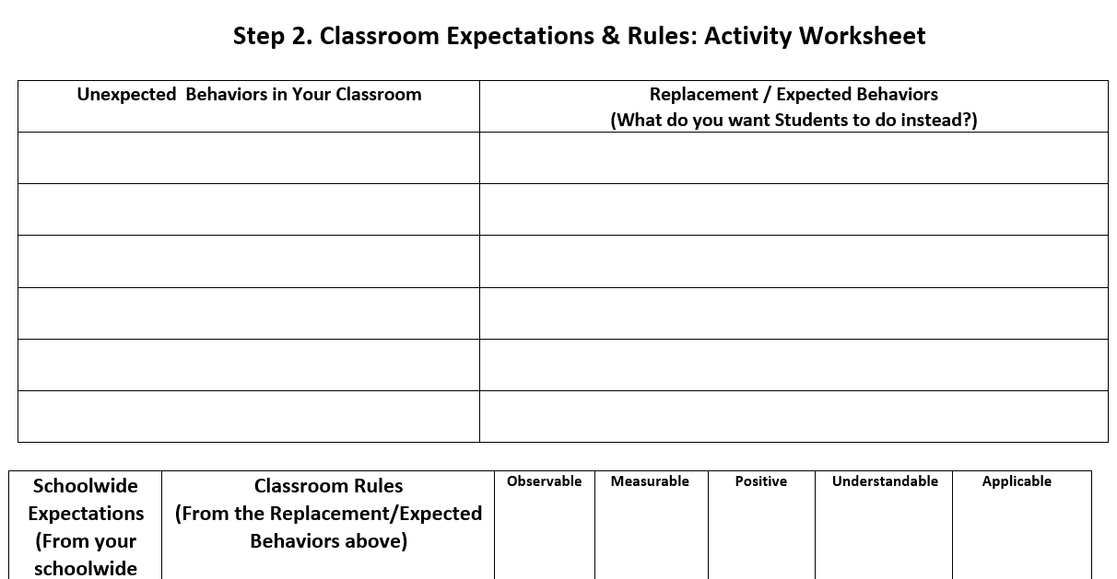
Activity: Make It Your Own
Notes:
Trainer Notes:
To Know/To Say: This slide is just here as a reference to remind you to pull out the handout and complete Step 2.
Now work on drafting your classroom rules using the MO SW-PBS Classroom Expectations & Rules - Planning & Implementation Guide handout. As you do so, consider
What are the behaviors that would be unexpected in YOUR classroom setting?
What would be possible replacement behaviors for those that are unexpected?
Now group or categorize your brainstormed behaviors or rules so they align to the building wide expectations AND provide expected replacement behaviors for YOUR Classroom.
Finally, review each of your draft rules and consider if they meet the OMPUA guidelines.

Slide 23
Completed Matrix Example
Notes:
Trainer Notes:
To Know/To Say: You have just spent time writing your classroom expectations and rules that are somewhat broad in scope while also being aligned to your schoolwide expectations that apply at all times.
Now, consider the configurations of learning that occur in your classroom and reflect on how you expect students to behave during those particular learning times. For example:
Entering or exiting the classroom.
Whole group instruction.
Small group instruction.
Individual work time.
Transitions between whole-group-individual learning times

Slide 24
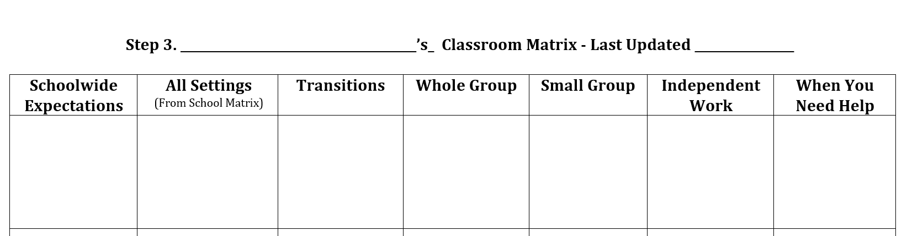
Activity: Create Your Own
Notes:
Trainer Notes: This activity utilizes the MO SW-PBS Classroom Expectations & Rules - Planning & Implementation Guide Handout
To Know/To Say: Now that you have reviewed your draft rules to ensure alignment to schoolwide expectations and OMPUA guidelines, you are ready to draft a matrix that clarifies for students which rules apply during various instructional contexts including transitions, whole group, small group and individual work time as well as when students need help.

Slide 25
Student Ownership
Creates ownership and commitment if students are involved
Ways to involve students:
  discuss why rules are important
  create a list of rules aligned to schoolwide expectations
  check all current or drafted rules for OMPUA
Notes:
Trainer Notes:
To Know/To Say: Students will have more ownership of classroom rules if they have given input on their development. This ownership will go a long way in fostering the students' sense of competence, relatedness and ultimately autonomy as they go about the daily workings of the classroom.
There are several ways to involve students including:
discuss why rules are important in the classroom and community.
have students make a list of rules aligned to schoolwide expectations that they believe would be helpful in the classroom.
have students check all current or drafted rules for OMPUA.

Slide 26

Family Involvement
How can you engage families in the process?
What is your plan to share your draft expectations and rules with your families?
Notes:
Possible adult engagement strategy: turn and talk to a neighbor about the discussion questions; Session-wide create a poster of ideas from the turn and talk at each table. EVERYONE needs more ideas!
To Know and Say: Engaging families in developing classroom expectations and rules can ensure that your rules are culturally responsive, relevant, and supported by the families of your students.
Now that you have engaged student voice into your classroom rules, consider what strategies your building leadership team suggested for engaging family voice? What is your plan to share your DRAFT Classroom Expectations and Rules with your families?
Use the MO SW-PBS Classroom Expectations & Rules - Planning & Implementation Guide to take notes and jot potential future plans

Slide 27
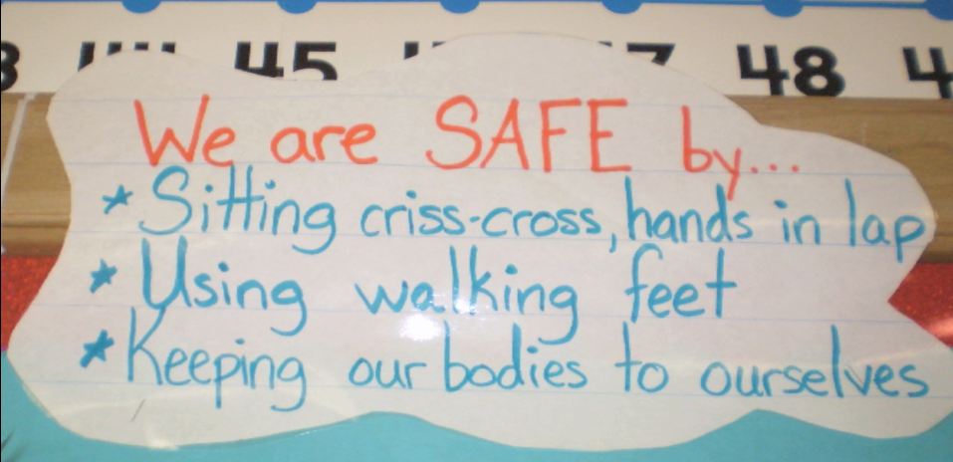
Classroom Signage Elementary Example
Notes:
Trainer Notes:
To Know/To Say: Once you have developed consistent classroom rules that follow the OMPUA guidelines and reflect stakeholder voice, it is important to use that language on a regular basis. Having the expectations and rules displayed in the classroom in a big, bold way will make it easier for YOU the classroom teacher (or a substitute) to consistently use the language. Signs also serve as visual cues to remind students of expected behaviors in different settings. Signage should directly match the expectations and rules from the matrix and should incorporate schoolwide as well as your additional classroom rules as applicable (Option 2 or 3 from above).
Review the following signage examples and decide if they are appropriate for your context.

Slide 28
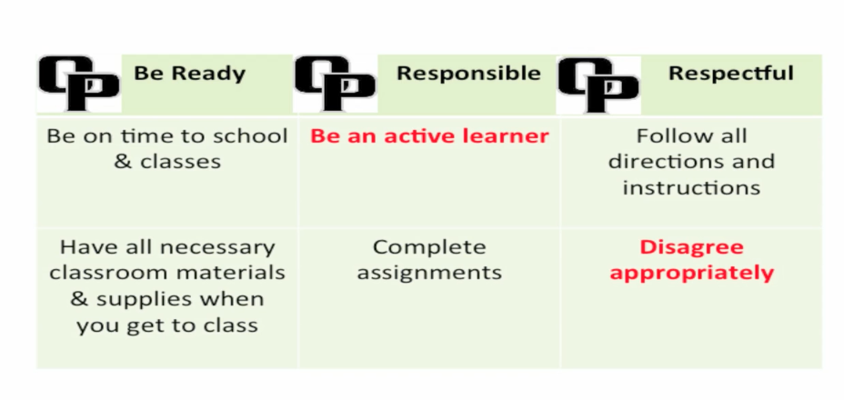
Classroom Signage Secondary Example
Notes:
Trainer Notes:
To Know/To Say: In the final matrix, from a Secondary building, the Rules in Red were to be more clearly defined in OMPUA terms by the classroom teacher in language specific to the course content and classroom context.
Make a plan to develop your classroom expectations and rules signage and note ideas on the back of your classroom matrix draft.

Slide 29
Teach Classroom Expectations and Rules
Tell
Show
Practice
Reinforce
Notes:
Trainer Notes:
To Know/To Say: We have to make sure students understand what we expect behaviorally before we hold them accountable for meeting our expectations. If a student is behaving unexpectedly, it will be very difficult for that student—and other students—to learn.
In addition, correcting unexpected behaviors takes up valuable instructional time, so why not teach students how you want them to behave before there is a problem? One of the reasons students engage is unexpected behavior is that they simply do not know what the expected behaviors are. It is not just important that teachers teach hte behavior, we have ot ensure that the students have learned the behaviors! This means they need repeated exposures until we know that they know it.
Research continues to demonstrate that teaching rules and routines to students at the beginning of the year and enforcing them consistently across time increases student academic achievement and task engagement.
Remember, as you plan to teach behavioral expectations to be efficient and effective and plan to intertwine academic and behavior instruction, rather than deliver them as separate systems in the classroom.

Slide 30
Activity: Classroom Rules and Expectations in Action 1
Write down your thoughts for student/ family involvement and signage on the
Classroom Expectations & Rules Planning & Implementation Guide (Step 4).
Notes:
Trainer Notes: Complete Step 4 on the MO SW-PBS Classroom Expectations & Rules - Planning & Implementation Guide handout
To Know/To Say: Take a moment to jot down your thoughts for developing a teaching plan for your classroom expectations and rules on the Classroom Expectation and Rules - Development prompts worksheet.

Slide 31
Teaching Schedule
Directly teach, and prompt daily– 1st Week
Periodic weekly review– 1st Quarter
Periodically review and re-teach throughout the year
Plan to re-teach as data indicates
Notes:
Trainer Notes:
To Know/To Say: Here is a suggested schedule for teaching your rules.
Directly teach and prompt classroom rules daily during the first week of school,
Then review the rules 2-3 times per week during the first grading period (quarter or trimester).
This provides students with multiple opportunities for review and practice. Along with practice opportunities it is important to continue providing frequent reinforcement and acknowledgement when rules are followed.
Examples for practice with older students includes oral review during the first or last few minutes of class; surprise quizzes about rules for extra credit points; or dividing students into teams, asking questions about rules and awarding team points for correct answers.
For younger students provide meta cognitive or “thinking out loud” narration as students demonstrate the classroom expected behavior and rules.
Just as we do with an academic task we continue to teach, review, practice and acknowledge success on behavioral tasks – which include following classroom rules.
Plan on BOOSTER teaching, prompting and reviewing after planned and unplanned breaks in school (e.g. winter break, snow days, etc.)
Use the MO SW-PBS Classroom Expectations & Rules - Planning & Implementation Guide to take notes and jot potential future plans.

Slide 32
Activity: Classroom Rules and Expectations in Action 2
Write down your thoughts for developing a teaching plan for your classroom expectations and rules on the MO SW-PBS Classroom Expectations & Rules - Planning & Implementation Guide (Step 4).
Notes:
Trainer Notes:
To Know/To Say: Take a moment to jot down your thoughts for developing a teaching plan for your classroom expectations and rules on the Classroom Expectation and Rules - Development prompts worksheet.

Slide 33

Pre-Correct (Elementary)
Pre-correcting
Strategy to remind students of expected behaviors or rules BEFORE they are to be used by the students, especially for rules that students sometimes do not follow correctly.
Notes:
Trainer Notes:
To Know/To Say: While teaching the expectations and rules is a critical step, teachers should also plan to use pre-correction to reduce learning errors. Pre-Correcting is a strategy to remind students of expected behaviors or rules BEFORE they are to be used by the students, especially for rules that students sometimes do not follow correctly.
For instance, a teacher might say, “When I call your name it will be your turn to stow your reading materials, get your lunch from your backpack if you brought it and then stand on your line spot, facing forward, with your voice at a zero.”

Slide 34

Pre-Correct (Secondary)
Pre-correcting
Strategy to remind students of expected behaviors or rules BEFORE they are to be used by the students, especially for rules that students sometimes do not follow correctly.
Notes:
Trainer Notes:
To Know/To Say: A teacher in a secondary classroom might say, “Heads up everyone, you have 3 more minutes to complete your lab notes for today. When the timer rings, you will need to submit your notebook, work with your lab partner to return your experiment materials in the designated containers, and get your backpacks and other materials ready to move to your final class of the day.”
What rules or transitions are typically ones that you find you are frequently correcting in your classroom? How can you use pre-correction to remind students of the expectation or rule, right before they would need to demonstrate it to increase their rule following behavior?
Take a moment to jot down your thoughts regarding necessary times for Pre-correction using the prompts on the MO SW-PBS Classroom Expectations & Rules - Planning & Implementation Guide.

Slide 35
Monitor & Provide Feedback
Monitor
Provide Feedback
  Specific Positive Feedback
  Error correction
Notes:
Trainer Notes:
To Know/To Say: Just as with new academic skills, children learn from feedback. Feedback includes specific positive feedback as well as error corrections. Specific positive feedback provides the student with reinforcement, so you should strive to provide positive feedback at a high frequency, and at higher rates than you provide error corrections. We typically recommend striving for at least a 4:1 positive to corrective ratio.
That said, students need to know when they are making behavioral errors so they will not become fluent in the incorrect behaviors. When correcting behavioral errors it is critical that we do so in the same calm, dispassionate tone that we use when correcting academic errors. When you observe a students making behavior errors, simply restate the behavior expectation, then gives specific positive feedback immediately when you observe the student demonstrating the expected behavior.
A simple way to monitor the frequency of specific positive feedback is to use a cheap golf stroke counter. Every time you give a student specific positive feedback, click the counter.
A simple way to monitor the ratio of specific positive feedback to corrective feedback is to keep four quarters and a penny in your right pocket. Every time you give specific positive feedback, move a quarter to your left pocket. Every time you give corrective feedback, move the penny. Try to have all quarters in your left pocket before giving your second corrective feedback.
How can you monitor your ratio of positive to corrective feedback?

Slide 36
Activity: Classroom Rules and Expectations in Action 3
How you can add feedback to your lesson plans and provide feedback, using the (Step 4).
Notes:
Trainer Notes:
To Know/To Say: Use the MO SW-PBS Classroom Expectations & Rules - Planning & Implementation Guide to jot down your thoughts for developing a feedback plan for your classroom expectations and rules on the Classroom Expectation and Rules

Slide 37
Next Steps
Gather student input on classroom expectations and matrix
Implement your classroom expectations and matrix.
Finalize a plan to consistently teach, practice and provide feedback to students on classroom expectations and rules.
Monitor your development and use of classroom expectations and rules.
Additional information about developing and implementing classroom expectations and rules can be found in the MO SW-PBS Handbook² and the Tier 1 Implementation Guide.⁸
Notes:
Trainer Notes:
To Know/To Say: During this lesson you learned:
your classroom expectations should align with school /district expectations.
classroom rules are the behaviors that demonstrate the specific criteria for meeting expectations.
classroom rules should meet the 5 guidelines of OMPUA (observable, measurable, positively stated, understandable, always applicable).
classroom expectations and rules must be taught, modeled, practiced and reinforced; feedback is regularly given.
how to develop classroom expectations and rules and establish a system to consistently teach and reinforce these expectations and rules.
how to self monitor the implementation of classroom procedures and routines with fidelity, consistency and equity.
Next steps for INDIVIDUALS include:
Use the Classroom Expectations & Rules Planning & Implementation Guide
Develop classroom expectations and rules into a matrix that aligns with school/districtwide expectations and rules.
Develop a plan to consistently teach and provide feedback to students on classroom expectations and rules as needed for fluency of expected behaviors.
Use the Expectations and Rules Self-Assessment and Practice Profile to monitor your development and use of classroom expectations and rules.

Slide 38
References
Brophy, J. (1998). Motivating students to learn. Boston: McGraw Hill.
Brophy, J. & Evertson, C. (1976). Learning from teaching: A developmental perspective. Boston, MA: Allyn and Bacon.
Everston, C. M., & Emmer, E. T. (1982). Preventive classroom management. Alexandria, VA: Association for Supervision and Curriculum Development.
Good, T. J., & Brophy, J. (2000). Looking into classrooms (8th Ed.) New York, NY: Longman Press.
Johnson, T. C., Stoner, G. & Green, S. K. (1996). Demonstrating the experimenting society model with classwide behavior management interventions. School Psychology Review, 25(2), 199-214.
Missouri Schoolwide Positive Behavior Support (2019). Missouri Schoolwide Positive Behavior Support Handbook.
Missouri Schoolwide Positive Behavior Support (2019). Missouri Schoolwide Positive Behavior Support Tier 1 Implementation Guide.
Scott, T., Hirn., R. and Cooper, J. (2017). Teacher and student behaviors: Keys to success in classroom instruction. Rowman & Littlefield.
Notes:
Trainer Notes:
To Know/To Say: Here are some of the references used in this lesson.

Slide 39


Contact Information
Check Out MO SW-PBS on Social Media:
Facilitator Contact Information:
pbismissouri.org
List HERE
facebook.com/moswpbs
instagram.com/moswpbs/
Notes:
Trainer Notes:
To Know/To Say:This lesson was made possible with funds from the Missouri Department of Elementary and Secondary Education, Division of Special Education; the Center on Positive Behavior Interventions and Supports and the University of Missouri Center for Schoolwide Positive Behavior Support.

