Slide 1
T1C8L5 Classroom Active Supervision
Tier 1 Effective Teaching & Learning Practices
(ETLPs) for the Classroom
Notes:
Trainer Notes:
To Know/To Say: This lesson is on the classroom Effective Teaching and Learning Practice (ETLP) of Active Supervision

Slide 2
Lesson Description
This lesson describes the 3 components of effective Active Supervision of Move, Scan, and Interact, and provides opportunities to plan for successful implementation and monitoring of this effective teaching and learning practice (ETLP).
Notes:
Trainer Notes:
To Know/To Say: This lesson describes the 3 components of effective Active Supervision of move, scan, and interact, and provides opportunities to plan for successful implementation and monitoring of this effective teaching and learning practice (ETLP).

Slide 3
Working Agreements
Be Respectful
Be an active listener—open to new ideas
Use notes for side bar conversations
Be Responsible
Be on time for sessions
Silence cell phones—reply appropriately
Be a Problem Solver
Follow the decision making process
Work toward consensus and support decisions of the group
Notes:
Trainer Notes:
To Know/To Say: These will be the Working Agreements we will honor during all our training sessions this year.

Slide 4
Introductions
Notes:
Trainer Notes: Facilitator: Select an introductions activity
To Know/To Say:

Slide 5
Attention Signal
Notes:
Trainer Notes: Facilitator: Select an attention signal.
To Know/To Say: One of our agreements is to follow the attention signal.
Your team will work with your school to develop an attention signal you will use in every setting.
In order to get all of you focused after discussions, activities or breaks,
I will ________________________________________.
(Insert your attention signal here.)
Your task will be to finish your sentence, quiet your voice and ____________________________.
(Insert what you want participants to do.)

Slide 6
Handouts
MO SW-PBS Teacher Tool- Active Supervision
Classroom Active Supervision - Planning & Implementation Guide
Notes:
Trainer Notes: Make copies or provide links to the following two documents: MO SW-PBS Teacher Tool- Active Supervision, and the MO SW-PBS Classroom Active Supervision - Planning & Implementation Guide
To Know/To Say: There are two handouts that we will use in this lesson. They are the MO SW-PBS Teacher Tool- Active Supervision, and the MO SW-PBS Classroom Active Supervision - Planning & Implementation Guide

Slide 7
Handouts
Handouts:
MO SW-PBS Teacher Tool- Active Supervision
Classroom Active Supervision - Planning & Implementation Guide
Notes:
Trainer Notes: Make copies or provide links to the following two documents: MO SW-PBS Teacher Tool- Active Supervision, and the MO SW-PBS Classroom Active Supervision - Planning & Implementation Guide
To Know/To Say: There are two handouts that we will use in this lesson. They are the MO SW-PBS Teacher Tool- Active Supervision, and the MO SW-PBS Classroom Active Supervision - Planning & Implementation Guide

Slide 8
Pre-Requisites
Knowledge of The Science of Behavior
Function Based Thinking
Completion of the following ETLP Lessons:
Lesson 1: Classroom Expectations & Rules
Lesson 2: Classroom Procedures & Routines
Lesson 3: Encouraging Expected Behaviors
Lesson 4: Discouraging Unexpected Behaviors
Notes:
Trainer Notes:
To Know/To Say: Before beginning this lesson, it is helpful to have a knowledge of the science of Behavior/Function Based Thinking. In addition, the first four ETLPs should be in place prior to implementing active supervision. As such, you will get more out of this lesson if you complete the following:
Lesson 1 - Classroom Expectations & Rules
Lesson 2 - Classroom Procedures & Routines
Lesson 3 - Classroom Encouraging Expected Behavior
Lesson 4 - Classroom Discouraging Unexpected Behavior

Slide 9
Session Outcomes
At the end of this session, you will…
List and describe the three components of active supervision.
Know strategies for creating classroom furniture arrangements that support active supervision.
Understand how active supervision supports the 3 psychological needs.
Plan to monitor, implement and improve active supervision in your classroom.
Notes:
Trainer Notes:
To Know/To Say: At the end of this session, you will be able to…
List and describe the three components of active supervision.
Know strategies for creating classroom furniture arrangements that support active supervision.
Understand how active supervision supports the 3 psychological needs.
Plan to monitor, implement and improve active supervision in your classroom.

Slide 10
Rationale
Rationale
While supervision is a responsibility of every teacher, actively supervising students is a skill that may not be intuitive, but is essential to creating effective learning environments.
Notes:
Trainer Notes:
To Know/To Say: While supervision is a teacher responsibility, actively supervising students is a skill that may not be intuitive but is essential to creating effective learning environments.
Active supervision done well is a quick and efficient process to encourage expected behaviors, provide increased opportunities to deliver positive, specific feedback, and to proactively discourage unexpected behaviors before they escalate.

Slide 11
Reflective Questions
How often do you move around the classroom observing and interacting with students?
How are you engaging with students in ways that build positive relationships, or provide increased feedback on academic and social behaviors?
Notes:
Trainer Notes: Have participants turn and talk about the two reflective questions. Consider whole group share out.
To Know/To Say:
How often do you move around the classroom observing and interacting with students?
How are you engaging with students in ways that build positive relationships, or provide increased feedback on academic and social behaviors?

Slide 12
Key Terms
Active Supervision: The process of monitoring learning and performance on classroom expectations and rules that
incorporates moving, scanning and interacting with students.
Move: Wander around the room in an unpredictable manner that ensures frequent, proximity to every student.
Scan: Constantly scan the instructional area.
Interact: Constantly interact with students, providing contingent and non-contingent feedback and academic and behavior error correction.
Notes:
Trainer Notes: Have participants find key terms with partners or table/group discussions, Come back whole group and have participants shout out key words they found.
To Know/To Say: Active Supervision is a 3-part classroom monitoring process in which teachers observe and interact with students, efficiently and effectively deliver contingent and non-contingent attention, reinforcement, and error correction. These three parts are move, scan, and interact.

Slide 13
MO SW-PBS Classroom Active Supervision Teacher Tool
Defines the practice
Shares research supporting practice
Alignment to MO Teacher Standards
Example of Practice
Steps for implementation
References for further study
Self-Assessment
Practice Profile
Notes:
Trainer Notes: Make sure all participants have a copy of the MO SW-PBS Classroom Active Supervision Teacher Tool
To Know/To Say: The focus of this lesson is on the development and use of the Active Supervision strategies in the classrooms. The MO SW-PBS Classroom Active Supervision Teacher Tool provides you with several resources to understand the importance of active supervision, and provide tips on how to implement and progress monitor your use of active supervision..
Each Teacher Tool:
Defines the practice,
Shares research supporting the use and effectiveness of the practice,
Indicates how the practice aligns to Missouri Teacher Standards,
Describes an example of the practice,
Provides steps and examples of how to implement the practice,
Lists research references for further study.
Includes a Self-Assessment
Includes a Practice Profile
You will learn more about the Self-Assessment and the Practice Profile later in this lesson. Make sure to have a copy of the Active Supervision Teacher Tool handy during this lesson.

Slide 14
3 Components of Active Supervision
Notes:
Trainer Notes:
To Know/To Say: In this next section, we will discuss the 3 components of active supervision.

Slide 15
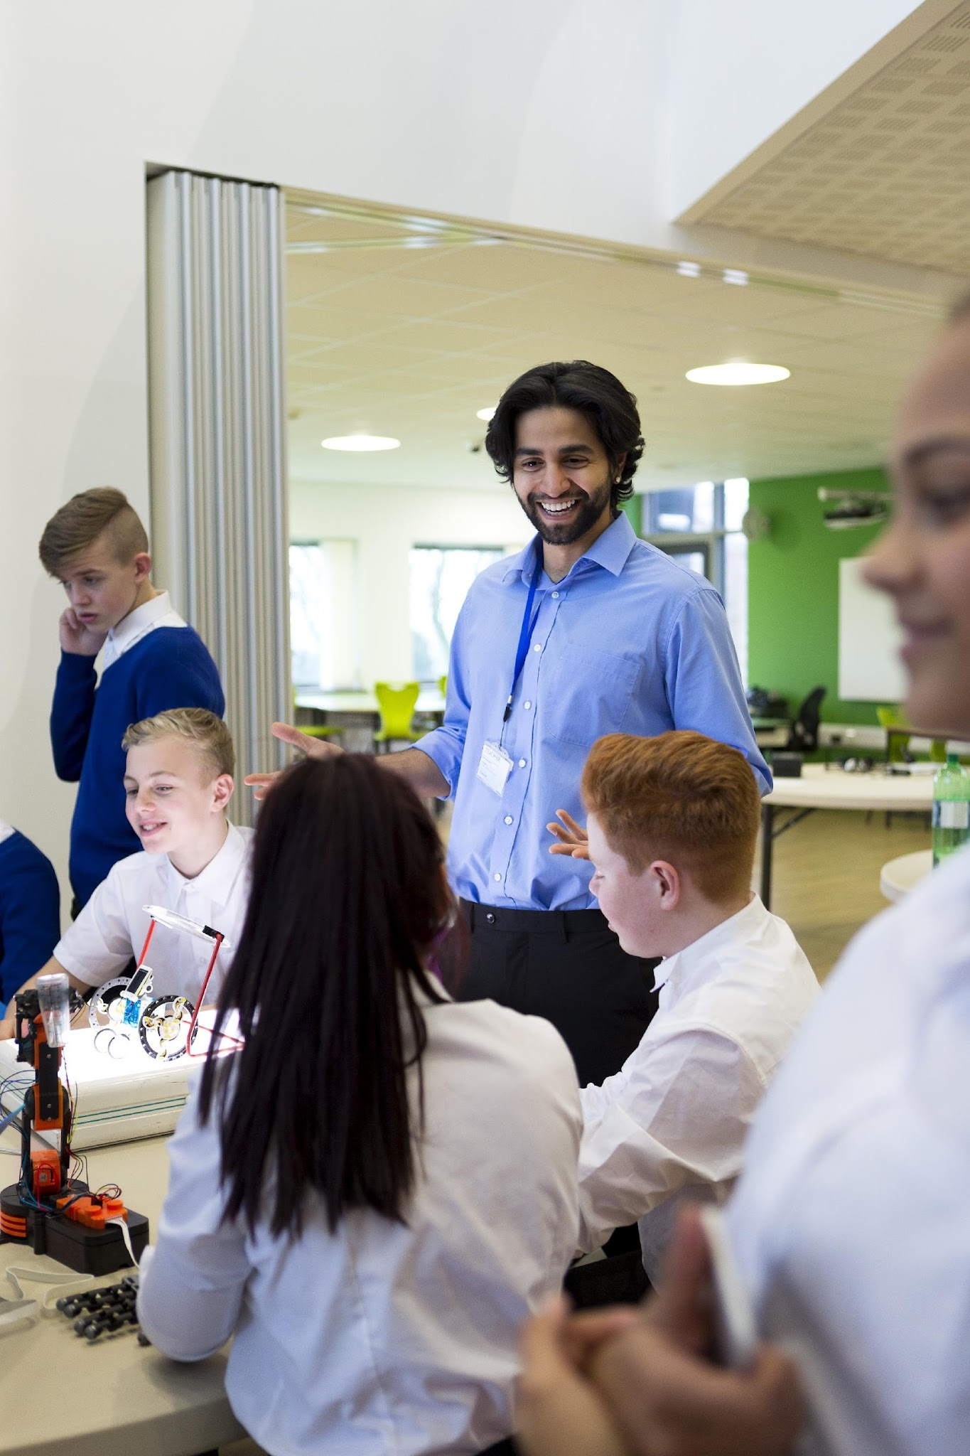
Quote from Jeffery Sprick
“The goal of effective classroom management is not creating ‘perfect’ children but providing the perfect environment for enhancing their growth and using research-based strategies that guide students toward increasingly responsible and motivated behavior.” Sprick, et al.
Notes:
Trainer Notes:
To Know/To Say: Recall from ETLP Lessons 1-4 how you developed your classroom expectations and rules, classroom procedures and routines, a system for encouraging expected behavior and a consistent framework for discouraging unexpected behavior. Active supervision is a practice that will help ensure that ETLP 1-4 are implemented, continuously supported, and sustained.

Slide 16
The Value of Active Supervision
Encourages student engagement.
Improves adult/student relationships.
Reduces unexpected behavior; increases expected behavior.
  Supports frequent encouragement of expected behavior.
  Supports immediate academic/behavior error correction.
Notes:
Trainer Notes:
To Know/To Say: Supervision allows you to monitor learning and to identify students who may have questions or need your assistance. We know that when adults are present and actively supervising, student behavior is better (Simonsen, et al., 2008).
Your physical presence itself tends to reduce the occurrence of student misbehavior. We have all experienced how we are more likely to honor traffic regulations when a police officer is around. So it is with students. This has the added benefit of encouraging the student to stay engaged in the instructional activity.
Additionally, monitoring students closely is the only way you will know if students are meeting your expectations. Having clearly defined expectations and teaching them has a limited impact without consistently upholding those expectations through supervision paired with encouragement and correction. Supervision will, of course, allow you to ensure student safety and possibly prevent problematic or even dangerous situations. Possibly most important, supervision provides an opportunity to establish positive relationships with your students. Adult attention is one of the most powerful ways to impact student positive affect, increase compliance, and meet student needs for attention. Finally, all of the above help to improve the quality of instructional time.

Slide 17

3 Components of Active Supervision
Monitor any school setting using three practices:
Move
Scan
Interact
MO SW-PBS
Notes:
Trainer Notes:
To Know/To Say: Active supervision is more than simple supervision. The three components of active supervision are what make it active, as well as effective. These components are:
Move: Teacher constantly moves in a random, unpredictable manner, so as to frequently come in proximity to every student.
Scan: Teacher constantly scans the room, making eye contact (when culturally appropriate) and paying special attention to problem spots.
Interact: Teacher interacts frequently with students, engaging in positive interactions, providing specific positive feedback and reinforcement, correcting unexpected behavior and academic errors, and, if necessary, delivering consequences for unexpected behavior
(DePry & Sugai, 2002).

Slide 18
Activity: Classroom Active Supervision - Planning & Implementation Guide
Read and consider the classroom scenario on the Classroom Active Supervision - Planning & Implementation Guide
Underline each Active Supervision practice and note whether it is an example of moving (M), scanning (S), or interacting (I).
Be prepared to share or compare your answers.
Notes:
Trainer Notes: Provide approximately 3 minutes for this activity. The scenario is on the next slide and the Answers are provided on the slide after that.
To Know/To Say:
Read and consider the classroom scenario on the MO SW-PBS Classroom Active Supervision - Planning & Implementation Guide
Underline each Active Supervision practice and note whether it is an example of moving (M), scanning (S), or interacting (I).
Be prepared to share or compare your answers.

Slide 19
Classroom Active Supervision - Planning & Implementation Guide -Part 1 Scenario
“The teacher Ms. Hailey directed the class to finish writing a paragraph by themselves. She then moved slowly down the aisles looking from side to side quietly acknowledging the students for starting quickly. She stood beside Enrico for a moment, as he usually does not do well with independent work and praised him for getting started. Ms. Hailey then stopped, turned around, and watched the front half of the class. She continued to loop around the class, checking students’ work and making compliments here and there.” –(Colvin, 2009, p.46)
Notes:
Trainer Notes:
To Know/To Say: Using your handout, Read the scenario in which the classroom teacher uses active supervision techniques.
Use the following codes beside each one you identify:
M = MOVE S = SCAN I = INTERACT

Slide 20

Activity: Classroom Active Supervision Planning & Implementation Guide
The teacher, Ms. Hailey, directed the class to finish writing a paragraph by themselves. She then moved slowly down the aisles(M) looking from side to side (S) quietly acknowledging (I ) the students for starting quickly. She stood beside (M) Enrico for a moment, as he usually does not do well with independent work, and praised him (I) for getting started. Ms. Hailey then stopped, turned around, and watched (S) the front half of the class. She continued to loop (M) around the class, checking the students’ work, and making compliments (I) here and there.
(Colvin)
Notes:
Trainer Notes: Direct participants to check their work using the answer key on this slide.
To Know/To Say: Now check your responses to those on the slide. How did your answers compare to these?
Let’s take a more in-depth look at each of the practices used in Active Supervision.

Slide 21
Move
What it is
When supervising work or activities, circulate among students.
Continuously move.
Avoid staying overly long in any location
Maintain frequent proximity with all students.
Random or unpredictable.
Frequent proximity to students with challenging behavior classroom “hot spots.”
Notes:
Trainer Notes:
To Know/To Say: The first component of active supervision that we will discuss is move.
Continuously move.
Avoid staying overly long in any location
Maintain frequent proximity with all students.
Random or unpredictable.
Frequent proximity to students with challenging behavior classroom “hot spots.” (Lampi, Fenty, & Beaunae, 2005).

Slide 22
Move
What it does
Close proximity discourages unexpected behavior.
Proximity shows interest in students.
Enables discrete academic and behavior error correction.
Notes:
Trainer Notes:
To Know/To Say:
While circulating around the classroom, move closer to students who are non-compliant or off task as needed. As mentioned earlier, simply being in close proximity to students discourages off task and unexpected behaviors.
Proximity also demonstrates interest in students, which can help support positive teacher-student relationships..
Finally, proximity allows the teacher to discreetly correct academic and behavioral errors. This prevents the student from being publicly shamed for an academic or behavioral error, which helps maintain positive teacher-student relationships.

Slide 23
Move
Application
  Whole group instruction – when the teacher is working with all students
  Small group instruction – when the teacher is working with a group, but monitoring all students
  Individual instruction – when the teacher is working with a single student, but monitoring all students
  Transitions / Classroom Arrival & Dismissal –when students are moving between instructional modes, and/or in or out of the classroom.
Notes:
Trainer Notes:
To Know/To Say: Thinking about the active component Move, use the MO SW-PBS Classroom Active Supervision - Planning & Implementation Guide Step 2 to jot down notes regarding your movement in your classroom, how you might modify or increase your movement, and practices you should eliminate as they relate to the following common instructional and classroom activities.
Whole Group Instruction
Small Group Instruction
Individual Instruction
Transitions/Classroom Arrival and Dismissal

Slide 24
Scan
What it is
Continuously scan the instructional area:
Make eye contact (when culturally appropriate) with students.
Scan all areas of the instructional area.
When interacting with an individual student or small group, position yourself so you can still see all students.
  Continue to frequently scan the room.
Notes:
Trainer Notes:
To Know/To Say: Now let’s consider the second component of Active Supervision: Scan.
Whether you are moving around the room, working with a small group or individual, or leading the group from the front of the room, you should frequently and intentionally look around at the students. This visual scanning includes establishing eye contact (when culturally appropriate) with students. Visually sweep all areas of the room, including those students nearest you. If you are working with an individual student, position yourself so you see all students, and continue to scan the entire room.

Slide 25
Scan
What it does
Students see you see them.
Catch kids being good.
Spot off-task or unexpected behavior before it escalates.
Spot unsafe situations.
Spot students who need help.
Notes:
Trainer Notes:
To Know/To Say: Constantly scanning the room:
First and foremost let’s students see you see them. In other words, it lets them know that they are being monitored, thereby encouraging them to stay engage and discouraging off task or unexpected behavior.
Allows you to “catch kids being good,” so that you can reinforce expectations following behavior and provide specific positive feedback for academic and social emotional behavior.
Allows you to spot off task or unexpected behaviors before they escalate.
Allows you to spot unsafe situations.
Finally, it allows you to spot students in need of assistance.

Slide 26
Scan
Application
  Whole group instruction – when the teacher is working with all students
  Small group instruction – when the teacher is working with a group, but monitoring all students
  Individual instruction – when the teacher is working with a single student, but monitoring all students
  Transitions / Classroom Arrival & Dismissal –when students are moving between instructional modes, and/or in or out of the classroom.
Notes:
Trainer Notes:
To Know/To Say: Think about your current practice related to the active supervision component Scan. Does the classroom arrangement allow for visual monitoring of all areas where students might engage in each situation above? Are there visual obstacles when the teacher is engaged in small group or individual instruction? Is the classroom arranged so the teacher can see the students while using technology (like an interactive whiteboard or video)?
Use the MO SW-PBS Classroom Active Supervision - Planning & Implementation Guide Step 2 to jot down notes regarding your habits related to scanning in your classroom, how you might modify or increase your your use of scanning, and practices you should eliminate as they relate to the following common instructional and classroom activities.
Whole Group Instruction
Small Group Instruction
Individual Instruction
Transitions/Classroom Arrival and Dismissal

Slide 27
Interact
What it is
Proximity, signals and non-verbal cues
Pre-correction
Non-contingent attention
Specific positive feedback
The continuum of responses to address unexpected behavior
Listening, eye contact (when culturally appropriate), smiles, pleasant voice tone, and use of student’s name.
Notes:
Trainer Notes:
To Know/To Say: The final component of active supervision is Interact. You can interact with students by moving closer to them, giving them a signal or other non-verbal cues, providing prompts or pre-corrections, providing relationship-building non-contingent attention, giving specific positive feedback to encourage preferred academic or social behavior, or discreetly responding to off-task or unexpected behavior. Make a point to listen to the student, make eye contact (when culturally appropriate), smile, use a pleasant tone of voice, and use the students name

Slide 28
Interact
What it does
While moving and scanning you should also frequently interact with students. Interacting…
Communicates care, trust, and respect, and helps build relationships.
Creates positive climate and increases likelihood of accepting correction if needed.
Provides students with performance feedback.
Reinforces expected behavior.
Discourages unexpected or off task behavior.
Notes:
Trainer Notes:
To Know/To Say:
Interacting with students builds teacher to student relationships. It communicates care, trust, and respect, and helps build relationships. Positive relationships create a positive class climate and increases the likelihood that students will accept correction when it is needed. in addition, interacting with students provides them with performance feedback, both specific positive feedback and corrective feedback. It can be used to reinforce expectation following behavior. Finally, interactions can be used to discourage unexpected or off task behavior.

Slide 29
Interact
Application
  Whole group instruction – when the teacher is working with all students
  Small group instruction – when the teacher is working with a group, but monitoring all students
  Individual instruction – when the teacher is working with a single student, but monitoring all students
  Transitions / Classroom Arrival & Dismissal –when students are moving between instructional modes, and/or in or out of the classroom.
Notes:
Trainer Notes: Direct participants to the slide and have them consider their own classrooms. Direct them to take notes on the MO SW-PBS Classroom Active Supervision - Planning & Implementation Guide handout, or have a discussion at their tables.
To Know/To Say: Now think about your behavior in your classroom. What signals have you already developed for use to engage in non-verbal interaction with students? How do you use precorrects to interact (e.g., "Two more minutes to finish up your sentences, then you will need to put it in your project folder”)? What ideas do you have for making interaction effective and efficient for your classroom?
Use the MO SW-PBS Classroom Active Supervision - Planning & Implementation Guide handout to make notes about what you’re doing now to interact efficiently and effectively in your classroom.
What will you continue? What would you like to add? What would you like to eliminate?

Slide 30
Class Arrangement
What it does
Conducive to common instructional activities.
Enables you to move freely and randomly about the classroom.
Enables you to frequently come in contact with any student, and therefore enables frequent interaction
Provides direct sightlines to anywhere in the room.
  You can see every student with just a turn of your head.
  Students see you see them.
  Assess student engagement within one second.
Terry Scott (2025) https://www.youtube.com/watch?v=xS3zGre8ORM&t=5s
Notes:
Trainer Notes:
To Know/To Say: A critical component to moving, scanning and interaction the arrangement of your classroom. You want a classroom arrangement that not only allows for common instructional configurations (Whole Class, Small Group, Individual Instruction, Seat Work, transitions), but has an open flow arrangement so that you can easily wander randomly, coming into close proximity of any student within a few steps. An open flow room arrangement that allows you to freely move about the room also enables you to frequently interact with your students. You also want furniture arrangements that create direct sightlines to any part of the room no matter where you are in the room. You need to be able to see every student at all times. Direct sightlines do several things: You can see every student with just a turn of your head, meaning you can quickly catch students being good, as well as spot off task or unexpected behavior before it can escalate. In addition, as Dr. Scott says, students can see you see them. In other words, they know they are being monitored. This knowledge, alone, can be a powerful motivator for students to stay on task!

Slide 31
Class Arrangement
What it is
Teacher Desk (Front)
  Can they see you seeing them?
Open Flow Arrangements
Large Furniture next to walls to avoid obstructing sightlines
Terry Scott (2025) https://www.youtube.com/watch?v=xS3zGre8ORM&t=5s
Notes:
Trainer Notes:
To Know/To Say: Let’s start with where you place your desk. Dr. Terry Scott points out that even if you move, scan, and interact, you will still spend some time at your desk, and therefore you need to place your desk where you have a direct sightline to all students. Some teachers put their desks in the back of the room thinking that the students won’t know when they are being observed. Dr. Scott argues putting the desk in front so students know you are observing them.
Your desk should be positioned so you can see and make eye contact (when culturally appropriate) with every student in the class with just a turn of your head.
In addition to the position of your desk, you should go for an open flow desk arrangement of your students. This will allow you to casually wander the room, and have easy proximity to any student within 3-4 steps.
Finally, if there is large furniture, Dr. Scott recommends placing it next to a wall in order to limit or eliminate blind spots.

Slide 32
Traditional Desk Arrangement: Rows
Student Desk
Student Desk
Student Desk
Student Desk
Student Desk
Student Desk
Student Desk
Student Desk
Student Desk
Student Desk
Student Desk
Student Desk
Student Desk
Student Desk
Student Desk
Student Desk
Student Desk
Student Desk
Student Desk
Student Desk
Student Desk
Student Desk
Student Desk
Student Desk
T
Teacher Desk
Adapted from Terry Scott (2019)
Notes:
Trainer Notes:
To Know/To Say: Most of the common classroom seating arrangements have advantages and disadvantages. This slide depicts the traditional arrangement of student desks arranged in rows. There are a couple of advantages to this arrangement: 1) students are facing the front so they can easily see the teacher and presentations, use of smart/white boards, etc., while still being able to use their desks for note taking; and 2) it allows the teacher to isolate students with challenging behaviors. However, there are a number of disadvantages. It is difficult for the teacher to wonder the room. Depending on the size of room, number of students and the size of the students and teacher, it can be difficult to move between rows without first walking back to the front of the room. Furthermore, if the teacher has walked down one of the center rows, his or her back is to a large portion of the class. Finally, this arrangement makes certain classroom instructional structures difficult.

Slide 33
Pod arrangement
Student Desk
Student Desk
Student Desk
Student Desk
Student Desk
Student Desk
Student Desk
Student Desk
Student Desk
Student Desk
Student Desk
Student Desk
Student Desk
Student Desk
Student Desk
Student Desk
Student Desk
Student Desk
Student Desk
Student Desk
Student Desk
Student Desk
Student Desk
Student Desk
T
Teacher Desk
Adapted from Terry Scott (2019)
Notes:
Trainer Notes:
To Know/To Say: A pod arrangement where the pods are spread out is more conducive to teacher movement and allows for small group work. You can see how the teacher can easily wander the room and quickly be in close proximity to any student in the classroom. A disadvantage is that some students will have their backs to the front of the room.

Slide 34
Open Flow Pod Arrangement
Student Desk
Student Desk
Student Desk
Student Desk
Student Desk
Student Desk
Student Desk
Student Desk
Student Desk
Student Desk
Student Desk
Student Desk
Student Desk
Student Desk
Student Desk
Student Desk
Student Desk
Student Desk
Student Desk
Student Desk
Student Desk
Student Desk
Student Desk
Student Desk
Student Desk
T
Teacher Desk
Adapted from Terry Scott (2019)
Notes:
Trainer Notes:
To Know/To Say: This is another pod arrangement that allows the teacher to freely wander about the room, and to be in close proximity to any student within 3-4 steps. This arrangement would also work with rounds. Again, a disadvantage is that some students will have their backs to the front of the room.

Slide 35
Classroom Arrangement Application Part 1
Draw a sketch of your current classroom arrangement
Draw a arrows to indicate how you currently move through the classroom
Ask yourself:
  Can I move easily wander the room ?
  Can I quickly get from anywhere in the room to any student within 3-4 steps
  Can I see all students from anywhere in the room?
Notes:
Trainer Notes: Provide participants with a piece of scratch paper.
To Know/To Say:
Classroom sketch: (optional for consultants to do with participants)
Take a moment and do a basic sketch of your classroom on a piece of scratch paper. Draw arrows or otherwise represent how you currently move through the classroom.
Ask yourself: Is the current arrangement of my classroom conducive to efficient movement?. Can you quickly and efficiently get from anywhere in the room to any student within 3-4 steps? What about sight lines? Are there blind spots?

Slide 36
Classroom Arrangement Application Part 2
What is working about your current classroom arrangement?
Are there opportunities to change the arrangement to improve sightlines and movement?
What are they?
How will you incorporate them into your classroom arrangement?
Notes:
Trainer Notes:
To Know/To Say: Use the MO SW-PBS Classroom Active Supervision - Planning & Implementation Guide handout to make notes about what you’re doing now to MOVE efficiently and effectively in your classroom.
To do: Direct participants to make notes and then share with a partner/table group OR participants get up and find a partner that is not at their table to share their thoughts
What will you continue, what you’d like to add, and what you’d like to eliminate?

Slide 37

Active Supervision Builds Classroom Belonging
Notes:
Trainer Notes:
To Know/To Say:
Moving, scanning and interacting allows teachers to observe academic and social behavior and quickly and consistently convey to each student “you are seen, and you are part of this learning community,” as well as efficiently and effectively deliver non-verbal reinforcement, positive specific feedback or error correction to help the student get back on academic or social behavioral track.
When students know teachers have high expectations, belief in the student’s ability to meet the expectation, and a consistent process to monitor and interact, students grow in their confidence of knowing what to do, when and how to do it, and in their ability to independently meet the expectation.

Slide 38
Increasing Student Motivation
Self-Determination Theory has identified 3 primary human needs that help individuals to grow their internal motivation:
Competence: perceived ability to succeed.
Autonomy: being in control of one’s life.
Relatedness: feeling connected with others.
Notes:
Trainer Notes:
To Know/To Say: Recall from the Function Based Thinking course that self-determination theory has identified 3 primary psychological needs that support self-regulation and intrinsic motivation:
Competence: perceived ability to succeed.
Autonomy: being in control of one’s life.
Relatedness: feeling connected with others.

Slide 39
Think, Pair Share
How does active supervision support competence, autonomy and relatedness?
Notes:
Trainer Notes:
To Know/To Say:
Take a moment to consider how active supervision supports competence, authonomy, and relatedness in your students. Then turn to a shoulder partner and take turns sharing your ideas.

Slide 40
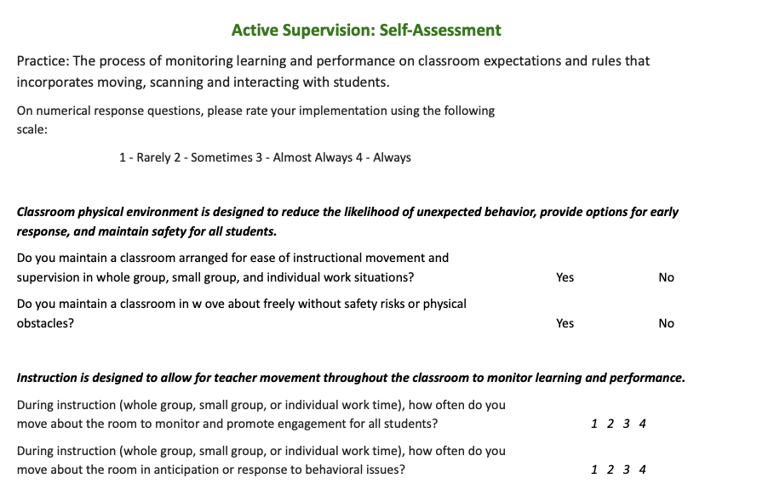
Pause & Reflect: Self Assessment
Turn to page 3 of the Classroom Active Supervision Teacher Tool
Complete the Self Assessment
Notes:
Trainer Notes: Direct participants to make notes and then share with a partner/table group OR participants get up and find a partner that is not at their table to share their thoughts
To Know/To Say: What is your current reality? How do you currently implement active supervision in your classroom. Turn to the Self-Assessment section on the MO SW-PBS Classroom Active Supervision Teacher Tool to rate your current implementation of Active Supervision to support expected classroom behavior.

Slide 41
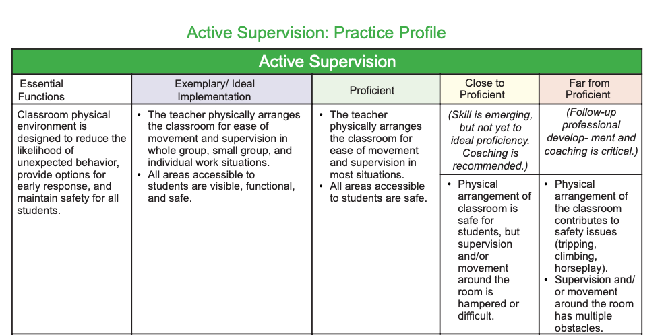
Pause & Reflect :
Identify Current Implementation
Turn to page 4 of the Classroom Active Supervision Teacher Tool
Where does your current practice fit on the rubric?
Notes:
Trainer Notes: Direct participants to make notes and then share with a partner/table group OR participants get up and find a partner that is not at their table to share their thoughts
To Know/To Say: Then, turn to the Practice Profile on the MO SW-PBS Classroom active Supervision Behavior Teacher Tool to consider where your current implementation falls on the rubric’s continuum from Exemplary or Ideal, through Proficient, Close to Proficient, or Far From Proficient

Slide 42
Pause & Reflect Step: Collect & Analyze
What are you currently doing well?
What are opportunities for growth?
What is ONE thing that if you can begin implementing would give you the biggest change for the effort?
Share your thoughts with a shoulder partner. If you are ready to commit to a change, share your commitment with a shoulder partner.
Notes:
Trainer Notes: Direct participants to make notes and then share with a partner/table group OR participants get up and find a partner that is not at their table to share their thoughts
To Know/To Say:
Now that you have reflected on your current use of Active Supervision, what are you currently doing well. What are some opportunities for growth. Jot down one strategy that if you begin implementing would give you a big change for the effort.

Slide 43
Next Steps
Use the Classroom Active Supervision Planning & Implementation Guide to
  Develop a draft for classroom Active Supervision steps to continue, add or eliminate.
  Consistently implement Active Supervision to pre-correct or reinforce expected student behavior and to discourage unexpected behavior.
Use the Teacher Tool - Active Supervision Self-Assessment and Practice Profile and the Teacher ETLP Self-Monitoring Plan to monitor your development and use of classroom Active Supervision.
Notes:
Trainer Notes:
To Know/To Say:
Next steps include:
Use the Classroom Active Supervision Planning & Implementation Guide to
Develop a draft for classroom Active Supervision steps to continue, add or eliminate.
Consistently implement Active Supervision to pre-correct or reinforce expected student behavior and to discourage unexpected behavior.
Use the Teacher Tool - Active Supervision Self-Assessment and Practice Profile and the Teacher ETLP Self-Monitoring Plan to monitor your development and use of classroom Active Supervision.

Slide 44
References
Colvin, G. (2009). Managing noncompliance and defiance in the classroom: A road map for teachers, specialists, and behavior support teams. Thousand Oaks, CA: Corwin Press.
Depry, R. L., & Sugai, G. (2002). The effect of active supervision and pre-correction on minor behavioral incidents in a sixth grade general education classroom. Journal of Behavioral Education, 11(4), 255–267.
Lampi, A. R., Fenty, N. S., & Beaunae, C. (2005). Making the Three Ps Easier: Praise, Proximity, and Precorrection. Beyond Behavior, 15(1).
Scott, T. (2025). Classroom Management: Physical Arrangement. Center for Instructional and Behavioral Research in Schools (CIBRS). Retrieved on 9/4/2026 from https://www.youtube.com/watch?v=xS3zGre8ORM&t=5s
Scott, T. (2024). Session 2H: Best Practices for Promoting Positive Classroom Environments. Presentation give at the 2024 National PBIS Leadership Forum
Sprick, R., Knight, J., Reinke, W., & McKale, T. (2006). Coaching classroom management: Strategies and tools for administrators and coaches. Eugene, OR: Pacific Northwest Publishing.
Notes:
Trainer Notes:
To Know/To Say: Here are some of the references that were used to inform this lesson.

Slide 45


Contact Information
Check Out MO SW-PBS on Social Media:
Facilitator Contact Information:
pbismissouri.org
List HERE
facebook.com/moswpbs
instagram.com/moswpbs/
Notes:
Trainer Notes:
To Know/To Say: This lesson was made possible with funds from the Missouri Department of Elementary and Secondary Education, Division of Special Education; the Center on Positive Behavior Interventions and Supports and the University of Missouri Center for Schoolwide Positive Behavior Support.

