Slide 1
Knowing the A-B-C’s of Behavior
Science of Behavior
Notes:
Trainer Notes: Intro Slide. Added video and set video format>color>video color options>brightness to 15%. In the course and lesson text box, enter the course lesson number before the “:” and course title after, then enter the Lesson number before the “:” and the Lesson Title After (this text box is located above the “MO SW-PBS” text, and you may need to drag it so it is not directly over MO SW-PBS so you can see what you type; Just drag it back when you are finished typing). Type your introduction to the lesson for the voice over text, below, after “Say”; Record your introduction. When finished, click on the Playback” button in the menu ribbon, then check the box that says “hide during show” and use the dropdown to the right of “Start” to set the audio to start “automatically. Then click on “animation” and drag the audio icon to just below “Textbox 1”. Make the animation reads “Start with previous” and set the delay to “6.00”. Test this to make sure the voice over comes in as the music fades. The video on this slide is set to go for 19 seconds, so we will want to want to trim the video just after the voice over narration ends. To trim the video, click anywhere on the green background of the screen outside. Video controls should appear on the bottom of the screen. Click “Playback” on the menu ribbon and click on “Trim video” Use the red slider tool on the right to set the video to end 1-2 seconds after the voice over introduction ends.
To Know/To Say:
This lesson focuses on the Science of Behavior and using these principles to support students in following behavior expectations in schools.

Slide 2
Working Agreements
Be Respectful
Be an active listener—open to new ideas
Use notes for side bar conversations
Be Responsible
Be on time for sessions
Silence cell phones—reply appropriately
Be a Problem Solver
Follow the decision making process
Work toward consensus and support decisions of the group
Notes:
Trainer Notes: Hide or delete this slide if presenting the entire PLM
To Know/To Say: “These will be the Working Agreements we will honor during all our training sessions this year.”

Slide 3
Attention Signal
Notes:
Trainer Notes: Hide or delete this slide if presenting the entire PLM; Facilitator: Select an attention signal.
To Know/To Say: “One of our agreements is to follow the attention signal.”
“Your team will work with your school to develop an attention signal you will use in every setting.”
“In order to get all of you focused after discussions, activities or breaks,
I will ________________________________________.”
(Insert your attention signal here.)
“Your task will be to finish your sentence, quiet your voice and ____________________________.”
(Insert what you want participants to do.)

Slide 4
Introductions
Notes:
Trainer Notes: Hide or delete this slide if presenting the entire PLM; Select an introductions activity.
To Know/To Say:

Slide 5
Handouts
HO 1 ABC Worksheet
HO2 ABC Worksheet Answers
HO3 ABC Schoolwide Planning Document
Notes:
Trainer Notes:
To Know/To Say: These are the handouts that we will be referencing during this lesson

Slide 6
Lesson Description
This is the first lesson in a 4-part series that explains
the ABC’s of behavior,
the function of behavior,
motivation and self-regulation,
self regulation and the science of behavior
Notes:
Trainer Notes:
To Know/To Say: This lesson is the first in a four-part series that examines
The ABCs of behavior
The function of behavior
Motivation and self-regulation
And how the science of behavior can support students in moving toward more self-regulated behavior

Slide 7

Outcomes
At the end of this session, you will …
understand that behavior is predictable.
identify antecedent(s), behavior(s), and consequence(s) from scenarios.
Notes:
Trainer Notes:
To Know/To Say:
Outcomes for this lesson include:
understand that behavior is predictable.
identify antecedent(s), behavior(s), and consequence(s) from scenarios.

Slide 8
Reflective Questions
Why do people do the things they do?
How would understanding the A-B-C’s of student behavior in the classroom help educators be more effective?
Notes:
Trainer Notes:
To Know/To Say:
As we go through the lesson, think about how you would answer the following questions:
Why do people do the things they do?
How would understanding the A-B-C’s of student behavior in the classroom help educators be more effective?

Slide 9

Rationale
We cannot make students learn or behave. We can create environments to increase the likelihood students learn and behave.
-Tim Lewis
Notes:
Trainer Notes:
To Know/To Say:
Why do people behave the way they do? Usually, it is because they have learned over time that behaving in certain ways under certain conditions often result in the satisfaction of legitimate needs.
The behavior or class of behaviors may be contextually appropriate or contextually inappropriate.
By understanding the relationship between student behaviors, the conditions in which they occur, and the need that the behavior is communicating, we can identify and implement modifications to the learning environment that support expectation following behavior and reduce unexpected behavior. We call this understanding and manipulation of the relationship between environmental conditions, behavior, and the need that the student is trying to satisfy the Science of Behavior.
The Science of Behavior serves as the foundation of Schoolwide Positive Behavior Support, informing everything from the Effective Teaching and Learning Practices implemented in the classroom at Tier 1, to the individualized behavior intervention plans provided to students needing more intensive supports at Tier 3.
As Tim Lewis has said, we cannot make students learn or behave; however, we can create environments that increase the likelihood that students will learn and behave

Slide 10

Behavior Results from a Learning History
Notes:
Trainer Notes:
To Know/To Say:
When we begin to view behavior as the result of a learning history wherein the student has learned that a certain type of behavior satisfies a legitimate need, we are less likely to take the behavior as a personal affront, or view the behavior as something inherent to the student, and more likely to view the behavior objectively, as something that has a cause and effect, and which we can influence.

Slide 11
Key Concepts
SW-PBS is grounded in the logic of Applied Behavior Analysis (ABA)
Behavior is learned.
Behavior is predictable.
Behavior is a form of communication.
Changing the environment leads to changes in behavior.
Notes:
Trainer Notes:
To Know/To Say:
The science of behavior, also known as Applied Behavior Analysis (ABA), is the design, implementation, and evaluation of environmental modifications to produce socially significant improvement in behavior (Alberto & Troutman, 2012; Baer, Wolf, & Risley, 1968; Sulzer-Azaroff & Mayer 1991).
In short, the science of behavior focuses on making changes to the environment that lead to changes in behavior. Understanding the importance and relevance of the Science of Behavior principles will aid teachers and staff to utilize these principles in their professional practice.
Applied behavior analysis relies on the following assumptions:
Behavior is learned – over-time, individuals learn to demonstrate certain behaviors.
Behavior is predictable – in the presence of certain triggers and consequential responses, behavior is maintained. Continued access to these triggers and responses will result in a pattern of behavior developing.
Behavior is a form of communication – behavior is functionally related to a need. Individuals continue to demonstrate a behavior because the consequence to the behavior consistently results in the need being met.
In essence, you can increase the likelihood that someone will engage in a given behavior by structuring the environment in predictable ways. SW-PBS helps schools make changes in the physical environment and adult behaviors that exist in those environments that will, in turn, encourage change in student behavior.
SW-PBS has used the ABCs of behavior to inform the essential components of this framework. Here we will provide you more detailed information about the Science of Behavior and how this understanding will deepen your knowledge of many concepts that provide the foundation of SW-PBS.

Slide 12

Key Terms
Antecedent - Includes Setting Events which are conditions or circumstances that alter the probability of a behavior occurring and Triggers which are an event that activates the behavior of interest.
Behavior - An observable, measurable act
Consequence - The resulting event or outcome that occurs immediately following the behavior
Notes:
Trainer Notes:
To Know/To Say:
Here are the key terms associated with the lesson. Take a moment to familiarize yourself with these terms.
Antecedent - Includes Setting Events which are conditions or circumstances that alter the probability of a behavior occurring and Triggers which are an event that activates the behavior of interest.
Behavior - An observable, measurable act
Consequence - The resulting event or outcome that occurs immediately following the behavior

Slide 13
ABC’s of Behavior
A B C
Student Learns through repeated experience, that under
these specific Antecedent conditions, if he/she engage
in this Behavior, he/she can expect this Consequence
Notes:
Trainer Notes:
To Know/To Say:
Central to understanding Applied Behavior Analysis is knowing your ABCs: an acronym for the three-part contingency of Antecedent–Behavior–Consequence. That is, something happens (the Antecedent), which leads to a Behavior, resulting in a Consequence.
When the same pattern of A-B-C happens repeatedly, we know the antecedents and consequences are maintaining the behavior.

Slide 14

A, B, C Contingency Example
EXAMPLE:
You are going to a potluck lunch to celebrate with friends. You decide to make a recipe that was recommended to you, and that you’ve been really wanting to try (the Antecedent).
You make the new recipe and bring it to the potluck (the Behavior)
Everyone at the potluck tries your recipe and tells you how wonderful it is. At the end of the lunch, all you’re left with is an empty dish and lots of requests for sharing the recipe (the Consequence).
Notes:
Trainer Notes: Introduce scenario, pause for time to read, then engage.
To Know/To Say:
Consider the following example.
You are going to a potluck lunch to celebrate with friends. You decide to make a recipe that was recommended to you, and that you’ve been really wanting to try (which is the Antecedent).
You make the new recipe and bring it to the potluck (Which is the Behavior). .
Everyone at the potluck tries your recipe and tells you how wonderful it is. At the end of the lunch, all you’re left with is an empty dish and lots of requests for sharing the recipe (which are the Consequences).
Given this current scenario, how likely are you to bring this dish to another potluck?
Consider how this scenario might differ had the consequences been different.
What if, for instance, no one indicated how much they liked your recipe, there were no requests for you to share your recipe, and you left with most of the contents of your dish while others left with empty dishes?
How likely would you be to make this dish for the next potluck?
The antecedents and consequences work in tandem to impact future demonstration of a behavior.

Slide 15

Antecedents
Notes:
Trainer Notes:
To Know/To Say
Remember, antecedents include triggers which are an event that activates the behavior of interest AND setting events which are conditions or circumstances that alter the probability of a behavior occurring.
Antecedents can include the physical setting, the time of the day, the materials, person or people present, all setting events
as well as how and what directions are given, or the trigger.
When you ensure a well-managed classroom setting, provide appropriate materials, establish clear expectations, and give specific directions, you can increase the likelihood of expected student behavior.

Slide 16

Behavior
Notes:
Trainer Notes:
To Know/To Say:
Behavior is an action; essentially, it’s what someone does.
Behavior can be observed and therefore measured as to how long, how often, or how intensely it occurs. Sitting is a behavior. Standing is a behavior. Singing is a behavior. Raising your hand in a large group is a behavior. Drinking, eating, laughing, writing, drawing, ignoring, refusing, fighting, cussing, helping, cleaning, typing, and chatting are all behaviors.

Slide 17

Consequences
Notes:
Trainer Notes:
To Know/To Say:
Consequences are the resulting events or outcomes that occur immediately following the behavior. In the classroom, this might include the reaction of the teacher and peers (such as attention, specific positive feedback, or correction) or might include removal of tasks or removal of the student from the environment.
Consequences may increase, maintain, or decrease the likelihood of future behavior. In ABA jargon, if a consequence increases or maintains the behavior, we say that the consequence is reinforcing. However, if the consequence decreases the occurrence of behavior, we say that it is punishing. Please note that this use of the word “punishment” in ABA, is different from the common use of the word, which many of us think of as to cause discomfort or pain.
It’s important to remember that certain factors will influence the effectiveness of a consequence. The same consequence may differentially affect behavior based upon the individual student and other variables. These attributes become very important when planning for future use of consequences.
Think about a student who is suspended over and over again, but the behavior continues or even gets worse. If the consequence does not decrease unexpected behaviors, does it make sense to keep assigning the same consequence?

Slide 18
Discussion: A, B or C?
As the whole group prepares to debrief after a chemistry experiment, the teacher reminds everyone that the agreed procedure is to raise their hands to indicate they wish to speak.
Then the teacher asks, “What was your most surprising finding today?”
Some students begin talking out loud. Most students raise a hand to share a finding, Jerry is one of them.
The teacher ignores the students who are talking out.
The teacher calls on Jerry to share his findings. She asks probing follow-up questions to help Jerry and the other students apply the underlying scientific concepts to their observation.
Notes:
Trainer Notes:
To Know/To Say: So, let’s practice: Read the scenario on the screen, then discuss and identify with your team the antecedent, behavior, and consequence.
Pause the video while you consider or discuss these questions. You may resume the lesson when you are ready.
.

Slide 19
Antecedent, Behavior, Consequence Classroom Example
Antecedent | Behavior | Consequence
As the whole group prepares to debrief after a chemistry experiment, the teacher reminds everyone that the agreed procedure is to raise their hands to indicate they wish to speak. Then the teacher asks, “What was your most surprising finding today?” | Some students begin talking out loud. Most students raise a hand to share a finding, Jerry is one of them. | The teacher ignores the students who are talking out. The teacher calls on Jerry to share his findings. She asks probing follow-up questions to help Jerry and the other students apply the underlying scientific concepts to their observation.
Notes:
Trainer Notes:
To Know/To Say:
How do your responses align with what’s on the screen?
In this example, there were two behavioral responses that resulted from the antecedents: some students talking out loud and other students, like Jerry, raising their hands to share. In response to these behaviors, the teacher delivered two different consequences: ignoring the unexpected behavior of talking out loud and attending to the expected behavior of hand raising.
In order to determine whether a consequence served as either reinforcement or punishment, it is important to examine the impact on the behavior. If, for instance, ignoring the talking out loud behavior results in the behavior occurring less frequently, it serves as a discouragement.
If Jerry’s hand raising behavior continues or increases, calling on him serves as a reinforcer.
Repeated exposure to consequences can create a history of reinforcement or punishment that then serves as an antecedent or a setting event for future expected behavior of hand raising behavior. Only further interaction and observation can confirm the function the consequence serves.

Slide 20
Activity: Identifying antecedents, behavior, and consequences
With your team complete “HO1 ABC Worksheet.”
When completed check your answers with “HO2 ABC Worksheet Answers”.
Notes:
Trainer Notes: This may be an optional activity given the amount of practice participants need. It can be structured as an independent or small group activity. Each participant will need a copy of HO1 ABC Worksheet. HO2 ABC Worksheet Answers can be used by the facilitator.
To Know/To Say: We’re going to take some time and practice more of the ABC logic with some scenarios. With your team complete “HO1 ABC Worksheet.” When completed check your answers with “HO2 ABC Worksheet Answers”.

Slide 21
Discussion:
Think about a recent situation where a student wasn’t demonstrating the expected behavior.
Apply the ABC logic to this situation. What were the antecedent(s), behavior, and consequence(s)?
How does knowing this information impact your professional practice?
Notes:
Trainer Notes:
To Know/To Say: Now think about a recent situation where a student wasn’t demonstrating the expected behavior.
Apply the ABC logic to this situation.
How does knowing this information impact your professional practice?

Slide 22

Wise Interventions & Situation Crafting
Wise Interventions:
“- interventions that nurture people’s belonging and self worth.” pg xiii
“...are ideally the right small thing, just what is psychologically needed for a specific person in a specific time and place to set them on a better path.” p 45
“Situation crafting: shaping a situation, even in seemingly minor ways, in order to foster belonging.” pg 3
“What is the next smallest thing you can do to achieve the outcomes you have set as your goal?” ~ Dr. Rob Horner, National Center on PBIS originating co-founder
Notes:
Trainer Notes:
To Know/To Say:
In his book Belonging: The Science of Creating Connection and Bridging Divides, Geoffrey Cohen provides two ideas that set forth a proactive framework for intervening:
Wise Interventions:
“- are interventions that nurture people’s belonging and self worth.” pg xiii
“...and are ideally the right small thing, just what is psychologically needed for a specific person in a specific time and place to set them on a better path.” p 45
And “Situation crafting: is shaping a situation, even in seemingly minor ways, in order to foster belonging.” pg 3
Dr. Rob Horner, National Center on PBIS originating co-founder always encouraged educators to consider…
“What is the next smallest thing you can do to achieve the outcomes you have set as your goal?”
Let’s take a look at applying these ideas with the A-B-C’s in mind.

Slide 23
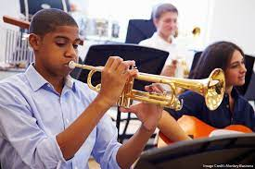
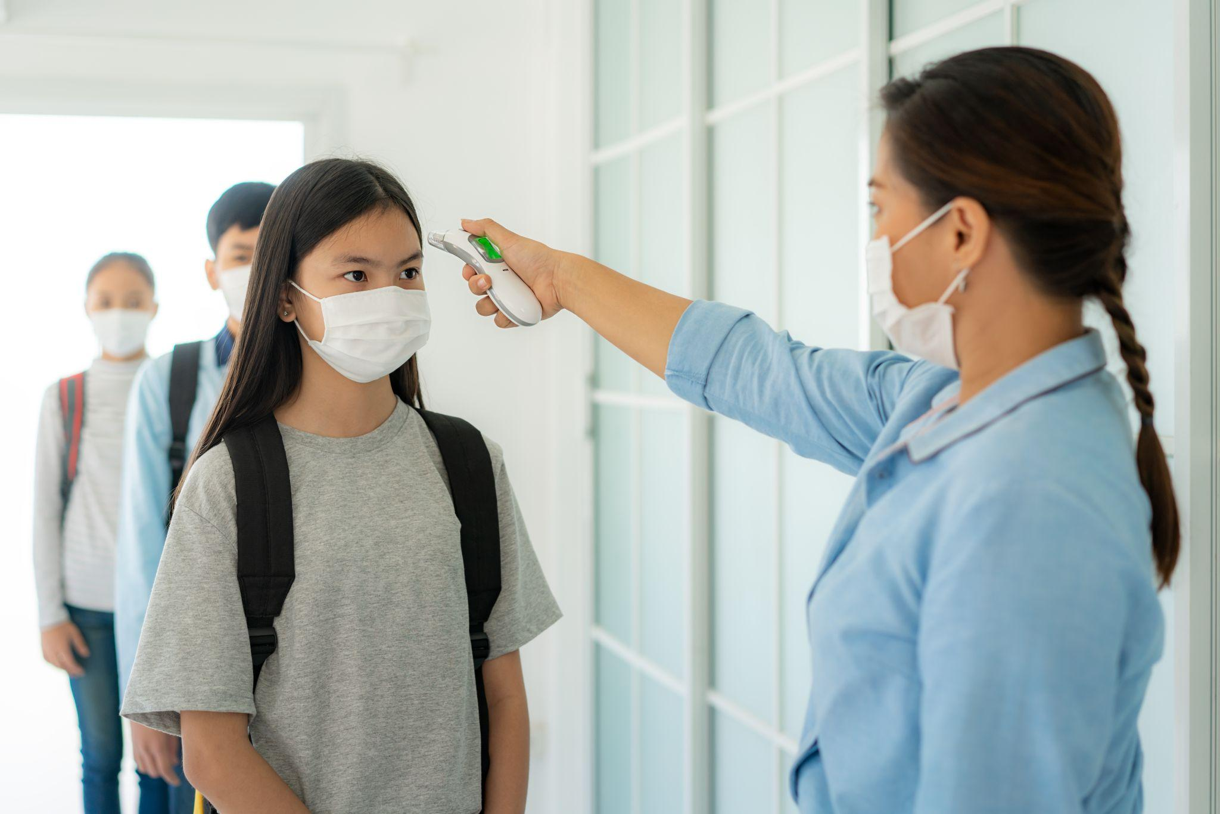




Situation Crafting in Practice - Schools
1
2
3
4
5
6
Notes:
Trainer Notes:
To Know/To Say:
After each of the following questions, individually reflect or turn and talk with a partner and compare your thoughts:
What kinds of expectations and procedures do band teachers have to plan for, teach directly and reinforce in order to have an orderly and melodious classroom?
Pause the video while consider this question
2. What kind of expectations, rules and procedures did schools plan for and implement to meet CDC or state guidelines for reopening during Covid?
Pause the video while consider this question
3. What kinds of expectations and procedures do science teachers have to plan for, teach directly and reinforce in order to have a safe and orderly environment for student scientific investigation?
Pause the video while consider this question
4. What expectations, rules and procedures do administrators and teachers have to plan for, teach directly and reinforce in order to have an orderly and successful lunch hour?
Pause the video while consider this question
5. What expectations, rules and procedures do administrators and teachers have to plan for, teach directly and reinforce in order to have an orderly and successful arrival or dismissal?
Pause the video while consider this question
6. What kinds of expectations and procedures do teachers have to plan for, teach directly and reinforce in order to have orderly and academically rigorous instruction?
Pause the video while consider this question

Slide 24
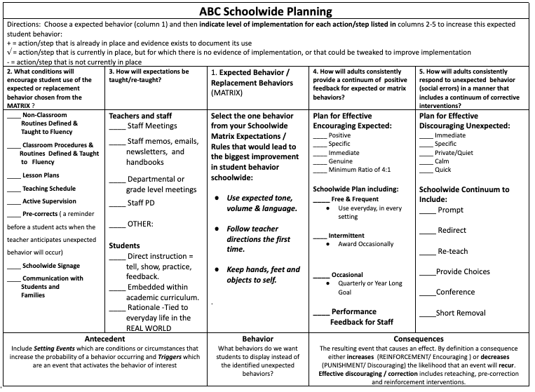
Situation Crafting with A-B-C’s
Notes:
Trainer Notes: Provide the handout if participants are in school / BLT teams and have them use this form to assess what’s “in place”.
To Know/To Say:
We know that increased structure and consistency increases the likelihood that students will demonstrate expected behaviors.
The handout shown on the screen provides a systematic process for schoolwide planning to set students up for success using the A-B-C framework.
Let’s take a closer look.

Slide 25
Situation Crafting Schoolwide - BEHAVIOR
Select one behavior from your Schoolwide Matrix Expectations / Rules that would be a “replacement” for current or frequent schoolwide unexpected behavior, that would lead to the biggest improvement in student behavior schoolwide:
Use expected tone, volume & language.
Follow teacher directions the first time.
Keep hands, feet and objects to self.
Notes:
Trainer Notes:
To Know/To Say:
It seems a little counterintuitive, but when you begin planning, BEGIN with the desired Behavior in the A-B-C framework, rather than the Antecedent.
For example, consider the following common unexpected behaviors in schools:
Students talking loudly during independent reading
Students are defiant
Students horseplaying, hitting, or pushing each other
Now let’s consider example expected behaviors from a Schoolwide Expectations and Rules Matrix that could serve as replacement behaviors, or “what we want students to do instead.”
For example:
Instead of Talking loudly during independent reading, we expect them to Use expected tone, volume & language.
Instead of being defiant, we expect them to Follow teacher directions the first time.
And, instead of horseplaying, hitting or pushing each other, we expect them to Keep hands, feet and objects to self.
Think of a common unexpected behavior in your school or classroom; is there a behavior on your schoolwide or classroom expectations and rules matrix that could serve as a replacement?

Slide 26
Situation Crafting Schoolwide Antecedents
What conditions will encourage student use of the expected replacement behavior chosen from the schoolwide MATRIX ? ____ Non-Classroom Routines Defined & Taught to Fluency ____ Classroom Procedures & Routines Defined & Taught to Fluency ____ Lesson Plans for Schoolwide Expectations ____ Schoolwide Teaching Schedule ____ Active Supervision ____ Pre-corrects (reminders to follow expectations) ____ Schoolwide Signage ____ Communication with Students and Families (e.g., handbooks, social media, morning announcements, PTA meetings, school events, etc.) | How will expectations be taught/re-taught? For Teachers and Staff ____ Establish schoolwide Common Philosophy & Purpose; develop organization wide knowledge of Function Based Thinking & Human Motivation Theory ____ Staff Meetings ____ Staff memos, emails, newsletters, and handbooks ____ Collaborative Teams > departmental or grade level meetings ____ Scheduled Staff PD (e.g., New Staff Orientation, Back to School events) For Students ____ Direct instruction = tell, show, practice, feedback. ____ Embedded within academic curriculum. ____ Rationale -Tied to everyday life in the REAL WORLD
+ = in place w/evidence
√ = in place w/out evidence
- = not currently in place
Notes:
Trainer Notes:
To Know/To Say:
Now, let’s review the HO3 ABC Schoolwide Planning handout. This handout lists Antecedent interventions that building leadership teams should plan for, provide training to staff on how to use, and monitor the implementation of to increase the likelihood that schoolwide environments will be safe, orderly and productive. How would you rate your schoolwide implementation of these Antecedent interventions?
CLICK to ANIMATE
Put a plus sign for each action step that is in place, and there is evidence that it is being used.
Put a check mark for each action step that is currently in place, but for which there is no evidence of implementation, or that could be tweaked to improve implementation.
Finally , put a minus sign for each action step that is currently not in place.
Pause the video as you complete this activity; you may resume the lesson when you are ready.

Slide 27
Situation Crafting Schoolwide Consequences
How will adults consistently provide a continuum of positive feedback for schoolwide expected /matrix behaviors and classroom expectations and rules? Plan for Effective Positive Feedback: ____ Positive ____ Specific ____ Immediate ____ Genuine ____ Minimum Ratio of 4:1 Schoolwide Plan including: ____ Free & Frequent Use everyday, in every setting ____ Intermittent Award Occasionally ____ Occasional Quarterly or Year Long Goal ____ Performance Feedback for Staff | How will adults consistently respond to unexpected behaviors (social errors) that includes a continuum of corrective interventions? Plan for Effective Discouraging Unexpected / Error Correction: ____ Immediate ____ Specific ____ Private/Quiet ____ Calm ____ Quick Schoolwide Continuum to Include: ____ Prompt ____ Redirect ____ Re-teach ____Provide Choices ____Conference ____Short Removal
+ = in place w/evidence
√ = in place w/out evidence
- = not currently in place
Notes:
Trainer Notes:
To Know/To Say:
On the same handout in the two columns on the right are examples of consequence interventions that building leadership teams should also plan for, provide staff training on, and then monitor implementation of to increase the likelihood that schoolwide environments will be safe, orderly and productive. How would you rate your schoolwide implementation of these consequence interventions?
CLICK to ANIMATE
Put a plus sign for each action step that is in place, and there is evidence that it is being used.
Put a check mark for each action step that is currently in place, but for which there is no evidence of implementation, or that could be tweaked to improve implementation.
Finally, put a minus sign for each action step that is currently not in place.
Pause the video as you complete this activity; you may resume the lesson when you are ready.

Slide 28
Situation Crafting Schoolwide Planning
Antecedents | Expected Behaviors (What Expected Behaviors does our school need to focus on?) | Consequences Encourage = Sustain / increase Discourage = Reduce
Keep Doing: Tweak: Rethink - Start: | Schoolwide Expectations & Rules Common Classroom Expectations | Keep Doing: Tweak: Rethink - Start:
Notes:
Trainer Notes:
To Know/To Say:
Use the second page of the HO3 ABC Schoolwide Planning handout to plan for additional antecedent and consequence interventions.
Begin by defining and/or selecting the expected behavior for all schoolwide settings, and possibly a core set of common expectations for all classrooms.
Next plan for effective schoolwide Antecedent interventions that could include
Developing expectations, procedures & routines schoolwide and in the classroom
Planning lessons and a schedule for teaching expectations and rules.
Providing pre-corrects, active supervision, and using posted expectations and rules as cues and teaching tools,
And Establishing effective 2-way communication with students and families, such as handbooks, newsletters, social media, and/or school or community events
Which of these does your team already have in place that you plan to continue?
Which are in place, but based on observation need to be tweaked?
Which do you need to begin to implement?
And, which are ineffective and should be eliminated?
Finally, plan for and deliver Consequences to Reinforce or Encourage Expectations, and deliver consequences to Discourage Unexpected behaviors.

Slide 29

Change the Environment to Change the Behavior
Environmental Interventions Are Key
Environments that increase the likelihood expected behaviors will occur/recur are guided by a core set of effective practices that are implemented with fidelity, consistency and equity.
Notes:
Trainer Notes:
To Know/To Say:
Environments that increase the likelihood expected behaviors will occur or recur are guided by a core set of effective practices that are implemented with fidelity, consistency and equity.
Fidelity means the intervention is delivered as designed.
Consistency means the intervention is delivered in a predictable and constant manner all day, every day.
And, Equity means the intervention is delivered in the same manner regardless of the students, time of day, or day of week, so that all students have equal access to the intervention.
What can your organization put in place to increase the likelihood that the adults implement the schoolwide plan with fidelity, consistency and equity to support success for all students?

Slide 30
Closing and Next Steps
Effective school and classroom managers are known, not by what they do when misbehavior occurs, but by what they do to set their classroom up for academic success and to prevent problems from occurring.
Challenge yourself to regularly apply the ABC model to your professional practice.
Notes:
Trainer Notes:
To Know/To Say:
During this lesson, you learned about Science of Behavior principles, specifically the 3-term ABC contingency model. Additional information can be found in the MO SW-PBS Handbook.
While this information is important, it is only one piece of the larger process in trying to understand and change behavior. As you will learn in the following lessons, the ABC model can help us identify the ‘why’ behind the behavior.
As you leave this lesson, challenge yourself to begin regularly applying this content to your professional practice.

Slide 31
References
Alberto, P. A., & Troutman, A. C. (2012). Applied behavior analysis for teachers (9th ed.). Upper Saddle River, NJ: Pearson.
Baer, D., Wolf, M., & Risley, R. (1968). Some current dimensions of applied behavior analysis. Journal of Applied Behavior Analysis, 1(1), 91–97. https://doi.org/10.1901/jaba.1968.1-91
The IRIS Center. (2009). Functional behavioral assessment: Identifying the reasons for problem behavior and developing a behavior plan. Retrieved from https://iris.peabody.vanderbilt.edu/module/fba/#content
Sulzer-Azaroff, B., & Mayer, G. R. (1991). Behavior analysis for lasting change. Fort Worth, TX: Holt, Rinehart, & Winston.
Notes:
Trainer Notes:
To Know/To Say: Here are the references that were used to inform this lesson
Alberto, P. A., & Troutman, A. C. (2012). Applied behavior analysis for teachers (9th ed.). Upper Saddle River, NJ: Pearson.
Baer, D., Wolf, M., & Risley, R. (1968). Some current dimensions of applied behavior analysis. Journal of Applied Behavior Analysis, 1(1), 91–97. https://doi.org/10.1901/jaba.1968.1-91
The IRIS Center. (2009). Functional behavioral assessment: Identifying the reasons for problem behavior and developing a behavior plan. Retrieved from https://iris.peabody.vanderbilt.edu/module/fba/#content
Sulzer-Azaroff, B., & Mayer, G. R. (1991). Behavior analysis for lasting change. Fort Worth, TX: Holt, Rinehart, & Winston.

Slide 32


Contact Information
Check Out MO SW-PBS on Social Media:
Facilitator Contact Information:
pbismissouri.org
facebook.com/moswpbs
Notes:
Trainer Notes:
To Know/To Say: Here is our contact and social media information you can use if you need additional information or support

