Slide 1
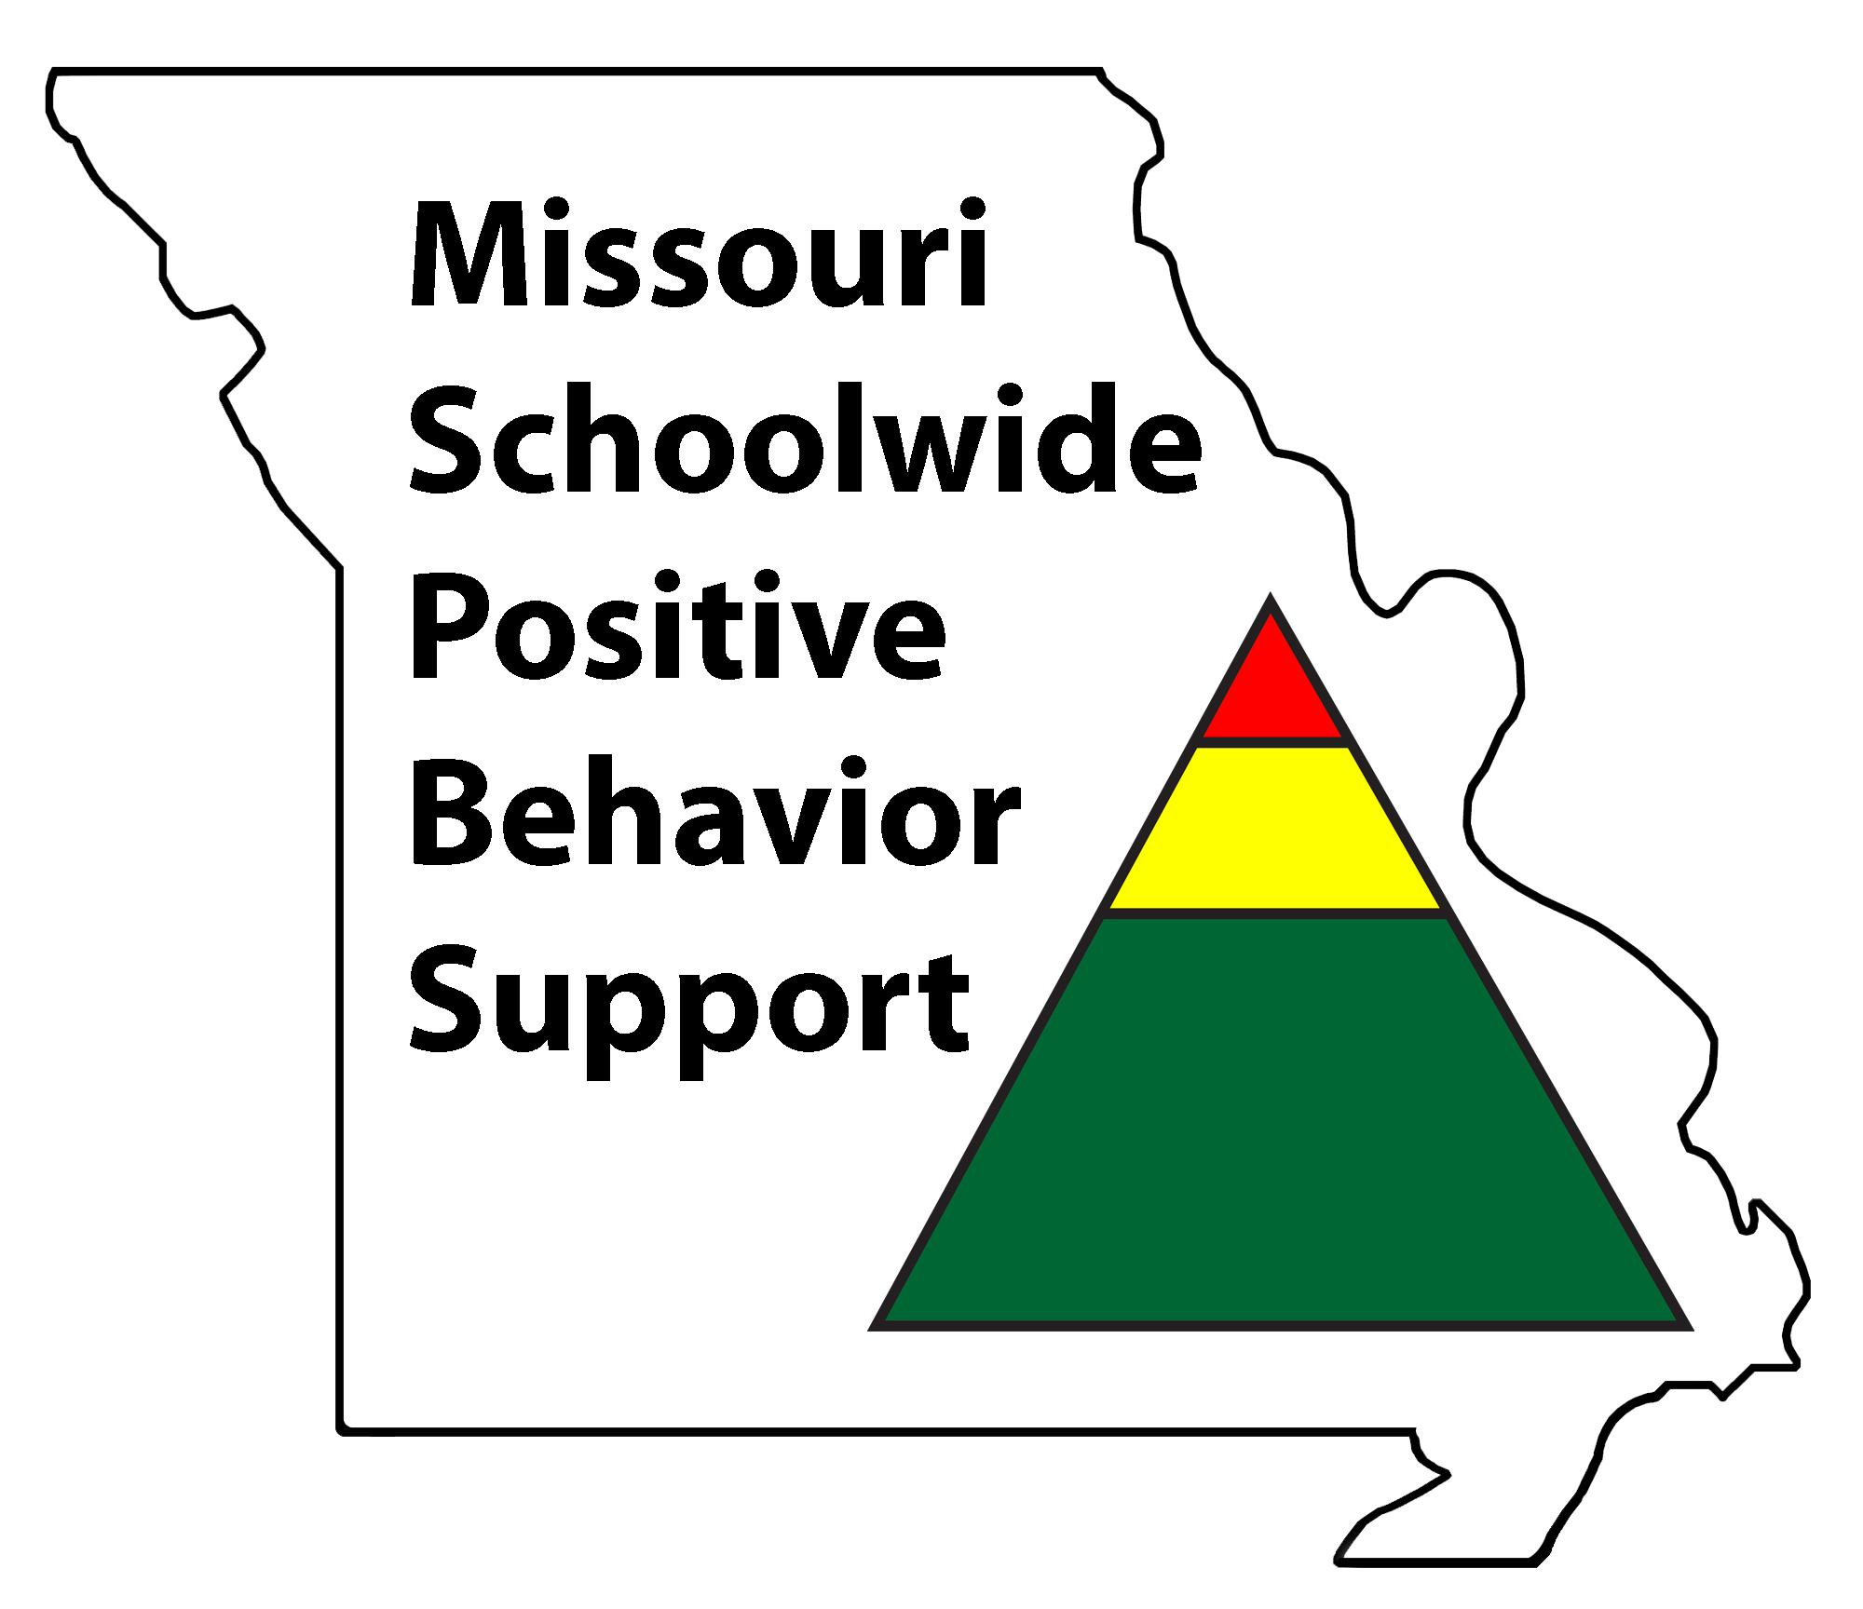
T1C8L5 Classroom Encouraging Expected Behavior
Tier 1 Effective Teaching & Learning Practices
(ETLPs) for the Classroom
Notes:
Welcome to Lesson 5 of the MO SW-PBS Effective Teaching & Learning or ETLP series. This lesson describes the use of positive, specific feedback mirroring a schoolwide recognition system within the classroom environment to encourage expected behavior. This lesson was made possible with funds from the Missouri Department of Elementary and Secondary Education, Division of Special Education; the Center on Positive Behavior Interventions and Supports and the University of Missouri Center for Schoolwide Positive Behavior Support.

Slide 2
Working Agreements
Be Respectful
Be an active listener—open to new ideas
Use notes for side bar conversations
Be Responsible
Be on time for sessions
Silence cell phones—reply appropriately
Be a Problem Solver
Follow the decision making process
Work toward consensus and support decisions of the group
Notes:
“These will be the Working Agreements for our time together.”

Slide 3
Attention Signal Practice
Select and teach an attention signal.
Notes:
“One of our agreements is to follow the attention signal.”
“Your team will work with your school to develop an attention signal you will use in every setting.”
“In order to get all of you focused after discussions, activities or breaks, I will ________________________.”
(Insert your attention signal here.)
“Your task will be to finish your sentence, quiet your voice and ____________________________.”
(Insert what you want participants to do.)

Slide 4
Introductions
Insert an Introductions Activity.
Notes:
Choose an Introductions Activity/Ice Breaker appropriate for your context and audience

Slide 5
Handouts
Handouts
MO SW-PBS Classroom Encouraging Expected Behavior Teacher Tool
Classroom Encouraging Planning & Implementation Guide
3. Teacher Effective Teaching & Learning Practices (ETLP) Self-Monitoring Plan
Notes:
To know/say: There are several handouts that will be referenced during this lesson. If you have not downloaded them from the lesson website, please do so now.

Slide 6
Session Outcomes
At the end of the session, you will be able to…
Create a plan to leverage Preferred Adult Behaviors.
Explain the rationale for using positive specific feedback to reinforce expected student behaviors within classrooms.
Develop a menu of reinforcers that includes social attention, activities and tangibles that appeal to all students, that are available frequently, intermittently and/or occasionally.
Establish and implement a process/strategy for self-monitoring the use of positive specific feedback with fidelity, consistency and equity with all students.
Notes:
To Know/Say: “Here are the outcomes for this session.
Create a plan to leverage Preferred Adult Behaviors.
Explain the rationale for using positive specific feedback to reinforce expected student behaviors within classrooms.
Develop a menu of reinforcers that includes social attention, activities and tangibles that appeal to all students, that are available frequently, intermittently and/or occasionally.
Establish and implement a process/strategy for self-monitoring the use of positive specific feedback with fidelity, consistency and equity with all students.

Slide 7
Encouraging whether academics or behavior is the same process. Teachers use encouragement to motivate students as they are initially learning expected skills and it maintains the expectations as students become more fluent with use of the skill. Encouraging also leads to a more positive classroom environment.
Rationale
Notes:
To Know/To Say:
“When students can predict the events throughout their school day, they are more likely to be engaged and less likely to display problem behavior. One way to increase predictability in a classroom is to establish routines, particularly early in the school year”
~ Kern & Clemens, 2007

Slide 8
Missouri Teacher Standards Addressed
2.1: Cognitive, social, emotional and physical development
2.6: Language, culture, family and knowledge of community
3.1: Implementation of curriculum standards
5.1: Classroom management, motivation and engagement
5.2: Managing time, space, transitions and activities
5.3: Classroom, school and community culture
6.1: Verbal and nonverbal communication
6.2: Sensitivity to culture, gender, intellectual and physical differences
8.1: Self-assessment and improvement
8.2: Professional learning
Notes:
Trainer Notes:
To know/To say: These are the Missouri Teacher Standards that will be addressed in this lesson. If you want more information regarding these standards visit DESE.MO.GOV

Slide 9
Reflective Questions
How do you provide positive specific feedback to students when they demonstrate expected academic, athletic, artistic or other behaviors?
How do you provide non-contingent and contingent feedback to your students?
How do you ensure that you provide behavioral positive specific feedback to all students in an equitable manner?
How do you know?
Notes:
How do you provide positive specific feedback to students when they demonstrate expected academic, athletic, artistic or other behaviors?
How do you provide non-contingent and contingent feedback to your students?
How do you ensure that you provide behavioral positive specific feedback to all students in an equitable manner?
What is your ratio of positive to corrective feedback for expected academic behaviors? (How do you know?)
What is your ratio of positive to corrective feedback for expected social behaviors? (How do you know?)
How do you self-monitor your use of the evidence-based practice of positive specific feedback?

Slide 10
Teacher giving student a high five
Notes:
Trainer Notes:
To know/To say: As you begin this lesson, it is important for you as a classroom teacher to reflect on your current implementation of positive, specific feedback:
How do you provide positive specific feedback to students when they demonstrate expected academic, athletic, artistic or other behaviors?
How do you provide non-contingent and contingent feedback to your students?

Slide 11
Teacher talking to students
Notes:
Trainer Notes:
To know/To say: How do you ensure that you provide behavioral positive specific feedback to all students in an equitable manner?
What is your ratio of positive to corrective feedback for expected academic behaviors? (How do you know?)
What is your ratio of positive to corrective feedback for expected social behaviors? (How do you know?)
How do you self-monitor your use of the evidence-based practice of positive specific feedback?

Slide 12
Pre-requisites
Pre-Requisites
Knowledge of The Science of Behavior (completion of at least ONE of the courses/resources below):
MO SW-PBS Handbook - Function Based Thinking
Tier 1 Implementation Guide - Encouraging Expected Behavior
MO SW-PBS Online Course -
Foundation - Science of Behavior
Tier 1 - Encouraging Expected Behavior
Completion of the following ETLP Lessons:
Lesson 1: Overview of the 8 Classroom ETLPs
Lesson 2: Systems to Support Implementation of ETLPs
Lesson 3 - Classroom Expectations & Rules
Lesson 4 - Classroom Procedures & Routines
Notes:
Trainer Notes:
To Know/To Say: There are several lessons that will be beneficial for you to complete before you begin this lesson. We highly encourage any
one who is engaging in this lesson on Classroom Encouraging to first engage with at least one of the Science of Behavior resources listed prior to taking this lesson. Doing so will provide critical background information necessary to be able to understand and apply the concepts shared here for classroom implementation of encouraging expected behaviors with fidelity, consistency and equity.
In addition, participants should also complete the Overview of the 8 Classroom ETLPs, (Lesson 1) and Classroom Expectations & Rules (Lesson 3) and Classroom Procedures & Routines (Lesson 4) so that they can make a plan for what expectations and procedures they will be working to consistently and with fidelity be reinforcing in their classroom.
If you are a member of a building or district leadership team we encourage you to FIRST complete the Systems to Support Implementation of ETLPs (Lesson2) and establish building or district systems to support all instructional staff in the delivery of all 8 ETLPs.
All of these resources can be found on the MO SW-PBS website located at pbismissouri.org .

Slide 13
Keywords
Reinforcement
Positive Specific Feedback
Praise
Notes:
To Know/To Say: There are a number of key terms to know and understand that are provided in the Pre-Requisite Resources just shared. These terms are repeated here as a brief primer to prepare you to apply the concepts in planning for encouragement of expected behaviors in your classroom.
Reinforcement: overarching term for a contingently delivered consequence associated with an increased likelihood of future behavior. Reinforcement can take many forms, most commonly general praise or positive, specific feedback (social reinforcement), but also tangible reinforcement (tickets, tokens, coupons, etc.), and activity reinforcers. Positive Specific Feedback: verbal statement delivered contingent upon successful performance of a task or behavior that provides information describing the successful behavior while reinforcing or increasing the likelihood that behavior will be repeated; combines social attention, instruction, and reinforcement. Praise: a general positive statement directed to an individual or a group; an expression of admiration for performance that serves to reinforce the behavior; verbal recognition. Know/To Say: Here are key terms and acronyms that will be used in this lesson.

Slide 14
Keywords/Vocabulary
Non-contingent attention / behaviors Contingent feedback Frequent feedback Intermittent feedback Occasional feedback
Notes:
These additional keywords relate to when positive feedback or attention is delivered. Non-contingent attention / behaviors – attention or behaviors provided regardless of performance and includes such things as greetings, proximity, smiles, and conversations. Contingent feedback – provided upon student performance of an identified expectation or behavior. Frequent feedback – positive teacher and staff interactions should occur at a frequent rate, with a ratio of 4:1, or four instances of positive interaction for each corrective or negative interaction.
Intermittent feedback – acknowledgement of expected behavior may occur less frequently, in an intermittent way, reinforcing skill learning in the fluency stage of learning.
Occasional feedback – a comprehensive system to encourage expected behavior would also include some long-term, occasional activities. Occasional encouragement assists in the maintenance and generalization stages of learning

Slide 15
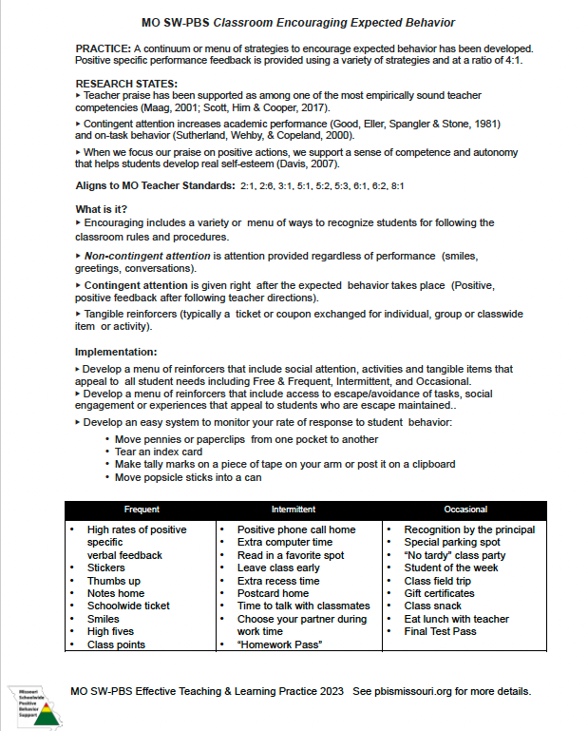
Classroom Encouraging Expected Behavior
Notes:
Trainer Notes:
To Know/To Say: The focus of this lesson is on the development and use of the Encouragement strategies in the classrooms. The MO SW-PBS Classroom Encouraging Expected Behavior Teacher Tool provides you with several resources to understand the importance of, provide tips for drafting and metrics to progress monitor your development and use of procedures and routines.
ARROW > The first 2 pages of each Teacher Tool defines the practice,
ARROW > shares research regarding the practice, ARROW > indicates how the practice aligns to Missouri Teacher Standards, ARROW > describes an example of the practice, ARROW > provides steps and examples of how to implement the practice, ARROW > and lists research references for further study.
You will learn more about page 3 the Self-Assessment and page 4 the Practice Profile later in this course. Make sure to have a copy of the Classroom Encouraging Expected Behavior Teacher Tool handy during this lesson.

Slide 16
Effective feedback scale
Notes:
Trainer Notes:
To Know/To Say: There is strong scientific evidence that feedback is a powerful strategy for promoting student success (Brophy, 2006; Cameron & Pierce, 2002, Hattie, 2009). In a meta-analysis of 196 studies, John Hattie (2009) found feedback was among one of the 10 most influential practices on student achievement.
Despite strong evidence that teacher feedback is a highly effective instructional practice, a large scale study of over 6,700 classroom observations in 2017 (Scott, Hirn & Cooper, 2017) indicated that the rates and ratios of positive, specific feedback remain startlingly low, especially in middle and high school classrooms. Even in elementary classrooms, positive feedback only happens on average every 7:29 minutes. For most students this rate may be insufficient to sustain student engagement, let alone student learning.

Slide 17
Te
Notes:
Trainer Notes:
To Know/To Say: Researchers continue to observe in classrooms across all grade levels that a positive ratio of positive teacher feedback to reprimands or corrections, has a powerful impact on improving not only student behavior, but also increasing their engagement in class and their academic grades. In the case of middle schools, if a teacher could even maintain a 1:1 ratio of positive to negative feedback, there was a greater likelihood of improved student behavior (see Caldarella and colleagues in references at the end of this presentation).

Slide 18
Picture of a book “Teacher and Student Behaviors
Notes:
Trainer Notes:
To Know/To Say: But despite strong evidence that teacher feedback is a highly effective instructional practice, a large-scale study of over 6,700 classroom observations in 2017 (Scott, Hirn & Cooper, 2017) indicated that the rates and ratios of positive, specific feedback remain startlingly low, especially in middle and high school classrooms. Even in elementary classrooms, positive feedback only happens on average every 7:29 minutes. For most students this rate may be insufficient to sustain student engagement, let alone student learning.
Revisiting the science of behavior can perhaps go a long way in helping teachers reflect upon and improve their feedback ratios.

Slide 19
ABC Chart for Behavior
Notes:
Trainer Notes:
To Know/To Say: Recall from the Science of Behavior course, one of the researched tenets that is basic to schoolwide positive behavior support is the Antecedent - Behavior - Consequence continuum, which posits that a reinforcing consequence following a behavior will increase the likelihood of a future occurrence of the behavior.
In other words, if we deliver a positive, specific comment or provide access to a desired activity or tangible item after an expected behavior is demonstrated by a student, we are intending to increase the likelihood the expected behavior will take place again in the future.

Slide 20
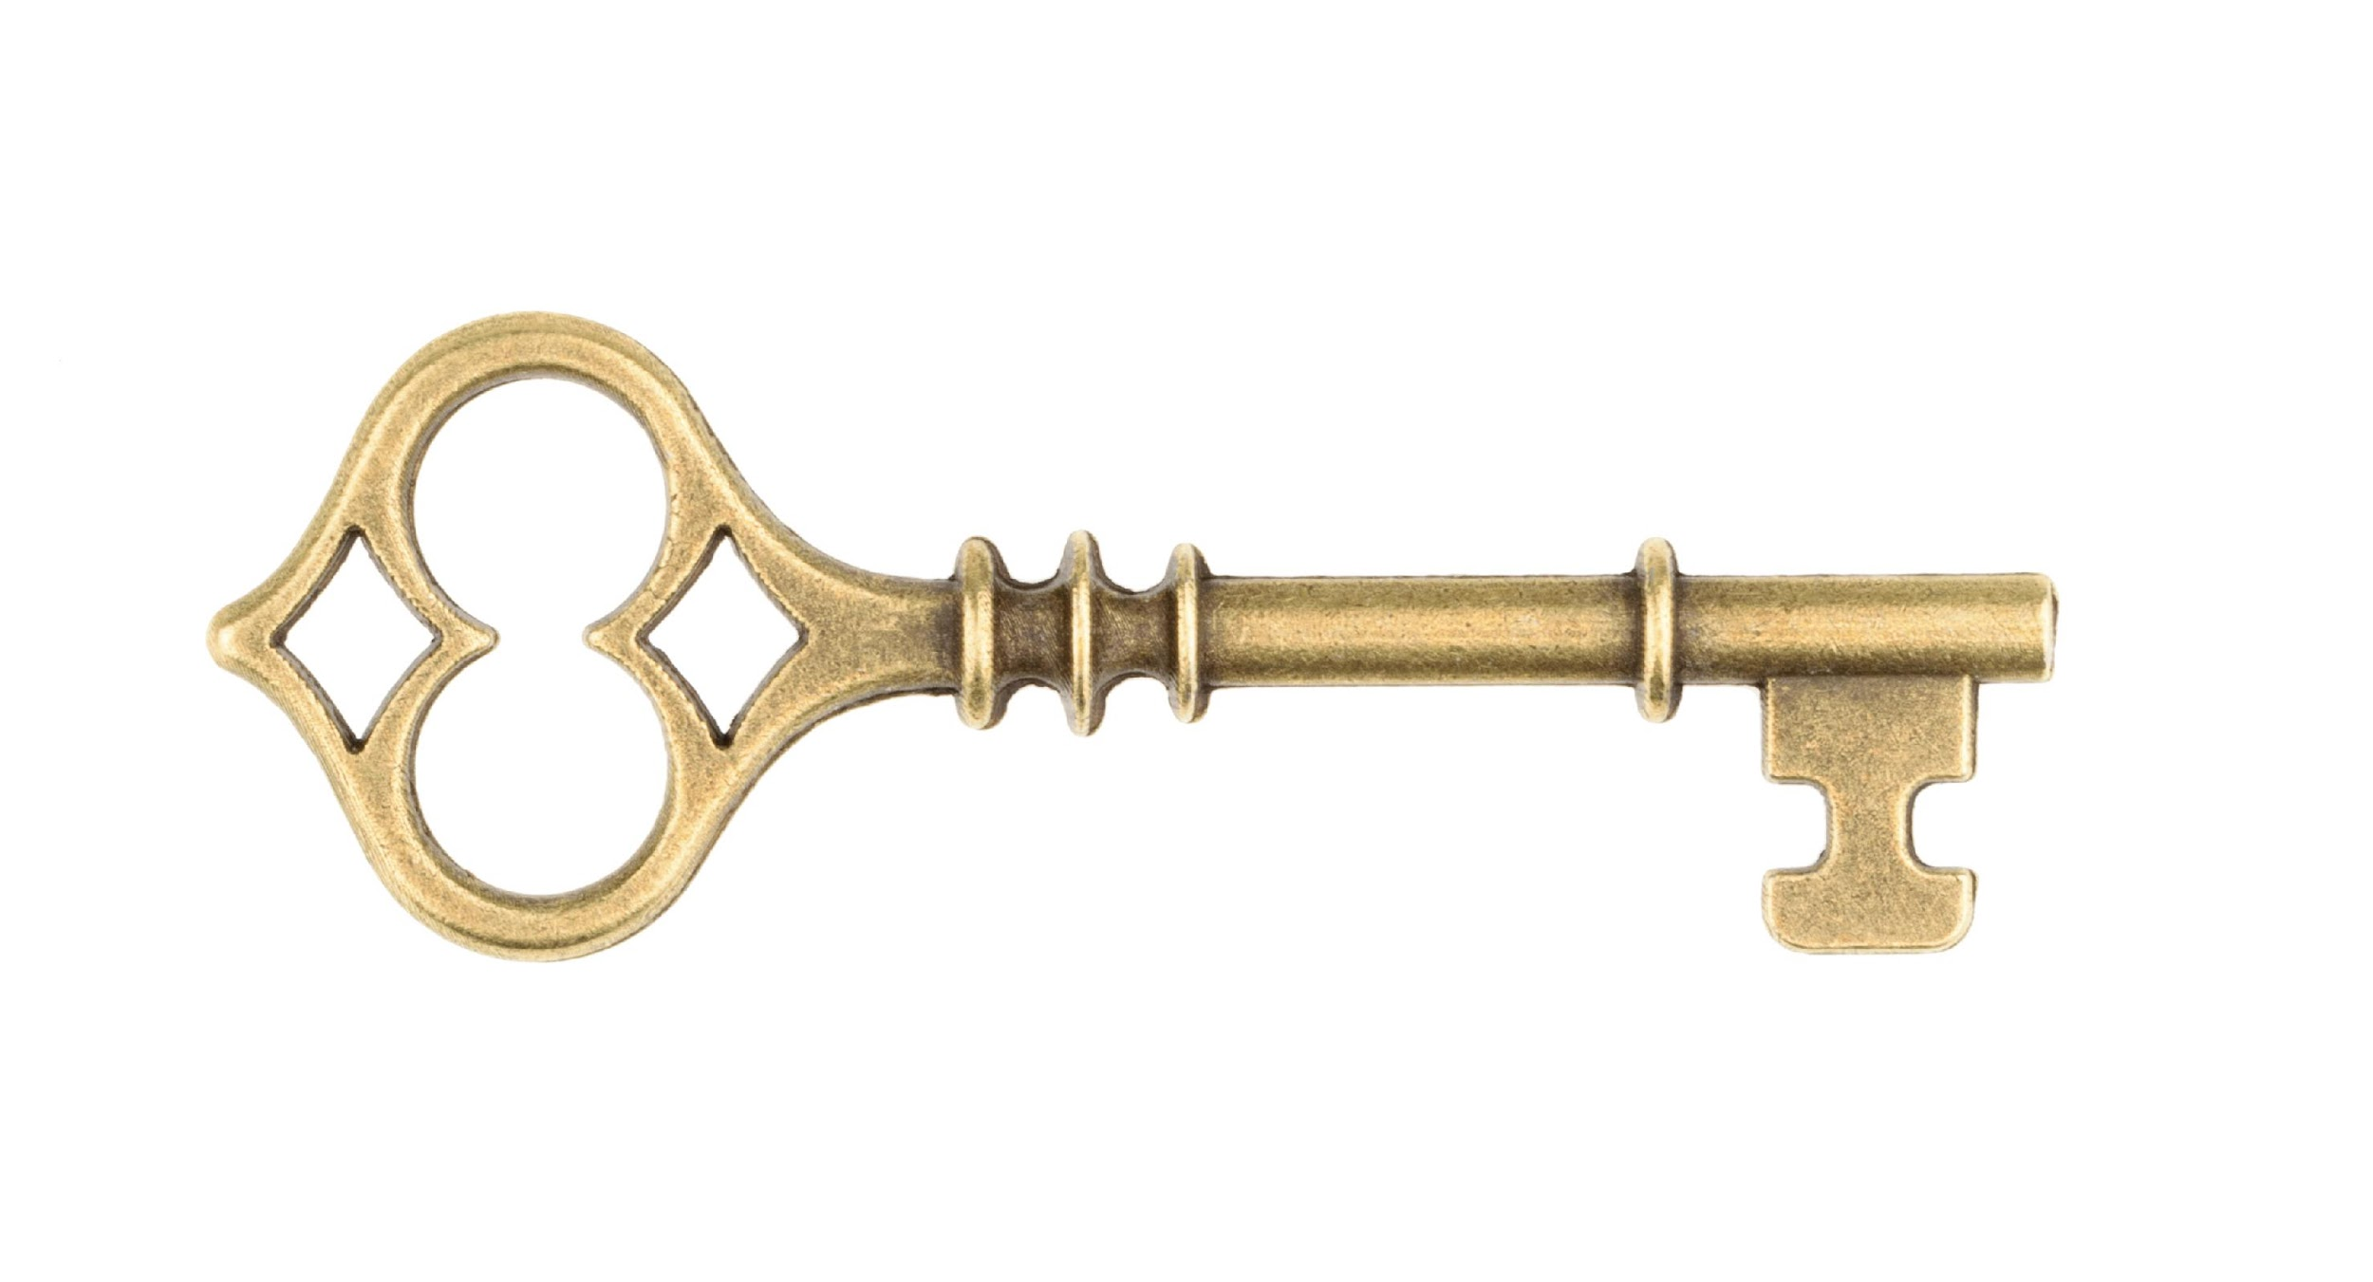
Picture of a key
Notes:
Trainer Notes:
To Know/To Say: It is important/ KEY to note consequence is only reinforcing when it serves to strengthen or increase the use of the expected behavior.
In other words, the function of the consequence is always based from the perspective of the learner, not the intentions of the individual delivering the consequence. There are no universal reinforcers.

Slide 21
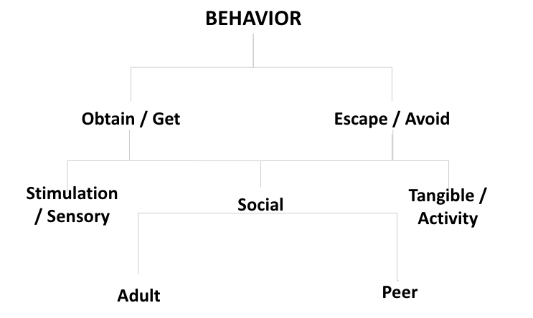
Function of Behavior
Notes:
Trainer Notes:
To Know/To Say: The function of most human behavior falls within two broad categories, either to OBTAIN attention, objects or experiences; or to AVOID attention, objects or experiences. For many, but not all students, teacher attention functions as a positive reinforcer, IF it increases the likelihood that the demonstrated behavior will recur. For a more thorough explanation regarding all facets of the Science of Behavior see the MO SW-PBS website.
If you have not previously engaged with those resources, we strongly encourage you to pause this video, and access those materials before proceeding.

Slide 22
Increasing Student Motivation
Self-Determination Theory has identified 3 primary human needs that help individuals to grow their internal motivation:
Competence
Autonomy
Relatedness
Notes:
Trainer Notes:
To Know/To Say: Recall from the Science of Behavior Course, which is referenced as a suggested pre-requisite for the ELTPs, ALL humans have 3 primary needs to support their internal motivation: competence, autonomy and relatedness.
As you learn more about ETLPs in the classroom, keep these needs in mind. How might encouragement support a student’s sense of competence or relatedness in your classroom?

Slide 23
Adult Attention
Two types of adult attention:
Non-contingent – attention provided regardless of performance
Greetings, proximity, smiles, conversations, jobs, etc.
Contingent – provided based upon student performance of an identified expectation or behavior
Praise, Positive Specific Feedback, Reinforcement, and/or a Tangible item.
MO SW-PBS
Notes:
To do: Read the slide
To say: “Both non-contingent and contingent attention have a positive impact on teacher-student and student-student interactions in schools. Together, both types of attention create a positive school climate and build rapport and relationships, and help students learn social behavioral expectations.”

Slide 24
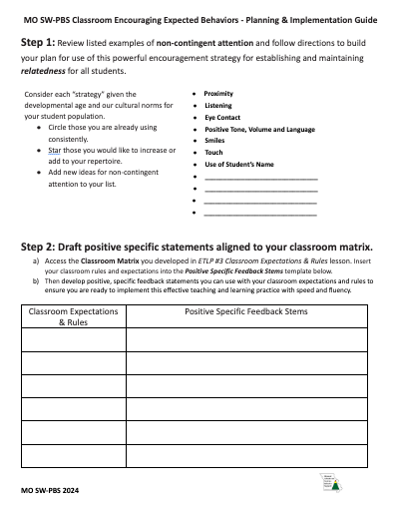
Classroom Encouraging Planning Guide
Non-Contingent Attention
Positive, Specific Feedback
Menu of Classroom Reinforcers
Classroom Continuum of Reinforcers - With Frequency in Mind
Teacher Self-monitoring Plan
Notes:
To do:
To say: Access the Classroom Encouraging Planning Guide handout # 2 and use this resource to document your reflections and ideas as you plan for a comprehensive classroom encouraging plan. The following slides will walk you through
Non-Contingent Attention
Positive, Specific Feedback
Menu of Classroom Reinforcers
Classroom Continuum of Reinforcers - With Frequency in Mind… and finally a
Teacher Self-monitoring Plan

Slide 25
Picture of a teacher and students
Notes:
Trainer Notes:
To Know/To Say: There is a growing body of research that indicates academic achievement and stu­dents’ behavior are both influenced by the quality of teacher-student relationship (Jones & Jones, 1998 and Algozzine, Wang, & Violette, 2010).
We sometimes call non-contingent teacher attention, Preferred Teacher Attention because by definition students should be able to access positive interaction, regardless of their performance. For students who struggle academically as well as behaviorally this may be the only interactions during which the student feels safe or as a valued member of the classroom community.

Slide 26
Picture of a teacher and students in a classroom
Notes:
Trainer Notes:
To Know/To Say: Proximity–communicate privately at 20” distance with individual students; remember that communication across the room is reserved for information intended for the entire group only

Slide 27
Picture of a teacher and students sitting in a circle.
Notes:
Trainer Notes:
To Know/To Say: Listening–pause, attend thoughtfully to the student

Slide 28
Picture of a teacher working with a student
Notes:
Trainer Notes:
To Know/To Say: Eye Contact–communicate at eye level; as appropriate look student in the eye when instructing or directing. in some cultures direct eye gaze is not the norm, so be aware of student preferences.

Slide 29
Teacher reading to students
Notes:
Trainer Notes:
To Know/To Say: Tone, Volume and Language–use calm pleasant voice when talking with, praising, and/or correcting students

Slide 30
Teacher working with students
Notes:
Trainer Notes:
To Know/To Say: Smiles–sustain pleasant facial expression and frequent smiles

Slide 31
Teacher talking to student
Notes:
Trainer Notes:
To Know/To Say: Touch–offer appropriate brief nurturing touch

Slide 32
Teacher in front of the class
Notes:
Trainer Notes:
To Know/To Say: Use of Student’s Name–begin interactions with student name and use frequently during interactions

Slide 33
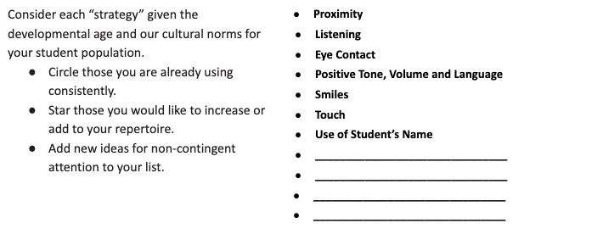
Step 1. Non-Contingent Attention
Notes:
Trainer Notes:
To Know/To Say: Use the Classroom Encouraging Planning & Implementation Guide handout Step 1: Review listed examples of non-contingent attention and follow directions to build your plan for use of this powerful encouragement strategy for establishing and maintaining relatedness for all students.

Slide 34
Student raising their hand
Notes:
Trainer Notes:
To Know/To Say:
Positive, specific feedback has several 2 core elements:
It is contingently delivered following the expected behavior, preferably as soon after the expected behavior is demonstrated
It includes a positive acknowledgement that specifically describes how the behavior was an example of the expectations.
“When I said it was time to begin, you cleared off your desk, got your materials out immediately, and began working quickly.” Positive, specific feedback also frequently includes a rationale of why the expected behavior is important.
“Getting started right away shows cooperation, and if we save time during directions, you will have more time to complete your work, and possibly less homework.”

Slide 35
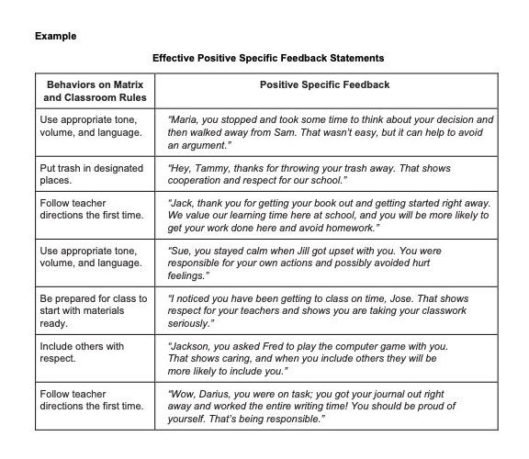
Effective Positive Specific Feedback Statements
Notes:
Trainer Notes:
To Know/To Say: In ETLP Lesson 3, you developed your classroom Rules and Expectations Matrix, making sure that it was aligned to the schoolwide expectations and rules that your building has developed. Review examples of effective Positive Specific Feedback stems to see how feedback statements can be specifically aligned to typical schoolwide and/or classroom expectations and rules.

Slide 36
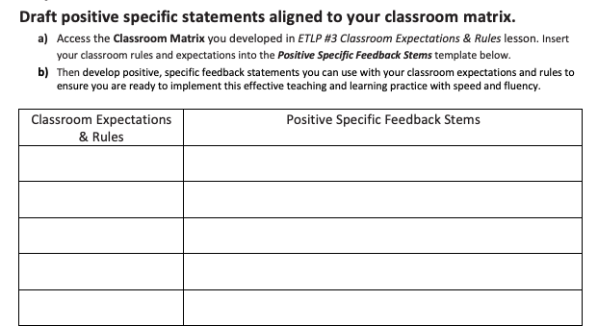
2. Write Feedback Statements
Notes:
Trainer Notes:
To Know/To Say: Use the Classroom Encouraging Planning & Implementation Guide handout Step 2. to develop positive, specific feedback statements you can use with your classroom expectations and rules to ensure you are ready to implement this effective teaching and learning practice with speed and fluency.

Slide 37
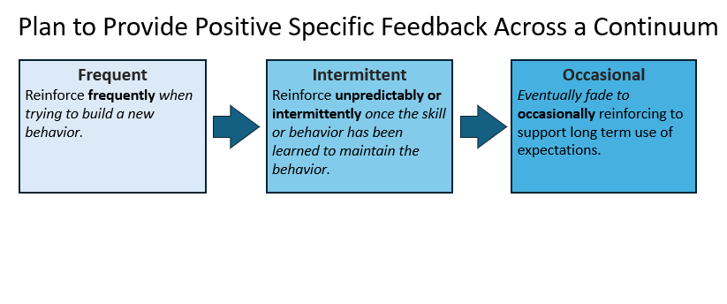
Positive Specific Feedback Continuum
Notes:
Trainer Notes:
To Know/To Say: With prepared positive specific feedback statements aligned with the classroom matrix, and with a renewed understanding of the benefits of non-contingent teacher behaviors to further enrich the depth and breadth of positive student-teacher relationships, the next step is to plan to provide positive specific feedback across a continuum.
Reinforce frequently when trying to build a new behavior.
Reinforce unpredictably or intermittently once the skill or behavior has been learned to maintain the behavior.
Eventually fade to occasionally reinforcing to support long term use of expectations.
Remember to be genuine, sincere, appropriate for the situation and individual, be creative and mix it up and keep it fresh.

Slide 38
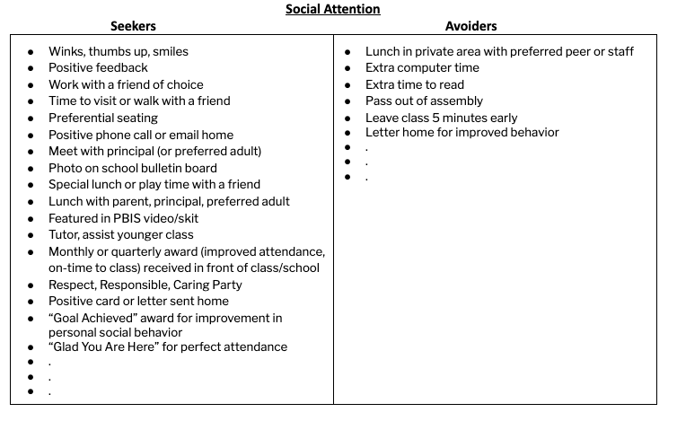
Step 3. Menu of Reinforcers
Notes:
Trainer Notes:
To Know/To Say: Review the Menu of Reinforcers in Step 3 of the Classroom Encouraging Planning & Implementation Guide. The example displayed is for Social Attention. the handout includes categories that also include Activities or Privileges or Tangible items as well.
Remembering that there are no universal reinforcers, and that within your classroom there will be students who are seeking attention and access to items or activities and those who will actively avoid attention, activities or certain experiences you need to consider a continuum of options. From the examples offered:
Circle those reinforcers you currently use.
Star those reinforcers that you can foresee adding to your current continuum of reinforcement.
Add one or two ideas specific to your classroom context.
. Now with a working list, consider how to engage student and family voice in drafting your menu of reinforcers.
Consider what information about your menu of reinforcers you could leave for a substitute or consider a special menu when a substitute fills in for you.

Slide 39
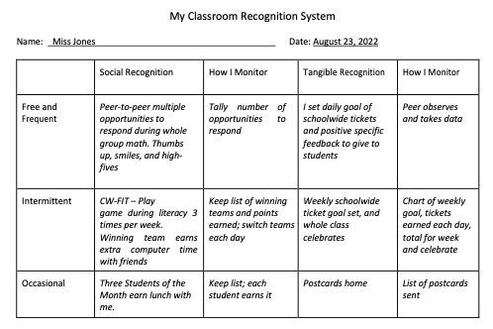
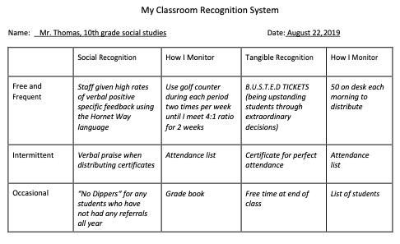
My Classroom Recognition System
Notes:
Trainer Notes:
To Know/To Say: Now that you have a menu of reinforcers that provide options for reinforcing all your students, consider when to use options that work in your classroom context.
CLICK
Note in both the elementary and secondary examples they planned for encouragement delivered Frequently, Intermittently or only Occasionally. They also planned for a sufficient variety of both social and tangible that students can receive as a consequence of demonstrating expected classroom behaviors. This kind of detail in planning increases the likelihood that you deliver feedback with fidelity and consistency, but also with equity.
Finally, as their plan was developed, they also considered how to monitor ongoing delivery of the planned reinforcement.

Slide 40
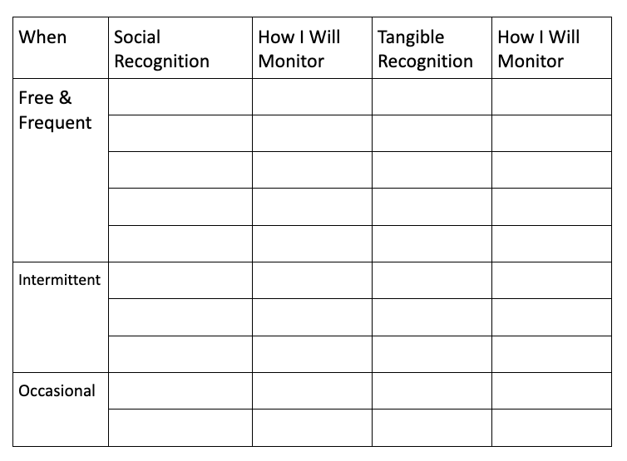
Step 4. Classroom Continuum
Notes:
Trainer Notes:
To Know/To Say: Use the Classroom Encouraging Planning & Implementation Guide, your ratings and additional ideas from step 3 to either create or update your classroom recognition continuum. Step 4 of the handout offers you a framework (as seen on the screen), which helps you consider if the reinforcement is something you will deliver frequently, intermittently or only occasionally.
How will engage partner voice (think students and families) as you develop your encouraging continuum to ensure it is developmentally and culturally relevant for everyone?

Slide 41
Picture of various speech bubbles
Colleagues
FAMILIES
STUDENTS
ADMINS
Notes:
Trainer Notes:
To Know/To Say: Once your encouraging continuum is completed, how will you share it with
Students
Families,
Grade level or departmental team:
Your building administrator:
What parts of this plan would be beneficial to share with substitute teachers?

Slide 42
Teacher high fiving a student
Notes:
Trainer Notes:
To Know/To Say: Many educators may think, “I already give kids non-contingent and contingent attention.” How do you know for sure? Research has shown us that the average teacher fails to take advantage of the power of attention. In fact years of research has shown that teachers positively respond to student academic performance much more frequently than expected student social behavior. (Beaman & Wheldall, 2000). In addition, teachers’ heightened attention to unexpected classroom behavior can in fact be reinforcing or increasing that behavior rather than reducing it.
The good news is we can change this to help us improve the learning environment and teach and support student use of important social skills…which are important life skills.

Slide 43
Why Monitor Your Classroom Encouragement?
Average teacher fails to take advantage of the power of attention.
Approval statements for academic responses far outweigh those for social behavior.
Highest rates of attention for social behavior occur in 2nd grade and decrease dramatically after that.
Teachers respond more frequently to inappropriate social behavior than to appropriate social behavior.
This attention inadvertently maintains or increases the misbehavior.
Notes:
Trainer Notes:
To Know/To Say: In fact, years of research has shown that teachers positively respond to student academic performance much more frequently than expected student social behavior. In addition, teachers’ heightened attention to unexpected classroom behavior can in fact be reinforcing or increasing unexpected behavior rather than reducing it. The good news is we can change this to help us improve the learning environment and teach and support student use of important social skills…which are important life skills.

Slide 44
3 : 1 or 4 : 1 3:1 (Shores, Gunter & Jack, 1993), 4:1 (Trussell, 2008), or 5:1 (Flora, 2000)
Notes:
Trainer Notes:
To Know/To Say: Finally, consider how the increase in your positive to negative feedback ratio can help increase a students’ sense of RELATEDNESS and COMPETENCE, both of which are key elements of self-determination and ultimately support intrinsic motivation. Historic research had often reported a 3:1 or 4:1 positives to reprimand statement was optimal. There have been recent nuanced outcomes that indicate needed updates to the recommended ratio based on student age and/or risk categorization.
3:1 (Shores et al., 1993), 4:1 (Trussell, 2008), or 5:1 (Flora, 2000).

Slide 45
9 : 1 elementary students
w/ EBD (Caldarella, Larsen, Williams, Wills, & Wehby, 2019) PRR = Praise to Reprimand Ratio
Notes:
Trainer Notes:
To Know/To Say: In a study with over 500 elementary students across more than 130 teachers new metrics for Praise to Reprimand Ratio or PRR have emerged. For students at-risk for EBD the optimal PRR ratio was closer to 9:1 if the goal was to improve the students’ engagement and disruption rates.
Caldarella, Larsen, Williams, Wills, & Wehby (2019).

Slide 46
“...teacher reprimands did not decrease students’ future disruptive behavior or increase their engagement or vice versa.” (Caldarella, Larsen, Williams, Wills, & Wehby, 2021)
Notes:
Trainer Notes:
To Know/To Say: It is critical to note, in a recent study of over 149 teachers across 19 elementary schools in 3 states (including Missouri) focused on 311 students at-risk for emotional and behavioral disorders, teacher reprimands did not decrease students’ future disruptive behavior or increase their engagement or vice versa. Teachers may indeed find reprimands may suppress misbehavior momentarily; however they do not appear to be effective in decreasing students’ disruptive behavior or increasing their engagement over time. Caldarella, Larsen, Williams, Wills, & Wehby (2021)
Self-Determination Theory, Punishment is imposing control on students, students will be subversive because they do not want to get caught. Where are Positive Specific Feedback gives them information that helps them work towards competence and relatedness.

Slide 47
1 : 1 middle school students (Caldarella, Larsen, Williams, & Wills, 2023)
Notes:
Trainer Notes:
To Know/To Say: In a recent study of 28 middle schools a novel finding showed that as Praise to Reprimand Ratio (PPR) increased so did the grades of target students, in addition if teachers could reach a simple 1:1 PRR ratio they could see significant improvement in classwide on-task behavior and a 50% reduction in disruptions for target students, and grades for target students averaging a C. In no-praise classrooms, target students were predicted to have, on average, D grades.
The authors speculate that the difference in PRR ratios between elementary and middle school classrooms can be attributed to the relatively non-existent rates of praise for behavior in secondary classrooms (White, 1975) and potentially greater capacity for self-management in older students. (Caldarella, Larsen, Williams, & Wills, 2023)

Slide 48
Teacher in front of the classroom
Notes:
Trainer Notes:
To Know/To Say: The Praise to Reprimand Ratio (PPR) for high school classrooms have not been studied as widely as those for elementary and middle school students. In recent pilot and single subject studies the results demonstrate that teachers appeared to be able under study conditions to increase their behavior-specific praise rates and decrease their reprimand rates, while students appeared to respond with increased on-task behavior. One can hypothesize that if secondary teachers tend on average to deliver little if any positive feedback for behavior, if they can find a mechanism to increase their PRR to more of a 1:1 ratio for behavior that all students would benefit both behaviorally as well as academically.(Caldarella, Richards, Williams, & Warburton, 2023; Speight, Kucharczyk, & Whitby, 2022).

Slide 49
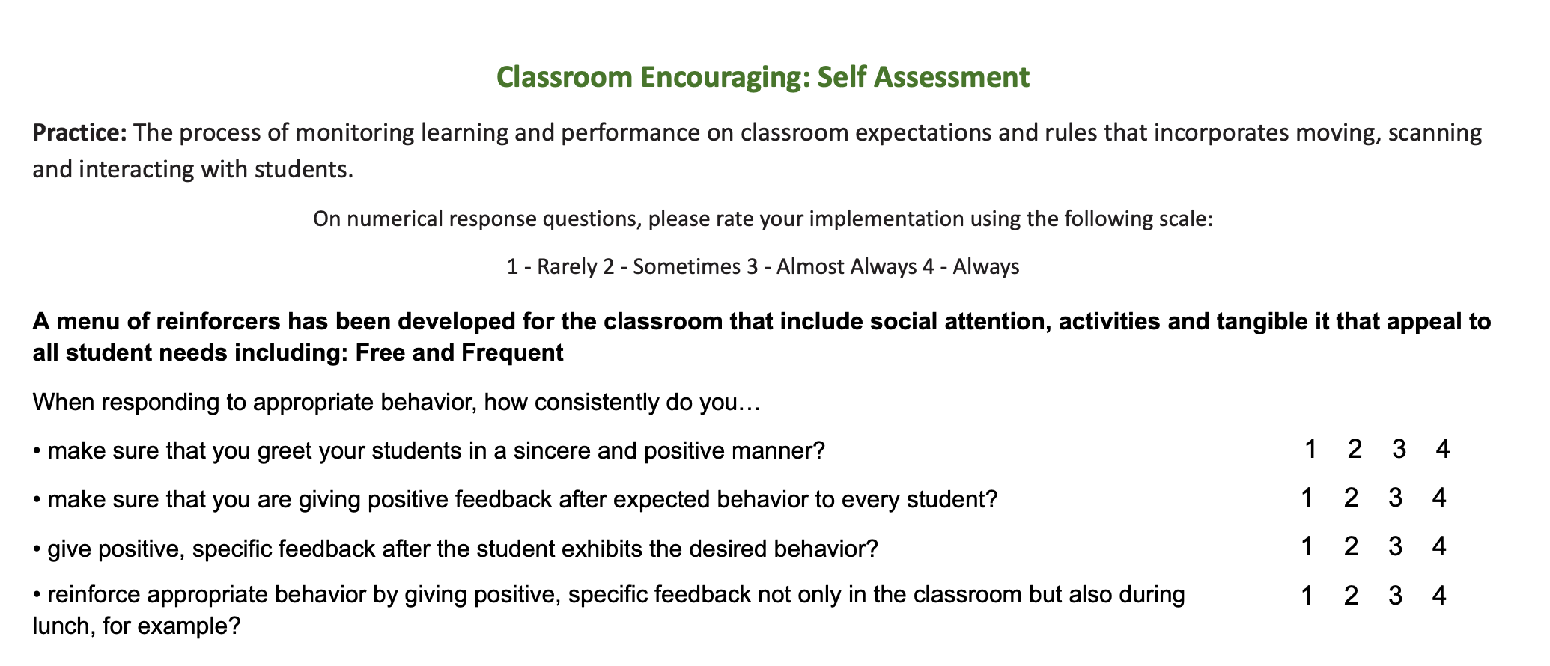
Step 5a: Self Assessment
Turn to page 3 of the Classroom Encouraging Expected Behavior “Teacher Tool”
Complete the Self Assessment
Notes:
Trainer Notes:
To Know/To Say: You began planning for delivering encouragement by using Classroom Encouraging Planning & Implementation Guide and now you can turn to the Self-Assessment section on the MO SW-PBS Classroom Encouraging Teacher Tool, to rate your current implementation of encouragement for expected classroom behavior.

Slide 50
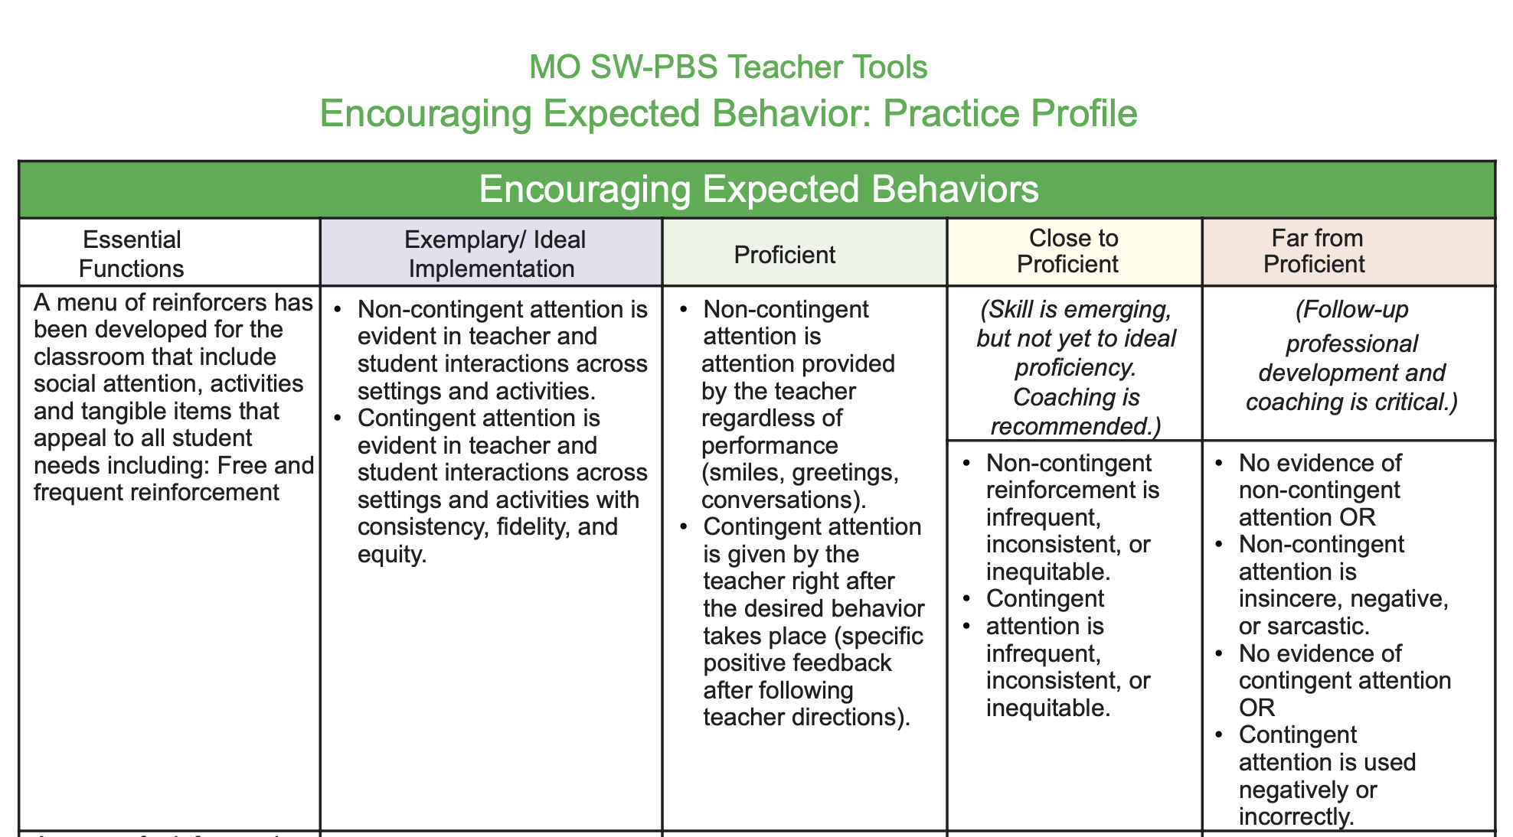
Step 5b: Identify Current Implementation
Turn to page 4 of the Classroom Encouraging Expected Behavior “Teacher Tool”
Where does your current practice fit on the rubric?
Notes:
Trainer Notes:
To Know/To Say: Then, turn to the Practice Profile on the MO SW-PBS Classroom Encouraging Expected Behavior Teacher Tool to consider where your current implementation falls on a continuum from Exemplary or Ideal, through Proficient, Close to Proficient, or Far From Proficient

Slide 51
Picture pf clocks
Notes:
Trainer Notes:
To Know/To Say:
Whatever template you use to develop your self-monitoring plan, you need to consider when and how you will self-monitor your delivery of encouraging expected behaviors in your classroom.
Step 5 of the Classroom Encouraging Planning & Implementation Guide offers prompts to get you going, let’s take a closer look!
Specific questions for developing a self-monitoring plan for encouraging expected behaviors include:
What time of day or during what instructional time do you think your rates or ratios of positive specific feedback are optimum? When are they not optimum? How do you know?
What dimension of delivering positive specific feedback will you monitor? For instance, your:
RATE per minute
or
RATIO of positive specific feedback to corrective feedback?

Slide 52
Picture of post-its
Notes:
Trainer Notes:
To Know/To Say: What procedure can you use to self-monitor your delivery of positive, specific feedback? For example, each time you deliver positive specific feedback
move a paper clip from your one pocket to another,
add a tick mark on a post-it note, or
use a golf stroke counter to keep track.

Slide 53
Teacher reading to students in the circle
Notes:
Trainer Notes:
To Know/To Say: What procedure can you use to self-monitor your RATIO of positive, specific feedback to corrective feedback?
You could use tick marks on a post-it note to count positive specific feedback and corrective feedback statements.
Consider having a colleague conduct a 5-minute classroom observation
or record yourself using audio or video during part or all of a lesson.

Slide 54
Teacher working with student
Notes:
Trainer Notes:
To Know/To Say:Finally, what student group might you want to target in your delivery of positive specific feedback?
students with IEPs,
students who display higher rates of unexpected behavior
or students who are struggling with a specific academic area?

Slide 55
Two adults working together
Notes:
Trainer Notes:
To Know/To Say Once you have set your goal, established a process to monitor, collected your implementation data, it is time to analyze your results and either:
celebrate, self-reward and plan how to sustain;
celebrate, self-reward and plan how to adjust and enhance;
or pause to consider how to improve your delivery of positive, specific feedback.

Slide 56
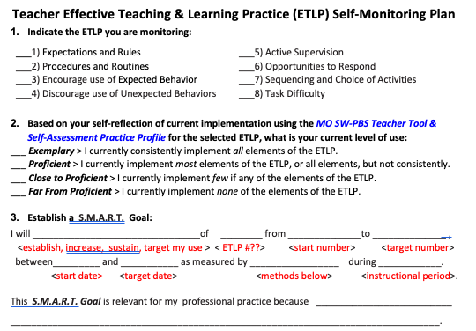
Step 5c: Self-Monitoring Plan
Access the Teacher ETLP Self-Monitoring Plan
Set a SMART Goal a process for self-monitoring, sustaining & rewarding.
Notes:
Trainer Notes:
To Know/To Say: Finally, recall the Teacher ETLP Self-Monitoring Plan - Template shared in Lesson 2 Systems for ETLPs to help you create an implementation and self-monitoring plan for each of the 8 ETLPs. Use the template offered, or one provided by your building leadership team, to now formally plan for your implementation and self-monitoring of Encouraging Expected Behaviors in your classroom. What is your personal base rate for delivering encouragement for expected behaviors in your classroom? What is your goal to either enhance or sustain your delivery of this high leverage instructional practice?

Slide 57
Picture of hand holding a magnifying glass

Slide 58
Next Steps
Use the Classroom Encouraging Planning & Implementation Guide to
Develop a draft for classroom encouragement systems and resources; make a plan to engage student and family voice in the final review and editing.
Consistently provide positive specific feedback to students on classroom expectations & rules and procedures as needed.
Use the Teacher Tool - Procedures and Routines Self-Assessment and Practice Profile and the Teacher ETLP Self-Monitoring Plan to monitor your development and use of classroom encouraging.
Notes:
Next steps include:
Use the Classroom Encouraging Planning & Implementation Guide to
Develop a draft for classroom encouragement systems and resources; make a plan to engage student and family voice in the final review and editing.
Consistently provide positive specific feedback to students on classroom expectations & rules and procedures as needed.
Use the Teacher Tool - Procedures and Routines Self-Assessment and Practice Profile and the Teacher ETLP Self-Monitoring Plan to monitor your development and use of classroom expectations and rules. to monitor your development and use of classroom encouraging.

Slide 59
References
Beaman, R., & Wheldall, K. (2000). Teachers' use of approval and disapproval in the classroom. Educational Psychology, 20(4), 431–446.
Brophy, J. (1998). Motivating students to learn. Boston: McGraw Hill.
Brophy, J. (2006). History of research on classroom management. Handbook of classroom management: Research, practice, and contemporary issues, 17-43.
Caldarella, P., Richards, E.J., Williams, L. et al. Improving Behavior in an Alternative High School Summer Program Using Class-Wide Function-Related Intervention Teams: A Pilot Study. Educ. Treat. Child. 46, 351–365 (2023).
Caldarella, P., Larsen, R. A., Williams, L., Wills, H. P., & Wehby, J. H. (2019). Teacher Praise-to-Reprimand Ratios. Education and Treatment of Children, 42(4), 447-468
Caldarella, P., Larsen, R. A. A., Williams, L., & Wills, H. P. (2023). Effects of Middle School Teachers’ Praise-to-Reprimand Ratios on Students’ Classroom Behavior. Journal of Positive Behavior Interventions, 25(1), 28-40.
Cameron, J., & Pierce, W. D. (1994). Reinforcement, reward, and intrinsic motivation: A meta-analysis. Review of Educational research, 64(3), 363-423.
Everston, C. M., & Emmer, E. T. (1982). Preventive classroom management. Alexandria, VA: Association for Supervision and Curriculum Development.
Evertson, C. M., Emmer, E. T., & Worsham, M. E. (2003). Classroom management for secondary teachers. Allyn and Bacon.
Flora, S. R. (2000). Praise’s magic reinforcement ratio: Five to one gets the job done. The Behavior Analyst Today, 1, 64 – 69. doi:10.1037 /h0099898
Notes:
References
Here are the references used to develop this material. If you need more information, see the MO SW-PBS tier 1 Workbook available online at pbismissouri.org

Slide 60
References Continued
Good, T. L., & Brophy, J. E. (2003). Looking in classrooms (9th ed.). Boston: Allyn & Bacon.
Hattie, J., & Yates, G. C. (2013). Visible learning and the science of how we learn. Routledge.
Kern, L., & Clemens, N.H. (2007). Antecedent strategies to promote appropriate classroom behavior. Psychology in the Schools, 44(1), 65-75.
Missouri Schoolwide Positive Behavior Support (2019). Missouri Schoolwide Positive Behavior Support Handbook.
Missouri Schoolwide Positive Behavior Support (2019). Missouri Schoolwide Positive Behavior Support Tier 1 Implementation Guide.
Scott, T., Hirn., R. and Cooper, J. (2017). Teacher and student behaviors: Keys to success in classroom instruction. Rowman & Littlefield.
Shores, R. E., Gunter, P. L., & Jack, S. L. (1993). Classroom management strategies: Are they setting events for coercion? Behavioral Disorders, 18, 92 – 102. doi:10.1177/019874299301800207
Soar, R., & Soar, R. (1979). Emotional climate and management. In P.L. Peterson & H. J. Walberg (Eds.), Research on teaching. Berkeley, CA: McCutchan.
Speight, R., Kucharczyk, S., & Whitby, P. (2022). Effects of a behavior management strategy, CW-FIT, on high school student and teacher behavior. Journal of Behavioral Education, 31(4), 751-770.
Trussell, R. P. (2008). Classroom universals to prevent problem behaviors. Intervention in School and Clinic, 43, 179 – 185. doi:10.1177 /1053451207311678
Notes:
References Continued

Slide 61
Slide with Contact Information
Contact Information
Facilitator Contact Information:
Email:
Phone:
pbismissouri.org
facebook.com/moswpbs
@MOSWPBS
MO SW-PBS
Notes:
This lesson was made possible with funds from the Missouri Department of Elementary and Secondary Education, Division of Special Education; the Center on Positive Behavior Interventions and Supports and the University of Missouri Center for Schoolwide Positive Behavior Support.

