Slide 1
T1C8L3 Classroom Expectations & Rules
Tier 1 Effective Teaching & Learning Practices
(ETLPs) for the Classroom
Notes:
Trainer Notes:
To Know/To Say: Welcome to Lesson 3 MO SW-PBS of the Effective Teaching & Learning or ETLP series. This lesson describes the value of having classroom expectations and rules clarified and aligned to schoolwide and/or districtwide expectations. The key to successful classroom management is prevention of problems before they occur. Clarifying specific expected rules for the classroom is essential, and the same rules that reduce classroom disruptions are clearly associated with increased student learning.

Slide 2
T1C8L3 Classroom Expectations and Rules
Tier 1 Effective Teaching & Learning Practices
(ETLPs) for the Classroom
Notes:
Trainer Notes:
To Know/To Say:

Slide 3
Working Agreements
Be Respectful
Be an active listener—open to new ideas
Use notes for side bar conversations
Be Responsible
Be on time for sessions
Silence cell phones—reply appropriately
Be a Problem Solver
Follow the decision making process
Work toward consensus and support decisions of the group
Notes:
Trainer Notes: To Know/To Say: “These will be the Working Agreements we will honor during all our training sessions this year.”

Slide 4
Attention Signal
Notes:
Trainer Notes: Select an attention signal.
To Know/To Say: “One of our agreements is to follow the attention signal.”
“Your team will work with your school to develop an attention signal you will use in every setting.”
“In order to get all of you focused after discussions, activities or breaks,
I will ________________________________________.”
(Insert your attention signal here.)
“Your task will be to finish your sentence, quiet your voice and ____________________________.”
(Insert what you want participants to do.)

Slide 5
Introductions
Notes:
Trainer Notes Select an introductions activity.
To Know/To Say:

Slide 6
Handouts
T1C8L3 HO1. MO SW-PBS TT Expectations & Rules
T1C8L3 HO2. MO SW-PBS Classroom Expectations and Rules Teacher Tool
T1C8L3 HO3. Classroom Expectations & Rules Planning & Implementation Guide
Notes:
There are handouts that will be referenced during this lesson. If you have not downloaded them from the lesson website, please pause the video while you access these documents.
Read slide.

Slide 7
Lesson Outcomes
At the end of this session, you will be able to…
Understand how the language of the classroom expectations reflects the language of school/districtwide expectations.
Understand that classroom rules are specific criteria for meeting expectations.
Understand that classroom rules meet the 5 guidelines of OMPUA.
Understand that classroom expectations and rules must be taught, modeled, and practiced, and that feedback is regularly given.
Develop classroom expectations and rules and establish a system to consistently teach and reinforce these expectations and rules.
Establish a process to self monitor the implementation of classroom procedures and routines with fidelity, consistency and equity.
Notes:
Trainer Notes:
To Know/To Say: Read slide.

Slide 8
Quote
“Although expectations used by effective educators may vary from teacher to teacher and school to school, we do not find effectively managed schools and classrooms operating without them.”
~ Carolyn Evertson, PhD – Peabody College, Vanderbilt University

Slide 9
Missouri Teacher Standards Addressed
2.1: Cognitive, social, emotional and physical development
2.6: Language, culture, family and knowledge of community
3.1: Implementation of curriculum standards
5.1: Classroom management, motivation and engagement
5.2: Managing time, space, transitions and activities
5.3: Classroom, school and community culture
6.1: Verbal and nonverbal communication
6.2: Sensitivity to culture, gender, intellectual and physical differences
8.1: Self-assessment and improvement
8.2: Professional learning
Notes:
Trainer Notes:
To know/To say: These are the Missouri Teacher Standards that will be addressed in this lesson. If you want more information regarding these standards visit DESE.MO.GOV

Slide 10
Pre-requisites
Pre-Requisites
Knowledge of The Science of Behavior (completion of at least ONE of the courses/resources below):
MO SW-PBS Handbook - Function Based Thinking
Tier 1 Implementation Guide - Encouraging Expected Behavior
MO SW-PBS Online Course -
Foundation - Science of Behavior
Tier 1 - Encouraging Expected Behavior
Effective Teaching & Learning Practices Lessons
Lesson 1: Overview of the 8 Classroom ETLPs
Lesson 2: Systems to Support Implementation of ETLPs (for LEADERSHIP TEAM members)
Notes:
Trainer Notes:
To Know/To Say: There are are several courses and lessons that will be beneficial for you to complete before you begin this lesson. We highly encourage anyone who is engaging in this lesson on Classroom Expectations & Rules to first engage with at least one of the Science of Behavior resources listed prior to taking this lesson. Doing so will provide critical background information necessary to be able to understand and apply the concepts shared here for classroom implementation of encouraging expected behaviors with fidelity, consistency and equity.
In addition, participants should also complete the Overview of the 8 Classroom ETLPs, (Lesson 1)
If you are a member of a building or district leadership team we encourage you to FIRST complete the Systems to Support Implementation of ETLPs (Lesson2) and establish building or district systems to support Theall instructional staff in the delivery of all 8 ETLPs.
Note: ETLP Lessons 3-10 will primarily focus on the 8 Classroom ETLPs through the lens of INDIVIDUAL classroom educators. If
All of these resources can be found on the MO SW-PBS website located at pbismissouri.org .

Slide 11
Keywords
Expectations: three to five words/phrases that define the kind of people you want your students to be, which are a direct outgrowth of your beliefs, vision and mission.
Behaviors/Rules: the specific tasks students are to do to demonstrate the schoolwide expectations.
Notes:
To Know/To Say: Here are key terms and acronyms that will be used in this lesson.
. Expectations: three to five words/phrases that define the kind of people you want your students to be, which are a direct outgrowth of your beliefs, vision and mission. Typically, the schoolwide expectations may be set by a building LEADERSHIP TEAM( BLT) or the district LEADERSHIP TEAM (DLT).
. Behaviors/Rules: the specific tasks students are to do to demonstrate the schoolwide expectations. For the remainder of this lesson we will use the term RULES to mean the specific tasks that demonstrate the expectation.

Slide 12
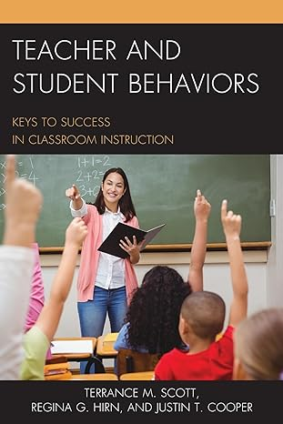
Overview of Classroom Expectations & Rules
Large scale study of over 6,500 classroom found the commonality across all classrooms was the generally low level of implementation of teaching and learning practices.
In addition, clarifying specific expected behaviors and rules for the classroom is essential, and the same behaviors and rules that reduce classroom disruptions are clearly associated with increased student learning.
Notes:
Trainer Notes
To know/To say: The current need for clear and consistent classroom rules is evident. In a large-scale study in over 6,500 classrooms in the late-2010’s, Scott, Hirn and Cooper found the commonality across all classrooms was the generally low level of implementation of teaching and learning practices with large effect sizes.
The work of Scoot and colleagues is undergirded by research spanning more than 40 years which consistently indicates that clarifying specific expected behaviors and rules for the classroom is essential, and the same behaviors and rules that reduce classroom disruptions are clearly associated with increased student learning.
In addition we know from research that
A dependable system of rules and procedures provides structure for students and helps them to be engaged with instructional tasks.⁴
Teaching rules and routines to students at the beginning of the year and enforcing them consistently across time increases student academic achievement and task engagement. ^{5,6}
Clearly established classroom expectations and rules provide language for teaching and feedback for students, staff and parents.⁷
For further research on this topic, see the citations at the end of this lesson.

Slide 13
Supporting Student Needs
Self-Determination Theory has identified 3 primary human needs that help individuals to grow their internal motivation:
Competence
Autonomy
Relatedness
Notes:
Trainer Notes
To know/To say:Recall from the Science of Behavior Course, which is referenced as a suggested pre-requisite for the ELTPs, ALL humans have 3 primary needs to support their self-determination and internal motivation: competence, autonomy and relatedness. As you learn more about ETLPs in the classroom, keep these needs in mind. How might having clear and consistent classroom expectations and rules support a student’s sense of competence, autonomy or relatedness in your classroom?

Slide 14
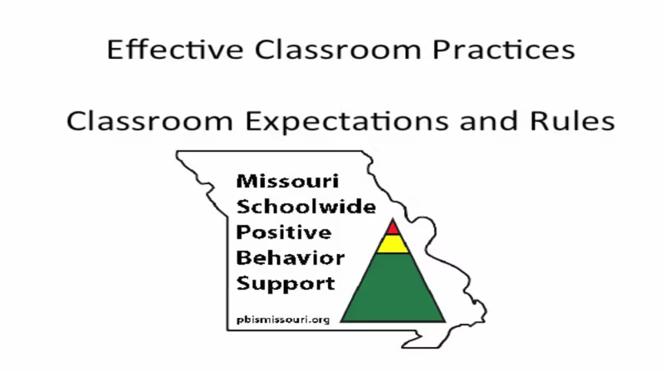
Activity : Classroom Rules and Expectations in Practice
Expectations & Rules Training Video (12-minutes)
(Embed Vimeo Link - https://vimeo.com/174282584
Notes:
Trainer Notes:
To Know/To Say: Watch this 12-minute video that includes classroom implementation examples and interviews with teachers about having clear classroom expectations & rules. Consider how establishing clear classroom expectations and rules that align with schoolwide expectations could benefit classrooms.

Slide 15
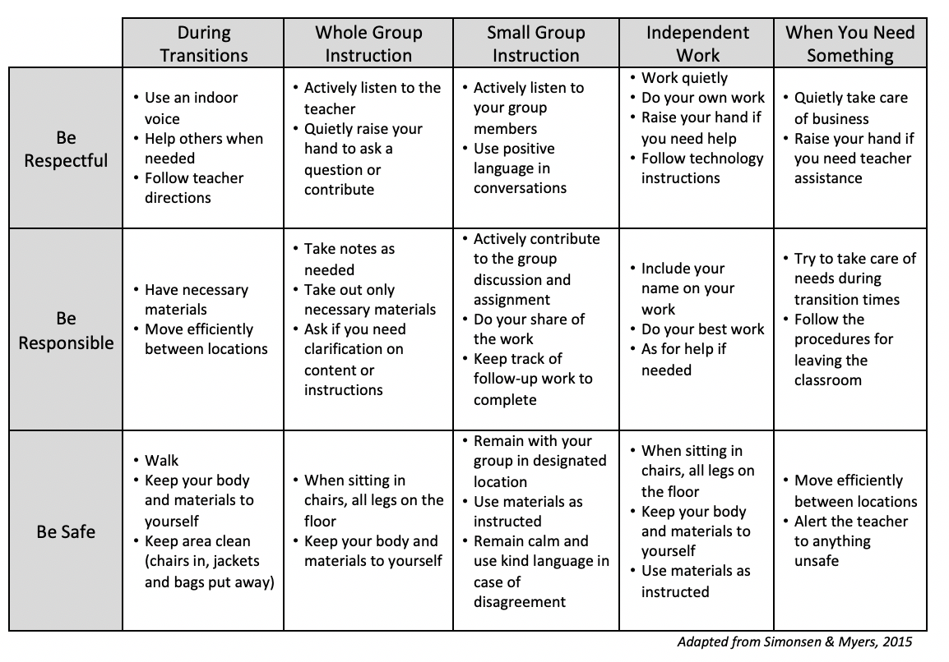
Classroom Matrix
Notes:
Trainer Notes:
To know/To say: A classroom matrix describes the expectations for successful learning in all classroom activities. The rules describe how to demonstrate successful learning behavior.
This sample matrix describes the expectations and rules in a middle school classroom. image adapted from Simonsen & Myers 2015
This lesson will walk you through the process of drafting classroom rules aligned to schoolwide expectations, developing a classroom matrix, creating a plan to teach and reinforce your classroom rules, and finally self-assess your implementation of classroom expectations and rules.

Slide 16
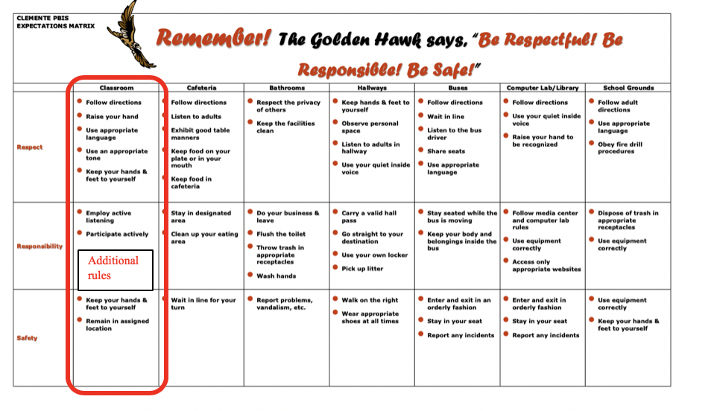
Common Classroom Expectations & Rules - Teachers Augment
Notes:
Trainer Notes:
To Know/To Say: You will need to know what the schoolwide Expectations are and which if any Rules have been established by the leadership team for ALL classroom settings. In the example schoolwide matrix the building leadership team opted to create certain rules that apply in all classrooms.

Slide 17
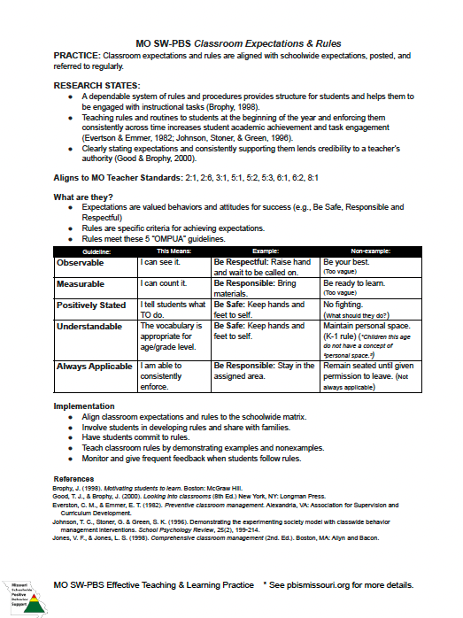
Classroom Expectations and Rules
Notes:
Trainer Notes
To know/To say: This slide is just here as a reference to remind you to pull out the handout!
The MO SW-PBS Classroom Expectations and Rules Teacher Tool provides you with several resources to understand the importance of, provide tips for drafting and metrics to progress monitor your development and use of classroom procedures and routines.
1. The first 2 pages of each Teacher Tool defines the practice,
2. shares research regarding the practice,
3. indicates how the practice aligns to Missouri Teacher Standards,
4. describes an example of the practice,
5. provides steps and examples of how to implement the practice,
6. and lists research references for further study.
You will learn more about page 3 Self-Assessment and page 4 Practice Profile later in this course. Make sure to have a copy of the Classroom Expectations & Rules Teacher Tool handy during this
lesson.

Slide 18
Drafting Classroom Rules that are OMPUA
• Observable – Behaviors we can see
• Measurable – We can count occurrences
• Positively Stated – What we do to be successful
• Understandable – Student-friendly language
• Always Applicable – The same everyday
Notes:
Trainer Notes:
To Know/To Say: Drafting Classroom Rules that are OMPUA
No matter which option your LEADERSHIP TEAM chooses, it is important that all YOUR classroom rules that are selected to define the expectations follow the same OMPUA Guidelines used for development of the rules that define the expectations at the building level in schoolwide settings (think hallway, cafeteria, commons or on the playground).
Specifically Identified behaviors should be:
• Observable – Behaviors we can see
• Measurable – We can count occurrences
• Positively Stated – What we do to be successful
• Understandable – Student-friendly language
• Always Applicable – The same everyday
For instance, being respectful means different things to different people. We have to define what respect looks like for our students at our school and in our classrooms. It may mean ‘Eyes on the speaker,’ ‘Sitting quietly with hands to self,’ or ‘Asking for your partner’s opinion,’ depending on the context or routine.

Slide 19
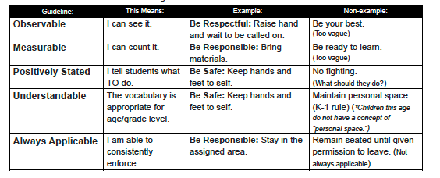
Activity: Classroom Rules and Expectations in Practice
Notes:
Trainer Notes: Recall the video shared earlier < https://vimeo.com/174282584>.
To Know/To Say: Take a moment to review the examples and non-examples of rules and the ratings each has been given in regard to a specific OMPUA guideline.
This OMPUA checklist is part of the Teacher Tool collection, see MO SW-PBS Classroom Expectations & Rules handout.

Slide 20
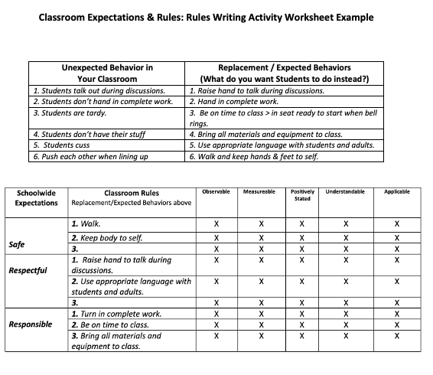
Activity : Classroom Rules & Expectations in Practice
Notes:
Trainer Notes:
To Know/To Say: Now it is time to practice writing classroom rules that are aligned with your schoolwide expectations, your instructional contexts and follow the OMPUA Guidelines. First, review the Classroom Expectations & Rules Planning & Implementation Guide handout. Review the example and formulate your thoughts.
What were the unexpected behaviors this teacher observed?
What were the possible replacement behaviors this teacher listed?
Consider if you agree that this teacher’s brainstormed list of behaviors and rules meet the OMPU guidelines.

Slide 21
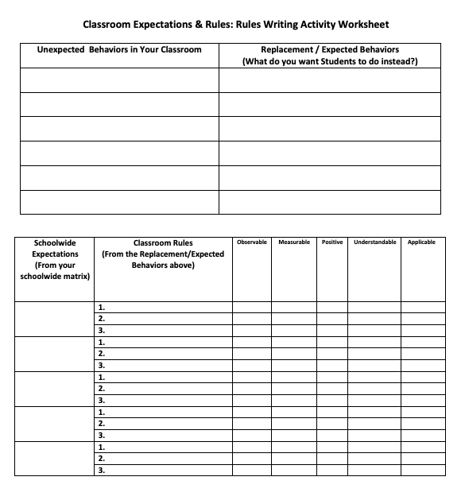
Activity: Classroom Rules and Expectations in Action
Notes:
Trainer Notes:
To Know/To Say: This slide is just here as a reference to remind you to pull out the handout!
Now work on drafting your classroom rules using the Classroom Expectations & Rules Planning & Implementation Guide handout. As you do so, consider
What are the behaviors that would be unexpected in YOUR classroom setting?
What would be possible replacement behaviors for those that are unexpected?
Now group or categorize your brainstormed behaviors or rules so they align to the building wide expectations AND provide expected replacement behaviors for YOUR Classroom.
Finally, review each of your draft rules and consider if they meet the OMPUA guidelines.

Slide 22
Matrix
Notes:
Trainer Notes:
To Know/To Say: You have just spent time writing your classroom expectations and rules that are somewhat broad in scope while also being aligned to your schoolwide expectations. Now consider the configurations of learning that occur in your classroom and reflect on how you expect students to behave during those particular learning times:
Consider the configurations of learning that occur in your classroom and reflect on how you expect students to behave during those particular learning times:
Entering or exiting the classroom.
Whole group instruction.
Small group instruction.
Individual work time.
Transitions between whole-group-individual learning times

Slide 23
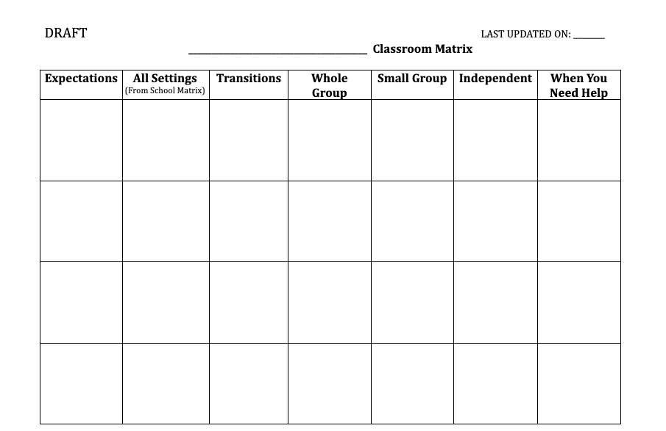
Activity: Classroom Rules & Expectations in Action
Notes:
Trainer Notes:
To Know/To Say: Now that you have reviewed your draft rules to ensure alignment to schoolwide expectations and OMPUA guidelines, you are ready to draft a matrix that clarifies for students which rules apply during various instructional contexts including transitions, whole group, small group and individual work time as well as when students need help.

Slide 24
Picture of students
Notes:
Trainer Notes:
To Know/To Say: Students will have more ownership of classroom rules if they have given input on their development. This ownership will go a long way in fostering the students' sense of competence, relatedness and ultimately autonomy as they go about the daily workings of the classroom.
There are several ways to involve students including:
discuss why rules are important in the classroom and community, there are numerous picture books and academic outcomes that would align with this strategy.
have students make a list of rules aligned to schoolwide expectations that they believe would be helpful in the classroom.
have students check all current or drafted rules for OMPUA.

Slide 25
Picture of teacher and students
Notes:
To Know and Say
have a class discussion to clarify expectations and rules and begin having students model or practice them in the classroom.
get student commitment and for older students consider having them sign a classroom covenant that includes the collectively developed rules.

Slide 26
Picture of teacher working with students
Notes:
To Know and Say
Now that you have engaged student voice into your classroom rules, consider what strategies has your building leadership team suggested for engaging family voice? What is your plan to share your DRAFT Classroom Expectations and Rules with your families?
Use the Classroom Expectations & Rules Planning & Implementation Guide to take notes and jot potential future plans

Slide 27
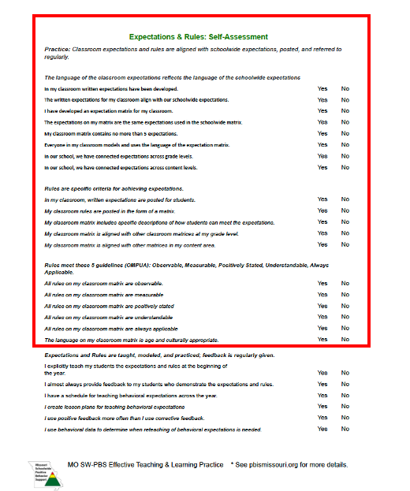
Expectations and Rules Practice Profile
Notes:
To Know and Say
This slide is just here as a reference to remind you to pull out the handout!
You have spent time drafting your classroom rules and ensured they align to the schoolwide expectations, considered instructional contexts (e.g.,
entering and exiting the classroom, whole group instruction, small group instruction, transitions, etc.) ensuring your rules provide effective structure for
each, you have engaged student and family voice in refining your rules and you organized your classroom rules into a matrix format.
Take a moment to assess the quality of your efforts before you finalize and post or share your classroom matrix. The first 3 Essential Functions of the
Expectations and Rules Self-Assessment has prompts designed to help you do just that.
Use the Classroom Expectations & Rules Planning & Implementation Guide to take notes and jot potential future plans

Slide 28
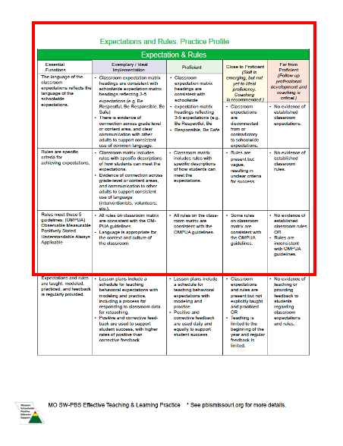
Visual chart for the practice profile
Notes:
To Know and Say
This slide is just here as a reference to remind you to pull out the handout!
You can use your Self-Assessment answers, in conjunction with the Expectations & Rules Practice Profile as a mechanism to assess your current
implementation of Expectations and Rules in YOUR classroom, and as feedback for final edits to your matrix.
Use the Classroom Expectations & Rules Planning & Implementation Guide to take notes and jot potential future plans

Slide 29
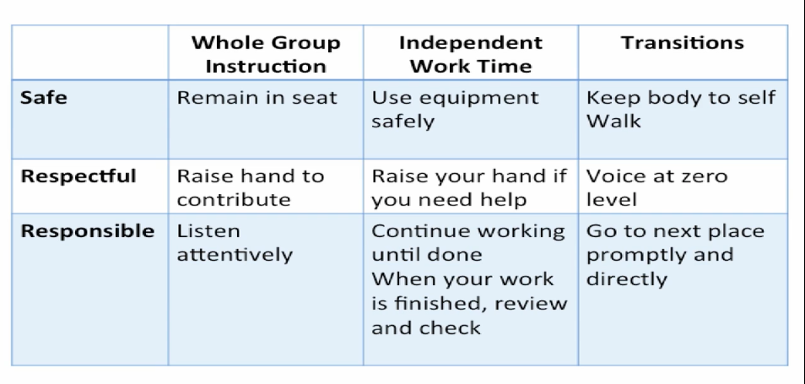
Classroom Signage
Notes:
Trainer Notes:
To Know/To Say: Once you have developed consistent classroom rules that follow the OMPUA guidelines and reflect stakeholder voice, it is important to use that language on a regular basis. Having the expectations and rules displayed in the classroom in a big, bold way will make it easier for YOU the classroom teacher (or a substitute) to consistently use the language. Signage should directly match the expectations and rules from the matrix and should incorporate schoolwide as well as your additional classroom rules as applicable (Option 2 or 3 from above).
Review the following signage examples and decide if they are appropriate for your context.

Slide 30
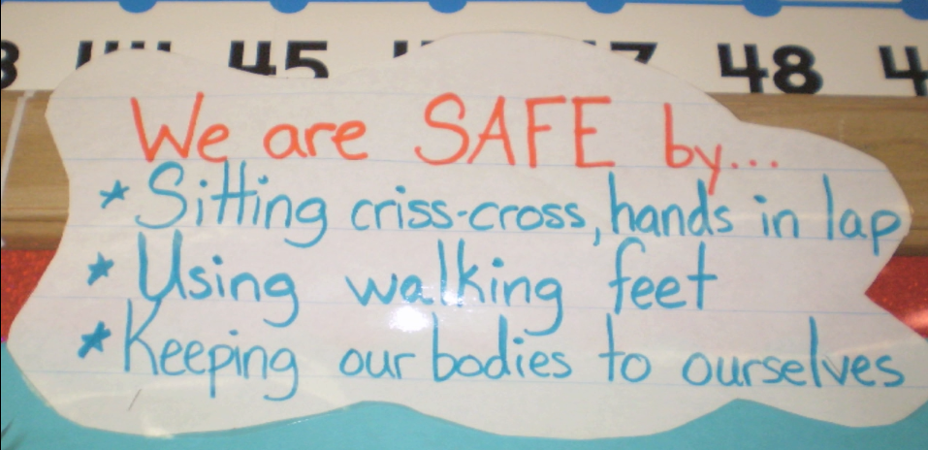
Classroom Signage
Notes:
Trainer Notes:
To Know/To Say: Classroom Signage should include behaviors/rules that are aligned with schoolwide / districtwide expectations and are visually large enough for the YOU and your students to refer to during academic instruction times from various locations in the classroom.
You may choose to display the entire matrix, or smaller chunks as in this example

Slide 31
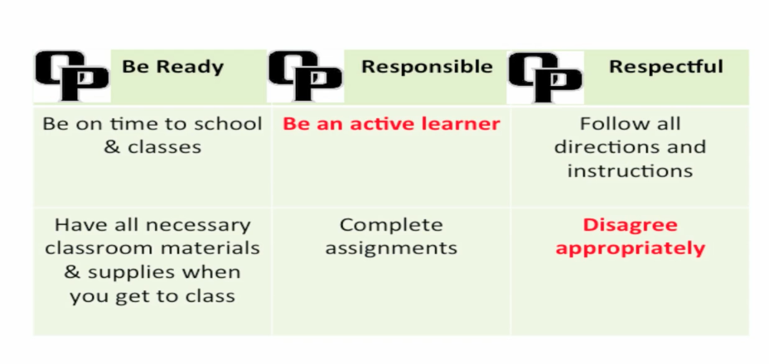
Classroom Signage Secondary
Notes:
Trainer Notes:
To Know/To Say: In the final matrix, from a Secondary building, the Rules in Red were to be more clearly defined in OMPUA terms by the classroom teacher in language specific to the course content and classroom context.
Make a plan to develop your classroom expectations and rules signage and note ideas on the back of your classroom matrix draft.

Slide 32
Teach Classroom Rules and Expectations
Notes:
Trainer Notes:
To Know/To Say: We have to make sure students understand what we expect behaviorally before we hold them accountable for meeting our expectations. If a student is behaving unexpectedly, it will be very difficult for that student—and other students—to learn.
In addition, correcting unexpected behaviors takes up valuable instructional time, so why not teach students how you want them to behave before there is a problem?
Research continues to demonstrate that teaching rules and routines to students at the beginning of the year and enforcing them consistently across time increases student academic achievement and task engagement.
Remember, as you plan to teach behavioral expectations to be efficient and effective and plan to intertwine academic and behavior instruction, rather than deliver them as separate systems in the classroom.

Slide 33
Teaching Schedule
Directly teach, and prompt DAILY during the first weeks of school.
Periodic weekly review through the first grading period
Periodically review and re-teach throughout the remainder of the year.
Plan on BOOSTER teaching, prompting and reviewing after planned and unplanned breaks in school (e.g. winter break, snow days, etc.)
Notes:
Trainer Notes:
To Know/To Say: Here is a suggested schedule for teaching your rules.
Directly teach and prompt classroom rules daily during the first week of school,
Then review the rules 2-3 times per week during the first grading period (quarter or trimester).
This provides students with multiple opportunities for review and practice. Along with practice opportunities it is important to continue providing frequent reinforcement and acknowledgement when rules are followed.
Examples for practice with older students includes oral review during the first or last few minutes of class; surprise quizzes about rules for extra credit points; or dividing students into teams, asking questions about rules and awarding team points for correct answers.
For younger students provide meta cognitive or “thinking out loud” narration as students demonstrate the classroom expected behavior and rules,
Just as we do with an academic task we continue to teach, review, practice and acknowledge success on behavioral tasks – which include following classroom rules.
Plan on BOOSTER teaching, prompting and reviewing after planned and unplanned breaks in school (e.g. winter break, snow days, etc.)
Use the Classroom Expectations & Rules Planning & Implementation Guide to take notes and jot potential future plans

Slide 34
Directions for writing down your feedback for the activity
Activity: Classroom Rules and Expectations in Action
Write down your thoughts for developing a teaching plan for your classroom expectations and rules on the Classroom Expectations & Rules Planning & Implementation Guide
Notes:
Trainer Notes:
To Know/To Say: Take a moment to jot down your thoughts for developing a teaching plan for your classroom expectations and rules on the Classroom Expectation and Rules - Development prompts worksheet.

Slide 35
Picture of teacher and students in a row
Notes:
To Know and Say:
While teaching the expectations and rules is a critical step, teachers should also plan to use pre-correction to reduce learning errors. Pre-Correcting is a strategy to remind students of expected behaviors or rules BEFORE they are to be used by the students, especially for rules that students sometimes do not follow correctly.
For instance, a teacher might say, “In a minute, but not yet, you will need to put away your reading materials and prepare to transition into line to head to go to the cafeteria for lunch. When I call your name it will be your turn to stow your reading materials, get your lunch from your backpack if you brought it and then stand on your line spot, facing forward, with your voice at a zero.”

Slide 36
Picture of teacher talking to the classroom
Notes:
Trainer Notes:
To Know/To Say: A teacher in a secondary classroom might say, “Heads up everyone, you have 3 more minutes to complete your lab notes for today. When the timer rings, you will need to submit your notebook, work with your lab partner to return your experiment materials in the designated containers, and get your backpacks and other materials ready to move to your final class of the day.”
What rules or transitions are typically ones that you find you are frequently correcting in your classroom? How can you use pre-correction to remind students of the expectation or rule, right before they would need to demonstrate it to increase their rule following behavior?
Take a moment to jot down your thoughts regarding necessary times for Pre-correction using the prompts on the Classroom Expectations & Rules Planning & Implementation Guide

Slide 37
Picture of teacher and students Secondary
Notes:
Trainer Notes:
To Know/To Say: Recall that positive, specific feedback delivered soon after the classroom expectation and rule have been demonstrated is a critical piece of the tell-show-practice-feedback process for learning. It does not go without saying that as a teacher you need to consider a plan that helps you deliver positive, specific feedback with fidelity, consistency and equity.
For more ideas on HOW to provide effective positive, specific feedback take time to engage with Lesson 5: Classroom Encouraging Expected Behavior
Also know there will be times when students display unexpected behaviors in the classroom, even after you have clearly defined, demonstrated, taught, prompted practice and given positive, specific feedback. For strategies on how to respond to unexpected classroom behavior engage in Lesson 6: Classroom Discouraging Unexpected Behavior

Slide 38
Directions to write down your feedback about the activity
Activity: Classroom Rules and Expectations in Action
Write down your thoughts for developing a feedback plan for your classroom expectations and rules on the Classroom Expectations & Rules Planning & Implementation Guide.
Notes:
Trainer Notes:
To Know/To Say: Take a moment to jot down your thoughts for developing a feedback plan for your classroom expectations and rules on the Classroom Expectation and Rules

Slide 39
Activity: Classroom Rules and Expectations
Notes:
Trainer Notes:
To Know/To Say: You developed a draft plan to teach your classroom Expectations and Rules across the school year that included telling, showing, offering opportunities to practice the rules and you developed a plan to deliver positive, specific feedback as well as corrective feedback with fidelity, consistency and equity.
How will you KNOW that you have engaged in the effective steps to implement and leverage the classroom expectations and rules you developed?
Take a moment to assess the quality of your efforts to implement Classroom Expectations and Rules with fidelity, consistency and equity. The final Essential Function of the Expectations and Rules Self-Assessment has prompts that are designed to help you do just that.

Slide 40
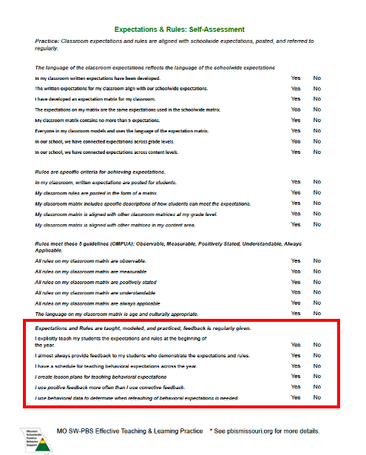
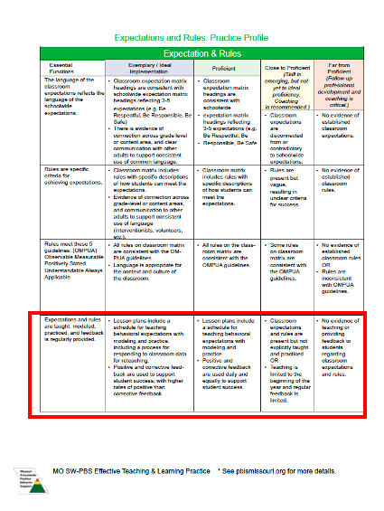
Activity: Classroom Rules and Expectations Practice Profile
You can use your Self-Assessment answers, in conjunction with the Expectations & Rules Practice Profile as a mechanism to assess your current implementation of Expectations and Rules in YOUR classroom.
Notes:
Trainer Notes:
To Know/To Say: You can use your Self-Assessment answers, in conjunction with the Expectations & Rules Practice Profile as a mechanism to assess your current implementation of Expectations and Rules in YOUR classroom, and as feedback for ongoing adjustments or celebrations of your implementation efforts.

Slide 41
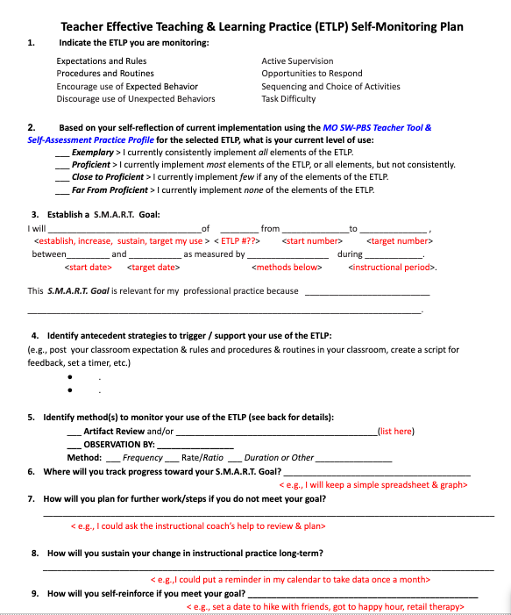
Effective Teaching and Learning Practices – Self monitoring plan
Notes:
Trainer Notes
To know/To say:
Finally, recall the Teacher ETLP Self-Monitoring Plan - Template shared in Lesson 2 Systems for ETLPs to help you create an implementation and self-monitoring plan for each of the 8 ETLPs.
Use the template offered, or one provided by your building leadership team, to now formally plan for your implementation and self-monitoring of Classroom Expectations & Rules in your classroom.

Slide 42
Picture of teacher in front of the class
Notes:
Trainer Notes
To know/To say:Remember the predictability of the classroom is a key to fostering student self-determination. By having clear and consistent expectations and rules that are taught with fidelity, consistency and equity you will increase student confidence and competence to be a successful classroom participant.
sense of relatedness to you and their classmates and their
sense of autonomy to work independently within your classroom setting.
Based on your Self-Assessment and Rating on the Practice profile, and the plan you developed using the Teacher ETLP Self-Monitoring Plan, what are your next steps for utilizing the powerful tools of Expectations and Rules , for creating a safe, efficient, effective and productive classroom environment?

Slide 43
Closing/Next Steps
Next steps include :
Use the Classroom Expectations & Rules Planning & Implementation Guide
Develop classroom expectations and rules into a matrix that aligns with school/districtwide expectations and rules.
Develop a plan to consistently teach and provide feedback to students on classroom expectations and rules as needed for fluency of expected behaviors.
Use the Expectations and Rules Self-Assessment and Practice Profile to monitor your development and use of classroom expectations and rules.
Additional information about developing and implementing classroom expectations and rules can be found in the MO SW-PBS Handbook² and the Tier 1 Implementation Guide.⁸
Notes:
Trainer Notes:
To Know/To Say: During this lesson INDIVIDUALS learned:
the language of the classroom expectations reflects the language of school / districtwide expectations.
classroom rules are the behaviors that demonstrate the expectations specific criteria for meeting expectations.
classroom rules should meet the 5 guidelines of OMPUA (observable, measurable, positively stated, understandable, always applicable).
classroom expectations and rules must be taught, modeled, and practiced; feedback is regularly given.
how to develop classroom expectations and rules and establish a system to consistently teach and reinforce these expectations and rules.
how to self monitor the implementation of classroom procedures and routines with fidelity, consistency and equity.
Next steps for INDIVIDUALS include:
Use the Classroom Expectations & Rules Planning & Implementation Guide
Develop classroom expectations and rules into a matrix that aligns with school/districtwide expectations and rules.
Develop a plan to consistently teach and provide feedback to students on classroom expectations and rules as needed for fluency of expected behaviors.
Use the Expectations and Rules Self-Assessment and Practice Profile to monitor your development and use of classroom expectations and rules.

Slide 44
References
Brophy, J. (1998). Motivating students to learn. Boston: McGraw Hill.
Brophy, J. & Evertson, C. (1976). Learning from teaching: A developmental perspective. Boston, MA: Allyn and Bacon.
Everston, C. M., & Emmer, E. T. (1982). Preventive classroom management. Alexandria, VA: Association for Supervision and Curriculum Development.
Good, T. J., & Brophy, J. (2000). Looking into classrooms (8th Ed.) New York, NY: Longman Press.
Johnson, T. C., Stoner, G. & Green, S. K. (1996). Demonstrating the experimenting society model with classwide behavior management interventions. School Psychology Review, 25(2), 199-214.
Missouri Schoolwide Positive Behavior Support (2019). Missouri Schoolwide Positive Behavior Support Handbook.
Missouri Schoolwide Positive Behavior Support (2019). Missouri Schoolwide Positive Behavior Support Tier 1 Implementation Guide.
Scott, T., Hirn., R. and Cooper, J. (2017). Teacher and student behaviors: Keys to success in classroom instruction. Rowman & Littlefield.
Notes:
Trainer Notes:
To Know/To Say:

Slide 45
Contact Information
Check Out MO SW-PBS on Social Media:
Facilitator Contact Information:
pbismissouri.org
facebook.com/moswpbs
@MOSWPBS

