Slide 1
T1C8L2 Systems to Support ETLPs
Tier 1 Effective Teaching & Learning Practices
(ETLPs) for the Classroom
Notes:
Trainer Notes:
To Know/To Say: Welcome to Lesson 2 MO SW-PBS of the Effective Teaching & Learning or ETLP series. This lesson describes the tools and processes for supporting INDIVIDUALS in the implementation of Effective Teaching and Learning Practices (ETLPs). Using the Self-Assessments and Practice Profiles provided for each of the ETLPs, the LEADERSHIP TEAM will reflect on a plan for training, coaching, and providing feedback to support teachers. This lesson is most applicable for LEADERSHIP TEAMs.

Slide 2
Working Agreements
Be Respectful
Be an active listener—open to new ideas
Use notes for side bar conversations
Be Responsible
Be on time for sessions
Silence cell phones—reply appropriately
Be a Problem Solver
Follow the decision making process
Work toward consensus and support decisions of the group
Notes:
Trainer Notes: To Know/To Say: “These will be the Working Agreements we will honor during all our training sessions this year.”

Slide 3
Attention Signal
Notes:
Trainer Notes: Select an attention signal.
To Know/To Say: “One of our agreements is to follow the attention signal.”
“Your team will work with your school to develop an attention signal you will use in every setting.”
“In order to get all of you focused after discussions, activities or breaks,
I will ________________________________________.”
(Insert your attention signal here.)
“Your task will be to finish your sentence, quiet your voice and ____________________________.”
(Insert what you want participants to do.)

Slide 4
Introductions
Notes:
Trainer Notes Select an introductions activity.
To Know/To Say:

Slide 5
Handouts
MO SW-PBS Classroom ETLP Teacher Tools*
T1C8L2 HO1. Teacher ETLP Self-Monitoring Plan
T1C8L2 HO1. for Planning Professional Learning Supports
*ETLP Teacher Tools are found within each of the 8 lessons.
Notes:
There are several handouts that will be referenced during this lesson. If you have not downloaded them from the lesson website, please pause the video while you access these documents.
*Note there are 8 different Teacher Tools, one for each Effective Teaching and Learning Practice or ETLP. These are available with course materials and online at PBISmissouri.org.

Slide 6
Lesson Outcomes
At the end of this session, you will …
Understand the logic of multi-tiered approach to teacher professional learning and support.
Become familiar with the MO SW-PBS Classroom Effective Teaching and Learning Practices Teacher Tools that include Self-Assessments and Practice Profiles, and how the self-assessments can help teachers and leadership teams set goals and determine professional development priorities
Become familiar with the Teacher ETLP Self Monitoring Planning Guide which walks individual teachers through making their own plan for professional growth.
Learn the components a leadership team needs to put in place to provide coordinated, organization wide high-quality professional development (HQPD).
Notes:
Trainer Notes:
To Know/To Say By the end of this lesson, participants will ….

Slide 7
Rationale
Notes:
Years of educational research has shown that in classrooms where ETLPs are consistently in use, students are less likely to demonstrate unexpected behaviors² and more likely to achieve greater levels of academic success³. However, for students in high-risk schools, the evidence suggests that teachers historically tend to have the lowest use of ETLPs⁴.
Given the relatively low rates of ETLP implementation in general, and for students deemed high-risk in particular, education is calling for more robust systems of professional learning, including elements of training, teacher self-monitoring, coaching and feedback. These systems must include opportunities for collaboration and dialog, to support sustainable professional learning^{1,}.⁵.
A key component for sustainable professional learning that is sometimes overlooked is meaningfully engaging all teachers in the process. It is important for teachers to set goals, make plans to self-monitor, and participate in professional dialogs.

Slide 8
Missouri Teacher Standards Addressed
2.1: Cognitive, social, emotional and physical development
2.6: Language, culture, family and knowledge of community
3.1: Implementation of curriculum standards
5.1: Classroom management, motivation and engagement
5.2: Managing time, space, transitions and activities
5.3: Classroom, school and community culture
6.1: Verbal and nonverbal communication
6.2: Sensitivity to culture, gender, intellectual and physical differences
8.1: Self-assessment and improvement
8.2: Professional learning
Notes:
Trainer Notes:
To know/To say: These are the Missouri Teacher Standards that will be addressed in this lesson. If you want more information regarding these standards visit DESE.MO.GOV

Slide 9
Pre-Requisites
Pre-Requisites
Knowledge of The Science of Behavior (completion of at least ONE of the courses / access to resources below):
MO SW-PBS Handbook - Function Based Thinking
MO SW-PBS Online Course -
Foundations - Science of Behavior
Effective Teaching & Learning Practices Course
Lesson 1: Overview of the 8 Classroom ETLPs
Notes:
Trainer Notes:
To Know/To Say:
Knowledge of The Science of Behavior (completion of at least ONE of the courses / access to resources below):
MO SW-PBS Handbook - Function Based Thinking
MO SW-PBS Online Course -
Foundations - Science of Behavior
Lesson 1: is an Overview of the 8 Classroom ETLPs. provides a broad overview of the classroom ETLPs and how they parallel schoolwide work defining, and teaching expected behaviors and then providing performance feedback. If you are either a classroom teacher or a leadership team member and have not yet engaged with that lesson, pause this video and do so now.

Slide 10
Reflection Question
Does your district / school have a plan to offer differentiated training and support to all teachers in growth of knowledge around and capacity to deliver evidence based instructional practices?
If yes, is the plan implemented universally with fidelity, consistency and equity?
Does your district / school provide tools to all teachers for reflection and self-monitoring of professional growth?
Notes:
Does your district / school have plan to offer differentiated training and support to all teachers in growth of knowledge around and capacity to deliver evidence based instructional practices?
If yes, is the plan implemented universally with fidelity, consistency and equity?
Does your district / school provide tools to all teachers for reflection and self-monitoring of professional growth?

Slide 11
Keywords
Self-Assessment
Practice Profile
Didactic Teaching / Training
Notes:
To Know/To Say: Here are key terms and acronyms that will be used in this lesson.
Self-Assessment: a tool designed to be used by teachers and teacher teams to gauge the depth of their implementation of selected effective teaching and learning practices.
Practice Profile: A framework developed by the National Implementation Research Network (NIRN) as a way of outlining criteria using a rubric structure with clearly defined practice-level characteristics.
Didactic Teaching / Training : Didaktikos is a Greek word that means "apt at teaching."
Define the concept
Model the concept
Offer practice opportunities & provide feedback
Test knowledge of concept

Slide 12
Based on observation in 6,752, K-12 classrooms.
Based on observation in 6,752, K-12 classrooms.
Notes:
To ensure students receive the support they need, we must offer teachers the training, support, and feedback necessary to support implementation of the Effective Teaching and Learning practices, or ETLPs.
In a multi-year study, Terry Scott and colleagues observed 6,752 classrooms (Pre-K – 12), in schools considered high-risk to low risk, across numerous content areas, and in classrooms with diverse teacher and student populations¹. The commonality across all classrooms was the generally low level of implementation of teaching and learning practices with large effect sizes.

Slide 13
Effective Teaching & Learning Practices (aka ETLPs)
Classroom Expectations & Rules
Classroom Procedures & Routines
Classroom Encouraging Expected Behavior
Classroom Discouraging Unexpected Behavior
Classroom Active Supervision
Classroom Opportunities to Respond
Classroom Activity Sequencing & Choice
Classroom Task Difficulty
Notes:
Trainer Notes:
To Know/To Say: One efficient and effective way to get teachers engaged in professional learning is offer them a limited set of evidence based instructional practices that are applicable across grade levels and content domains and can easily be interleaved with academic instruction to provide robust classroom instruction. MO SW-PBS offers 8 Effective Teaching and Learning Practices (ETLPs) which have been shown to increase instructional time and improve student engagement.
Classroom Expectations & Rules
Classroom Procedures & Routines
Classroom Encouraging Expected Behavior
Classroom Discouraging Unexpected Behavior
Active Supervision
Opportunities to Respond
Activity Sequencing & Choice
Adjusting Task Difficulty

Slide 14
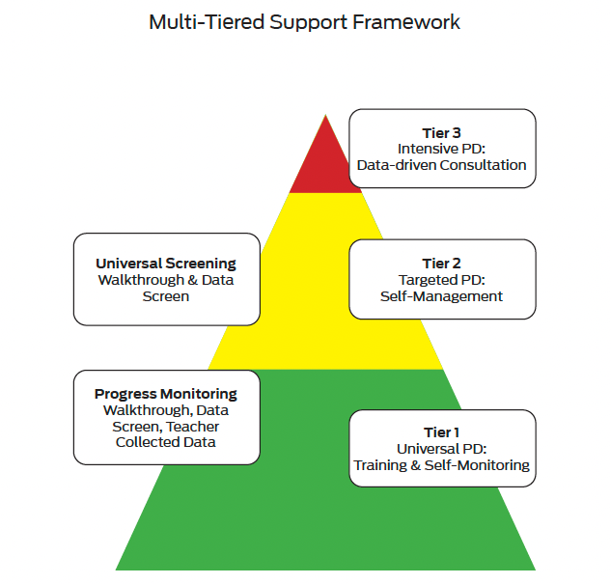
Multi-Tiered Support Framework
(Simonsen, et al., 2014)
Notes:
One of the most important roles of the district or building LEADERSHIP TEAM is to provide quality professional learning activities that engage teachers in each step of the process. We have already discussed how teachers can use the MO SW-PBS ETLP Teacher Tool Self-Assessment and Practice Profiles for self reflection and how the Teacher ETLP Self- Monitoring Plan can walk a teacher through the steps of goal setting and self-monitoring.
Simonsen et al. (2014)⁶ offer a professional learning model to provide efficient methods to enhance teachers' use of ETLPs while engaging teachers in learning and self-reflection. This model is based on the same prevention theory and science of behavior that form the foundation of SW-PBS.
Arrow > Universal PD for all teachers should include brief, direct training on an ETLP, offer resources for the teachers to self-monitor, record one’s own behavior, and a process for ongoing feedback.
Arrow > Progress monitoring takes place in the form of classroom observation and feedback for all instructional staff. This also offers a process to determine which staff may require more support to become fluent in the ETLP. All staff who are identified as fluent continue a process of ongoing or periodic self-monitor to sustain their implementation fidelity, consistency and equity.
Arrow > A new cycle of Targeted support, in the form of additional training, feedback and progress monitoring for some teachers commences with those who are not yet demonstrating fluency of implementation with the selected ETLP. Teachers who demonstrate improved fidelity after receiving targeted support shift to ongoing self-monitoring.
Arrow > Finally the leadership team will implement a cycle of Individualized support for a few teachers who continue to demonstrate a need for ongoing support, while all others maintain fluency w/ self-monitoring.
For the sake of brevity, this lesson will focus on providing systems planning for Universal PD training and self-monitoring for all teachers and organizational Progress Monitoring for the ETLPs. Look to the pbismissouri.org website for more information on Tier 2 Targeted PD with self-management and tier 3 Intensive PD and learning supports.

Slide 15
Graphic of chicken and egg
Notes:
The Multi-Tiered Support Framework for Teachers begins with Tier 1 Universal PD which may pose a potential chicken or the egg issue.
If buildings or the entire district are all new to SW-PBS the leadership team may opt to take an approach that begins with Universal PD for All, then have All Teachers Self-Assess and Set Goals, conduct classroom walk-throughs in all classrooms and analyze collated data to determine next steps.
If on the other hand some or all buildings in a district have been working to implement SW-PBS for some time, the leadership team may decide to provide brief reviews of a few targeted ETLP, then ask All Teachers to Self-Assess and Set Goals, conduct classroom walk throughs are completed and data are collated and analyzed to determine next steps in buildings considered veteran to the SW-PBS work, while providing a more comprehensive or universal approach in buildings that are new to SW-PBS .
This lesson will take the approach that the majority of buildings are new to SW-PBS and the district begins with Universal PD Training for ALL instructional staff. The scope of this lesson will be training, self-assessment and individual teacher goal setting along with a process to utilize data to identify organizational priorities from self-assessment and other available data..

Slide 16
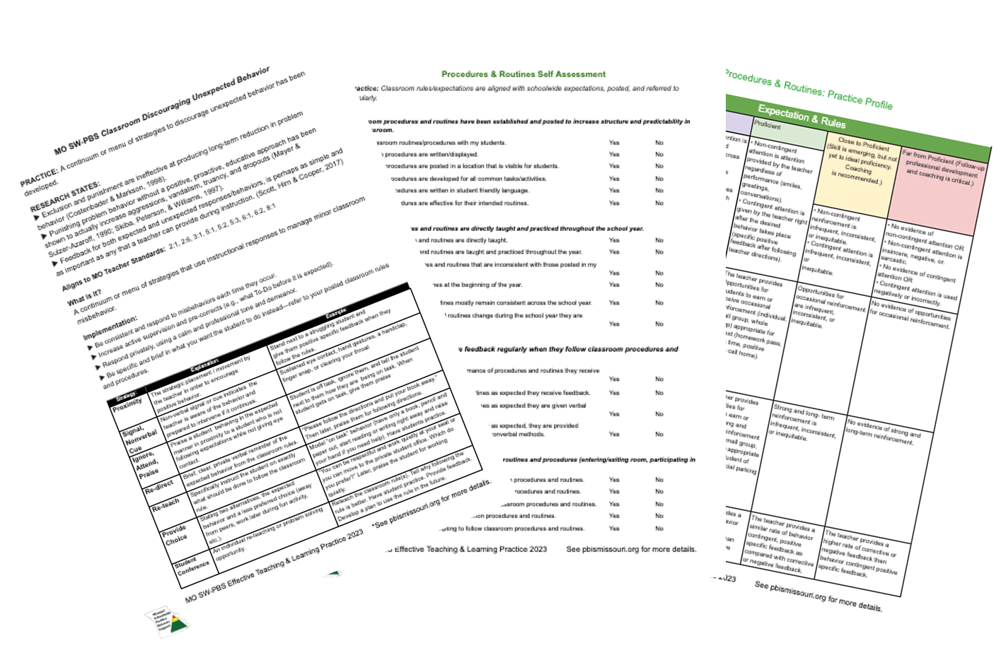
Woman on megaphone
Notes:
The first steps in a districtwide or buildingwide Universal PD approach are to establish organizational expectations. Clear is kind and before embarking on comprehensive process to support the implementation of the ETLPs the organization should establish and communicate leadership team expectations for
learning and implementation by all instructional staff including planning for and protecting time for both training and expected post-learning activities.
procedures to identify a districtwide or buildingwide ETLP of focus, the potential desired student outcome, and determine the evidence that will be used to measure progress toward the goal.
At timestamp *:**, do CHECKLIST .jpg
completion of Self-Assessment (SA) and Practice Profiles.
systems for ongoing self-monitoring.
At timestamp *:**, do BINOCULARS .jpg
classroom walkthrough observations.
standard procedures to collect and collate Self Assessment and walk-through data,
At timestamp *:**, do DBDM .jpg
standard procedures to analyze SA and walk-through data
At timestamp *:**, do Bullhorn .jpg
standard procedures to communicate de-identified SA and walkthrough results to teachers (e.g., district wide, building wide or collaborative team levels or rates).

Slide 17
Universal PD Training
Define the concept
Model the concept
Offer practice opportunities & provide feedback
Test knowledge of concept
Notes:
At a minimum, Simonsen and colleagues indicate that all teachers need a universal dose or session of Didactic Teaching or Training on the instructional practices they are expected to deliver to ensure there is no ambiguity regarding what the practice is and is not. Didactic stems for the Greek word Didaktikos that means "apt at teaching” and within the Multi-tiered support Framework for teachers at the UNIVERSAL Level, the following steps are suggested:
Define the concept
Model the concept
Offer practice opportunities & provide feedback
Test knowledge of concept
The lesson materials that MO SW-PBS has developed offer clear definitions of each practice and walk the teacher through any pre-implementation planning necessary and suggest ways to practice. Each lesson also includes directions for teachers to utilize the MO SW-PBS Teacher Tools associated with the target ETLP, which offer practitioners an opportunity to “test” their knowledge and implementation of the ETLPs. Anyone interested can establish a free account for the website.

Slide 18
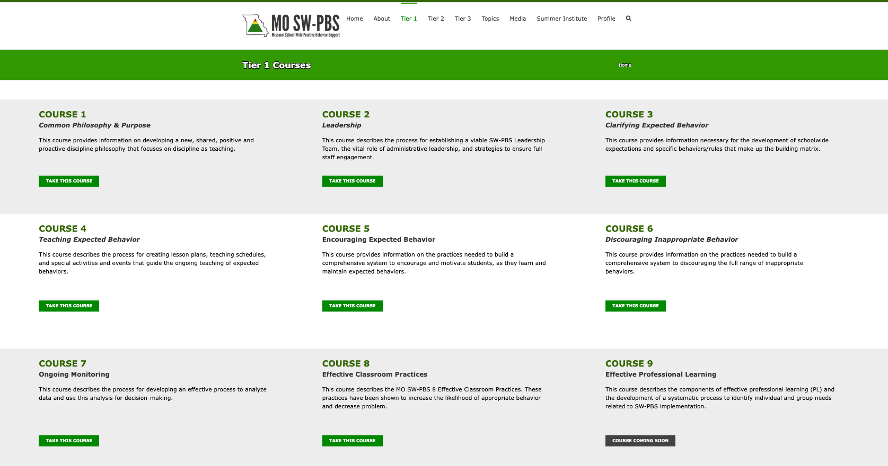
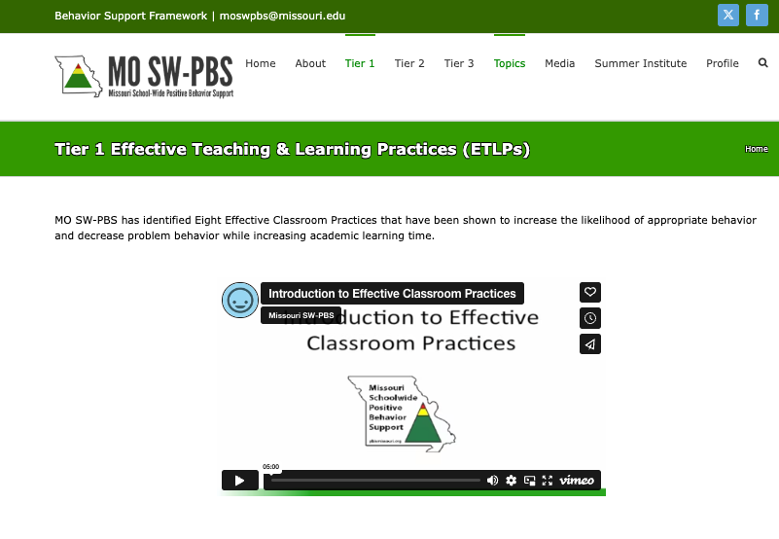
Tier 1 Courses
Notes:
Universal PD > Training
Planning all details of a Universal Professional Development process is beyond the scope of this single lesson.
The focus of the remainder this lesson will be to create awareness of the resources MO SW-PBS has developed to assist leadership teams in planning and delivering training and ongoing support for the implementation of the ETLPs. We will also provide some tips specific to organizational efficiency in the planning process.
At timestamp *:**, do
Insert Star at Course 9 > To learn more about a comprehensive PD process see Effective Professional Development Course in the Tier 1 Course section of the webpage https://pbismissouri.org/tier-1-courses/
At timestamp *:**, do
Insert Star at Course 8 > It is on this same page that you will also be able to access self-paced online video lessons for each of the ETLPs.
At timestamp *:**, do
MO SW-PBS has also developed ETLP course and lesson materials for teams to use for professional development activities. These can be found on the ETLP section of their website. https://pbismissouri.org/tier-1-effective-classroom-practices/

Slide 19
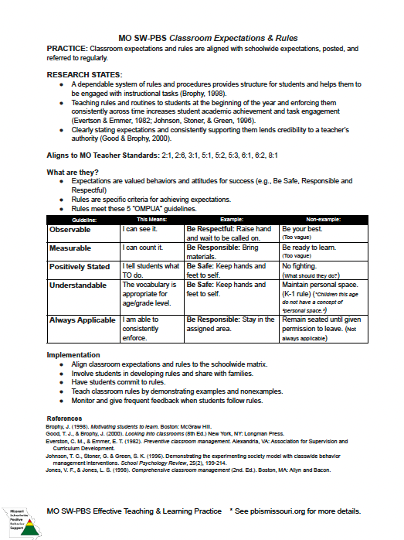
MO SW-PBS Teacher Tool
Practice
Research States
MO Tchr Stand
What are they?
Implementation
References
Notes:
For each ETLP there is a MO SW-PBS Classroom ETLP Teacher Tool that serves 3 distinct functions. These Teacher Tools are available within each lesson’s materials and online at PBISmissouri.org. Let’s take a deeper look at one to understand how to use them to support a professional learning continuum.
Transcript
Each MO SW-PBS Classroom Expectations and Rules Teacher Tool provides individual teachers with several resources to understand the importance of, provide tips for drafting and metrics to progress monitor their development and use of classroom ETLPs.
At timestamp *:**, do… insert arrow next to PRACTICE:
The first 2 pages of each Teacher Tool defines the practice,
At timestamp *:**, do… insert arrow next to RESEARCH STATES
shares research regarding the practice,
At timestamp *:**, do… insert arrow next to Aligns to…
indicates how the practice aligns to Missouri Teacher Standards,
At timestamp *:**, do… insert arrow next to What are they?
describes an example of the practice,
At timestamp *:**, do… insert arrow next to IMPLEMENTATION
provides steps and examples of how to implement the practice,
At timestamp *:**, do… insert arrow next to REFERENCES
and lists research references for further study.

Slide 20
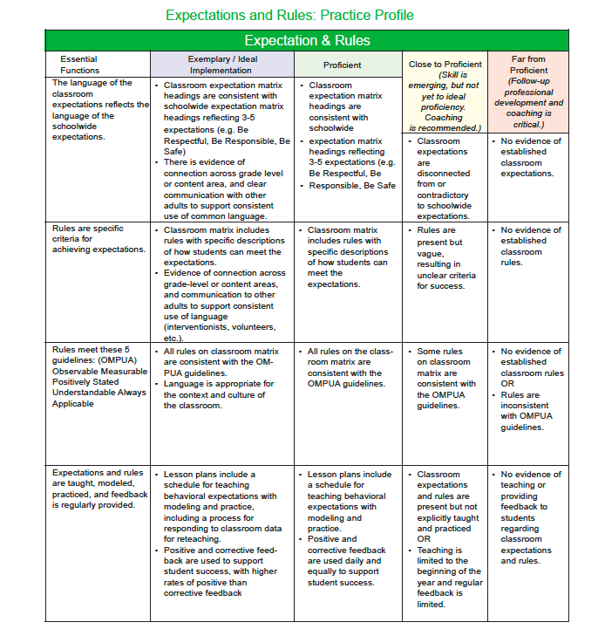
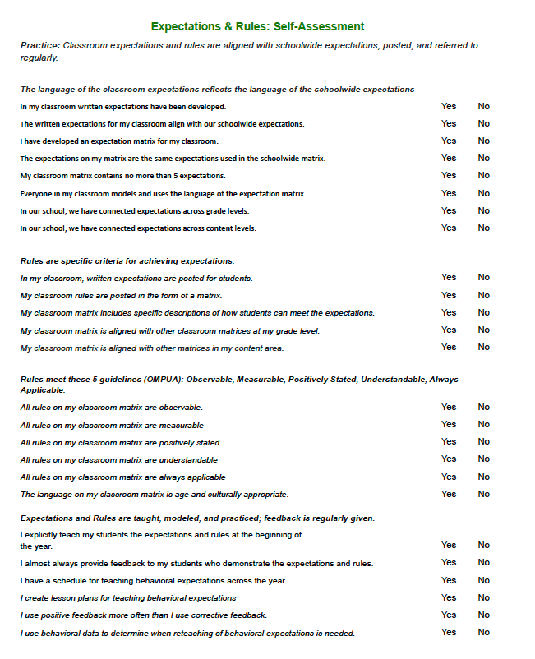
Universal PD - Self Monitoring
Notes:
Practice Profiles have been developed for each ETLP. They outline expectations for the skills and knowledge that should be learned, practiced, and steps taken to prepare to deliver the ETLP with fidelity, consistency and equity. Criteria for the Essential Functions of each ETLP is described with specific information regarding how a practice should look when applied in context. Educators are able to assess their own current levels of knowledge, skills, and abilities relative to each ETLP.
Self Assessment questionnaires are developed for each ETLP to provide a method of determining where along the Practice Profile rubric an individual or group feels they align most closely to the criteria. Each Self Assessment includes the Essential Functions which in turn each have several descriptor stems that the user self-rates.
Selecting a focus ETLP and / or progress monitoring implementation will be dependent on the data available to the leadership team. A leadership team can use the teacher self-assessment and practice profile ratings data to drive decision making if the establish a process for teachers self-report their ratings:
First, teachers use the self-assessment stems to reflect upon their current implementation of the Essential Functions of the ETLP and use their collective self-assessment ratings for each Essential Function in order to select their perceived Implementation level (Exemplary / Ideal, Proficient, Close to Proficient or Far From Proficient).

Slide 21
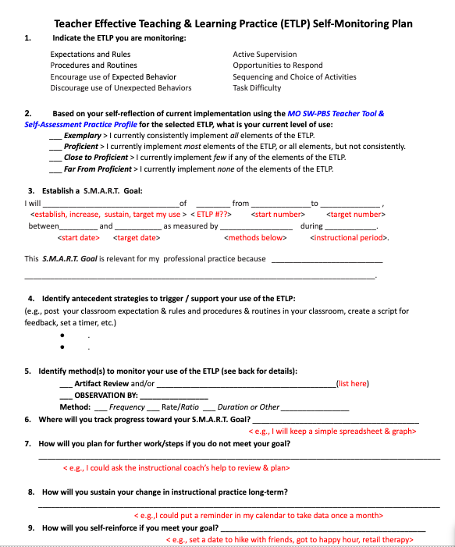
Teacher ETLP Self-Monitoring Plan
Notes:
From their Self-Assessment and Practice Profile ratings, teachers can set plans to improve or sustain their implementation of the ELTPs as an individually motivated process, or as part of districtwide or buildingwide improvement process. The Teacher ETLP Self-Monitoring Plan is intended to help teachers go step-by-step to create an implementation and self-monitoring plan for each of the 8 ETLPs.
We will briefly walk through each of the 9 steps.
Step 1 The teacher indicates the ETLP they are targeting for implementation and monitoring. The ETLP can be self-selected or assigned as part of a comprehensive district or school level improvement process.
Tchr-ETLP-SMP-Step2.jpg
Step 2 the teacher indicates their overall self-rating based on the corresponding ETLP Self-Assessment and Practice Profile.
Tchr-ETLP-SMP-Step3.jpg
Step 3 the teacher establishes a SMART Goal that is
Specific,
Measurable,
Achievable,
Relevant, and
Time-Bound
first using the prompts and then if desired rewording into a straight forward or restated SMART Goal.
Tchr-ETLP-SMP-Step4.jpg
Step 4 the teacher identifies for themselves possible antecedent strategies that will serve as cues that the time is right to implement the SMART Goal to either improve or sustain implementation of the ETLP with fidelity, consistency and equity.
Tchr-ETLP-SMP-Step5.jpg
Step 5 the teacher identifies ways to monitor the use of the ETLP in the expected manner in real time. more information on methods to monitor are on the backside of the plan and will be discussed in just a few minutes.
Tchr-ETLP-SMP-Step6.jpg
Step 6 prompts the teacher to consider where they will keep track of their self-monitoring data and ultimately their progress towards their goal. Some data options will be easily documented in a spreadsheet, while others are contemplative and better suited to narrative reflection.
Tchr-ETLP-SMP-Step7.jpg
Step 7 directs the teacher to consider action steps if their progress towards the goal is not proceeding at a pace or in the direction desired.
Tchr-ETLP-SMP-Step8.jpg
Step 8 prompts the teacher to consider how to sustain implementation with fidelity, consistency and equity long term once they meet the SMART Goal.
Tchr-ETLP-SMP-Step9.jpg
Step 9 encourages the teacher to consider how they might self-reinforce for meeting the SMART Goal. Teachers should ponder a reinforcer that is not a daily habit, but something that they would consider a “treat” or a “bonus” in their everyday life. This could include making time for a “Happy Hour” event with friends that could be a walk, visit to a museum or other activity of collective interest.

Slide 22
Team making a decision
Notes:
Once the teacher has set a SMART goal, considered antecedent strategies to prompt their implementation, a decision needs to be made on HOW the ETLP implementation will be monitored and WHO will be enlisted to assist them in the monitoring process.
Depending upon your leadership team’s approach this may be something that is mandated for all, at the discretion of each individual or somewhere in between.
A short primer on ETLP monitoring will be shared here, for more information on monitoring see the Professional Learning Course.

Slide 23
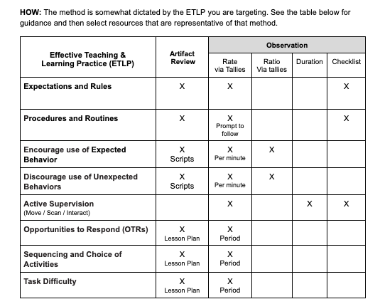
Monitoring implementation of the ETLPs
Notes:
The method for monitoring implementation is somewhat dictated by the ETLP the teacher is targeting. methods for monitoring implementation include:
Artifact review > for example, has the teacher documented their classroom expectations and rules, classroom procedure & routines? Have they spent time alone or with a team writing possible scripts for providing positive specific feedback and/or corrective feedback statements that align with their content area and development level of their students? Do lesson plans indicate Opportunities to Respond, options for activity sequencing and choice and variety of difficulty levels?
Rate Tallies > are applicable in the implementation of all 8 ETLPs. Does the teacher refer to expectations, demonstrate or provide feedback on the use of procedures, deliver feedback, engage in active supervision?
Ratios > can be calculated from tallies of Positive Specific Feedback to Corrective Feedback.
Duration > the length of time the teacher engages in the instructional practice is most applicable during Active Supervision.
Checklists > can be an option for documenting the evidence of or implementation of all 8 ETLPs.
See the table on page 2 of the Teacher Self-Monitoring Plan for guidance and then select resources that are representative of that method.

Slide 24
Method of documenting implementation
Notes:
Once the method for monitoring has been selected based on the target ETLP, consider how to help the teachers plan for who might assist them in this effort. Some methods lend themselves to independent monitoring while others might require a trusted colleague or an impartial observer assigned by the leadership team to function as the observer.
Self-monitoring: using tallies, or a golf stroke counting device
Video Taping: set up a small recording device and select a specific period to record for review
Student monitors: ask students to tally the number of OTRs or positive and negative feedback statements
Collegial Peer Observation: work within your grade level team, department, or with administrators to identify a peer who can come and conduct a non-evaluative observation during a specified time, using the method and target ETLP you choose.

Slide 25
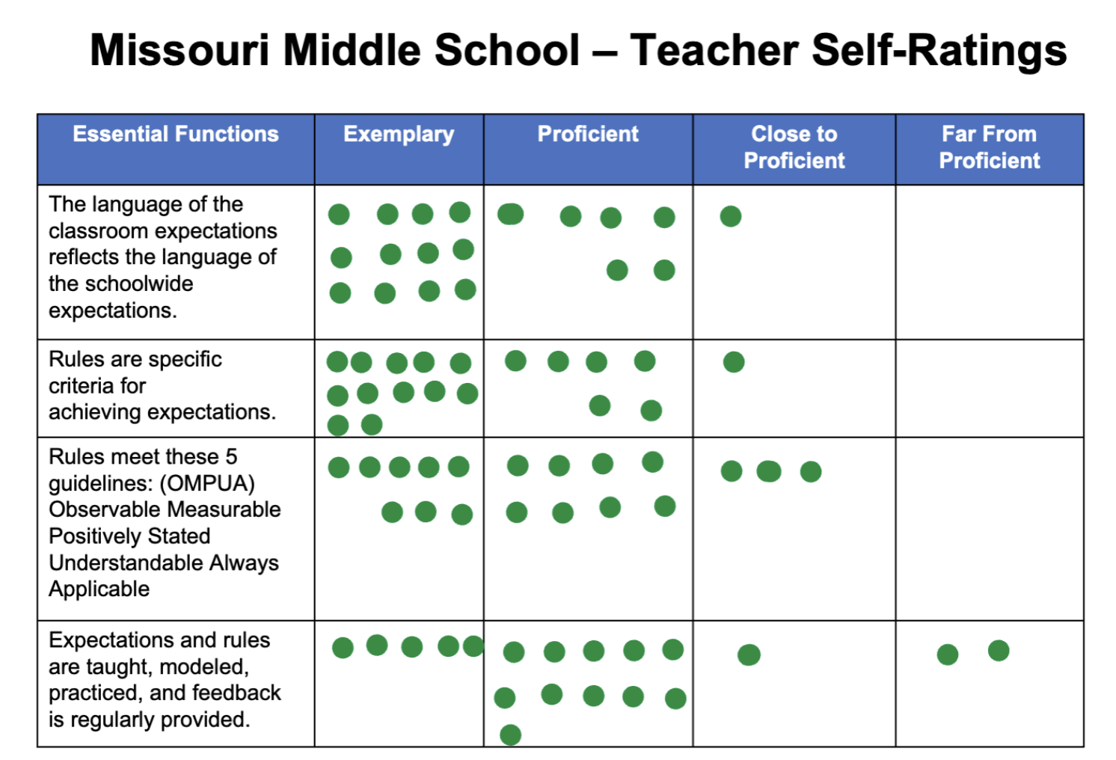
Missouri Middle School – Teacher Self-Ratings
Classroom Expectations & Rules
Essential Functions | Exemplary | Proficient | Close to Proficient | Far From Proficient
The language of the classroom expectations reflects the language of the schoolwide expectations.
Rules are specific criteria for achieving expectations.
Rules meet these 5 guidelines: (OMPUA) Observable Measurable Positively Stated Understandable Always Applicable
Expectations and rules are taught, modeled, practiced, and feedback is regularly provided.
Notes:
Selecting a focus ETLP and / or progress monitoring implementation will be dependent on the data available to the leadership team. A leadership team can use the teacher self-assessment and practice profile ratings data to drive decision making if the establish a process for teachers self-report their ratings:
First, teachers use the self-assessment stems to reflect upon their current implementation of the Essential Functions of the ETLP and use their collective self-assessment ratings for each Essential Function in order to select their perceived Implementation level (Exemplary / Ideal, Proficient, Close to Proficient or Far From Proficient).
Next, teachers report their self-rated implementation level for each Essential Function so that an aggregate perception of implementation can be assessed.
ANIMATION
This aggregation of self-ratings could be done in a Google Survey, with sticky dots on chart paper, or a method of the DLT or BLTs choosing. Depending upon the size of the buildings and district this aggregation can begin in collaborative or departmental teams, at the BLT or DLT level.

Slide 26
Alignment of SAS 4.0 & ETLPs
SAS 4.0 Classroom Items | ETLPs
1. Behavioral Expectations | Classroom Expectations & Rules
2. Procedures & Routines | Classroom Procedures & Routines
3. Feedback & Acknowledgement | Classroom Encouraging Expected Behavior
4. Response to Behavior | Classroom Discouraging Unexpected Behavior
5. Active Supervision | Active Supervision
6. Actively Engage Students | Opportunities to Respond
7. Differentiated Instruction | Activity Sequencing & Choice
8. Academic Success | Adjusting Task Difficulty
Notes:
Leadership teams can also use the aggregate self-rating data in conjunction with Classroom Items on the Self-Assessment Survey (or SAS) 4.0 (available free to schools from PBISApps.org) that all
MO SW-PBS participating schools are strongly encouraged to complete.

Slide 27
Missouri Middle School SAS 4.0 Classroom Items
Notes:
Here is a report for Missouri Middle School after they completed the SAS 4.0 Classroom Items.

Slide 28
Activity: Practice with Example Data
Notes:
Review the data Missouri Middle School has at their fingertips at this point:
Teacher Self Ratings on the Classroom Expectations & Rules Practice Profile
SAS 4.0 Classroom Items.
Consider what the Missouri Middle School team might want to focus on after having provided the Universal Professional Development for Classroom Expectations & Rules and receiving teacher Practice Profile self-ratings and generating an aggregate report of the Self-Assessment Survey or SAS 4.0 Classroom Items?

Slide 29
Setting up ahead of time
Notes:
The ETLPs are organized in a somewhat linear fashion and we recommend for first time groups that they begin with Expectations & Rules and complete the entire series in order. As the leadership team plans to deliver the direct training they should ahead of time:
Set date, time and location for professional learning.
Consider the best modality for training including offering some resources as flipped instructional “pre-activities”.
Gather training materials and resources.
Send pre-meeting information including date, time, location information and instructions for any expected pre-activities to all participants.

Slide 30
Leadership Team Data
What additional data or information does your leadership team have readily at your fingertips?
Patterns of unexpected classroom managed or minor behaviors in the classroom.
Patterns of Office Discipline Referrals (ODRs).
Student academic performance.
Observation of instructional practices (including the ETLPs) identified as a priority for delivery at the districtwide, schoolwide, grade level, or content area.
Current rate or ratio of positive to corrective feedback.
Frequency and quality of current Opportunities to Respond (OTRs).
Notes:
Using data from a variety of sources can provide the leadership team with a well-rounded set of information from which to identify needs for all, some or just a few teachers in terms of training or coaching needed.
What additional data might a Leadership Team use to prioritize the selection of the focus ETLP or to progress monitor implementation efforts buildingwide or districtwide? Consider adding the following, typically available data to your leadership team decision-making process:
Patterns of unexpected classroom managed or minor behaviors in the classroom.
Office Discipline Referrals (ODRs).
Student academic performance.
Observation of instructional practices (including the ETLPs) identified as a priority for delivery at the districtwide, schoolwide, grade level, or content area.
Current rate or ratio of positive to corrective feedback.
Frequency and quality of current Opportunities to Respond (OTRs).

Slide 31
Next steps for your Leadership Team include:
Consider data you already have available to identify teacher support needs, and plan how to integrate Self-Assessment results to help inform decision-making.
Establish systems & tools for teachers to self-assess and/or receive observation feedback
Use the current Data Collection and PD Schedule to Allocate time for
teacher self-assessment & BLT DBDM cycles
PD for all teachers, begin with
Selected ETLP
Use of the Teacher Self-Monitoring Plan
Engage in cycles of PD, implementation, data collection & analysis while providing levels of support needed as indicated by analysis
Notes:
Next steps for your Leadership Team include:

Slide 32
References
Hofmeister, A. M., & Lubke, M. (1990). Research into practice: Implementing effective teaching strategies.
Reinke, W.M., Herman, K.C., & Stormont, M. (2013). Classroom-level positive behavior supports in schools implementing SW-PBIS: Identifying areas for enhancement. Journal of Positive Behavior Interventions, 15(1), 39-50.
Scheuermann, B. K. and Hall, J. A. (2008). Positive behavioral supports for the classroom. Upper Saddle River, NJ: Pearson Merrill Prentice Hall.
Scott, T. M., Hirn, R., & Cooper, J. (2017). Teacher and student behaviors: Keys to success in classroom instruction. Rowman & Littlefield.
Simonsen, B., MacSuga-Gage, A. S., Briere III, D. E., Freeman, J., Myers, D., Scott, T. M., & Sugai, G. (2014). Multitiered support framework for teachers’ classroom-management practices: Overview and case study of building the triangle for teachers. Journal of Positive Behavior Interventions, 16(3), 179-190.
Sprick, R., Knight, J., Reinke, W. & McKale, T. (2006). Coaching classroom management: Strategies and tools for administrators and coaches. Eugene, OR: Pacific Northwest Publishing.
Stichter, J. P., Lewis, T. J., Johnson, N., & Trussell, R. (2004). Toward a structural assessment: Analyzing the merits of an assessment tool for a student with E/BD. Assessment for Effective Intervention, 30(1), 25-40.
Sugai, H., Horner, R. H. & McIntosh, K., 2018. Multi-Tiered Systems of Behavior Support, Implementing PBIS at Scales of Social Significance. OSEP Center on Positive Behavior Interventions & Support
Walberg, H. (1988). Synthesis of research on time and learning. Educational Leadership 45(6), 76-85.
Notes:
Trainer Notes:
To Know/To Say: Here are the references for this lesson. If more references are needed, you can refer to the Reference section in the Missouri SW-PBS Tier 1 Implementation Guide available on the Missouri SW-PBS website.

Slide 33
Contact Information
Contact Information
Facilitator Contact Information:
Email:
Phone:
pbismissouri.org
facebook.com/moswpbs
@MOSWPBS
Notes:
This lesson was made possible with funds from the Missouri Department of Elementary and Secondary Education, Division of Special Education; the Center on Positive Behavior Interventions and Supports and the University of Missouri Center for Schoolwide Positive Behavior Support.

