Slide 1
T1C8L1 OVERVIEW
Tier 1 Effective Teaching & Learning Practices
(ETLPs) for the Classroom
Notes:
Trainer Notes:
To Know/To Say: Welcome to Lesson 1 MO SW-PBS of the Effective Teaching & Learning or ETLP series. This lesson introduces the Classroom Effective Teaching and Learning Practice (ETLPs) for behavior. These eight instructional practices have been shown to decrease unexpected behavior and increase academic learning time.

Slide 2
Working Agreements
Be Respectful
Be an active listener—open to new ideas
Use notes for side bar conversations
Be Responsible
Be on time for sessions
Silence cell phones—reply appropriately
Be a Problem Solver
Follow the decision making process
Work toward consensus and support decisions of the group
Notes:
Trainer Notes: To Know/To Say: “These will be the Working Agreements we will honor during all our training sessions this year.”

Slide 3
Attention Signal
Notes:
Trainer Notes: Select an attention signal.
To Know/To Say: “One of our agreements is to follow the attention signal.”
“Your team will work with your school to develop an attention signal you will use in every setting.”
“In order to get all of you focused after discussions, activities or breaks,
I will ________________________________________.”
(Insert your attention signal here.)
“Your task will be to finish your sentence, quiet your voice and ____________________________.”
(Insert what you want participants to do.)

Slide 4
Introductions
Notes:
Trainer Notes Select an introductions activity.
To Know/To Say:

Slide 5
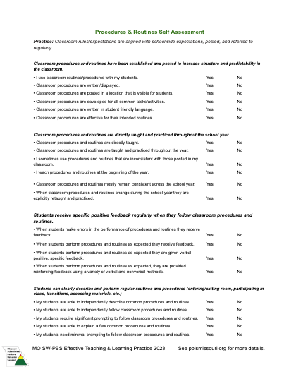
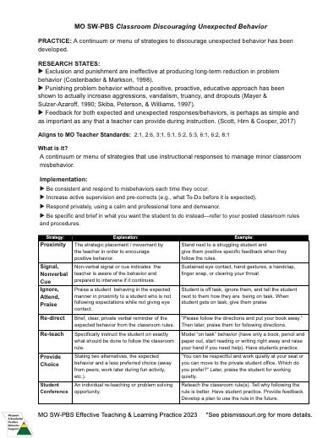
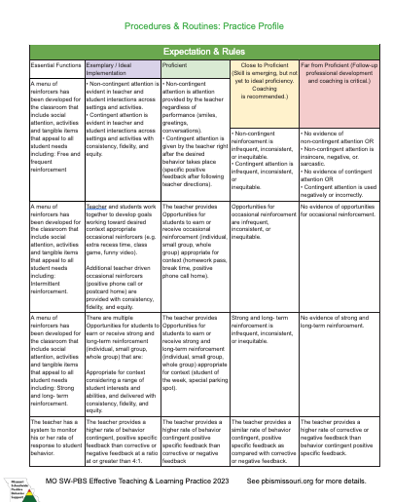
MO SW-PBS Teacher Tools
Notes:
Trainer Notes:
To Know/To Say: There are a number of resources available that are related to the ETLP course. While this lesson does not have any specific handouts, participants might be interested in reviewing the MO SW-PBS Classroom ETLP Teacher Tools developed for each of the 8 ETLPs to become more familiar with these resources as they provide a framework for professional learning, teacher self reflection and monitoring of each practice, and a practice profile for use as a self-rating scale.
In addition, each ETLP lesson will have a corresponding planning and implementation guide, and there is a Teacher ETLP Self-Monitoring Planning Guide that can be used with all 8 ETLs. These are available with course and lesson materials and online at PBISmissouri.org.

Slide 6
Lesson Outcomes
At the end of this session, you will be able to…
Explain to others the power of positive and proactive strategies in establishing an effective classroom learning environment.
Understand and access the 8 ETLPs Lessons and Materials available for professional learning and implementation support.
Notes:
Trainer Notes:
To Know/To Say By the end of this lesson, participants will be able to ….
Explain to others the power of positive and proactive strategies in establishing an effective classroom learning environment.
Understand and access the 8 ETLPs Lessons and Materials available for professional learning and implementation support.

Slide 7
Quote by Terrance Scott
“Teaching provides an impact on probability (of student success) and the selection of high-probability teaching behaviors must be seen as a sacred responsibility.”
Terrance Scott, Ph.D. (2017)
Notes:
Trainer Notes:
To Know/To Say:Throughout this course, participants will not only learn more about relevant research pertaining to high-probability teaching behaviors aka ETLPs, they will be taken step by step through a series of activities to develop systems to support as well as individual steps to plan for, implement and self monitor each one.

Slide 8
Missouri Teacher Standards Addressed
2.1: Cognitive, social, emotional and physical development
2.6: Language, culture, family and knowledge of community
3.1: Implementation of curriculum standards
5.1: Classroom management, motivation and engagement
5.2: Managing time, space, transitions and activities
5.3: Classroom, school and community culture
6.1: Verbal and nonverbal communication
6.2: Sensitivity to culture, gender, intellectual and physical differences
8.1: Self-assessment and improvement
8.2: Professional learning
Notes:
Trainer Notes:
To know/To say: These are the Missouri Teacher Standards that will be addressed in this lesson. If you want more information regarding these standards visit DESE.MO.GOV

Slide 9
Knowledge of The Science of Behavior (completion of at least ONE of the courses / access to resources below):
MO SW-PBS Handbook - Function Based Thinking
Tier 1 Implementation Guide - Encouraging Expected Behavior
MO SW-PBS Online Course -
Foundation - Science of Behavior
Tier 1 - Encouraging Expected Behavior
Pre-Requisites
Notes:
Trainer Notes:
To Know/To Say: There are several courses and lessons that will be beneficial for you to complete before you begin this lesson.
The Clarifying Expected Behaviors Course focuses on defining schoolwide expectations and rules, and understanding the schoolwide expectations and rules in the building will inform the work on classroom rules and expectations.

Slide 10
Reflective Question
Has your district articulated a limited set of evidence based instructional practices that all teachers from kindergarten through high school should use with fidelity, consistency and equity to increase student engagement and success?

Slide 11
Teacher Interacting with Students
Notes:
Trainer Notes:
To Know/To Say: This overview lesson introduces the Classroom Effective Teaching and Learning Practice (ETLPs) for Behavior, sometimes also referred to as Effective Classroom Practices (ECPs) in some of the historic training videos and resources. These practices have been shown to increase efficiency, predictability and structure in classrooms, increase expected behavior and student engagement, decrease unexpected behavior and increase academic learning time. This lesson provides a rationale for classroom ETLPs and provides a brief overview of the course.

Slide 12
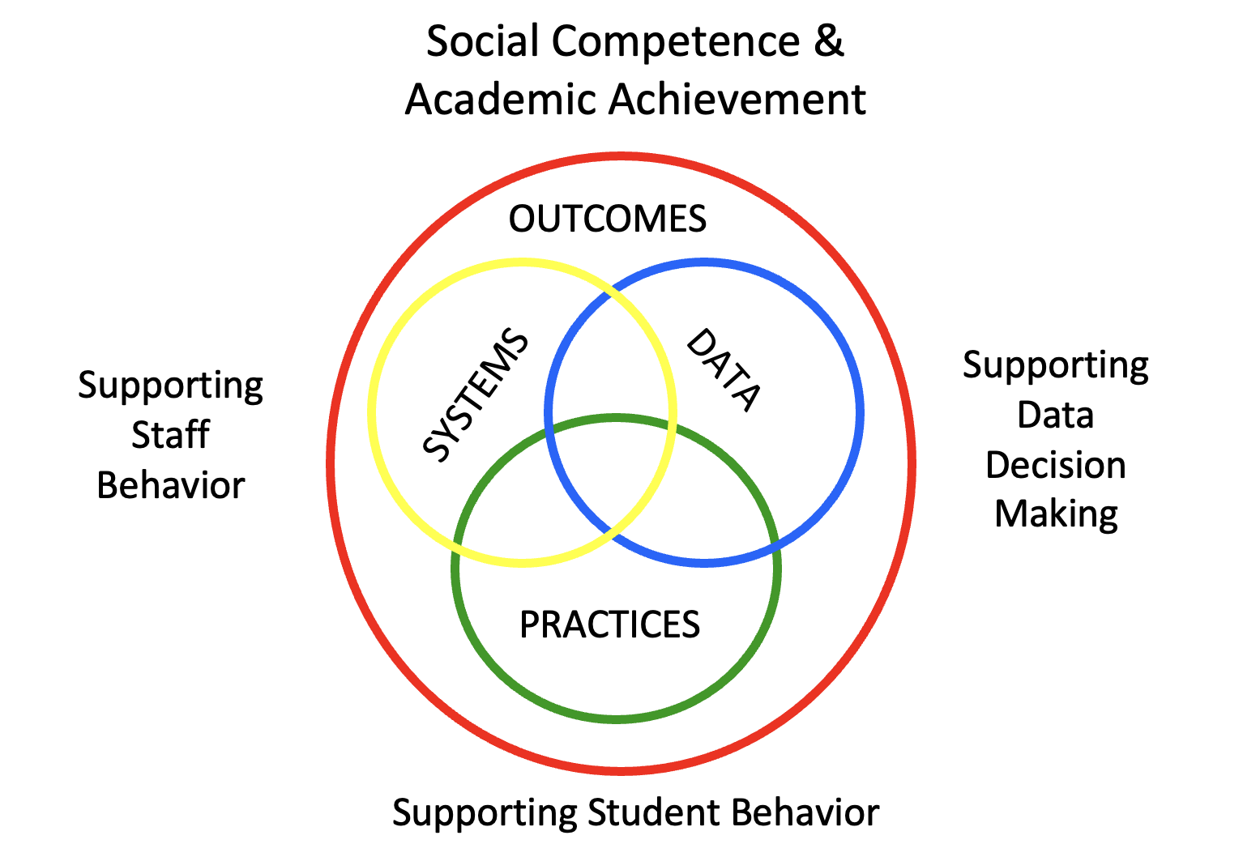
National Center on PBIS 4 Part Framework
Notes:
Trainer Notes:
To Know/To Say: Lesson 2 Systems for Supporting the Implementation of ETLPs course is geared toward building leadership teams (BLTs) and district leadership teams (DLTs) and gives a broad overview of how to plan the Systems, Data and Practices for professional learning activities related to the ETLPs, thereby increasing the likelihood for achieving organizational student outcome goals. Lesson 2 will also have extra resources for the BLT or DLT to plan training and coaching support specific to each of the 8 ETLPs. Lessons 3-10 describe each of the 8 ETLPs in detail and are geared for individual classroom teachers.

Slide 13
Keywords
Effective Teaching and Learning Practices (ETLPs)
Passive Engagement
Active Engagement
Notes:
To Know/To Say: Here are key terms and acronyms that will be used in this lesson.
Effective Teaching and Learning Practices: The research-based practices demonstrated to increase the likelihood of expected behavior and decrease unexpected behavior, while increasing academic learning time.
Passive Engagement: a teacher is “instructing” but no specific question or task has been posed, the student is attentive and doing what is expected at that time in instruction. For example a student is seated with eyes on the teacher.
Active Engagement: a student has been given a specific question or task and is responding either verbally or nonverbally. For example a student is asked to work a math problem independently and they do so.

Slide 14
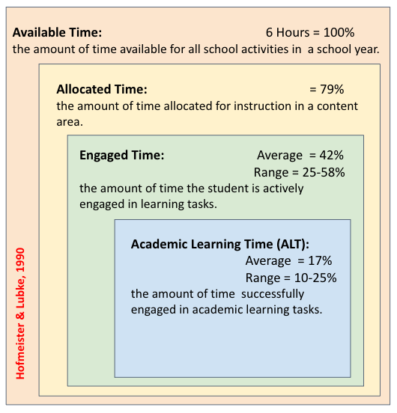
Hofmeister & Lubke (1990) Instructional Time
Notes:
Trainer Notes:
To Know/To Say: Why are the classroom ETLPs so critical? Take a look at the graphic describing classroom time management by Hofmeister & Lubke (1990). They broke down time for instruction in the following manner:
CLICK > animates the arrows They defined Available Time as the amount of time available for all school activities in a school year, typically 6 hours per day.
CLICK > animates the arrows
They defined Allocated Time as the amount of time allocated for instruction in a content area. Taking into account lunch, assemblies, announcements, bathroom breaks, transitions and in some instances recess, they proposed 79% of a 6 hour day.
CLICK . Animates the arrows
They defined Engaged Time as the amount of time the student is actively engaged in learning tasks. Characterized as writing, listening to the teacher, or answering questions. The authors posited that 50% of teacher time was instructional and the other 50% was spent arranging students for instruction, orienting students to the learning task and dealing with disruptive behavior. CLICK > animates the arrows
Finally, they defined Academic Learning Time or ALT as the amount of time spent by a student engaged in academic learning tasks, in which there are few errors and where the task is directly related to an academic learning outcome (Romberg, 1980). The average and range for ALT of 10-25% was cited from an often referenced article by Fisher and colleagues in 1980.

Slide 15
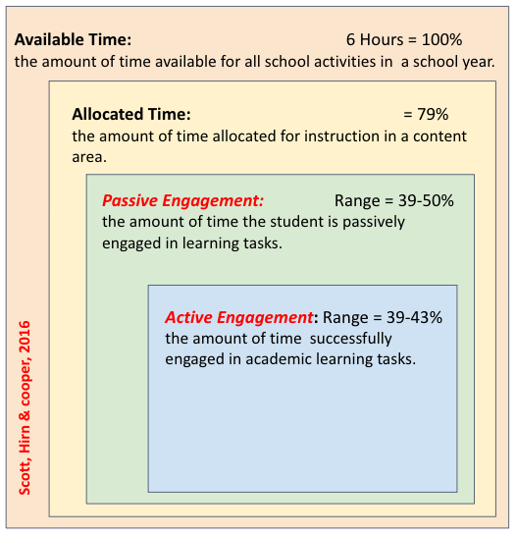
Scott, Hirn and Cooper (2016) Instructional Time
Notes:
Trainer Notes:
To Know/To Say: In a more recent large-scale study in over 6,500 classrooms some 30 years later by Scott, Hirn and Cooper (2016), found more promising student engagement data. Scott (who coined the term high-probability teaching) and colleagues used slightly different terms, with Engagement being separated into two distinct types:
CLICK > animates the arrows
Passive engagement, when a teacher is “instructing” but no specific question or task has been posed, and the student is attentive and doing what is expected at that time in instruction. Their range for passive engagement was 39-50%.
CLICK > animates the arrows
Active engagement, when a student has been given a specific question or task and is responding. Their range for active engagement was 39-43%.

Slide 16
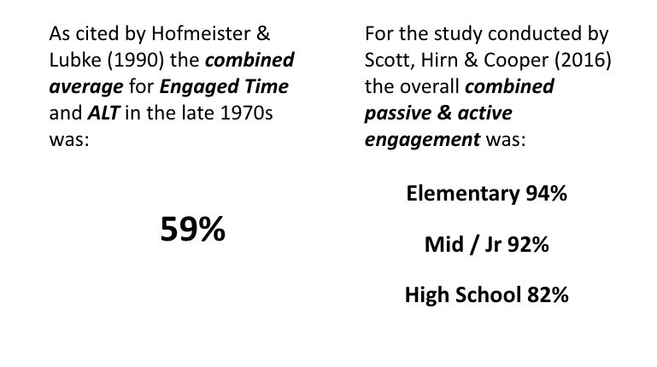
ALT Compared to ALL Engaged Time
Notes:
Trainer Notes:
To Know/To Say: In swapping out Engaged Time for Passive Engagement and swapping out Academic Learning Time or ALT for Active Engagement in the model proposed by Hofmeister and Lubke, the more recent study data on classroom instruction looks more promising.
When comparing studies of student classroom engagement 30 years or more apart, there is a significant difference in average rates of engagement, with potential improvement noted. However, it is important to note that the passive engagement of students was still 39-50%. This indicates that while there may have been improvements in terms of the amount of overall engaged time, there are opportunities to improve the actively engaged time of students in all grade levels. The Classroom ETLPs are proposed as strategies to do just that.

Slide 17
Effective Teaching & Learning Practices (aka ETLPs)
Classroom Expectations & Rules
Classroom Procedures & Routines
Classroom Encouraging Expected Behavior
Classroom Discouraging Unexpected Behavior
Classroom Active Supervision
Classroom Opportunities to Respond
Classroom Activity Sequencing & Choice
Classroom Task Difficulty
Notes:
Trainer Notes:
To Know/To Say: Here are the 8 Effective Teaching and Learning Practices or ETLPs that MO SW-PBS strongly encourages all teachers to implement with fidelity, consistency and equity.
Classroom Expectations & Rules
Classroom Procedures & Routines
Classroom Encouraging Expected Behavior
Classroom Discouraging Unexpected Behavior
Classroom Active Supervision
Classroom Opportunities to Respond
Classroom Activity Sequencing & Choice
Classroom Task Difficulty Lets break these down a bit more.

Slide 18
Passive Engagement
Classroom Expectations & Rules
Classroom Procedures & Routines
Classroom Encouraging Expected Behavior
Classroom Discouraging Unexpected Behavior
= Passive Engagement (Teacher Instruction)
Notes:
Trainer Notes:
To Know/To Say: In the first 4 ETLPs …are practices that impact passively engaged time–the proportion of time allocated for instruction that actually results in teaching or instruction to which the student is attentive in the expected manner.
In many classrooms a lack of clear procedures and routines, disruptive student behavior, and lengthy transitions contribute to significantly diminished instructional or passively engaged time. An effective classroom manager will clarify the behaviors needed to be successful in each classroom setting or activity, teach and review those expected behaviors routinely, acknowledge students being successful, and provide immediate, objective correction when behavior does not meet expectations.

Slide 19
Active Engagement
Classroom Active Supervision
Classroom Opportunities to Respond
Classroom Activity Sequencing & Choice
Classroom Task Difficulty
= Active Engagement (Student Responding))
Notes:
Trainer Notes:
To Know/To Say: The final four practices include: 1) active supervision 2) opportunities to respond 3) sequencing and choice of activities and 4) task difficulty.
These practices positively impact active engaged time, that proportion of instructional time where students are actively engaged in learning as evidenced by responding frequently and accurately, completing work, and interacting in expected ways with peers about assigned work.
Together these eight practices impact academic learning time (think passive and most importantly active engagement) and ultimately student achievement while ensuring a positive learning environment. They represent facets of classroom teaching under the teacher’s control that have been identified as evidence-based practices to maximize learning for all students while minimizing discipline problems.
Implementation of all eight of these ETLPs by ALL classroom teachers is critical to the success of SW-PBS at the classroom level.

Slide 20
ABCs of Beahvior
Notes:
Trainer Notes:
To Know/To Say:The majority of the Classroom Effective Teaching and Learning Practices (ETLPs) act as antecedents;
CLICK > STAR
meaning they set the stage, or trigger, expected behaviors and maximize the probability of student academic and behavioral success.
CLICK STAR
In addition, some of the practices function as consequences, or the resulting event or outcome that occurs immediately following the behavior and impacts future occurrence of the behavior. Consequences serve to either increase or decrease behavior.

Slide 21
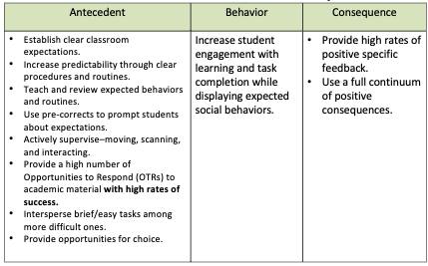
A-B-C Example
Notes:
Trainer Notes:
To Know/To Say: Establishing clear classroom expectations, increasing predictability through clear procedures and routines, actively supervising, providing high rates of opportunities to respond, using activity sequencing and offering choice, and adjusting task difficulty support increased student engagement, task completion, and learning. All of these evidence-based practices serve as antecedent interventions and maximize the probability of expected student behaviors occurring and recurring.
Using a full continuum of positive consequences to reinforce expected behaviors, as well as creating and implementing a continuum of strategies to discourage unexpected behavior demonstrates the power of consequence interventions in the classroom.

Slide 22
Supporting Student Needs
Self-Determination Theory has identified 3 primary human needs that help individuals to grow their internal motivation:
Competence
Autonomy
Relatedness
Notes:
Trainer Notes:
To Know/To Say: Recall from the Science of Behavior Course, which is referenced as a suggested pre-requisite for the ELTPs Course , ALL humans have 3 primary needs to support their self-determination and internal motivation: competence, autonomy and relatedness.
When teachers thoughtfully plan for and consistently deliver both antecedent and consequence practices, this instructional sequence sets the stage for a well-managed, positive classroom environment. In addition, these instructional practices also increase the predictability of the classroom, fostering student self-determination. When teacher leverage the power of the ETLPs by planning for and then implementing them with fidelity, consistency and equity they all increase student
confidence and competence to be a successful classroom participant.
sense of relatedness to you and their classmates and their
sense of autonomy to work independently within your classroom setting.

Slide 23
Pause & Reflect - Administrator
If you are an administrator, consider the following:
What strategies are teachers consistently using to increase passively engaged time?
What strategies are teachers consistently using to increase actively engaged time?
How do you know?
Notes:
Pause & Reflect
If you are an administrator, consider the following:
What strategies are teachers consistently using to increase passively engaged time?
What strategies are teachers consistently using to increase actively engaged time?
How do you know?

Slide 24
Pause & Reflect – Classroom Teacher
If you are a classroom teacher, consider the following:
What do you currently do to support passively engaged time?
What do you currently do to ensure uninterrupted actively engaged time?
How consistent is your use of these practices?
How do you know?
Notes:
Pause & Reflect
If you are a classroom teacher, consider the following:
What do you currently do to support passively engaged time?
What do you currently do to ensure uninterrupted actively engaged time?
How consistent is your use of these practices?
How do you know?

Slide 25
Summary of Stitcher, Lewis, Johnson & Trussell study from 2004
(Stichter, Lewis, Johnson, & Trussell, 2004)
Notes:
Trainer Notes:
To Know/To Say: Throughout the ETLP course teachers will be challenged to investigate not only their plans for, but more importantly their delivery of the evidence based practices with fidelity, consistency and equity. A single subject study illustrates the importance of this concept and provides support for the need of self-monitoring and reflection of all instructional staff.
Eli was a second-grade student who already had an IEP for emotional and behavioral disorders (EBD) and was taking medication for ADHD. His teacher had volunteered to be part of a study investigating the impact of ETLP delivery, having identified Eli as a student who might need a re-evaluation of his IEP. The teacher was asked to complete documents articulating their expectations & rules in the form of a matrix, and her classroom routines.
(Stichter, Lewis, Johnson, & Trussell 2004)

Slide 26
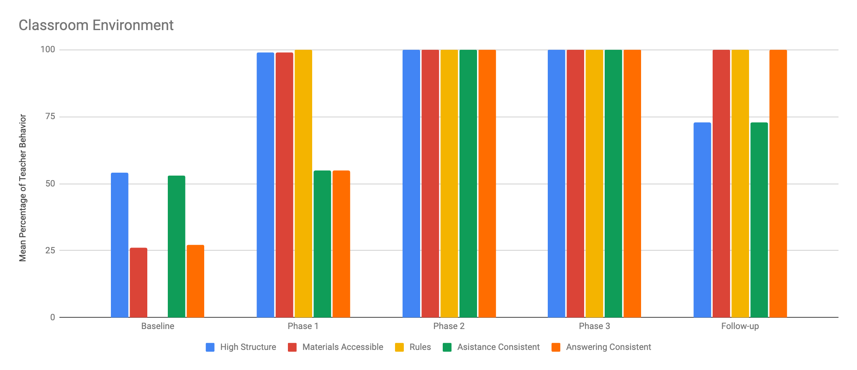
Graph of Classroom Variables Over Time
Notes:
Trainer Notes:
To Know/To Say:The study involved phases or levels of observation and feedback on teacher instructional practices which were grouped as high structure, materials available, rules visible, assistance consistent, and teacher expectations for answering questions consistent.
During the baseline phase the teacher had only 2 of 5 areas at the 50% level observed. After receiving a first round of feedback the teacher increased their classroom structure, materials available and rules visible to 100%. After the second round of feedback the teacher was able to bring the delivery of all 5 areas to 100% and maintained this delivery over time. During the 3 days of follow-up observation several weeks later the teacher’s delivery of the 5 areas did dip.
(Stichter, Lewis, Johnson, & Trussell 2004)

Slide 27
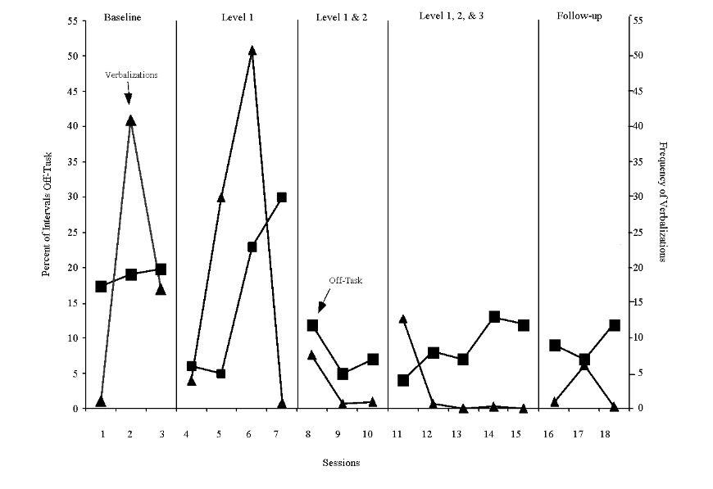
Graph of student behavior over time.
Notes:
Trainer Notes:
To Know/To Say:During the corresponding observation periods, you can see Eli demonstrating high
levels of variability in his off-task behavior which ranged from 5-30% with an average close to 20% of the time. He had verbalizations that ranged from 0 to 50 in one instructional hour. Once the teacher became consistent in classwide expectations, rules and procedures and enforced expectations for seeking assistance or answering questions in whole group that applied with fidelity, consistency and equity to all students, Eli’s out of turn verbalizations had dropped to near 0 and his off-task behavior dropped to an average of less than 10%. What Eli, and most students, not just students with specialized needs, require to be successful is a classroom where teachers deliver their plan for effective classroom management with fidelity, consistency and equity. Self-monitoring and periodic feedback from an external agent can help teachers make their intentions a day-to-day reality for themselves and their students. This course intended to provide the resources so that teachers can successfully accomplish this goal.
(Stichter, Lewis, Johnson, & Trussell 2004)

Slide 28
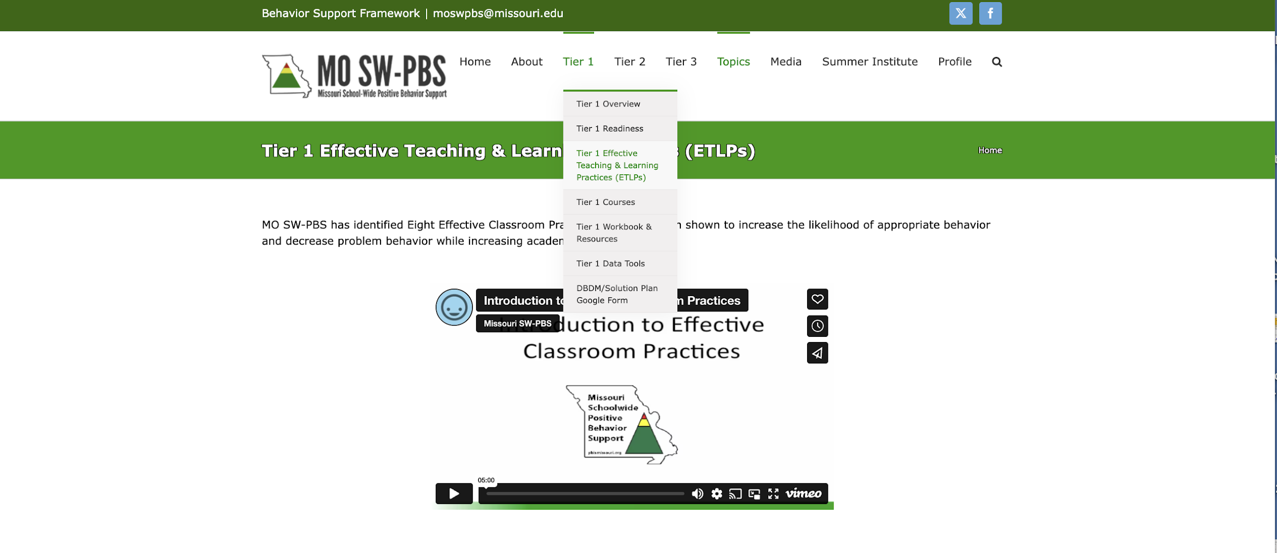
PBISMissouri.org
Notes:
Visit the MO SW-PBS website at pbismissouri.org
CLICK
Select Tier 1 along the top menu.
CLICK
Select Tier 1 Effective Teaching & Learning Practices
There you will find training materials and resources for each of the 8 ETLPs. For the first 4 ETLPs you will find video examples taken in Missouri classrooms of teachers demonstrating the ETLPs.

Slide 29
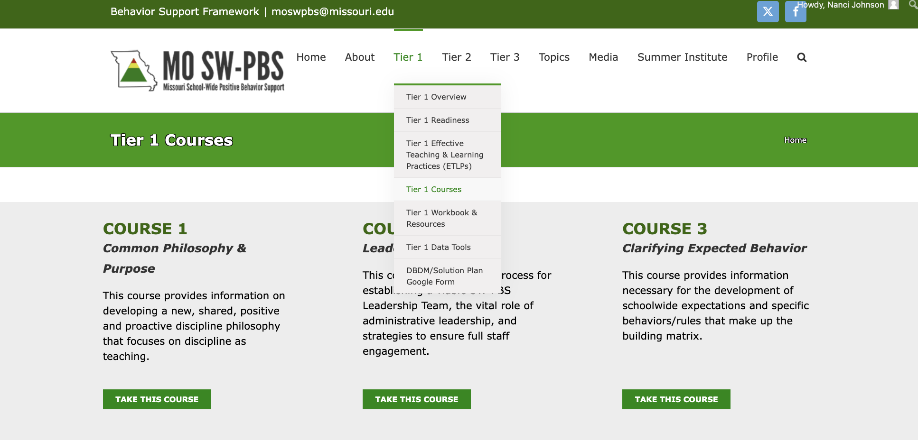
PBISMissouri.org – Access Courses
Notes:
Trainer Notes:
To Know/To Say: Alternatively,
“CLICK”
Select Tier 1 Courses and scroll down to access online courses that can be accessed by individuals or groups for on demand versions of the course ppts available on the ETLP section of the website.
“CLICK” While all courses are free, we do ask those who have access to create a user profile so that we can track without names how often users log in, start or course or complete pre/post tests and where they are from.

Slide 30
Group of adults gathered around data.
Notes:
Trainer Notes:
To Know/To Say:The next lesson, Lesson 2 in this course, is designed primarily for collaborative team (CT), building LEADERSHIP TEAM(BLT) and/or district LEADERSHIP TEAM (DLT) aka Leadership Team, to guide planning for the organizational systems necessary for implementation of training, coaching, data collection and reporting components to progress monitor as an INDIVIDUAL or as the Leadership Team.
Your job will be to use data to identify which ETLPs ALL instructional staff need to learn more about and/or improve the fidelity , consistency or equity of their implementation. Next your team will need to develop organizational systems to provide the support necessary to move each member closer to the agreed upon goal.

Slide 31
Adult reflecting on their instructional practice.
Notes:
Trainer Notes:
To Know/To Say:The remaining 8 lessons will cover the Classroom Effective Teaching and Learning Practices for Behavior in more detail, providing description and implementation features of each practice. These lessons will walk participants step by step through developing resources for implementation and self-monitoring with fidelity, consistency and equity.
Teachers can investigate these ETLPs as an individual, as part of a community of practice (or CoP) or as part of a building or district comprehensive school improvement effort. The first 4 practices are somewhat linear, and participants are encouraged to engage in them in order.

Slide 32
Teacher sitting at Table with students.
Notes:
Trainer Notes:
To Know/To Say:Recall
classroom expectations
classroom procedures and routines
classroom encouraging expected behaviorclassroom discouraging unexpected behavior
CLICK - Animation are intended to increase passive engagement / teacher instructional time.

Slide 33
Teacher in computer lab with students.
Notes:
Trainer Notes:
Know/To Say: While
active supervision
opportunities to respond
sequencing and choice of activities
task difficulty.
CLICK - Animation
are intended to increase student active engagement and student responding.

Slide 34
Rob Horner Quote
District
“unit of implementation”
Building
“unit of
analysis”
Classroom
Student
“unit of impact”
~ Horner, 2016
Notes:
https://safesupportivelearning.ed.gov/sites/default/files/05_MTSS-B-Implement_2018-01-04.pdf
Trainer Notes:
To Know/To Say: What we have learned from Rob Horner, co-founding partner of the Center for PBIS, is that…
‘While students remain the “unit of impact, and schools are the “unit of analysis,” districts are the “unit of implementation,” and remain the key structure for achieving scaled and sustained effects.’
What SYSTEMs can your district IMPLEMENT across the organization to increase the likelihood that all buildings MONITOR the districtwide implementation of ETLPs with fidelity, consistency and equity by all instructional staff?
What academic and social behavioral outcomes can we anticipate for all students if in each classroom there is a teacher who is sufficiently trained and supported to DELIVER the ETLPs with fidelity, consistency and equity?
Reference no need to read. (Sugai, H., Horner, R. H. & McIntosh, K., 2018. Multi-Tiered Systems of Behavior Support, Implementing PBIS at Scales of Social Significance: OSEP Center on Positive Behavior interventions & Support)

Slide 35
Closing/Next Steps
Notes:
Trainer Notes:
To Know/To Say:During this lesson, you learned how to …
Explain to others the power of positive and proactive strategies in establishing an effective classroom learning environment.
Access the 8 ETLPs Lessons and Materials available for professional learning and implementation support.

Slide 36
Next steps for your Leadership Team include:
Plan for strategies to engage all individual classroom teachers in understanding the need to establish, implement, self-reflect and sustain their classroom instructional practices. Lesson 2 Classroom systems for ETLPs, will provide a framework and tools to make your plan.
Use the results of the PBIS Self-Assessment Survey (SAS) to gain perspective from all staff, and results from the PBIS Tiered Fidelity Inventory (TFI) to gain perspective from your Building Leadership Teams. This data in conjunction with classroom walkthroughs will help your organization identify where to begin.
Notes:
Trainer Notes:
To Know/To Say: Next steps for your Leadership Team include:
Plan for strategies to engage all individual classroom teachers in understanding the need to establish, implement, self-reflect and sustain their classroom instructional practices. Lesson 2 Classroom systems for ETLPs, will provide a framework and tools to make your plan.
Use the results of the PBIS Self-Assessment Survey (SAS) to gain perspective from all staff, and results from the PBIS Tiered Fidelity Inventory (TFI) to gain perspective from your Building Leadership Teams. This data in conjunction with classroom walkthroughs will help your organization identify where to begin.

Slide 37
Next steps for individual teachers include:
Reflect on your current level of knowledge and use of proactive instructional practices to increase instructional time and student engagement. The MO SW-PBS ETLP Teacher Tools are one strategy for self reflection.
Investigate the MO SW-PBS website to learn more about the depth and breadth of resources available for your personal learning.
Notes:
Trainer Notes:
To Know/To Say: Next steps for individual teachers include: Reflect on your current level of knowledge and use of proactive instructional practices to increase instructional time and student engagement. The MO SW-PBS ETLP Teacher Tools are one strategy for self reflection.
Investigate the MO SW-PBS website to learn more about the depth and breadth of resources available for your personal learning.
Additional information about establishing ETLPs in your district, school or classroom can be found in the
MO SW-PBS Handbook
Tier 1 Implementation Guide

Slide 38
References
Hofmeister, A. M., & Lubke, M. (1990). Research into practice: Implementing effective teaching strategies.
Reinke, W.M., Herman, K.C., & Stormont, M. (2013). Classroom-level positive behavior supports in schools implementing SW-PBIS: Identifying areas for enhancement. Journal of Positive Behavior Interventions, 15(1), 39-50.
Scheuermann, B. K. and Hall, J. A. (2008). Positive behavioral supports for the classroom. Upper Saddle River, NJ: Pearson Merrill Prentice Hall.
Scott, T. M., Hirn, R., & Cooper, J. (2017). Teacher and student behaviors: Keys to success in classroom instruction. Rowman & Littlefield.
Sprick, R., Knight, J., Reinke, W. & McKale, T. (2006). Coaching classroom management: Strategies and tools for administrators and coaches. Eugene, OR: Pacific Northwest Publishing.
Stichter, J. P., Lewis, T. J., Johnson, N., & Trussell, R. (2004). Toward a structural assessment: Analyzing the merits of an assessment tool for a student with E/BD. Assessment for Effective Intervention, 30(1), 25-40.
Sugai, H., Horner, R. H. & McIntosh, K., 2018. Multi-Tiered Systems of Behavior Support, Implementing PBIS at Scales of Social Significance. OSEP Center on Positive Behavior Interventions & Support
Walberg, H. (1988). Synthesis of research on time and learning. Educational Leadership 45(6), 76-85.
Notes:
Trainer Notes:
To Know/To Say: Here are the references for this lesson. If more references are needed, you can refer to the Reference section in the Missouri SW-PBS Tier 1 Team Workbook available on the Missouri SW-PBS website.

Slide 39
Contact Information
Facilitator Contact Information:
Check Out MO SW-PBS on Social Media:
pbismissouri.org
facebook.com/moswpbs
@MOSWPBS

