Slide 1
MO SW-PBS Advanced Tiers Course & Lesson HERE

Slide 2
Developer Notes: Delete this Slide
Use this slide deck to develop each lesson in the course.
Yellow slides to be deleted by developer & / or Facilitator as appropriate.
Salmon colored slides are slides that will be personalized by the presenter
Incorporate at least one activity for every 10 minutes of instruction
LESS is more in terms of words on a slide
Use IMAGES and then have notes to describe the concept
Format a screenshot of a handout to look like a page on a desk and say pull out handout X vs expecting people to be able to read HO content.
If walking through how to use the handout step by step use screen captures to do this

Slide 3
Facilitator Notes: Delete This Slide

Slide 4
Working Agreements
Be Respectful
Be an active listener—open to new ideas
Use notes for side bar conversations
Be Responsible
Be on time for sessions
Silence cell phones—reply appropriately
Be a Problem Solver
Follow the decision making process
Work toward consensus and support decisions of the group
Notes:
Trainer Notes:
To Know/To Say: “These will be the Working Agreements we will honor during all our training sessions this year.”

Slide 5
Attention Signal
Notes:
Trainer Notes: Facilitator: Select an attention signal.
To Know/To Say: “One of our agreements is to follow the attention signal.”
“Your team will work with your school to develop an attention signal you will use in every setting.”
“In order to get all of you focused after discussions, activities or breaks,
I will ________________________________________.”
(Insert your attention signal here.)
“Your task will be to finish your sentence, quiet your voice and ____________________________.”
(Insert what you want participants to do.)

Slide 6
Introductions
Notes:
Trainer Notes: Facilitator: Select an introductions activity
To Know/To Say:

Slide 7
Handouts
T1C5L5 HO 1 Frequency and Type of Student Interactions
HOAP Action Plan
HOAPC Tier 1 Action Plan Checklist
HOAC Tier 1 Artifact Checklist
Notes:
Trainer Notes:
To Know/To Say: There are 4 handouts that will be referenced during this lesson. If you have not downloaded them from the lesson website, please pause the video while you access these documents.

Slide 8
Lesson Description
This lesson describes the importance of having methods to monitor staff’s use of encouragement strategies with students when developing a schoolwide encouragement system.
Notes:
Trainer Notes:
To Know/To Say: This lesson describes the importance of having methods to monitor staff’s use of encouragement strategies with students when developing a schoolwide encouragement system.

Slide 9
Lesson Outcomes
At the end of this session, you will be able to…
Notes:
Trainer Notes:
To Know/To Say: At the end of this session, you will be able to….Develop methods to monitor staff’s use of encouragement strategies with students.

Slide 10
Rationale
Monitoring the use of Positive Specific Feedback supports the fidelity of implementation of this practice
Monitoring the use of Positive Specific Feedback also determines if the rate of positive specific feedback students are earning is optimal for the environment you desire
The goal is always to maintain an average 4 to 1 ratio of positive responses to correction.
Notes:
Trainer Notes:
To Know/To Say: It is important to check on the use of contingent and non-contingent feedback in classroom and non-classroom settings, both for fidelity of implementation and to determine if the rate of positive specific feedback students are earning is optimal for the environment you desire. Fidelity checks will determine if the majority of staff are effectively using contingent positive specific feedback for student behavior as described earlier in the module.
In addition, the goal is always to maintain an average 4 to 1 ratio of positive responses to correction. Checks can also determine if this optimal ratio is being met. Both a fidelity check and a ratio check will provide information for the SW-PBS Leadership Team to determine how to support staff to effectively encourage student behavior. There are a number of ways to do this monitoring: monitoring the use of schoolwide tangibles, self-monitoring, and observations.

Slide 11
Reflective Questions
Thinking back on your responses to your students' behaviors, do you...
Find yourself giving a higher rate of corrective feedback than positive specific feedback?
Find that you provide an equal amount of corrective and behavior contingent positive feedback?
Find that you provide more positive specific feedback than corrective?
Find that you provide positive specific feedback and corrective feedback at a ratio at or greater than 4:1?
Notes:
Trainer Notes:
To Know/To Say:

Slide 12
Pre-Requisites
For additional information, see the MO SW-PBS Tier 1 Workbook
Course 5 of the Tier 1 Implementation Guide, Encouraging Expected Behavior and Effective Teaching and Learning Practice # 3 Encourage Use of Expected Behavior in MO SW-PBS Handbook

Slide 13
Missouri Teacher Standards Addressed
2.1: Cognitive, social, emotional and physical development
2.6: Language, culture, family and knowledge of community
3.1: Implementation of curriculum standards
5.1: Classroom management, motivation and engagement
5.2: Managing time, space, transitions and activities
5.3: Classroom, school and community culture
6.1: Verbal and nonverbal communication
6.2: Sensitivity to culture, gender, intellectual and physical differences
8.1: Self-assessment and improvement
8.2: Professional learning
Notes:
Trainer Notes:
To know/To say: These are the Missouri Teacher Standards that will be addressed in this lesson. If you want more information regarding these standards visit DESE.MO.GOV

Slide 14
Discussion
Discuss how might you monitor each of these How do you and / or we currently use these methods to monitor the use of positive specific feedback to students?
Notes:
Trainer Notes:
To Know/To Say: A continuum or menu of strategies to encourage expected behavior has been developed. Positive specific performance feedback is provided using a variety of strategies and at a ratio of 4:1.
Discuss how might you monitor each of these How do you and / or we currently use these methods to monitor the use of positive specific feedback to students?

Slide 15
Key Terms
Effective positive specific feedback: 1) specifically describes the behavior, 2) provides reasons or rationales, and 3) can include a positive consequence.
Notes:
Trainer Notes:
To Know/To Say:
Read slide to participants and create an opportunity for self-reflection, partner dialogue, or whole group dialogue (1-2 big ideas related to this question).

Slide 16
MONITORING USE OF SCHOOLWIDE TANGIBLES
What are your school’s current methods for utilizing tangibles such as tickets to increase rates of positive specific feedback?
Are student and staff names on the tickets?
Can classroom teachers submit those tickets weekly to a designated person that has the time and commitment to create a school-wide report and visual graph of the use of those tickets earned per week or month?
How might a visual graph support school-wide expectations of how staff are using positive specific feedback to increase expected behaviors?
Notes:
Trainer Notes:
To Know/To Say: Monitoring Use of Schoolwide Tangibles
If a schoolwide raffle is used, tickets can simply be counted prior to the raffle. If student and staff names are on tickets, that data can be collected as well as the overall number. Classroom teachers can submit weekly counts to a designated person in the building who can then create regular reports of the number of tickets earned per class, grade level, or for the building as a whole. A visual graph of tickets earned per week or month can serve as a reminder to staff to focus on giving students positive specific feedback for expected behavior.
Trainer Notes:
To Know/To Say:
Monitoring Use of Schoolwide Tangibles
If a schoolwide raffle is used, tickets can simply be counted prior to the raffle. If student and staff names are on tickets, that data can be collected as well as the overall number. Classroom teachers can submit weekly counts to a Trainer Notes:
To Know/To Say:
Monitoring Use of Schoolwide Tangibles
If a schoolwide raffle is used, tickets can simply be counted prior to the raffle. If student and staff names are on tickets, that data can be collected as well as the overall number. Classroom teachers can submit weekly counts to a designated person in the building who can then create regular reports of the number of tickets earned per class, grade level, or for the building as a whole. A visual graph of tickets earned per week or month can serve as a reminder to staff to focus on giving students positive specific feedback for expected behavior.
designated person in the building who can then create regular reports of the number of tickets earned per class, grade level, or for the building as a whole. A visual graph of tickets earned per week or month can serve as a reminder to staff to focus on giving students positive specific feedback for expected behavior.

Slide 17
Using Self Monitoring Strategies to Monitor the Use of Positive Specific Feedback in Practice
Ways to Self monitor and collect the rate of responses to positive student behavior compared to corrections:
• Move pennies or paperclips from one pocket to another when expected student behavior is recognized.
• Tear an index card to collect the number of positive responses and corrections.
• Make tally marks on a piece of tape on your arm or sticky note on a clipboard.
• Move popsicle sticks into cans.
Notes:
Trainer Notes:
To Know/To Say: SELF-MONITORING. It is important that all staff get information about their personal efforts to respond to students who are displaying expected behavior, especially as staff are first learning how to effectively give positive specific contingent feedback. Individual self-monitoring is one way to do this. Remember this data collection does not need to occur for the duration of an entire day. Rather, pick a 5- to 10-minute period and consistently collect data over a few days each week.
There are a number of easy ways to collect the rate of responses to positive student behavior compared to corrections:
• Move pennies or paperclips from one pocket to another when expected student behavior is recognized.
• Tear an index card to collect the number of positive responses and corrections.
• Make tally marks on a piece of tape on your arm or sticky note on a clipboard.
• Move popsicle sticks into cans.

Slide 18
Using Observation to Monitor the Use of Positive Specific Feedback in Action
Simple, non-evaluative observations (peer-to-peer) to monitor staff use of positive specific feedback
Create a School-wide Schedule for peer-to-peer observations
Staff identify a colleague to partner with to complete a short (5-10 minute) observation to look for positive specific feedback
Identify a method of observation (e.g., post-it to tally the number of positive specific feedback responses to leave with colleague or an electronic form with 1-2 simple prompts such as “Date, Number of Positive Specific Feedback provided to students, Number of Positive Consequences provided to students)
Notes:
Trainer Notes:
To Know/To Say: Do a simple observation and tally staff interactions with students. This observation can be done by tallying the teacher responses to expected (positive) student behavior and teacher responses to student unexpected (negative) behavior. Periodically observe and record occurrences of teacher responses and use of positive specific feedback for a short time duration (5 to 10 minutes) and compare like settings and situations (e.g., classroom to classroom, cafeteria, etc.). These observations can be done by pairing teachers to do peer observations or by having the SW-PBS Leadership Team members observe in non-classroom settings. For example, frequency of interactions might be compared in each hallway or during whole group lessons in all classrooms. If this tallying is done periodically throughout the year, the ratio can be compared over time. A simple format for tallying staff interactions with students follows.
Remember as you are observing or self-monitoring, , just because feedback is given using a pleasant tone of voice does not make the interaction positive. it is the student behavior that is occurring at the time of the interaction, not the tone of the interaction, that determines whether an interaction is positive or negative. Share and discuss the information about monitoring the use of positive specific feedback with staff. Seek ideas about how to practically and efficiently monitor use of feedback. Also discuss with staff who will see the results and what will be done with the data. Remember as you are observing or self-monitoring, just because feedback is given using a pleasant tone of voice does not make the interaction positive. It is the student behavior that is occurring at the time of the interaction, as well as the manner in which the feedback is given that makes the interaction positive or negative.

Slide 19
Discussion
Discuss the information about monitoring the use of positive specific feedback.
How might you monitor and ensure staff are using high rates of encouragement with students across the school?
With your team review HO#5 Frequency and Type of Student Interactions.
Discuss how might you use this handout to gather data to inform coaching with staff? Also discuss who will see the results and what will be done with the data.
Notes:
Trainer Notes:
To Know/To Say: Discuss the information about monitoring the use of positive specific feedback. How might you monitor and ensure staff are using high rates of encouragement with students across the school? With your team review HO#5 Frequency and Type of Student Interactions. Discuss how might you use this handout to gather data to inform coaching with staff? Also discuss who will see the results and what will be done with the data. Discuss the information about monitoring the use of positive specific feedback. How might you monitor and ensure staff are using high rates of encouragement with students across the school? With your team review HO#5 Frequency and Type of Student Interactions. Discuss how might you use this handout to gather data to inform coaching with staff?
Also discuss who will see the results and what will be done with the data. Discuss the information about monitoring the use of positive specific feedback. How might you monitor and ensure staff are using high rates of encouragement with students across the school? With your team review HO#5 Frequency and Type of Student Interactions. Discuss how might you use this handout to gather data to inform coaching with staff?
Also discuss who will see the results and what will be done with the data.

Slide 20
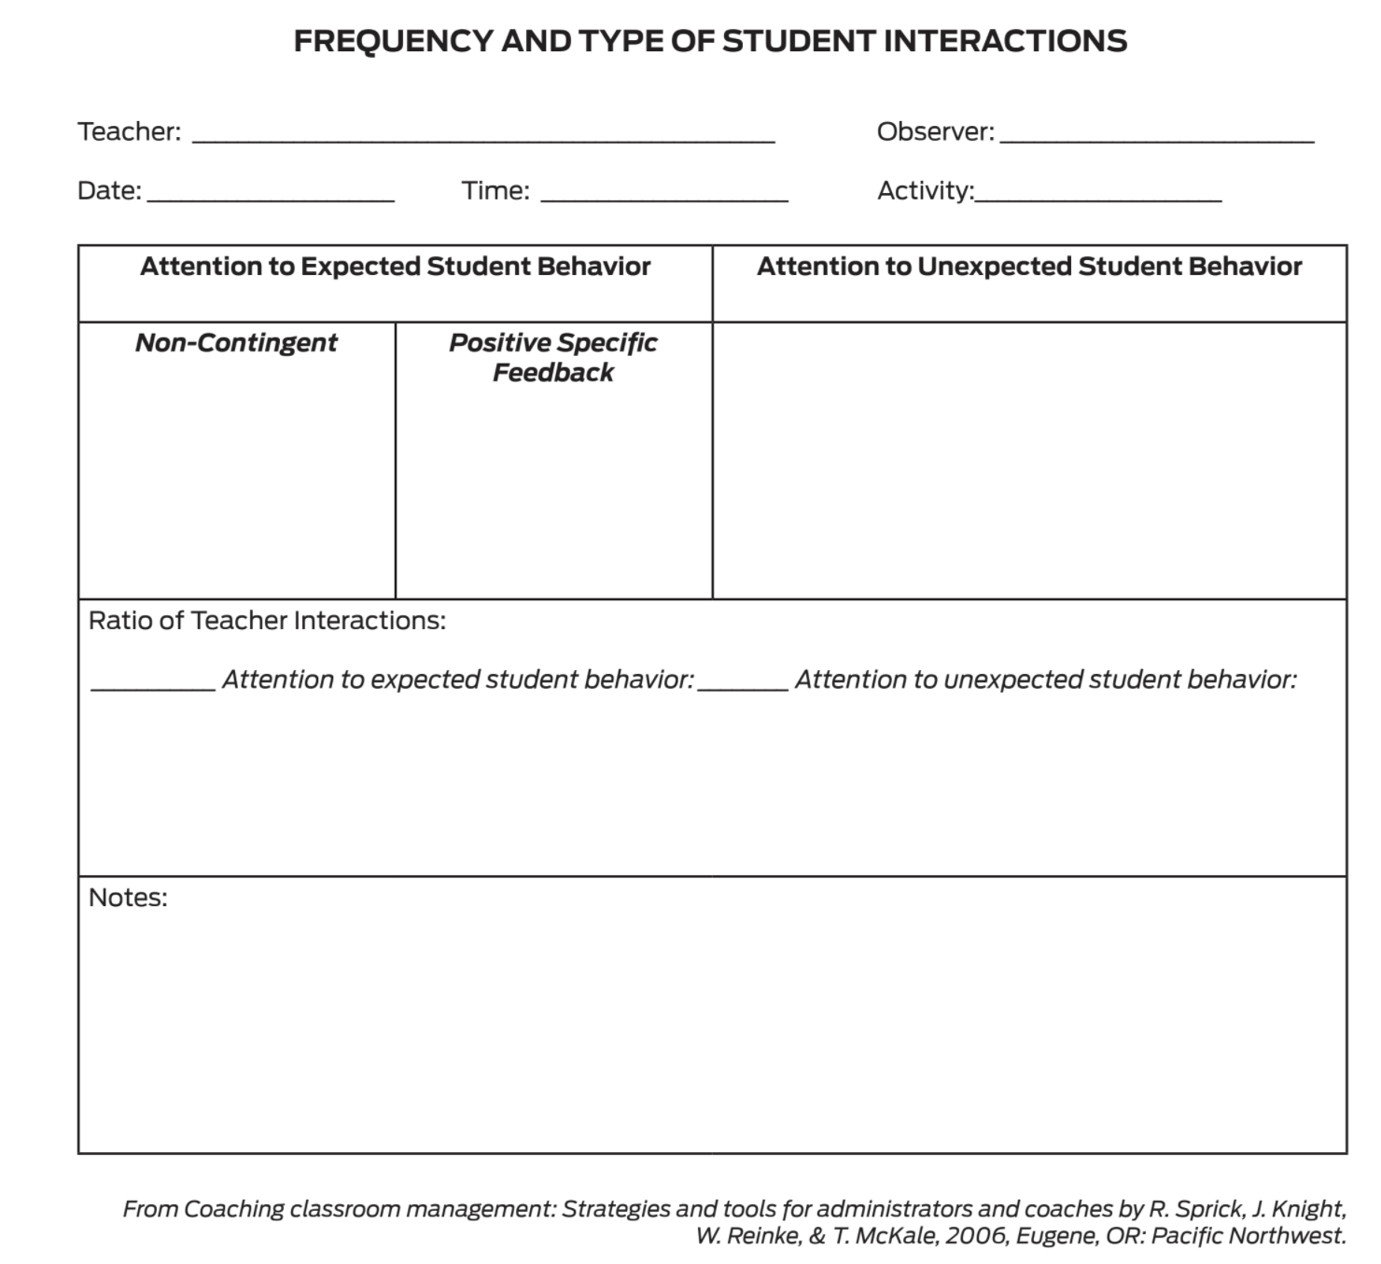
Monitoring the Use of Positive Specific Feedback in Action
Notes:
Trainer Notes:
To Know/To Say: Look at the T1C5L5 HO1 Frequency and Type of Student Interactions. How might you use this handout to gather data to inform coaching?
Staff Engagement
Share and discuss the information about monitoring the use of positive specific feedback with staff. Seek ideas about how to practically and efficiently monitor use of feedback. Also discuss who will see the results and what will be done with the data.

Slide 21
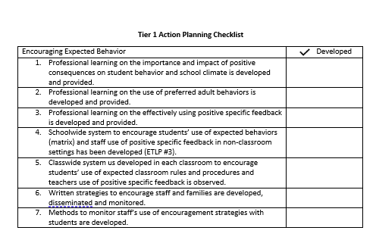
Progress Monitoring
Notes:
Trainer Notes:
To Know/To Say: There are several tools that your team can use to monitor whether you have the essential elements or features developed, to assess the quality of your artifacts and to gain feedback from school staff regarding implementation efforts.
These tools include the:
Tier 1 Action Planning Checklist Use this checklist to confirm everything that your team has developed and create action steps on those that are unchecked.

Slide 22
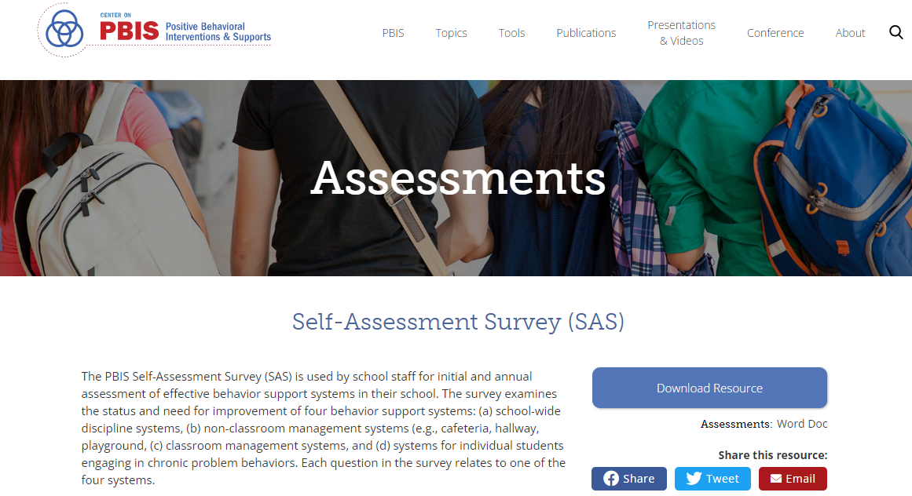
Progress Monitoring
Notes:
Trainer Notes:
To Know/To Say: Self-Assessment Survey (or SAS) – The SAS is a research validated survey that measures perceptions of all staff on the status and priority for improvement of SW-PBS.

Slide 23
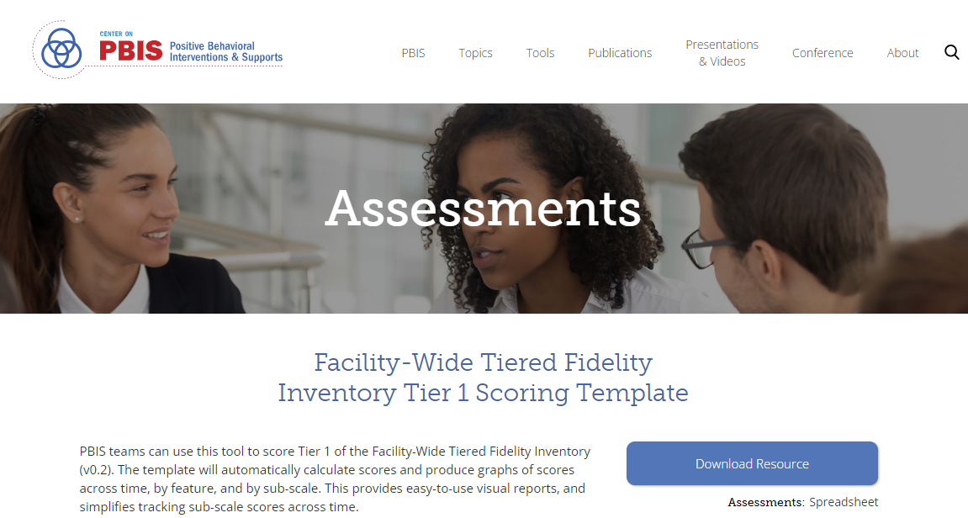
Progress Monitoring
Notes:
Trainer Notes:
To Know/To Say: Finally, the Tiered Fidelity Inventory (or TFI) – The TFI is a research validated tool that measures the building leadership teams perception of implementation fidelity of all three tiers.

Slide 24
Next Steps
Next steps include:
Decide upon simple action steps your team will take to give staff practice providing specific feedback and what steps your team will make to encourage staff use of a 4:1 ratio.
Update your action plan using the Tier 1 Action Plan template and the Tier 1 Action Planning Checklist.
Use the Tier 1 Artifacts Rubric to assess the quality of the resources your team develops.
Use the results of the PBIS Self-Assessment Survey (SAS) to gain perspective from all staff, and results from the PBIS Tiered Fidelity Inventory (TFI) to gain perspective from your building leadership team.
Additional information can be found in the SW-PBS Handbook and Tier 1 Implementation Guide.
Notes:
Trainer Notes:
To Know/To Say: During this lesson you have learned the importance of staff knowing how to effectively use specific positive feedback with students’ use of schoolwide expectations, as well as with other behaviors such as acts of kindness, compassion, and helpfulness. A ratio of 4 positive interactions to 1 corrective interaction is ideal. What steps will your team take to encourage staff to use this ratio?
Next steps include
Decide upon simple action steps your team will take to give staff practice providing specific feedback and what steps your team will make to encourage staff use of a 4:1 ratio.
Update your action plan using the Tier 1 Action Plan template and the Tier 1 Action Planning Checklist.
Use the Tier 1 Artifacts Rubric to assess the quality of the resources your team develops.
Use the results of the PBIS Self-Assessment Survey (SAS) to gain perspective from all staff, and results from the PBIS Tiered Fidelity Inventory (TFI) to gain perspective from your building leadership team.
Additional information can be found in the SW-PBS Handbook and Tier 1 Implementation Guide.

Slide 25
References
Sprick, R., Knight, J., Reinke, W., & McHale, T. (2006). Coaching classroom management: Strategies and tools for administrators and coaches. Eugene, OR: Pacific Northwest.
Notes:
Trainer Notes:
To Know/To Say: Here are the references for this lesson. If more references are needed, you can refer to the Reference section in the Missouri SW-PBS Tier 1 Team Workbook available on the Missouri SW-PBS website.

Slide 26
Contact Information
Check Out MO SW-PBS on Social Media:
Facilitator Contact Information:
pbismissouri.org
List HERE
facebook.com/moswpbs
instagram.com/moswpbs/

