Slide 1
MO SW-PBS Advanced Tiers Course: Encouraging Expected Behavior Lesson 3 Teach Staff to Effectively Use Positive Specific Feedback

Slide 2
Developer Notes: Delete this Slide
Use this slide deck to develop each lesson in the course.
Yellow slides to be deleted by developer & / or Facilitator as appropriate.
Salmon colored slides are slides that will be personalized by the presenter
Incorporate at least one activity for every 10 minutes of instruction
LESS is more in terms of words on a slide
Use IMAGES and then have notes to describe the concept
Format a screenshot of a handout to look like a page on a desk and say pull out handout X vs expecting people to be able to read HO content.
If walking through how to use the handout step by step use screen captures to do this

Slide 3
Facilitator Notes: Delete This Slide

Slide 4
Working Agreements
Be Respectful
Be an active listener—open to new ideas
Use notes for side bar conversations
Be Responsible
Be on time for sessions
Silence cell phones—reply appropriately
Be a Problem Solver
Follow the decision making process
Work toward consensus and support decisions of the group
Notes:
Trainer Notes:
To Know/To Say: “These will be the Working Agreements we will honor during all our training sessions this year.”

Slide 5
Attention Signal
Notes:
Trainer Notes: Facilitator: Select an attention signal.
To Know/To Say: “One of our agreements is to follow the attention signal.”
“Your team will work with your school to develop an attention signal you will use in every setting.”
“In order to get all of you focused after discussions, activities or breaks,
I will ________________________________________.”
(Insert your attention signal here.)
“Your task will be to finish your sentence, quiet your voice and ____________________________.”
(Insert what you want participants to do.)

Slide 6
Introductions
Notes:
Trainer Notes: Facilitator: Select an introductions activity
To Know/To Say:

Slide 7
Handouts
T1C5L3 HO 1 Writing Positive Specific Feedback (PSF) Statements
HOAP Action Plan
HOAPC Tier 1 Action Plan Checklist
HOAC Tier 1 Artifact Checklist
Notes:
Trainer Notes:
To Know/To Say: There are several handouts that will be referenced during this lesson. If you have not downloaded them from the lesson website, please pause the video while you access these documents.

Slide 8
Lesson Description
Students need clear, specific feedback on their use of:
Schoolwide expectations
Other behaviors such as:
acts of kindness
compassion
helpfulness
general positive citizenship that are extended reflections of your expectations.
Notes:
Trainer Notes:
To Know/To Say: Positive relationships are not sufficient to change and sustain behavior. Students need clear, specific feedback on their use of the schoolwide expectations and any other behaviors such as acts of kindness, compassion, helpfulness, and general positive citizenship that are
extended reflections of your expectations. This lesson focuses on contingent attention of specific positive feedback and how to teach staff to use it effectively.
For positive specific feedback to be effective it needs to: 1) specifically describe the behavior, 2) provide reasons or rationales, and 3) can include a positive consequence.

Slide 9
Lesson Outcomes
At the end of this session, you will be able to…
Teach staff to effectively use positive specific feedback
Notes:
Trainer Notes:
To Know/To Say: Read slide to participants.

Slide 10
Rationale
With specific positive feedback you are recognizing attainment of specific performance criteria, effort, or successes at tasks that are difficult for the student, and “providing information to the student in regard to whether or the degree to which their performance was correct.”
Notes:
Trainer Notes:
To Know/To Say: Positive specific feedback is a critical type of contingent attention. With positive specific feedback you are recognizing attainment of specific performance criteria, effort, or successes at tasks that are difficult for the student, and “provid[ing] information to the student in regard to whether or to the degree to which their performance was correct.” ⁵ To ensure continued use, positive specific feedback is essential. General praise or commonly used phrases such as “good job,” though important for a pleasant classroom, are inadequate for building and sustaining expected behavior.

Slide 11
Reflective Questions
How do you use positive specific feedback for students’ academic, behavior, and social emotional performances schoolwide and in your classroom?
How do staff model this language, so that students understand what is expected of them across various settings?
Notes:
Trainer Notes:
To Know/To Say:

Slide 12
Pre-Requisites
Encouraging Expected Behavior Lessons 1 & 2
Course 5 of the Tier 1 Implementation Guide, Encouraging Expected Behavior
Effective Teaching and Learning Practice # 3 Encourage Use of Expected Behavior in MO SW-PBS Handbook.
Notes:
Pre- Requisites for this lesson: Lessons 1 & 2, Course 5 of the Tier 1 Implementation Guide, Encouraging Expected Behavior and Effective Teaching and Learning Practice # 3 Encourage Use of Expected Behavior in MO SW-PBS Handbook.

Slide 13
Missouri Teacher Standards Addressed
2.1: Cognitive, social, emotional and physical development
2.6: Language, culture, family and knowledge of community
3.1: Implementation of curriculum standards
5.1: Classroom management, motivation and engagement
5.2: Managing time, space, transitions and activities
5.3: Classroom, school and community culture
6.1: Verbal and nonverbal communication
6.2: Sensitivity to culture, gender, intellectual and physical differences
8.1: Self-assessment and improvement
8.2: Professional learning
Notes:
Trainer Notes:
To know/To say: These are the Missouri Teacher Standards that will be addressed in this lesson. If you want more information regarding these standards visit DESE.MO.GOV

Slide 14
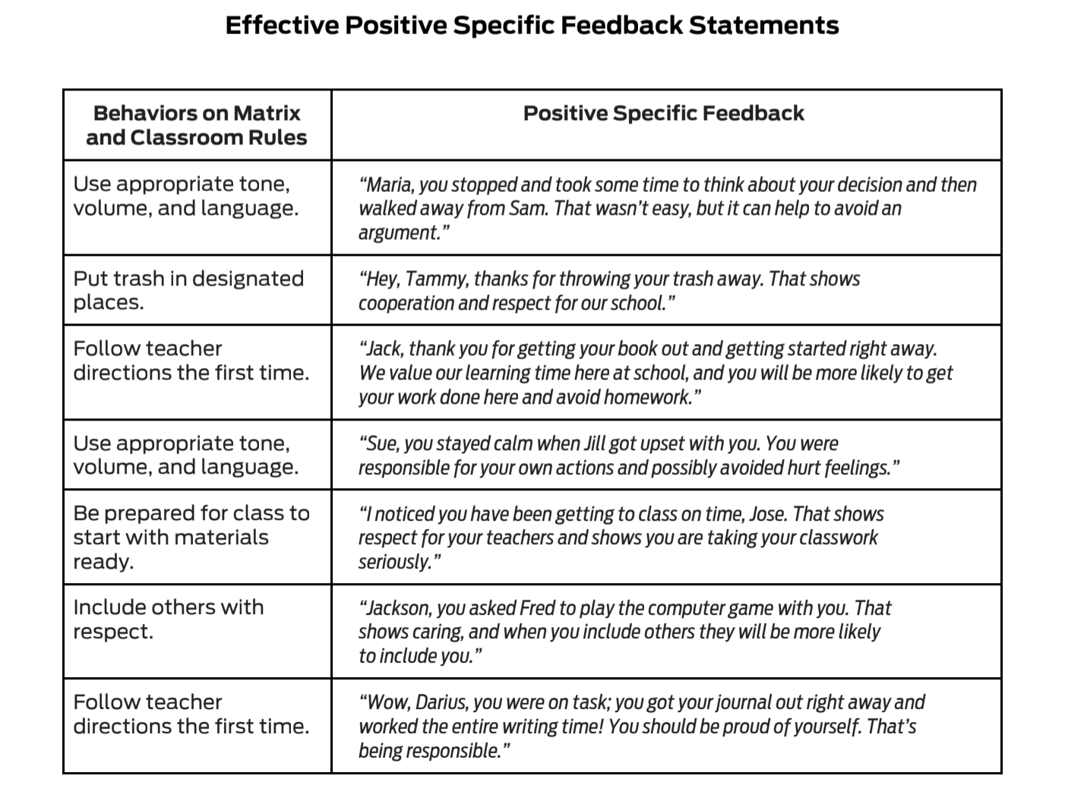
Effective Positive Specific Feedback
Notes:
Trainer Notes:
To Know/To Say: Students need clear, specific feedback on their use of the school-wide expectations and any other behaviors such as acts of kindness, compassion, helpfulness, and general positive citizenship that are extended reflections of your expectations. It is important that positive specific feedback be given sincerely and appropriately for a student's age. This is especially important when working with older students. Staff need to find their own style to communicate sincere care and concern for the student. Use of a variety of phrases shows spontaneity and therefore credibility.

Slide 15
Key Terms
Effective specific positive feedback: 1) specifically describes the behavior, 2) provides reasons or rationales, and 3) can include a positive consequence
Notes:
Trainer Notes:
To Know/To Say: Here are key terms and acronyms that will be used in this lesson.

Slide 16
Teaching Staff to Effectively Use Positive Specific Feedback
Benefits of Specific Positive Feedback:
Helps adults and students focus on positive social behaviors and actions.
It is the most powerful behavior change tool teachers have in their repertoire.
Increases the likelihood students will use the recognized behaviors and skills in the future.
Decreases unexpected behavior and, therefore, reduces the need for correction.
Enhances self-esteem and helps build internal locus of control (i.e., self-regulation).
Notes:
Trainer Notes:
To Know/To Say: Benefits of positive specific feedback
Positive specific feedback…
• Helps adults and students focus on positive social behaviors and actions.
• It is the most powerful behavior change tool teachers have in their repertoire.
• Increases the likelihood students will use the recognized behaviors and skills in the future.
• Decreases unexpected behavior and, therefore, reduces the need for correction.
• Enhances self-esteem and helps build internal locus of control (i.e., self-regulation).

Slide 17
Teaching Staff to Effectively Use Positive Specific Feedback
Schools should develop and implement a variety of positive consequences, including tangible reinforcers.
Tangibles are typically a ticket or coupon (e.g., compliment cards, Bulldog Bucks, Braggin Dragon cards, Bee Tickets, etc.)
Tangibles are often reinforcing as they are a reminder for teachers to have frequent, positive interactions with students, including delivery of specific positive feedback on social behaviors.
Notes:
Trainer Notes:
To Know/To Say: One of the hallmarks of Schoolwide Positive Behavior Support is the development and implementation of a variety of positive consequences, including tangible reinforcers. The tangible is typically in the form of a ticket or coupon (e.g., Compliment Cards, Bulldog Bucks, Braggin’ Dragon Cards, Bee Tickets, etc.). These tangibles are often reinforcing in and of themselves as they are a reminder for teachers to have frequent, positive interactions with students, including delivery of positive specific feedback on social behaviors. This process mirrors the use of grading and providing written formative feedback on student academic work.

Slide 18
Teaching Staff to Effectively Use Positive Specific Feedback
It is typically not until a stage where all three needs (competence, relatedness, and autonomy) are met that school tasks and activities are integrated by a student to the point of being fully, intrinsically motivated.
Feedback is needed as part of a planned system to support (i.e., externally regulate) student behavior.
Notes:
Trainer Notes:
To Know/To Say: Recall that many activities that fill a typical school day are not in and of themselves intrinsically motivating. ^{2 I} It is typically not until a stage where all three needs (competence, relatedness, and autonomy) are met that school tasks and activities are integrated by a student to the point of being fully, intrinsically motivated. As such, feedback is needed as part of a planned system to support (i.e., externally regulate) student behavior.

Slide 19
Effectively Using Positive Specific Feedback
“The purpose of tangibles in the positive consequence continuum is to prompt adults to provide feedback at rates or ratios that are likely to support consistent student demonstration of expected academic or social behaviors”.⁴
Tickets can have further reinforcing value if they are used within a token economy.
Notes:
Trainer Notes:
To Know/To say: “The purpose of tangibles in the positive consequence continuum is to prompt adults to provide feedback at rates or ratios that are likely to support consistent student demonstration of expected academic or social behaviors." ⁴ Tickets can have further reinforcing value if they are used within a token economy. This might include a personally selected reinforcer from a menu or list to help meet a jointly set goal, purchase of an item from a school store, a raffle opportunity, etc.

Slide 20
Tangibles are Reminders
Set goals for handing out tangibles
Use positive specific feedback describing why tangible was earned “You followed directions; that helped you complete your assignment quickly and accurately. Because you followed directions, you have earned a Tiger Ticket”
Notes:
Trainer Notes:
To Know/To Say: Remember, tangibles serve as a visual reminder for staff to watch for desired behaviors and then deliver positive specific feedback. Some schools replenish the teachers’ supply of tickets daily, thus reminding them to frequently catch students demonstrating desired behaviors. Setting a goal, for example, to intentionally look for students who are demonstrating respect by following directions right away and recognizing 10 students in 60 minutes can help a teacher focus on looking for expected behavior by ensuring all 10 tickets are gone by the end of class.
In addition, the proximity required to deliver the ticket helps to ensure the effectiveness of the teacher’s social attention and feedback. Looking at the student and saying, “You followed directions; that helped you complete your assignment quickly and accurately. Because you followed directions, you have earned a Tiger Ticket,” can enhance the relationship between the student and teacher.

Slide 21
Tangibles are Reminders
Once a tangible has been earned it should not be taken away
Encouraging expected behavior by acknowledging success moves the student closer to closing the gap between current performance and expected performance. ³
"The purpose of tangibles in the positive consequence continuum is to prompt adults to provide feedback at rates or ratios that are likely to support consistent student demonstration of expected academic or social behaviors." ⁴
Notes:
Trainer Notes:
To Know/To Say: It is critical to note that once a ticket or other tangible recognition has been earned it should not be taken away. Rather, another one should not be awarded until the student next earns it. Making a behavioral error does not negate the previous behavioral success. Encouraging expected behavior by acknowledging success moves the student closer to closing the gap between current performance and expected performance. ³
"The purpose of tangibles in the positive consequence continuum is to prompt adults to provide feedback at rates or ratios that are likely to support consistent student demonstration of expected academic or social behaviors." ⁴

Slide 22
Discussion
“I have not worked with a school that has been able to give enough feedback to students to maintain positive behavior without using a tangible item, like a Pride ticket. The tangible helps staff remember to give positive recognition to students.“ Tim Lewis
Things to Consider
What are some strategies your leadership team and / or staff can use to reinforce and encourage staff who are actively teaching and encouraging students?
What are some strategies your leadership team and / or staff can use to reinforce and encourage families to use specific positive feedback at home?
Notes:
Trainer Notes:
To Know/To Say: Consider this quote by Dr. Tim Lewis “I have not worked with a school that has been able to give enough feedback to students to maintain positive behavior without using a tangible item, like a Pride ticket. The tangible helps staff remember to give positive recognition to students." ⁵ As schools create exciting ways to encourage students, you may also want to consider a list of reinforcers to encourage staff who are actively teaching and encouraging students. In addition, some schools consider ways they can “share the good news” about student behavior with families and, therefore, reinforce their efforts at home to support your work. your team brainstorm possible reinforcers for students and staff who are actively teaching and encouraging students. Also consider ways to share the good news about student behavior with families.

Slide 23
Effectively Using Positive Specific Feedback
Preferred adult behaviors and non-contingent attention are not sufficient to change and sustain behavior;
Contingent attention or positive specific feedback is essential.
Specific feedback, recognizes attainment of specific performance criteria, effort, or successes at tasks that are difficult for the student.
Notes:
Trainer Notes:
To Know/To Say: Teachers are creative when implementing a structured way to give non-contingent attention. Some elementary teachers place a sign on their entryway so students can choose a morning greeting from the teacher — hug, fist bump, or secret handshake. Middle and high school teachers' greetings are more likely to be a smile and verbal welcome. YouTube has several inventive and entertaining videos showing teachers greeting their students. However, the preferred adult behaviors and non-contingent attention we have talked about are not sufficient to change and sustain behavior; just as we shared earlier, contingent attention or positive specific feedback is essential. With positive specific feedback, you are recognizing attainment of specific performance criteria, effort, or successes at tasks that are difficult for the student.

Slide 24
Effectively Using Positive Specific Feedback
Effective positive specific feedback statements:
specifically describe the behavior,
provide reasons or rationales, and
can include a positive consequence (tangible)
Notes:
Trainer Notes:
To Know/To Say: To ensure continued use, positive specific feedback is essential. General praise or commonly used phrases such as “good job,” though important for a pleasant classroom, are inadequate for building and sustaining desired behavior. Students need clear, specific feedback on their use of the schoolwide expectations and any other behaviors such as acts of kindness, compassion, helpfulness, and general positive citizenship that are extended reflections of your expectations. Effective positive specific feedback statements: 1) specifically describe the behavior, 2) provide reasons or rationales, and 3) can include a positive consequence (tangible). A ratio of 4 positive interactions to 1 corrective interaction is ideal. How to give positive specific feedback is described in detail in the Implementation Guides.

Slide 25
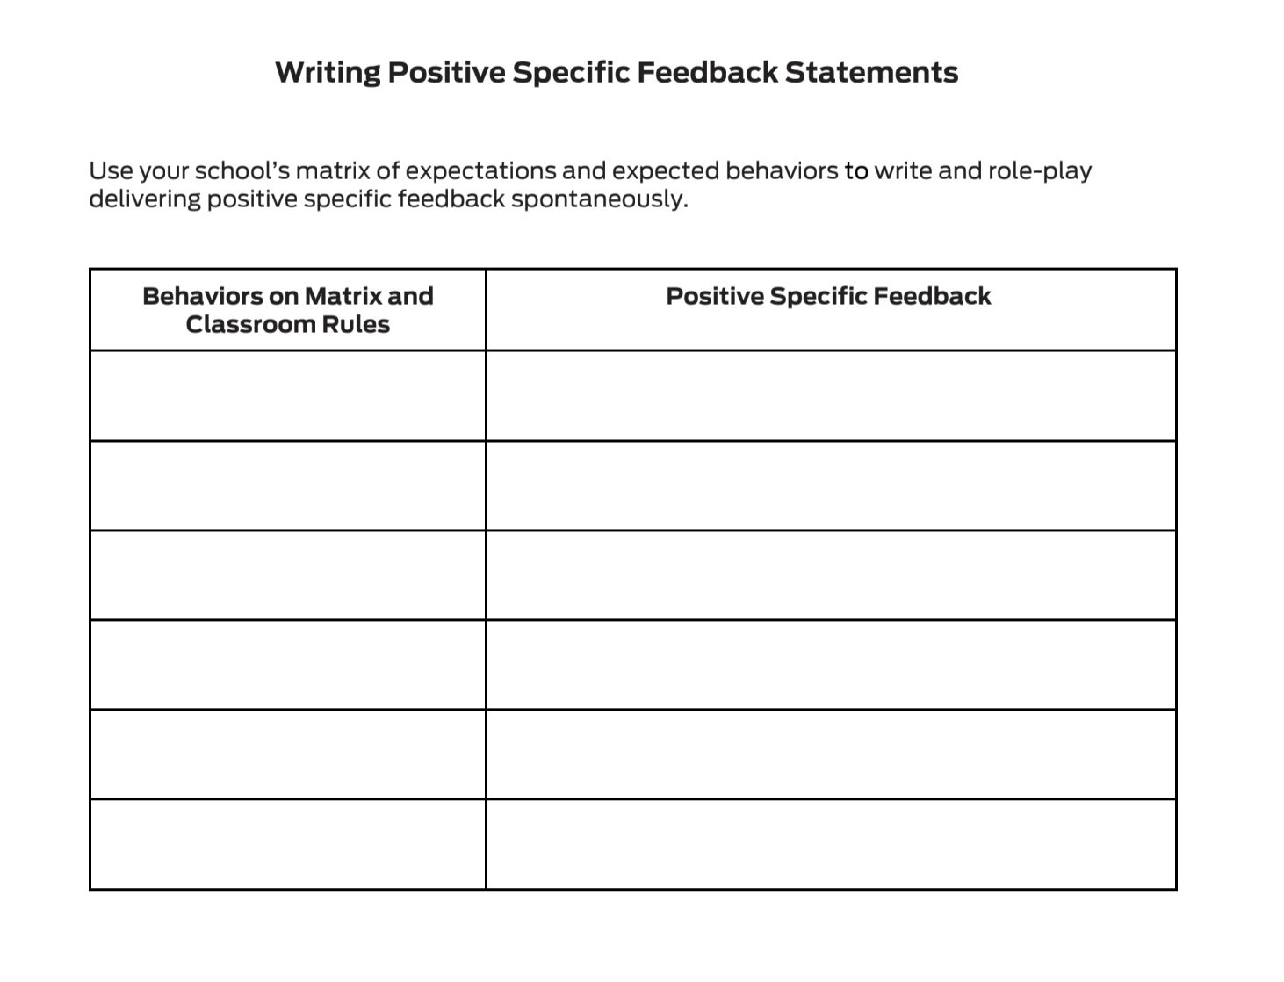
Pause & Reflect
Activity
Notes:
Trainer Notes:
To Know/To Say: With your team use your school’s matrix of expectations and expected behaviors to write positive specific feedback statements then practice delivering these positive specific feedback statements by role-playing. Then discuss how your team will provide staff practice providing positive specific feedback. A ratio of 4 positive interactions to 1 corrective interaction is ideal. What steps will your team take to encourage staff to use this ratio?
This is an activity can be used with staff to help them practice delivering positive specific feedback statements that are aligned to your schoolwide expectations spontaneously. Use T1C5L3 H01 Writing Positive Specific Feedback Statements to practice utilizing feedback aligned to your schoolwide expectations. Discuss how your team will provide staff practice providing positive specific feedback. A ratio of 4 positive interactions to 1 corrective interaction is ideal. What steps will your team take to encourage staff to use this ratio?

Slide 26
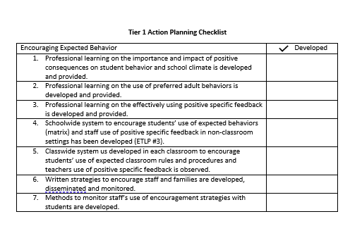
Progress Monitoring
Notes:
Trainer Notes:
To Know/To Say: There are several tools that your team can use to monitor whether you have the essential elements or features developed, to assess the quality of your artifacts and to gain feedback from school staff regarding implementation efforts.
These tools include the:
Tier 1 Action Planning Checklist Use this checklist to confirm everything that your team has developed and create action steps on those that are unchecked.

Slide 27
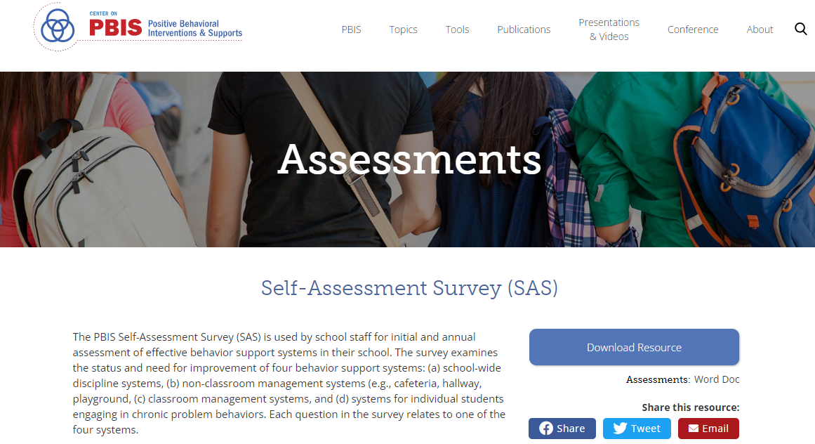
Progress Monitoring
Notes:
Trainer Notes:
To Know/To Say: Self-Assessment Survey (or SAS) – The SAS is a research validated survey that measures perceptions of all staff on the status and priority for improvement of SW-PBS.

Slide 28
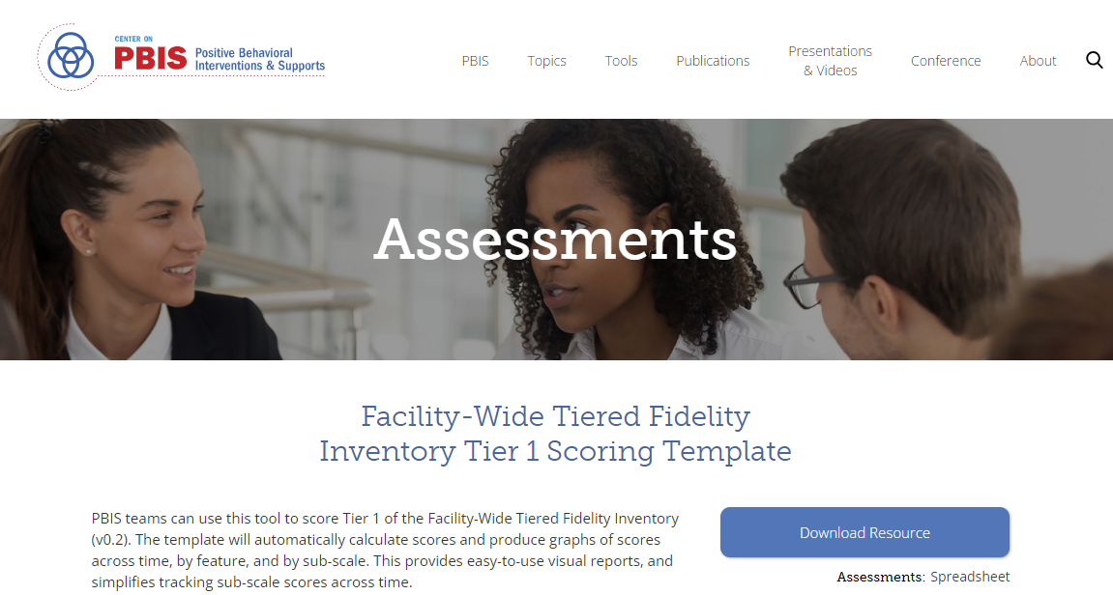
Progress Monitoring
Notes:
Trainer Notes:
To Know/To Say: Finally, the Tiered Fidelity Inventory (or TFI) – The TFI is a research validated tool that measures the building leadership teams perception of implementation fidelity of all three tiers.

Slide 29
Next Steps
Next steps include
Decide upon simple action steps your team will take to give staff practice providing specific feedback and what steps your team will make to encourage staff use of a 4:1 ratio.
Update your action plan using the Tier 1 Action Plan template and the Tier 1 Action Planning Checklist.
Use the Tier 1 Artifacts Rubric to assess the quality of the resources your team develops.
Use the results of the PBIS Self-Assessment Survey (SAS) to gain perspective from all staff, and results from the PBIS Tiered Fidelity Inventory (TFI) to gain perspective from your building leadership team.
Notes:
Trainer Notes:
To Know/To Say: During this lesson you have learned the importance of staff knowing how to effectively use specific positive feedback with students’ use of schoolwide expectations, as well as with other behaviors such as acts of kindness, compassion, and helpfulness. A ratio of 4 positive interactions to 1 corrective interaction is ideal. What steps will your team take to encourage staff to use this ratio?
Next steps include
Decide upon simple action steps your team will take to give staff practice providing specific feedback and what steps your team will make to encourage staff use of a 4:1 ratio.
Update your action plan using the Tier 1 Action Plan template and the Tier 1 Action Planning Checklist.
Use the Tier 1 Artifacts Rubric to assess the quality of the resources your team develops.
Use the results of the PBIS Self-Assessment Survey (SAS) to gain perspective from all staff, and results from the PBIS Tiered Fidelity Inventory (TFI) to gain perspective from your building leadership team.
Additional information can be found in the SW-PBS Handbook and Tier 1 Implementation Guide.

Slide 30
References
Scott, T. M. (2017). Teaching behavior: Managing classrooms through effective instruction. Sage: Thousand Oaks, CA.
Ryan, R. M., & Deci, E. L. (2000). Intrinsic and extrinsic motivations: Classic definitions and new directions. Contemporary Educational Psychology, 25(1), 54–67.
Scott, T. M. (2017). Teaching behavior: Managing classrooms through effective instruction. Sage: Thousand Oaks, CA.
Scott, T. M. (2017). Teaching behavior: Managing classrooms through effective instruction. Sage: Thousand Oaks, CA.
Lewis, T. (2018). Keynote. Missouri Schoolwide Positive Behavior Support Summer 2018 Institute. (Timothy J. Lewis, 2002)
Notes:
Trainer Notes:
To Know/To Say: Here are the references for this lesson. If more references are needed, you can refer to the Reference section in the Missouri SW-PBS Tier 1 Team Workbook available on the Missouri SW-PBS website.

Slide 31
Contact Information
Check Out MO SW-PBS on Social Media:
Facilitator Contact Information:
pbismissouri.org
List HERE
facebook.com/moswpbs
instagram.com/moswpbs/

