Slide 1
MO SW-PBS Tier 1 Course: Encouraging Expected Behavior Lesson 2 Using Preferred Adult Behavior

Slide 2
Developer Notes: Delete this Slide
Use this slide deck to develop each lesson in the course.
Yellow slides to be deleted by developer & / or Facilitator as appropriate.
Salmon colored slides are slides that will be personalized by the presenter
Incorporate at least one activity for every 10 minutes of instruction
LESS is more in terms of words on a slide
Use IMAGES and then have notes to describe the concept
Format a screenshot of a handout to look like a page on a desk and say pull out handout X vs expecting people to be able to read HO content.
If walking through how to use the handout step by step use screen captures to do this

Slide 3
Facilitator Notes: Delete This Slide

Slide 4
Working Agreements
Be Respectful
Be an active listener—open to new ideas
Use notes for side bar conversations
Be Responsible
Be on time for sessions
Silence cell phones—reply appropriately
Be a Problem Solver
Follow the decision making process
Work toward consensus and support decisions of the group
Notes:
Trainer Notes:
To Know/To Say: “These will be the Working Agreements we will honor during all our training sessions this year.”

Slide 5
Attention Signal
Notes:
Trainer Notes: Facilitator: Select an attention signal.
To Know/To Say: “One of our agreements is to follow the attention signal.”
“Your team will work with your school to develop an attention signal you will use in every setting.”
“In order to get all of you focused after discussions, activities or breaks,
I will ________________________________________.”
(Insert your attention signal here.)
“Your task will be to finish your sentence, quiet your voice and ____________________________.”
(Insert what you want participants to do.)

Slide 6
Introductions
Notes:
Trainer Notes: Facilitator: Select an introductions activity
To Know/To Say:

Slide 7
Handouts
T1C5L2 HO 1 Topic in Action: My Favorite Teacher
HOAP Action Plan
HOAPC Tier 1 Action Plan Checklist
HOAC Tier 1 Artifact Checklist
Notes:
Trainer Notes:
To Know/To Say: There are several handouts that will be referenced during this lesson. If you have not downloaded them from the lesson website, please pause the video while you access these documents.

Slide 8
Lesson Description
Adult attention helps to create a positive and safe environment.
Adult attention sets the mood of the school.
How do these ideas related to adult attention connect to meeting academic and behavioral goals?
Notes:
Trainer Notes:
To Know/To Say: Teacher and staff attention have a powerful influence on the behavior of individuals, and small and whole groups of students. Adult attention helps create a positive and safe learning environment.
This lesson focuses on how staff’s use of both, non-contingent and contingent attention to recognize students’ efforts to meet academic and behavioral goals that will set the tone or mood of the school through relationships with students and families.
Could allow participants to turn and talk to an elbow partner on their answers to the question on the slide. Then share out 2-3 big ideas from the whole group.

Slide 9
Lesson Outcomes
At the end of this session, you will be able to…
Use preferred adult behaviors
Notes:
Trainer Notes:
To Know/To Say:

Slide 10
Rationale
When students are asked, “What makes a teacher special and worthy of respect,” students consistently cite three characteristics: firmness, compassion, and an interesting, engaging, and challenging teaching style.” ³
Notes:
Trainer Notes:
To Know/To Say: Related to teacher attention is the student-teacher relationship and preferred adult behaviors. There is a growing body of research that indicates academic achievement and students’ behavior are both influenced by the quality of teacher-student relationship. ^{1,2} When students are asked what makes a teacher special and worthy of respect, students consistently cite three characteristics: firmness, compassion, and an interesting, engaging, and challenging teaching style ^{.3}

Slide 11
Reflective Questions
How do you define, teach, model, and reinforce expected adult behaviors for all staff that will encourage students to model expected behaviors?
How can you collaborate with other staff members to use the School-based Implementation Coaching Professional Learning Module to better understand how to provide feedback on expected adult behaviors to increase the likelihood of staff using effective teaching and learning practices throughout your school?
Notes:
Trainer Notes:
To Know/To Say:

Slide 12
Pre-Requisites
Encouraging Expected Behavior Lesson 1
Course 5 of the Tier 1 Implementation Guide, Encouraging Expected Behavior
Effective Teaching and Learning Practice # 3 Encourage Use of Expected Behavior in MO SW-PBS Handbook.

Slide 13
Missouri Teacher Standards Addressed
2.1: Cognitive, social, emotional and physical development
2.6: Language, culture, family and knowledge of community
3.1: Implementation of curriculum standards
5.1: Classroom management, motivation and engagement
5.2: Managing time, space, transitions and activities
5.3: Classroom, school and community culture
6.1: Verbal and nonverbal communication
6.2: Sensitivity to culture, gender, intellectual and physical differences
8.1: Self-assessment and improvement
8.2: Professional learning
Notes:
Trainer Notes:
To know/To say: These are the Missouri Teacher Standards that will be addressed in this lesson. If you want more information regarding these standards visit DESE.MO.GOV

Slide 14
Adult Behaviors That Build Relationships Include:
communicating privately, in close proximity with each student,
listening,
eye contact,
pleasant voice tone,
smiles,
appropriate professional touch and
use of students’ names.
Notes:
Trainer Notes:
To know/To say: Given these relationships, teachers and staff need to learn simple behaviors that will positively impact relationships.
Adult behaviors that build relationships include: 1) communicating privately, in close proximity with each student, 2) listening, 3) eye contact, 4) pleasant voice tone, 5) smiles, 6) appropriate professional touch and 7) use of students’ names.

Slide 15
Preferred Adult Behaviors
Preferred adult behaviors express warmth, care, and concern for students while also communicating respect.
They increase student affect, compliance and enhance learning.
These adult behaviors not only impact relationships but also set the stage for effective interaction with students and delivery of genuine feedback. ⁴
Wong & Wong (2005) describe these teachers as “intentionally inviting.”
Notes:
Trainer Notes:
To Know/To Say: These behaviors express warmth, care, and concern for students while also communicating respect.
They increase student affect (the likelihood that they will say they like school or their teacher), compliance (the likelihood that they will do as asked) and enhance learning.
These adult behaviors not only impact relationships but also set the stage for effective interaction with students and delivery of genuine feedback. ⁴
Wong & Wong (2005) describe these teachers as “intentionally inviting.” Their professional attitude depicts their view of students as able, valuable, and responsible.

Slide 16
Two Types of Adult Attention
Two types of adult attention
Non-contingent Attention + Contingent Attention =
Positive School Climate
Positive Rapport
Positive Relationships
helps students to learn social behavioral expectations
Notes:
Trainer Notes:
To Know/To Say: There are two types of adult attention, and both have a positive impact on interactions in schools. Staff using both contingent and noncontingent adult attention effectively builds rapport and relationships with students and families, and helps students learn social behavioral expectations and meet academic goals

Slide 17
Key Terms
Non-contingent attention: attention provided regardless of performance and includes such things as greetings, proximity, smiles, and conversations.
Contingent attention: provided based upon student performance of an identified expectation or behavior.
Specific Positive Feedback
Notes:
Trainer Notes:
To Know/To Say: Here are key terms that will be used in this lesson.
Non-contingent attention: attention provided regardless of performance and includes such things as greetings, proximity, smiles, and conversations.
Contingent attention: provided based upon student performance of an identified expectation or behavior.
An example is Specific Positive Feedback

Slide 18
Use for Outcome Divider

Slide 19
Unpacking Using Preferred Adult Behavior
Use preferred adult behaviors to build teacher student relationships when providing non-contingent and contingent behavior.
Non Contingent Behavior
If adults provide sufficient non-contingent attention, the frequency of unexpected behavior may decrease.
Teachers report that positive student–teacher interactions increase, the number of out of school suspensions that students receive decreases.
Notes:
Trainer Notes:
To Know/To Say: Non-contingent Attention
Most teachers and staff understand the importance of positive relationships with their students. Non-contingent attention is one of the many ways to enhance adult-student relationships. Given that many instances of unexpected behavior are based on a desire for attention, if we provide sufficient non-contingent attention, the frequency of unexpected behavior may decrease. As teachers report that positive student–teacher interactions increase, the number of out of school suspensions that students receive decreases.

Slide 20
Non-Contingent Attention Continued
Non-Contingent Attention provides students with:
roles models of positive social interactions
Examples of non-contingent attention are smiles, greetings, community-building activities
these types of interactions help students accept corrections when they are needed
Students report with an increase in the quality of student–teacher relationships, a corresponding increase in on-task behavior and decrease in the number of behavior referrals they receive.⁶
Notes:
Trainer Notes:
To Know/To Say: Also, as students report an increase in the positive emotional quality of student–teacher relationships, there is a corresponding decrease in the number of behavior referrals they receive, and an increase in the amount of time students spend on-task. ⁶
Finally, non-contingent attention provides students with role models of positive social interactions. Non-contingent adult attention such as smiles, greetings, and community-building activities are examples of antecedents that help establish positive relationships between students and staff and set the stage for students to display the expected academic and behavioral expectations. They also create the relationships that will help students accept corrections when it is needed.

Slide 21
Teacher Behaviors that Enhance Positive Teacher–Student Relationships
1) communicating privately, in close proximity with each student,
2) listening,
3) eye contact,
4) pleasant voice tone,
5) smiles,
6) appropriate professional touch and
7) use of students’ names.
Notes:
Trainer Notes:
To Know/To Say: Teacher Behaviors that Enhance Positive Teacher–Student Relationships
Recall teacher behaviors that enhance positive teacher-student relationships include 1) communicating privately, in close proximity with each student, 2) listening, 3) eye contact, 4) pleasant voice tone, 5) smiles, 6) appropriate professional touch and 7) use of students’ names.

Slide 22
Non-contingent Teacher Behaviors that Enhance Positive Teacher-Student Relationships
Greet students by name as they enter the room
Ask students about their interest and hobbies
Use students’ names when interacting with them, even if they are not in your classroom
Smile!
Provide positive, non-judgmental attention and statements
Notes:
Trainer Notes:
To Know/To Say: Non-Contingent Teacher Behaviors that Enhance Positive Teacher–Student Relationships
• Greet students as they enter the classroom, using the student’s name, smiling and asking them a question related to the student's interests. “Hey, Tim, good to see you today. How’s that guitar playing going for you?”
• Use a student's name when interacting with a student. “Demarco, what is the idea you took away from reading that passage?”
• Smile! Teachers are often so busy thinking about the academic content and learning targets they are trying to address that they forget to smile. A smile is a powerful tool to communicate the message, “I value you.”
• Provide positive, non-judgmental regard by:
attending before- and after-school events,
responding to student social media posts (as appropriate),
reading literature they are interested in,
listening to music/artists that they recommend,
recalling details about the daily lives of students and demonstrating genuine concern: “Keith, I was sorry to hear about the death of your grandfather.”

Slide 23
Contingent Attention - Preferred Adult Behaviors
• Providing private positive feedback, a teacher kneels next to the student’s desk and whispers “Thank you Michael for getting ready for our math lesson by getting your book out and getting right to work.”
• Teacher smiles and says to the entire class, “Thank you for lining up swift, straight and silent. We can now head to lunch!”
• The teacher listens quietly, providing eye contact and nodding their head as a student explains how they solved a math problem during small group math instruction.
Notes:
Trainer Notes:
To Know/To Say:
• Providing private positive feedback, a teacher kneels next to the student’s desk and whispers “Thank you Michael for getting ready for our math lesson by getting your book out and getting right to work.”
• Teacher smiles and says to the entire class, “Thank you for lining up swift, straight and silent. We can now head to lunch!”
• The teacher listens quietly, providing eye contact and nodding their head as a student explains how they solved a math problem during small group math instruction.

Slide 24
Discussion: Preferred Adult Behavior in Practice
Review the preferred adult behaviors for building positive teacher-student relationships.
What behaviors do you currently personally use that you want to continue?
Do you use these preferred adult behaviors equally with all students?
Which behaviors do you need to add?
Notes:
Trainer Notes:
To Know/To Say: Review the preferred adult behaviors for building positive teacher-student relationships. Discuss the extent in which staff in your school use these preferred adult behaviors when interacting with students. Reflect on how your building leadership team engages staff in discussing the importance and impact of different types of preferred adult behavior to increase expected behaviors from all students.

Slide 25
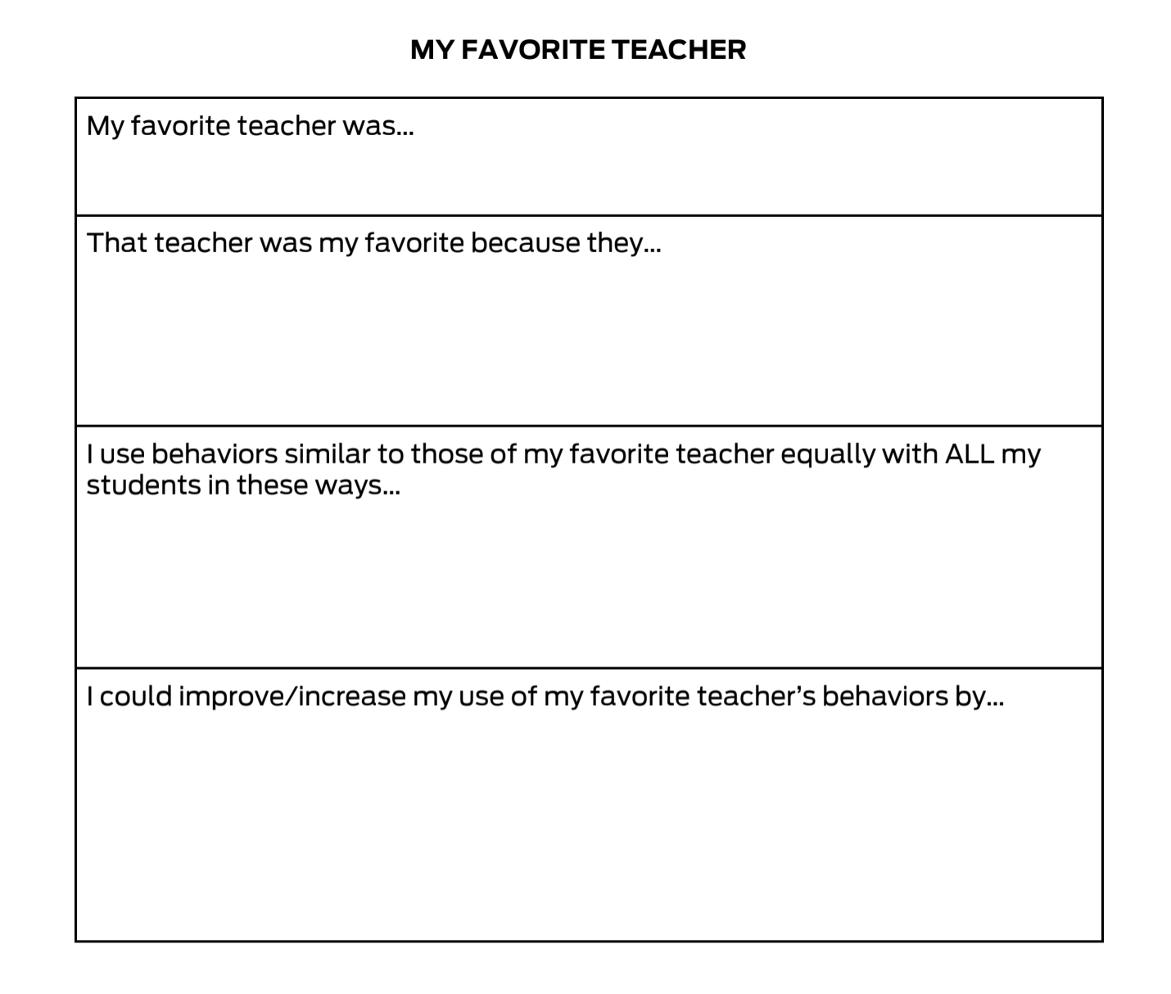
Pause and Reflect: My Favorite Teacher
Notes:
Trainer Notes: Multiple ways to complete this activity: partners talk and share out - recorder for the group, includes key characters across prompts that whole staff can have dialogue around. Small groups can complete this and follow the same process to discuss as a larger group.
To Know/To Say: As individual team members, think about your favorite teacher when you were in school. Think about the characteristics and actions the teacher possessed that made that teacher special. Then reflect on how your interactions with all your students are similar to that teacher. Finally, what could you do to become your favorite teacher? Use handout 1 Topic in Action My Favorite teacher to complete this activity.

Slide 26
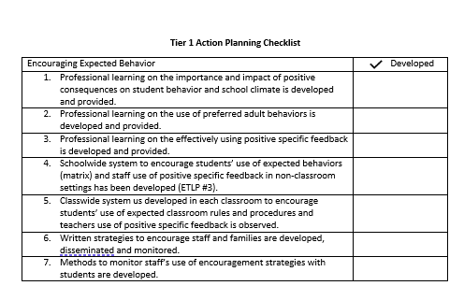
Progress Monitoring
Notes:
Trainer Notes:
To Know/To Say: There are several tools that your team can use to monitor whether you have the essential elements or features developed, to assess the quality of your artifacts and to gain feedback from school staff regarding implementation efforts.
These tools include the:
Tier 1 Action Planning Checklist Use this checklist to confirm everything that your team has developed and create action steps on those that are unchecked.

Slide 27
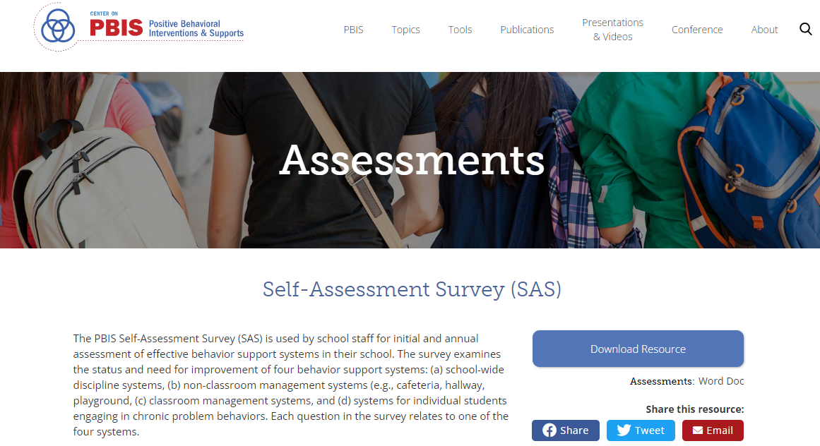
Progress Monitoring
Notes:
Trainer Notes:
To Know/To Say: Self-Assessment Survey (or SAS) – The SAS is a research validated survey that measures perceptions of all staff on the status and priority for improvement of SW-PBS.

Slide 28
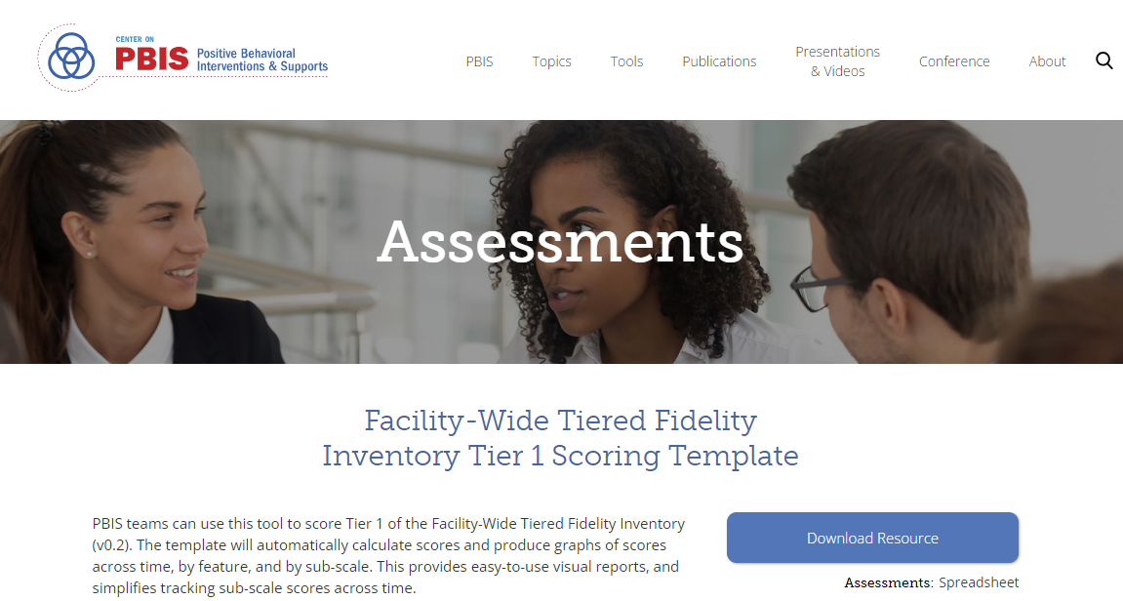
Progress Monitoring
Notes:
Trainer Notes:
To Know/To Say: Finally, the Tiered Fidelity Inventory (or TFI) – The TFI is a research validated tool that measures the building leadership teams perception of implementation fidelity of all three tiers.

Slide 29
Closing
Reflect on how your building leadership team engages staff in discussing the importance and impact of different types of adult behavior to increase expected behaviors from all students.
Notes:
Trainer Notes:
To Know/To Say During this lesson, you learned how teacher and staffs’ use of preferred adult behaviors can create a positive safe learning environment and influence the behavior of students to meet behavior and academic goals.
Although there are no universal reinforcers that will increase the likelihood that all students will repeat the expected skills in the future, adult attention is reinforcing for most students, especially when adults have previously built a positive relationship with them. Positive reinforcement (e.g., positive adult attention or positive specific feedback) for most students increases the probability that they will use the expected behavior again. ⁸
How will your building leadership team engage staff in discussing the importance and impact of different types of preferred adult behavior to increase expected behaviors from all students?

Slide 30
Next Steps
Next steps include
Decide upon simple action steps for how your building leadership team will engage staff in discussing the importance and impact of different types of preferred adult behavior to increase expected behavior from all students .
Update your action plan using the Tier 1 Action Plan template and the Tier 1 Action Planning Checklist.
Use the Tier 1 Artifacts Rubric to assess the quality of the resources your team develops.
Use the results of the PBIS Self-Assessment Survey (SAS) to gain perspective from all staff, and results from the PBIS Tiered Fidelity Inventory (TFI) to gain perspective from your building leadership team.
Notes:
Trainer Notes:
To Know/To Say Next steps include
Decide upon simple action steps for how your building leadership team will engage staff in discussing the importance and impact of different types of preferred adult behavior to increase expected behavior from all students .
Update your action plan using the Tier 1 Action Plan template and the Tier 1 Action Planning Checklist.
Use the Tier 1 Artifacts Rubric to assess the quality of the resources your team develops.
Use the results of the PBIS Self-Assessment Survey (SAS) to gain perspective from all staff, and results from the PBIS Tiered Fidelity Inventory (TFI) to gain perspective from your building leadership team.
Additional information can be found in the SW-PBS Handbook and Tier 1 Implementation Guide.

Slide 31
References
Jones, V. F., & Jones, L. S. (1998). Comprehensive classroom management (2nd ed.). Boston: Allyn and Bacon.
Algozzine, B., Wang, C., & Violette, A. S. (2011). Reexamining the relationship between academic achievement and social behavior. Journal of Positive Behavior Interventions, 13(1), 3–16.
Noguera, P. (1995). Preventing and producing violence: A critical analysis of responses to school violence. Harvard Educational Review, 65, 189–212.
Wong, H. K., & Wong, R. T. (2005). The first days of school: How to be an effective teacher (4th ed.). Mountain View, CA: Harry K. Wong Publications, Inc.
Scott, T. M. (2017). Teaching behavior: Managing classrooms through effective instruction. Sage: Thousand Oaks, CA.
Decker, D.M., Dona, D.P., & Christenson, S.L. (2007). Behaviorally at-risk African American students: The importance of student–teacher relationships for student outcomes. Journal of School Psychology, 45, 83–109.
Sutherland, K. S., Wehby, J. H., & Copeland, S. R. (2000). Effect of varying rates of behavior-specific praise on the on-task behavior of students with EBD. Journal of Emotional and Behavior Disorders, 8, 2–8.
Maag, J. (2001). Management of surface behavior: A new look at an old approach. Counseling and Human Development. Love Publishing Co. . High Beam Research
Notes:
Trainer Notes:
To Know/To Say: : Here are the references for this lesson. If more references are needed, you can refer to the Reference section in the Missouri SW-PBS Tier 1 Team Implementation Guide available on the Missouri SW-PBS website.

Slide 32
Contact Information
Check Out MO SW-PBS on Social Media:
Facilitator Contact Information:
pbismissouri.org
List HERE
facebook.com/moswpbs
instagram.com/moswpbs/

