Slide 1
MO SW-PBS Tier 1 Course: Encouraging Expected Behavior Lesson 1 Understand the Importance and Impact of Positive Consequences

Slide 2
Developer Notes: Delete this Slide
Use this slide deck to develop each lesson in the course.
Yellow slides to be deleted by developer & / or Facilitator as appropriate.
Salmon colored slides are slides that will be personalized by the presenter
Incorporate at least one activity for every 10 minutes of instruction
LESS is more in terms of words on a slide
Use IMAGES and then have notes to describe the concept
Format a screenshot of a handout to look like a page on a desk and say pull out handout X vs expecting people to be able to read HO content.
If walking through how to use the handout step by step use screen captures to do this

Slide 3
Facilitator Notes: Delete This Slide

Slide 4
Working Agreements
Be Respectful
Be an active listener—open to new ideas
Use notes for side bar conversations
Be Responsible
Be on time for sessions
Silence cell phones—reply appropriately
Be a Problem Solver
Follow the decision making process
Work toward consensus and support decisions of the group
Notes:
Trainer Notes:
To Know/To Say: “These will be the Working Agreements we will honor during all our training sessions this year.”

Slide 5
Attention Signal
Notes:
Trainer Notes: Facilitator: Select an attention signal.
To Know/To Say: “One of our agreements is to follow the attention signal.”
“Your team will work with your school to develop an attention signal you will use in every setting.”
“In order to get all of you focused after discussions, activities or breaks,
I will ________________________________________.”
(Insert your attention signal here.)
“Your task will be to finish your sentence, quiet your voice and ____________________________.”
(Insert what you want participants to do.)

Slide 6
Introductions
Notes:
Trainer Notes: Facilitator: Select an introductions activity
To Know/To Say:

Slide 7
Handouts
HOAP Action Plan
HOAPC Tier 1 Action Plan Checklist
HOAC Tier 1 Artifact Checklist
Notes:
Trainer Notes:
To Know/To Say: There are several handouts that will be referenced during this lesson. If you have not downloaded them from the lesson website please do so now.

Slide 8
Lesson Description
Build a comprehensive (schoolwide) system that includes practices to
Encourage and motivate students as they are learning the expected behaviors.
Maintain those skills as students become more fluent in their use.
Notes:
Trainer Notes:
To Know/To Say: This lesson provides the practices needed to build a comprehensive system to encourage and motivate students as they are learning the expected behaviors, and then to maintain those skills as students become more fluent in their use.

Slide 9
Lesson Outcomes
At the end of this session, you will be able to…
Understand the importance and impact of positive consequences on student behavior and school climate.
Notes:
Trainer Notes:
To Know/To Say: : By the end of this lesson, participants will:
Understand the importance and impact of positive consequences on student behavior and school climate.

Slide 10
Rationale
“The purpose of schoolwide recognition is to acknowledge and show appreciation to students who have provided positive demonstrations of the school-wide behavioral expectations." ¹
Teaching alone is insufficient for success in learning social behavior.
Adult attention and other forms of reinforcement can be considered consequences that are likely to increase or decrease future behaviors.
Notes:
Trainer Notes:
To Know/To Say: : “The purpose of schoolwide recognition is to acknowledge and show appreciation to students who have provided positive demonstrations of the school-wide behavioral expectations." ¹
One of the outcomes schools seek when deciding to implement Schoolwide Positive Behavior Support is improvement of the school climate or environment.
Encouraging expected behavior is crucial to helping students learn the expectations and shift the focus from addressing unexpected behavior to responding with positive specific feedback for expected social behavior.

Slide 11
Reflective Questions
What practices are you currently using as positive consequences for students who are demonstrating expected behaviors?
Notes:
Trainer Notes:
To Know/To Say:

Slide 12
Pre-Requisites
This course is designed for Tier 1 SW-PBS Leadership Teams that have secured administrator and staff support for implementation of Schoolwide Positive Behavior Support (SW-PBS). For additional information on that topic, please see the Leadership Course.
Read Overview of a Systems Approach to SW-PBS: MO SW-PBS Handbook.
Read Course 5 Encouraging Expected Behavior: MO SW-PBS Tier 1 Implementation Guide
Complete Course 4 Teaching Expected Behavior.

Slide 13
Missouri Teacher Standards Addressed
2.1: Cognitive, social, emotional and physical development
2.6: Language, culture, family and knowledge of community
3.1: Implementation of curriculum standards
5.1: Classroom management, motivation and engagement
5.2: Managing time, space, transitions and activities
5.3: Classroom, school and community culture
6.1: Verbal and nonverbal communication
6.2: Sensitivity to culture, gender, intellectual and physical differences
8.1: Self-assessment and improvement
8.2: Professional learning
Notes:
Trainer Notes:
To know/To say: These are the Missouri Teacher Standards that will be addressed in this lesson. If you want more information regarding these standards visit DESE.MO.GOV

Slide 14
Key Terms
Antecedent: Events that happen before and immediately trigger the behavior.
Behavior: An observable act (what the student does).
Consequence: The resulting event or outcomes that occur immediately following the behavior.
Notes:
Trainer Notes:
To Know/To Say: Here are key terms and acronyms that will be used in this lesson
Antecedent: Events that happen before and immediately trigger the behavior.
Behavior: An observable act (what the student does).
Consequence: The resulting event or outcomes that occur immediately following the behavior.

Slide 15
Lesson Overview
Teaching alone is insufficient for success in learning social behavior.
Adult attention and other forms of reinforcement can be considered consequences that are likely to increase or decrease future behaviors.
Notes:
Trainer Notes:
To Know/To Say: SW-PBS includes a component for developing a schoolwide system to encourage expected behavior because teaching alone is insufficient for success in learning social behavior.
It is important to follow demonstrations of expected behavior with consequences that are reinforcing to most students, such as adult attention, along with other forms of reinforcement.

Slide 16
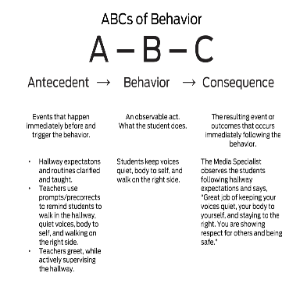
ABCs of Behavior
Notes:
Trainor Notes:
To Know/To Say The consequences of behavior affect future performance of that behavior. One effect is an increase in the likelihood the behavior will recur in the future.
A consequence can also decrease the likelihood the behavior will recur in the future.
The ABC’s of Behavior table illustrates how consequences can increase the likelihood the behavior will be repeated in the future.

Slide 17
Unpacking the Importance and Impact of Positive Consequences
Specific Positive Feedback should be provided enough to ensure expected student behavior receives more attention than unexpected behavior.
4 positive interactions for each corrective interaction (4:1 ratio)
It is critical to use positive specific feedback when students are in the initial acquisition phase of learning new skills.
Other forms of reinforcement can occur less frequently, such as monthly, quarterly, or annually as ways to reinforce skills in the fluency stage of learning.
Notes:
Trainer Notes:
To Know/To Say: As schools develop their schoolwide system to encourage expected behavior, it is important to think about when recognition will take place. We have discussed how specific positive feedback should be provided frequently enough to ensure appropriate student behavior receives more attention than unexpected behavior. Research in education and psychology indicates positive teacher and staff interactions should occur at a frequent rate, with a ratio of 4:1, or four instances of positive interaction for each corrective or negative interaction. This is especially important when students are in the initial acquisition phase of learning new skills.
Other components of the schoolwide system to encourage expected behavior may occur less frequently, in an intermittent way, reinforcing skill learning in the fluency stage of learning. Just as quarterly honor roll students are announced, monthly or quarterly recognition for social behavior gives students goals to work toward.
A comprehensive schoolwide system to encourage expected behavior would also include some long-term, occasional activities at the end of the semester or school year. Occasional encouragement assists in the maintenance and generalization stages of learning. A range of recognition activities will help keep your school wide system interesting and fun for students and staff.

Slide 18
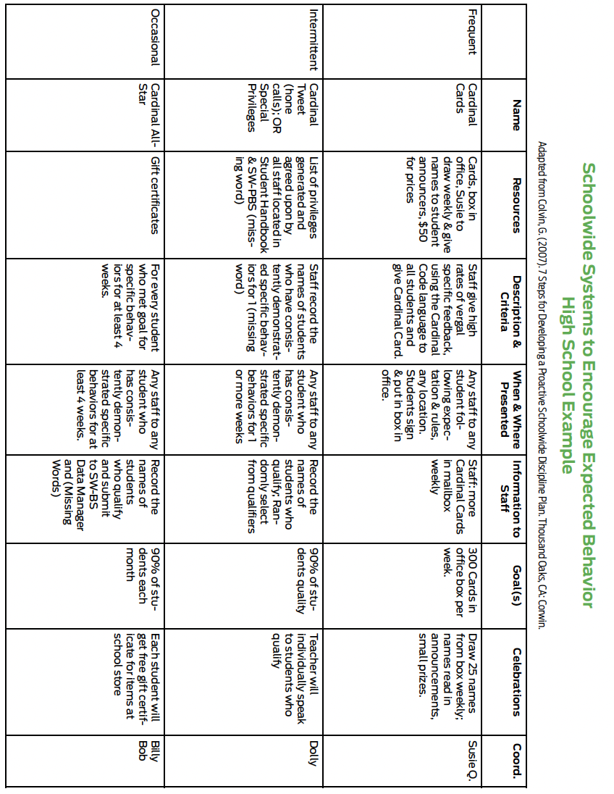
Example of a Schoolwide System to Encourage Expected Behavior
Notes:
Trainer Notes:
To Know/To Say:
The phases of learning directly affect the frequency of feedback students need to successfully continue through the phases.
In addition, a written schoolwide system to encourage expected behavior should include enough information to thoroughly describe how each component is intended to be implemented. This slide is an example of a schoolwide system to encourage expected behavior that is comprehensive and detailed that would be an important addition to a school’s staff SW-PBS handbook.

Slide 19
Things to include when developing a schoolwide encouragement system:
Not all students are encouraged by the same thing or in the same ways.
As students are learning new skills, they need immediate and frequent reinforcement.
As students demonstrate mastery, they respond to intermittent and long-term reinforcement to maintain their social behavioral efforts.
Many students try to get social attention, others try to avoid
Students who avoid social attention may be reinforced by solitary activities, privileges, or tangibles.
Young students are often motivated by adult attention, while older students typically are more motivated by peer attention, activities, privileges, or freedom.
Notes:
Trainer Notes:
To Know/To Say: It is typical for schools to have a variety of ways to encourage students to improve academic, artistic, or athletic performance such as daily grades, quarterly and semester grades, honor roll, awards assemblies, math bowl trophies, music certificates, drama medals, athletic “letters,” etc. A schoolwide system to encourage expected behavior is similar to encouragement for other forms of performance. Yet often this schoolwide system to encourage expected behavior is rarely as organized or systematized in our schools. If the schoolwide systems do exist for student of the month, citizenship awards, and the like, they are rarely tied to the schoolwide expectations and SW-PBS systems.
MO SW-PBS encourages schools to pull strategies together to create and document a comprehensive schoolwide system to encourage expected behavior. While a “ticket” or tangible schoolwide system for encouraging expected behavior will cover many of your reinforcement needs, it is important to remember:
• Not all students are encouraged by the same thing or in the same ways.
• As students are learning new skills, they need immediate and frequent reinforcement.
• As students demonstrate mastery, they respond to intermittent and long-term reinforcement to maintain their social behavioral efforts.
• Many students try to get or seek social attention, while others try to avoid it.
• Students who avoid social attention may be reinforced by solitary activities, privileges, or tangibles.
• Many young students are motivated by adult attention, while older students typically are more motivated by peer attention, activities, privileges, or freedom.
Therefore, it is recommended that a schoolwide system to encourage students include social attention, activities, or tangible items that appeal to all student needs in your school. ² Keep in mind your school context, budget/resources, existing systems, and other considerations when developing the schoolwide system. Once developed, it must be implemented with fidelity, consistency, and equity, and be sustainable over time.

Slide 20
Discussion
With your team, discuss what kind of encouragement system might work in your school.
What are some ways you can reinforce students frequently?
Intermittently and occasionally?
How will you reinforce students who want to avoid social attention?
Notes:
Trainer Notes:
To Know/To Say: With your team, discuss what kind of encouragement system might work in your school. What are some ways you can reinforce students frequently? Intermittently and occasionally? How will you reinforce students who want to avoid social attention?

Slide 21
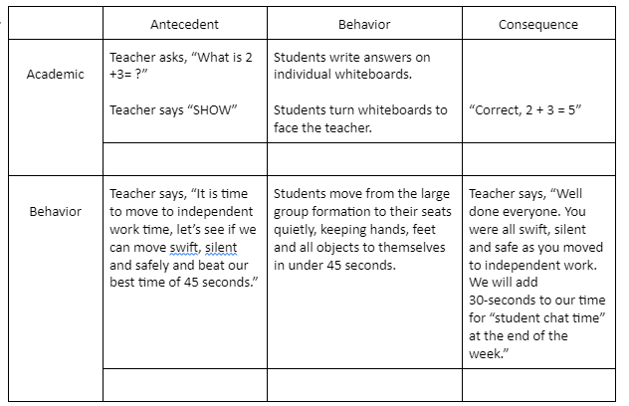
Pause & Reflect
EXAMPLE OF ACADEMIC AND
BEHAVIOR CONSEQUENCES
Notes:
Trainer Notes:
To Know/To Say: Engagement Activity: With your team review the example of academic and behavior consequences.
As you can see, “Student chat time” is time earned for students to engage in socialization, and used as a student chosen positive reinforcer.
List ways your school uses positive consequences to reinforce students for academic performance. Now list ways your school reinforces students for social behavioral performance. How can you tie these together?
Pause the video, when you are ready, resume the video to continue.
Provide staff professional learning so all staff understand the ABCs of behavior, emphasizing the connection between antecedents that can set students up for successful behavior and consequences that encourage future use of the same behavior.
The activity you just completed is a good way to make this point with staff.

Slide 22
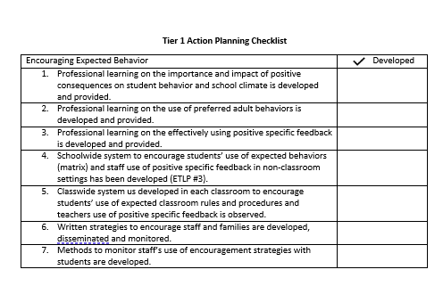
Progress Monitoring
Notes:
Trainer Notes:
To Know/To Say: There are several tools that your team can use to monitor whether you have the essential elements or features developed, to assess the quality of your artifacts and to gain feedback from school staff regarding implementation efforts.
These tools include the:
Tier 1 Action Planning Checklist Use this checklist to confirm everything that your team has developed and create action steps on those that are unchecked.

Slide 23
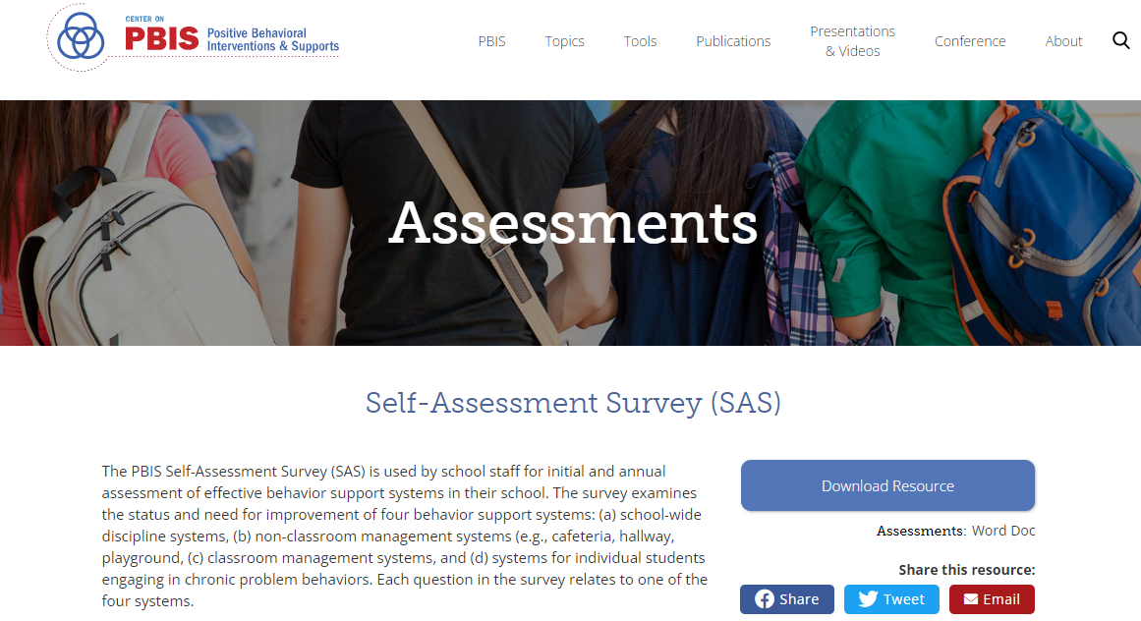
Progress Monitoring
Notes:
Trainer Notes:
To Know/To Say: Self-Assessment Survey (or SAS) – The SAS is a research validated survey that measures perceptions of all staff on the status and priority for improvement of SW-PBS.

Slide 24
Progress Monitoring
Notes:
Trainer Notes:
To Know/To Say: Finally, the Tiered Fidelity Inventory (or TFI) – The TFI is a research validated tool that measures the building leadership teams perception of implementation fidelity of all three tiers.

Slide 25
Closing/Next Steps
Reflect on how your building leadership team engages staff in discussing the importance and impact of positive consequences on student behavior and school climate.
Next steps include
Decide upon simple action steps to develop and sustain your schoolwide system for encouraging expected behavior.
Update your action plan using the Tier 1 Action Plan template and the Tier 1 Action Planning Checklist.
Use the Tier 1 Artifacts Rubric to assess the quality of the resources your team develops.
Use the results of the PBIS Self-Assessment Survey (SAS) to gain perspective from all staff, and results from the PBIS Tiered Fidelity Inventory (TFI) to gain perspective from your building leadership team.
Notes:
Trainer Notes:
To Know/To Say: During this lesson, you learned the importance of building a comprehensive system to encourage and motivate students as they are learning expected behaviors and maintain those skills as they become fluent in their use.
How will your SW-PBS Leadership Team engage staff in discussing the importance and impact of positive consequences on student behavior and school climate?
Next steps include
Decide upon simple action steps to develop and sustain your schoolwide system for encouraging expected behavior.
Update your action plan using the Tier 1 Action Plan template and the Tier 1 Action Planning Checklist.
Use the Tier 1 Artifacts Rubric to assess the quality of the resources your team develops.
Use the results of the PBIS Self-Assessment Survey (SAS) to gain perspective from all staff, and results from the PBIS Tiered Fidelity Inventory (TFI) to gain perspective from your building leadership team.
Additional information can be found in the SW-PBS Handbook and Tier 1 Implementation Guide.

Slide 26
References
1. Colvin, G. (2007). 7 steps for developing a proactive school discipline plan: A guide for principals and leadership teams. Thousand Oaks, CA: Corwin.
2. Lane, K. L., Kalberg, J. R., & Menzies, H. M. (2009). Developing schoolwide programs to prevent and manage problem behaviors: A step-by-step approach. New York: Guilford.
Notes:
Transcript for video version: Here are the references for this lesson.
1. Colvin, G. (2007). 7 steps for developing a proactive school discipline plan: A guide for principals and leadership teams. Thousand Oaks, CA: Corwin.
2. Lane, K. L., Kalberg, J. R., & Menzies, H. M. (2009). Developing schoolwide programs to prevent and manage problem behaviors: A step-by-step approach. New York: Guilford.
If more references are needed, you can refer to the Reference section in the Missouri SW-PBS Tier Implementation Guide available on the Missouri SW-PBS website.

Slide 27
Contact Information
Check Out MO SW-PBS on Social Media:
Facilitator Contact Information:
pbismissouri.org
List HERE
facebook.com/moswpbs
instagram.com/moswpbs/

