Slide 1
The Role Function Plays in Behavior
Notes:
Trainer Notes:
To Know/To Say:

Slide 2
Working Agreements
Be Respectful
Be an active listener—open to new ideas
Use notes for side bar conversations
Be Responsible
Be on time for sessions
Silence cell phones—reply appropriately
Be a Problem Solver
Follow the decision making process
Work toward consensus and support decisions of the group
Notes:
Trainer Notes: Hide or delete this slide if presenting the entire PLM
To Know/To Say: “These will be the Working Agreements we will honor during all our training sessions this year.”

Slide 3
Attention Signal
Notes:
Trainer Notes: Hide or delete this slide if presenting the entire PLM; Facilitator: Select an attention signal.
To Know/To Say: “One of our agreements is to follow the attention signal.”
“Your team will work with your school to develop an attention signal you will use in every setting.”
“In order to get all of you focused after discussions, activities or breaks,
I will ________________________________________.”
(Insert your attention signal here.)
“Your task will be to finish your sentence, quiet your voice and ____________________________.”
(Insert what you want participants to do.)

Slide 4
Introductions
Notes:
Trainer Notes: Hide or delete this slide if presenting the entire PLM; Select an introductions activity.
To Know/To Say:

Slide 5
Handouts
FC2L2 HO1 A-B-C Classroom Management
FC2L2 HO2 Comparing Similar Behaviors
FC2L2 HO3 ABC with Function
FC2L2 HO4 ABC with Function - Answer Key
FC2L2 HO5 ABC Strategies
FC2L2 HO6 ABC Strategies - Answer Key

Slide 6
Lesson Description
This lesson will build understanding around function-based thinking, specifically focusing on the role function plays in behavior. Participants will learn how to use the science of behavior to determine why students are behaving the way they are (function) and use this logic in their professional practice.
Notes:
This lesson will build understanding around function-based thinking, specifically focusing on the role function plays in behavior. Participants will learn how to use the science of behavior to determine why students are behaving the way they are (function) and use this logic in their professional practice.

Slide 7
Lesson Outcomes
At the end of this session, you will be able to…
Define function of behavior.
Identify functions that typically maintain behavior.
Apply functional logic in choosing strategies to modify the environment to increase the likelihood that the expected behavior will be demonstrated.
Notes:
Trainer Notes:
To Know/To Say:

Slide 8
Reflective Questions
How can an environment encourage or discourage certain behaviors?
How can understanding function of behavior help educators be more efficient and effective in managing classroom behavior and increase student success?

Slide 9
Pre-Requisites
Missouri SW-PBS Handbook > “Foundations of Function Based Thinking- The Science of Behavior”
Course - A Systems Approach to SW-PBS

Slide 10
Key Terms
Antecedent: Includes Setting Events which are conditions or circumstances that alter the probability of a behavior occurring and Triggers which are an event that activates the behavior of interest.
Behavior: An observable, measurable act.
Consequence: The resulting event or outcome that occurs immediately following the behavior.
Function of behavior: The ‘why’ of the behavior.
.
Notes:
Trainer Notes:
To Know/To Say: Here are key terms and acronyms that will be used in this lesson.

Slide 11
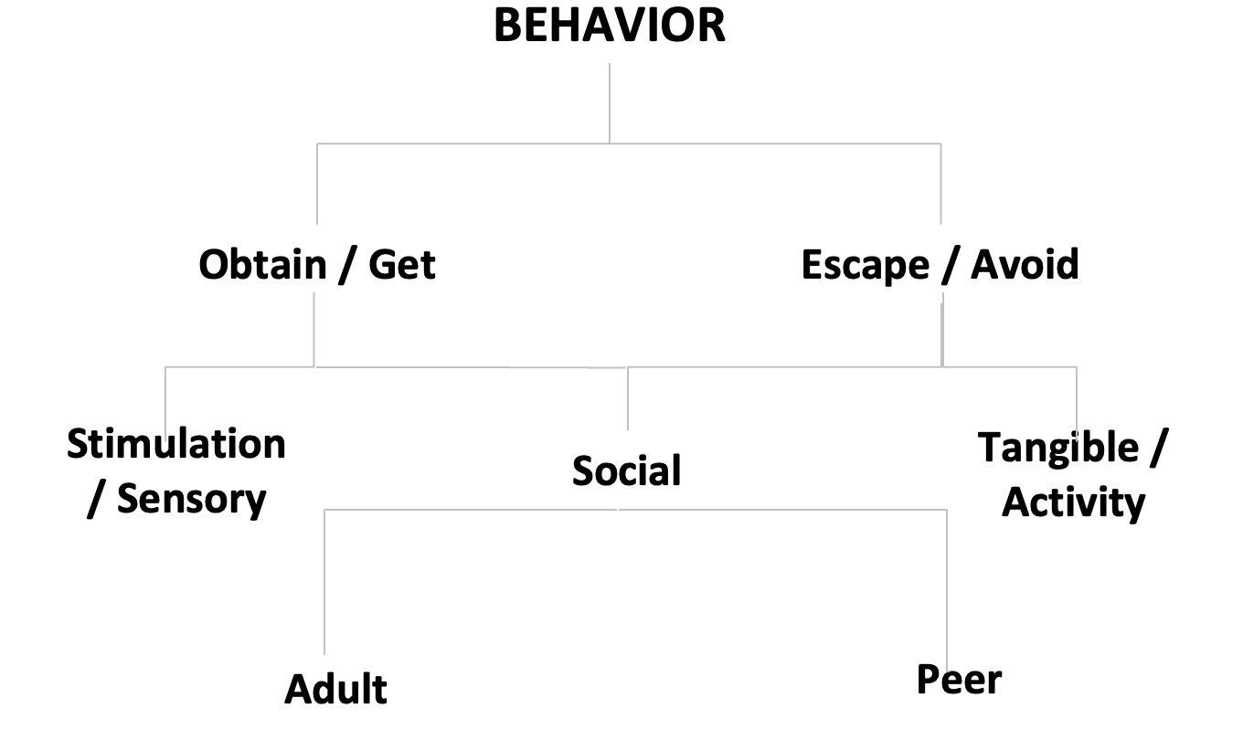
Function of Behavior
Notes:
Trainer Notes:
To Know/To Say: Humans learn through repeated experience that, under specific Antecedent conditions, engaging in a particular Behavior will reliably result in a particular Consequence or outcome. The goal is to look for and find patterns within student behavior to identify the function of behavior.
For the most part, the function of human behavior can boil down to either a need or desire to obtain or avoid
attention (from certain peers or adults),
activities or items
sensory experiences or sensations

Slide 12
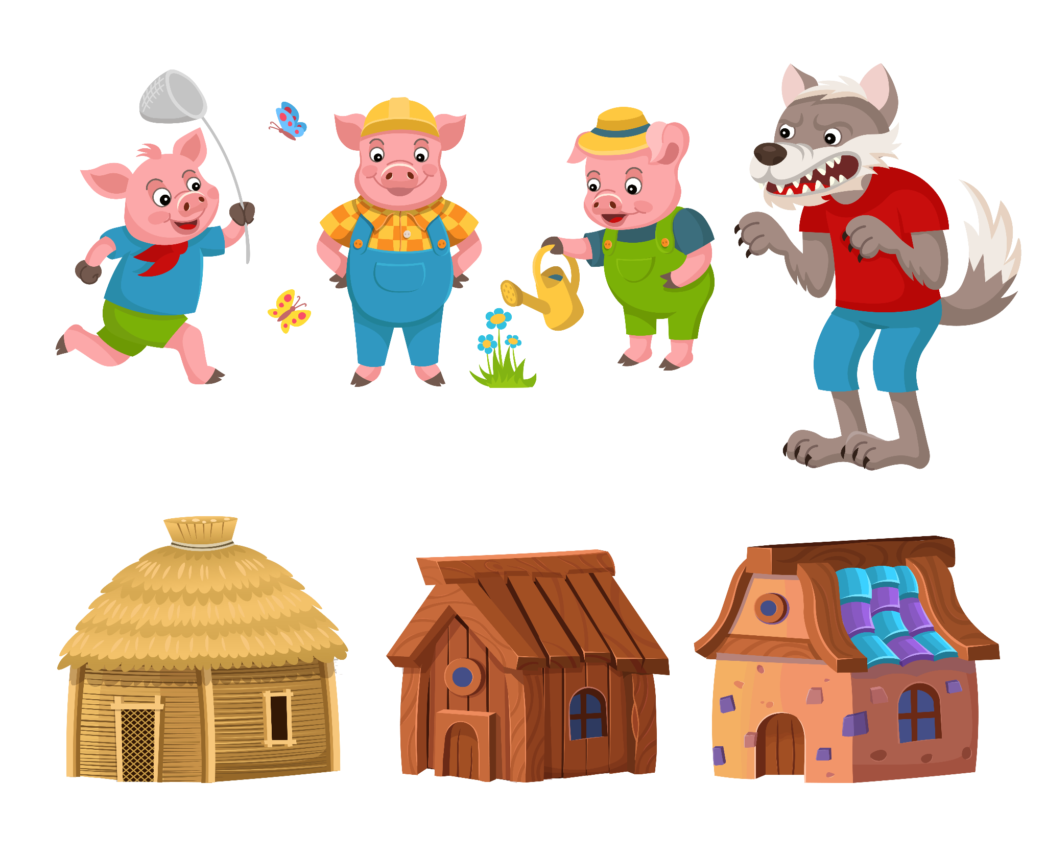
Activity: Alternative Explanations
What is the function of the Big Bad Wolf’s behavior? How would we know?
Notes:
Trainer Notes:
To Know/To Say: Recall that behavior is a form of communication. Unfortunately, some students learn that unexpected behavior is the most efficient and effective method to communicate their needs. If a student repeatedly engages in unexpected behavior, he/she is most likely doing it because the behavior is functional, meaning the behavior is serving a purpose for the student.
In the story of the 3 Little Pigs we see the wolf repeatedly knocking down the homes of the 3 pigs. We always assume that the function of the Wolf’s behavior is that he intends to eat them.
Given this is a fairy tale, which means anything is possible, is there an alternative function of the wolf’s behavior? How would we know what the function of the wolf’s behavior is?

Slide 13
Analyzing Behavior
Big Bad Wolf
Antecedent | Behavior | Consequence | Function
The Big Bad Wolf approaches the door of one of the 3 Little Pigs and knocks loudly. The Pigs deny entry to Big Bad. | Big Bad is so angry, he loses his temper & huffs & puffs w/ all his might. | The house falls down and the pig runs away. | While Brothers Grimm would tell us Big Bad is hungry…What Could the function of Big Bads’ behavior be … … he wants a friend?
Notes:
Trainer Notes
To Know/To Say: Let’s look a bit deeper.
The antecedent to Big Bad’s “tantrum” is he approaches the door of one of the 3 Little Pigs and innocently knocks and offers a greeting.
The Pig denies entry to Big Bad.
The Behavior and in this case we’d call it unexpected, big Bad is so hurt and angry he loses his temper, and and he huffs and puffs with all his might
The Consequence Big Bad accidentally blows the house down and the frightened Pig runs away before he can explain his intentions.
The Function…or WHY Big Bad is behaving this way…is sometimes more complicated than it might appear at first glance. While Brothers Grim would tell us Big Bad is hungry…What Could the function of Big Bads’ behavior be
He’s new to the neighborhood and wants to say hello?
He wants to borrow a cup of sugar to make some cookies?
He is lonely and wants to make a friend but doesn’t know how?
In reality, sometimes the function is obvious, other times the dynamics at play in behavior are complex and require further investigation.

Slide 14
What About Power or Control?
Notes:
Trainer Notes:
To Know/To Say:“Power” and “control” are sometimes referred to as function of behavior; however, the constructs of power and control do not provide enough observable or measurable descriptors to provide a purpose of behavior, nor to provide sufficient information to develop an environmental adjustment to either antecedents or Rather, every instance where a student is attempting to achieve a function is an attempt to control the outcome. Knowing what outcome the student is attempting to achieve helps us understand why the behavior is happening, which can lead to a successful intervention. Knowing the student is attempting to control the outcome does not provide us with this information.
consequences.
Consider a student who makes up stories about peer behavior during recess and is sent to the office for lying. One might suggest that the student is looking to control others (their teachers) or exhibit power (over peers). A more thorough examination of this scenario might show that in getting sent to the office, the student is escaping the playground where they are often bullied. So the function of the behavior in this instance might be avoidance of peer attention and/or certain situations. In addition, the student might enjoy watching what is going on in the office while waiting to talk to an administrator, or might enjoy the one-on-one attention of adults, or one adult in particular.
Research by Iovanonne, Anderson, and Scott suggest that if initial instincts are to classify the function of a particular behavior as either power or control, to ask “How do you know that the function is power or control” or “What does that look like, power over who or what; what is being controlled?” Often, answers to these questions will identify an observable outcome that is serving as the function of the behavior¹.

Slide 15
Consider Max
Notes:
Trainer Notes:
To Know/To Say: Max is a student who has a history taunting peers. When teachers were initially asked about Max’s behavior and potential function, they indicated that Max engages in this behavior in order to demonstrate power over other individuals.
Knowing that it is not possible to plan a behavioral intervention around power, the teachers were asked:
“What does that look like, power over who or what; what is being controlled?”
In response, the teachers were able to identify that Max taunts peers and that those peers will ultimately do whatever Max wants them to do in order to avoid further negative interactions (e.g., access to the front of the line for playground equipment, an object they possess).
While the initial suggestion was that Max’s behavior was a result of power over others, deeper analysis indicates that the function maintaining Max’s behavior is getting access to peers. The issue is Max doesn’t know how to make friends in a manner that other students know and would prefer him to use.
Individually or with your team reflect on the example and contemplate or discuss why “control” and “power” are not helpful when attempting to analyze behavior.

Slide 16
Is Function Important?
Let’s listen to what Dr. Terrance Scott (4:55 to 7:10) has to say about the importance of looking at function
Notes:
Trainer Notes: Advance the video the indicated segment (4:55 to 7:10). https://www.google.com/url?q=https://vimeo.com/92366677&sa=D&source=editors&ust=1636654843177000&usg=AOvVaw2xatiMfHY7PbRl12Z4hQX-
To Know/To Say:
Watch the video then say; One takeaway from this segment of the video is that the same behavior can have different functions. Therefore, when planning a response to a behavior, it is more important to think about the function driving the behavior when selecting strategies as opposed to the behavior itself.

Slide 17
Activity: Comparing Scenarios
Comparing Similar Behaviors with a Different Function
Access HO3 “Comparing Similar Behaviors”
Read through the 2 scenarios.
Answer the questions that follow the scenarios.
Notes:
Trainer Notes:
To Know/To Say: The following activity on comparing similar behaviors helps illustrate the importance of considering function when responding and selecting strategies to change student behavior.
Access Handout 3 Comparing Similar Behaviors and read through the 2 scenarios.
Then with your team or individually answer the questions following the scenarios to complete the ABC-Function Table.
Finally, consider these guiding questions:
What unexpected behaviors are similar for these two students?
What are the antecedents to these unexpected behaviors?
What are the consequences of these unexpected behaviors?
As a result, what are the functions of Bill and Ann’s behaviors?
How might your strategies to change these students' behavior be different based on the function?

Slide 18
A-B-Cs Planning, Begin with B
A - B - C
Notes:
Understating the chain of behavior will help you teachers be proactive and effective in increasing the likelihood of EXPECTED behavior, providing more opportunities to delivery specific, positive feedback, reducing the likelihood of unexpected behavior, and improve planning when responding to UNEXPECTED behavior is required.
While the chain is usually taught as A-B-C, when educators plan they
Begin with the “B” or EXPECTED Behavior that is the target for students to achieve,
Then plan Antecedents to increase the likelihood of the EXPECTED Behavior being displayed and
Finally plan Consequence strategies to systematically reinforce EXPECTED behaviors and strategies to efficiently and effectively discourage UNEXPECTED Behavior.
Let’s take a closer look at all 3 components more closely

Slide 19
Replacement Behavior
Notes:
Trainer Notes:
To Know/To Say: First, identify the replacement behavior, this means a classroom expected behavior that will achieve the same function for the student. For instance, if the individual is seeking attention, the replacement behavior will need to provide access to attention and not access to another function, like escape.
Once the replacement behavior has been identified, it needs to be explicitly taught and modeled so that the student would be able to independently demonstrate fluency with use of the replacement behavior. If the student has trouble demonstrating the behavior or completing the task consider if the task is developmentally or academically appropriate for the student.
Once a replacement behavior has been identified and taught to fluency, then you will want to re-examine the antecedents and consequences to determine what changes would be required in order to increase the likelihood of the replacement behavior being demonstrated and decrease the likelihood of the unexpected behavior being demonstrated.

Slide 20
Planning Antecedent Interventions
Antecedent Strategies
Notes:
Trainer Notes
To Know/To Say: Next the teacher needs to consider antecedent interventions to increase the likelihood that the student will demonstrate the expected replacement behavior.
A beginning place is to directly teach the replacement behavior with a tell-show-practice approach.
For a student acting out as a strategy for avoiding academic tasks, task initiation or persistence is the expected behavior and the teacher needs to consider task difficulty, or activity sequencing and choice.
For Max, the student taunting peers practicing classroom expectations and routines, as well as planning for more opportunities to partner with peers in structured ways might be enough for him to build some prosocial friendships. Max might also need some targeted social skills lessons.

Slide 21
Planning Consequences
Consequence Strategies
Notes:
Trainer Notes:
To Know/To Say: The final planning component is consideration of a consequence system.
In traditional reactive or punitive approaches to discipline, the emphasis is on consequences, or what is done following the unexpected behavior, with the intention to punish or decrease the likelihood of the behavior being demonstrated again.
In many instances, adults use strategies they presume will decrease the unexpected behavior.
This punishment may actually inadvertently reinforce or increase the unexpected behavior because it allows the student to escape the task, activity, or interactions that they wish to avoid. Example: If a student is sent to the office for problem behavior in a specific class, the punishment of sending to the office may reinforce the problem behavior if the student is successfully getting out of the task. Additionally, the extra attention from an adult may also serve a function of reinforcing the unexpected student behavior.

Slide 22
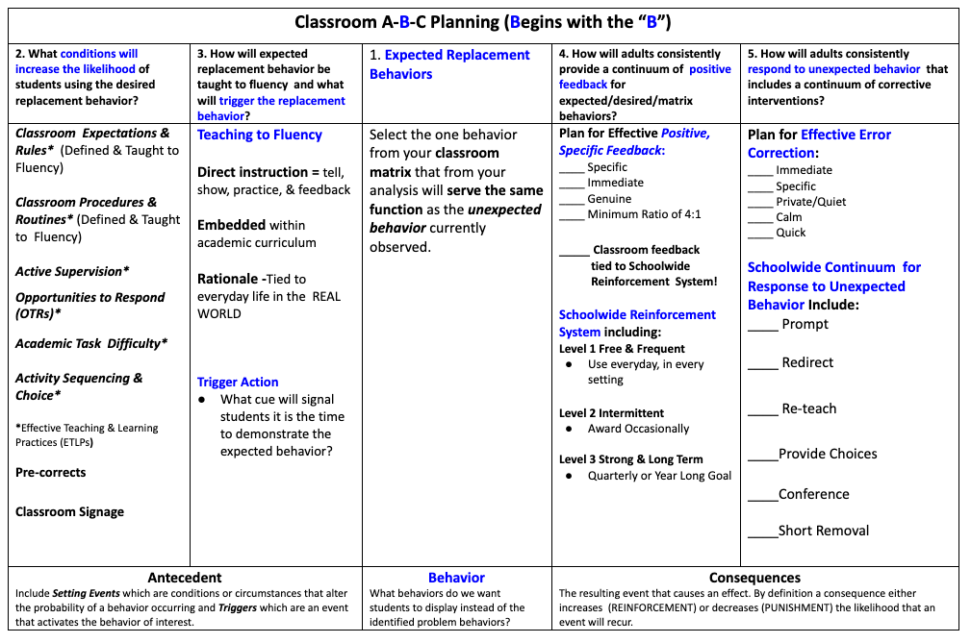
Classroom A-B-C Planning
https://pbismissouri.org/
Notes:
How to go about planning with Function AND the ABCs in mind is a fairly straightforward process. This table outlines the evidence based antecedent and consequence practices MO SW-PBS encourages all districts, schools and classrooms to use, as well as a process for clarifying expected student behavior in all settings including classrooms. On our website PBISMissouri.org you can learn more by looking at three areas: the Tier 1 Workbook and Resources page, the Tier 1 Courses page along with the page in Tier 1 focused on the Effective Teaching & Learning Practices (ETLPs).
The process outlined here could also be applied at the schoolwide level by exchanging the ETLPs with Tier 1 Clarifying & Teaching Expected Behaviors in column 2 while retaining Active Supervision, Pre-Corrects and signage but changing it to schoolwide signage.

Slide 23
Examine the Antecedent and Consequences
Brian is a student in Ms. Smith’s class. Ms. Smith assigns Brian to a cooperative learning group.
The peers in this group complain when Brian talks too loudly and interrupts other group members.
As a result, Ms. Smith tells Brian, “Please return to your desk and work alone.”
Notes:
Trainer Notes: Chart with possible answers to prompts below is on the next slide.
To Know/To Say: Consider the A-B-C and the function of this scenario.

Slide 24
Examine the Antecedent and Consequences – ABC + F
Current ABCs with Function
Antecedent(s) Working in a cooperative group. | Behavior Brian talks too loudly and interrupts others. | Consequence(s) Brian has to work alone. | Function Escape or avoid peers.
Notes:
Trainer Notes:
To Know/To Say: Possible answers include:
Antecedent(s): Working in a cooperative group.
Behavior: Brian talks too loudly and interrupts others. Consequence(s): Brian has to work alone.
Function: Escape from peers.
In reviewing the scenario, the first step in shifting Brian’s behavior from his current unexpected behavior, to those the teacher has identified as expected, the potential function of Brian’s unexpected behavior needs to be identified so that environmental changes can be planned and more importantly implemented.
What is the function of Brian’s unexpected behavior?
What would the replacement behavior be for Brian?
What could possible antecedents be that would support Brian demonstrating those replacement behaviors?
What consequences would support the replacement behavior?

Slide 25
Replacement Scenario - 1
Antecedent | Behavior | Consequence | Function
Notes:
Trainer Notes:
To Know/To Say: Let’s Practice
-What could the replacement behaviors be for Brian? Remember he is behaving unexpectedly in order to escape academic tasks.

Slide 26
Replacement Scenario - 2
Antecedent | Behavior | Consequence | Function
 | asking appropriately to work alone or take a break working with preferred peer(s) working for brief periods in small groups
Notes:
Trainer Notes:
To Know/To Say:
-What could the replacement behaviors be for Brian?
Brian could
ask appropriately to work alone or to take a brief break from work with peers
work with preferred peer(s)
working for brief periods in small groups

Slide 27
Replacement Scenario - 3
Antecedent | Behavior | Consequence | Function
reminder or pre-correct of expected behaviors re-learning the rules of small groups allowing choice of work in a smaller group, with a preferred partner, or alone using a timer to set work with peers duration | asking appropriately to work alone or take a break working with preferred peer(s) working for brief periods in small groups
Notes:
Trainer Notes:
To Know/To Say: - What could possible antecedents be that would support Brian demonstrating those replacement behaviors?
Teacher could provide
reminder or pre-correct of expected behaviors
reteach the rules of small groups working together
allow choice of work in a smaller group, with a preferred partner, or alone
a timer to set work with peers duration

Slide 28
Replacement Scenario - 4
Antecedent | Behavior | Consequence | Function
reminder or pre-correct of expected behaviors re-learning the rules of small groups allowing choice of work in a smaller group, with a preferred partner, or alone using a timer to set work with peers duration | asking appropriately to work alone or take a break working with preferred peer(s) working for brief periods in small groups | working alone or with preferred peer / group for brief periods (if appropriately requested) positive, specific feedback for demonstration of expected behavior
Notes:
Trainer Notes:
To Know/To Say: - What consequences would support the replacement behavior?
Brian works with preferred peer(S) for brief periods of time
Brian gets to work independently part of the time
Brian can receive more positive attention than corrective attention

Slide 29
Replacement Scenario - 5
Antecedent | Behavior | Consequence | Function
reminder or pre-correct of expected behaviors re-learning the rules of small groups allowing choice of work in a smaller group, with a preferred partner, or alone using a timer to set work with peers duration | asking appropriately to work alone or take a break working with preferred peer(s) working for brief periods in small groups | working alone or with preferred peer / group for brief periods (if appropriately requested) positive, specific feedback for demonstration of expected behavior | escape from work with peer(s) adult attention
Notes:
Trainer Notes:
To Know/To Say:- What resulting functions occur that could support Brian’s persisting with the replacement behavior?
Primarily, Brian could
escape from work with peer(s)
Also, consider Brian might benefit from some positive or reinforcing interaction from adults. In addition, giving Brian strategies to advocate for himself, while maintaining an expectation that he learn to and sustain the ability to work with peers. These expectations, as well as the antecedent supports to help Brian meet them, can help foster a sense of relatedness or belonging to his classroom community and help him grow his competence in navigating peer relations. Relatedness and competence are 2 critical elements of human motivation which we will learn more about in lesson 3 of this course.

Slide 30
Consequence Strategies
Watch Dr. Terrance Scott Video (7:10 to 9:08) on the importance of changing more than just the consequences.
Notes:
Trainer Notes: Read the script below and then watch the video, advancing to 7:10 to 9:08 https://www.google.com/url?q=https://vimeo.com/92366677&sa=D&source=editors&ust=1636654843178000&usg=AOvVaw1pawTcg_RFeW5b38MB6BaX
To Know/To Say: Watch the video from Dr. Terrance Scott³ on the importance of changing more than just the consequences.

Slide 31
Teacher Providing Feedback
Notes:
Trainer Notes:
To Know/To Say: While teachers may occasionally need to plan for making environmental adjustments to meet the needs of individual students., the ABC-Function logic can also be applied to larger populations of students (e.g., classwide, or schoolwide in specific non-classroom settings).
For instance, a teacher may use classroom minor behavior data to focus on behaviors that are collectively unexpected such as blurting out answers during group instruction. In this instance additional instruction, practice, positive specific feedback, which could be tied to rewards or tangibles can be given to support students’ use of the identified replacement behavior of hand raising during certain whole group activities.

Slide 32
Pre-Correcting
Notes:
Trainer Notes:
To Know/To Say: In a schoolwide setting such as bus dismissal procedures, the Building Leadership Team may provide updated lessons and pre-correcting scripts for expected dismissal behaviors;
morning announcements might remind everyone of the dismissal expectations;
teachers may deliver min-lessons;
the dismissal active supervision directions are re-distributed to all staff and prompts to be ready and actively supervising are provided in emails, staff memos, posted in teacher lounge and workroom;
special tickets for expected dismissal behaviors are distributed by staff as they provide dismissal supervision between periods and students can use these at the school store.

Slide 33
Pre-Correcting at Secondary Level
Notes:
Trainer Notes:
To Know/To Say: In a schoolwide setting such as the cafeteria, the Building Leadership Team may provide updated lessons and pre-correcting scripts for expected cafeteria behaviors;
At the secondary level the antecedent strategies my be more focused on signage, student handbook information and direct teaching on a jump start day where freshmen student go through orientation.
The cafeteria active supervision directions are re-distributed to all staff and prompts to be ready and actively supervising are provided in emails, staff memos, posted in teacher lounge and workroom;
special tickets for expected cafeteria behaviors are distributed by staff as they provide cafe supervision and can be used to purchase items in the cafeteria.

Slide 34
Activities:
Complete “HO4 ABC with Function”
Then use “HO5 ABC with Function - Answer Key” to compare to your answers.
Complete “HO6 ABC Strategies”
Then use “HO7 ABC Strategies - Answer Key” to compare to your answers.
Notes:
Trainer Notes:
To Know/To Say:Now that you understand the importance of function, access the “HO4 ABC with Function” handout for additional practice with identifying the function of behavior. Compare your responses with the answers provided in “HO5 ABC with Function - Answer Key.”
For more practice on selecting function based strategies, access the “HO6 ABC Strategies” handout. Compare your responses to the answers provided in the “HO7 ABC Strategies - Answer Key” handout.
Pause the video, and when you are ready, continue watching.

Slide 35
Discussion
Use classroom minor behavior data to identify a common unexpected behavior in your classroom or school.
What is the possible function of the unexpected behavior?
What do you want students to do instead? Have you taught that behavior to fluency?
What antecedent strategies would increase the likelihood the expected behavior will be demonstrated? How will expected behavior be cued or activated?
What consequence would encourage the expected behavior? Does this consequence serve the same function?
What consequence would discourage unexpected behavior?
Notes:
Trainer Notes:
To Know/To Say:Use classroom minor behavior data to identify a common unexpected behavior in your classroom or school.
What is the possible function of the unexpected behavior?
What do you want students to do instead? Have you taught that behavior to fluency?
What antecedent strategies would encourage the expected behavior?
What consequence would support the expected behavior? Does this consequence serve the same function?
What consequence would discourage unexpected behavior?
If you have some students who do not respond, how might you differentiate to support a different function?

Slide 36
Next Steps
Notes:
To Know/To Say: During this lesson, you learned how to apply function-based thinking to individuals or groups of students. By examining patterns of behavior through the ABC model, you were able to determine the ‘why’ of the behavior. Using this information, you were able to identify how to change behavior(s) by teaching a replacement behavior and then manipulating the antecedents and consequences. Additional information can be found in the MO SW-PBS Handbook.
Now what? How can you take what you have learned and share with others in your building or district?
If you are a classroom teacher how will planning with function in mind change how you plan for instruction in your classroom? Or when you join in a student assistance team meeting?
If you are a building administrator, how can you use a function-based approach to provide guidance when supporting a teacher one-on-one, or in a student assistance team meeting, or support schoolwide planning when your building leadership team or BLT meets and reviews schoolwide office discipline referral data?
If you work at the districtwide level, how could function based thinking become part of the knowledge base teachers, administrators and teams of educators leverage when they plan for instructional supports?

Slide 37
References & Resources
Iovanonne, R., Anderson, C. M., & Scott, T. M. (2013). Power and control: Useful functions or explanatory fictions? Beyond Behavior, 22(2), 3-6. https://doi.org/10.1177/107429561302200202
Scott, T. (2013). Function-based thinking and a simplified functional behavioral assessment [Video]. Vimeo. https://vimeo.com/92366677
Sugai, G., Horner, R. H., Dunlap, G., Hieneman, M., Lewis, T. J., Nelson, C. M., Scott, T., Liaupsin, C., Sailor, W., Turnbull, A. P., Turnbull, H. R., III, Wickham, D., Wilcox, B., & Ruef, M. (2000). Applying positive behavior support and functional behavioral assessment in schools. Journal of Positive Behavior Interventions, 2(3), 131-143. https://doi.org/10.1177/109830070000200302
MO SW-PBS Online: Tier 1 Workbook & Resources Tier 1 Courses ETLPs
Notes:
Trainer Notes:
To Know/To Say:

Slide 38
Contact Information
Check Out MO SW-PBS on Social Media:
Facilitator Contact Information:
pbismissouri.org
facebook.com/moswpbs

