Slide 1
Missouri Schoolwide Positive Behavior Support
Function Based Thinking

Slide 2
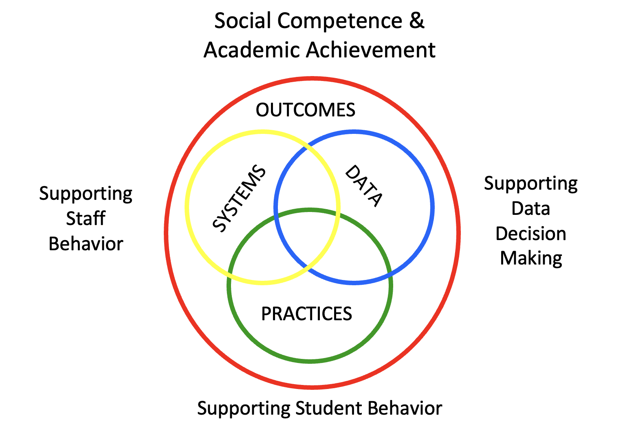

Slide 3
Common
Vision
Common
Language
Common
Experience
Mission
Vision
Goals
District Leadership Team
Building Leadership Team
Common Philosophy & Purpose
Function-based Thinking & Human Motivation Theory
Clarifying Expected Behavior
Teaching Expected Behavior
Encouraging Expected Behavior
Discouraging Unexpected Behavior
Effective Teaching & Learning Practices (ETLPs)
Data Based Decision-making
Students & Family
Non-Certified Staff
Certified Staff
Administration

Slide 5
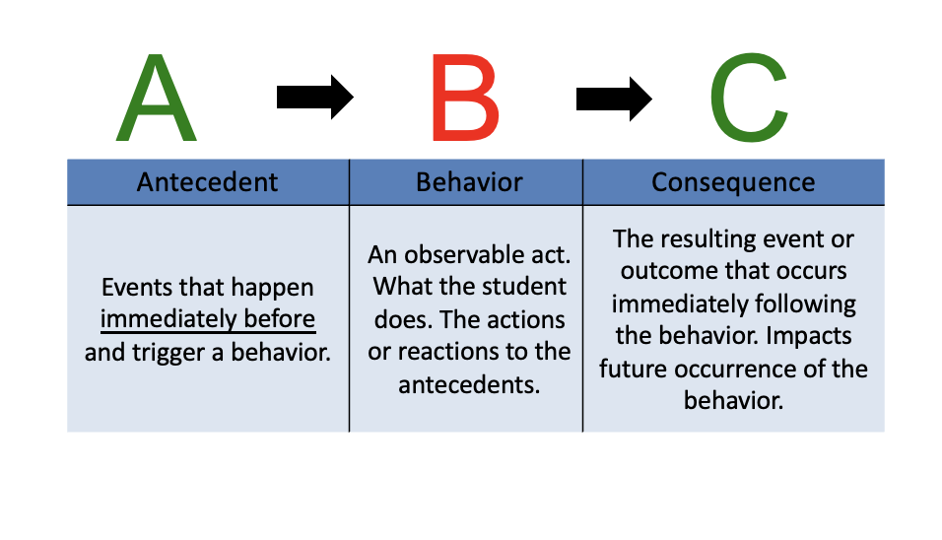
Behavior is functionally related to the environment.
Behavior = what the an individual ‘does’ (expected or unexpected).
Environment = all that happens before, during, and after the individual’s behavior.

Slide 6
Environmental Interventions Are Key
Environments that increase the likelihood expected behaviors will occur/recur are guided by a core set of effective practices that are implemented with fidelity, consistency and equity.
Notes:
Fidelity, consistency and equity are the characteristics that increase the probability of adults and students displaying expected behaviors day in and day out.

Slide 7
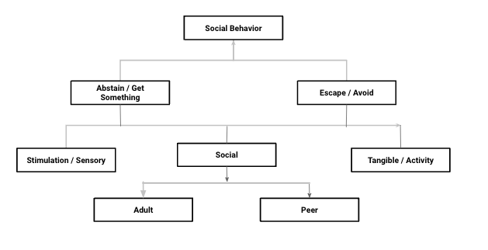
Function(s) of Behavior
Notes:
social behavior is driven by two main outcomes…obtaining or avoiding
this can either be obtain or avoid stimulation/sensory experiences, social interaction, or tangible or activity
in the social interaction it can be with adults, peers or both.

Slide 8
Notes:
Turn and talk with a partner… then we can compare thoughts:
seeking attention of teacher or Peers
seeking teacher approval, peer attention, or they enjoy the subject or all 3.
avoid teacher or task, or both…or they are tired
seeking activity, peer attention, sensory stimulation
avoid task
seek teacher attention, opportunity for positive feedback

Slide 9
A-B-Cs at work Schoolwide
Antecedent | Behavior | Consequence
Events that happen immediately before and trigger a behavior. Example: Hallway rules and procedures are established and taught. Teacher prompts, “Remember to stay right in the hallway.” | An observable act. What the student does. The actions or reactions to the antecedents. Example: Student keeps voice quiet, body to self and walks on the right. | The resulting event or outcome that occurs immediately following the behavior. Impacts future occurrence of the behavior. Example: Teacher gives specific verbal recognition. Expected hall behavior increases.
Notes:
3 minutes
Antecedent: Hallway expectations and routines clarified and taught
Teachers use prompts/pre-corrects to remind students to walk in the hallway, quiet voices, body to self, and walking on the right side.
Teachers greet, while actively supervising the hallway
Behavior: Students keep voices quiet, body to self, and walk on the right side
Consequence:
The Media Specialist observes the students following hallway expectations and says, “Great job of keeping your voices quiet, your body to yourself, and staging to the right. You are showing respect for others and being safe.”
To Know/To Say:
The consequences of behavior affect future performance of that behavior. One effect is an increase in the likelihood the behavior will recur in the future. A consequence can also decrease the likelihood the behavior will recur in the future. Knowing the function of the behavior helps identify what types of reinforcement we should provide students in order to increase expected behaviors. The ABC table shown illustrates how consequences can increase the likelihood the behavior will be repeated in the future.

Slide 10
FBT = Wise Interventions & Situation Crafting
Wise Interventions:
“- interventions that nurture people’s belonging and self worth.” pg xiii
“...are ideally the right small thing, just what is psychologically needed for a specific person in a specific time and place to set them on a better path.” p 45
“Situation crafting: shaping a situation, even in seemingly minor ways, in order to foster belonging.” pg 3
“What is the next smallest thing you can do to achieve the outcomes you have?” ~ Dr. Rob Horner, National Center on PBIS originating co-founder

Slide 11
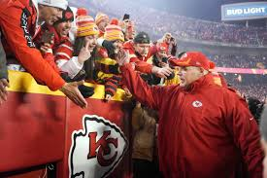
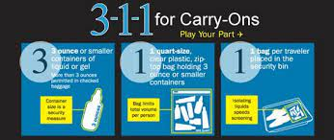
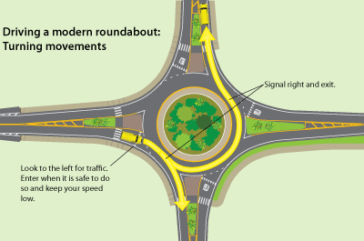
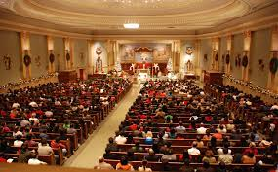
Examples of FBT / Situation Crafting in Practice - Community
1
2
3
4
5
6
Notes:
Turn and talk with a partner… then we can compare thoughts:
How has Taylor Swift used situation crafting to enhance the work environment and the participant experience of her “Eras tour?”
Handwritten notes and $100K bonus to each of the 55 truck drivers, bonuses to all creative staff and crew; for participants providing connections to music and looks from each of her ERAs
What is the culture and expectations for a Chief’s home game? Are all expectations explicit and written down? How are expectations shared?
How does the TSA communicate their expectations for aeronautical safety?
How do civil engineers teach the general public to safely navigate a roundabout?
How do churches engage in situation crafting to create a welcoming and predictable experience?
How do fast food establishments not only craft experiences for staff but also for customers?

Slide 12
Function Based Thinking
Schoolwide Application

Slide 13
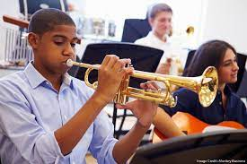
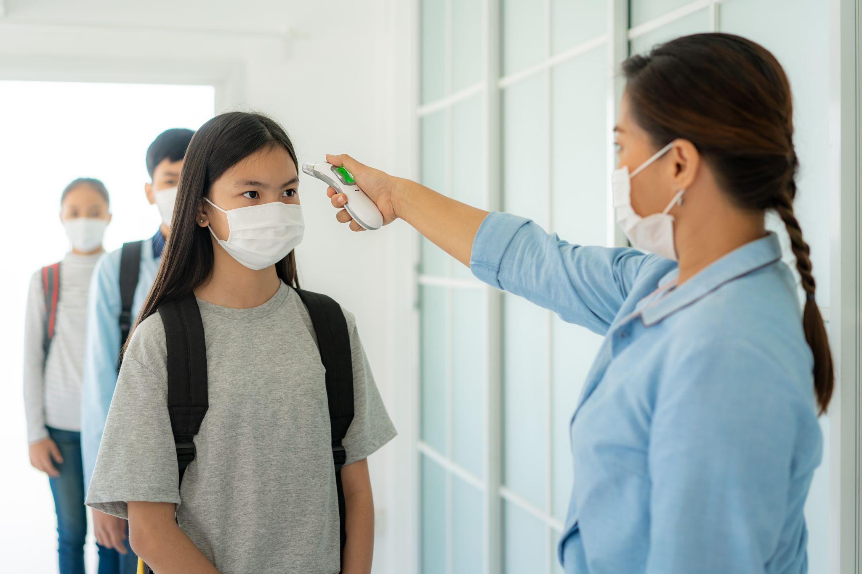
Examples of FBT / Situation Crafting in Practice - Schools
1
2
3
4
5
6
Notes:
Turn and talk with a partner… then we can compare thoughts:
1. What kinds of expectations and procedures do band teachers have to plan for, teach directly and reinforce in order to have an orderly and melodious classroom?
2. What kind of expectations, rules and procedures did schools plan for and implement to meet CDC or state guidelines for reopening?
3. What kinds of expectations and procedures do science teachers have to plan for, teach directly and reinforce in order to have orderly environment for student scientific investigation?
4. What expectations, rules and procedures for administrators and teachers have to plan for, teach directly and reinforce in order to have an orderly and successful lunch hour?
5. What expectations, rules and procedures for administrators and teachers have to plan for, teach directly and reinforce in order to have an orderly and successful arrival or dismissal?
6. 1. What kinds of expectations and procedures doctor content teachers have to plan for, teach directly and reinforce in order to have orderly and academically rigorous instruction?

Slide 14
FBT and Schoolwide Antecedents
What conditions will encourage student use of the expected replacement behavior chosen from the schoolwide MATRIX ? ____ Non-Classroom Routines Defined & Taught to Fluency ____ Classroom Procedures & Routines Defined & Taught to Fluency ____ Lesson Plans for Schoolwide Expectations ____ Schoolwide Teaching Schedule ____ Active Supervision ____ Pre-corrects (reminders to follow expectations) ____ Schoolwide Signage ____ Communication with Students and Families (e.g., handbooks, social media, morning announcements, PTA meetings, school events, etc.) | How will expectations be taught/re-taught? For Teachers and Staff ____ Establish schoolwide Common Philosophy & Purpose; develop organization wide knowledge of Function Based Thinking & Human Motivation Theory ____ Staff Meetings ____ Staff memos, emails, newsletters, and handbooks ____ Collaborative Teams > departmental or grade level meetings ____ Scheduled Staff PD (e.g., New Staff Orientation, Back to School events) For Students ____ Direct instruction = tell, show, practice, feedback. ____ Embedded within academic curriculum. ____ Rationale -Tied to everyday life in the REAL WORLD
+ = in place w/evidence
√ = in place w/out evidence
- = not currently in place
Notes:
Here are examples of Antecedent interventions that leadership teams need to plan for, deliver to staff and monitor to increase the likelihood that schoolwide environments will be safe, orderly and productive. How would you rate your schoolwide implementation of these Antecedent interventions?
+ = action/step that is already in place and evidence exists to document it’s use
√ = action/step that is currently in place, but for which there is no evidence of implementation, or that could be tweaked to improve implementation
- = action/step that is not currently in place

Slide 15
FBT and Schoolwide Consequences
How will adults consistently provide a continuum of positive feedback for schoolwide expected /matrix behaviors and classroom expectations and rules? Plan for Effective Positive Feedback: ____ Positive ____ Specific ____ Immediate ____ Genuine ____ Minimum Ratio of 4:1 Schoolwide Plan including: ____ Free & Frequent Use everyday, in every setting ____ Intermittent Award Occasionally ____ Occasional Quarterly or Year Long Goal ____ Performance Feedback for Staff | How will adults consistently respond to unexpected behaviors (social errors) that includes a continuum of corrective interventions? Plan for Effective Discouraging Unexpected / Error Correction: ____ Immediate ____ Specific ____ Private/Quiet ____ Calm ____ Quick Schoolwide Continuum to Include: ____ Prompt ____ Redirect ____ Re-teach ____Provide Choices ____Conference ____Short Removal
+ = in place w/evidence
√ = in place w/out evidence
- = not currently in place

Slide 16
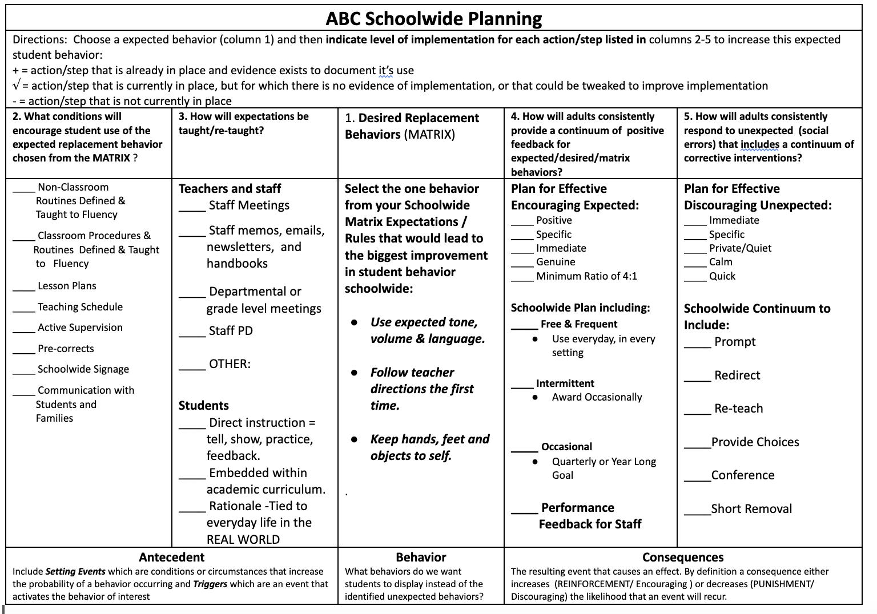
Notes:
Provide the handout if participants are in school / BLT teams and have them use this form to assess what’s “in place”.
What we know is that with increased classroom structure and consistency, the greater likelihood that students will demonstrate expected behaviors.
Begin by defining and/or selecting the desired/expected behavior
Next plan and deliver the Antecedent interventions …
expectations, procedures & routines schoolwide and in the classroom
Lesson Plans and a schedule for teaching expectations.
Delivering Active Supervision, providing pre-corrects, utilizing the schoolwide signage as a teaching resource
Establishing effective 2-way communication with students and families; handbooks, newsletters, social media, school / community events
Finally, plan for and deliver Consequences to Reinforce Expectations, and deliver consequences to Discourage Unexpected behaviors.

Slide 17
FBT - Schoolwide Planning
What Essential Components* of SW-PBS does your building have in place to serve as Antecedent Interventions? How will/do you monitor implementation fidelity?
What Essential Components* of SW-PBS does your building have in place to serve as Behavioral Interventions? How will/do you monitor implementation fidelity?
What Essential Components* of SW-PBS does your building have in place to serve as Consequence Interventions? How will/do you monitor implementation fidelity?
*Common Philosophy & Purpose - Leadership - Clarify - Teach - Encourage - Discourage - DBDM

Slide 18
FBT / Situation Crafting Schoolwide Planning
Antecedents | Expected Behaviors (What Expected Behaviors does our school need to focus on?) | Consequences
Keep Doing: Tweak: Rethink - Start: | Setting the stage for beginning of the year: Commonly needed during the school year: | Keep Doing: Tweak: Rethink - Start:
Notes:
Alternately teams could use a simple form such as this for planning what to keep, what to tweak and what to revamp or add.

Slide 19
Function Based Thinking
Classroom Application & the ETLPs

Slide 20
Common
Vision
Common
Language
Common
Experience
Mission
Vision
Goals
District Leadership Team
Building Leadership Team
Common Philosophy & Purpose
Function-based Thinking & Human Motivation Theory
Clarifying Expected Behavior
Teaching Expected Behavior
Encouraging Expected Behavior
Discouraging Unexpected Behavior
Effective Teaching & Learning Practices (ETLPs)
Classroom Expectations & Rules
Classroom Procedures & Routines
Classroom Encouraging Expected Behavior
Classroom Discouraging Unexpected Behavior
Classroom Active Supervision
Classroom Opportunities to Respond
Classroom Activity Sequencing & Choice
Classroom Task Difficulty
Data Based Decision-making
Students & Family
Non-Certified Staff
Certified Staff
Administration

Slide 21
What are the ETLPs?
Effective Teaching & Learning Practices
The research-based practices demonstrated to increase the likelihood of expected behavior and decrease unexpected behavior, while increasing academic learning time.

Slide 22
Effective Teaching & Learning Practices (ETLPs)
Classroom Expectations & Rules
Classroom Procedures & Routines
Classroom Encouraging Expected Behavior
Classroom Discouraging Unexpected Behavior
Classroom Active Supervision
Classroom Opportunities to Respond
Classroom Activity Sequencing & Choice
Classroom Task Difficulty
Classroom Expectations & Rules
Classroom Procedures & Routines
Classroom Encouraging Expected Behavior
Classroom Discouraging Unexpected Behavior
Classroom Active Supervision
Classroom Opportunities to Respond
Classroom Activity Sequencing & Choice
Classroom Task Difficulty
Notes:
The first 4 ETLPs are the application of the Tier 1 Schoolwide logic to the classroom:
Clarify and teach rules and expected classroom behaviors.
Clarify and teach procedures for expected classroom routines.
Encourage student use of expected behaviors.
Discourage student use of unexpected behaviors.
The BIG ideas to remember about the first 4 ELTPs are:
they form THE CORE for all Tier 2 or Tier 3 interventions and increase instructional time.
teachers cannot target or intensify what they are not yet delivering with fidelity, consistency and equity.
students cannot benefit from what they are not yet receiving, and identifying a student as non-responding or in need of tiered supports when they have not yet received tier 1 is counter productive.

Slide 23
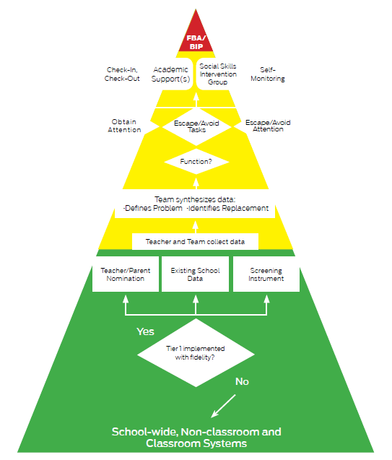
MO SW-PBS Student Support Model
The triangle is not to scale!
The foundational components schoolwide and at the classroom level need to be implemented with fidelity, consistency and equity in order for the advanced tier supports to be implemented with high levels of success.
Without fidelity, the number of students who appear to need advanced tier supports will easily outstrip the capacity to deliver tiered interventions.
Notes:
No school has the resources to provide targeted, intensive or individualized supports to all or even many students! In order to be efficient and effective w/ resources, schools need to implement schoolwide and classroom PBS to decrease the number of students who may be identified as non-responding.
Projected Capacity = using metrics commonly held of 80% for Tier 1, 15% for Tier 2 and 3-5% for Tier 3, how many students would be projected needing advanced tier support for a school the size of yours?
Schoolwide Base Rate = prevalence rate, or the proportion of students who exhibit indicators of risk.
Serviceable Base Rate = what is the capacity of the building to serve advanced tier supports? What is the amount of students identified as “at-risk” who could reasonably be served in small group or individual interventions. How many staff have capacity to provide CICO or SSIG with fidelity, consistency and equity? How many students can each of these people reasonably
serve?

Slide 24
Classroom Effective Teaching & Learning Practices
Antecedent | Behavior | Consequence
Establish clear classroom expectations. Increase predictability through clear procedures and routines. Teach and review expected behaviors and routines. Use pre-corrects to prompt students about expectations. Actively supervise–moving, scanning, and interacting. Provide a high number of Opportunities to Respond (OTRs) to academic material with high rates of success. Intersperse brief/easy tasks among more difficult ones. Provide opportunities for choice. | Increase student engagement with learning and task completion while displaying expected social behaviors. | Provide high rates of positive specific feedback. Use a full continuum of positive consequences. Use a full continuum corrective consequences.
Notes:
The ETLPs can be thought of through a FBT lens.

Slide 25
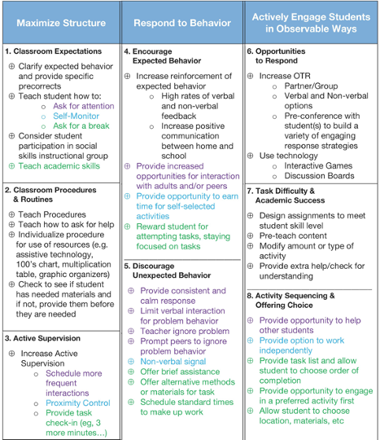
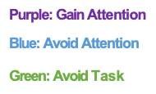
Effective Teaching & Learning Practices (ETLPs) & FBT
Applying FBT in the delivery of ETLPs, think whole class as well as individual student.

Slide 26
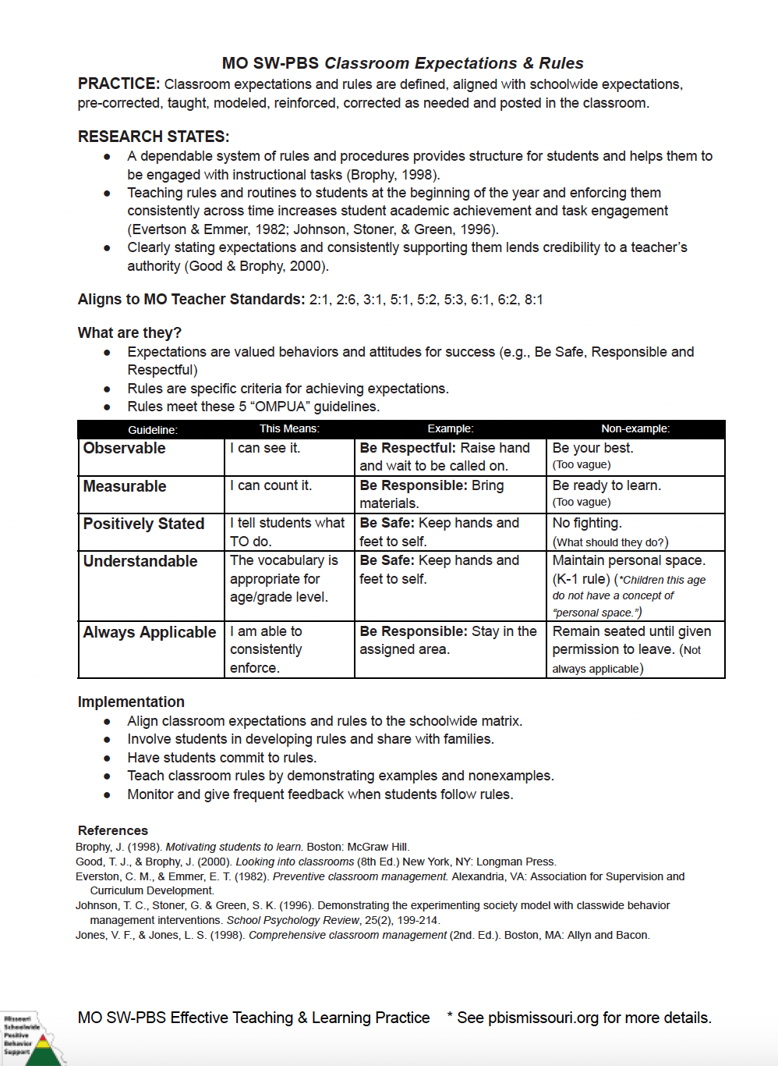
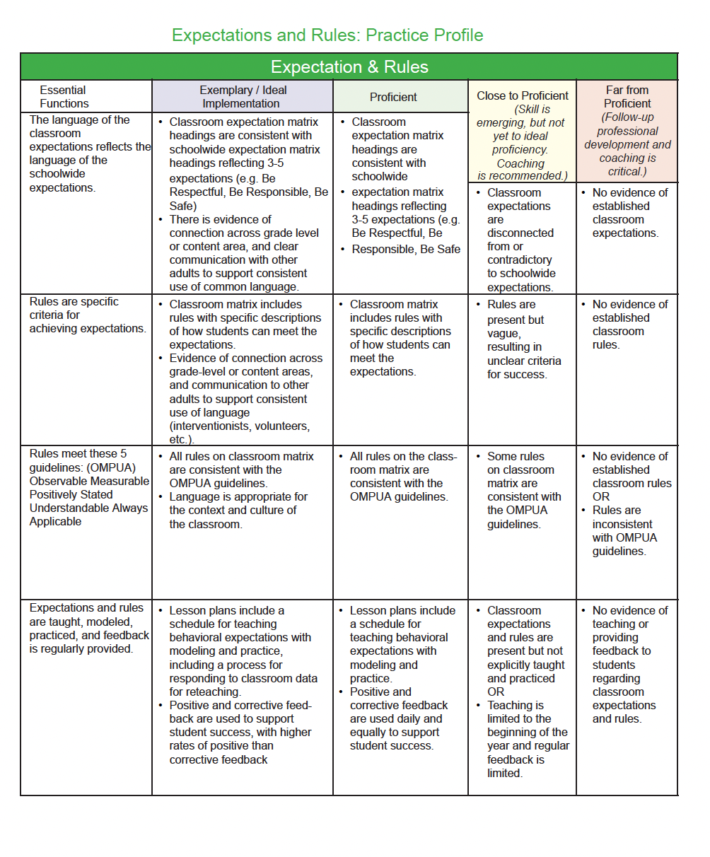
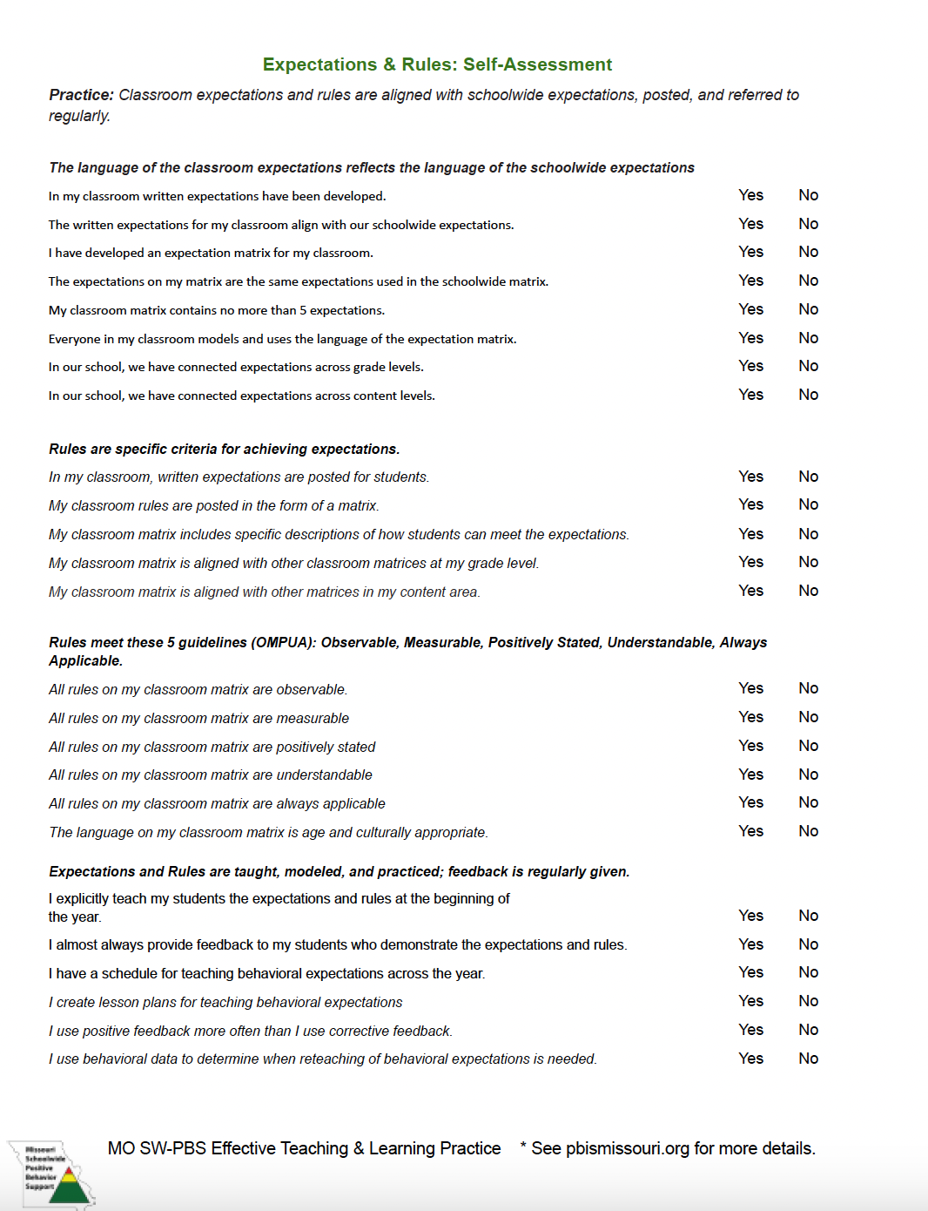
ETLP “Teacher Tools”
Link to ETLPs on the Web
Notes:
ETLP Teacher Tools are resources for educators to use for self reflection and planning. Each ETLP has an aligned Teacher Tool that provides two primary tools, the first of which is a single page summary that describes the practice, shares the research evidence for the practice, offers information about the practice, a summary of implementation tips is included along with references for further study as desired.
The second part of the Teacher Tool is a Self-Assessment and Practice Profile which provides the teacher with in-depth reflective questions relating to the critical elements of the practice, and a practice profile that allows the teacher to align their self ratings to a practice profile and consider if their practice is Far from Proficient, Close to Proficient, Proficient, or Exemplary.

Slide 27
FBT / Situation Crafting in MY Classroom
Antecedents | Expected Behaviors (What classroom expectations and/or procedures & routines do I need to focus on?) | Consequences
Keep Doing: Tweak: Rethink - Start: | Setting the stage for beginning of the year: Expectations to commonly teach/re-teach during the school year: | Keep Doing: Tweak: Rethink - Start:
Notes:
Alternately teams could use a simple form such as this for planning what to keep, what to tweak and what to revamp or add.

