Slide 1
Lesson 3: Developing Non-Classroom Procedures
MO SW-PBS

Slide 2
Facilitator Notes – Delete this slide
Handouts Needed:
HO 10 Missouri School Example Procedures List
HO 11 Non-Classroom Procedure Worksheet
HO 12 Writing Non Classroom Procedures
HO 13 Action Planning Checklist
HO-AP MO SW-PBS Tier 1 Action Plan
HO-APC MO SW-PBS Tier 1 Action Planning Checklist
HO-APR MO SW-PBS Tier 1 Artifact Rubric
Participants Need Access
MO SW-PBS Handbook
MO SW-PBS Tier 1 Implementation Guide

Slide 3
Session at a Glance
This lesson describes the process for defining non-classroom procedures. Clearly defined procedures allow staff to teach and supervise consistently and predictably. When students can predict the events throughout their school day, they are more likely to be engaged and less likely to display problem behavior.
Notes:
Trainer Notes: Read the slide
To Know/To Say:

Slide 4
Working Agreements
Be Respectful
Be an active listener—open to new ideas
Use notes for side bar conversations
Be Responsible
Be on time for sessions
Silence cell phones—reply appropriately
Be a Problem Solver
Follow the decision making process
Work toward consensus and support decisions of the group
Notes:
These will be the Working Agreements we will honor during all our training sessions this year.

Slide 5
Attention Signal Practice
Select and teach an attention signal.
Notes:
“One of our agreements is to follow the attention signal.”
“Your team will work with your school to develop an attention signal you will use in every setting.”
“In order to get all of you focused after discussions, activities or breaks,
I will ________________________________________.”
(Insert your attention signal here.)
“Your task will be to finish your sentence, quiet your voice and ____________________________.”
(Insert what you want participants to do.)

Slide 6
Introductions
Insert an Introductions Activity.
MO SW-PBS
Notes:
Choose an Introductions Activity

Slide 7
Lesson Outcomes
At the end of this session, you will be able to…
Determine procedures for each of the school’s non-classroom settings (e.g., arrival/departure, hallways, cafeteria, recess, restrooms, assemblies, etc.).

Slide 8
Importance of Developing Non-Classroom Procedures
Defining procedures for non-classroom settings is another step in the process of creating a comprehensive social behavioral curriculum.
Notes:
Trainer Notes: Read the slide
To Know/To Say: Defining procedures for non-classroom settings is another step in the process of creating a comprehensive social behavioral curriculum. When procedures are taught and reinforced over time, routines are established that help students meet the schoolwide expectations. Clearly established procedures can dramatically reduce this loss in instructional time.

Slide 9
Key Terms
Procedures: Processes for how things are done in non-classroom settings and each classroom.
Non-classroom areas: Those areas of the school that may be under the direct supervision of a variety of differing adults depending on the day or time.
Notes:
Read the slide or direct participants to read the slide,

Slide 10
Unpacking Developing Non-Classroom Procedures
Procedures are patterns for accomplishing classroom and non-classroom tasks.
Procedures explain the accepted process for carrying out a specific activity, such as sharpening pencils, turning in completed work, using lockers, attending an assembly, going to the restroom.
Procedures form routines that help students meet expectations as stated in schoolwide and classroom rules.
Notes:
Trainer Notes: Read the slide
To Know/To Say: “Procedures are the steps we take to complete a task or how we do something. Routines are the habits we form by repeating the same set of steps over and over.” Routines develop from consistent use of procedures.
Procedures are the processes for how things are done in non-classroom settings and in each classroom.
Procedures and routines are important because they help students follow rules and meet expectations.”

Slide 11
Why Focus on Procedures and Routines?
“When students can predict the events throughout their school day, they are more likely to be engaged and less likely to display problem behavior. One way to increase predictability in a classroom is to establish routines, particularly early in the school year.” Kern & Clemens, 2007, p. 67
Notes:
Trainer Notes: “Research tells us… then read the slide.
To Know/To Say:

Slide 12
Non-classroom Areas
Non-classroom areas are those areas of the school that may be under the direct supervision of a variety of differing adults depending on the day or time.
Non-classroom settings typically have fewer staff supervising larger numbers of students.
Non-classroom areas are often where expected behaviors are not clear or agreed upon by all staff.
Notes:
Trainer Notes:
To Know/To Say: Non-classroom areas are those areas of the school that may be under the direct supervision of a variety of differing adults depending on the day or time. Often these non-classroom settings also have fewer staff supervising larger numbers of students. Another challenge is that non-classroom areas are often those sites where expected behaviors are not clear or agreed upon by all staff.

Slide 13
Possible Procedures
Non-classroom
Arrival
Hallway
Cafeteria
Dismissal
Use of electronics
Classroom
Entering
Transitions
Whole class activities
Small group Activities
Independent Work
Use of electronics
Asking questions
Getting help

Slide 14
Unpacking Developing Non-Classroom Procedures
Effective procedures should be. . .
Positively stated
As brief and concise as possible
Worded in age-appropriate terms
Notes:
Trainer Notes:
To Know/To Say: When defining non-classroom procedures, it is important to consider what will help prevent congestion or confusion that may contribute to misbehavior. Reviewing existing or writing missing procedures may involve making environmental changes such as defining and labeling the “in” and “out” doors or rerouting lines of students to provide more space and to ease crowding. These procedures should be comprehensive enough to ensure student success in each specific setting. Procedures should also follow the OMPUA guidelines, they should be Observable, Measurable, Positively Stated, Understandable, and Always Applicable.

Slide 15
How to Create Effective Procedures
Identify the desired outcome of the procedure.
Sequentially list each step required to complete. an activity (each step must contain an observable action to be performed by the student).
Describe what to do, when to do it and how to do it.
Think of the errors students typically make before, during and after an activity when identifying the steps to include in the procedure.
Notes:
Read the slide, then say, Steps for creating effective procedures.

Slide 16
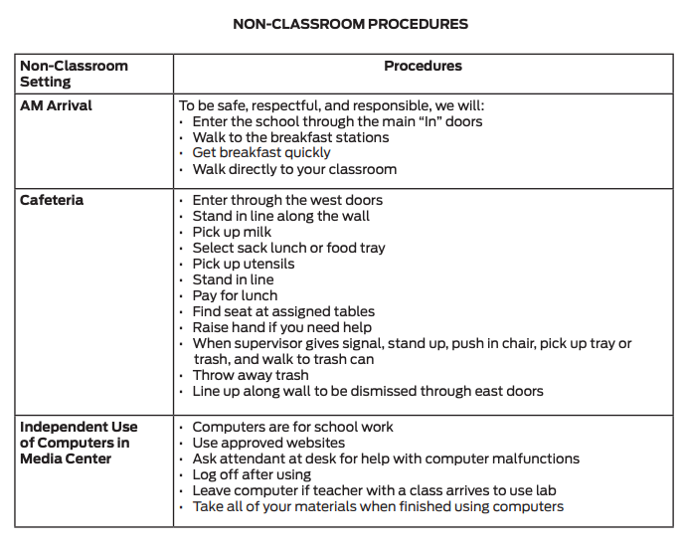
Unpacking Developing Non-Classroom Procedures
Clearly defined procedures allow staff to teach and supervise consistently and predictably.
All staff will teach, model, and reinforce the procedures so it will be important to have staff reach consensus on them.
Notes:
Trainer Notes:
To Know/To Say: Once you have identified your specific behaviors or rules for all settings and each non-classroom area, you may also need to consider more detailed procedures for these settings. Clearly defined procedures allow staff to teach and supervise consistently and predictably. All staff will teach, model, and reinforce the procedures so it will be important to have staff reach consensus on them.

Slide 17
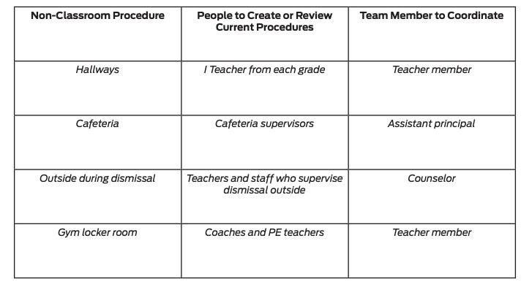
Missouri Middle School Example
Team decided to “divide and conquer” to review and revise existing procedures.
Team members used form to help them create or review current procedures and which team member would lead that process.
Team members identified the non-classroom settings that needed procedures to be established or revised.
Second, they identified staff members to either draft new or review current procedures.
Finally, they assigned a team member to coordinate each procedure.
Notes:
Trainer Notes:
To Know/To Say Here is a Missouri Middle School Example
The Missouri Middle School SW-PBS Leadership Team was feeling pretty good about completing their matrix, but they knew there was more work to be done to complete the social behavioral curriculum. They decided to “divide and conquer” to review and revise existing procedures. As a team, they developed a form to help them create or review current procedures and which team member would lead that process.
First, they identified the non-classroom settings that needed procedures to be established or revised.
Second, they identified staff members to either draft new or review current procedures.
Finally, they assigned a team member to coordinate each procedure.

Slide 18
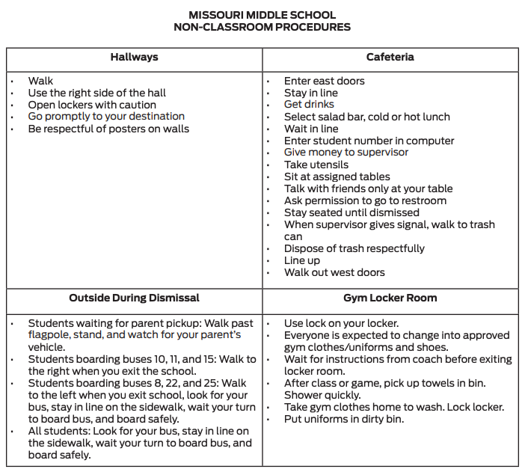
Missouri Middle School Non-Classroom Example Procedures
Notes:
Trainer Notes:
To Know/To Say; Four team members were responsible for observing each setting and coordinating the staff to review existing procedures or create new ones. After new procedures were created, they were shared with all staff who supervised those areas at the next staff meeting. The Leadership Team gave the new procedures to the principal to include in the staff and student handbook.

Slide 19
Activity: Procedure Writing
Review your list on Handout 9 with your team answer the following questions
Discuss and identify people who will draft new or review and revise existing procedures for the non-classroom settings you identified previously.
Document this information in the middle column titled “People to Draft or Review/Revise Current Procedures” of the handout, Non-Classroom Procedures Worksheet. Assign a team member to guide/lead this work and list their name in the “Team Member to Coordinate” right column.
Consider how you might also include students and families in developing non-classroom procedures.
What process will you put into place to get full staff consensus on non-classroom procedures?
How will the non-classroom procedures be shared with teachers, staff, students, and families?
Notes:
Read Slide

Slide 20
Topic in Action: Non-Classroom Procedures
With your team discuss this question
What are some non-classroom procedures that are currently absent or ineffective in your building that are needed to facilitate teaching and supervision?
Document these needed procedures on the left column titled “Non-Classroom Procedure” of the handout 9, “Non-Classroom Procedures Worksheet”.
Notes:
Read the slide, then provide time for this discussion.

Slide 21
Monitoring Quality of Your Work
Tier 1 Action Planning Checklist
Clarifying Expected Behaviors > Item 4
Tiered Fidelity Inventory (TFI)
Item 1.3
Self-Assessment Survey (SAS)
Non-Classroom Subsection Item 1
Notes:
There are several tools that your team can use to monitor the quality of your implementation efforts and/or gain feedback from school staff. these tools include the: Tier 1 Action Planning Checklist - to list products schools need to develop for successful implementation of all essential features of schoolwide Tier 1.
In THIS lesson your team learned about Tier 1 Action Planning Checklist item number number 4, “procedures for each of the schools’ non-classroom settings have been developed and shared with staff.”
Tiered Fidelity Inventory (or TFI) - is a research validated tool that measures the building leadership teams perception of implementation fidelity of all three tiers.
In THIS lesson your team learned about TFI item number 1.3, with the first part focusing on “3-5 schoolwide have been selected and shared with staff”.
Self-Assessment Survey (or SAS) - is a research validated survey that measures perceptions of all staff on the status and priority for improvement of SW-PBS.
In THIS lesson your team learned about SAS “Non-Classroom section “ item number 1, “Schoolwide expected student behaviors apply to non-classroom settings.”
Your team will learn about clarifying expected classroom behaviors and procedures in the Effective Teaching and Learning practices (ETLPs) course, Lessons 2 and 3.
To see the pertinent sections of each tool see the Tier 1 Implementation Guide.

Slide 22
Closing
During this lesson, you learned…
The importance of engaging the voice of all stakeholders in selecting schoolwide expectations?
Next steps include
Developing action steps and a timeline for completion of selecting three to five schoolwide expectations.
Updating your action plan, use the Tier 1 Action Plan Checklist and the MO SW-PBS Tier 1 Artifacts Rubric to assess the quality of your work.
Consider using results of the PBIS Self-Assessment Survey (SAS) to gain perspective from all staff, and results from the PBIS Tiered Fidelity Inventory (TFI) to gain perspective from your Building Leadership Team.
Notes:
Trainer Notes:
To Know/To Say: During this lesson, you learned the first step in developing a social behavioral curriculum, is identifying three to five overarching schoolwide social behavioral expectations that will be defined and agreed to by all staff. These schoolwide expectations will be the cornerstone for all that you will do to implement SW-PBS. How will you engage all staff in selecting schoolwide expectations, the first step to developing your building’s social behavioral curriculum? How will you engage the voice of students and families in developing your expectations?
Next steps include updating your Tier 1 Action Plan. Develop action steps and a timeline for completion for selecting three to five schoolwide expectations. Use the Tier 1 Action Plan Checklist and the MO
SW-PBS Tier 1 Artifacts Rubric to assess the quality of your work. Consider using results of the PBIS Self-Assessment Survey (SAS) to gain perspective from all staff, and results from the PBIS Tiered
Fidelity Inventory (TFI) to gain perspective from your Building Leadership Team.
Additional information about Selecting Schoolwide Expectations can be found in Course 3 of the Missouri SW-PBS Tier 1 Implementation Guide which can be found at www.pbismissouri.org.

Slide 23
Closing
During this lesson, you learned…
The benefits of having clearly established procedures. How will you engage all staff in a process for defining non-classroom procedures?
Next steps include updating your action plan. Develop action steps for a timeline of completion of non-classroom procedures. This includes gaining full staff consensus on non-classroom procedures and sharing these procedures with teachers, staff, students, and families.
Notes:
Trainer Notes:
To Know/To Say: During this lesson you learned the process of developing non classroom procedures and the benefits of having these procedures clearly defined. Clearly defined procedures allow staff to teach, supervise consistently and predictably. When students can predict the events throughout their school day, they are more likely to be engaged and less likely to display problem behavior. How will you engage all staff in a process for defining non-classroom procedures?
Next steps include updating your action plan. Develop action steps for a timeline of completion of non-classroom procedures. This includes gaining full staff consensus on non-classroom procedures and sharing these procedures with teachers, staff, students, and families.

Slide 24
References
Kern, L., & Clemens, N. H. (2007). Antecedent strategies to promote appropriate classroom behavior. Psychology in the Schools, 44(1), 65-75.
Wong, H. K., Wong, R. T., & Seroyer, C. (2005). The first days of school: How to be an effective teacher (p. 352). Mountain View, CA: Harry K. Wong Publications.

Slide 25
Contact Information
Remember to follow MO SW-PBS on social media
Consultant Contact Information:
pbismissouri.org
facebook.com/moswpbs
@MOSWPBS

