Slide 1
Developing a Schedule for Teaching Expectations
Teaching Expected Behavior
Notes:
Trainer Notes:
To Know/To Say:

Slide 2
Facilitator Notes: Delete This Slide
Handouts that will be needed for this PLM:
Example Teaching Schedule
Teaching Schedule Activity

Slide 3
Working Agreements
Be Respectful
Be an active listener—open to new ideas
Use notes for side bar conversations
Be Responsible
Be on time for sessions
Silence cell phones—reply appropriately
Be a Problem Solver
Follow the decision making process
Work toward consensus and support decisions of the group
Notes:
Trainer Notes: Hide or delete this slide if presenting the entire PLM
To Know/To Say: “These will be the Working Agreements we will honor during all our training sessions this year.”

Slide 4
Attention Signal
Notes:
Trainer Notes: Hide or delete this slide if presenting the entire PLM; Facilitator: Select an attention signal.
To Know/To Say:
“One of our agreements is to follow the attention signal.”
“Your team will work with your school to develop an attention signal you will use in every setting.”
“In order to get all of you focused after discussions, activities or breaks,
I will ________________________________________.”
(Insert your attention signal here.)
“Your task will be to finish your sentence, quiet your voice and ____________________________.”
(Insert what you want participants to do.)

Slide 5
Introductions
Notes:
Trainer Notes: Hide or delete this slide if presenting the entire PLM; Select an introductions activity.
To Know/To Say:

Slide 6
Lesson Outcomes
At the end of this session, you will be able to…
Develop a system to teach expected behavior in the social behavioral curriculum, that includes:
developing and sharing a schedule for teaching expected behaviors.
Notes:
Trainer Notes:
To Know/To Say:

Slide 7
“For a child to learn something new you need to repeat it an average of eight times.”
Harry Wong
MO SW-PBS
Notes:
“For a child to learn something new, you need to repeat it an average of eight times.
For a child to unlearn an old behavior and replace it with a new behavior, you need to repeat the new behavior an average of 28 times.
Twenty of those times are used to eliminate the old behavior, and eight of the times are used to learn the new behavior.”
Madeline Hunter

Slide 8
Common Language Requires Teaching
Notes:
Words are powerful. When all staff members use common language, we ensure consistency for all students which is especially important to ensure equitable implementation of practices. The consistency and predictability of a common language is also a critical support for students who are at-risk and at high-risk of behavior incidents, promoting a safe environment where students know the expectations and can predict how others will respond.
In order to establish this common language, the lessons plans that have been developed must be taught by all staff members to all students.

Slide 9
“For a child to learn something new you need to repeat it an average of eight times.”
Harry Wong
MO SW-PBS
Notes:
“For a child to learn something new, you need to repeat it an average of eight times.
For a child to unlearn an old behavior and replace it with a new behavior, you need to repeat the new behavior an average of 28 times.
Twenty of those times are used to eliminate the old behavior, and eight of the times are used to learn the new behavior.”
Madeline Hunter

Slide 10
Teaching Schedule
A significant amount of teaching is needed at the beginning of the year.
Teach just prior to needing to use the behavior (e.g., assembly behavior taught right before the first assembly).
Review should be planned throughout the year, particularly following breaks or holidays.
Teaching focus should reflect student needs; more teaching when problem behavior surfaces.
Develop a perpetual teaching schedule–what will be taught by whom, when.
A schedule for teaching helps to ensure accountability.
MO SW-PBS
Notes:
Direct participants to read the slide, then say,
“Teaching social behavior must be ongoing in order to increase the likelihood that all students will display appropriate behavior in all settings. You should consider reserving time now in the schedule for the teaching of lessons for the next school year.”
When developing a teaching schedule, the following points may need to be considered:
Instruction takes place each day, all day, throughout the entire school year for young students or for those students who continue to demonstrate they are at the acquisition level.
Focused lessons at the beginning of the year to teach all schoolwide and classroom expectations, rules, and procedures. This includes direct instruction the first few weeks of school in the setting where the skills or procedures are used.
Beginning of the school year orientation period, such as a day for underclassmen before all students attend school.
Weekly lessons in advisory period, homeroom, or classroom.
New Student Orientation using student ambassadors as orientation models for newly enrolled students.
Review lessons after school breaks (e.g., long weekends, winter and spring breaks). Weeklong or short reminder lessons as appropriate for the skill level and age of students.
Quarterly assemblies followed with group practice for students who have acquired the skill but need maintenance or an “extra dose” of instruction.

Slide 11
Arranging Time for Teaching
School orientation activities
“Boot camp” the first few weeks of school
Homeroom
Daily class meetings
School-wide announcements over intercom followed by 10-minute lessons
Daily or weekly web announcements
Embedding in academic subjects
Designated time for all to teach (e.g., class right before lunch to teach cafeteria behaviors)
MO SW-PBS
Notes:
“Here are suggestions for scheduling specific times to teach or reteach expectations and behaviors.”
Schools need to decide when lessons will be taught during the day or week. Some typical examples of how to arrange time for teaching social behavior skills might include: homeroom, daily class meetings, schoolwide announcement over the intercom, daily or weekly web announcements, embedding in academic subjects, and older students leading younger students through school orientation activities.

Slide 12
Teaching Schedule Example
Notes:
It is recommended that schools create a teaching calendar that schedules when lessons are to be taught all year long. When developing a teaching calendar, schools may consider devoting a significant amount of teaching at the beginning of the year. Reviews should be planned throughout the year, particularly following breaks or holidays. Teaching just prior to needing to use the behavior (e.g., assembly behavior taught right before the first assembly) should also be scheduled. The year long teaching schedule should provide an outline for the year, but allow for flexibility based on data.

Slide 13
Important Considerations
Schedule is acceptable to stakeholders.
Teaching schedule can be sustained.
Lessons are long enough to teach the skill, but doable.
Adequate staff are available to teach.
Notes:
There are many, many ways teaching can be accomplished. Some important considerations are : 1) making sure the schedule is acceptable to stakeholders, educators, and students teaching lessons, 2) ensuring the teaching schedule can be sustained throughout the year, 3) lessons are long enough to adequately teach the skill but short enough that staff will actually make time to teach and 4) adequate staff are available to teach in the identified settings.

Slide 14
Discussion: Scheduling Teaching
Discuss with your team and be prepared to share with the large group:
How will we arrange for initial teaching of social behaviors at our school?
How will we arrange for regular, ongoing teaching throughout the school year?
What are some creative ways to weave the school-wide teaching of social behavior into our school day and year?
Notes:
Direct participants to read the questions.
Then say,
“Your school may decide to reserve time in the schedule for teaching now, then during Emerging Training Session 1, specifically determine which lessons will be taught during each time.”
Provide approximately 10-15 minutes. Call on volunteers to respond to each of the questions

Slide 15
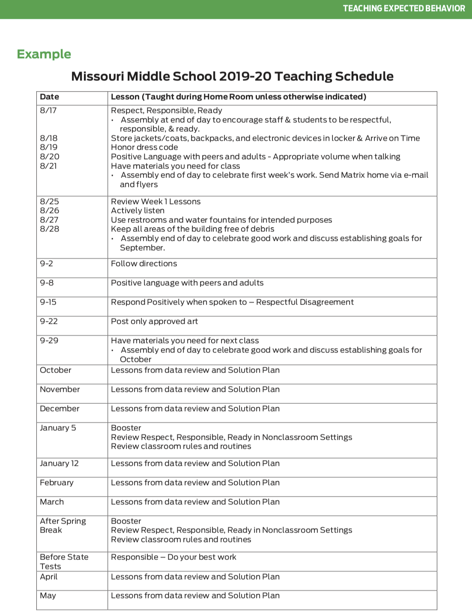
Discussion: Scheduling Teaching
Review and discuss the teaching schedule example.
Based on the grade levels of students in your school, what might be some logical ways to weave initial schoolwide teaching of social behavioral skills into your school day and year?

Slide 16
Activity: Developing a Teaching Schedule
How will you engage staff, students, and families to make decisions about your initial teaching schedule?
Use the lesson schedule form to practice writing a lesson schedule.

Slide 17
Closing and Next Steps
Develop action steps for the creation of an annual plan for the ongoing teaching of all expectations, rules, and procedures.
Notes:
To Know/To Say: During this lesson, you learned how to create an annual teaching schedule that allows for all developed lessons to be taught and also allows time for teaching based on data indicated needs.
Next steps include updating your action plan. Develop action steps for the creation of an annual plan for the ongoing teaching of all expectations and rules. Additional information about developing a teaching schedule can be found in the MO SW-PBS Handbook and the MO SW-PBS Tier 1 Implementation Guide.

Slide 18
References
Algozzine, B., Wang, C., & Violette, A. S. (2011). Reexamining the relationship between academic achievement and social behavior. Journal of Positive Behavior Interventions, 13(1), 3-16.
Notes:
Trainer Notes:
To Know/To Say:

Slide 19
Contact Information
Check Out MO SW-PBS on Social Media:
Facilitator Contact Information:
pbismissouri.org
facebook.com/moswpbs
@MOSWPBS

