Slide 1
Develop “Booster” Lessons for Maintenance of Expected Behavior
Teaching Expected Behavior
Notes:
Trainer Notes:
To Know/To Say:

Slide 2
Facilitator Notes: Delete This Slide
Handouts that will be needed for this lesson:
Example Maintenance Middle Lesson Follow Directions
Example Maintenance High School Lesson Follow Directions
Example Maintenance Secondary Cafeteria Procedure Lesson Plan
Maintenance Lesson Plan Template
Tier 1 Action Plan
Tier 1 Artifact Rubric
Tier 1 Action Planning Checklist

Slide 3
Working Agreements
Be Respectful
Be an active listener—open to new ideas
Use notes for side bar conversations
Be Responsible
Be on time for sessions
Silence cell phones—reply appropriately
Be a Problem Solver
Follow the decision making process
Work toward consensus and support decisions of the group
Notes:
Trainer Notes: Hide or delete this slide if presenting the entire PLM
To Know/To Say: “These will be the Working Agreements we will honor during all our training sessions this year.”

Slide 4
Attention Signal
Notes:
Trainer Notes: Hide or delete this slide if presenting the entire PLM; Facilitator: Select an attention signal.
To Know/To Say:
“One of our agreements is to follow the attention signal.”
“Your team will work with your school to develop an attention signal you will use in every setting.”
“In order to get all of you focused after discussions, activities or breaks,
I will ________________________________________.”
(Insert your attention signal here.)
“Your task will be to finish your sentence, quiet your voice and ____________________________.”
(Insert what you want participants to do.)

Slide 5
Introductions
Notes:
Trainer Notes: Hide or delete this slide if presenting the entire PLM; Select an introductions activity.
To Know/To Say:

Slide 6
Lesson Outcomes
At the end of this session, you will be able to…
Develop a system to teach expected behavior in the social behavioral curriculum, that includes:
creating a set of booster lessons for maintenance of expected behaviors.
Notes:
Trainer Notes:
To Know/To Say:

Slide 7
“”Booster” lessons are lessons taught periodically and are intended to help students maintain the skill over time and in a variety of setting and situations.”
MO SW-PBS
Notes:
Read the slide, then say,
“”Booster” lessons are lessons taught periodically and are intended to help students maintain the skill over time and in a variety of settings and situations.”¹
After you have developed acquisition level lesson plans for your social behavioral curriculum, it is important to consider ways to help students maintain the newly acquired skills. When students show fluency in their use of social behaviors from your matrix, teaching may transfer to more periodic maintenance or “booster” lessons.

Slide 8
Key Terms
Maintenance is the ability to perform a behavior over time.
Notes:
“Booster” lessons are lessons taught periodically and are intended to help students maintain the skill over time and in a variety of settings and situations. Maintenance is the ability to perform a behavior over time. These lessons would consist of reminders of when, where, and how expected behaviors are to be performed. Staff continue to actively supervise giving students feedback to maintain skill usage.
Understanding the skill level of students will ensure staff members design lessons that articulate the purpose of each lesson and use an understandable format to address student needs.

Slide 9
Maintenance “Booster” Lessons
Periodically taught
Intended to help students maintain the skills over time and in a variety of settings and situations
Notes:
In preschool and elementary school, the focus is on directly teaching students the expected social behavior through the tell, show, practice, monitor, and reteaching steps described earlier. Instruction takes place each day, throughout the day, all year long. With consistent and ongoing instruction throughout the year in elementary school, the focus of instruction in middle school and high school may change².

Slide 10
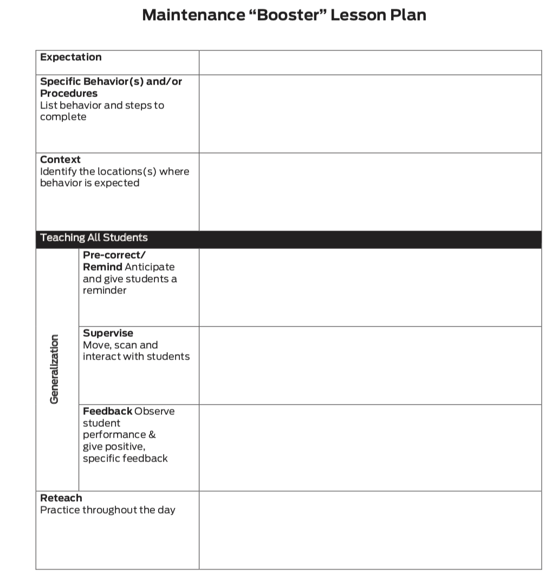
Putting It All Together: Maintenance “Booster” Lesson Plan
Expectation
Specific Behavior(s)
Context
Generalization
Pre-Correct
Supervise
Feedback
Reteach
Notes:
The focus of lessons for older students includes the components of Pre-Correct/Remind, Supervise, and Feedback and assumes:
faculty and staff have agreement on expectations and specific behaviors from their schoolwide matrix;
older students have had an orientation to these commonly held procedures and routines; and
it will be sufficient for supporting expected student behaviors of returning students or upperclassmen at the beginning of the year by the adult actions of Remind, Supervise, and Feedback.

Slide 11
Teaching Older Students
Beginning of School Year Orientation Day for underclassmen.
Time built in during first weeks of school and boosters later in year.
Advisory period, weekly throughout the year.
Assemblies followed with group practice.
New Student Orientation when needed.
Student Ambassadors to serve as support/models for newly enrolled students.
Notes:
“Here are more example activities your school can use to teach older students.”

Slide 12
Lesson Demonstration
[Insert expectation or behavior for which you will demonstrate a lesson. Conduct an example 5-7 minute lesson.]
Notes:
Select a lesson from Workbook pp. 143 – 148 to demonstrate.

Slide 13
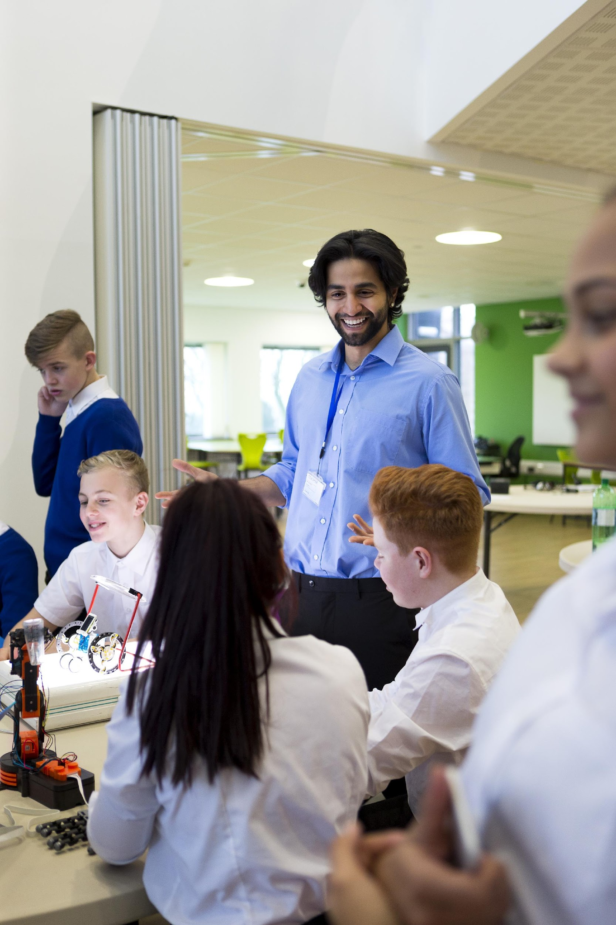
Maintenance Still Involves Teaching
Telling and expecting students to “know it” is insufficient for students to be fluent and competent in performing the social behaviors expected at school.
Notes:
Regardless of the age of students being taught, the critical idea is that consistent, ongoing, and planned instruction does indeed take place until students become fluent using the expected social skills.

Slide 14
Discussion: Developing Booster/Maintenance Lessons
Review the following sample lessons and look for commonalities and differences according to the age/grade levels they represent in relation to purpose, format, content, and setting.
Notes:
To Know/To Say: Review the following sample lessons and look for commonalities and differences according to the age/grade levels they represent in relation to purpose, format, content, and setting.
Provide access to different level example handouts.

Slide 15
Discussion: Developing Booster/Maintenance Lessons
Review monthly office discipline data to determine a skill your students are fluent in performing. Come to consensus on a skill for which a maintenance “booster” lesson is needed, and write that lesson using the Blank Maintenance “Booster” Lesson Plan form.

Slide 16
Discussion: Developing Booster/Maintenance Lessons
Discuss what behaviors/rules or procedures you need possible maintenance “booster” lesson plans for. Then decide on ways your school could share the work of writing “booster” lessons.

Slide 17
Closing and Next Steps
Develop action steps for developing “booster” or maintenance lessons based on your school’s social behavioral curriculum.
Update your action plan using the Tier 1 Action Plan template and the Tier 1 Action Planning Checklist.
Use the Tier 1 Artifacts Rubric to assess the quality of the resources your team develops.
Use the results of the PBIS Self-Assessment Survey (SAS) to gain perspective from all staff, and results from the PBIS Tiered Fidelity Inventory (TFI) to gain perspective from your Building Leadership Team.
Notes:
To Know/To Say:
Next steps include:
Develop action steps for developing “booster” or maintenance lessons based on your school’s social behavioral curriculum.
Update your action plan using the Tier 1 Action Plan template and the Tier 1 Action Planning Checklist.
Use the Tier 1 Artifacts Rubric to assess the quality of the resources your team develops.
Use the results of the PBIS Self-Assessment Survey (SAS) to gain perspective from all staff, and results from the PBIS Tiered Fidelity Inventory (TFI) to gain perspective from your Building Leadership Team.
Additional information about <Topic> can be found in the MO SW-PBS Handbook and the MO SW-PBS Tier 1 Implementation Guide.

Slide 18
References
MO SWPBS Tier 1 Implementation Guide
Colvin, G. (2007). 7 steps for developing a proactive school discipline plan: A guide for principals and Leadership Teams. Thousand Oaks, CA: Corwin Press.
Notes:
Trainer Notes:
To Know/To Say:

Slide 19
Contact Information
Check Out MO SW-PBS on Social Media:
Facilitator Contact Information:
pbismissouri.org
facebook.com/moswpbs
@MOSWPBS

