Slide 1
Develop Lessons to Initially Teach all Expected Behavior
Teaching Expected Behavior
Notes:
Trainer Notes:
To Know/To Say:

Slide 2
Facilitator Notes: Delete This Slide
Handouts that will be needed for this lesson:
Example Preschool Lesson Follow Directions
Example Elementary Lesson Follow Directions
Example Middle School Lesson Follow Directions
Example High School Lesson Follow Directions
Example Elementary Cafeteria Procedures Lesson Plan
Example Secondary Cafeteria Procedures Lesson Plan
Acquisition Lesson Plan Template
Tier 1 Action Plan
Tier 1 Artifact Rubric
Tier 1 Action Planning Checklist
Notes:
If you have not downloaded these handouts please download now

Slide 3
Working Agreements
Be Respectful
Be an active listener—open to new ideas
Use notes for side bar conversations
Be Responsible
Be on time for sessions
Silence cell phones—reply appropriately
Be a Problem Solver
Follow the decision making process
Work toward consensus and support decisions of the group
Notes:
Trainer Notes: Hide or delete this slide if presenting the entire PLM
To Know/To Say: “These will be the Working Agreements we will honor during all our training sessions this year.”

Slide 4
Attention Signal
Notes:
Trainer Notes: Hide or delete this slide if presenting the entire PLM; Facilitator: Select an attention signal.
To Know/To Say:
“One of our agreements is to follow the attention signal.”
“Your team will work with your school to develop an attention signal you will use in every setting.”
“In order to get all of you focused after discussions, activities or breaks,
I will ________________________________________.”
(Insert your attention signal here.)
“Your task will be to finish your sentence, quiet your voice and ____________________________.”
(Insert what you want participants to do.)

Slide 5
Introductions
Notes:
Trainer Notes: Hide or delete this slide if presenting the entire PLM; Select an introductions activity.
To Know/To Say:

Slide 6
Lesson Outcomes
At the end of this session, you will be able to…
Develop a system to teach expected behavior in the social behavioral curriculum, that includes:
creating a set of lesson plans to initially teach acquisition of expected behaviors.
Notes:
Trainer Notes:
To Know/To Say:

Slide 7
If a child doesn’t know how to read, we teach.
If a child doesn’t know how to swim, we teach.
If a child doesn’t know how to multiply, we teach.
If a child doesn’t know how to drive, we teach.
If a child doesn’t know how to behave, we…teach? …punish?
Why can’t we finish the last sentence as automatically as we do the others?
T. Herner
Notes:
Read the slide. Provide approximately 1 minute for participants to consider the last question.

Slide 8
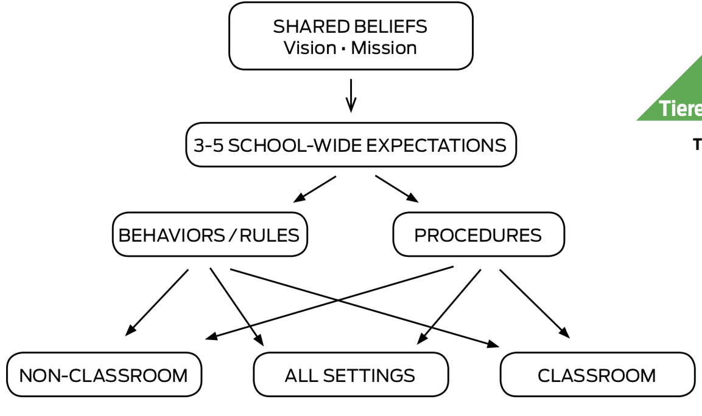
Teaching Encourages Common Language
Notes:
Directly teaching social skills encourages use of a common language among all staff. By using common language, we ensure consistency for all students which is especially important for students who are at-risk and high-risk of behavior incidents.

Slide 9
Key Terms
Acquisition: first phase of learning when a student is learning a new skill. This phase is followed by fluency, maintenance and generalization.
Re-teach: providing additional instruction and practice on each of the steps required to correctly exhibit the behavior.
Notes:
Trainer Notes:
To Know/To Say:

Slide 10
Acquisition Lesson Plan Format
Notes:
It is important for schools to write lesson plans that meet the needs of their students. To assist with the task of writing lesson plans for students who are at the acquisition phase, MO SW-PBS has developed a lesson plan template that can be utilized.
The rest of this lesson will describe all sections of the acquisition lesson plan format/template and provide examples that span grade levels.

Slide 11
Teaching Considerations
Skill Definition and Context–the Expectation from your schools matrix to help staff see how the lesson ties to the common language. The Specific Behavior(s) or Procedures defined. Context to identify the location(s) where the behavior is expected.
E.g., “Explain what Respect means in all settings of school.” Or, “Specify what students will have to do to actively listen in the classroom.”
Notes:
Skill Definition and Context
The first items that every lesson plan should include are:
The Expectation from your schools matrix to help staff see how the lesson ties to the common language.
Specific Behavior(s) and/or Procedures which is a clear description of the skill to be taught.
Context to identify the location(s) where the behavior is expected.
This information gives those teaching the lesson a clear understanding of the purpose of the skill and where the skill will be expected to be used.

Slide 12
Teaching Considerations
Acquisition Phase/Direct Teaching–includes tell, show, practice.
Tell–teacher provides definition, specific steps needed to correctly perform the skill and the location in which the skill will be expected.
Show–demonstrate or model expected behavior; include examples and non-examples.
Practice–guided practice ensures students can demonstrate the steps; best when practice occurs in the setting.
Notes:
Direct Teaching or Orientation
Each lesson plan for initial learning of a skill, regardless of the age of the students, will include ideas for teachers to directly teach the skill. Instruction of social behaviors for younger students in initial lessons for Acquisition includes tell, show and practice.
Tell means introducing the skill or behavior by directly telling the student the definition, the specific steps needed to correctly perform the skill and the location in which the skill will be expected.
Show means the teacher demonstrates or models the expected behavior. The teacher clarifies the difference between following the behavior and not following the behavior by providing positive examples and a negative example (non- example). Remember only an adult should demonstrate the non-example. Students in the class then demonstrate the examples.
The guided practice component of the lesson is a pivotal part of every lesson. Guided practice ensures that students can accurately and appropriately demonstrate the skill steps². Optimally, practice should occur in the appropriate setting(s) to effectively teach expected behaviors and procedures.

Slide 13
Teaching Considerations
Fluency Phase/Orientation Plan–for older students or new students to a building (e.g. 9th grade in high school) or transfer students. Provides a description of how students will receive instruction about skills as they pertain to the particular building.
Notes:
The acquisition lesson plan for older students provides a section for Orientation. These lesson plans will include information about how students new to a building receive instruction about the skill as it pertains to the particular building. An orientation plan for new 6th graders to a middle school or freshman in high school will describe how those students will learn all the behaviors and procedures unique to that building (e.g. cafeteria procedures, arrival and dismissal, use of electronic devices).
Orientation also includes information about how new students who transfer in during the year will receive instruction and guidance to help them feel welcome so they can become a member of the school community. The orientation plan also helps provide a rationale for why these skills are important for school success and life after graduation.

Slide 14
Teaching Considerations
Generalization Strategies–to help students maintain skills being taught and to encourage use of the skills in a variety of situations. Include:
Pre-correct or Remind – after students have been taught skill and when the teacher can anticipate students may have difficulty
Supervise – move, scan and frequent interaction strategies for staff
Feedback – positive to reinforce use of the skill and corrective to teach the student what the expected behavior is
Notes:
Generalization Strategies
Generalization is the fourth phase of learning where behavior occurs under different conditions other than those taught (people, settings, etc.). To help students maintain skills being taught and to encourage use of the skills in a variety of situations, generalization strategies are included in the lesson plan. These generalization strategies include: 1) pre-corrects or reminders, 2) supervision, and 3) feedback on performance.
Pre-Correct/Remind = Reminders before entering a setting or performing a task to promote successful demonstration of expected behaviors. Pre-corrects are best used after students have been formally taught and reminded of the correct behavior and procedures for a given setting. When a teacher can anticipate students may have difficulty, a pre-correct is given to them about the expected behavior^{3,4}. A pre-correct is different from a teacher directive. A pre-correct tells the students what to do and how to do it using the behaviors/rules that have already been taught. For example, if a teacher knows students will have trouble moving in the class without bumping into each other, the teacher might pre-correct students of the expected classroom behavior of maintaining personal space. Or before the students are asked to move into groups, the teacher would pre- correct by saying, “Remember to move safely and maintain your personal space.” Just before exiting school for the day, the teacher would pre-correct by saying, “Remember to walk in the hallways and into the parking lot.” In these examples, the pre-correct sets the stage for opportunities for the teacher to recognize students for walking quietly and safely.
Supervise = Monitor student performance or compliance in all settings. To have a positive impact on student behavior, to prevent problem behaviors from occurring and to monitor student performance, teachers must actively supervise students. Active supervision includes: 1) Moving = constantly, randomly, and targeting problem areas, 2) Scanning = observe all students, make eye contact, look and listen, and 3) Interacting Frequently = positive contact, frequent feedback, correct errors, deliver consequence.
Feedback = Information provided to students by adults and other students about how well students are performing the expected behaviors. Feedback can be categorized as positive (reinforcing the expected behavior), corrective (telling the student what the expected behavior is for the situation), and negative (giving the student a message to stop their current behavior with no information about a replacement behavior). Staff are encouraged to provide feedback, non-contingent and contingent, including specific positive feedback. To help students learn and maintain social behaviors teachers must recognize student effort. The least expensive and readily available way to recognize students is to provide specific verbal feedback and regularly recognize the efforts of students who correctly exhibit the behavior. When giving specific verbal feedback the teacher precisely states the skill the student displays so the student has no doubt about what he or she did correctly. An example would be, “Thank you Bob for being responsible by being on time and having your assignment ready to turn in.”

Slide 15
Teaching Considerations
Generalization Strategies–guided by purpose, age of student and prior learning history; vary strategies and modalities.
Writing activities–students describe the behaviors or illustrate through narrative, poetry, plays, songs, etc.
Artistic representation–performing skits, songs, posters, paintings, etc.
Sports teams, student organizations–connections to operational rules for these student groups.
Notes:
Read the slide, then say,
“These are examples of generalization strategies that involve different modalities to help students become fluent with the skill.”

Slide 16
Teaching Considerations
Reteaching
Provide additional instruction and practice on each of the steps required to correctly exhibit the behavior.
May include extension activities using other modalities through activities and games.
Important for staff to recognize “almost there” behavior as an instructional step toward perfect performance.
Notes:
Re-teaching is the process of providing additional instruction and practice on each of the steps required to correctly exhibit the behavior. As some students struggle to learn the expected social behavior, it is important to provide additional practice and recognition to them as they make progress toward correctly exhibiting the behavior (e.g. “Nice work, Ted, turning in your homework. Let me show you which bin you should place it in as you come in the door of the classroom.”). Re-teaching can also be supported through extension activities using other modalities. For example, if the class has been taught how to follow directions, the instructor could provide independent practice for the students through an art activity or game where they apply the steps in following directions. Sometimes teachers need to recognize “almost there” behavior as an incremental step toward perfect performance of a social behavior.

Slide 17
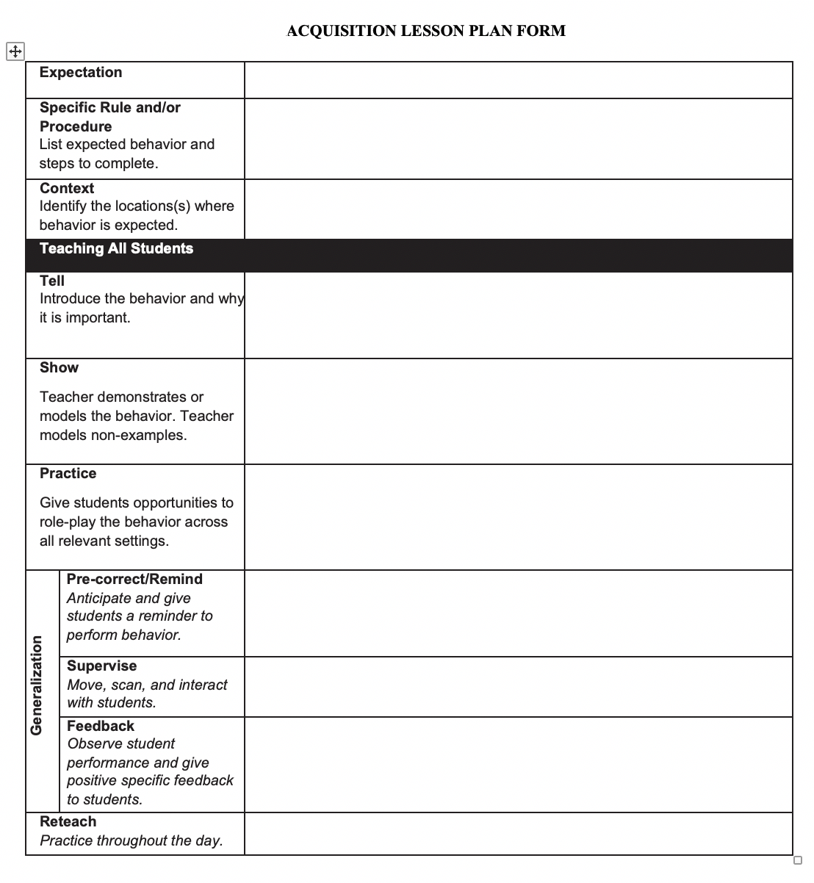
Putting It All Together: Acquisition Lesson Plan
Expectation
Specific Behavior(s) or Procedure
Context
Orientation Plan
Tell, Show, Practice
Generalization
Pre-Correct
Supervise
Feedback
Reteach
Notes:
Provide access to Workbook p. 154.
“Here is a template your team will use to write lessons to teach the expectations and rules/behaviors on your matrix.
First you will specify the behavior(s) you will teach.
Then you will identify the context or setting(s) in which the behavior should be exhibited (i.e. All settings, only nonclassroom settings or classrooms.)
You will define what the behavior will look or sound like and why it is important for your school community.
The orientation plan would be applicable for underclassmen and new students to the building.
Effective teaching will also include demonstrations of the behavior. Demonstrations will include an example, nonexample, then another example. Adults or students can provide examples of the appropriate behavior. Only adults should provide nonexamples.
Students should be provided multiple opportunities to practice the behavior in all settings in which the behavior is expected.
Help student generalize by reminding the students of the expected behavior before the students must exhibit the behavior and provide adequate supervision to increase the likelihood the behavior will be maintained. Provide performance feedback to all students.
Reteach when feedback indicates it is required, when new students join the class, or after extended breaks.

Slide 18
Discussion: Initially Teach all Expected Behavior
Review the sample lessons and look for commonalities and differences according to the age/grade levels they represent in relation to purpose, format, content, and setting.
Notes:
To Know/To Say: Review the following sample lessons and look for commonalities and differences according to the age/grade levels they represent in relation to purpose, format, content, and setting.
Provide access to different level example handouts.

Slide 19
Activity: Initially Teach all Expected Behavior
Use the Acquisition Lesson Plan template provided to practice writing a lesson for one of the topics your team previously chose as a priority lesson. You can write a lesson for a schoolwide procedure (similar to cafeteria) or for a behavior on your school’s matrix.
Make plans to complete all needed acquisition plans.
Notes:
To Know/To Say: Review the following sample lessons and look for commonalities and differences according to the age/grade levels they represent in relation to purpose, format, content, and setting.
Provide access to different level example handouts.

Slide 20
Closing and Next Steps
Develop action steps for the creation of acquisition lessons on schoolwide, non-classroom, and classroom expectations and procedures have been developed and shared with all staff.
Update your action plan using the Tier 1 Action Plan template and the Tier 1 Action Planning Checklist.
Use the Tier 1 Artifacts Rubric to assess the quality of the resources your team develops.
Use the results of the PBIS Self-Assessment Survey (SAS) to gain perspective from all staff, and results from the PBIS Tiered Fidelity Inventory (TFI) to gain perspective from your Building Leadership Team.
Notes:
To Know/To Say: During this lesson, you learned
How will you engage all staff in developing lesson plans that include all components of high quality acquisition teaching and cover all necessary components of your social behavioral curriculum?
Next steps include
Develop action steps for the creation of acquisition lessons on schoolwide, non-classroom, and classroom expectations and procedures have been developed and shared with all staff.
Update your action plan using the Tier 1 Action Plan template and the Tier 1 Action Planning Checklist.
Use the Tier 1 Artifacts Rubric to assess the quality of the resources your team develops.
Use the results of the PBIS Self-Assessment Survey (SAS) to gain perspective from all staff, and results from the PBIS Tiered Fidelity Inventory (TFI) to gain perspective from your Building Leadership Team.
Additional information about <Topic> can be found in the MO SW-PBS Handbook and the MO SW-PBS Tier 1 Implementation Guide.

Slide 21
References
Herner, T. (1998). Counterpoint. NASDE, p. 2.
Sugai, G., & Horner, R. H. (1999). Discipline and behavioral support: practices, pitfalls and promises. Effective School Practices, 17(4), 10-22.
Colvin, G., Sugai, G., & Patching, B. (1993). Precorrection: An instructional approach for managing predictable problem behaviors. Intervention in School and Clinic, 28(1), 143-150.
Lewis, T. J., Newcomer, L. L., Trussell, R., & Richter, M. (2006). Schoolwide positive behavior support: Building systems to develop and maintain appropriate social behavior. In C. M. Everston & C. S. Weinstein (Eds.) Handbook of classroom management: Research, practice, and contemporary issues (pp. 833-854). Mahwah, NJ: Lawrence Erlbaum Associates, Inc.
Notes:
Trainer Notes:
To Know/To Say:

Slide 22
Contact Information
Check Out MO SW-PBS on Social Media:
Facilitator Contact Information:
pbismissouri.org
facebook.com/moswpbs
@MOSWPBS

