Slide 1
Plan the Process of Writing Lessons
Teaching Expected Behavior
Notes:
Trainer Notes:
To Know/To Say:

Slide 2
Working Agreements
Be Respectful
Be an active listener—open to new ideas
Use notes for side bar conversations
Be Responsible
Be on time for sessions
Silence cell phones—reply appropriately
Be a Problem Solver
Follow the decision making process
Work toward consensus and support decisions of the group
Notes:
Trainer Notes: Hide or delete this slide if presenting the entire PLM
To Know/To Say: “These will be the Working Agreements we will honor during all our training sessions this year.”

Slide 3
Facilitator Notes: Delete This Slide
Handouts that will be needed for this lesson:
Tier 1 Action Plan
Tier 1 Artifact Rubric
Tier 1 Action Planning Checklist
Notes:
If you have not downloaded these handouts please download now

Slide 4
Attention Signal
Notes:
Trainer Notes: Hide or delete this slide if presenting the entire PLM; Facilitator: Select an attention signal.
To Know/To Say: “One of our agreements is to follow the attention signal.”
“Your team will work with your school to develop an attention signal you will use in every setting.”
“In order to get all of you focused after discussions, activities or breaks,
I will ________________________________________.”
(Insert your attention signal here.)
“Your task will be to finish your sentence, quiet your voice and ____________________________.”
(Insert what you want participants to do.)

Slide 5
Introductions
Notes:
Trainer Notes: Hide or delete this slide if presenting the entire PLM; Select an introductions activity.
To Know/To Say:

Slide 6
Lesson Outcomes
At the end of this session, you will be able to…
Develop a system to teach expected behavior in the social behavioral curriculum, that includes:
understand why teaching social behavioral skills is important.
engaging all staff in a process of writing lesson plans.
Notes:
Trainer Notes:
To Know/To Say:
This lesson focuses on developing a common understanding of why teaching social behavioral skills in schools is important and how to plan the process of engaging staff in writing lesson plans for all components of the social behavioral curriculum.

Slide 7
“Teaching behavior as relentlessly as we teach reading or other academic content is the ultimate act of prevention, promise and power underlying PBS and other preventive interventions in America’s schools.”
Algozzine, Wang & Violette
Notes:
Read the slide, then say,
“We also teach social behavior skills because we know there is a close connection between academic and social competence (Algozzine, Wang & Olivette, 2011; Horner & Sugai, 2005). Successful students and adults have both competencies. Just as we consider what to teach and how to structure the content based on what is age and developmentally appropriate for academic subject matter, we determine what is developmentally and age appropriate for teaching social behavior skills.”

Slide 8
Why Teach Expected Behavior?
IT WORKS!
Notes:
Why teach? We teach because it works. Teaching is an efficient process for clarifying what all members of a community should know and be able to do, as well as where, when and to what criteria to demonstrate the behavior. Leaving students to guess what they should do, and where they should do it is a sure-fire plan for student misbehavior.

Slide 9
Teaching Expected Behavior
Integrates the notion of what students should know and be able to do (your matrix) with how you will be sure they can do it.
To learn better ways of behaving, students must be directly taught the expected behaviors.
To retain new behaviors, students must practice in a variety of settings where the behaviors should be used.
Notes:
Teaching expected behavior is a cornerstone because it integrates the notion of what students should know and be able to do (your matrix) with how you will be sure they can do it.
Reaching today’s students requires a teaching focus–teaching students how to be successful and behave responsibly in school. This is based on the belief that social behavior is learned and therefore can be taught. Students can be taught socially acceptable ways of behaving just as one would teach any academic subject. Discipline should be based on the very same instructional concepts used to facilitate academic learning. Direct instruction in social behaviors can be provided to students, and practice, encouragement, and correction given as needed.

Slide 10
Once you have developed school-wide expectations, it is not enough to have them, post them or simply tell them to students….
You must TEACH.
Notes:
Direct participants to read the slide, then say,
“Have you ever heard the saying, ‘Tellin ain’t teachin’ and teachin’ ain’t taught? This saying emphasizes that teaching is much more complex than simply telling someone about a concept or skill.”
Once expectations have been defined, systematic teaching of those expected behaviors must be a routine part of the school day. Teaching social behavioral skills calls upon the same methods used to teach academics — direct instruction, modeling, practice, and feedback. At the beginning of the school year and in an ongoing fashion throughout the year, students should be taught how to behave responsibly in each school setting. Effective teachers spend up to one-third of their time during the first days or weeks of the new school year teaching their expectations, and frequently review or remind students of their expectations all year long².

Slide 11
Teaching Social Behavior Skills
Ensures that students know the expectations and are able to demonstrate appropriate social behavior.
Provides the foundation of Tiers 1, 2, and 3.
Requires instruction, practice, feedback, re-teaching, and encouragement.
If we think of the connections to academic instruction, we are more likely to embrace teaching social behaviors.
Notes:
Read the slide, then say, “Once you have identified the expected behaviors for your school community, you will instruct and provide opportunities to practice the expected behaviors. Effective teaching of the behaviors will also include the provision of feedback, reteaching and encouragement.”
“You will design more explicit teaching opportunities for students who require more intensive intervention based on the lessons you’ve developed to teach ALL students. Engaging in these teaching activities will increase the likelihood that ALL students will know and be able to engage in the behaviors you have identified.”
In summary, teaching social skills is the vehicle educators use to reach their goal of a more positive social culture in school. Teaching goes a long way to ensure students have a common experience at school.
Lesson plans, teaching schedules, and special activities and events are planned to guide the ongoing teaching of expected behaviors. Teaching of expectations should also include a plan to ensure that new students and staff are provided the opportunity to learn the behaviors that will lead to success in their new school.

Slide 12
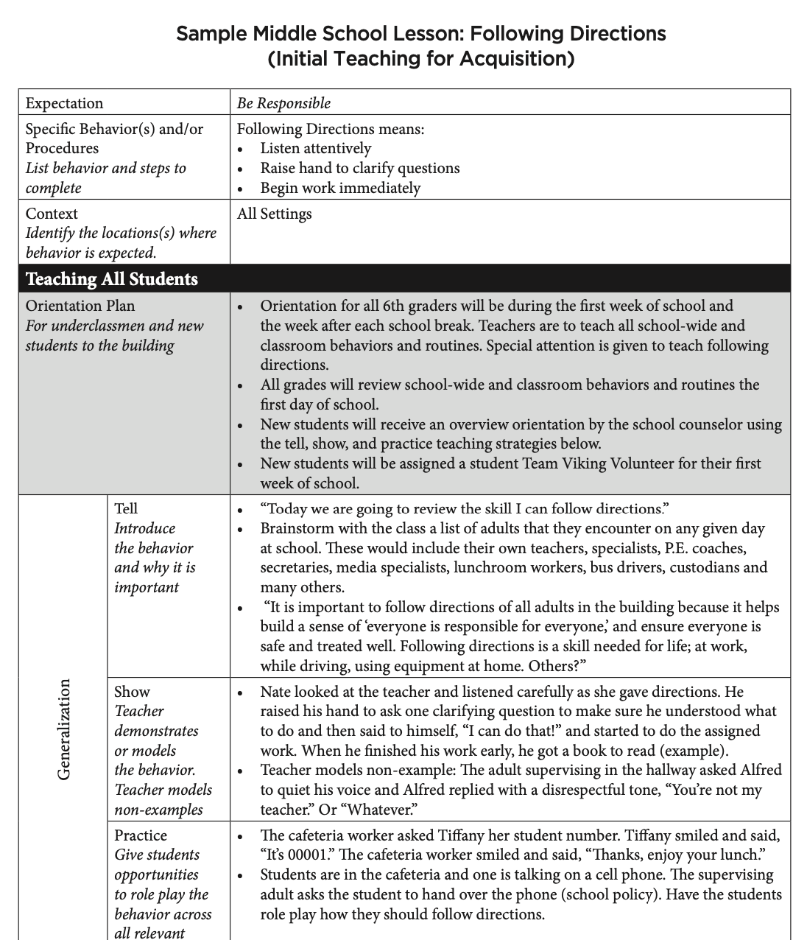
Example Lesson Plan

Slide 13
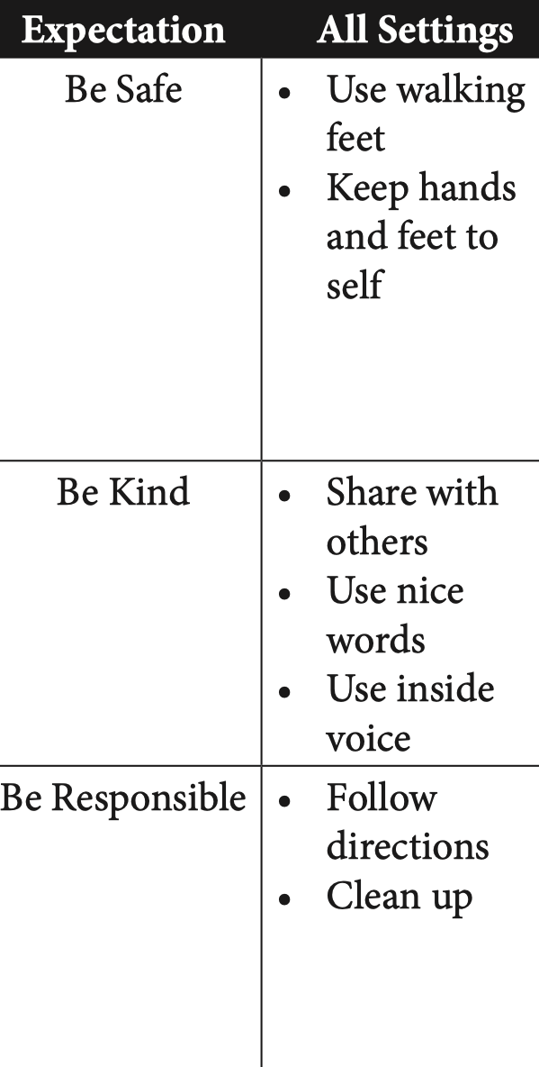
Lesson Needs
Behaviors/rules on your school’s matrix
Non-classroom procedures (arrival, cafeteria, playground rules, dismissal, etc.)
Classroom rules
Classroom procedures
Notes:
To support all staff and guide them to teach social skills, the SW- PBS Leadership Team will need to guide the development of lesson plans. In general, the SW-PBS Leadership Team will want to ensure you have lessons for all components of your social behavioral curriculum as described in the Clarifying Expected Behavior course. Lessons will be needed for:
Behaviors/rules on your school’s matrix
Non-classroom procedures (arrival, cafeteria, playground rules, dismissal, etc.)
Classroom rules
Classroom procedures
Non-classroom rules from the matrix and other non-classroom procedures are usually the first focus of teaching and therefore lesson writing. Focusing on teaching in non-classroom settings helps all staff practice using common language and learn the steps of directly teaching social behavior skills. Getting everyone involved in teaching in non-classroom settings can build a sense of course and common purpose.
Full implementation of teaching lessons, starting with lessons for non-classroom rules and procedures first, will begin to leverage implementation efforts for fidelity and sustainability over time³.

Slide 14
Discussion: The Importance of Teaching
Discuss with your team and be prepared to share with the large group:
What are the parallels between teaching academic skills and social behavior skills?
How might we help our staff to understand the importance of teaching social behavior?
Notes:
Direct participants to read the slide. Provide approximately 5-7 minutes for the discussion.

Slide 15
Prioritizing Lesson Writing
Lessons for “All Settings” behaviors is the logical place to start.
Consider combining 2-3 specific behaviors from your matrix for lessons.
Notes:
Below are some ideas of how the SW-PBS Leadership Team might prioritize which lessons to write first:
Consider guiding the staff to write lessons for the All Settings behaviors first. Your team and school will have determined those skills as needed throughout the school; therefore, this might be considered a good place to start lesson writing.
Non-classroom procedures need to be explicitly taught with fidelity, consistency, and equity. An overview of procedures for the most common settings needs to be introduced at the beginning of every year (e.g., hallways, cafeteria, etc.). Once introduced, more detailed lessons on specific behaviors (e.g., how to treat cafeteria servers) can be taught.
Review your draft matrix to decide if there are 2-3 rules listed that could logically be combined into one lesson. For example, an elementary matrix may list “flush” and “wash hands with soap and water” on the matrix. Both of these could be included in one lesson. A high school matrix may list “walk,” “use quiet voice,” and “take care of items in the hallways,” which could all be addressed in one lesson.
Review your office discipline referral data. What unexpected behaviors occur most frequently? What skill from your matrix do you want students to do instead? For example, if physical aggression was a frequent unexpected behavior, the specific be- havior of keeping hands and feet to self would be an important lesson to write.
Review your office discipline referral data to determine the non-classroom location of frequent unexpected behaviors. What skill from your matrix do you want students to do instead in that location? If unexpected behaviors take place in the hallways, do specific lessons need to be written to address getting to class on time?

Slide 16
Procedures for Writing Process
Write DRAFT on all lessons to indicate feedback is needed.
Include THE DATE on lessons to track versions.
Templates are available from MO SW-PBS.
Notes:
As your team begins to think about developing lessons to teach social skills you will want to be purposeful in involving others. Whoever is involved in lesson writing should be instructed to write DRAFT on lessons they develop to indicate feedback will be asked for. Also instruct lesson planners to write THE DATE on the lesson to help you keep track of various versions. In the next few lessons, you will learn about the templates used to write the lessons.

Slide 17
Sharing Responsibility for Writing Social Behavior Lesson Plans
Small work group of volunteers write draft lessons.
Vertical teams write lessons.
The SW-PBS Team writes draft lessons and gets feedback from staff.
At secondary level, departmental teams write lessons.
Notes:
“Involving all staff in writing the lesson plans will increase the likelihood that they will be utilized by all stakeholders. Here are suggestions to involve stakeholders in writing social behavioral lessons.”
Your team can involve students as well as staff in the development of teaching or training materials to increase the viability and relevancy of the desired behaviors. Family and community members can also be recruited to not only teach expected behaviors in school and community settings, but can also be tremendous resources for providing a compelling rationale for schoolwide expectations in the context of life outside or beyond the school setting.
There are a number of ways to get input from others but the most important thing to do is to seek and consider the feedback you get. Following are a few suggestions:
Ask vertical/grade level/department teams for lesson suggestions.
Ask ALL support staff (cafeteria supervisors, resource officers, secretaries, custodians, bus drivers) for lesson suggestions.
During a designated class period, discuss lesson ideas with all students. Have students turn in their suggestions.
Create a SW-PBS Advisory Council to both advise the Leadership Team and to gather input from the student body.
Ask for family input at Back to School Night, in school newsletter, and during parent conferences (a task to do while they are waiting).
Build a system of regularly scheduled opportunities to send information home to families (weekly folders, school newsletter with regular feature of “lesson of the week,” information about how to use lesson content at home, updates from the building administrator, district updates).
Conduct short surveys to ask staff, students and families to share their questions, ideas and views about SW-PBS lessons.
Ask drama classes to write, direct and act in video lessons.
Provide information to local newspapers, TV and radio stations.
Ask communication classes to write and broadcast daily/weekly lessons and announcements. It is important to remember that regardless of who writes them, lessons are drafts until reviewed, understood and approved by the appropriate stakeholders.

Slide 18
Discussion
Discuss the following with your SW-PBS Leadership team…
Which lessons should your school write first?
What will be your plan for how other lessons will be written in the future?
What are possible ways your school could share the work of writing lessons with all staff, and additional stakeholders?

Slide 19
Closing and Next Steps
Develop action steps for planning the process of writing lesson plans.
Update your action plan using the Tier 1 Action Plan template and the Tier 1 Action Planning Checklist.
Use the Tier 1 Artifacts Rubric to assess the quality of the resources your team develops.
Use the results of the PBIS Self-Assessment Survey (SAS) to gain perspective from all staff, and results from the PBIS Tiered Fidelity Inventory (TFI) to gain perspective from your Building Leadership Team.
Notes:
To Know/To Say:
During this lesson, you learned why teaching social behavioral skills is important and how to plan a process for engaging all staff in prioritizing and writing lesson plans. How will you engage all staff in prioritizing and writing lesson plans for all components of your social behavioral curriculum? Lessons will be needed for:
Behaviors/rules on your school’s matrix
Non-classroom procedures (arrival, cafeteria, playground rules, dismissal, etc.)
Classroom rules
Classroom procedures
Next steps include
Develop action steps for planning the process of writing lesson plans.
Update your action plan using the Tier 1 Action Plan template and the Tier 1 Action Planning Checklist.
Use the Tier 1 Artifacts Rubric to assess the quality of the resources your team develops.
Use the results of the PBIS Self-Assessment Survey (SAS) to gain perspective from all staff, and results from the PBIS Tiered Fidelity Inventory (TFI) to gain perspective from your Building Leadership Team.
Additional information about <Topic> can be found in the MO SW-PBS Handbook and the MO SW-PBS Tier 1 Implementation Guide.

Slide 20
References
Algozzine, B., Wang, C., & Violette, A. S. (2011). Reexamining the relationship between academic achievement and social behavior. Journal of Positive Behavior Interventions, 13(1), 3-16.
Cotton, K. (1995) Effective schools research summary: 1995 update. Portland, OR: Northwest Regional Educational Laboratory.
Mathews, S., McIntosh, K., Frank, J. L., & May, S. L. (2014). Critical features predicting sustained implementation of school-Wide positive behavioral interventions and supports. Journal of Positive Behavior Interventions, 16(3), pp 168-178.
Willingham, D. T. (2011). Can teachers increase students’ self-control? American Educator, 35(2), 22-27.
Scheuermann, B. K., & Hall, J. A. (2012). Positive behavioral supports for the classroom, 2nd Ed. Upper Saddle River, NJ: Pearson Education, Inc.
Notes:
Trainer Notes:
To Know/To Say:

Slide 21
Contact Information
Check Out MO SW-PBS on Social Media:
Facilitator Contact Information:
pbismissouri.org
facebook.com/moswpbs
@MOSWPBS

