Slide 1
Lesson 2: Creating a Matrix of Behaviors/Rules
MO SW-PBS

Slide 2
Facilitator Notes – Delete this slide
Handouts Needed:
HO 5 Blank Matrix
HO 6 Example Preschool Schoolwide Expectations
HO 7 Example Elementary Schoolwide Expectations
HO 8 Example High School Schoolwide Expectations
HO 9 Practice Creating Rules for All Settings
HO-AP MO SW-PBS Tier 1 Action Plan
HO-APC MO SW-PBS Tier 1 Action Planning Checklist
HO-APR MO SW-PBS Tier 1 Artifact Rubric
Participants Need Access
MO SW-PBS Handbook
MO SW-PBS Tier 1 Implementation Guide

Slide 3
Session at a Glance
When creating your schoolwide matrix of specific behaviors/rules for every setting in your school the specificity should be clear for teachers and students to know exactly what is to be done.
“What does [respect, responsibility, best effort, etc.] look like in all settings, in our [hallways, cafeteria, playground, commons, etc.] and in our classrooms?”
Notes:
Trainer Notes:
To Know/To Say: This session provides information necessary for the development of schoolwide expectations and specific behaviors/rules that make up the building matrix.

Slide 4
Working Agreements
Be Respectful
Be an active listener—open to new ideas
Use notes for side bar conversations
Be Responsible
Be on time for sessions
Silence cell phones—reply appropriately
Be a Problem Solver
Follow the decision making process
Work toward consensus and support decisions of the group
Notes:
These will be the Working Agreements we will honor during all our training sessions this year.

Slide 5
Attention Signal Practice
Select and teach an attention signal.
Notes:
“One of our agreements is to follow the attention signal.”
“Your team will work with your school to develop an attention signal you will use in every setting.”
“In order to get all of you focused after discussions, activities or breaks,
I will ________________________________________.”
(Insert your attention signal here.)
“Your task will be to finish your sentence, quiet your voice and ____________________________.”
(Insert what you want participants to do.)

Slide 6
Introductions
Insert an Introductions Activity.
MO SW-PBS
Notes:
Choose an Introductions Activity

Slide 7
Lesson Outcomes
At the end of this session, you will be able to…
Create a matrix of specific behaviors/rules to further clarify each schoolwide expectation for every setting.

Slide 8
Why Creating a Schoolwide Matrix is Important
The “hidden” social curriculum that requires students to observe and figure out what is expected creates confusion and inefficiencies leading to unexpected behavior. To alleviate confusion and make the “hidden” social curriculum visible, a matrix of explicit expected rules is created.
Notes:
Trainer Notes:
To Know/To Say: The “hidden” social curriculum that requires students to observe and figure out what is expected creates confusion and inefficiencies leading to unexpected behavior. To alleviate confusion and make the “hidden” social curriculum visible, a matrix of explicit expected rules is created. This social behavioral curriculum defines the social skills that we expect all students and staff to display. . If the staff expect students to achieve and behave appropriately, they will. Conversely, if the staff expect the students to underachieve and behave inappropriately, they will.²

Slide 9
Key Terms
Expectations: Three to five words that define the kind of people you want your students to be (e.g., respectful, responsible, etc.).
Behaviors/Rules: Specific tasks students do to demonstrate the schoolwide expectations.
Matrix: A format that is used to organize the behaviors/rules by schoolwide expectations and settings. This provides a single document that can be easily referenced and used by all staff.
Notes:
Read the key terms and definitions

Slide 10
Schoolwide Expectations Matrix
 | All Settings | Bus | Hallway | Cafeteria | Classroom
Be Safe | Walk Keep hands, feet & objects to yourself | Remain seated | Stay to the right | Stay seated until dismissed Report spills | Use materials appropriately Stay in assigned space
Be Respectful | Use appropriate language Use appropriate voice level | Go quickly to designated seat Exit quickly | Use only your assigned locker | Patiently wait in line | Listen to the speaker
Be Responsible | Follow Directions Keep all areas clean | Keep belongings inside the bus with you | Take most direct route Have a pass at all times | Clean up after yourself Ask permission before getting up | Do your work
MO SW-PBS
Notes:
Trainer Notes:
To Know/To Say: A matrix format is used to organize the behaviors or rules by schoolwide expectations and settings. This allows us to have a single document that can be easily referenced and used by all staff. Here is a matrix example to show you the big picture of where you are headed by defining your specific behaviors or rules.
“Here is a sample Matrix with Expectations and specifically defined behaviors.”

Slide 11
Defining Behaviors/Rules
Specifically Identified Behaviors should be:
Observable – Behaviors we can see
Measurable – We can count occurrences
Positively Stated – What students do to be successful
Understandable – Student-friendly language
Always Applicable – The same behavior is expected at all times in that setting
Notes:
Trainer Notes:
To Know/To Say: When defining behaviors or rules, we use the acronym, “OMPUA” to help us to remember how to specifically define behaviors.” Every behavior or rule listed on the matrix should follow these OMPUA guidelines:
0 – Observable. This means we can see or hear the behavior. Observable behaviors are described by action words.
M – Measurable. This indicates that the behavior can be counted, or the duration of the behavior can be timed.
P – Positively Stated. This means we are stating what we want the students to do.
U – Understandable. This indicates that the expected behavior must be developmentally appropriate and culturally relevant.
A - Always Applicable. This means the expected behavior must be applicable under all conditions in that setting.

Slide 12
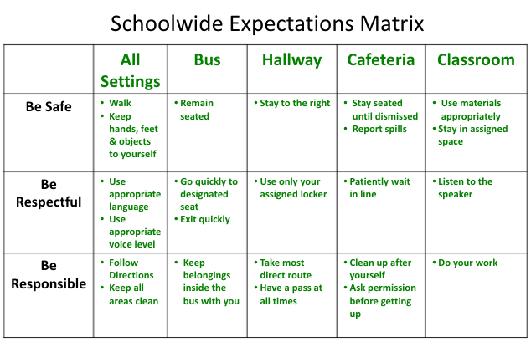
Unpacking and Defining Specific Behaviors
Rules and expectations for each school setting
Notes:
Trainer Notes:
To Know/To Say: Once we have identified three to five broad schoolwide expectations, we then need to define the expected social behaviors or rules which are what students do specifically to demonstrate those expectations. These tell us how we want our students to act in order to be successful. This process involves clarifying or defining specific behaviors/rules for different settings in our school. Expectations are commonly listed in the first column of the Matrix.
Specific locations in the school are commonly listed in the top row of each column of the Matrix.”
Remember the we are answering the question, “What does [respect, responsibility, best effort, etc.] look like in all settings, in our non-classroom settings [hallways, cafeteria, recess, commons, on the bus, etc.], and in our classrooms?”
Also, as stated earlier, it important the behaviors/rules that define the expectations in different settings on your matrix should be written so that they are observable, measurable, positively stated, understandable, and always applicable (OMPUA):
Observable
Measurable
Positively
Understandable
Always applicable
“

Slide 13
Activity: OMPUA
Keep hands, feet & objects to self.
Follow directions.
Try your best.
Walk.
Be a learner.
No talking in the hall.
Stay in assigned area until dismissed.
Notes:
This slide has animation.
Direct participants to give a “thumbs up” if the behavior meets OMPUA guidelines.
Direct participants to give a “thumbs down” if the behavior does not meet all OMPUA guidelines.
Click on each item after participants indicate thumbs up or thumbs down to access answer key.

Slide 14
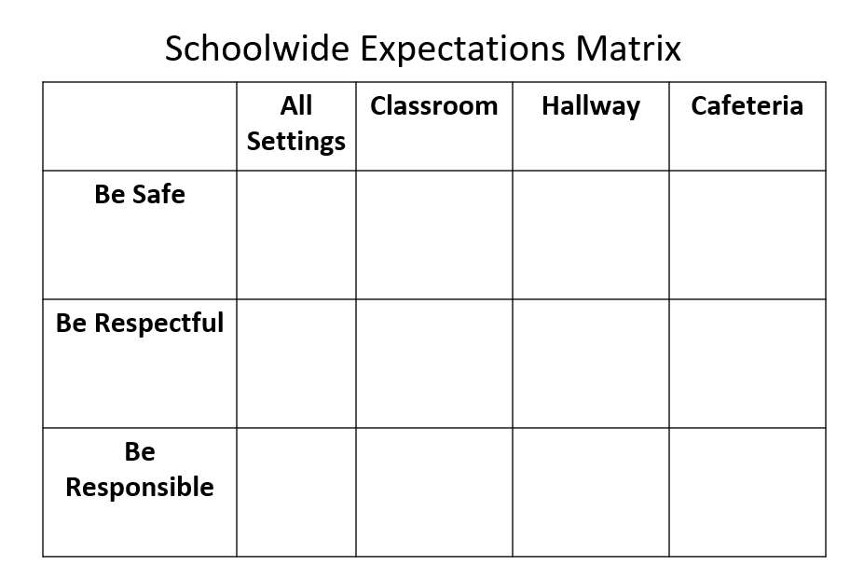
Developing Your Matrix
Notes:
Trainer Notes:
To Know/To Say: Your matrix will be developed by completing these actions:
• Write your 3-5 school expectations
• Write "All Settings" at the top of one column. These are the behavioral rules that define the expectations in each and every school location.
• Decide the settings to include on matrix columns, including “classroom.”
• Complete matrix by identifying each behavior that defines the school expectations for each setting. Keep in mind the behavior need only be stated once on the Matrix, resulting in fewer rules on the Matrix.

Slide 15
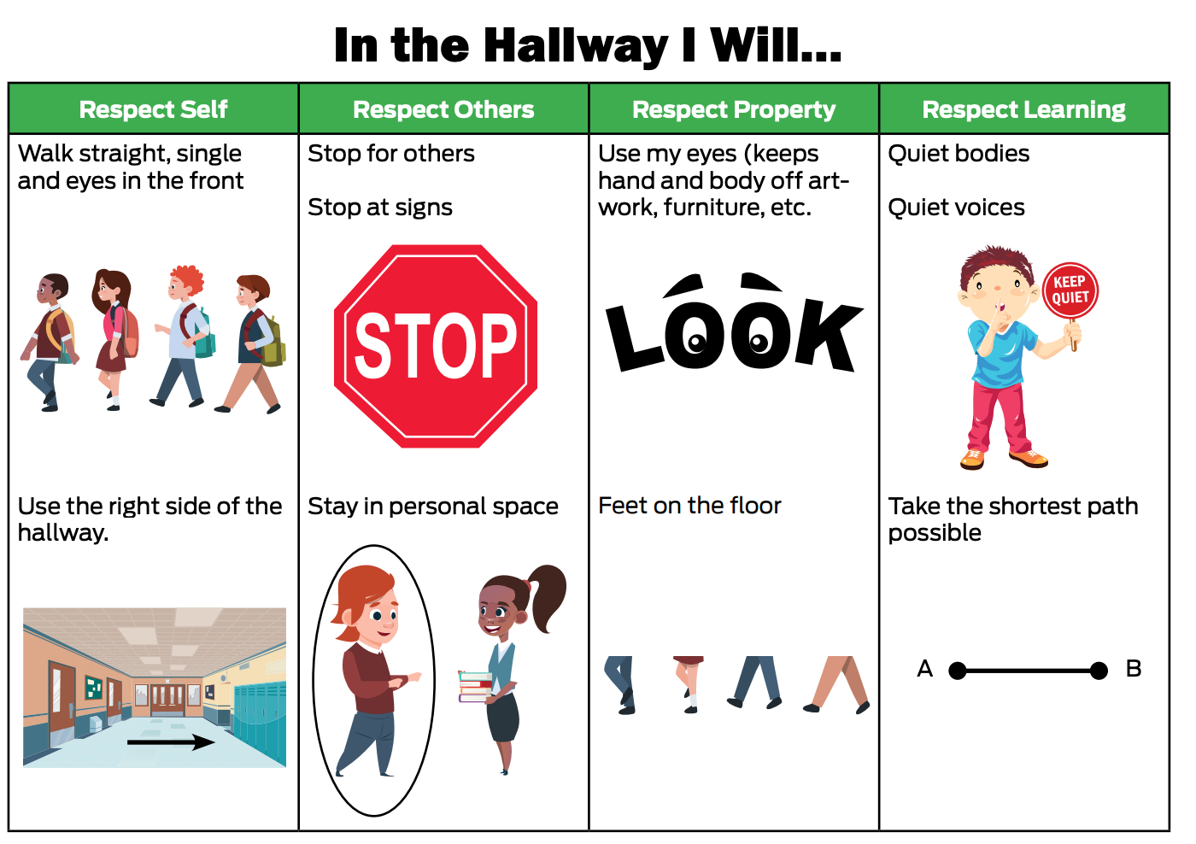
Matrix Will Be Unique to Your School
Notes:
Trainer Notes:
To Know/To Say: The matrix you develop will be unique to your school, based on the age of your students and include any customs pertinent to the cultures represented. Notice how the hallway-specific matrix reflects the context (elementary) of the building and provides pictures and illustrations in addition to the written expectations and rules to support primary students and English Learners.

Slide 16
All Settings Example
 | All Settings
Safe | Walk Keep hands and feet to myself Report if someone is hurt or could be hurt
Respectful | Use appropriate language Follow directions Take care of school property
Responsible | Ask permission to leave the area or school Use peaceful words to solve problems
Notes:
Trainer Notes:
To Know/To Say: Most schools begin developing their matrix by clarifying specific expectations and then the rules for all school settings. These are the behavioral rules that are expected in each and every school location and are connected to the 3-5 schoolwide expectations that they define. “Please, read the rules in this matrix. Do the rules describe what safe, respectful and responsible should look and sound like?

Slide 17
Activity: Practice Defining Behaviors
The Leadership Team can practice writing specific rules for Respect in All Settings, using handout Practice Creating Rules for All Settings.
Start by individually writing one behavior on a separate Post-it note.
Place all Post-it notes on the table. Eliminate all duplicates.
Come to consensus on 1-3 behaviors/rules.
Notes:
Trainer Notes:
To Know/To Say: The Leadership Team can practice writing specific rules for Respect in All Settings, using the form shown. Start by individually writing one behavior on a separate Post-it note. Place all Post-it notes on the table. Eliminate all duplicates. Come to consensus on 1-3 behaviors/rules.

Slide 18
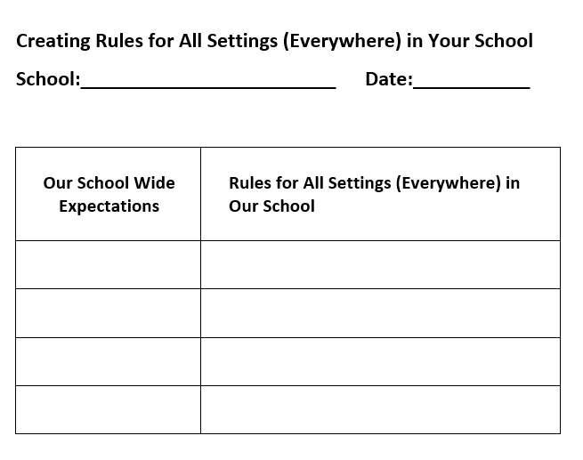
Practice writing Expected Behavior Rules for All Settings with Staff
Notes:
Trainer Notes:
To Know/To Say:
Once your school has selected schoolwide expectations and the leadership team has practiced a strategy to identify the behaviors/rules that define them, the team has a decision to make regarding how to proceed with drafting the schoolwide Matrix. There are several options teams have used.
Option 1
The leadership team can draft expectations for all settings, and then for specific settings such as hallways, bathrooms and cafeteria. Then the team takes the draft matrix to the staff and asks for input.
OR
Option 2
The SW-PBS Leadership Team may take time during the next faculty or staff meeting to share the drafting process with the staff, along with a quick review of the OMPUA guidelines.
Then give staff practice writing expected behavior rules, starting with all settings in the school. Create a form similar to the one your Leadership Team used to practice, listing your schoolwide expectations in the left column. Give each table a handout like the form similar to the one your team used and ask them as a group to reach consensus on two to three behaviors for each expectation.

Slide 19
Practice writing Expected Behavior Rules for All Settings with Staff
Another way to practice writing expected behavior rules for all settings with staff is to write each of your schoolwide expectations on one page of chart paper.
Divide the staff into the number of schoolwide expectations, assigning each group to one expectation. Instruct them to list ideas for specific behaviors, using OMPUA guidelines.
Once staff has practiced writing rules, the Leadership Team can ask for volunteers to form a workgroup to review the staff ideas and come up with a draft list of expected behaviors for all settings.
Notes:
Trainer Notes:
To Know/To Say:
Or Option 3
Post the papers around the room, one per expectation. Divide the staff into the number of schoolwide expectations, assigning each group to one expectation. Instruct them to list ideas for specific behaviors, using OMPUA guidelines.
Once staff has practiced writing expected behavior rules, the Leadership Team can ask for volunteers to form a workgroup to review the staff ideas and come up with a draft list of expected behaviors for all settings. The workgroup can then follow these steps:
Consider all the staff ideas and come up with 1-3 behaviors for each of the expectations.
Put the one to two expected behaviors on their matrix form.
Put a copy of the draft matrix for all settings in each teacher and staff members mailbox, asking for written suggestions to be given to the workgroup by a specific date.
The workgroup will review the suggestions and develop another draft.
Share the second draft with everyone at the next faculty meeting so staff can reach consensus on rules for all settings.

Slide 20
Unpacking Defining Specific Behaviors for Non-Classroom Areas
What?
– Any area of the school not under the direct and consistent supervision of one adult.
Why?
– Expectations are often not clear or agreed upon by all staff.
– Supervisors change day by day, hour by hour.
– Allows staff to teach expectations prior to entering the setting and consistently supervise
– Increases staff and student comfort when in these areas.
Notes:
Trainer Notes:
To Know/To Say: Non-classroom settings are those areas of the school that may be under the direct supervision of several different adults depending on the day or time. Cafeteria, hallways, bathrooms, and playground are examples of non-classroom areas. Often these non-classroom settings also have fewer staff supervising larger numbers of students Another challenge is that non-classroom areas are often those sites where expected behaviors are not clear or agreed upon by all staff. Having clear, agreed upon behaviors or rules and procedures will allow staff to teach students the expectations prior to entering the setting and consistently use them when supervising. Deciding on the behaviors or rules for these areas, assuring that all staff are fluent with them, and making a plan for how to train new staff throughout the year should also be addressed.

Slide 21
Unpacking Non-Classroom Behaviors
Same considerations for defining All-Settings behaviors.
Aligned/anchored to school-wide expectations.
OMPUA
Define behaviors in addition to those identified for All Settings that will lead to success in that specific setting.
Notes:
Trainer Notes:
To Know/To Say: The same considerations when defining specific behaviors or rules for all settings apply to non-classroom settings. First, they will be aligned or anchored to your schoolwide expectations. Again, clarity of expectations is critical; using OMPUA will help to ensure that behaviors or rules are clear and understandable. These specific behaviors should be student-centered and define behaviors/rules that will lead to success in that setting.

Slide 22
Possible Non-Classroom Areas
Restrooms
Cafeteria
Hallways
Recess or Breaks
Arrival/Departure
Assemblies/Pep Rallies
After School Activities
Homework Assistance
School Grounds/Parking Lot
Special Work Areas
Computer Lab
Office Area
Gym or Equipment Area
Concerts or Performances
Notes:
Trainer Notes: Provide participants about 1 minute to review the list, then say
To Know/To Say: We typically think of a few common non-classroom areas – hallways, cafeteria, recess, bus, restrooms, etc., but the list can include such times or areas as AM arrival/PM departure, after school activities, bus waiting area, computer “area”, special work or group areas, assemblies, pep rallies, school grounds, etc.

Slide 23
Ensure your Matrix Reflects valued Behaviors of Students and Families
Give every student a copy of the draft matrix during homeroom or advisory period and have them hand in their suggestions for a small workgroup.
Consider also providing all students a school map and have them mark 1) areas where they feel safe and respected and 2) areas where they do not feel safe or disrespected.
Families can be given an email copy of the draft matrix and asked to send suggestions back to the school.
Have copies of the draft matrix in the office for parents to review when they visit the school.
If the timing works, the Leadership Team could give families a copy of the draft matrix to review while they are waiting for parent-teacher conferences
Notes:
Trainer Notes:
To Know/To Say: To ensure your matrix reflects valued behaviors of students and families, your team can seek their input on behaviors or rules for every setting in the school. There are many creative ways to do this.
One idea would be to give every student a copy of the draft matrix during homeroom or advisory period and have them hand in their suggestions for a small workgroup of students to review. Consider also providing all students a school map and have them mark 1) areas where they feel safe and respected and 2) areas where they do not feel safe or disrespected. Ask students to give examples of what they mean when they indicate safe and respected and unsafe and disrespected. Use this data to inform the behaviors and rules that are needed in various settings from the student’s point of view.
Similarly, families can be given an email copy of the draft matrix and asked to send suggestions back to the school. Have copies of the draft matrix in the office for parents to review when they visit the school. If the timing works, the Leadership Team could give families a copy of the draft matrix to review while they are waiting for parent-teacher conferences.

Slide 24
Important to share matrix with Stakeholders
Ways to share
Newsletters
Handbooks
School Website
Posting in each Specific Setting
Notes:
Trainer Notes:
To Know/To Say: After you have obtained staff, student, and family input into your matrix and staff members agree on specific behaviors or rules, they can be added to your matrix. As you work through the process of gaining consensus it is advisable to date your matrix and write DRAFT on it until staff, students and families agree it is “final.”
Once your matrix is complete, it will be important to share with staff, students and families in newsletters, handbooks, and the school website, as well as posting the behaviors or rules in each specific setting.

Slide 25
Important to Develop Effective Signage
The Purpose of the Signage is to provide the consistent language for all staff to use when teaching, Encouraging or providing Correction.
Notes:
Trainer Notes:
To Know/To Say: When posting your expectations and behaviors/rules, it is important to develop effective signage that will be used to support staff and students. All locations in your building should have location specific behaviors/rules posted along with the “all settings” section of your matrix.
The purpose of the signage is to provide the consistent language for all staff to use when teaching, encouraging, or providing correction. The wording on the signage should exactly match the wording used on your schoolwide matrix and be large enough that staff can see and read the signage from anywhere in that location. It might also be necessary to have multiple sets of signage in larger locations such as the cafeteria or gym.

Slide 26
Reflection/Discussion
With your team, review the example matrix provided in the handouts section that is tailored for your building’s grade level. Consider the following:
What are a few examples of behaviors/rules that are expected in all settings of your building?
How could defining behaviors or rules for each of your schoolwide expectations support appropriate student behavior?
What are the benefits to staff in having clear, consistent behaviors/rules?
Who will be responsible for downloading the blank matrix template and adding your schoolwide expectations?
Notes:
Trainer Notes:
To Know/To Say:

Slide 27
Reflection/Discussion
Now with your team discuss these questions:
What are the benefits to defining specific behaviors/rules that are aligned to schoolwide expectations and are applicable in ALL school settings?
How will you engage your entire staff in defining behavior specifically for all settings of your school?
What non-classroom settings should be included on your building’s matrix?
What are the benefits of engaging students and families in the creation of your matrix?
How will you get student and family input?
Who will be responsible for making sure that the matrix is shared with all stakeholders in newsletters and handbooks? Who will post the matrix on the school website?
How will you arrange for effective signage to be posted throughout the building?
Notes:
Trainer Notes:
To Know/To Say:

Slide 28
Monitoring the Quality of Your Work
Tier 1 Action Planning Checklist
Clarifying Expected Behaviors > Item 2
MO SW-PBS Tier 1 Artifact Rubric
See Schoolwide Matrix
Tiered Fidelity Inventory (TFI)
Item 1.3
Self-Assessment Survey (SAS)
Schoolwide Subsection Item 1
Notes:
Audio 24
There are several tools that your team can use to monitor whether you have the essential elements or features developed, the quality of your artifacts and gain feedback from school staff regarding implementation efforts. These tools include the:
Tier 1 Action Planning Checklist - to list products schools need to develop for successful implementation of all essential features of schoolwide Tier 1.
In THIS lesson your team learned about Tier 1 Action Planning Checklist item number 2, a matrix with specific schoolwide rules has been created and shared with staff.
MO SW PBS Tier 1 Artifacts Rubric - to help your team assess the quality of the materials your team develops.
In THIS lesson your team learned about MO SW PBS Tier 1 Artifacts Rubric for a Schoolwide Matrix, the specific rules for each expectation have been agreed upon for all settings and meet the OMPUA guidelines.
Tiered Fidelity Inventory (or TFI) - is a research validated tool that measures the building leadership teams perception of implementation fidelity of all three tiers. In THIS lesson your team learned about
TFI item number 1.3, the second part of this item, by providing specific “examples by setting have been agreed upon.”
Self-Assessment Survey (or SAS) - is a research validated survey that measures perceptions of all staff on the status and priority for improvement of SW-PBS.
In THIS lesson your team learned about SAS “Schoolwide section “ item number 1, with the first part which focuses on “clearly stated student expectations or rules are defined”.
In Lesson 3 of Clarifying Expected Behavior, your team will learn about developing procedures for non-classroom settings.
Your team will learn about clarifying expected classroom behaviors in the Effective Teaching and Learning practices (ETLPs) course, Lessons 2 and 3.

Slide 29
Closing
During this lesson, you learned…
The importance of engaging the voice of all stakeholders in selecting schoolwide expectations?
Next steps include
Developing action steps and a timeline for completion of selecting three to five schoolwide expectations.
Updating your action plan, use the Tier 1 Action Plan Checklist and the MO SW-PBS Tier 1 Artifacts Rubric to assess the quality of your work.
Consider using results of the PBIS Self-Assessment Survey (SAS) to gain perspective from all staff, and results from the PBIS Tiered Fidelity Inventory (TFI) to gain perspective from your Building Leadership Team.
Notes:
Trainer Notes:
To Know/To Say: During this lesson, you learned how you will engage all staff and stakeholder voices in selecting schoolwide expectations, the first step to developing your building’s social behavioral curriculum. These schoolwide expectations will be the cornerstone for all that you will do to implement SW-PBS.
Next steps include
Developing action steps and a timeline to complete the task of selecting three to five schoolwide expectations that includes the voice of all stakeholders.
Updating your action plan using the Tier 1 Action Plan template and the Tier 1 Action Planning Checklist.
Using the Tier 1 Artifacts Rubric to assess the quality of the resources your team develops.
Using, when available and appropriate, the results of the PBIS Self-Assessment Survey (SAS) to gain perspective from all staff, and results from the PBIS Tiered Fidelity Inventory (TFI) to gain perspective from your Building Leadership Team.
Additional information about Selecting Schoolwide Expectations can be found in Course 3 of the Missouri SW-PBS Tier 1 Implementation Guide which can be found at www.pbismissouri.org.

Slide 30
References
Colvin, G. (2007). 7 steps for developing a proactive school discipline plan: A guide for principals and leadership teams. Thousand Oaks, CA: Corwin.

Slide 31
Contact Information
Remember to follow MO SW-PBS on social media
Consultant Contact Information:
pbismissouri.org
facebook.com/moswpbs
@MOSWPBS

