Slide 1
Lesson 1: Selecting Schoolwide Expectations
MO SW-PBS

Slide 2
Facilitator Notes – Delete this slide
Handouts Needed:
HO1 Valued Expectations/Character Traits and Attitudes
HO 2 Determining Weighted Vote
HO 3 Discussion Notes to Engage Staff
Participants Need Access
MO SW-PBS Handbook
MO SW-PBS Tier 1 Implementation Guide

Slide 3
Session at a Glance
This lesson describes the first step in developing a social behavioral curriculum, identifying three to five overarching schoolwide social behavioral expectations that will be defined and agreed to by all staff. These expectations are valued social skills and behaviors for success at school and eventually in life. Examples include: respectful, responsible, safe, cooperative, and kind.
Notes:
Read slide

Slide 4
Working Agreements
Be Respectful
Be an active listener—open to new ideas
Use notes for side bar conversations
Be Responsible
Be on time for sessions
Silence cell phones—reply appropriately
Be a Problem Solver
Follow the decision making process
Work toward consensus and support decisions of the group
Notes:
These will be the Working Agreements we will honor during all our training sessions this year.

Slide 5
Attention Signal Practice
Select and teach an attention signal.
Notes:
“One of our agreements is to follow the attention signal.”
“Your team will work with your school to develop an attention signal you will use in every setting.”
“In order to get all of you focused after discussions, activities or breaks,
I will ________________________________________.”
(Insert your attention signal here.)
“Your task will be to finish your sentence, quiet your voice and ____________________________.”
(Insert what you want participants to do.)

Slide 6
Introductions
Insert an Introductions Activity.
MO SW-PBS
Notes:
Choose an Introductions Activity

Slide 7
Lesson Outcomes
At the end of this session, you will be able to…
Select three to five schoolwide expectations that define success for all students and are applicable in all settings (e.g., respectful, cooperative, safe, kind).

Slide 8
Importance of Identifying Expectations and Rules
Without a curriculum to guide what we want our students to achieve socially, little consistent teaching and monitoring can occur.
With a proactive and instructional approach to discipline, we first develop a social behavioral curriculum.
Notes:
Trainer Notes:
To Know/To Say: Schools have curricula to guide the teaching of each and every subject. No teacher would be expected to teach math, reading, or the sciences without one. The curriculum ensures that all teachers are working in harmony toward the same end goals. And yet for the social behavioral development of our students, much has been left up to individual teachers and staff to determine what social behavior will be encouraged, allowed, or disallowed. Without a curriculum to guide what we want our students to achieve socially, little consistent teaching and monitoring can occur. With a proactive and instructional approach to discipline, we first develop a social behavioral curriculum.

Slide 9
Key Terms
Expectations: Define the kind of people that you want your students to be (e.g., respectful, responsible, etc.)
Behaviors/Rules: Specify the tasks students are to do to meet the schoolwide expectations
Notes:
Read the slide or direct participants to read the slide,

Slide 10
Importance of Identifying Expectations and Rules
Provides consistency in language.
Provides consistency in what to teach.
Provides consistency in what to recognize.
Provides consistency in what to correct.
Notes:
Trainer Notes:
To Know/To Say: “One of the most important tasks your team and school will accomplish is the development of a clear set of positive schoolwide behavioral expectations. Why is this so important? Common expectations provide the basis for ALL adults in the school to create a common experience for ALL children.”
“Simply put, if the staff expect students to achieve and behave appropriately, they will.” Geoff Colvin, (2007). 7 Steps for Developing A Proactive Schoolwide Discipline Plan: A Guide for Principals and Leadership Teams.

Slide 11
Unpacking Schoolwide Expectations
Broad constructs or descriptions of the characteristics of positive behavior
Positively stated
Brief – no more than 3 to 5 in number
Comprehensive
The cornerstone for all you will do to implement SW-PBS!
Notes:
Trainer Notes:
To Know/To Say: Read the slide or direct participants to read the slide, then say, “Schoolwide expectations are guiding principles – valued attitudes for success at school.
1)They are broad constructs or classes of behavior,
2) positively stated,
3) brief – no more than three to five in number, and
4) comprehensive, that is they allow you to address a set of behaviors by referencing one of them.
Schoolwide expectations reflect the language and culture of each school. They will become the language all staff use when they teach, remind, recognize, and correct students.”

Slide 12
Unpacking Schoolwide Expectations
Schoolwide Expectations Reflect the Language and Culture of the School
These expectations become the language all staff use when they teach, remind, recognize, and correct students.
This language promote relationship building and promote belonging at school.
Notes:
Trainer Notes:
To Know/To Say: The SW-PBS Leadership Team will want to ensure the schoolwide expectations reflect the language and culture of each school. For example, if your school community includes students and families who speak Spanish as their primary language, not only is it important to ensure that the expectations are printed and posted in Spanish and English, but that the expectations also are representative of the culture and valued outcomes of the community.
These expectations become the language all staff use when they teach, remind, recognize, and correct students. When the expectations are reflective of the school community, this language serves to promote relationship building and promote belonging at school. These efforts to promote a welcoming culture in the school are reflected in staff, students, and families reporting a more positive school climate (Banks & Obiakor, 2015).

Slide 13
Schoolwide Expectations - Examples
The Five B’s | At East High School we will…
Be Respectful Be Responsible Be Cooperative Be Productive Be Safe | Respect Ourselves and Others Respect Property Respect Our Leaning time
Notes:
Trainer Notes:
To Know/To Say: Often schools use their mascot or slogan as an inspiration to create their expectations.
The process for selecting schoolwide expectations for your school is a visionary task–what you want students to be. So while your school mascot or slogan may fit this important visioning work, do not be tied to them if the connection is forced or fake such as coming up with an acrostic to fit S-T-A-R that does not speak to the student you envision.
Later, we will identify specific behaviors/rules that students do that operationally define the expectations in specific settings.
Here are a few examples of the many varied schoolwide expectations that schools have developed.
“Additional examples are on page 79 in the Tier 1 Implementation Guide.”

Slide 14
Activity
Read through the list of valued behaviors and attitudes on the handout entitled, Valued Expectations/Character Traits and Attitudes. Circle approximately ten that resonate with you personally. Feel free to add values that come to mind that are not listed.
Now, read through the list again, this time placing a checkmark by approximately ten expectations/character traits or attitudes that are essential for the success of your students. These may be different from your personal values that you just circled.
Share your list with your team, noting similarities and differences. If you could choose only five, which would be your top five – those most important for your students’ success? Order by their rank of importance.
Now, list the problem behaviors in your school. What behaviors are students receiving office discipline referrals for most frequently? Would you be able to address those problem behaviors by referencing one of your selected expectations?
Notes:
Trainer Notes:
To Know/To Say: The following activity gives your team an opportunity to practice the steps of a method for selecting your schoolwide expectations. Your SW-PBS Leadership Team will want to plan how to engage staff in this same process.
Read through the list of valued behaviors and attitudes on the handout entitled, Valued Expectations/Character Traits and Attitudes. Circle approximately ten that resonate with you personally. Feel free to add values that come to mind that are not listed.
Now, read through the list again, this time placing a checkmark by approximately ten expectations/character traits or attitudes that are essential for the success of your students. These may be different from your personal values that you just circled. Again, feel free to add any important but missing values.
Share your list with your team, noting similarities and differences. If you could choose only five, which would be your top five – those most important for your students’ success? Order by their rank of importance.
Now, list the problem behaviors in your school. What behaviors are students receiving office discipline referrals for most frequently? Would you be able to address those problem behaviors by referencing one of your selected expectations?

Slide 15
Engage Staff in Selection of Schoolwide Expectations
Engaging all staff in selecting schoolwide expectations is a critical piece in ensuring staff buy-in and future implementation fidelity.
Notes:
Trainer Notes:
To Know/To Say: Engaging all staff in selecting schoolwide expectations is a critical piece in ensuring staff buy-in and future implementation fidelity. While the team may feel that it is more efficient to select the expectations without involving the full staff, this approach is not likely to garner the support that is needed for widespread use of the language.
Your staff can be asked to complete the previous activity during a staff meeting, an early release or professional development day, in grade level teams or in department meetings. Once you have each staff member’s top five preferred expectations in rank order, a weighted vote will allow you to analyze their preferences with priority in mind.

Slide 16
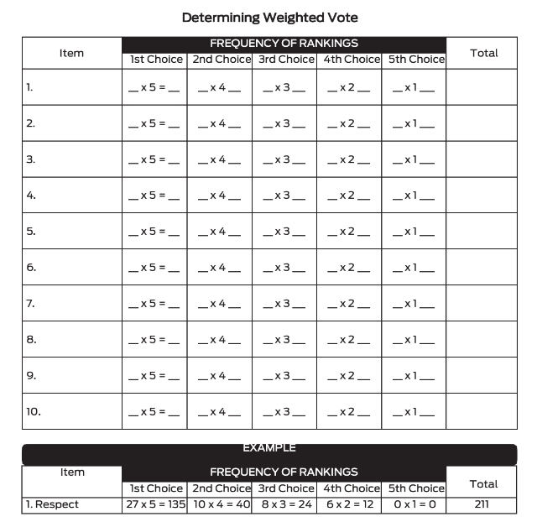
Unpacking Schoolwide Expectations
Remember, involve all stakeholders when developing your schoolwide expectations.
A process to involve all school staff in the development of schoolwide expectations is to use a weighted vote.
Notes:
Trainer Notes:
To Know/To Say: Once the SW-PBS team has identified possible expectations, the team can solicit feedback from staff using a weighted vote to help identify the agreed upon schoolwide expectations. A weighted vote is helpful when you ask people to mark a ranking of ideas or, in this case, their valued behaviors and attitudes. A weighted vote is completed by counting the number of responses that staff gave a specific choice and multiplying that number by the ranking. If 5 is “the best” or “most preferred,” you would count the number of people who listed that expectation or character trait as 5 and multiply the number of people by 5. If 1 is “the poorest” or “very least preferred” choice, you could again count the number of people who gave that expectation or character trait a 1 and multiply this number by 1. This form is helpful to determine a weighted vote.

Slide 17
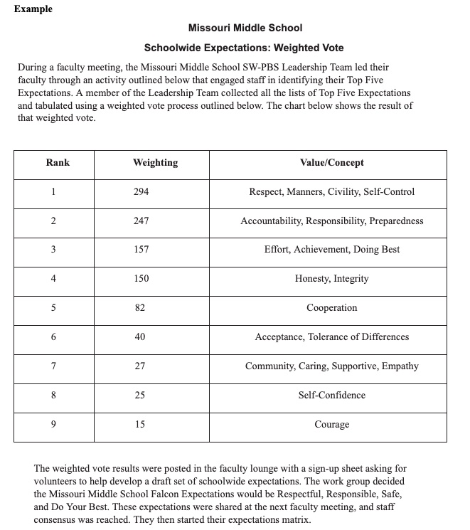
Review an Example Weighted Vote
Notes:
Refer to Missouri Middle School, Schoolwide Expectations Weighted Vote for an example of how one school engaged staff in a clarifying activity.
How might your team use this process to gain stakeholder input?

Slide 18
Engaging ALL Stakeholders
Notes:
As you are considering using a weighted vote with your staff members, consider how will your leadership team engage the voice of additional stakeholders such as students, families or community
members? Two options to consider include:
Your Leadership Team could repeat the process described earlier to gain staff input into the schoolwide expectations with students. then the team can compare what students feel are priorities for expected
behavior to those of the teachers.
Or, once staff have come to a consensus on their suggested expectations, they can be presented to students, families and community members for their feedback.
What are additional ways your team can include the voice of all stakeholders to ensure the expectations are culturally relevant for all students?

Slide 19
Engaging All Stakeholders in Selection of Schoolwide Expectations
Once you engaged the voice of all stakeholders, a work group can be formed to prepare a draft set of schoolwide expectations.
These draft expectations will need to be reviewed by the stakeholders again to gain final consensus.
Once the three to five expectations have been agreed upon, the Leadership Team will want to consider where and how to display them throughout the building and across all communication venues such as social media and bulletins.
Notes:
Trainer Notes:
To Know/To Say:
Once you have the completed a process to engage all stakeholder’s voice, a work group can be formed. Using stakeholder input (for instance as summarized in the weighted vote), this work group will be
asked to prepare a draft set of schoolwide expectations and any related slogan or logo. Their draft work can then be brought back to the staff to discuss, revise, and check for consensus.
These draft expectations will need to be reviewed by the staff and additional stakeholders again to gain final consensus.
Once the three to five expectations have been agreed upon, the Leadership Team will want to consider where and how to display them throughout the building. Large posters or paintings in the school
entryway, in the main office, and other prominent common areas are effective ways to communicate commitment to your schoolwide expectations. also consider how to communicate these expectations
through social media and other typical forms of stakeholder communication.
Once you have the weighted vote, a work group can be formed. Using staff input as summarized in the weighted vote, this work group will be asked to prepare a draft set of schoolwide expectations and any related slogan or logo. Their draft work can then be brought back to the staff to discuss, revise, and check for consensus.
These draft expectations will need to be reviewed by the staff again to gain final consensus.
Once the three to five expectations have been agreed upon, the Leadership Team will want to consider where and how to display them throughout the building. Large posters or paintings in the school entryway, in the main office, and other prominent common areas are effective ways to communicate commitment to your schoolwide expectations.

Slide 20
Discussion
Discuss how you will engage staff in selecting schoolwide expectations.
Use the handout provided, “Discussion Notes to Engage Staff” to jot down your team decisions.
Discuss the process your team will follow to engage staff in selecting schoolwide expectations. The following questions may be used to guide your action planning.
How will we engage staff in selecting schoolwide expectations, starting with each staff member creating their top five preferred expectations in rank order?
When?
Who will facilitate the process?
Notes:
Trainer Notes:
To Know/To Say: Discuss how you will engage staff in selecting schoolwide expectations.
Use the handout provided, “Discussion Notes to Engage Staff” to jot down your team decisions.
Discuss the process your team will follow to engage staff in selecting schoolwide expectations. The following questions may be used to guide your action planning.
How will we engage staff in selecting schoolwide expectations, starting with each staff member creating their top five preferred expectations in rank order?
When?
Who will facilitate the process?

Slide 21
Monitoring Quality of Your Work
Tier 1 Action Planning Checklist
Clarifying Expected Behaviors > Item 1
MO SW-PBS Tier 1 Artifact Rubric
See Schoolwide Matrix
Tiered Fidelity Inventory (TFI)
Item 1.3
Self-Assessment Survey (SAS)
Schoolwide Subsection Item 1
Notes:
There are several tools that your team can use to monitor the quality of your implementation efforts and/or gain feedback from school staff. these tools include the: Tier 1 Action Planning Checklist - to list products schools need to develop for successful implementation of all essential features of schoolwide Tier 1.
In THIS lesson your team learned about Tier 1 Action Planning Checklist item number one, developing 3-5 schoolwide have been selected and shared with staff.
MO SW PBS Tier 1 Artifacts Rubric - to help your team assess the quality of the materials your team develops.
In THIS lesson your team learned about MO SW PBS Tier 1 Artifacts Rubric for a Schoolwide Matrix, developing 3-5 schoolwide have been selected and shared with staff will set the foundation for further clarifying of the behavioral rules which you will learn about in the next lesson.
Tiered Fidelity Inventory (or TFI) - is a research validated tool that measures the building leadership teams perception of implementation fidelity of all three tiers.
In THIS lesson your team learned about TFI item number 1.3, with the first part focusing on “3-5 schoolwide have been selected and shared with staff”.
Self-Assessment Survey (or SAS) - is a research validated survey that measures perceptions of all staff on the status and priority for improvement of SW-PBS.
In THIS lesson your team learned about SAS “Schoolwide section “ item number 1, with the first part which focuses on “3-5 schoolwide have been selected and shared with staff”.
In Lesson 2 of Clarifying Expected Behavior, your team will learn about developing clearly stated rules for all settings that exemplify each of the schoolwide expectations that have been agreed upon. Your team will learn about clarifying expected classroom behaviors in the Effective Teaching and Learning practices (ETLPs) course, Lessons 2 and 3. To see the pertinent sections of each tool see the Tier 1 Implementation Guide.

Slide 22
Closing
During this lesson, you learned…
The importance of engaging the voice of all stakeholders in selecting schoolwide expectations?
Next steps include
Developing action steps and a timeline for completion of selecting three to five schoolwide expectations.
Updating your action plan, use the Tier 1 Action Plan Checklist and the MO SW-PBS Tier 1 Artifacts Rubric to assess the quality of your work.
Consider using results of the PBIS Self-Assessment Survey (SAS) to gain perspective from all staff, and results from the PBIS Tiered Fidelity Inventory (TFI) to gain perspective from your Building Leadership Team.
Notes:
Trainer Notes:
To Know/To Say: During this lesson, you learned the first step in developing a social behavioral curriculum, is identifying three to five overarching schoolwide social behavioral expectations that will be defined and agreed to by all staff. These schoolwide expectations will be the cornerstone for all that you will do to implement SW-PBS. How will you engage all staff in selecting schoolwide expectations, the first step to developing your building’s social behavioral curriculum? How will you engage the voice of students and families in developing your expectations?
Next steps include updating your Tier 1 Action Plan. Develop action steps and a timeline for completion for selecting three to five schoolwide expectations. Use the Tier 1 Action Plan Checklist and the MO
SW-PBS Tier 1 Artifacts Rubric to assess the quality of your work. Consider using results of the PBIS Self-Assessment Survey (SAS) to gain perspective from all staff, and results from the PBIS Tiered
Fidelity Inventory (TFI) to gain perspective from your Building Leadership Team.
Additional information about Selecting Schoolwide Expectations can be found in Course 3 of the Missouri SW-PBS Tier 1 Implementation Guide which can be found at www.pbismissouri.org.

Slide 23
References
Banks, T., & Obiakor, F. E. (2015). Culturally responsive positive behavior supports- considerations for practice. Journal of Education and Training Studies, 3(2), 83–90.
Colvin, Geoff (2007). 7 Steps for Developing A Proactive Schoolwide Discipline Plan: A Guide for Principals and Leadership Teams.
OSEP Center on Positive Behavior Interventions and Support, U.S. Department of Education, Office of Special Education Programs (2015). Implementation blueprint and self-assessment: positive behavioral interventions and support. Retrieved from www.pbis.org.
Vincent, C.G., Randall, C., Cartledge, G., Tobin, T.J & Swain-Bradway, J. (2011). Toward a conceptual integration of cultural responsiveness and schoolwide positive behavior support. Journal of Positive Behavior Interventions, 13(4), 219–229.

Slide 24
Contact Information
Remember to follow MO SW-PBS on social media
Consultant Contact Information:
pbismissouri.org
facebook.com/moswpbs
@MOSWPBS

