Slide 2
Facilitator Notes: Delete This Slide
Handouts
Example Meeting Agenda
Activity Team Agenda
Tier 1 Action Plan
Tier 1 Artifact Rubric
Tier 1 Action Planning Checklist
MO SW-PBS
Notes:
To Know/To Say: This lesson uses 2 handouts. If you have not already done so, download the handouts at this time.

Slide 3
Working Agreements
Be Respectful
Be an active listener—open to new ideas
Use notes for side bar conversations
Be Responsible
Be on time for sessions
Silence cell phones—reply appropriately
Be a Problem Solver
Follow the decision making process
Work toward consensus and support decisions of the group
MO SW-PBS
Notes:
Trainer Notes: Hide or delete this slide if presenting the entire PLM
To Know/To Say: “These will be the Working Agreements we will honor during all our training sessions this year.”

Slide 4
Attention Signal
Notes:
Trainer Notes: Facilitator: Select an attention signal.
To Know/To Say: “One of our agreements is to follow the attention signal.”
“Your team will work with your school to develop an attention signal you will use in every setting.”
“In order to get all of you focused after discussions, activities or breaks,
I will ________________________________________.”
(Insert your attention signal here.)
“Your task will be to finish your sentence, quiet your voice and ____________________________.”
(Insert what you want participants to do.)

Slide 5
Introductions
Notes:
Trainer Notes: Facilitator: Select an introductions activity
To Know/To Say:

Slide 6
Lesson Outcomes
At the end of this session, you will be able to…
Create a standard meeting agenda and format.
Notes:
Trainer Notes:
To Know/To Say: At the end of this session, you will be able to…Create a standard meeting agenda and format.

Slide 7
Key Concepts/Rationale
“Creating an effective agenda is one of the most important elements for a productive meeting.”
MO SW-PBS, 2019
MO SW-PBS
Notes:
Trainer Notes:
To Know/To Say:
Quote: “Creating an effective agenda is one of the most important elements for a productive meeting.”¹ As the SW-PBS Leadership Team begins to meet on a consistent basis, it is critical that the team meeting is driven by a well organized agenda. This lesson will walk through the important elements of an effective agenda and provide a template for the team to utilize. This same template can be used to store meeting notes related to agenda items.

Slide 8
Purpose of Agenda
The agenda typically communicates:
objectives/outcomes or topics for discussion,
a time allotment for each topic, and
the person responsible for reporting or leading.
MO SW-PBS
Notes:
To Know/To Say: Creating an effective agenda is one of the most important elements for a productive meeting.
The agenda typically communicates:
objectives/outcomes or topics for discussion,
a time allotment for each topic, and
the person responsible for reporting or leading.

Slide 9
Importance of an Effective Agenda
The most common elements of ineffective meetings include:
disorganization in planning,
lack of clear meeting objective or purpose,
ineffective processes for running the meeting, and
lack of closure or follow-up.
An effective agenda can provide an organizational structure that promotes clear meeting objectives and effective time management.
MO SW-PBS
Notes:
Trainer Notes:
To Know/To Say:
The most common elements of ineffective meetings include disorganization in planning, lack of clear meeting objective or purpose, ineffective processes for running the meeting, and no closure or follow-up. Having an effective agenda can provide an organizational structure that promotes clear meeting objectives and effective time management.

Slide 10
Agenda Template & Procedures
Distribute before the meeting, let participants know what will be discussed.
Include the following:
a space to take notes or indicate members present;
tasks, activities, or assignments to be done before the next meeting; and
the dates of future meetings and possible agenda items.
MO SW-PBS
Notes:
To Know/To Say: It can also be used as a checklist to ensure that all information is covered and, if it is distributed before the meeting, lets participants know what will be discussed. This gives the team an opportunity to come to the meeting prepared for the upcoming discussions or decisions. Additionally, agendas often include a space to take notes or indicate members present; tasks, activities, or assignments to be done before the next meeting; and the dates of future meetings and possible agenda items.
An agenda can be more focused and helpful in guiding an efficient meeting when objectives or outcomes replace simple topics. Terms such as “review and edit,” “discuss and decide,” “draft a plan for,” “determine next steps,” etc., help to avoid unfocused, long-winded discussions of topics and guide all team members toward specific outcomes. With each agenda item spelled out in this manner, the purpose and desired accomplishments are clear, and when team members are off on tangents, the speaker has a clear purpose to bring them back to.
Important Note: You may be asked to share your monthly meeting agendas with your district and/or regional SW-PBS coaches as a means to keep them informed of your work and to guide their planning for needed technical assistance. Consider an efficient and effective method to share your agendas with your support personnel.

Slide 11
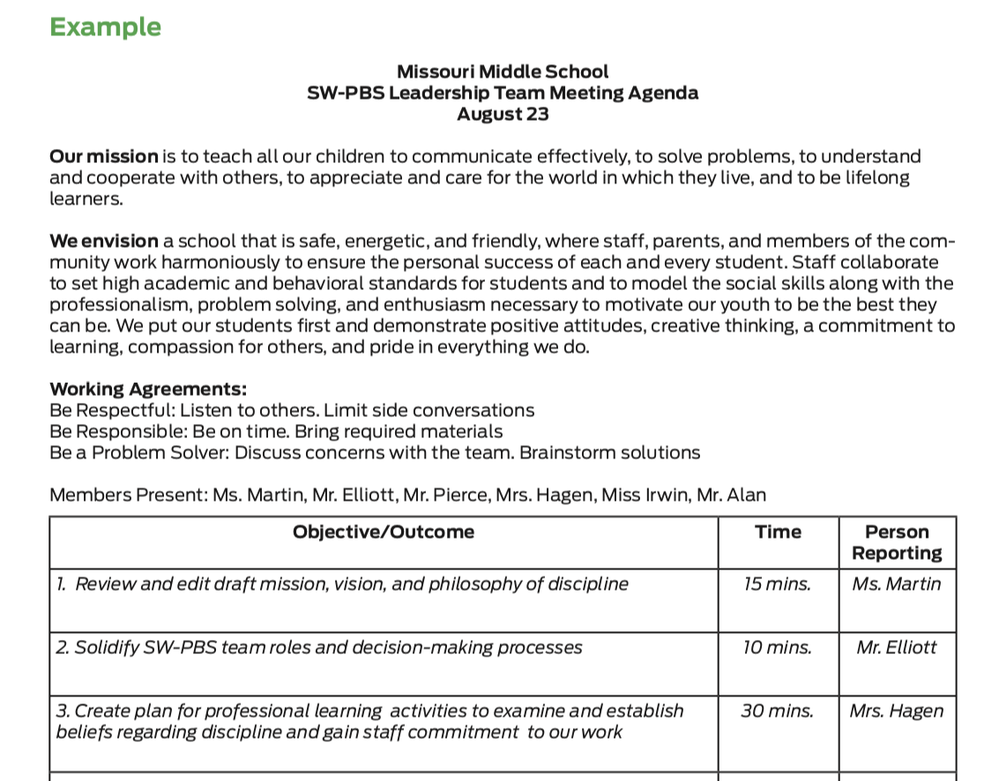
Discussion: Agenda Format
Review the example agenda and the form provided.
Decide if you will use this format or if you will adjust it.
Notes:
To Know/To Say: Review the example agenda and the form provided. Decide if you will use this format or if you will adjust it.
HO5 Example Meeting Agenda
HO6 Activity Team Agenda

Slide 12
Closing and Next Steps
Develop action steps for making a final decision about an agenda form for your SW-PBS Leadership Team meetings
Develop action steps for how your team will share meeting notes with stakeholders/district team/consultant.
Update your action plan using the Tier 1 Action Plan template and the Tier 1 Action Planning Checklist.
Use the Tier 1 Artifacts Rubric to assess the quality of the resources your team develops.
Use the results of the PBIS Self-Assessment Survey (SAS) to gain perspective from all staff, and results from the PBIS Tiered Fidelity Inventory (TFI) to gain perspective from your Building Leadership Team.
MO SW-PBS
Notes:
To Know/To Say: During this lesson, you learned the importance of having a standardized meeting agenda format and were provided an example template for your team to use.
How will you engage the SW-PBS Leadership Team in adopting an efficient meeting agenda format?
Next steps include
Develop action steps for making a final decision about an agenda form for your SW-PBS Leadership Team meetings
Develop action steps for how your team will share meeting notes with stakeholders/district team/consultant.
Update your action plan using the Tier 1 Action Plan template and the Tier 1 Action Planning Checklist.
Use the Tier 1 Artifacts Rubric to assess the quality of the resources your team develops.
Use the results of the PBIS Self-Assessment Survey (SAS) to gain perspective from all staff, and results from the PBIS Tiered Fidelity Inventory (TFI) to gain perspective from your Building Leadership Team.
Additional information about meeting agendas can be found in the MO SW-PBS Handbook and the MO SW-PBS Tier 1 Implementation Guide.

Slide 13
References
Missouri SW-PBS (2019). Missouri schoolwide positive behavior support tier 1 implementation guide.
MO SW-PBS
Notes:
Trainer Notes:
To Know/To Say:

