Slide 1
Leadership for Behavior
Notes:
Trainer Notes:
To Know/To Say:

Slide 2
Facilitator Notes: Delete This Slide
Handouts
Example and Activity Team Working Agreements
Tier 1 Action Plan
Tier 1 Artifact Rubric
Tier 1 Action Planning Checklist
MO SW-PBS
Notes:
To Know/To Say: This lesson uses one handout. If you have not already done so, download the handouts at this time.

Slide 3
Working Agreements
Be Respectful
Be an active listener—open to new ideas
Use notes for side bar conversations
Be Responsible
Be on time for sessions
Silence cell phones—reply appropriately
Be a Problem Solver
Follow the decision making process
Work toward consensus and support decisions of the group
MO SW-PBS
Notes:
Trainer Notes: Hide or delete this slide if presenting the entire PLM
To Know/To Say: “These will be the Working Agreements we will honor during all our training sessions this year.”

Slide 4
Attention Signal
Notes:
Trainer Notes: Facilitator: Select an attention signal.
To Know/To Say: “One of our agreements is to follow the attention signal.”
“Your team will work with your school to develop an attention signal you will use in every setting.”
“In order to get all of you focused after discussions, activities or breaks,
I will ________________________________________.”
(Insert your attention signal here.)
“Your task will be to finish your sentence, quiet your voice and ____________________________.”
(Insert what you want participants to do.)

Slide 5
Introductions
Notes:
Trainer Notes: Facilitator: Select an introductions activity
To Know/To Say:

Slide 6
Lesson Outcomes
At the end of this session, you will be able to…
Create clearly defined working agreements.
MO SW-PBS
Notes:
Trainer Notes:
To Know/To Say: By the end of this lesson participants will be able to create clearly defined working agreements.

Slide 7
Key Terms
Working agreements: ground rules that assist staff in achieving their meeting goals and increasing the productivity and effectiveness of their time.
MO SW-PBS
Notes:
Trainer Notes:
To Know/To Say: Working agreements: ground rules that assist staff in achieving their meeting goals and increasing the productivity and effectiveness of their time.

Slide 8
Key Concepts/Big Ideas
“Unproductive meetings can dim enthusiasm for your work and slow efforts, while effective team processes excite and inspire, and fuel progress.”
MO SW-PBS, 2019
MO SW-PBS
Notes:
Trainer Notes:
To Know/To Say: Quote: “Unproductive meetings can dim enthusiasm for your work and slow efforts, while effective team processes excite and inspire, and fuel progress.”¹
Once your SW-PBS Leadership Team has been established and is preparing for the first team meeting, it is important that working agreements be established. This lesson will provide information on the importance of working agreements, provide examples, and give guidance on developing these ground rules for team meetings.

Slide 9
Why Working Agreements?
The most common categories of ineffective meetings include:
disorganization in planning; no clear meeting objective or purpose,
ineffective processes for running the meeting, and
no closure or follow-up.
Working agreements are one way to increase productivity and avoid ineffective team meeting processes.
Notes:
To Know/To Say: Time is the most valuable resource for educators. Meeting and planning time is often scarce so we must learn to work smarter, maximizing our time and outcomes.
The most common categories of ineffective meetings include: 1) disorganization in planning; no clear meeting objective or purpose, 2) ineffective processes for running the meeting, and 3) no closure or follow-up. Working agreements are one way to increase productivity and avoid ineffective team meeting processes.

Slide 10
Effective Working Agreements
Working agreements should be:
developed by the team,
posted visibly during meetings,
reviewed as each meeting is initiated,
occasionally used to review team performance at the close of meetings, and
revised as new issues surface.
MO SW-PBS
Notes:
To Know/To Say: Working agreements provide a guide for professional staff behavior. They express the behaviors that are valued by the team and help to ensure every team member knows exactly what is expected. They not only increase productivity and staff comfort but can also help you avoid conflict and provide the standards that allow the team to evaluate their performance.
Working agreements should be:
developed by the team,
posted visibly during meetings,
reviewed as each meeting is initiated,
occasionally used to review team performance at the close of meetings, and
revised as new issues surface.

Slide 11
Effective Working Agreements
All team members should be willing to confront behaviors that are in violation.
Effective working agreements are behaviorally specific.
Working agreements create a picture of how a professional behaves and contributes to the team discipline planning process and the group’s work culture.
MO SW-PBS
Notes:
To Know/To Say: All team members should be willing to confront behaviors that are in violation of their working agreements when they occur during meetings. Effective working agreements are behaviorally specific — they should be readily understood by all — and stated as the desired or positive behavior. They create a picture of how a professional behaves and contributes to the team discipline planning process and the group’s work culture.

Slide 12
Examples
Start on time; end on time.
Stay on topic.
Avoid unnecessary repetition.
Give your full attention; silence cell phones
during meetings.
Clarify agenda/meeting outcomes and time
allotments before beginning.
If presenting, be prepared.
Watch and be considerate of time.
MO SW-PBS
Notes:
To Know/To Say:
Working Agreements: Some Possibilities
Start on time; end on time.
Stay on topic.
Avoid unnecessary repetition.
Give your full attention; silence cell phones during meetings.
Clarify agenda/meeting outcomes and time allotments before beginning.
If presenting, be prepared.
Watch and be considerate of time.
Other examples from the tier 1 Implementation Guide include:
Attend to the speaker; use sticky notes for side conversations.
Wait to speak; use active listening.
Indicate support for ideas you like or agree with.
Ask for clarification if you don’t understand.
Share concerns thoughtfully; pair criticism with a way to improve.
Keep focus on the group goal and what is best for students.
Be willing to doubt your own infallibility, and compromise when necessary.

Slide 13
Increasing Effectiveness
Written as a team.
Posted for team members to see during team meetings.
Reviewed at start of each meeting.
Reviewed at the conclusion of each meeting.
Discussion on what worked, what didn’t, what needs improved.
MO SW-PBS
Notes:
To Know/To Say: In order for working agreements to be most effective it is important that they are written as a team and then posted for team members to see during team meetings. Working agreements can be reviewed at the start of meetings by all team members and then reviewed at the conclusion of the meeting to discuss what worked, what didn’t, and what needs to be improved.

Slide 14
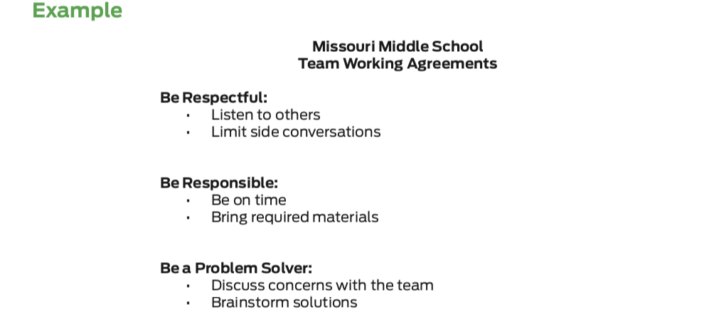
Discussion: Working Agreements
Review this example and consider what working agreements you think are important during team meetings.
Notes:
To Know/To Say: Missouri Middle School’s SW-PBS Leadership Team aligned the working agreements that they developed to the overall schoolwide expectations. Review this example and consider what working agreements you think are important during team meetings.
HO4 Example and Activity Team Working Agreements

Slide 15
Example
Be Respectful | Listen to Others Use Post-Its or Notepads to communicate ideas between times designated for discussion
Be Responsible | Be on Time Bring Required Materials
Be a Problem Solver | Discuss Concerns With The Team Brainstorm Solutions
MO SW-PBS
Notes:
To Know/To Say: “Here is an example of one set of working agreements.”

Slide 16
Activity: Creating Working Agreements
Each team member takes 2-4 Post It Notes.
Team members take time to identify agreements and write them Post It Notes --10 minutes
Put all Post It Notes on Team Parking lot.
Group the Post It Notes in silence --7 minutes.
Group and prioritize agreements--10 minutes.
Write prioritized agreements on chart paper.
Notes:
To Know/To Say: “Follow the directions above to develop your team working agreements. We have provided three expectations:
Be Respectful, Be Responsible, and Be a Problem Solver to help you get started.
You may use other expectations if you wish.”
“Some of you may already have developed working agreements that you use for collaborative meetings. If so, review and revise if needed.” When you complete this activity you will have created working agreements that will guide your meetings throughout this year.”
Provide 20-30 minutes to work on this task.

Slide 17
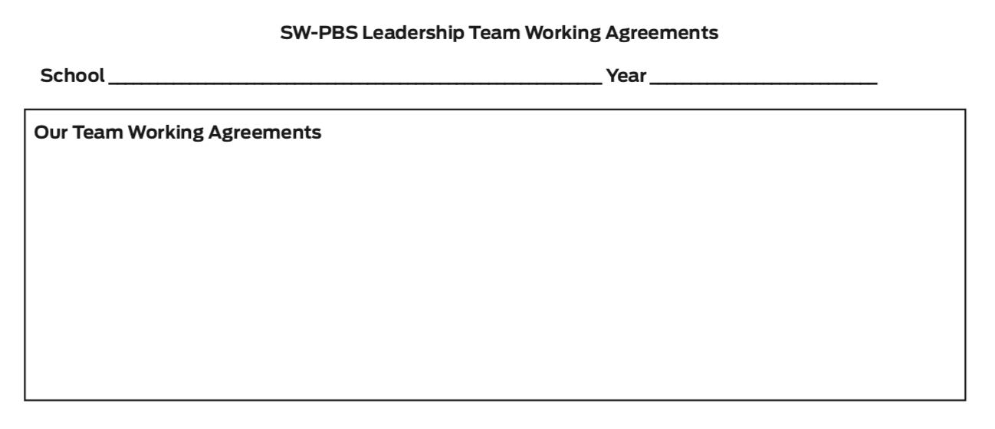
Discussion: Working Agreements
Reflect on the professional behaviors that characterize efficient and effective meetings you have attended.
What working agreements will support your team’s work and heighten your productivity?
Write your team’s working agreements using the form provided.
Notes:
To Know/To Say: Reflect on the professional behaviors that characterize efficient and effective meetings you have attended.
What working agreements will support your team’s work and heighten your productivity?
Write your team’s working agreements using the form provided.
HO4 Example and Activity Team Working Agreements

Slide 18
Closing and Next Steps
Develop action steps for developing your team working agreements and make a plan for how you will make them visible during your team meetings.
Update your action plan using the Tier 1 Action Plan template and the Tier 1 Action Planning Checklist.
Use the Tier 1 Artifacts Rubric to assess the quality of the resources your team develops.
Use the results of the PBIS Self-Assessment Survey (SAS) to gain perspective from all staff, and results from the PBIS Tiered Fidelity Inventory (TFI) to gain perspective from your Building Leadership Team.
MO SW-PBS
Notes:
To Know/To Say: During this lesson, you learned that working agreements provide a guide for professional staff behavior. They not only increase productivity and staff comfort but can also help you avoid conflict and provide the standards that allow the team to evaluate their performance.
How will you engage the SW-PBS Leadership Team in creating and continually using working agreements?
Develop action steps for developing your team working agreements and make a plan for how you will make them visible during your team meetings.
Update your action plan using the Tier 1 Action Plan template and the Tier 1 Action Planning Checklist.
Use the Tier 1 Artifacts Rubric to assess the quality of the resources your team develops.
Use the results of the PBIS Self-Assessment Survey (SAS) to gain perspective from all staff, and results from the PBIS Tiered Fidelity Inventory (TFI) to gain perspective from your Building Leadership Team.
Additional information about working agreements can be found in the MO SW-PBS Handbook and the MO SW-PBS Tier 1 Implementation Guide.

Slide 19
References
Missouri SW-PBS (2019). Missouri schoolwide positive behavior support tier 1 implementation guide.
Garmston, R. J, & Wellman, B. M. (2009). The adaptive school: A sourcebook for developing collaborative groups. Norwood, MA: Christopher-Gordon Publishers, Inc.
MO SW-PBS
Notes:
Trainer Notes:
To Know/To Say:

