Slide 2
Facilitator Notes: Delete This Slide
Handouts Example Team Meeting Dates Activity Team Meeting Dates Tier 1 Action Plan Tier 1 Artifact Rubric Tier 1 Action Planning Checklist
MO SW-PBS
Notes:
To Know/To Say: This lesson uses 2 handouts. If you have not already done so, download the handouts at this time.

Slide 3
Working Agreements
Be Respectful
Be an active listener—open to new ideas
Use notes for side bar conversations
Be Responsible
Be on time for sessions
Silence cell phones—reply appropriately
Be a Problem Solver
Follow the decision making process
Work toward consensus and support decisions of the group
MO SW-PBS
Notes:
Trainer Notes: Hide or delete this slide if presenting the entire PLM
To Know/To Say: “These will be the Working Agreements we will honor during all our training sessions this year.”

Slide 4
Attention Signal
Notes:
Trainer Notes: Facilitator: Select an attention signal.
To Know/To Say: “One of our agreements is to follow the attention signal.”
“Your team will work with your school to develop an attention signal you will use in every setting.”
“In order to get all of you focused after discussions, activities or breaks,
I will ________________________________________.”
(Insert your attention signal here.)
“Your task will be to finish your sentence, quiet your voice and ____________________________.”
(Insert what you want participants to do.)

Slide 5
Introductions
Notes:
Trainer Notes: Facilitator: Select an introductions activity
To Know/To Say:

Slide 6
Lesson Outcomes
At the end of this session, you will be able to…
Create a SW-PBS Leadership Team meeting schedule.
MO SW-PBS
Notes:
Trainer Notes:
To Know/To Say: To Know/To Say: At the end of this session, you will be able to create a SW-PBS Leadership Team schedule.

Slide 7
Key Concepts/Big Ideas
“Meeting and planning time is often scarce, so we must learn to work smarter, maximizing our time and outcomes.”
MO SW-PBS, 2019
MO SW-PBS
Notes:
Trainer Notes:
To Know/To Say:
Quote: “Meeting and planning time is often scarce, so we must learn to work smarter, maximizing our time and outcomes.”¹
Time is the most valuable resource for educators. This lesson will focus on the importance of establishing a SW-PBS Leadership Team meeting schedule that involves a minimum of one meeting per month, usually an hour in length, and prioritizing these meetings on the school calendar.

Slide 8
Protected Work Time is Essential
MO SW-PBS
Notes:
To Know/To Say: In order to provide leadership for the development, implementation, and evaluation of universal procedures in the entire building for all students and staff the SW-PBS Leadership Team must have protected time to work as a team.

Slide 9
Scheduling Team Meetings
Enter all dates on master calendar.
Meet for at least an hour, once per month.
MO SW-PBS
Notes:
To Know/To Say: It is recommended that your meetings be entered on the school master calendar early in the school year so other activities do not crowd out these important meetings.
Additionally, teams are encouraged to schedule the length of meetings so as to allow ample uninterrupted time to plan; at least an hour is ideal.

Slide 10
Creative Scheduling
Before or after school
Early-release days
Common planning time
Occasional “retreat” to allow longer, uninterrupted planning time.
Creative scheduling helps to provide the time necessary to ensure positive outcomes for your school.
MO SW-PBS
Notes:
To Know/To Say: Schools often schedule meetings before or after school, on early-release days, or at a time during the day when all or most share a common planning time; in some cases, substitutes could be scheduled as necessary. Some schools occasionally “retreat” to allow longer, uninterrupted planning time. Creative scheduling helps to provide the time necessary to ensure positive outcomes for your school.

Slide 11
Supporting SW PBS Leadership Team
Arranging meeting times and hiring substitutes for a portion of the day when meetings are held.
Meeting outside of regular school hours with extra pay.
Arranging for additional preparation time by periodically supervising team members’ classes for them.
Relieving participating team members of other duties such as bus supervision, recess duty, cafeteria supervision, etc.
Notes:
To Know/To Say: The time commitment to participate on a SW-PBS Leadership Team sometimes goes beyond the normal responsibilities of staff members. While respected professionals often make such a commitment gladly without thought of compensation, some consideration should be given to how to support team members for their commitment and work. This might include:
Arranging meeting times and hiring substitutes for a portion of the day when meetings are held.
Meeting outside of regular school hours with extra pay.
Arranging for additional preparation time by periodically supervising team members’ classes for them.
Relieving participating team members of other duties such as bus supervision, recess duty, cafeteria supervision, etc.

Slide 12
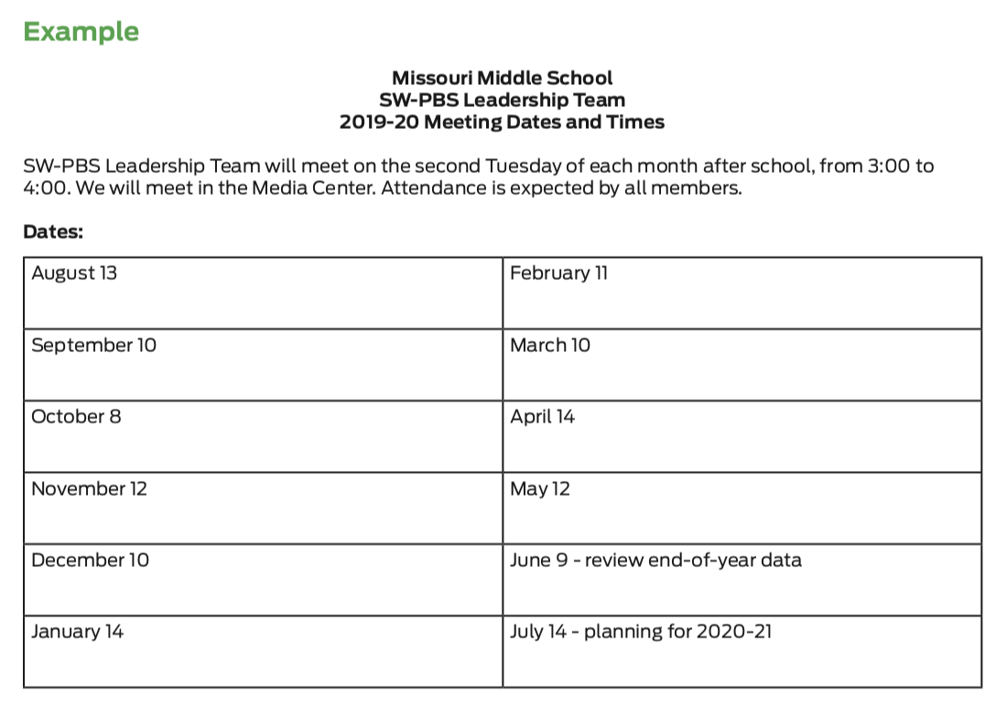
Discussion: Team Meetings
Review the example SW-PBS Leadership Team meeting schedule and consider when your SW-PBS Leadership could meet.
Notes:
To Know/To Say:
Review the example SW-PBS Leadership Team meeting schedule and consider when your SW-PBS Leadership could meet.
HO2 Example Team Meeting Dates

Slide 13
Review example SW-PBS Leadership Team meeting schedule and consider when your SW-PBS Leadership could meet.
MO SW-PBS

Slide 14
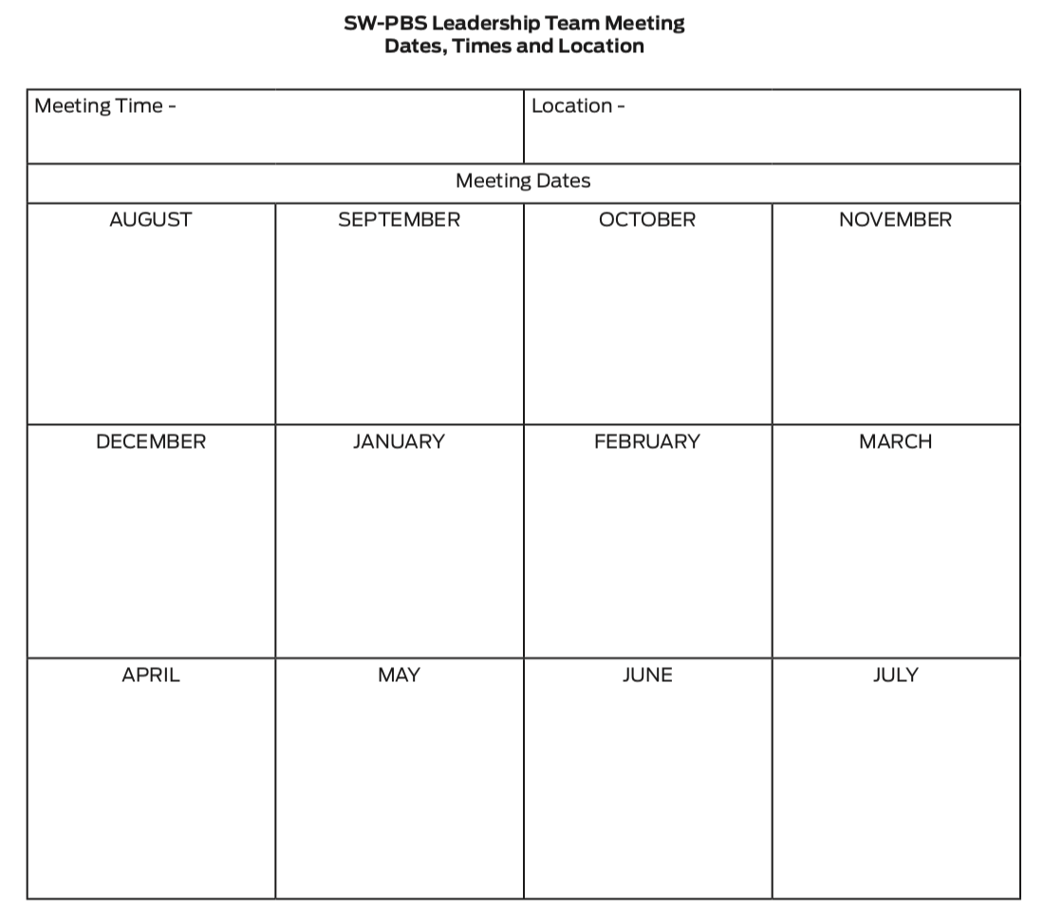
Discussion: Team Meetings
Use the form provided to schedule your SW-PBS Leadership Team meeting dates, times, and location.
Notes:
To Know/To Say: Use the form provided to schedule your SW-PBS Leadership Team meeting dates, times, and location.
HO3 Activity Team Meeting Dates

Slide 15
Review the example SW-PBS Leadership Team meeting schedule and consider when your SW-PBS Leadership could meet.
MO SW-PBS

Slide 16
Closing and Next Steps
Develop action steps for scheduling SW-PBS Leadership Team meetings and adding the dates/time to the school calendar.
Update your action plan using the Tier 1 Action Plan template and the Tier 1 Action Planning Checklist.
Use the Tier 1 Artifacts Rubric to assess the quality of the resources your team develops.
Use the results of the PBIS Self-Assessment Survey (SAS) to gain perspective from all staff, and results from the PBIS Tiered Fidelity Inventory (TFI) to gain perspective from your Building Leadership Team.
MO SW-PBS
Notes:
To Know/To Say: During this lesson, you learned the importance of establishing monthly meetings that are at least one hour in length for the SW-PBS Leadership Team to accomplish their work.
Next steps include updating your action plan. Develop action steps for scheduling SW-PBS Leadership Team meetings and adding the dates/time to the school calendar.
Additional information about SW-PBS Leadership Team meeting scheduling can be found in the MO SW-PBS Handbook and the MO SW-PBS Tier 1 Implementation Guide.

Slide 17
References
Missouri SW-PBS (2019). Missouri schoolwide positive behavior support handbook.
MO SW-PBS
Notes:
Trainer Notes:
To Know/To Say:

