Slide 1
District Leadership
Tim Lewis, Ph.D.
University of Missouri

Slide 2
Things On My Mind….
Returning to best practices
Student needs out resourcing our current structures within schools
One more school shooting
Spending money wisely
Its not sexy…. But it works

Slide 3
Returning to Best Practice

Slide 4
Social Competence &
Academic Achievement
SW-Positive
Behavior
Support
OUTCOMES
Supporting
Decision
Making
Supporting
Staff Behavior
SYSTEMS
DATA
PRACTICES
Supporting
Student Behavior

Slide 5
District-wide MTSS
Core academics plus differentiated instruction and accommodations
Core social, emotional, behavioral skills plus differentiated instruction and environmental/ community supports
Alignment across all systems, personnel, and community partners

Slide 6
District-Wide Logic
All schools receive training & support to implement essential Universal support practices and systems
District develops (and revises based on outcomes) a standard Tier 2 and 3 system
A percentage of current behavioral/academic expertise will move from traditional case by case, to supporting school team Tier 2 and 3 systems

Slide 7
Need overwhelming our current school systems

Slide 8
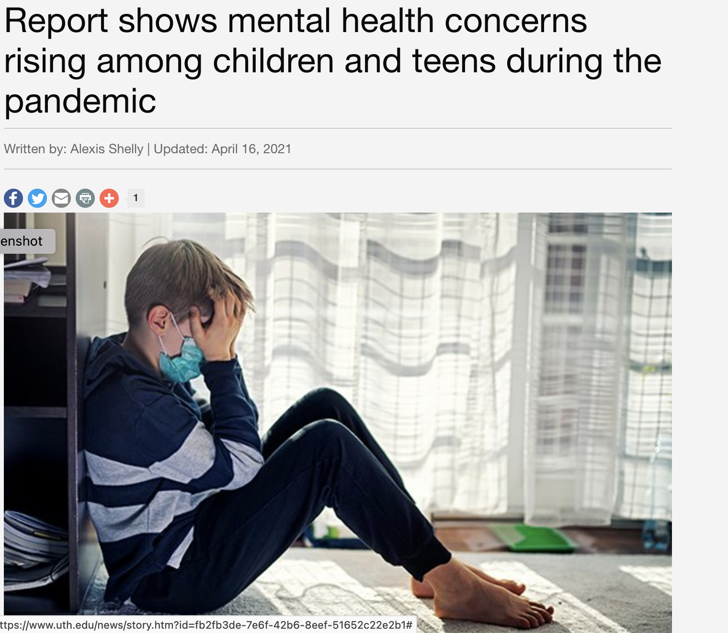
Pre-Pandemic
Prevalence estimates
5-7% disabilities
10-20% mental health (short/long term)
Counselors split across buildings
Large percentage of behavioral specialists FTE dedicated to evaluation/re-evaluation IDEA process
7 out of 10 Schools seeing rise
Washington Post, 5-31-22

Slide 9
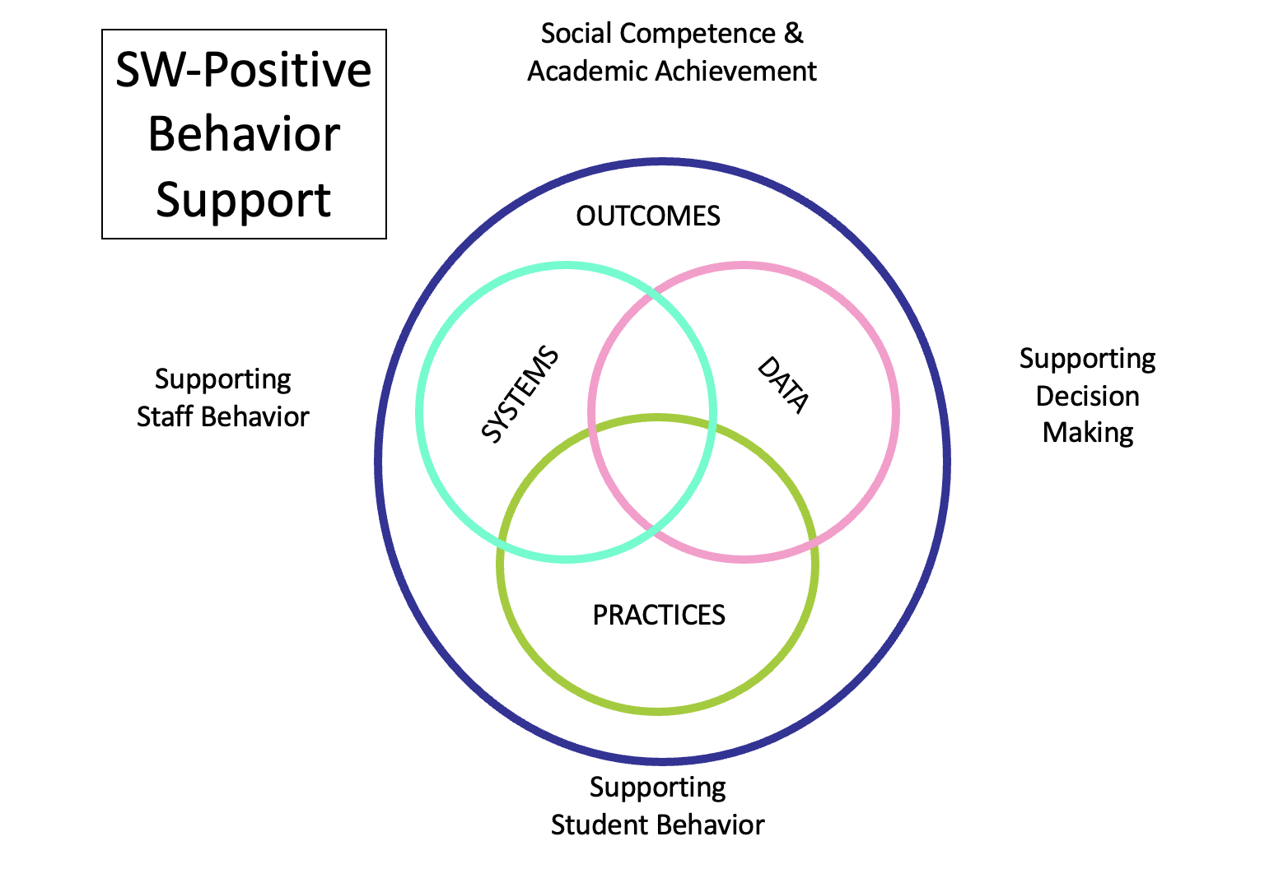
Three basic options
Continue current support structures based on prior prevalence and engage community resources
Place more supports in current system
Design new support systems

Slide 10
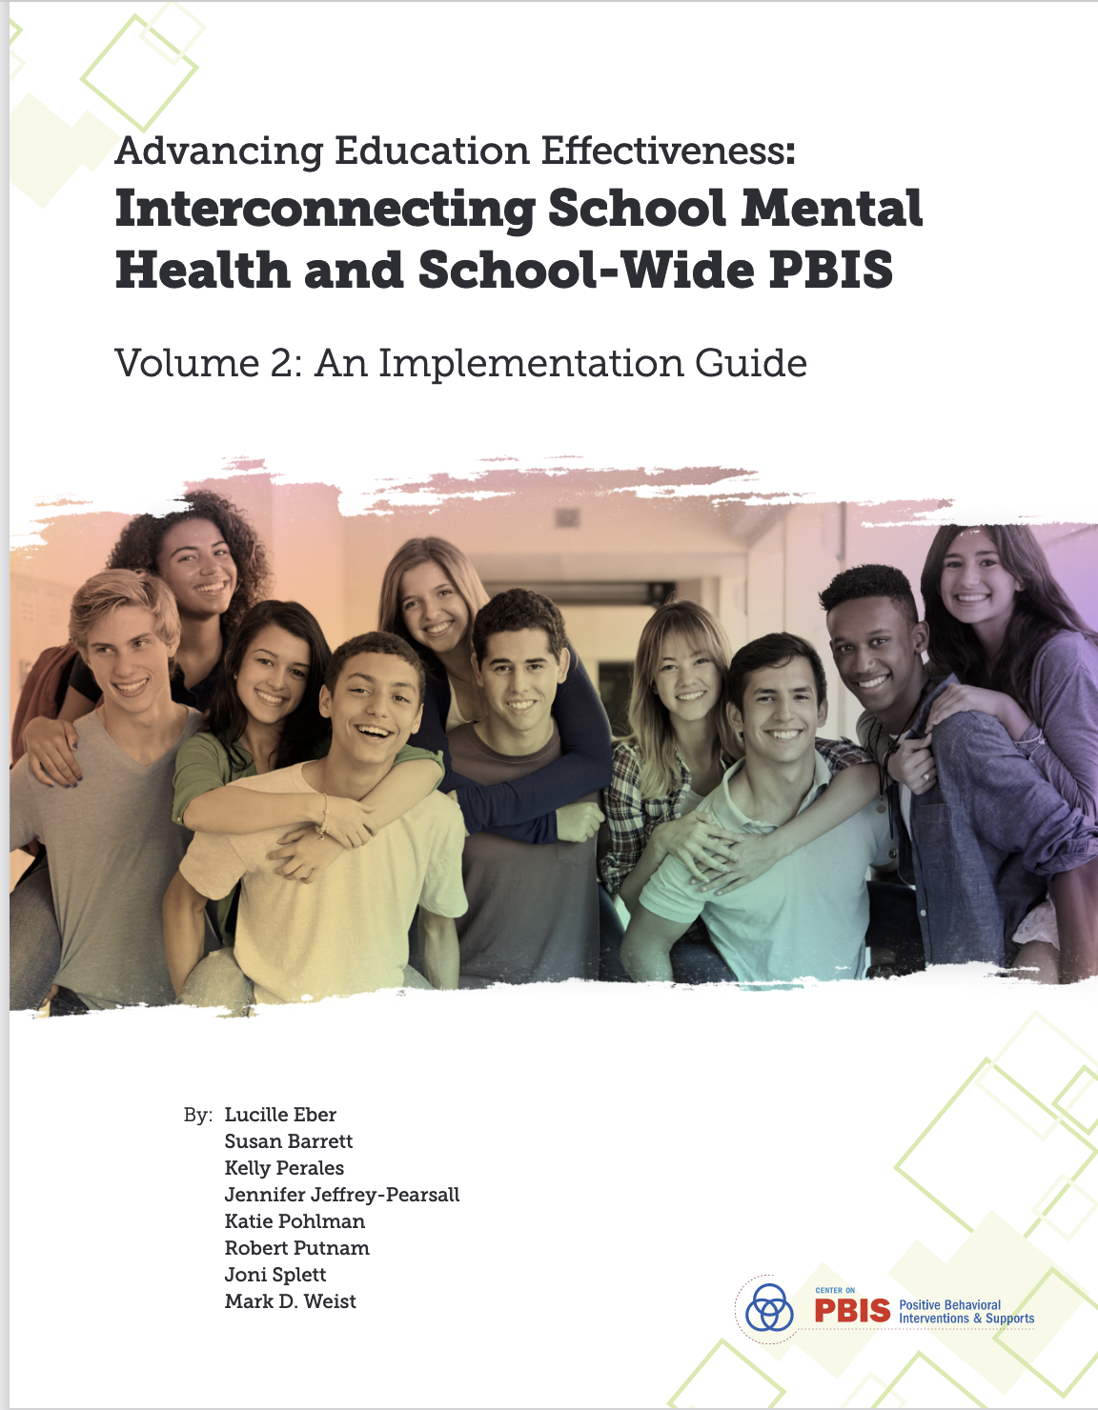
Connections to Mental Health and Community Agencies
https://www.pbis.org/resource/interconnecting-school-mental-health-and-pbis-volume-2

Slide 11
May 24, 2022

Slide 12
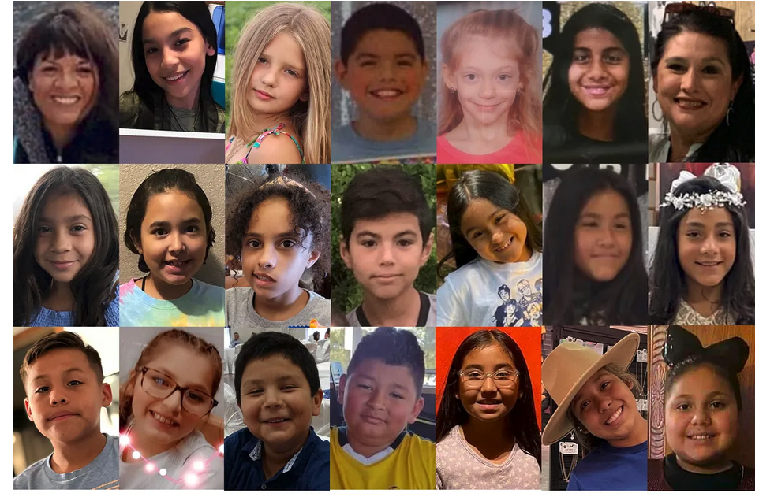
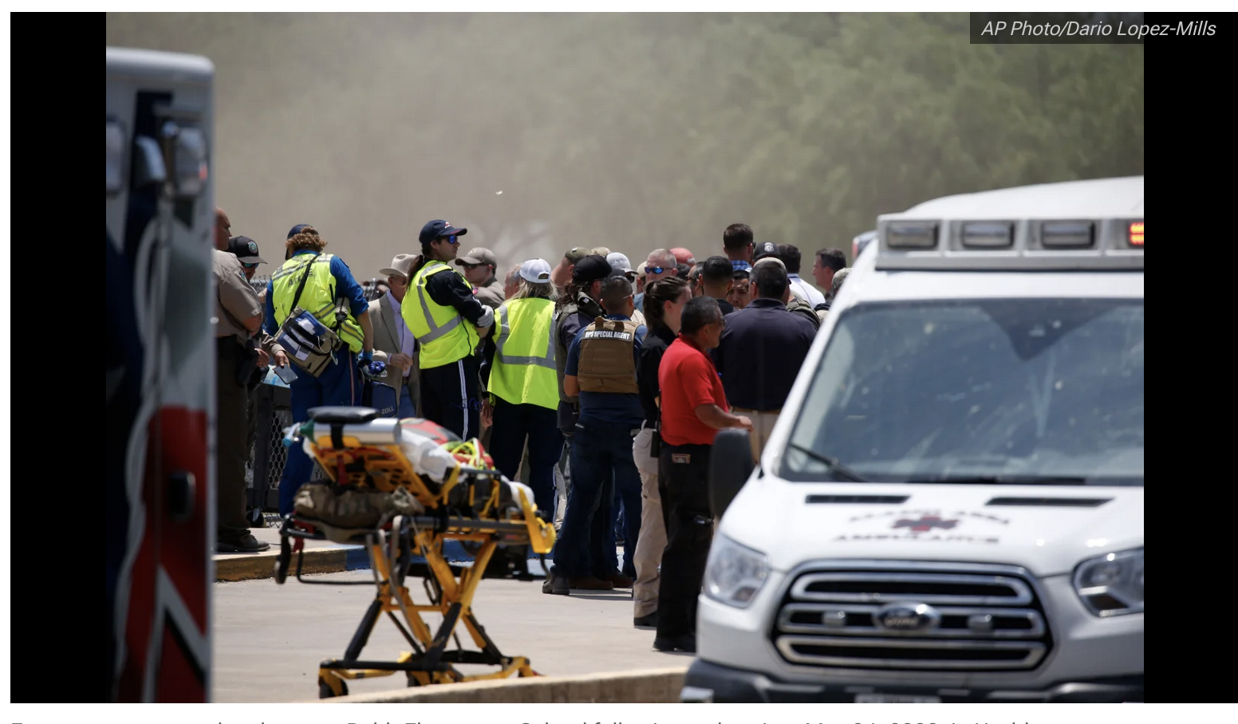
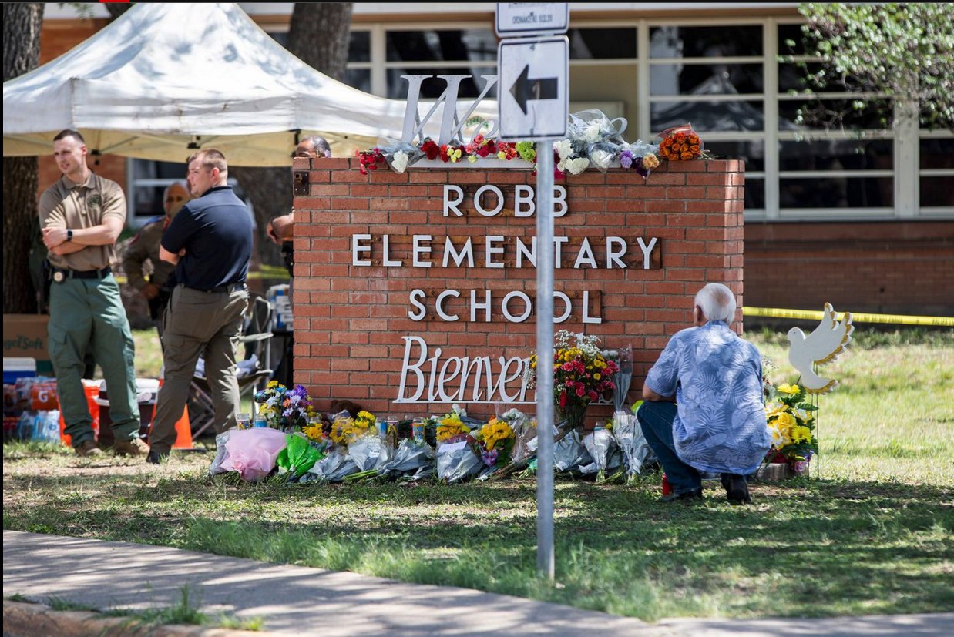
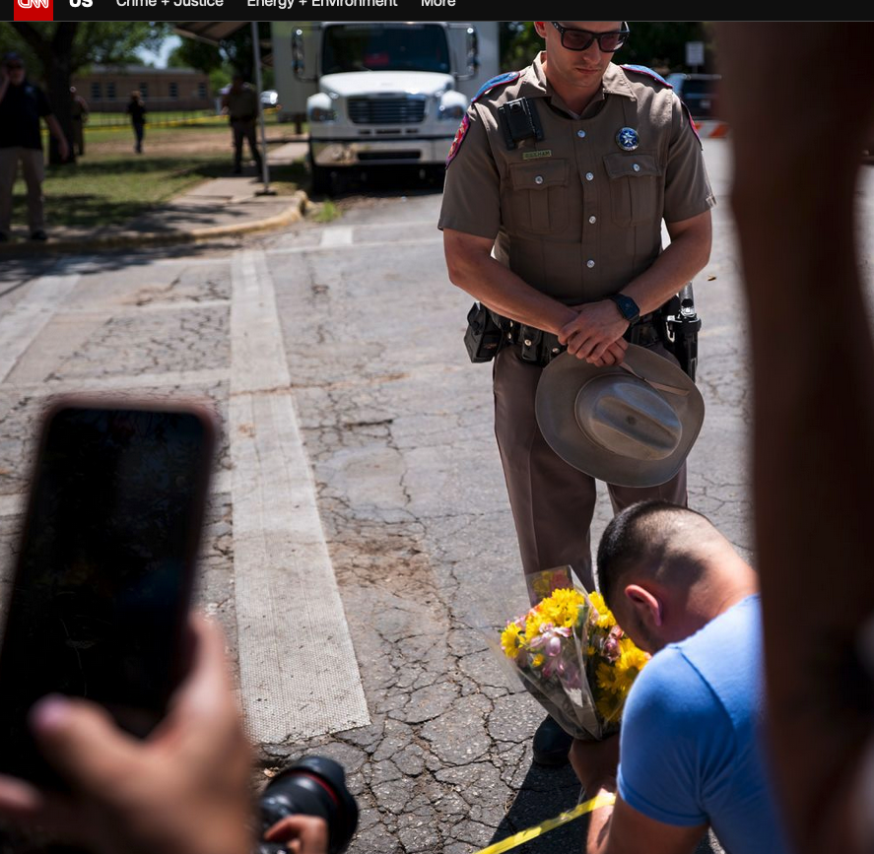

Slide 13
“Since 1970, there have been 1316 school shootings”
“In 4 out of 5 school shootings, at least one other person had knowledge of the attacker’s plan but failed to report it”
https://www.thetrace.org/2019/08/children-teens-gun-deaths-data/
Vossekuil, et al, 2002
+53

Slide 14
School security = $2.7 Billion annual market (Washington Post, November 13, 2018)

Slide 15
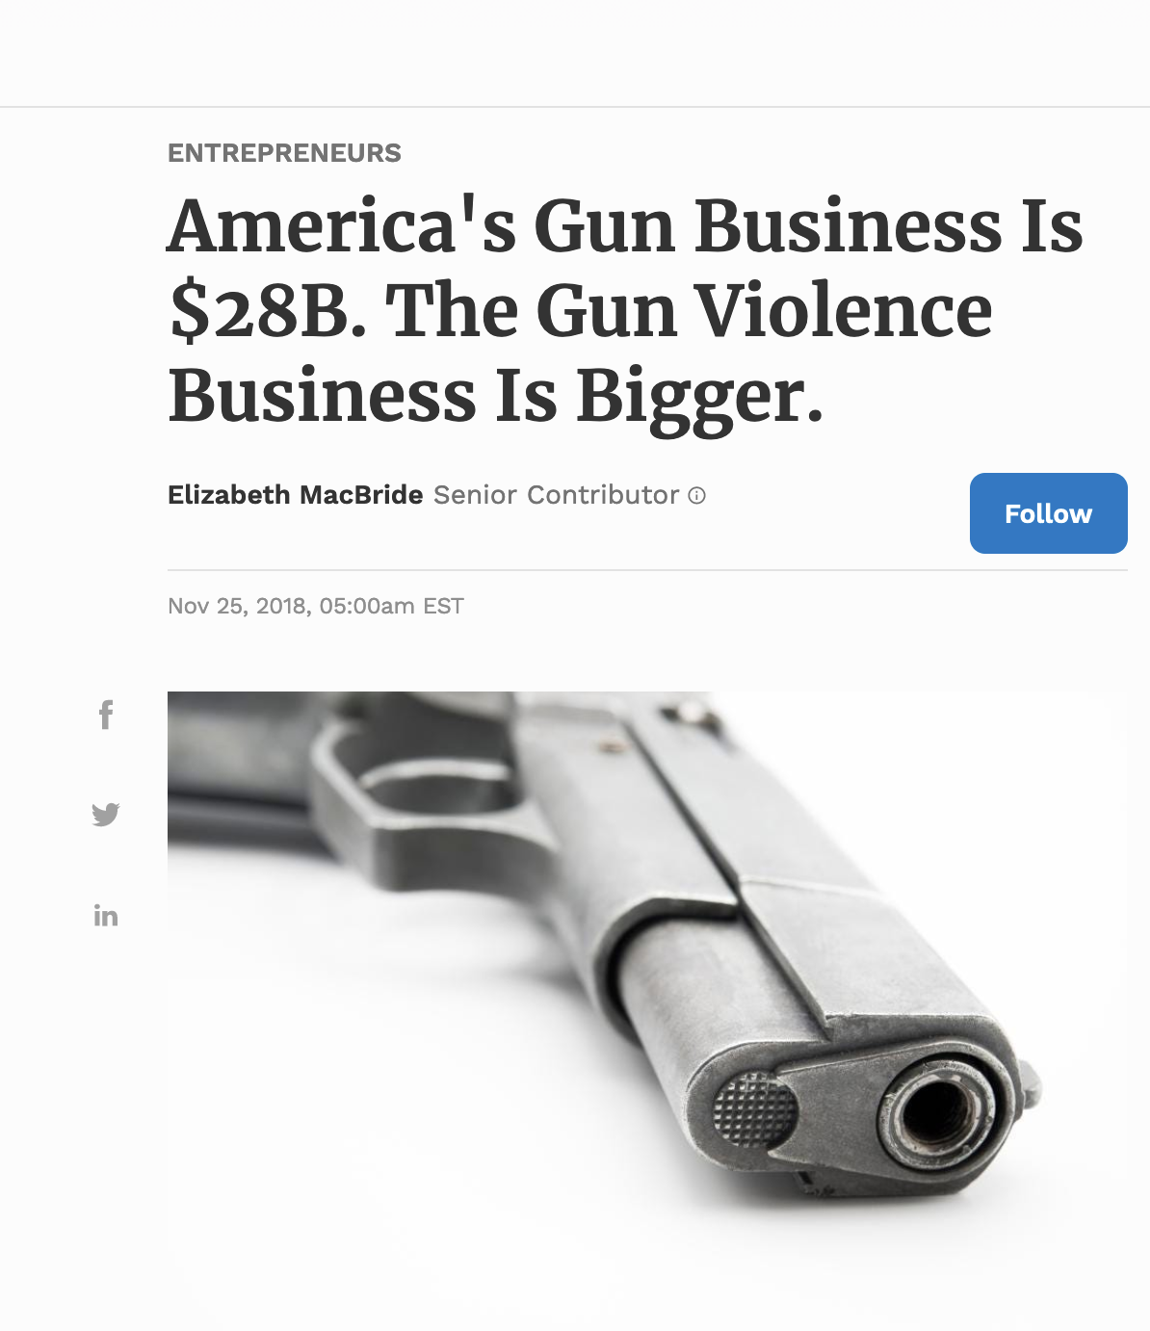
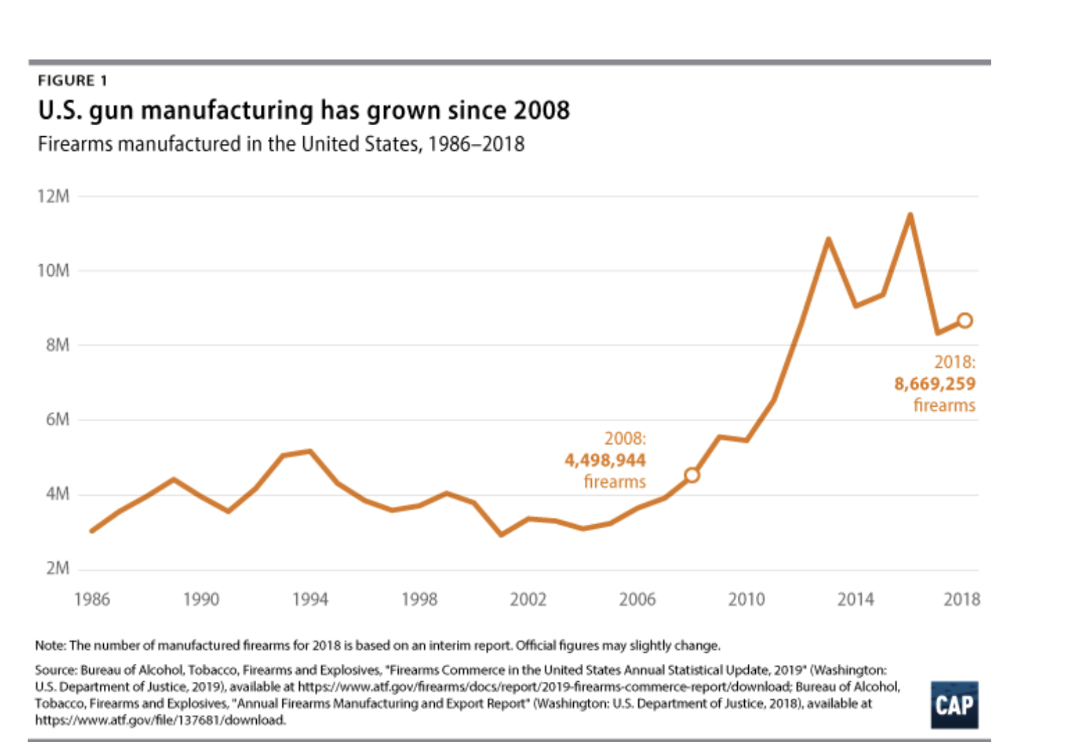

Slide 16
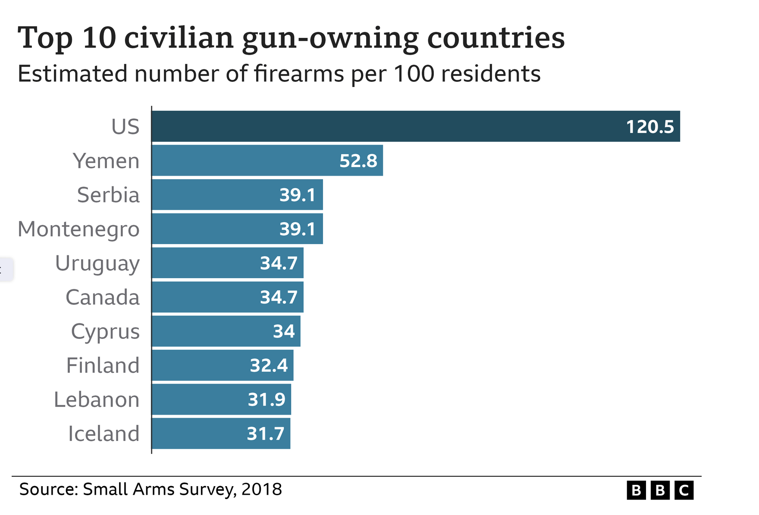
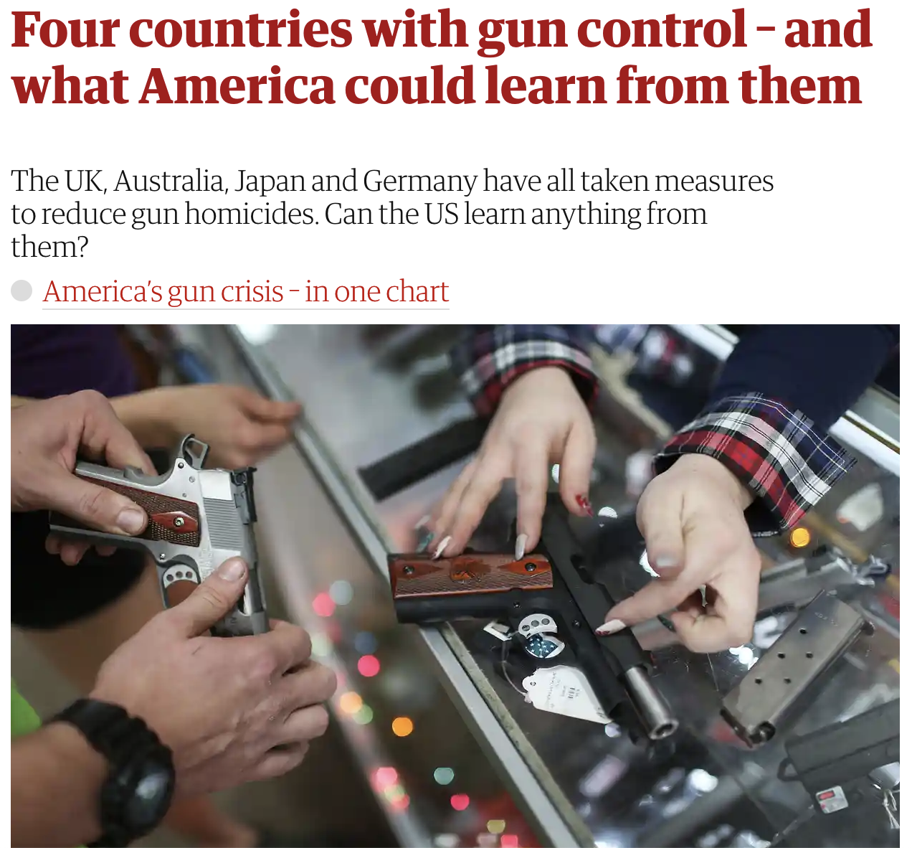

Slide 17
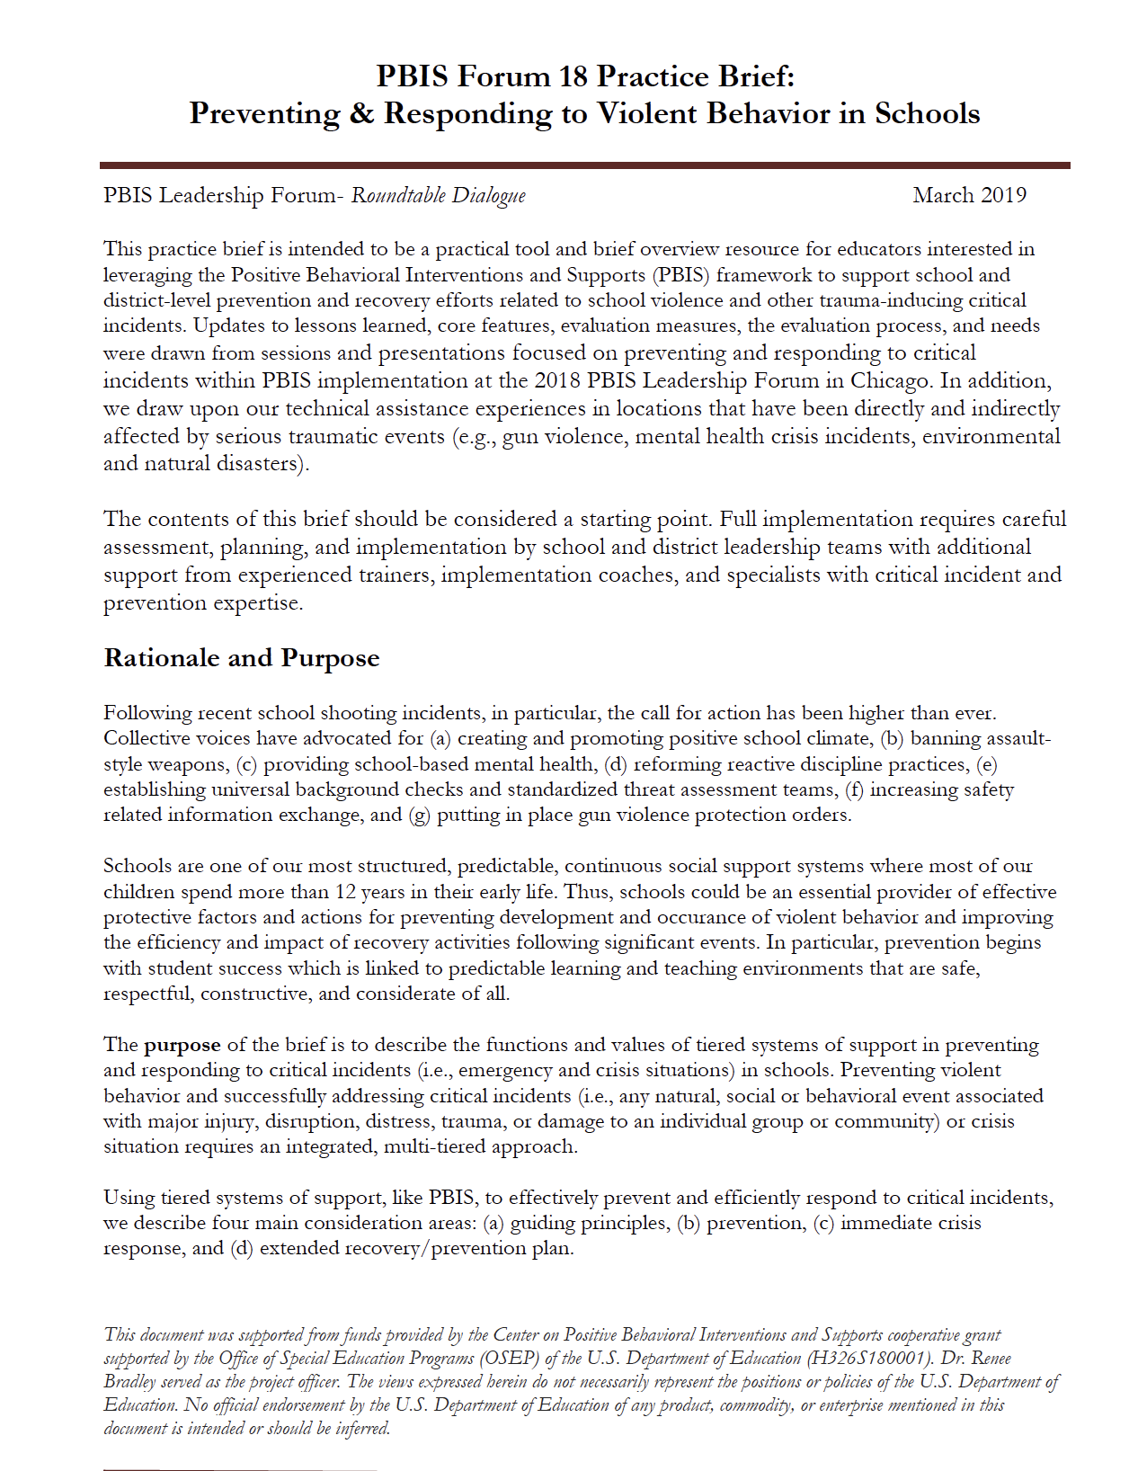
https://www.pbis.org/resource/preventing-responding-to-violent-behavior-in-schools

Slide 18
More resources continue to be added!
PBIS.ORG

Slide 19
Spending money wisely

Slide 20
The Coronavirus Aid, Relief, and Economic Security Act: Elementary and Secondary School Emergency Relief Fund (2020)
$13.2 Billion
American Rescue Plan; Education Emergency Relief (2021)
$122 Billion
Before you invest in any academic, social, emotional, or behavior practice or support, remember to demand that they…..

Slide 21
Show me
the DATA!!!

Slide 22
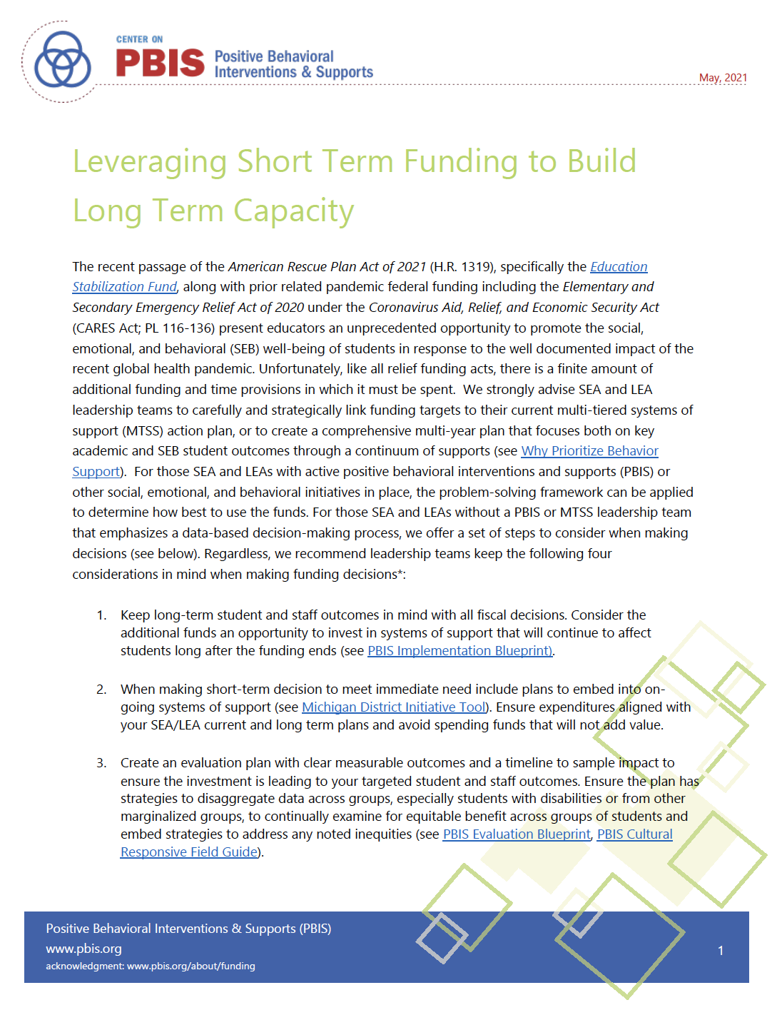

Slide 23
ARPA Recommendations
Keep long-term student and staff outcomes in mind with all fiscal decisions
When making short-term decisions to meet immediate need include plans to embed into on-going systems of support
Create an evaluation plan with clear measurable outcomes and a timeline to sample impact to ensure the investment is leading to your targeted student and staff outcomes
Be good consumers

Slide 24
Maintaining EBP Implementation with Fidelity through an MTSS framework is Hard Work
So Why Bother?

Slide 25
Average time to implementation fidelity
Nese, R. N. T., Nese, J. F. T., McIntosh, K., Mercer, S. H., & Kittelman, A. (2019). Predicting latency of reaching adequate implementation of tier I school-wide positive behavioral interventions and supports. Journal of Positive Behavior Interventions, 21, 106-116.

Slide 26
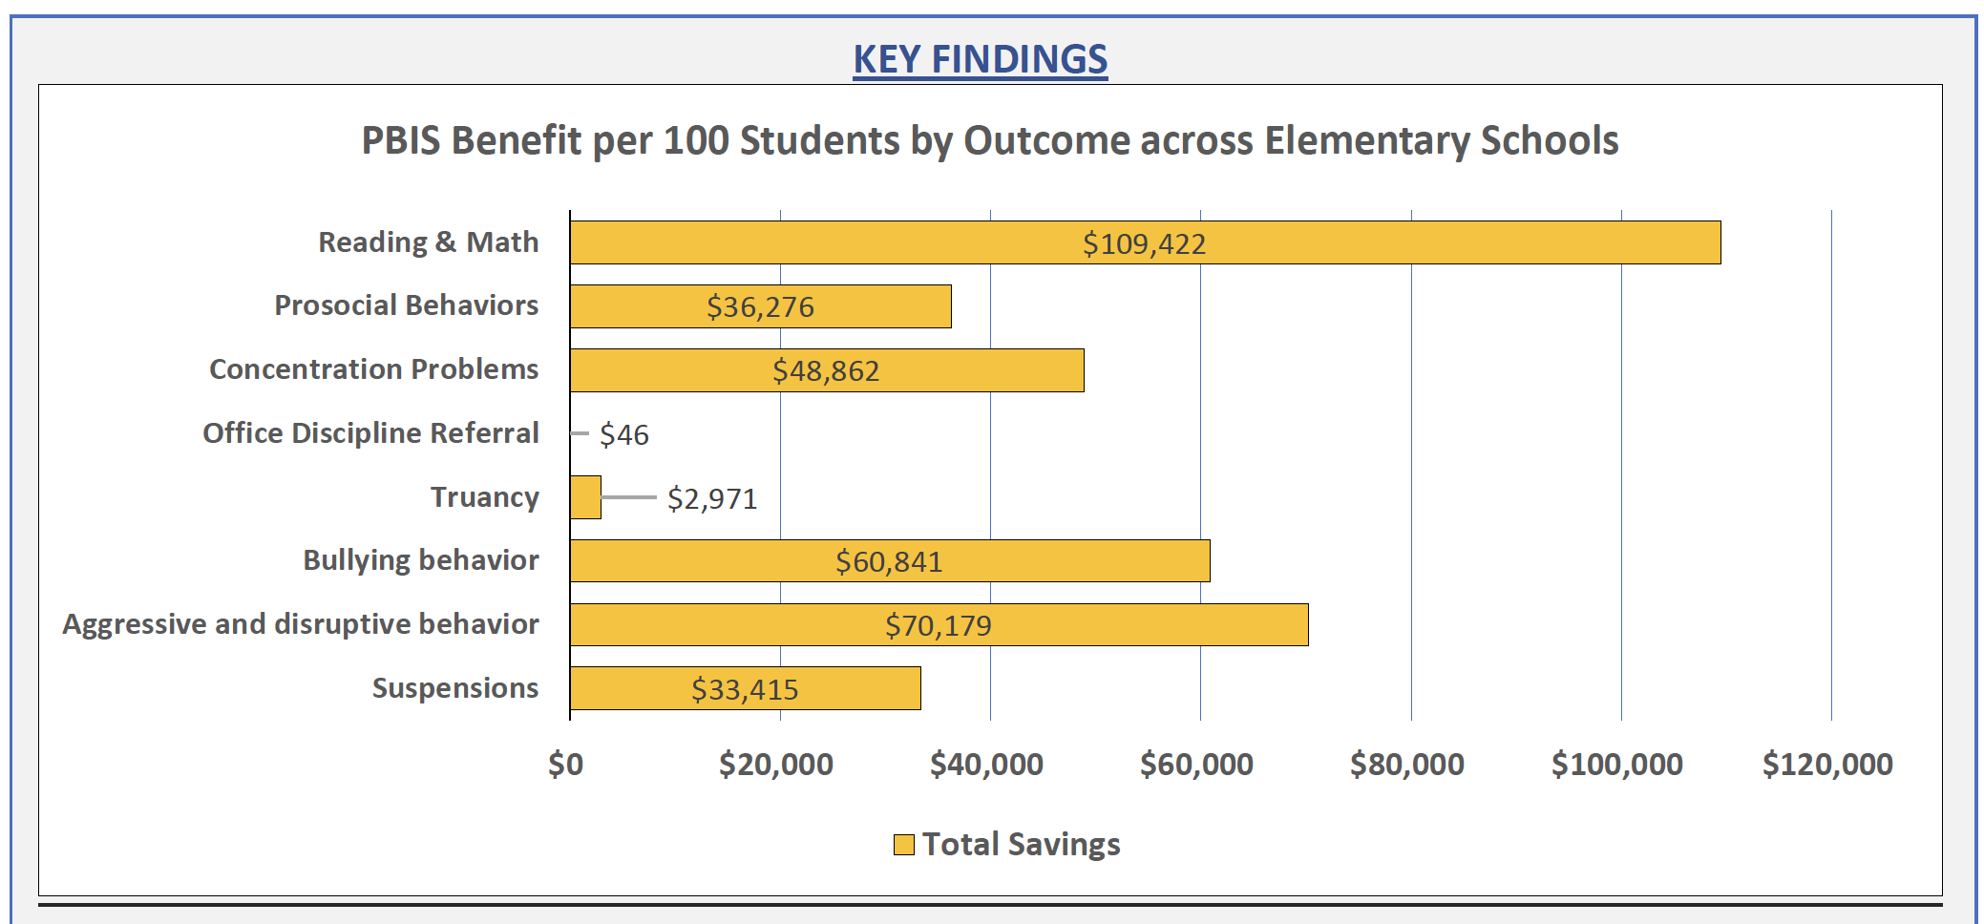
Bradshaw, C. P., Johnson, S. L., Zhu, Y., Pas, E. Y. (2020). Scaling-up behavioral health promotion efforts in Maryland: The economic benefit of positive behavioral interventions and supports. School Psychology Review, 50, 99-109.
Notes:
Using shadow pricing: (represent the amount of resource someone would be willing to pay to obtain a particular outcome).

Slide 27
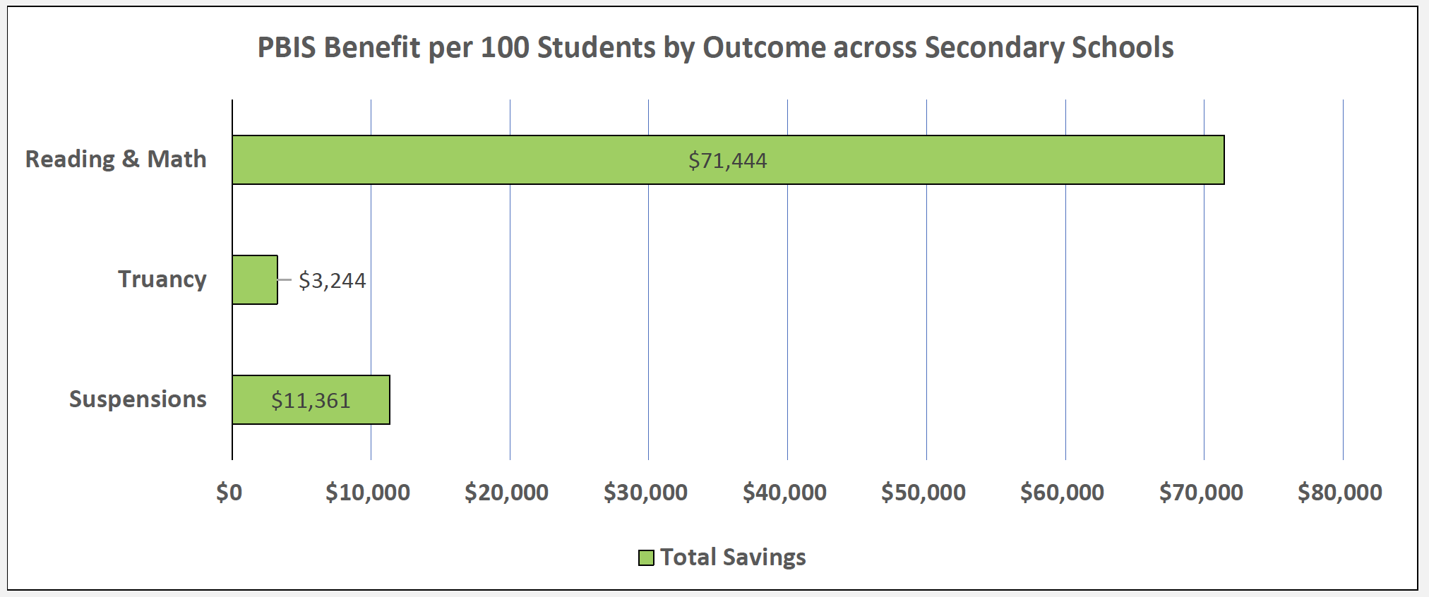
Bradshaw, C. P., Johnson, S. L., Zhu, Y., Pas, E. Y. (2020). Scaling-up behavioral health promotion efforts in Maryland: The economic benefit of positive behavioral interventions and supports. School Psychology Review, 50, 99-109.

Slide 28
Positive School Climate and Academic Achievement
In a study of 173 schools, it was found that the relationship between higher achievement scores and a positive school environment was stronger than the relationship between higher achievement scores and any of the following: Parent support, teacher excellence, student commitment, school leadership, instructional quality, or resource management.
West. R.P., et al., Utah State Univ, 2007

Slide 29
Missouri SW- PBS Impact on Students with Disablities
1084 schools from the state of Missouri
542 school implementing
130 receiving recognition (Bronze, Silver, Gold)
412 not receiving recognition
542 schools not implementing
Propensity score matched on demographic variables
Independent variable
Recognition status
Dependent variables (Quartiles)
Attendance
MAP CA
MAP MA
OSS per 100 students
Analysis
Ordinal Logistic Regression

Slide 30
Impact of MO SWPBS to date….
Twice as likely to increase attendance for all, 1.5 for students with IEPs
Twice as likely to score higher on Communication Arts Assessment, 1.5 for students with IEPs
Twice as likely to score higher on Math Assessment including students with IEPs

Slide 31
LEA Capacity
 | Y1 | Y2 | Y3
 | Setting
# of Schools | 6 | 6 | 6
# of Participating Schools | 5 | 5 | 3
% of Schools Participating | 83.3% | 83.3% | 50.0%
 | Supports Provided
Average TA Hours | 14 | 14 | 10
 | District Fidelity Measures
BPSA/DSFI
Overall Average | 24.5% |  | 38.2%
Leadership Teaming | 83.3% |  | 77.8%
Stakeholder Support | 25.0% |  | 33.3%
Funding | 0.0% |  | 31.3%
Policy and Systems Alignment | 18.8% |  | 20.0%
Workforce Capacity | 30.0% |  | 83.3%
Training | 42.9% |  | 33.3%
Coaching | 0.0% |  | 37.5%
Evaluation and Performance Feedback | 28.6% |  | 27.3%
Behavioral Expertise | 16.7%
Local Implementation Demonstrations | 83% |  | 50%

Slide 32
 | School Fidelity Measures
TFI - Tier 1 Subscale
District Average | 97.3% | 92.7% | 92.2%
% of Implementing Schools at Fidelity | 100% | 80% | 100.0%
School 1 | 100.0% | 100.0% | 90.0%
School 2 | 100.0% | 100.0% | 100.0%
School 3 | 90.0% | 100.0%
School 4 | 96.7% | 66.7%
School 5 | 100.0% | 96.7% | 86.7%
School 6
SAS - SW Subscale
District Average | 89.6% | 76.2%
% of Schools at Fidelity | 100.0% | 83.3%
School 1 | 93.0% | 86.9%
School 2 | 93.0% | 89.6%
School 3 | 93.0% | 46.7%
School 4 | 90.0% | 70.7%
School 5 | 79.0% | 77.1%
School 6 |  | 86.2%

Slide 33
What we hope to learn from you
What external support is needed to reach district fidelity
What internal supports do you put in place to help your schools reach fidelity
How do you use data to make resource allocation and curricula decisions
How do you integrate social, emotional, and behavioral supports

Slide 34
District Exemplars

Slide 35
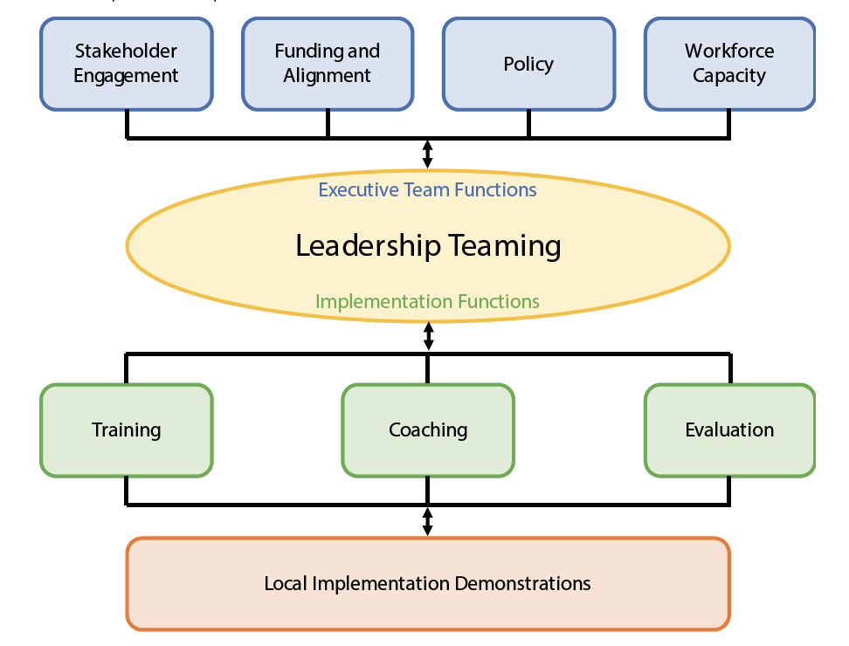
District Exemplars
Leadership Teaming & Action Planning
Fulton Public Schools
Evaluation & Data-based Decision Making
Center School District
Training & Capacity for Professional Development
Green Ridge R-8 School District

Slide 36
Fulton Public Schools

Slide 37
FULTON PUBLIC SCHOOLS
PBIS
DISTRICT LEADERHIP TEAM

Slide 38
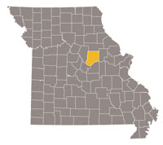
About Us
PBIS DLT
since 2018
Fulton Public Schools (Fulton, MO)
1 Early Childhood Center
3 Elementary Schools (K-5)
1 Middle School
1 High School
89 students (PK) / 2,144 (K-12)
78% White, 10% Multiracial,
8% Black, 3% Hispanic
38.0% FRL
14.3% SpEd
2020-2021 Data

Slide 39
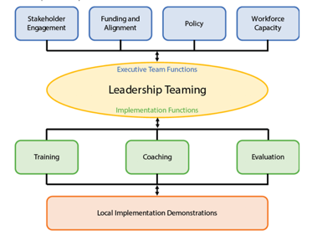
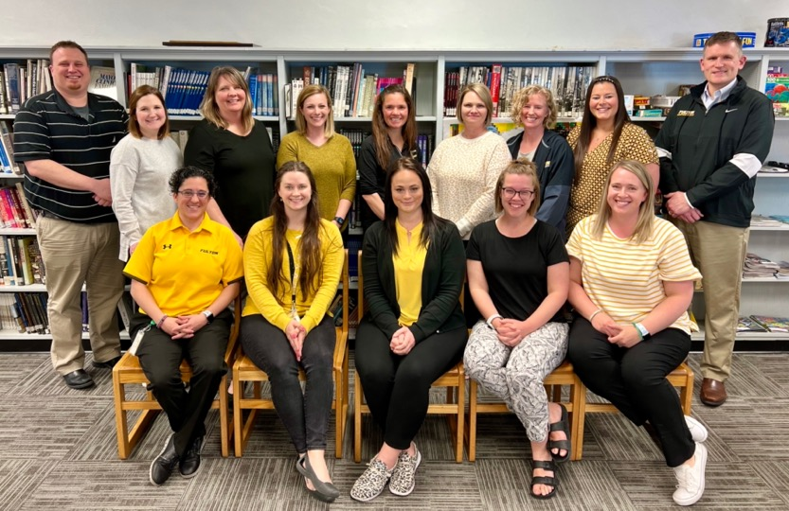
Leadership Teaming
Representation from all campuses (PK-12) w/ experience at Tiers 1-3
Executive leadership participates in meetings
Monthly meetings w/ standard Google agenda focused on action plan

Slide 40
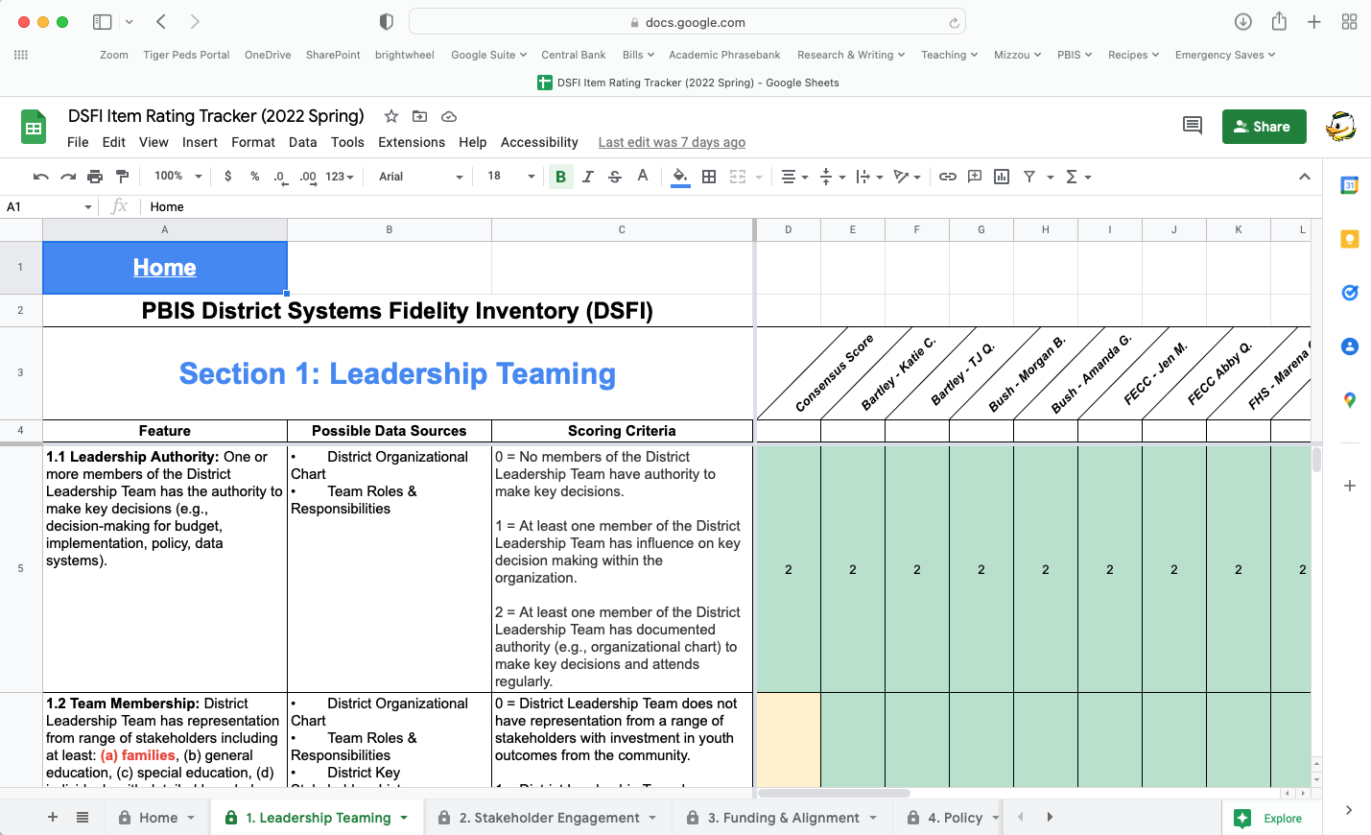
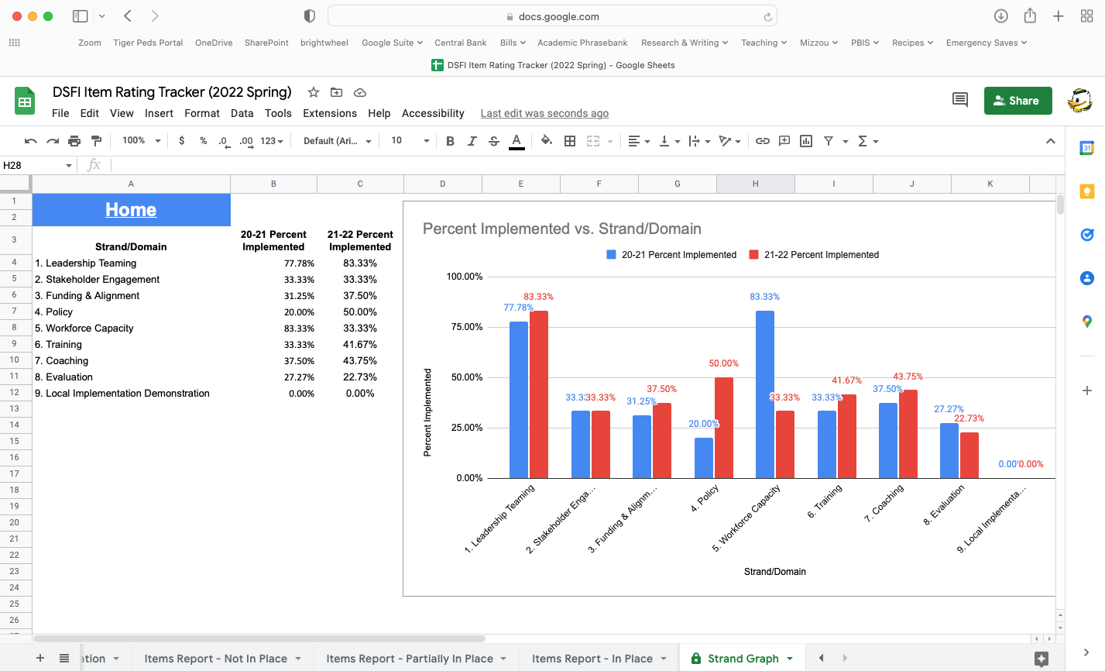
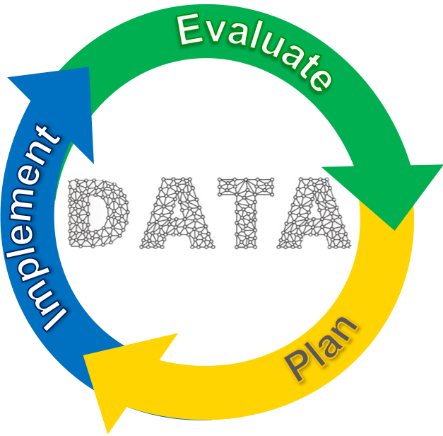
DSFI and Action Planning
Google Sheet for DSFI Item Ratings and Analysis
Data-based Decision Making and Prioritization

Slide 41
Subcommittees
Training
Auditing of existing training materials (building-level) to facilitate development of consistent district-level materials aligned with Center on PBIS PD Blueprint
- DSFI 6.2, 6.3, 6.4
Coaching
Addressed coaching functions and implemented new titles - DSFI 7.6
District-wide classroom implementation walkthrough process and pilot – DSFI 7.8
Evaluation
Assessment calendar with 1-page FAQ for common PBIS Assessments
Organization of district-wide walkthrough data for DLT analysis

Slide 42
Center School District

Slide 43
Center School District - Data-driven Decision Making Process
Data Sources Used to Determine Need:
*Social, Academic, and Emotional Behavior Screener (SAEBRS)
*PBIS Tiered Fidelity Inventory (TFI)
*Office Discipline Referrals (ODR)
PBIS Self-Assessment Survey (SAS)
Attendance
High-level Achievement
*District and Building Walk-through
Satchel Pulse Climate and Culture Survey

Slide 44
Center School District - Data-driven Decision Making Process
How Data is Used to Support Schools:
Differentiated Professional Developed
Tier 1 Lead training
Targeted individual support (e.g., 1-on-1 coaching, individualized PD)
Resources Shared (e.g., Monthly PBIS Moments)
District Behavior Coach support

Slide 45
Green Ridge

Slide 46
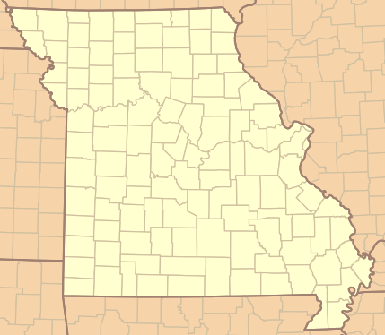
District Demographics*
Buildings: 2 – Elementary & Secondary
K-12 Enrollment: 365
Race/Ethnicity: 90% White
FRPL: 46%
ELL: 11%
SPED: 13%
Certified Staff: 35
*2020-2021 Data
Notes:
Quick intro about your district.

Slide 47
Approach to Staff Training
DLT Receives Training
MO SW-PBS trains & models content
DLT Modifies & Practices Training
DLT modifies presentation
DLT Trains Staff
DLT presents to staff
DLT practices presentation and receives feedback from MO SW-PBS personnel
MO SW-PBS are present to coach & assist
Train-the-Trainer Model
Notes:
Our approach to training our staff, districtwide, has been to grow the capacity of our district leadership team. Our goal is to take ownership of this context and the support needed to fully implement. Traditionally, this has been outsourced from Regional Professional Development Centers (RPDCs) – consultants come in on specified training days, present to staff, and then leave. While this can be helpful in getting an “expert” in from of our staff, the leadership team (the individuals charged with supporting implementation) often don’t have any deeper of an understanding of the content than the rest of the staff. For our universal framework – the content that we want all staff to do – we wanted to become the experts. Just like with our universal academic content, we have to own it and be able to support one another with implementation.
Discussion of how this approach has been used (could use an example of function-based thinking, expectations, or encouraging):
MO SW-PBS Personnel model the training with the district leadership team (not only present the material but talk about their experience with the content – where teams struggle, examples they use to highlight/extend the training, activities utilized).
DLT makes modifications to the training to “own” the content and make it contextually relevant for staff (sometimes the examples used are from larger schools or don’t always speak to our staff/context).
DLT determines who will present what content and then practices it; MO SW-PBS provides feedback to the presentation team.
DLT presents the content to staff. MO SW-PBS personnel are present, but they rarely say anything – they’re there to answer questions or assist the presenter if needed.

Slide 48
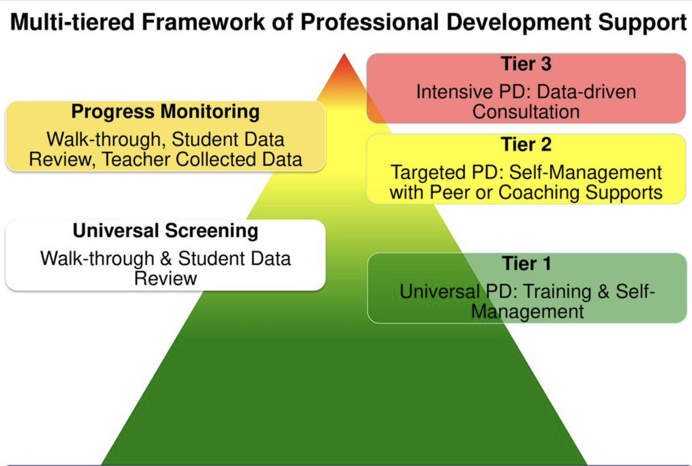
Follow-up & Next Steps
Follow-up:
- DLT processes feedback (from staff, from presenters, from MO SW-PBS Personnel)
Next Steps:
Determine content to use for…
All staff refresh
New staff onboarding
Determine implementation fidelity data sources
Use implementation fidelity data to determine next steps…
Notes:
After we present, we utilize a DLT meeting to discuss how the presentation went. We sometimes have a formal feedback process we utilize with staff, other times we use more anecdotal data. This process helps us explore how the content was received, how we did as presenters, and identify any immediate follow-up pieces that might be needed to help with clarity.
From there, and this process is still in development, we start exploring what next steps need to follow the training to support staff with implementing the training content.
One piece that we know is needed is a system to continuously refresh staff on the content (prompts, reminders, overviews) to make sure this materials stays relevant and a priority. Additionally, because staff turnover is a reality, we look at the content and are determining a system to integrate it into our new staff onboarding system.
Additionally, as we move away from a “train and pray” approach, our DLT is examining what data sources we can utilize to help us understand how well staff are doing what we’ve trained them on doing. This will be a focus for this coming year and we are going to explore self-management/self-monitoring, walkthrough/peer observations, and potentially other sources.
Our intent is to use these data to help us determine next steps to support deeper implementation:
If many staff need support – what universal, more targeted/training and broad coaching is needed to support all staff?
If most staff are implementing, but some staff need support – what small group, targeted PD and/or intensive training and coaching might be needed?

Slide 49
Team Table Topics

Slide 50
Team Table Topics
Leadership Teaming & Action Planning
Who are the members of your DLT? How do you ensure adequate representation (e.g., grade levels, executive leadership, decision-making influence/ability, expertise with Tiers 1-3, stakeholders)?
What is your DLT action planning process?
Evaluation
How is your DLT using common data to guide and drive decisions?
Training
What is your DLT doing to build internal training capacity?

Slide 51
Stars, Stairs, and Challenges
Where does your district shine?
Where are you going next?
What’s in your way?

Slide 52
Stars, Stairs, & Challenges
 | Stars | Stairs | Challenges
Leadership Teaming | Where do you shine? | Where are you going next? | What’s in your way?
Action Planning
Training
Evaluation

Slide 53
Team Table Topics
Leadership Teaming & Action Planning
Who are the members of your DLT? How do you ensure adequate representation (e.g., grade levels, executive leadership, decision-making influence/ability, expertise with Tiers 1-3, stakeholders)?
What is your DLT action planning process?
Evaluation
How is your DLT using common data to guide and drive decisions?
Training
What is your DLT doing to build internal training capacity?

Slide 54
Save the Date!
October 26-28, 2022
PBIS Leadership Forum
More information pbis.org

