Slide 2
Facilitator Notes: Delete This Slide
Handouts
Example Leadership Team Composition
Action Plan
Artifact Rubric
Action Planning Checklist
MO SW-PBS
Notes:
To Know/To Say: This lesson uses 4 handouts. If you have not already done so, download the handout at this time.

Slide 3
Working Agreements
Be Respectful
Be an active listener—open to new ideas
Use notes for side bar conversations
Be Responsible
Be on time for sessions
Silence cell phones—reply appropriately
Be a Problem Solver
Follow the decision making process
Work toward consensus and support decisions of the group
MO SW-PBS
Notes:
Trainer Notes: Hide or delete this slide if presenting the entire PLM
To Know/To Say: “These will be the Working Agreements we will honor during all our training sessions this year.”

Slide 4
Attention Signal
MO SW-PBS
Notes:
Trainer Notes: Hide or delete this slide if presenting the entire PLM; Facilitator: Select an attention signal.
To Know/To Say: “One of our agreements is to follow the attention signal.”
“Your team will work with your school to develop an attention signal you will use in every setting.”
“In order to get all of you focused after discussions, activities or breaks,
I will ________________________________________.”
(Insert your attention signal here.)
“Your task will be to finish your sentence, quiet your voice and ____________________________.”
(Insert what you want participants to do.)

Slide 5
Introductions
MO SW-PBS
Notes:
Trainer Notes: Hide or delete this slide if presenting the entire PLM; Select an introductions activity.
To Know/To Say:

Slide 6
“Schools that share leadership can be responsive to and include the voice — the opinions, viewpoints, feedback, insights, and wisdom — of all members of their school community, including underserved and underrepresented families and cultures.”
MO SW-PBS
Notes:
To Know/To Say: Read Quote :“Schools that share leadership can be responsive to and include the voice — the opinions, viewpoints, feedback, insights, and wisdom — of all members of their school community, including underserved and underrepresented families and cultures.”
The process recommended for effective school improvement is based on strong leadership, shared decision-making and consensus building among all school staff. It begins with the formation of a SW-PBS Leadership Team. This team will assist staff in the continual process of developing and maintaining a positive school environment.
This lesson will provide information and examples on creating a representative SW-PBS Leadership Team for your school.

Slide 7
Lesson Outcomes
At the end of this session, you will be able to…
Create a SW-PBS Leadership Team that is representative of the school.
MO SW-PBS
Notes:
Trainer Notes:
To Know/To Say: At the end of this session, you will be able to create a SW-PBS Leadership Team that is representative of the school.

Slide 8
Key Concepts/Big Ideas
MO SW-PBS
Notes:
To Know/To Say: The purpose of the Tier 1 SW-PBS Leadership Team is to provide leadership for the development, implementation, and evaluation of universal procedures in the entire building for all students and staff. To effectively and efficiently complete their work, membership of the Tier 1 SW-PBS Leadership Team should be representative of the school as a whole.

Slide 9
Effective school leadership teams use of data were the best predictors of fidelity of implementation.
McIntosh, et al., 2013
A team-based approach to implementation is much more likely to achieve fidelity of implementation and improved outcomes.
Fixsen, et al., 2005
MO SW-PBS
Notes:
Read the slide, then say,
“Research conducted by Kent McIntosh, Mercer, Hume, Frank, Turri and Matthews involving 257 schools across 14 states, including Missouri, found that effective leadership teams were the key to successful sustained implementation.”
“Dean Fixsen, Karen Blasé, Naoon, Friedman and Wallace studied effective implementation of evidence-based practices.
They found that establishing and training a leadership team increased the likelihood of successful implementation that resulted in improved outcomes.”
Fixsen, D., Naoom, S.F., Blase, D.A., Friedman, R.M., Wallace, F. (2005). Implementation research: A synthesis of the literature. University of South Florida, Louis de la Parte Florida Mental Health Institute, The National Implementation Research Network.
McIntosh, K., Mercer, S. H., Hume, A. E., Frank, J. L., Turri, M. G., & Mathews, S.
(2013). Factors related to sustained implementation of school-wide positive behavior support. Exceptional Children.

Slide 10
SW-PBS Leadership Team Role
Assigned to provide leadership but is not to assume sole responsibility for developing a school action plan.
Involve the entire staff in:
rethinking their beliefs about student behavior,
reviewing existing procedures, and
developing more effective practices and policies.
MO SW-PBS
Notes:
Trainer Notes:
To Know/To Say: Staff members who serve on the SW-PBS Leadership Team will have the opportunity to play a key role in shaping the school climate. Assigned to provide leadership, this team is not to assume sole responsibility for developing a school action plan. Instead, they will thoughtfully involve the entire staff in rethinking their beliefs about student behavior, reviewing existing procedures, and developing more effective practices and policies. When everyone has a hand in developing schoolwide discipline procedures, ownership is increased, consensus is more readily obtained, and the likelihood staff will consistently implement procedures is increased.

Slide 11
Potential Challenges
a current lack of cohesiveness among staff,
lack of experience in knowing how to work together,
weak communication between different grade levels or departments, and
disconnects between administrators and staff.
MO SW-PBS
Notes:
Trainer Notes:
To Know/To Say: As you undertake your social behavioral school improvement effort you may uncover potential challenges that could impact your progress. Examples of this could be:
a current lack of cohesiveness among staff,
lack of experience in knowing how to work together,
weak communication between different grade levels or departments, and
disconnects between administrators and staff.
As challenges arise, it is even more important to have strong leadership that involves the entire staff in the process.

Slide 12
SW-PBS Leadership Team Responsibilities
Assess, summarize and share information with staff, students & families on important social behavioral outcomes
Discuss and Prioritize Issues
Engage staff in the work group process to develop and revise practices
Schedule and plan Professional Development
Ask for and respond to Feedback
Develop & review Action Plan
MO SW-PBS
Notes:
To Know/To Say:The SW-PBS Leadership Team is a standing committee responsible for developing and maintaining effective discipline procedures that reflect the unique needs of the school and its community. This includes:
Initially gathering input from staff, families, and students as well as other data sources to evaluate the effectiveness of current policies and practices and using that information to gain staff commitment to the needed changes.
Developing a common philosophy of discipline.
Assisting staff to understand best practices for developing responsible student behavior and the elements of an effective school discipline policy.
Guiding staff through a procedure development process to improve less effective practices and to protect effective practices by clarifying them and putting them in writing.
Once practices are developed and protected in writing, this team is responsible for overseeing the implementation, maintenance, and revision of procedures. This includes: 1) reviewing procedures with staff (especially new staff) at the start of the year to ensure consistency, 2) coordinating dissemination of information to parents and students, 3) organizing schoolwide discipline-related instructional activities, 4) bringing staff concerns to the team, and 5) reviewing ongoing data to determine successes and continuing needs for in-service or modification of procedures.

Slide 13
Team Composition
Representative of School
Administrator
Faculty
Staff
Parent
Student – if applicable
Other
MO SW-PBS
Notes:
Trainer Notes:
To Know/To Say:Schoolwide discipline planning should not be viewed as either a top-down or a bottom-up process. Rather, it is a collaborative venture with administration and staff working together. Therefore, it is essential the team include a building administrator and full representation of the building staff.
Maintaining a well-disciplined school is one of the primary roles of the building administrator. Therefore, the nature of the work of this committee, along with the need to ensure that practices are in line with board policy and legal stipulations, requires that an administrator be directly involved. Participation of the principal or assistant principal on this team is crucial.
Recommended membership for the Tier 1 SW-PBS Leadership Team, includes:
Administrator
Teacher Representatives (each grade, team, department)
Special Educator
Counselor
Paraprofessional
Student
Family Representative

Slide 14
Once the Tier 1 SW-PBS Leadership Team members are chosen, what methods will be used to communicate the names of the Tier 1 SW-PBS Leadership Team with all stakeholders?
Staff Engagement
MO SW-PBS
Notes:
To Know/To Say: Schools often expect all staff to participate on one of the school’s leadership teams, such as a building leadership team, social team, etc. When a Tier 1 SW-PBS Leadership Team is needed, it will become one of the teams that provides leadership for the entire school. Often administrators allow staff to choose a building-wide team while also “hand-picking” participants to ensure members of the team are highly qualified to do the work. Often building leadership will want to ensure the Tier 1 SW-PBS Leadership Team has a mix of highly regarded veteran members and young professionals who will learn about SW-PBS.
Other considerations for Tier 1 SW-PBS Leadership Team membership are non-certified staff (e.g., cafeteria workers, office personnel), family members, and students.

Slide 15
Student Engagement
How will student voices be represented on your team?
Regularly and actively elicit student feedback.
Seek student representatives for your team.
MO SW-PBS
Notes:
To Know/To Say: Student Engagement
How will student voices be represented on your team? Seeking student representatives on your team can take place through teacher nominations or students completing and submitting applications. If the size of the SW-PBS Leadership Team is a concern, student ownership voice and representation can be achieved through a “Respect Club” or “School Culture Club” where members’ ideas and voices are shared by one or two representatives to the SW-PBS Leadership Team. Regardless of the method used, the important point is to regularly and actively elicit student feedback and to seriously consider their ideas and viewpoints.

Slide 16
Families & Community Engagement
Seek the voices of all the families represented in your school.
Direct team member, or family & community subcommittee.
MO SW-PBS
Notes:
To Know/To Say: Families and Community Engagement
It is ideal to have family and community members on your SW-PBS Leadership Team. If team size is a concern, consider using a family and community subcommittee. It is important to seek the voices of all the families represented in your school, especially underserved families and all dimensions of diversity.

Slide 17
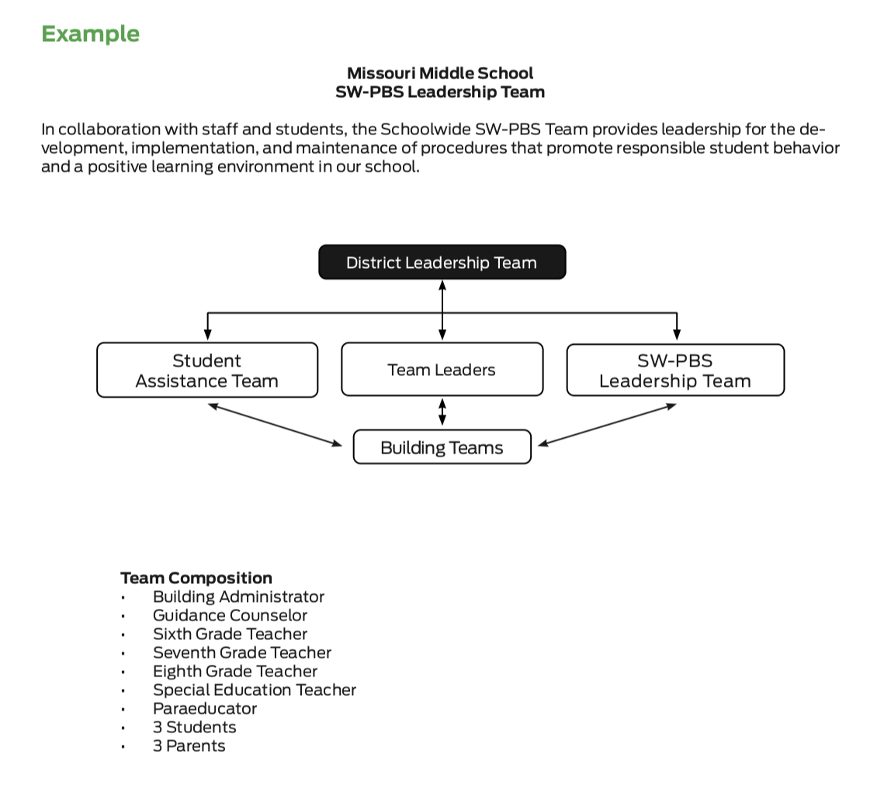
Discussion: Example Team
Review the Example Tier 1 SW-PBS Leadership Team.
Discuss how your team might be similar and what you might need to change to ensure you have a leadership team representative of your school.
Notes:
Trainer Notes:
To Know/To Say: Review the Example Tier 1 SW-PBS Leadership Team.
Discuss how your team might be similar and what you might need to change to ensure you have a leadership team representative of your school.
HO1 Example Leadership Team Composition

Slide 18
Discussion: SW-PBS Leadership Team
Discuss these questions to ensure you have a SW-PBS Leadership Team representative of your school.
Why is representation important in your school?
What would a representative team look like in your school?
How will you ensure students, families, and other stakeholders are represented?
Do you need to add any additional members to your team?
Notes:
Trainer Notes:
To Know/To Say: Discuss these questions to ensure you have a SW-PBS Leadership Team representative of your school.
Why is representation important in your school?
What would a representative team look like in your school?
How will you ensure students, families, and other stakeholders are represented?
Do you need to add any additional members to your team?

Slide 19
Closing and Next Steps
Develop action steps for establishing a representative SW-PBS Leadership Team.
Update your action plan using the Tier 1 Action Plan template and the Tier 1 Action Planning Checklist.
Use the Tier 1 Artifacts Rubric to assess the quality of the resources your team develops.
Use the results of the PBIS Self-Assessment Survey (SAS) to gain perspective from all staff, and results from the PBIS Tiered Fidelity Inventory (TFI) to gain perspective from your Building Leadership Team.
MO SW-PBS
Notes:
To Know/To Say: During this lesson, you learned the importance of creating a SW-PBS Leadership Team that is representative of your school. How will you engage students, families, and the community so that their voice is represented on your SW-PBS Leadership Team?
Next steps include updating your action plan using the Tier 1 Action Plan template and the Tier 1 Action Planning Checklist. Consider using the Tier 1 Artifacts Rubric to assess the quality of the resources your team develops. And finally, consider using the results of the PBIS Self-Assessment Survey (SAS) to gain perspective from all staff, and results from the PBIS Tiered Fidelity Inventory (TFI) to gain perspective from your Building Leadership Team.
Additional information about the creation of a SW-PBS Leadership Team can be found in the MO SW-PBS Handbook and the MO SW-PBS Tier 1 Implementation Guide.

Slide 20
References
Missouri SW-PBS (2019). Missouri schoolwide positive behavior support tier 1 implementation guide.
Missouri SW-PBS (2019). Missouri schoolwide positive behavior support handbook.
Fixsen, D., Naoom, S.F., Blase, D.A., Friedman, R.M., Wallace, F. (2005). Implementation research: A synthesis of the literature. University of South Florida, Louis de la Parte Florida Mental Health Institute, The National Implementation Research Network.
McIntosh, K., Mercer, S. H., Hume, A. E., Frank, J. L., Turri, M. G., & Mathews, S. (2013). Factors related to sustained implementation of school-wide positive behavior support. Exceptional Children.
MO SW-PBS
Notes:
Trainer Notes:
To Know/To Say:

