Slide 1
Gain and Document Staff Commitment to SW-PBS
Common Philosophy & Purpose
Notes:
Trainer Notes:
To Know/To Say:

Slide 2
Facilitator Notes: Delete This Slide
Handouts Needed:
Example Our Beliefs, Mission, Vision
Activity Philosophy of School Discipline
Tier 1 Action Plan
Tier 1 Artifact Rubric
Tier 1 Action Planning Checklist
Participants Need Access to:
MO SW-PBS Handbook
MO SW-PBS Tier 1 Implementation Guide
Notes:
Trainer Notes:
To Know/To Say:

Slide 3
Working Agreements
Be Respectful
Be an active listener—open to new ideas
Use notes for side bar conversations
Be Responsible
Be on time for sessions
Silence cell phones—reply appropriately
Be a Problem Solver
Follow the decision making process
Work toward consensus and support decisions of the group
Notes:
Trainer Notes: Hide or delete this slide if presenting the entire PLM
To Know/To Say: “These will be the Working Agreements we will honor during all our training sessions this year.”

Slide 4
Attention Signal
Notes:
Trainer Notes: Hide or delete this slide if presenting the entire PLM; Facilitator: Select an attention signal.
To Know/To Say:
“One of our agreements is to follow the attention signal.”
“Your team will work with your school to develop an attention signal you will use in every setting.”
“In order to get all of you focused after discussions, activities or breaks,
I will ________________________________________.”
(Insert your attention signal here.)
“Your task will be to finish your sentence, quiet your voice and ____________________________.”
(Insert what you want participants to do.)

Slide 5
Introductions
Notes:
Trainer Notes: Hide or delete this slide if presenting the entire PLM; Select an introductions activity.
To Know/To Say:

Slide 6
Lesson Outcomes
At the end of this session, you will be able to…
gain and document staff commitment to SW-PBS;
draft your philosophy of discipline.
Notes:
Trainer Notes:
To Know/To Say: By the end of this lesson, participants will….gain and document staff commitment to SW-PBS as you draft your philosophy of discipline.

Slide 7
“Schools that have implemented positive, proactive, and instructional approaches to discipline see a decrease in the frequency and severity of unexpected behavior. They also find changes to culture and climate that come from the unification of staff and collaborative work.”
MO SW-PBS, 2019
Notes:
Trainer Notes:
To Know/To Say: This lesson will focus on strategies to help obtain commitment to the work from all stakeholders as well as the importance of putting your work in writing to create your philosophy of discipline.

Slide 8
Gaining Staff Commitment
Fundamental change is impossible without the participation of everybody with a stake in the problem or issue.
Without full participation of all, perspectives will be missed.
Building staff awareness of SW-PBS, the possible outcomes, the vision, and evolving beliefs about student discipline and behavior should lead to a sense of eagerness and full participation.
Notes:
Trainer Notes:
To Know/To Say: Change efforts have a great deal to do with personal motivation. Setting a new direction for the future is one of the most powerful ways of motivating any group and effecting change. Once staff is committed, together you will find ways to be effective.
Fundamental change is impossible without the participation of everybody with a stake in the problem or issue.² Without full participation of all, perspectives will be missed, there is a good chance that some of the issues involved will go unaddressed, and implementation will be restricted. Building staff awareness of SW-PBS, the possible outcomes, the vision, and evolving beliefs about student discipline and behavior should lead to a sense of eagerness and full participation.

Slide 9
Research indicates, that for initial implementation to be successful, the following are critical:
Administrative Support
Staff Buy-In
Fidelity of Implementation
Efficient and Effective Teaming
MO SW-PBS
Notes:
Trainer Notes:
To Know/To Say: Emerging research on implementation of SW-PBS, research including Missouri SW-PBS schools, indicates that for initial implementation administrative support, staff buy-in, fidelity of implementation and efficient and effective teaming are critical.³ It is also important to note that findings indicate a need to establish consensus to implement PBIS in the classroom setting as soon as it is implemented in non-classroom settings (ie., schoolwide).⁴

Slide 10
Securing Staff Commitment
Provide opportunities for new learning
Engage in the joint development of mission, vision, and beliefs or guiding principles
Confirm by an official commitment process
Notes:
Trainer Notes:
To Know/To Say: Securing staff commitment can be done by providing opportunities for new learning, the jointly developing mission, vision, and belief statements, and finally confirmed by implementing an official commitment process.

Slide 11
Providing Learning on SW-PBS
Strategies for providing new learning include:
formal presentations/staff learning opportunities,
study groups or book studies,
articles or readings,
sharing and discussion opportunities,
surveys or data, and
personal conversations.
Notes:
Trainer Notes:
To Know/To Say: Earlier in this Common Philosophy and Purpose course you learned additional strategies for fully engaging your staff in the joint development of beliefs, mission and vision.
Strategies for providing new learning include:
formal presentations/staff learning opportunities,
study groups or book studies,
articles or readings,
sharing and discussion opportunities,
surveys or data, and
personal conversations.
In the Leadership for Behavior Course you will learn additional strategies for fully engaging your staff in the joint development of vision and beliefs. Once your staff has a solid understanding of the desired change, it is helpful to confirm commitment. In some schools, the principal simply makes a point of having a personal conversation with each and every staff member, visiting about the exciting opportunity and asking if they are on board, or if they can be counted on to join in the work ahead. An agreement, contract, or covenant is another way for staff to show support.

Slide 12
Discussion: Staff Learning
How will you engage staff in learning about SW-PBS?
What conversations will you engage them in regarding a proactive, positive approach to discipline?
Notes:
Trainer Notes:
To Know/To Say:

Slide 13
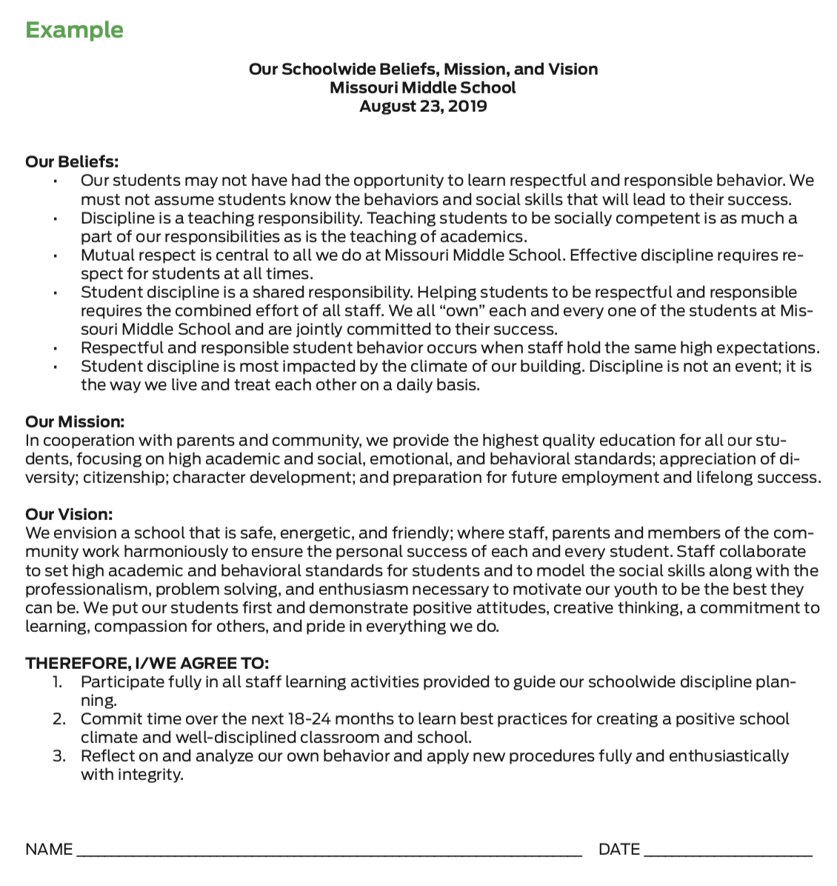
Activity: Example Agreement
Review the example that includes the school’s philosophy, beliefs and agreements that bond the staff to their schoolwide discipline work. It provides a place for staff to sign, indicating their commitment.
How might you document your staff’s commitment?
Notes:
Trainer Notes:
To Know/To Say: Review the example that includes the school’s philosophy of discipline, beliefs, mission and vision that bond the staff to their schoolwide discipline work. It provides a place for staff to sign, indicating their commitment.
How might you document your staff’s commitment to a common philosophy of discipline?

Slide 14
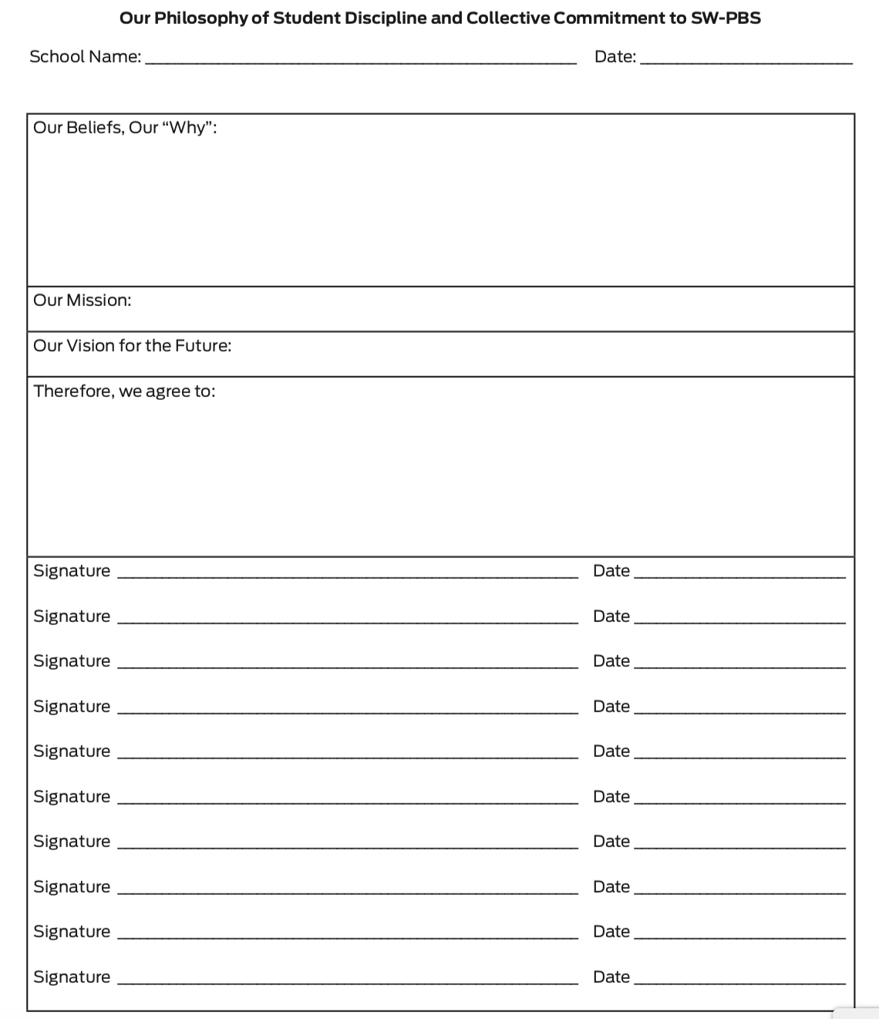
Activity: Commitment to Philosophy of Discipline
Use the handout Activity - Our Philosophy of Student Discipline and Collective Commitment to SW-PBS to combine your beliefs, mission and vision into a philosophy of discipline.
Notes:
Trainer Notes:
To Know/To Say: Use the handout Activity - Our Philosophy of Student Discipline and Collective Commitment to SW-PBS to combine your beliefs, mission and vision into a philosophy of discipline.

Slide 15
Discussion: Stakeholder Engagement and Communication
Once your team has documented a written philosophy, share with staff, students, and families by:
including in staff and student handbooks,
publish on the school website, and
posting in the main hall and main office.
Make a plan for sharing with important stakeholder.
Notes:
Trainer Notes:
To Know/To Say:
Stakeholder Engagement and Communication
Once your team has documented a written philosophy of discipline, you will want to share with staff, students, and families by:
including in staff and student handbooks,
posting on the school website, and
posting in the main hall and main office.
How will you plan to share your philosophy of discipline documentation with all stakeholders?

Slide 16
Closing and Next Steps
How will you engage staff and families in committing to your collectively drafted and documented beliefs, mission, vision, and overall philosophy of discipline?
Next steps include
Develop action steps for how you will document your philosophy of discipline including your collective beliefs, mission and vision. Be sure to add action steps about how you will communicate the written philosophy of discipline to all staff, students, and families.
Update your action plan using the Tier 1 Action Plan template and the Tier 1 Action Planning Checklist.
Use the Tier 1 Artifacts Rubric to assess the quality of the resources your team develops.
Use the results of the PBIS Self-Assessment Survey (SAS) to gain perspective from all staff, and results from the PBIS Tiered Fidelity Inventory (TFI) to gain perspective from your Building Leadership Team.
Notes:
To Know/To Say: During this lesson, you learned the importance of putting all of your work in writing and documenting staff commitment to the work of SW-PBS.
How will you engage staff and families in committing to your collectively drafted and documented beliefs, mission, vision, and overall philosophy of discipline?
Next steps include
Develop action steps for how you will document your philosophy of discipline including your collective beliefs, mission and vision. Be sure to add action steps about how you will communicate the written philosophy of discipline to all staff, students, and families.
Update your action plan using the Tier 1 Action Plan template and the Tier 1 Action Planning Checklist.
Use the Tier 1 Artifacts Rubric to assess the quality of the resources your team develops.
Use the results of the PBIS Self-Assessment Survey (SAS) to gain perspective from all staff, and results from the PBIS Tiered Fidelity Inventory (TFI) to gain perspective from your Building Leadership Team.
Additional information about gaining and documenting staff commitment can be found in the MO SW-PBS Handbook and the MO SW-PBS Tier 1 Implementation Guide.

Slide 17
References
Missouri SW-PBS (2019). Missouri schoolwide positive behavior support tier 1 implementation guide.
U.S. Department of Education (2014). Guiding principles: A resource guide for improving school climate and discipline. http://www2.ed.gov/policy/gen/guid/school-discipline/index.html
McIntosh, K., Predy, L. K., Upreti, G., Hume, A. E., Turri, M. G., & Mathews, S. (2014). Perceptions of contextual features related to implementation and sustainability of school-wide positive behavior support. Journal of Positive Behavior Interventions, 16(1), 31-43.
Mathews, S., McIntosh, K., Frank, J. L., & May, S. L. (2014). Critical Features Predicting Sustained Implementation of School-Wide Positive Behavioral Interventions and Supports. Journal of Positive Behavior Interventions, 16(3), pp 168-178.
Notes:
Trainer Notes:
To Know/To Say:

Slide 18
Contact Information
Check Out MO SW-PBS on Social Media:
Facilitator Contact Information:
pbismissouri.org
facebook.com/moswpbs
@MOSWPBS

