Slide 1
Review or Create Your School Vision
Common Philosophy & Purpose
Notes:
Trainer Notes:
To Know/To Say:

Slide 2
Facilitator Notes: Delete This Slide
Handouts Needed:
Example and Activity Vision Statement
Tier 1 Action Plan
Tier 1 Artifact Rubric
Tier 1 Action Planning Checklist
Participants Need Access to:
MO SW-PBS Handbook
MO SW-PBS Tier 1 Implementation Guide
Notes:
Trainer Notes:
To Know/To Say:

Slide 3
Working Agreements
Be Respectful
Be an active listener—open to new ideas
Use notes for side bar conversations
Be Responsible
Be on time for sessions
Silence cell phones—reply appropriately
Be a Problem Solver
Follow the decision making process
Work toward consensus and support decisions of the group
Notes:
Trainer Notes: Hide or delete this slide if presenting the entire PLM
To Know/To Say: “These will be the Working Agreements we will honor during all our training sessions this year.”

Slide 4
Attention Signal
Notes:
Trainer Notes: Hide or delete this slide if presenting the entire PLM; Facilitator: Select an attention signal.
To Know/To Say:
“One of our agreements is to follow the attention signal.”
“Your team will work with your school to develop an attention signal you will use in every setting.”
“In order to get all of you focused after discussions, activities or breaks,
I will ________________________________________.”
(Insert your attention signal here.)
“Your task will be to finish your sentence, quiet your voice and ____________________________.”
(Insert what you want participants to do.)

Slide 5
Introductions
Notes:
Trainer Notes: Hide or delete this slide if presenting the entire PLM; Select an introductions activity.
To Know/To Say:

Slide 6
Lesson Outcomes
At the end of this session, you will be able to…
review and/or create a vision statement to verify that it addresses the development of student social competence.
Notes:
Trainer Notes:
To Know/To Say:
At the end of this session, you will be able to…
review and/or create a vision statement to verify that it addresses the development of student social competence.

Slide 7
Vision Statements
A vision is a clearly articulated, results-oriented picture of the future you intend to create.
MO SW-PBS, 2019
Notes:
Trainer Notes:
To Know/To Say: This lesson will prepare your team to verify that your school and/or district vision statement addresses the development of student social competence.

Slide 8
Big Ideas
Unlike a mission that is practical, a vision is idealistic.
A vision focuses on the end results and values, not on the specific means of getting there.
A vision is the crystallization of your “whys,” desires, values, and beliefs.
It is critical as you begin implementation of SW-PBS that the importance of focusing on student social competence is addressed within the vision statement.
Notes:
Trainer Notes:
To Know/To Say: Unlike a mission that is practical, a vision is idealistic. A vision is a clearly articulated, results-oriented picture of the future you intend to create. A vision focuses on the end results and values, not on the specific means of getting there. A vision is the crystallization of your “whys,” desires, values, and beliefs. Many schools and/or districts already have developed vision statements to guide their goals and work. It is critical as you begin implementation of SW-PBS that the importance of focusing on student social competence is addressed within the vision statement, making it clear that SW-PBS is not something ‘additional’, but rather, a critical component of achieving the vision of the schools and/or district.

Slide 9
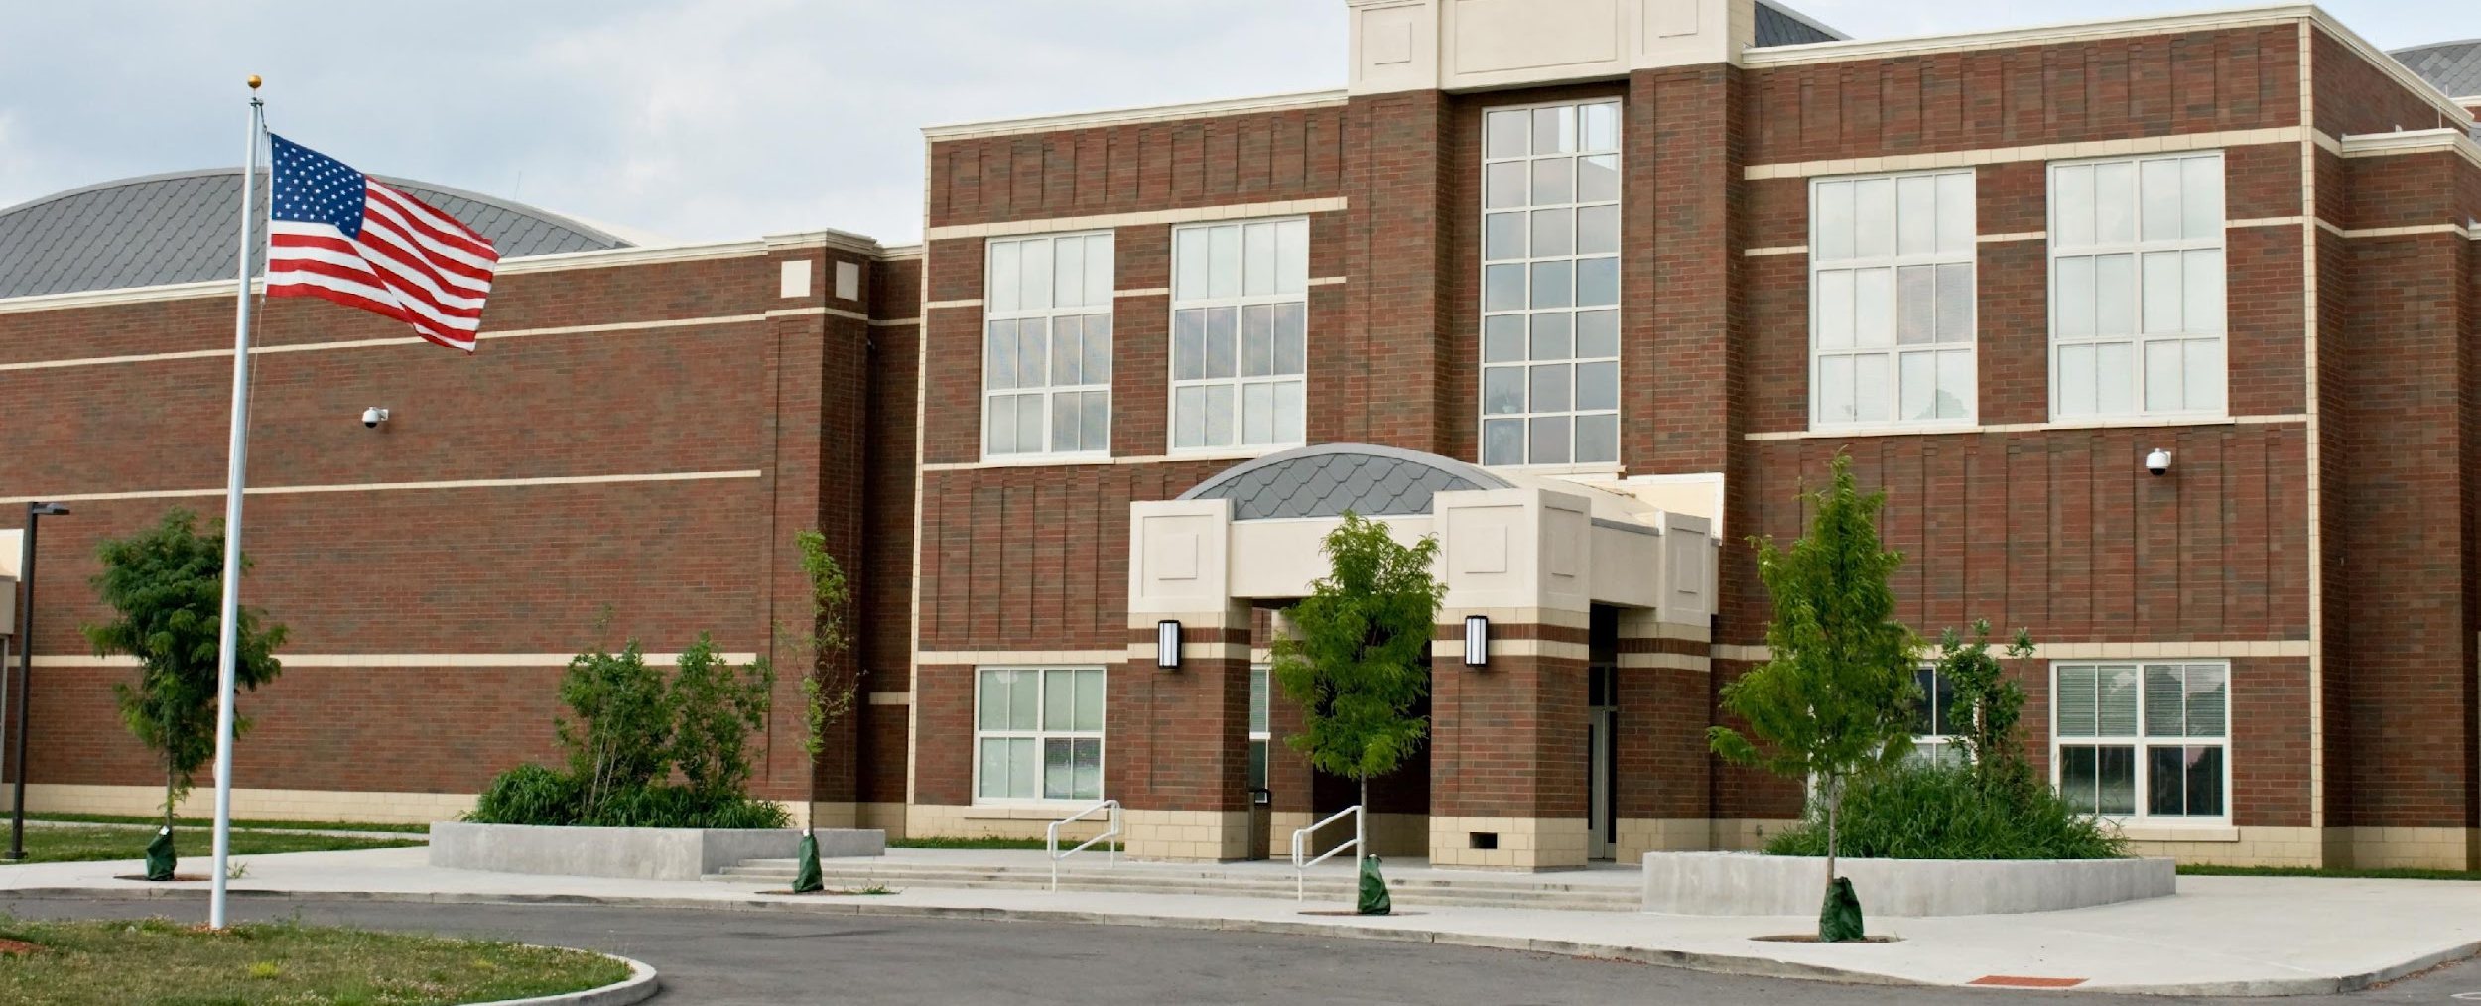
Developing a Common Vision
When a school collectively develops and owns a vision, staff, student, and family relationships to school are changed.
It is no longer “their school;” it becomes “our school.”
Notes:
Trainer Notes:
To Know/To Say: A shared vision is a force in people’s hearts and answers the question, “What do we want to create?” It is the picture that people throughout the school carry in their heads and hearts. It completes the statement, “I have a dream that one day...” and reaches into the future, drives actions, and helps to create a sense of community. When a school collectively develops and owns a vision, staff, student, and family relationships to school are changed. It is no longer “their school;” it becomes “our school.” This is particularly important as school demographics and cultures represented in your school change over time.

Slide 10
Developing a Common Vision
Vision statements derive their power from the desire to be connected in an important undertaking, to become a part of pursuing a larger purpose.
Ensuring the social and academic success of each and every student, and creating a positive school climate, can be that purpose.
Notes:
Trainer Notes:
To Know/To Say: Vision statements derive their power from the desire to be connected in an important undertaking, to become a part of pursuing a larger purpose. Ensuring the social and academic success of each and every student, and creating a positive school climate, can be that purpose.
You cannot have a learning organization without a shared vision to guide the work and pull you toward your goal.

Slide 11
Discussion: Vision
Do you have a vision that compels new ways of thinking and acting?
Does your vision consider the “whole student”?
Notes:
Trainer Notes:
To Know/To Say: Discussion: Do you have a vision that compels new ways of thinking and acting? Does your vision consider the “whole student”?

Slide 12
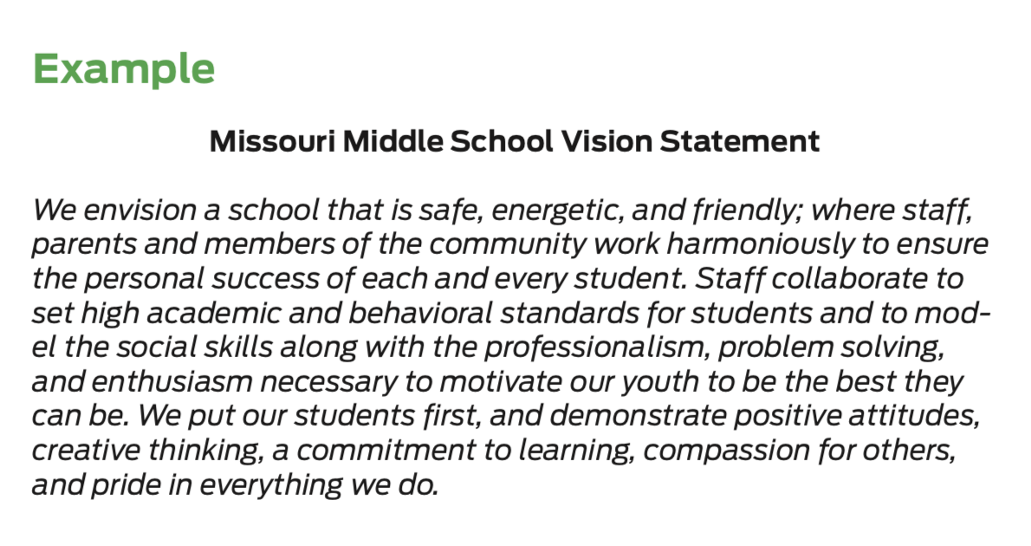
Activity: Example Vision
Review the example vision statement provided, identify the pieces that directly promote and support the development of student social competence.
Notes:
Trainer Notes: Example and Activity Vision Statement
To Know/To Say: Review the example vision statement provided, identify the pieces that directly promote and support the development of student social competence.

Slide 13
Discussion: Vision
Now that you have reviewed the example vision statement, consider the following questions, individually at first:
If you could create the school of your dreams, what would it look like?
What is your mental model for the future?
What do you want your school to be?
What is your compelling dream for how school should be as a result of your work with MO SW-PBS?
Notes:
Trainer Notes:
To Know/To Say: Working with your team, discuss your vision of your school:
If you could create the school of your dreams, what would it look like?
What is your mental model for the future?
What do you want your school to be?
What is your compelling dream for how school should be as a result of your work with MO SW-PBS?

Slide 14
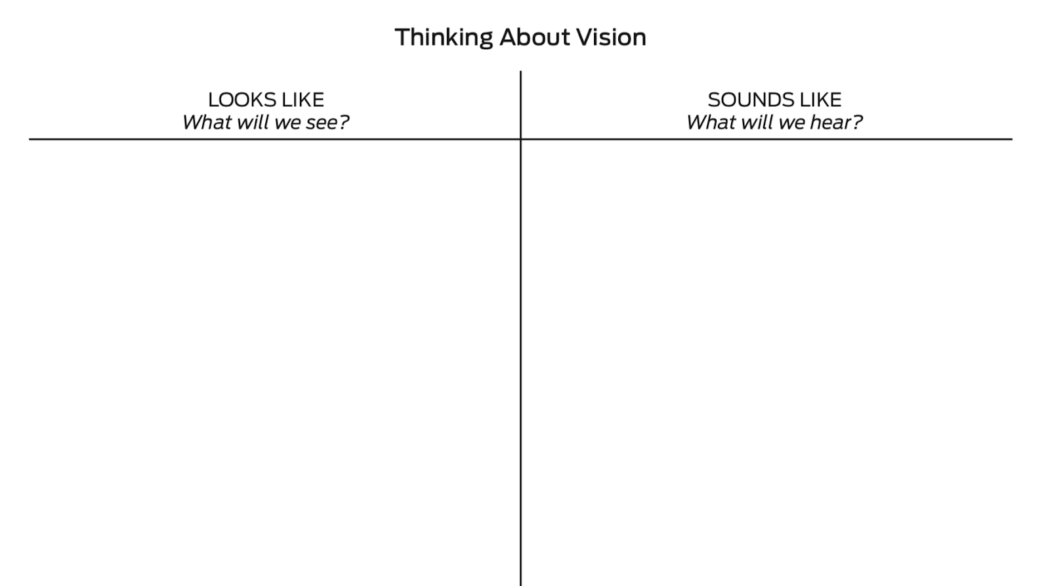
Activity: Thinking About Vision
Now as a team, use a T chart to guide a group dialog.
What will your school look like and sound like with a positive, proactive, and instructional approach to discipline?
Notes:
Trainer Notes:
To Know/To Say:

Slide 15
Discussion: Staff Engagement
How will you engage staff in your discussions about Vision?
Ideas to consider:
Share the T-chart with staff to solicit their vision about the future.
Give each staff member paper strips to complete the phrase “I have a dream that one day our school will...”
Collect the paper strips, categorize them, and use them to create your school’s vision.
Post the paper strips in a prominent area of the school.
Post chart paper during a staff professional learning session to gain staff vision of the school.
Consider how to share the collated vision with district leadership.
Notes:
Trainer Notes:
To Know/To Say: As your team engages staff in creating a vision for the school, remind them to think about every student in your school: the most academically talented students; the least academically talented; the most kind, thoughtful, and respectful students; students who are experiencing social/emotional challenges; students of all racial and ethnic make-ups; socially popular students; and students who do not have many friends. Specific activities to engage staff include:
Share the T-chart with staff to solicit their vision about the future.
Give each staff member paper strips to complete the phrase “I have a dream that one day our school will...” Collect the paper strips, categorize them, and use them to create your school’s vision. Post the paper strips in a prominent area of the school.
Post chart paper during a staff professional learning session to gain staff vision of the school.
Consider how to share the collated vision with district leadership.

Slide 16
Discussion: Family Engagement
How will you engage students and families?
Ideas to consider:
Give students and family members paper strips to complete the phrase “I have a dream that one day our school will...” Collect the paper strips, categorize them, and use them to inform your team’s work on your school’s vision. Other strip ideas include: “I want my child to go to a school that...” and “I will want to go to school every day when my school...”
Post the T-chart in a public location (main school entrance, at sporting events, concerts, etc.) to solicit student and family thoughts about the school’s vision for the future.
Ask students and families for their dream for the school on the school website, in school newsletters, and in classroom communications (e.g., Friday folders, mass emails) and then provide a mechanism for these dreams to be shared with the leadership team.
Notes:
Trainer Notes:
To Know/To Say: Specific activities to engage students and family members include:
Give students and family members paper strips to complete the phrase “I have a dream that one day our school will...” Collect the paper strips, categorize them, and use them to inform your team’s work on your school’s vision. Other strip ideas include: “I want my child to go to a school that...” and “I will want to go to school every day when my school...”
Post the T-chart in a public location (main school entrance, at sporting events, concerts, etc.) to solicit student and family thoughts about the school’s vision for the future.
Ask students and families for their dream for the school on the school website, in school newsletters, and in classroom communications (e.g., Friday folders, mass emails) and then provide a mechanism for these dreams to be shared with the leadership team.

Slide 17
Closing and Next Steps
How will you engage staff, students and families in developing and/or revising a vision statement?
Next steps include updating your action plan.
Develop action steps for reviewing, revising, or creating your current school or district vision statement with your staff.
Review the ideas for student and family engagement and decide which action steps you will add to your team Action Plan.
Update your action plan using the Tier 1 Action Plan template and the Tier 1 Action Planning Checklist.
Use the Tier 1 Artifacts Rubric to assess the quality of the resources your team develops.
Use the results of the PBIS Self-Assessment Survey (SAS) to gain perspective from all staff, and results from the PBIS Tiered Fidelity Inventory (TFI) to gain perspective from your Building Leadership Team.
Notes:
To Know/To Say: During this lesson, you learned that having a vision statement that communicates value for social competence in school and for students’ lifelong success will give legitimacy to your work and direct your actions.
How will you engage staff and families in developing and/or revising a mission statement?
Next steps include updating your action plan.
Develop action steps for reviewing, revising, or creating your current school or district vision statement with your staff.
Review the ideas for student and family engagement and decide which action steps you will add to your team Action Plan.
Update your action plan using the Tier 1 Action Plan template and the Tier 1 Action Planning Checklist.
Use the Tier 1 Artifacts Rubric to assess the quality of the resources your team develops.
Use the results of the PBIS Self-Assessment Survey (SAS) to gain perspective from all staff, and results from the PBIS Tiered Fidelity Inventory (TFI) to gain perspective from your Building Leadership Team.
Additional information about vision statements can be found in the MO SW-PBS Handbook and the MO SW-PBS Tier 1 Implementation Guide.

Slide 18
References
Missouri SW-PBS (2019). Missouri schoolwide positive behavior support tier 1 implementation guide.
Notes:
Trainer Notes:
To Know/To Say:

Slide 19
Contact Information
Check Out MO SW-PBS on Social Media:
Facilitator Contact Information:
pbismissouri.org
facebook.com/moswpbs
@MOSWPBS

