Slide 1
Review or Create Your School Mission
Common Philosophy & Purpose
Notes:
Trainer Notes:
To Know/To Say:

Slide 2
Facilitator Notes: Delete This Slide
Handouts Needed:
Example High School Mission Statement
Tier 1 Action Plan
Tier 1 Artifact Rubric
Tier 1 Action Planning Checklist
Participants Need Access to:
MO SW-PBS Handbook
MO SW-PBS Tier 1 Implementation Guide
Notes:
Trainer Notes:
To Know/To Say:

Slide 3
Working Agreements
Be Respectful
Be an active listener—open to new ideas
Use notes for side bar conversations
Be Responsible
Be on time for sessions
Silence cell phones—reply appropriately
Be a Problem Solver
Follow the decision making process
Work toward consensus and support decisions of the group
Notes:
Trainer Notes: Hide or delete this slide if presenting the entire PLM
To Know/To Say: “These will be the Working Agreements we will honor during all our training sessions this year.”

Slide 4
Attention Signal
Notes:
Trainer Notes: Hide or delete this slide if presenting the entire PLM; Facilitator: Select an attention signal.
To Know/To Say:
“One of our agreements is to follow the attention signal.”
“Your team will work with your school to develop an attention signal you will use in every setting.”
“In order to get all of you focused after discussions, activities or breaks,
I will ________________________________________.”
(Insert your attention signal here.)
“Your task will be to finish your sentence, quiet your voice and ____________________________.”
(Insert what you want participants to do.)

Slide 5
Introductions
Notes:
Trainer Notes: Hide or delete this slide if presenting the entire PLM; Select an introductions activity.
To Know/To Say:

Slide 6
Lesson Outcomes
At the end of this session, you will be able to…
review and/or create a mission statement to verify that it addresses the development of student social competence.
Notes:
Trainer Notes:
To Know/To Say:

Slide 7
Mission Statements
Every school or district has one. They define our purpose. They are practicable, a blueprint for current practice or what we do. Missions answer the questions, “Why do we exist? What do we do?”
MO SW-PBS, 2019
Notes:
.Trainer Notes:
To Know/To Say: Every school or district has one. They define our purpose. They are practicable, a blueprint for current practice or what we do. Missions answer the questions, “Why do we exist? What do we do?”
Many schools and/or districts already have developed mission statements to guide their goals and work It is critical as you begin implementation of SW-PBS that the importance of focusing on student social competence is addressed within the mission statement, making it clear that SW-PBS is not something ‘additional’, but rather, a critical component of achieving the mission of the schools and/or district.

Slide 8
Key Terms
A mission statement represents the reason that the school and/or district exists, and is usually a short statement.
Notes:
Trainer Notes:
To Know/To Say: A mission statement represents the reason that the school and/or district exists, and is usually a short statement.

Slide 9
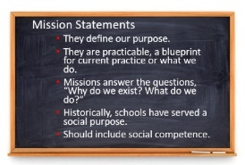
Mission Statements
Notes:
Trainer Notes:
To Know/To Say: Every school or district has one. They define our purpose. They are practicable, a blueprint for current practice or what we do. Missions answer the questions, “Why do we exist? What do we do?” Historically, schools have served a social purpose.
Parents, as they sent their children off to school, expected that they would learn essential social skills: how to get along with others, how to work cooperatively, how to be a leader. We are the one institution with a mandate to serve all children. With that mandate came an expectation to help students become not only academically skilled but also socially acceptable.
Until more recently, that role was seldom articulated or addressed directly. We assumed that social competence would be a by-product of academic learning. We now know that we must be more systematic about this important school function.

Slide 10
Discussion: Mission
Does your district or school mission address the development of student social competence?
Notes:
Trainer Notes:
To Know/To Say:
If not, it should. It will give legitimacy to your work and direct your actions. It communicates value for social competence in school and for students’ lifelong success.

Slide 11
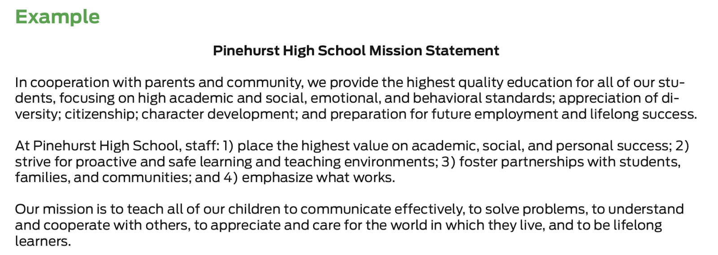
Activity: Example Mission
Review the example mission statement provided and identify the pieces that directly promote and support the development of student social competence.
Notes:
Trainer Notes:
To Know/To Say:
Review the example mission statement provided, identify the pieces that directly promote and support the development of student social competence.
HO2 Example High School Mission Statement

Slide 12
Activity: Mission Review
Working with your team, review your school or district mission statements.
Do existing statements include the essential focus on both academic and social outcomes for all students?
Do the mission statements reflect inclusive and equitable practices for all students and families?
How does your school mission relate to your “why”?
What changes does the team suggest to your school or district mission statement?
What suggestions would your team forward to your district leadership team after reviewing district mission documentation?
Notes:
Trainer Notes:
To Know/To Say: Working with your team, review your school or district mission statements.
Do existing statements include the essential focus on both academic and social outcomes for all students?
Do the mission statements reflect inclusive and equitable practices for all students and families?
How does your school mission relate to your “why”?
What changes does the team suggest to your school or district mission statement?
What suggestions would your team forward to your district leadership team after reviewing district mission documentation?

Slide 13
Discussion: Staff Engagement
How can you include staff in reviewing your school and/or district mission statement(s)?
What “look fors” would you want staff to consider when reviewing your school and/or district mission statement(s)?
How does your school mission relate to your “why”?
Notes:
Trainer Notes:
To Know/To Say: How can you include staff in reviewing your school and/or district mission statement(s)?
What “look fors” would you want staff to consider when reviewing your school and/or district mission statement(s)?
Do the mission statements reflect inclusive and equitable practices for all students and families?
How does your school mission relate to your “why”?

Slide 14
Discussion: Family Engagement
When staff have completed a draft review of the school and/or district mission statement(s), how will you share with families for their feedback?
Share the draft mission statement(s) on the school website, in school newsletters, and in classroom communications (e.g. Friday folders, mass emails) with an invitation for suggestions.
Notes:
Trainer Notes:
To Know/To Say: When staff have completed a draft review of the school and/or district mission statement(s), share with families for their feedback.
Share the draft mission statement(s) on the school website, in school newsletters, and in classroom communications (e.g. Friday folders, mass emails) with an invitation for suggestions.

Slide 15
Closing and Next Steps
How will you engage staff and families in developing and/or revising a mission statement?
Next steps include
Develop action steps for engaging staff in a review of your school and/or district mission statement(s).
Additionally, add action steps to address family engagement in the review of school and/or district mission statement(s).
Update your action plan using the Tier 1 Action Plan template and the Tier 1 Action Planning Checklist.
Use the Tier 1 Artifacts Rubric to assess the quality of the resources your team develops.
Use the results of the PBIS Self-Assessment Survey (SAS) to gain perspective from all staff, and results from the PBIS Tiered Fidelity Inventory (TFI) to gain perspective from your Building Leadership Team.
Notes:
To Know/To Say: During this lesson, you learned that having a mission statement that communicates value for social competence in school and for students’ lifelong success will give legitimacy to your work and direct your actions.
How will you engage staff and families in developing and/or revising a mission statement?
Next steps include
Develop action steps for engaging staff in a review of your school and/or district mission statement(s).
Additionally, add action steps to address family engagement in the review of school and/or district mission statement(s).
Update your action plan using the Tier 1 Action Plan template and the Tier 1 Action Planning Checklist.
Use the Tier 1 Artifacts Rubric to assess the quality of the resources your team develops.
Use the results of the PBIS Self-Assessment Survey (SAS) to gain perspective from all staff, and results from the PBIS Tiered Fidelity Inventory (TFI) to gain perspective from your Building Leadership Team.
Additional information about mission statements can be found in the MO SW-PBS Handbook and the MO SW-PBS Tier 1 Implementation Guide.

Slide 16
References
Missouri SW-PBS (2019). Missouri schoolwide positive behavior support tier 1 implementation guide.
Notes:
Trainer Notes:
To Know/To Say:

Slide 17
Contact Information
Check Out MO SW-PBS on Social Media:
Facilitator Contact Information:
pbismissouri.org
facebook.com/moswpbs
@MOSWPBS

