Slide 1
Course: Data-Based Decision-Making Lesson: DBDM/Solution Plan: Using ODR Data to Improve Outcomes for Students
Notes:
To Say/To Know: This lesson covers a special form of data-based decision-making. In it, you will learn to use monthly office discipline referral data to create a Solution Plan, a monthly behavior improvement plan for the entire school.

Slide 2
Handouts
HO1_Key Words and Phrases
HO2_Pause and Reflect #1 Handout
HO3_Blank DBDM/Solution Plan Form
HO4 Completed DBDM/Solution Plan
HO5_Pause and Reflect #2 Handout
HO6_Results Indicators
HO7_Decision Making Flow
HO8_SWOT
HO-AP SW-PBS Action Plan
HO-APC Tier 1 Action Planning Checklist
HO-APR MO SW-PBS Tier 1 Artifacts Rubric 2021
Notes:
To Say/To Know: Handouts for this lesson are available on this page. If you haven’t yet downloaded the handouts, please pause the video and download at this time.

Slide 3
By the end of this session, you will be able to…
review Office Discipline Referral (ODR) Data to identify a problem.
analyze schoolwide ODR data to define context surrounding the problem.
select targeted, evidence based practices to address the problem.
review data to monitor and adjust plans.
evaluate plan success.
Notes:
To Know/To Say: By the end of this lesson, you will know what contextual data is important to collect and review to select a problem to solve, be able to analyze this data to narrow your focus so as to select a targeted intervention that is more likely to succeed, know what data to monitor so as to be able to make any necessary midcourse adjustments, and evaluate the plan so as to inform future decisions.

Slide 4
Rationale
Notes:
To Know/To Say: This special case uses the logic of a functional assessment and behavior improvement plan and applies it to the entire school. The school is the unit of implementation and analysis. This is a Tier 1 or universal approach to improving school climate and student behavior, meaning that all students in all settings have access to schoolwide interventions. Students who need additional, more intensive supports should be referred to the Tier 2 or Tier 3 team, whichever is more appropriate.

Slide 5
Keywords and Phrases
Big 5
Disaggregate
Simple Problem Statement
Precision Problem Statement
Solution Plan
Solution Component
Notes:
To Know/To Say: Here are a list of keywords and terms that will be discussed as part of this lesson.

Slide 6
Unpacking DBDM/Solution Plan:
Using ODR Data to Improve Outcomes for Students
Notes:
Trainer Notes:
To Know/To Say: So, let’s dig into just how a team would use ODR data to improve schoolwide behavior and climate.

Slide 7
Did the intervention work?
Did the intervention work?
Is there a problem?
Is there a problem?
What can be done about the problem?
What can be done about the problem?
Why is the problem happening?
Why is the problem happening?
Tilly 2008
Notes:
Trainer Notes: This slide is animated.
To Know/To Say: Schools are encouraged to select and use a standardized data-based decision-making protocol. Such a protocol guides the team through the important steps that lead to effective decisions. Tilly (2008) identified 4 essential questions that any effective data-based decision-making protocol must answer. Throughout the remainder of this lesson, these questions will be used to anchor our discussion of the DBDM/Solution Plan. For more information about using the essential questions to select a DBDM protocol, refer to the Data-Based Decision-Making Overview lesson in this course.

Slide 8
Did the intervention work?
Did the intervention work?
Is there a problem?
Is there a problem?
What can be done about the problem?
What can be done about the problem?
Why is the problem happening?
Why is the problem happening?
Tilly 2008
Notes:
Trainer Notes: This slide is animated.
To Know/To Say: The first question that any good data-based decision-making protocol must answer is, “is there a problem.”

Slide 9
Select a problem
What
Where
When
Who
Notes:
To Know/To Say: Teams select a problem to solve from one of the following categories:
Most frequent behavior, or
The location where unexpected behaviors tend to occur, or
The time of day/activity during which most unexpected behaviors occur, or
Or the student group that is engaged in most unexpected behaviors
Activity may be more helpful than time of day. Use time of day to help you to identify common activities that students are engaged in in different classes. For example, a high school team may notice several times throughout the day when they experience increases in unexpected behaviors. A closer analysis shows that these times correspond with independent seat work.
Also, remember, if you choose to focus on students involved that this is a Universal intervention: focus on a group of students (grade level, demographic group, proficiency group) rather than on individual students who may benefit from targeted or intensive support.

Slide 10
Identify a Problem
How often?
What?
Where?
When?
Who?
The Big-5
Notes:
To Know/To Say: To identify a problem, the team looks at their office discipline data for the previous month to answer the Big 5 questions:
How often are problems occurring?
What are the most frequent problem behaviors?
Where are problem behaviors occurring?
When are problem behaviors occurring?
Who are the students engaged in the problem behaviors?
A standard report that answers these questions is referred to as the Big 5 Data report.

Slide 11
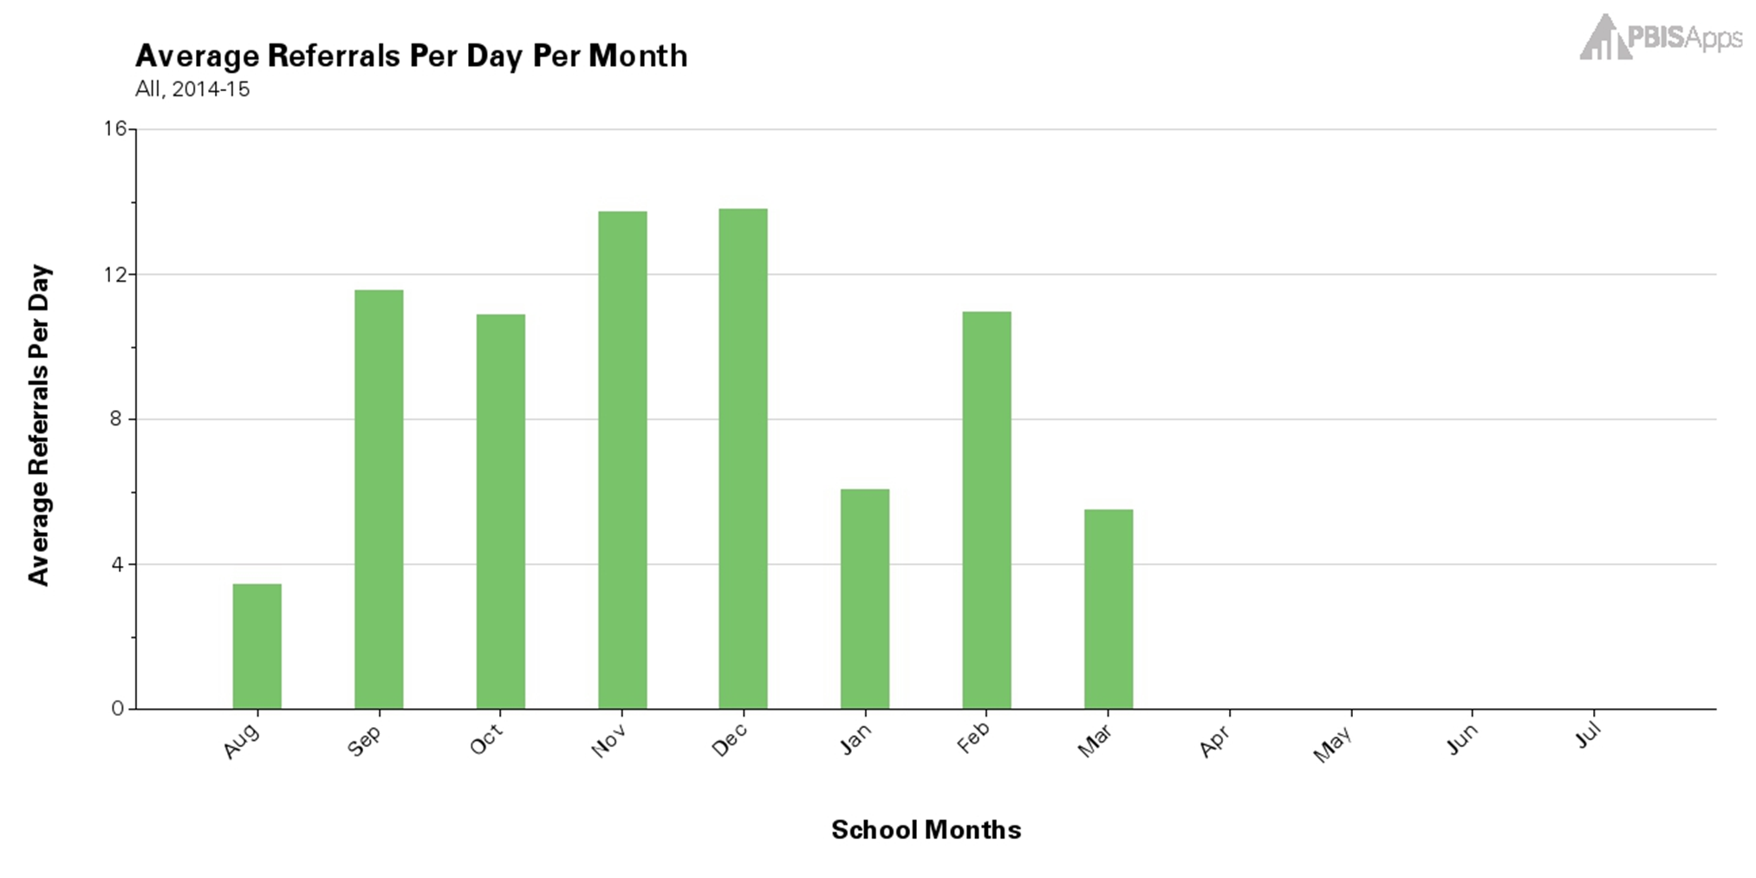
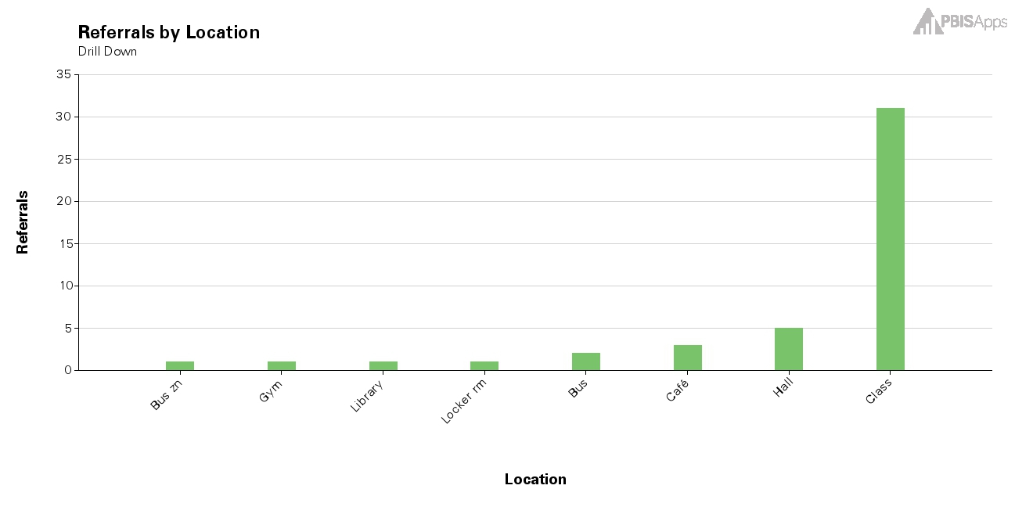
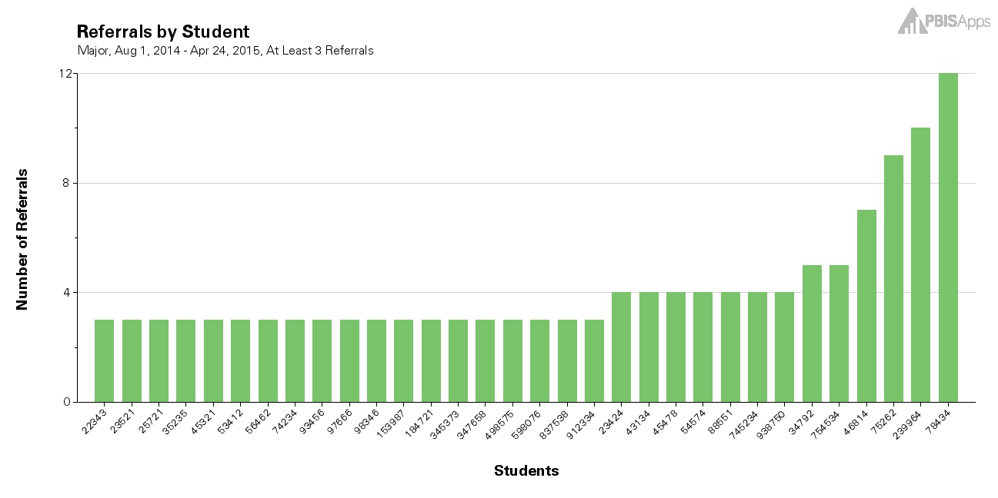
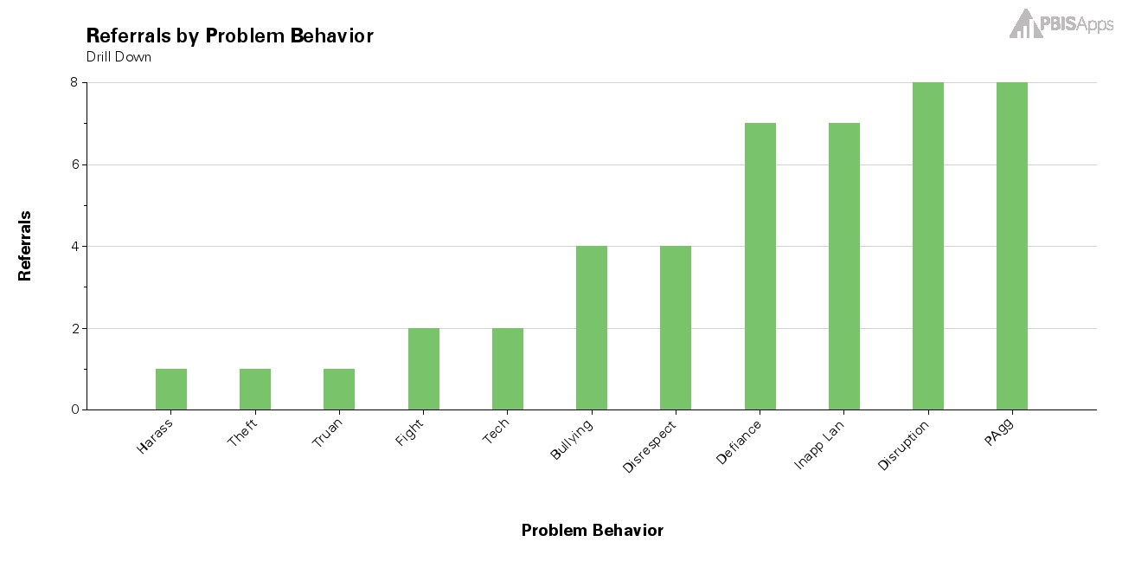
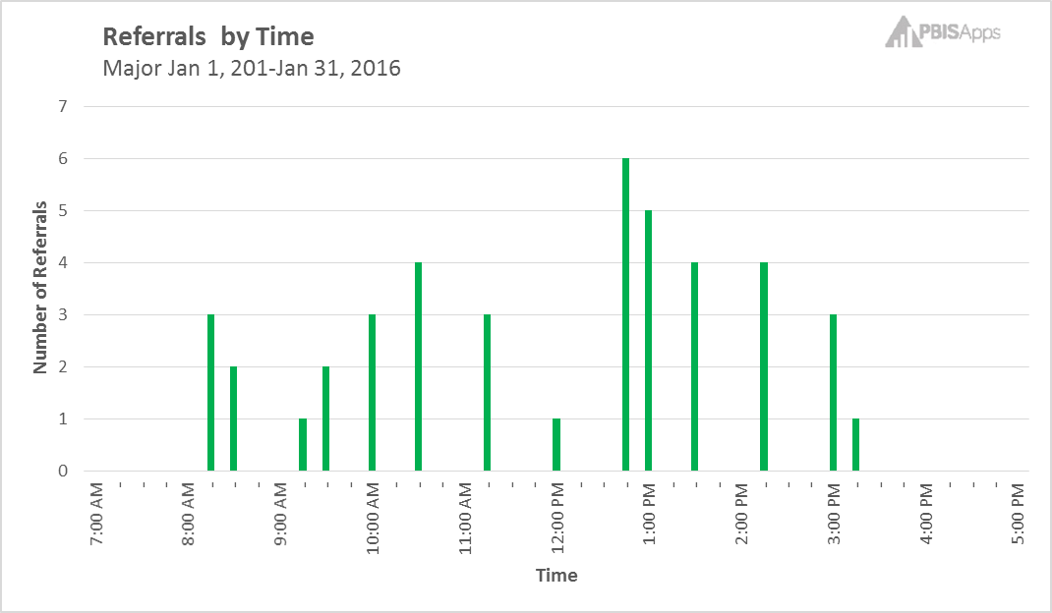
The Initial Big 5 Data Report
Per Day/Per Month
Location
Students
Select a red flag as a focus
Problem Behavior
Time of Day
Notes:
To Know/To Say: An initial Big 5 Data Report includes frequency charts per day per month, by type of behavior, by location of referral, by time of day of referral, and by the students engaging in the behavior incidents.

Slide 12
Simple Problem Statements
There were 1.5 ODRs per day in January.
Physical Aggression (14) and Disruption (14) were the most frequently reported behaviors.
Most incidents occurred in the classroom (31).
Most behavior incidents occurred at 12:45 PM (6)
Most of the behavior incidents involved 6th Grade students (16)
Notes:
To Know/To Say: The initial Big-5 data report can be summarized into a series of simple problem statements. Each of these statements describes one of the Big 5 charts.
The team will select ONE of these simple problem statements to solve in the coming month. This can be a behavior, a specific location, a time of day, OR a group of students.

Slide 13
Selecting a Problem on which to Focus
Consider the number of ODRs potentially impacted.
Select a Focus problem that will give you the biggest change for the least amount of effort.
Focus area should involve 10 or more students.
10+ = Systems Issue
Consider student safety.
Rob Horner, 2011
Personal Communication with Rob Horner, 2016
Notes:
To Know/To Say: When selecting a problem on which to focus, consider the following: First, consider the number of ODRs that would be impacted if the problem were solved (frequency).
Next, consider a problem that, if solved, would lead to the biggest change for the least amount of effort.
Also, remember that this is a schoolwide behavior improvement plan. Therefore, select a focus problem that involves 10 or more students, as this is indicative of a systems issue. For problems involving 10 or fewer students, select a different problem to solve. Individual students who meet decision rules and would benefit from more intensive supports can be referred to the Tier 2 or Tier 3 teams.
Last but far from least, give extra weight to problems that compromise student safety.

Slide 14
Did the intervention work?
Is there a problem?
What can be done about the problem?
Why is the problem happening?
Tilly 2008
Notes:
To Know/To Say: Once the team has selected a problem to solve, they should analyze the problem to identify contextual or environmental factors specifically related to the problem that may be contributing to the problem.

Slide 15
Disaggregate
Isolate data related to your inquiry (the problem)
Sort
Separate relevant from irrelevant
Filter
Remove irrelevant
Notes:
To Know/To Say: Behavior is functionally related to the learning environment. As such, it is helpful to gather some information about the context of the behaviors. To identify contextual and environmental factors that may contribute to the problem, use filters to isolate data related to incidents specifically involving the problem that is being solved, then run frequency reports of the contextual factors in this subset of data.
Alternatively, you can manually pull out all ODRs that are related to the problem, then tally the contextual factors from this subset.

Slide 16
Disaggregate
Notes:
To Know/To Say: The same Big 5 questions that were used to identify a problem to focus on can also be used to identify the contextual factors when applied to the focus problem. These contextual factors are behavior by type, location, time of day, and groups of students. The problem will be in one of these four categories (what, where, when and who). The team will answer the remaining Big 5 questions of the subset of data.

Slide 17
Focus Problem: Behavior
What
Physical Aggression
Where?
When?
Who?
Notes:
To Know/To Say: For example, say the team is solving for the behavior, physical aggression. The team pulls out all ODR data for the month involving incidents of physical aggression. They then answer the following questions as it relates to this subset of data:
Where is the physical aggression occurring?
When is the physical aggression occurring?
Who are the students that are engaging in physical aggression?

Slide 18
Precision Problem Statement
7th graders are engaging in physical aggression in the Halls at 1:00 PM.
Notes:
To Know/To Say: Once the team has answered these questions, they can incorporate them into a precision problem statement. This is a more specific, accurate, and actionable statement of the problem, and gives the team more information they can use to target their response

Slide 19
Did the intervention work?
Is there a problem?
What can be done about the problem?
Why is the problem happening?
Tilly 2008
Notes:
To Know/To Say: Now that the team has identified a problem and defined contributing contextual factors, they can craft a plan targeted at solving this specific problem.

Slide 20
Why Do Kids Engage in Unexpected Behavior?
They do not know the expectation.
They are not fluent in the expected behavior.
The unexpected behavior fulfils a need.
Gresham, Sugai, & Horner (2001)
Notes:
To Know/To Say: In order to target our plans to the specific problem that the team is trying to solve, it is helpful to quickly review the reasons students behave in unexpected ways.
The science of behavior teaches us that when students engage in unexpected behavior, it is generally because…
they don’t know what behavior is expected;
they are not fluent in the expected behavior;
the unexpected behavior serves a student need.
Knowing this and understanding the context in which the unexpected behavior occurs will help you to understand why the solution components are effective practices for improving schoolwide behavior.

Slide 21
Makings of a Schoolwide Intervention
Identify replacement behavior.
Intensify active supervision.
Teach replacement behavior.
Reinforce replacement behavior.
Consistently correct unexpected behavior.
Notes:
To Know/To Say: To effectively address the reasons students behave unexpectedly, the team:
Identifies a replacement behavior, or “what you want them to do instead.”
Teaches the replacement behavior
Reinforces the replacement behavior
Consistently corrects the unexpected behavior
And Intensifies active supervision in the context that the unexpected behaviors are occurring.
A solution plan guides the team to complete these “solution components” in a way that targets the problem and contributing contextual factors.

Slide 22
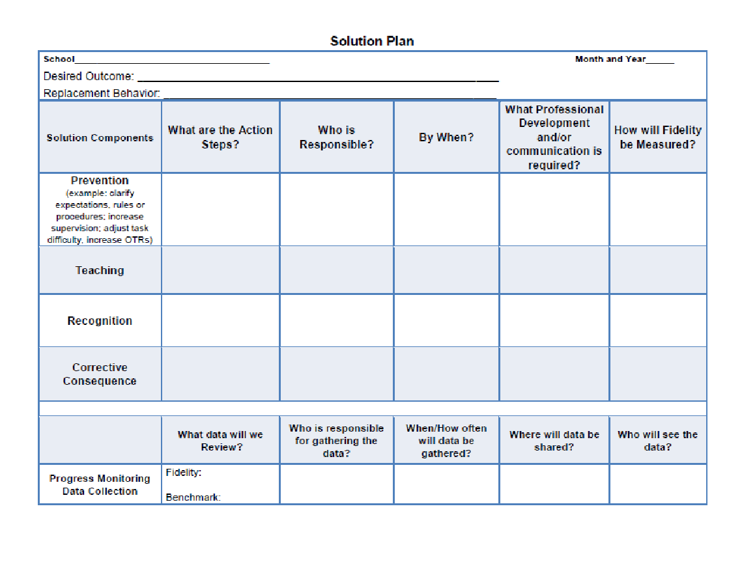
The Solution Plan
Action Plan Format
Solution Component
Action Steps
Person Responsible
Target Date
Communication/PD
Evidence action step completed
Results Indicators
Adapted from PBIS Apps (2016)
Notes:
To Know/To Say: A Solution Plan is a variation of an action plan that guides the team through the 5 steps of developing a schoolwide intervention. It provides a space for the team to write the replacement behavior. Then guides the team toward planning to intensify the solution components of prevention, teaching and reinforcing the replacement behavior, and correcting the unexpected behavior. In addition, the Solution Plan guides planning for implementation and accountability for implementing the solution components.

Slide 23
Are we making adequate progress?
Notes:
To Know/To Say: The Solution Plan also guides the team to identify and plan for monitoring Results Indicators. Results indicators are quick and easily collected intermediate data points that provide a reliable measure of whether the adults are implanting the plan and whether the plan is having the desired impact on student outcomes. Teams plan to review results indicators weekly or bi-weekly so that they can quickly respond if the data indicates a need for a mid-course correction.

Slide 24
Monitoring Data: How will you know?
Implementation Results Indicator
Outcome Results Indicator
Teacher lesson accountability sheet
Count of tickets given to students with specific positive feed back
Duty assignment attendance
Count of students for using conflict resolution strategy
Count of office referrals for physical aggression
Notes:
To Know/To Say: Here are some examples of implementation and outcome data points for progress monitoring our middle school physical aggression example. Notice that the implementation results indicator monitors whether the adults are implementing the plan; the student outcomes results indicators monitors whether students are making incremental progress toward the goal

Slide 25
Did we implement the plan?
Yes
No
Were the Solution Components targeted to address the precision problem statement?
Are there obstacles to implementation?
Yes
No
Yes
No
Intensify the plan
Modify plan to better address the precision problem statement.
Address obstacles.
Implement plan.
Notes:
To Know/To Say: If you are not making adequate progress toward your goal, you can use this decision tree to guide next steps.
Are we making adequate progress?
Yes: keep doing what we are doing
No: Did we implement the plan?
Yes
Did we find the right root cause?
Yes
Modify the plan to better address the root cause
No
Go back to data to identify the correct root cause
No
Are there obstacles to implementation
Yes: address the obstacles
No: Implement the plan

Slide 26
Did the intervention work?
Is there a problem?
What can be done about the problem?
Why is the problem happening?
Tilly 2008
Notes:
To Know/To Say:
3. What can be done about the problem?

Slide 27
Evaluate Plan
 | Goal not met | Goal met
Plan not implemented | Are there obstacles to implementation? Yes: Modify plan to eliminate the obstacles. No: Implement the plan. | Look at data to determine why the goal was achieved, so you can replicate.
Plan implemented | Re-analyze data; develop an alternate hypotheses; modify the plan to address the alternative hypothesis. | Plan for sustained implementation. Return to data to identify a new problem to address.
Notes:
To Know/To Say: This table shows a decision making rubric for evaluating the plan and determining next steps. This will work with any plan, academic or behavior. It is based on two questions: Did we meet our goal? And Did we implement our plan?
If the Goal was not met and the team did not implement with fidelity, then the team must determine whether there were obstacles to implementation. If so, they should modify the plan and try again. If there were no obstacles, then the team needs to implement their plan.
If the goal was not met and the team implemented the action steps with fidelity, then they should reanalyze the data and reassess whether they identified the correct problem and whether their action steps were aligned with the problem
If they met their goal, but they did not implement their plan, they may want to go back to the data to determine why the goal was met. This may help them to avoid or solve problems in the future.
Finally, if the goal was met, and they implemented the plan with fidelity, then they should go back to the data and begin the cycle again with a new focus problem. This proactive approach to solving problems will help the team to establish cycles of continuous improvement.

Slide 28
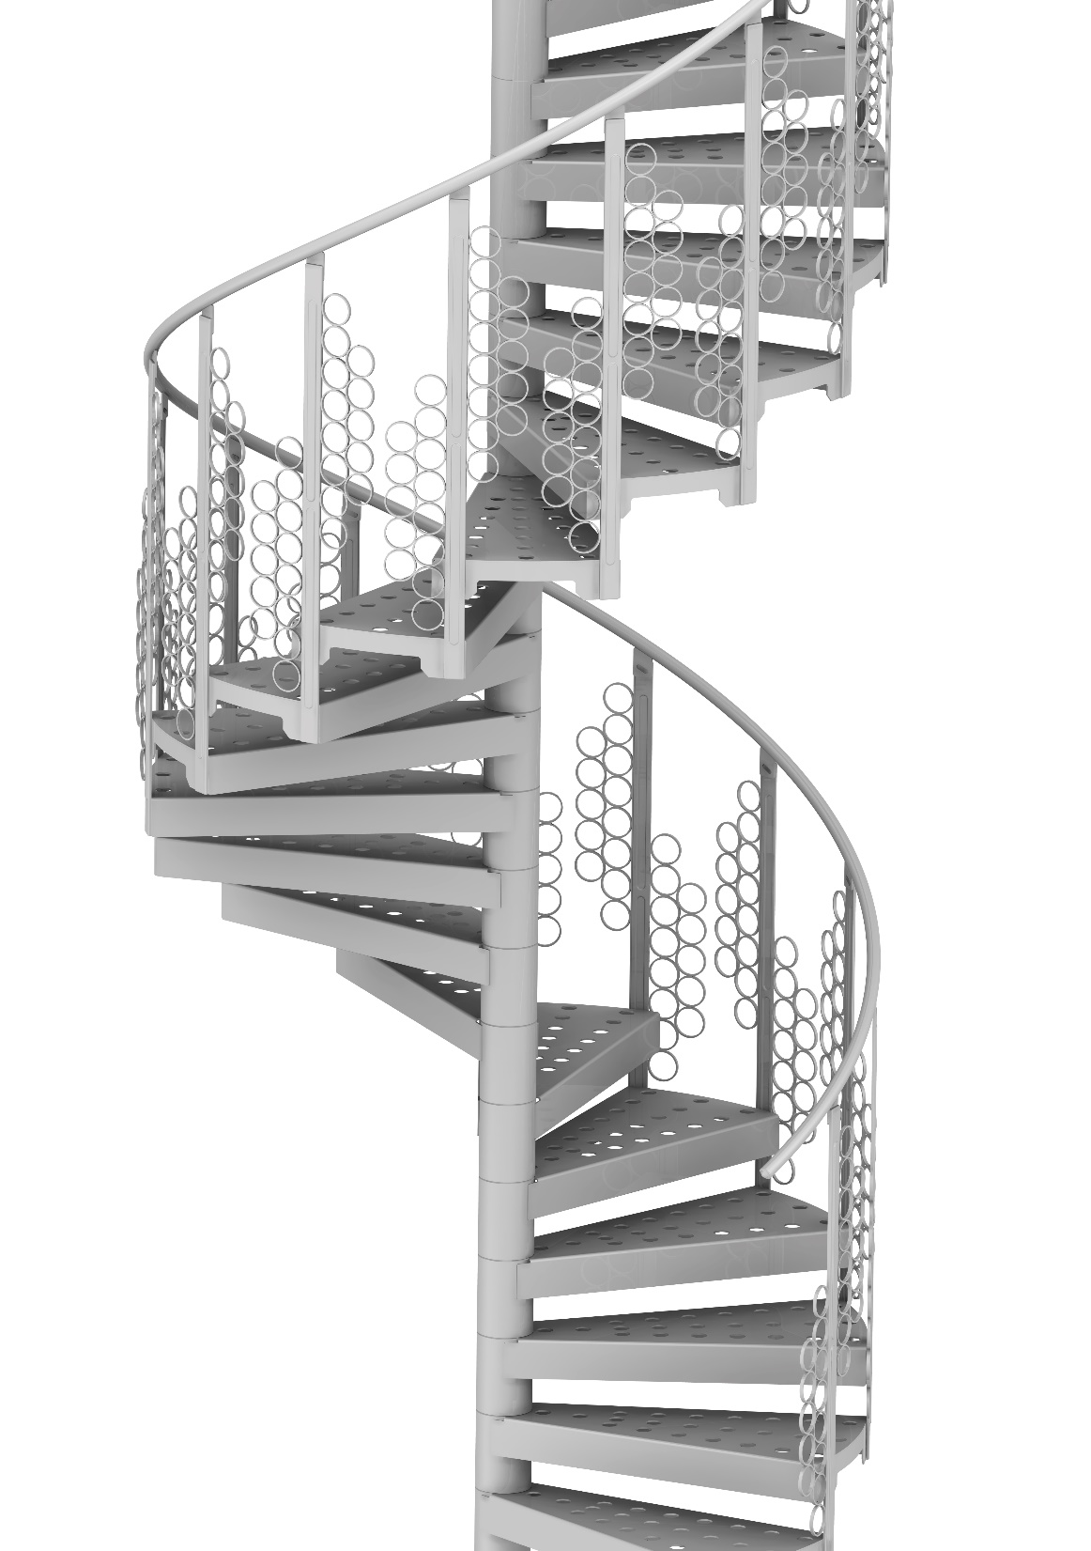
Then we systematically repeat…
Creating cycles of continuous improvement.
Notes:
To Know/To Say: Once the team has evaluated the plan, they start the cycle again, reviewing data to identify the next problem to solve. This usually occurs at the next data meeting following the end of a data cycle. Thus establishing cycles of continuous improvement.

Slide 29
Schoolwide DBDM in Action
Notes:
To Know/To Say: So, what does all this mean for you and your school?

Slide 30
SWOT: Are you Ready for Schoolwide DBDM?
Strengths | Weaknesses
Opportunities | Threats
Notes:
Trainer Notes: Copy the HO11 SWOT for each participant
To Know/To Say: If you are here as a team, use the chart paper to answer the SWOT questions as they relate establishing a schoolwide team to engage in DBDM using ODR data to improve student behavior and school climate, schoolwide. Otherwise, you may use the HO11 SWOT form.
What are your team’s strengths that will set you up for success as you implement schoolwide DBDM using ODR data? What do you do well that could assist you in implementing DBDM?
What are your team’s weaknesses? What are your personal opportunities for growth? What obstacles must be overcome to implement Schoolwide DBDM?
What are some opportunities that Schoolwide DBDM using ODR data present to you and your school? How can you turn your strengths into opportunities?
What are some of the threats that implementing Schoolwide DBDM exposes you to?

Slide 31
Team Talk
Based on the SWOT activity, what are your next steps toward implementing Schoolwide DBDM?
Notes:
To Know/To Say: Based on the SWOT activity you just completed, what are your logical next steps toward implementing Schoolwide DBDM using ODR data. Pay special attention to prerequisites that must be completed, obstacles that must be overcome, and structures that must be put in place.

Slide 32
Schoolwide DBDM Closing and Next Steps
Notes:
To Know/To Say: So, let’s take a moment to briefly review where we’ve been, and where to next.

Slide 33
Closing and Next Steps
Notes:
To Know/To Say: During this lesson, you learned about a special case of Data-Based Decision-Making: Schoolwide behavior teams utilizing ODR data to improve school climate and schoolwide behavior.
How will you engage the schoolwide leadership team to begin using ODR data in a DBDM process?
Next steps include updating your action plan using the Tier 1 Action Plan template and the Tier 1 Action Planning Checklist. Consider using the Tier 1 Artifacts Rubric to assess the quality of the resources your team develops. And finally, consider using the results of the PBIS Self-Assessment Survey (SAS) to gain perspective from all staff, and results from the PBIS Tiered Fidelity Inventory (TFI) to gain perspective from your Building Leadership Team.

Slide 34
References

Slide 35
References
Gresham, F. M., Sugai, G., & Horner, R. H. (2001). Interpreting outcomes of social skills training for students with high-incidence disabilities. Exceptional Children, 67(3), 331-344.
Horner, R. (March 8, 2016). Personal Communication.
Horner, R.H. (2011). Moving PBS forward with quality, equity and efficiency. Keynote: Eighth International Conference of the Association for Positive Behavior Support. Denver: CO.
PBIS Apps (2016). Swift at SWIS. University of Oregon.
Scott, T., Anderson, C., Alter, P. (2012). Managing classroom behavior using positive behavior supports. Pearson:Upper Saddle River, New Jersey.
Sugai, G., Sprague, J.R., Horner, R.H., & Walker, H.M. (2000). Preventing school violence. The use of office discipline referrals to assess and monitor schoolwide discipline interventions. Journal of Emotional and Behavioral Disorders, 9(2), 94–101.
Tilly, W. D. (2008). The evolution of school psychology to science-based practice: Problem-solving and the three-tiered model. In A. Thomas & J. P. Grimes (Eds.), Best practices in school psychology, V (pp. 17-36). Bethesda, MD: National Association of School Psychologists.

