Slide 1
Course: Data-Based Decision-Making Lesson: Data-Based Decision Making: Overview
Notes:
To Know/To Say: This lesson provides an overview of how districts and schools can use data to make decisions that improve outcomes for students.

Slide 2
Facilitator Notes: Delete This Slide
It is recommended that you read through the activities prior to the session; you may substitute activities that achieve the same goal (i.e., substitute one activation activity for another).
Some activities have handouts; be sure to read through the activity to decide whether you want to run off handouts, or make the information available in some other way.

Slide 3
Working Agreements
Be Respectful
Be an active listener—open to new ideas
Use notes for side bar conversations
Be Responsible
Be on time for sessions
Silence cell phones—reply appropriately
Be a Problem Solver
Follow the decision making process
Work toward consensus and support decisions of the group
Notes:
Trainer Notes: Hide or delete this slide if presenting the entire PLM
To Know/To Say: “These will be the Working Agreements we will honor during all our training sessions this year.”

Slide 4
Attention Signal
Notes:
Trainer Notes: Hide or delete this slide if presenting the entire PLM; Facilitator: Select an attention signal.
To Know/To Say: “One of our agreements is to follow the attention signal.”
“Your team will work with your school to develop an attention signal you will use in every setting.”
“In order to get all of you focused after discussions, activities or breaks,
I will ________________________________________.”
(Insert your attention signal here.)
“Your task will be to finish your sentence, quiet your voice and ____________________________.”
(Insert what you want participants to do.)

Slide 5
Welcome and Introductions
Our trainers for the day are:
Notes:
Presenter Notes: Add the name(s) of the trainer(s) to the slide.
To Say: The introductions may be formal or informal depending on how well you know the group. Trainers should use whatever process is comfortable for introductions. I am/we are _______________ (provide some background about trainers). Please introduce yourself to the group (name, district, position).

Slide 6
Session Outcomes
At the end of this session, you will…
understand the importance of Data Based Decision Making for improving outcomes for students;
know how different levels within an organization can use DBDM to achieve important goals;
have a basic understanding of the essential steps that must be part of any Data Based Decision Making process.
Notes:
To Know/To Say: The purpose of this session is to provide an overview of data-based decision making, so that you know what systems must be in place prior to implementing DBDM, to understand the purpose of DBDM in improving academic and behavioral outcomes, and to understand what features must be a part of any DBDM process, and use this information as you select a standard DBDM process for your organization. Future sessions will provide more detailed information of DBDM with behavior data at the schoolwide and grade or content level as the level of analysis.

Slide 7
Handouts
HO1_4 Corners
HO2_Key Terms and Phrases
HO3_Progress Monitoring Decision Tree
HO4_Compass Points
HO5_DBDM Overview References
HO-AP SW-PBS Action Plan
HO-APC Tier 1 Action Planning Checklist
HO-APR MO SW-PBS Tier 1 Artifacts Rubric 2021
Notes:
Presenter Notes: Determine whether you make the handouts available electronically, or run copies for the participants. HO2_What’s Your Data and HO4_Got It_Need_It are used for activities in the presentation. You may want to provide chart paper for these activities and have the participants work in teams.
To Know/To Say: These are the handouts we will be referencing during this lesson.

Slide 8
Importance of the Topic
Identify opportunities for improvement.
Select effective practices/strategies.
Build collective educator efficacy.
Establish cycles of continuous improvement.
Improve academic and behavioral outcomes.
Notes:
Trainer Notes: This is a slide adapted from PBIS APPS SWIS facilitator Training. This slide has animations.
To Know/To Say: It is important to remember why data-based decision-making is important. When a decision is based upon information, especially data, it is more likely to effectively address a true problem rather than someone’s impression. Data reviews help teams to identify opportunities to improve. Teams that analyze data to identify the root cause of problems are more likely to select practices and strategies that have a better chance of succeeding. As educators see the data respond to their efforts, they are more likely to feel empowered. This builds collective educator efficacy, or the feeling that “what we do makes a difference.” as schools and districts regularly and frequently use data to solve problems, they establish cycles of continuous improvement. Finally, and most importantly, data-based decision-making can result in better academic and behavioral outcomes for our students.

Slide 9
Key Terms
Notes:
Trainer Notes: Consider an activity for familiarizing the participants with key terms. One such activity is a variation of the children’s game “Head Bands.” In this activity, you can have participants find a partner. One partner faces the screen, the other has his/her back to the screen. The partner facing the screen gives clues regarding the meaning of the term, without saying the term. The partner with his/her back to the screen attempts to guess the word. Give a time limit per slide (30-60 seconds). Once you have made it through half of the terms, have the partners trade places, and continue the game.
To Know/To Say: There are a number of Key Terms associated with this course. These terms will be referenced in this and other lessons. It may be helpful to review these terms, and/or keep a copy for quick and easy reference.

Slide 10
Overview
School or District Annual Improvement.
Schoolwide Behavior Improvement Plans.
Decisions within collaborative data teams
Decisions around targeted and intensive interventions.
Notes:
To know/to say: Data-based decision-making is used at all levels of educational organizations. Schools and districts use data to identify, plan for, and achieve improvement goals. Building leadership teams use discipline data to improve student behavior schoolwide. Grade or content alike collaborative teams integrate academic and behavior data to improve student outcomes around a standard. Finally, Tier 2 and Tier 3 teams use data to select appropriate academic and behavior interventions and to make decisions based on the individual student’s response to the intervention.

Slide 11
Cause
Effect
Notes:
To Know/To Say: Think of data-based decision-making as a study in cause and effect. Adult actions result in certain outcomes for students. These outcomes can be desirable or undesirable. The goal of data-based decision-making is to manipulate adult activities to achieve the desired outcomes for students. In this way, data-based decision-making places the locus of control over student outcomes with the adults. While this can be intimidating, it is also very empowering!

Slide 12
Types of data
Implementation
Outcomes
PBIS Apps 2016
Notes:
To Know/To Say: Another way to think about cause and effect data is in terms of implementation and outcome data.
1. Implementation data is simply data that measures adult actions, or cause data.
2. Outcome data is the impact on desired student outcomes, or effect data.
Effective data-based decision-making monitors both implementation and outcome data related to the mission of the school or district.

Slide 13
Pause and Reflect
Notes:
To Know/To Say: Complete HO1 Four Corners Worksheet.
What academic and behavioral student outcome data does your school or district currently collect?
What implementation data related to activities intended to impact academic and behavior outcomes does your school currently collect.

Slide 14
PBIS Logic Model/Interconnected Elements
OUTCOMES
SYSTEMS
DATA
PRACTICES
Notes:
Trainer Notes: This slide has animations
To Know/To Say: This diagram is often used in SW-PBS to describe the relationship between Systems, Data, Practice, and Outcomes. They are often described as interconnected. However, one way to think about or interpret it is as a cyclical, iterative process. So, think about it this way:
The desired student outcome provides a reference point to which you compare data;
The discrepancy between the desired outcome and the data can help you to identify opportunities to improve.
Evidence-based practices are selected that are likely to lead to the desired outcome.
Systems are developed that support adults to engage in the evidence-based practices.
Implementation and outcome data points are used to monitor progress toward the desired outcome, and to evaluate the success of the plan.

Slide 15
Did the intervention work?
Did the intervention work?
Is there a problem?
Is there a problem?
What can be done about the problem?
What can be done about the problem?
Why is the problem happening?
Why is the problem happening?
Tilly 2008
Notes:
Trainer Notes: Read the notes as though this and the following 4 slides are part of the same animated slide.
To Know/To Say: Similarly, Tilly (2008) identified 4 questions that any effective data-based decision-making process must answer. These questions are:

Slide 16
Did the intervention work?
Did the intervention work?
Is there a problem?
Is there a problem?
What can be done about the problem?
What can be done about the problem?
Why is the problem happening?
Why is the problem happening?
Tilly 2008
Notes:
Trainer Notes: This slide is animated.
To Know/To Say: Is there a problem?

Slide 17
Did the intervention work?
Is there a problem?
What can be done about the problem?
Why is the problem happening?
Tilly 2008
Notes:
To Know/To Say: Why is the problem happening?

Slide 18
Did the intervention work?
Is there a problem?
What can be done about the problem?
Why is the problem happening?
Tilly 2008
Notes:
To Know/To Say: What can be done about the problem? and

Slide 19
Did the intervention work?
Is there a problem?
What can be done about the problem?
Why is the problem happening?
Tilly 2008
Notes:
To Know/To Say: Did the intervention work?
Notice that these questions are displayed in a circle. This represents the idea that the data-based decision-making process is cyclical: that is, as soon as you evaluate whether the plan worked, you reenter the cycle by reviewing data and identifying a new problem on which to focus.

Slide 20
PBIS Logic Model/Interconnected Elements
OUTCOMES
SYSTEMS
DATA
PRACTICES
Notes:
Trainer Notes: This slide has animations
To Know/To Say: How are the four questions related to the interconnected elements of outcomes, practices, systems and data?

Slide 21
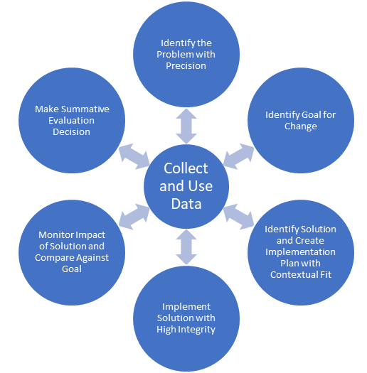
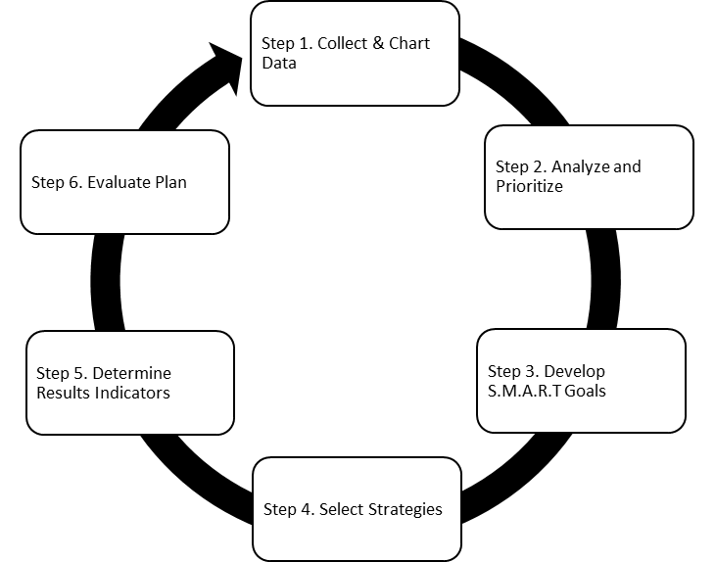
DBDM Protocols
MO SW-PBS Decision Making Model
National Center on PBIS T.I.P.S.
Leadership and Learning Data Teams
Notes:
To Know/To Say: Schools and districts are encouraged to select a standardized decision making process. There are many DBDM protocols on the market that answer the four essential questions. These are just three that schools or districts may choose from. Select the protocol that works for you and your organization.

Slide 22
Pause and Reflect
Notes:
To Know/To Say: Consider how your team would answer the following questions.
Does your team meet regularly to set goals and make plans based on data?
Does your team use a standard data based decision making process that addresses the following questions:
Do we have a problem?
Why is the problem happening?
What can be done about the problem?
And, did the intervention work?
If not, how will your team identify, evaluate and select a standardized data-based decision making process?

Slide 23
Did the intervention work?
Did the intervention work?
Is there a problem?
Is there a problem?
What can be done about the problem?
What can be done about the problem?
Why is the problem happening?
Why is the problem happening?
Tilly 2008
Notes:
Trainer Notes: This slide is animated.
To Know/To Say: For the remainder of this lesson, we will use the essential questions that every good DBDM protocol answers to help us to unpack data-based decision-making. The first of these questions is: Is there a problem? In other words, teams use student outcome to identify an opportunity to improve.

Slide 24
Enter with a Question
Do students feel safe at school?
Are all students disciplined equitably?
Are we over-relying on exclusionary discipline?
Are students attending school at high rates?
Are students graduating on time?
Notes:
To Know/To Say: to know what data to review to identify such opportunities, it may be helpful for the team to generate questions related to the important mission of the organization. Examples of questions that a school or district might ask are:
Do students feel safe at school?
Are all students disciplined equitably?
Are we over-relying on exclusionary discipline?
Are students attending school at high rates?
Are students graduating on time?
These questions drive data sources the team will gather and review in the problem finding process.

Slide 25
Gather Data
What Data would Answer your questions?
School Climate Survey
Risk Ratios on office referrals by race or disability
ISS, OSS, and Expulsion rates
Average Daily Attendance
4-year graduation rates
Notes:
To Know/To Say: Here are some examples of data sources that might answer the questions that the team generated.
To determine whether students feel safe at school, the team might review school climate survey results;
To determine whether all students are disciplined equitably, the team can review Risk Ratios or other equity data comparing how students belonging to different demographic groups are disciplined;
To determine whether the school is over-relying on exclusionary discipline, the team might review ISS, OSS, and expulsion data;
To determine whether students are students attending school at high rates, the team can review Average Daily Attendance data;
Finally, if the team wants know whether students are graduating on time, they can review data on 4-year graduation rates.
As you review this data, take time to notice and celebrate what is going well! Then get down to the business of finding an opportunity for growth.

Slide 26
Pause and Reflect
Notes:
To Know/To Say: Consider how your team would answer the following questions:
Think of a valued outcome you have for students at your school: What questions do you have related to that outcome?
What are one or more sources of data that would provide the answers to your questions?

Slide 27
Select an Opportunity for Growth
Small in number
Important for students in school and in life
Focus on mission
Contextual fit
Biggest change for the effort
Horner 2011
Notes:
To Know/To Say: Even the best run organizations can find many opportunities to grow. Unfortunately, having too many goals can set the team up for failure. To improve the likelihood of success, the team should narrow their focus to a small number of improvement goals at a time. Teams can prioritize improvement goals by considering outcomes that are important for students, either in school or in life. These goals should help the school or district achieve their mission. Goals should have contextual fit; that is, they should be relevant for all stakeholders. Finally, it is helpful to consider Rob Horner’s advice to select a goal that would produce the greatest change with the smallest amount of effort.

Slide 28
Did the intervention work?
Is there a problem?
What can be done about the problem?
Why is the problem happening?
Tilly 2008
Notes:
To Know/To Say: Once the team has identified a problem to solve, it is important to understand why the problem is occurring. Knowing why something is happening can help us to identify strategies to effectively address the problem.

Slide 29
Data Analysis
Notes:
To Know/To Say: Just as the team used data to identify a problem, they analyze data to determine possible causes of the problem. Data analysis is a detailed examination of the structure or elements of something. It helps the team to identify contextual factors that may contribute to the problem, and possible causes of the problem.

Slide 30
Make a causal inference
Notes:
To Know/To Say: Data analysis provides the information teams use to infer why the problem is happening.

Slide 31
Did the intervention work?
Is there a problem?
What can be done about the problem?
Why is the problem happening?
Tilly 2008
Notes:
To Know/To Say: Once the team has identified a possible cause, they can better select a strategy that directly addresses the cause, or at least meliorate the effects of the problem.

Slide 32
Select Change
Directly addresses root cause
Evidence-based
Contextual fit
Capacity
Notes:
To Know/To Say: When selecting an action step to address the problem, look for a practice or strategy for which there is evidence to support its use in solving the specific problem, preferably with a population similar to your target population. In addition, you will want to consider “Contextual Fit.” In other words, is it aligned with the skills, values and resources of those who will implement it. Finally, do you have the capacity (time, skills, knowledge base, resources) to implement the action steps?

Slide 33
Create a Plan
Goal
Practice/strategy
Action steps
Resources
Person(s) responsible
Timeline
Evidence of completion
Notes:
To Know/To Say: Once you have identified a goal and selected an appropriate practice or strategy, it is important to put it into an action plan format. While there are a variety of action plan formats you can select, a good action plan identifies what you are trying to do, how you will do it, who is responsible for what, and when will it be accomplished. In addition, you may want to consider what additional resources will be needed and identify how you will know when a given action step or series of action steps have been completed.

Slide 34
Implement Change
Notes:
To Know/To Say: The number one reason why a plan fails is that it was never implemented! Implement the plan! As you implement, hold yourselves accountable to your action plan by meeting periodically to monitor plan implementation and progress toward your goal.

Slide 35
Monitor Progress
Notes:
To Know/To Say: Progress monitoring involves reviewing two pieces of data, one that measures whether the adults are implementing important components of the plan, and whether students are making adequate progress toward the goal.

Slide 36
Did we implement the plan?
Yes
No
Did we find the right root cause?
Did we address the right root cause?
Are there obstacles to implementation?
Yes
No
Yes
No
Modify plan to better address cause.
Go back to data to determine root cause.
Address obstacles.
Implement plan.
Notes:
To Know/To Say: If you are not making adequate progress toward your goal, you can use this decision tree to guide next steps.
Are we making adequate progress?
Yes: keep doing what we are doing
No: Did we implement the plan?
Yes
Did we find the right root cause?
Yes
Modify the plan to better address the root cause
No
Go back to data to identify the correct root cause
No
Are there obstacles to implementation
Yes: address the obstacles
No: Implement the plan

Slide 37
Did the intervention work?
Is there a problem?
What can be done about the problem?
Why is the problem happening?
Tilly 2008
Notes:
To Know/To Say: The final question that must be answered is, “Did the intervention work?” Implied in this question is a formative process of determining whether the intervention is working, as well as a final evaluation to determine whether the intervention worked as intended. Both the formative and evaluative functions involve collecting data on the progress students are making toward the desired outcome, as well as data on the extent to which adults are implementing the plan as intended.

Slide 38
Evaluate Plan
 | Goal not met | Goal met
Plan not implemented | Are there obstacles to implementation? Yes: Modify plan to eliminate the obstacles. No: Implement the plan. | Look at data to determine why the goal was achieved, so you can replicate.
Plan implemented | Re-analyze data; develop an alternate hypotheses; modify the plan to address the alternative hypothesis. | Plan for sustained implementation. Return to data to identify a new problem to address.
Notes:
To Know/To Say: This table shows a decision making rubric for evaluating the plan and determining next steps. This will work with any plan, academic or behavior. It is based on two questions: Did we meet our goal? And Did we implement our plan?
If the Goal was not met and the team did not implement with fidelity, then the team must determine whether there were obstacles to implementation. If so, they should modify the plan and try again. If there were no obstacles, then the team needs to implement their plan.
If the goal was not met and the team implemented the action steps with fidelity, then they should reanalyze the data and reassess whether they identified the correct problem and whether their action steps were aligned with the problem
If they met their goal, but they did not implement their plan, they may want to go back to the data to determine why the goal was met. This may help them to avoid or solve problems in the future.
Finally, if the goal was met, and they implemented the plan with fidelity, then they should go back to the data and begin the cycle again with a new focus problem. This proactive approach to solving problems will help the team to establish cycles of continuous improvement.

Slide 39
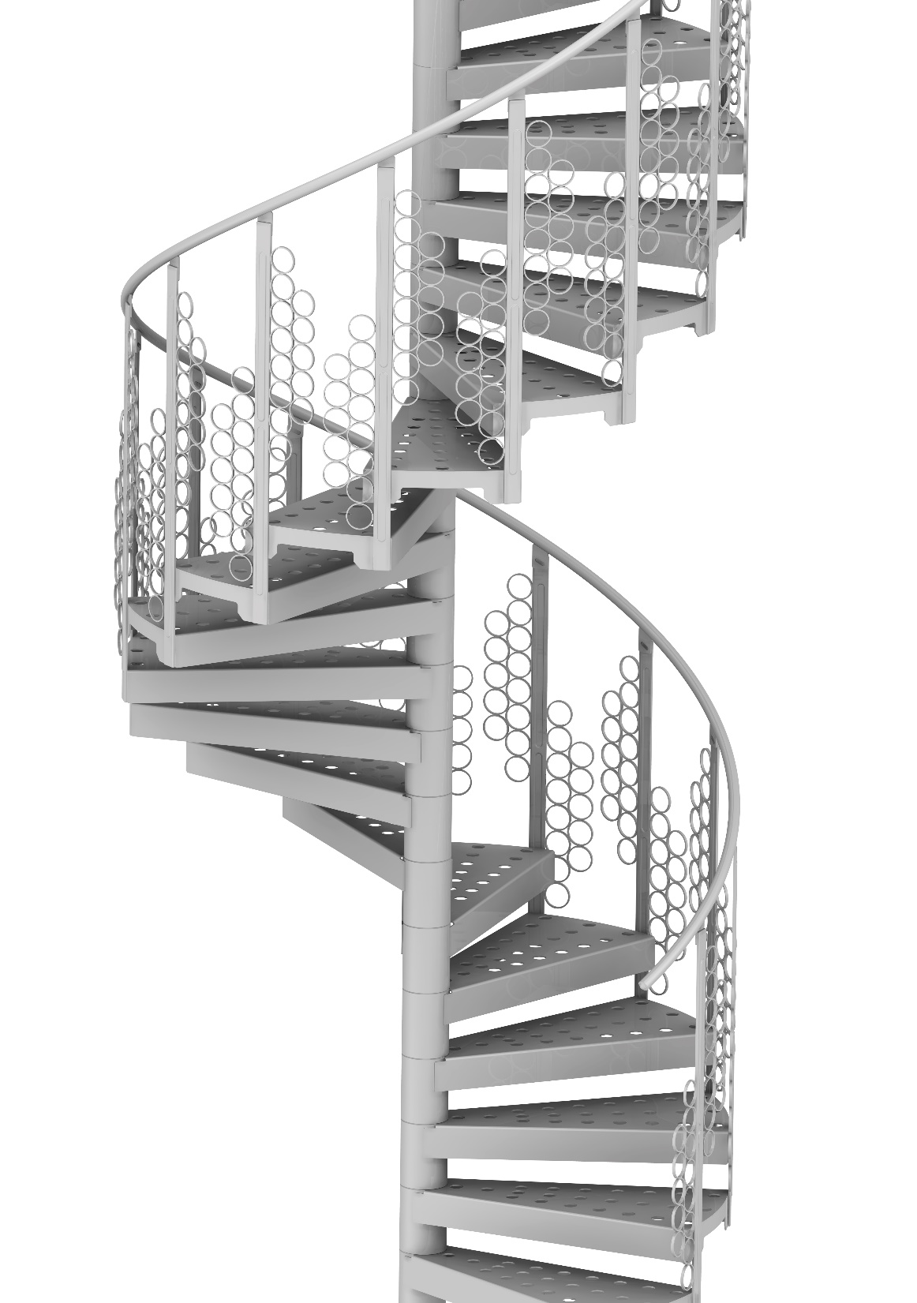
Then we systematically repeat…
Creating cycles of continuous improvement.
Notes:
To Know/To Say: Once the team has evaluated the plan, they start the cycle again, reviewing data to identify the next problem to solve. This usually occurs at the next data meeting following the end of a data cycle. Thus establishing cycles of continuous improvement.

Slide 40
Compass Points
Excites | Worries
Need to Know | Next Steps
Adapted from Ritchhart, R., Church, M., and Morrison, K. (2011).
Notes:
Trainer Notes: For this activity, participants can write in HO4 Compass Points, type in a google form or answer the questions with a partner. Alternatively, you can provide a piece of chart paper to each team. They divide their paper into four quadrants, labeling them E, W, N, and S. As a team, they fill in each segment with what Excites them, what Worries them, what they Need to know, and what their next Steps are.
To Know/To Say: As a team, complete compass points activity on the handout or a piece of chart paper. In the East quadrant, write what excites you; in the West Quadrant write what worries you. In the North Quadrant, write what you still need to know, and in the South quadrant, record your team’s next steps.

Slide 41
Closing and Next Steps
Notes:
To Know/To Say: During this lesson, you learned general information about Data-Based Decision-Making
How will you get staff at all levels of the organization to engage in Data-Based Decision-Making?
Next steps include updating your action plan using the Tier 1 Action Plan template and the Tier 1 Action Planning Checklist. Consider using the Tier 1 Artifacts Rubric to assess the quality of the resources your team develops. And finally, consider using the results of the PBIS Self-Assessment Survey (SAS) to gain perspective from all staff, and results from the PBIS Tiered Fidelity Inventory (TFI) to gain perspective from your Building Leadership Team.

Slide 42
Questions & Contacts
Name(s) and Contact Information
Notes:
Trainer Notes: Add names and contact information of the presenter(s) in the text box. Use this time to check for understanding and questions

Slide 43
References
Bernhardt, V. (1998) . Data Analysis for Comprehensive School Improvement. Eye on Education: Larchmont, New York.
Gilbert, T.F. (1978). Human competence: Engineering worthy performance. New York : McGraw-Hill.
Gresham, F. M., Sugai, G., & Horner, R. H. (2001). Interpreting outcomes of social skills training for students with high-incidence disabilities. Exceptional Children, 67(3), 331-344.
Horner, R. (March 8, 2016). Personal Communication.
Horner, R.H. (2011). Moving PBS forward with quality, equity and efficiency. Keynote: Eighth International Conference of the Association for Positive Behavior Support. Denver: CO.
Metz, A. & Louison, L. (2018) The Hexagon Tool: Exploring Context. Chapel Hill, NC: National Implementation Research Network, Frank Porter Graham Child Development Institute, University of North Carolina at Chapel Hill. Based on Kiser, Zabel, Zachik, & Smith (2007) and Blase, Kiser & Van Dyke (2013).retrieved on 5-13-2020 from https://nirn.fpg.unc.edu/resources/hexagon-exploration-tool.
PBIS Apps (2016). Swift at SWIS. University of Oregon.
Ritchhart, R., Church, M., Morrison, K. (2011). Making Thinking Visible: How to promote engagement, understanding, and independence for all learners. San Francisco, California: Josey-Bass
Reaves, D.A. (2006). The learning leader: How to focus school improvement for better results. Association for Supervision and Curriculum Development:Alexandria, Virginia.
Scott, T., Anderson, C., Alter, P. (2012). Managing classroom behavior using positive behavior supports. Pearson:Upper Saddle River, New Jersey.
Sugai, G., Sprague, J.R., Horner, R.H., & Walker, H.M. (2000). Preventing school violence. The use of office discipline referrals to assess and monitor schoolwide discipline interventions. Journal of Emotional and Behavioral Disorders, 9(2), 94–101.
Tilly, W. D. (2008). The evolution of school psychology to science-based practice: Problem-solving and the three-tiered model. In A. Thomas & J. P. Grimes (Eds.), Best practices in school psychology V (pp. 17-36). Bethesda, MD: National Association of School Psychologists.

