Slide 1
Central Middle School
Cape Girardeau, Missouri

Slide 3
Demographics
65% of students come from low income
11% of student receive Special Education
Ethic Distribution –
57% White
31% Black
8% Bi-racial
3% Hispanic
1% Asian

Slide 4
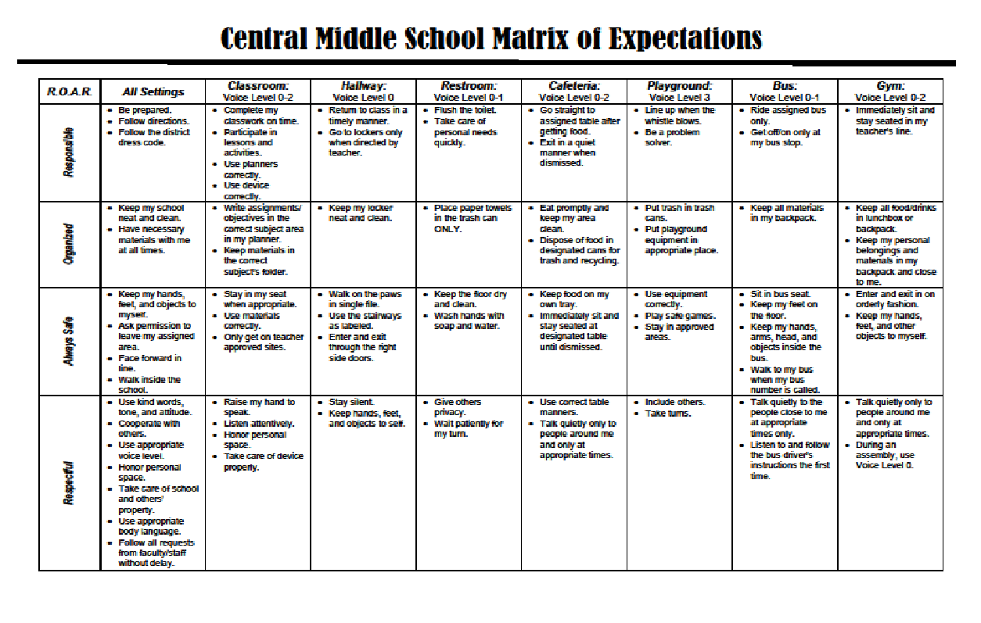

Slide 5
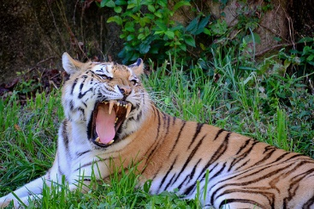
Our Tigers Needed a Voice

Slide 6
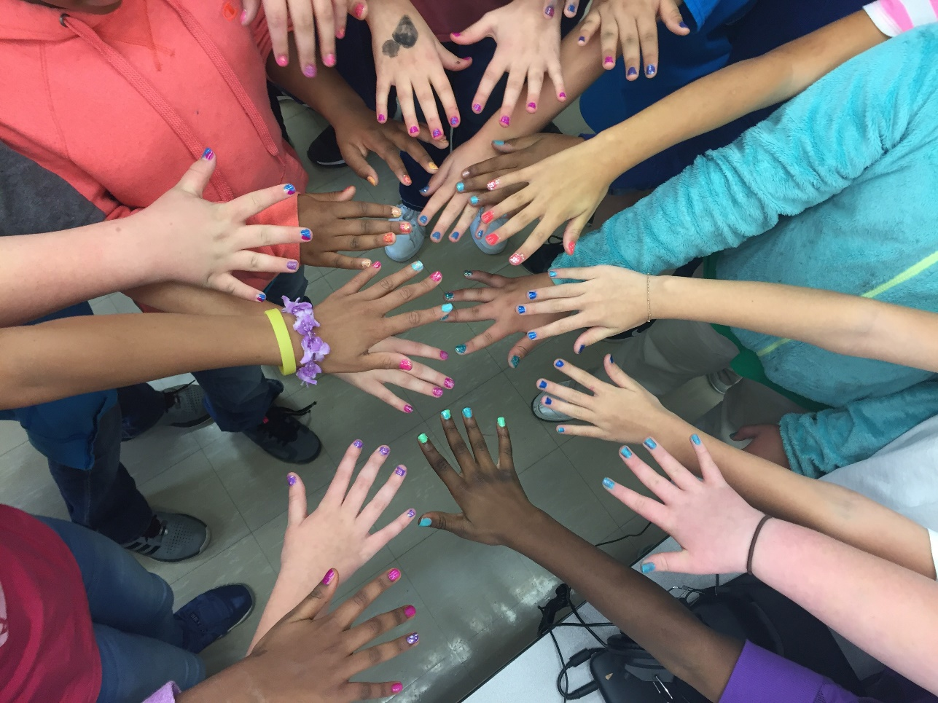
Action Step
# 1 Survey the Need

Slide 7
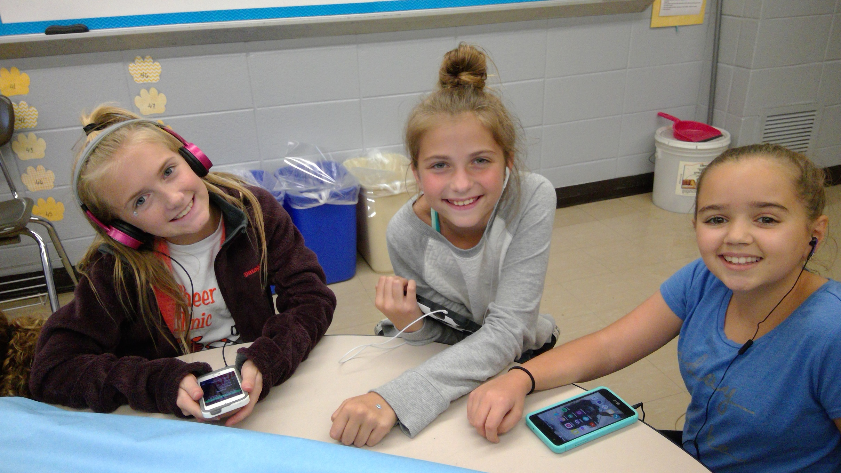
Survey Students
Students want to be heard and have a say in what was going on in their building

Slide 8
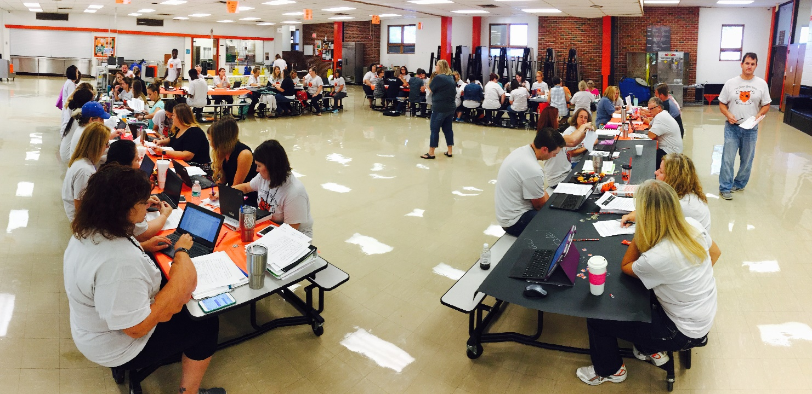
Survey Teachers
Student Leaders will give incite into the overall culture of the student body

Slide 9
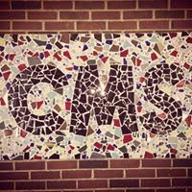
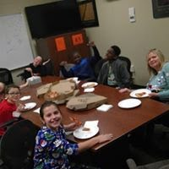
Action Steps
Educated students on What a Student Leadership team looks like.

Slide 10
Applications
Create
Promote
Collect
Select

Slide 11
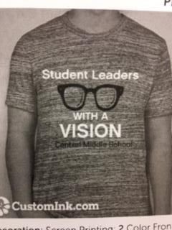
Action Step
Students Create a Mission/Vision for their Student Lead Team

Slide 12
Central Middle School Student Leadership Team Mission Statement
CMS student Leadership Team will work together to give all students a voice in creating a positive school community.

Slide 13
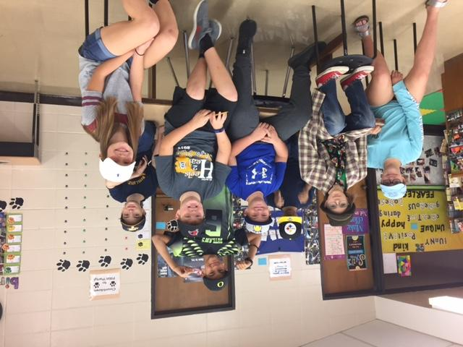
Structure
Who is responsible?
Meetings/Agenda
Events

Slide 14
Who is responsible?
Mrs. Wright, School Counselor
Staff and Administration can add to Monthly Meeting Agendas as needed.

Slide 15
Resources
PBIS- RPDC
Central High School Student Leaders

Slide 16
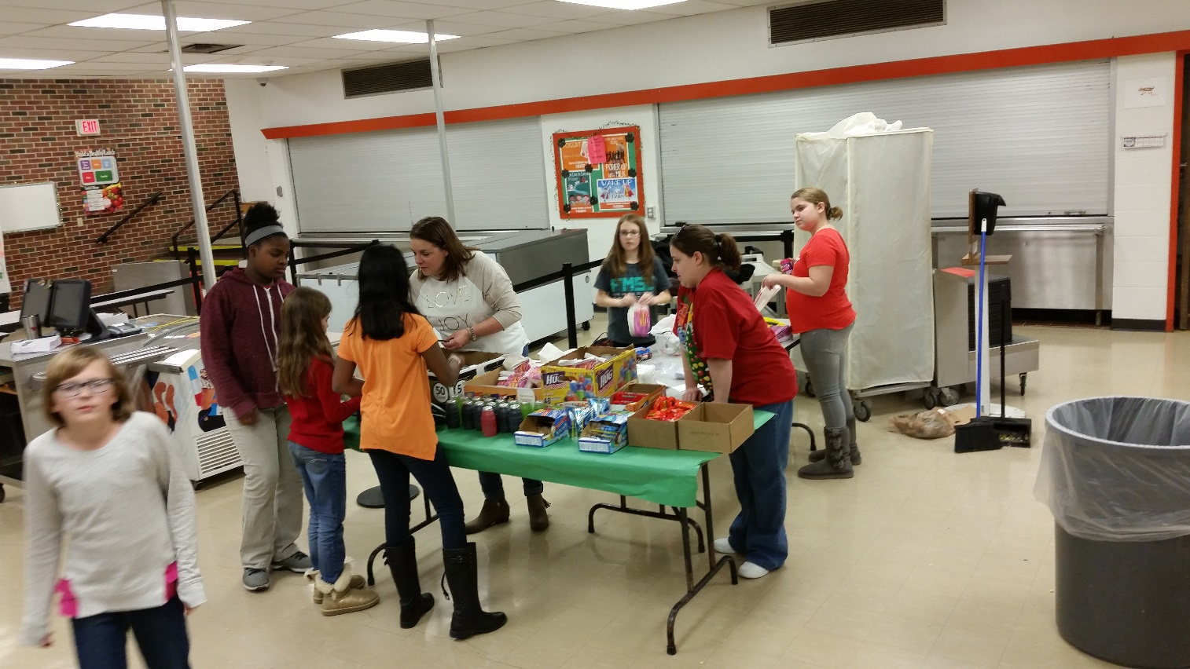
Philanthropy
Student Selected
Fundraising
Buddy Bench

Slide 17
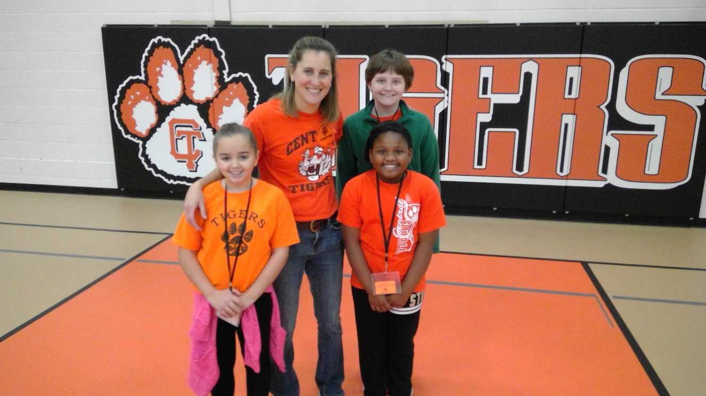
Ownership
Student Leadership Work Schedule
Every student is has a job responsibility

Slide 18
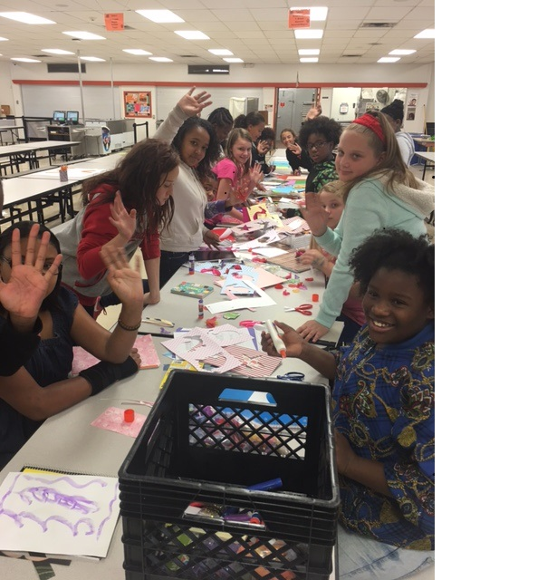
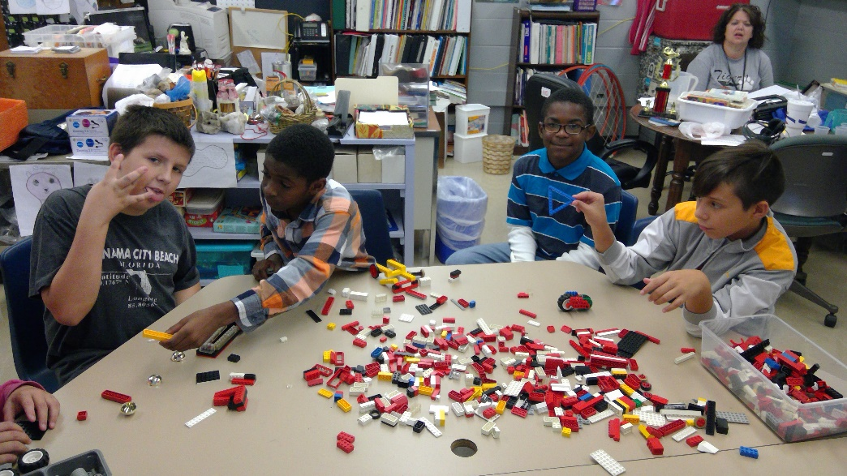
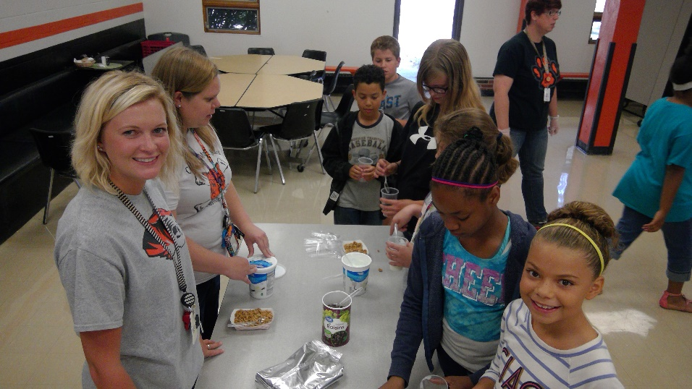
Positive Results
Student Buy in
Ownership
Pride in their school and in their accomplishments

Slide 20
Rebeka J. Wright
School Guidance Counselor
wrightr@capetigers.com

