Slide 1
Missouri Educator Evaluation System &
Positive Behavior Support

Slide 2
By the end of this session, you will:
Be able to discuss the new Missouri Educator Evaluation System, and how the essential principals relate to you.
Reflect how your classroom aligns to Teacher Standard 5: Listing the possible sources of evidence to demonstrate your level of proficiency in creating a positive effective classroom
Summarize your future action you will take as a result of what you have learned here today.

Slide 3
Success Criteria
I can describe the essential principals of the Missouri Educator Evaluation System
I can actively participate in learning how to use the Teacher Standards to inform and improve my own practice
I can reflect on my classroom using the Teacher Standard 5: listing the possible sources of evidence and action plan my growth model for my positive classroom Environment

Slide 4
Research says…..
You are the most important factor!
Notes:
No one is more important than you. Teachers are the most important factor in students achievement.
We are the most critical element whether a child succeeds in school, whether they are happy in school ,
The Relationships we form with students, the feedback we give to students both verbal and non verbal matter.

Slide 5
“The effect of increases in teacher quality swamps the impact of any other educational investment.”
Goldhaber, 2009
Notes:
Why is Educator Evaluation Important? How many of you went into education to have an effect? How do we know what we are doing in the classroom is effective?

Slide 6
“Having a high quality teacher throughout elementary school can substantially offset or even eliminate the disadvantage of socio-economic background.”
Rivkin, Hanushek and Kain 2002
Notes:
Building the capacity of teachers to become more effective ‘trumps” other initiatives, What does high quality look like?

Slide 7
“The greatest challenge that most students experience is the level of competence of the teacher.”
John Hattie
Notes:
Investing in our teachers, investing in ourselves…. Focusing on growth of teachers effectiveness Continual growth model
Why is Educator Evaluation Important?
Who determines the competency of the teacher

Slide 8
Educator Evaluation
Turn and Talk….
What has been your experience?
Notes:
What do you know….How did we get here. Who remembers the date for the No Child Left behind. Brief Summary-

Slide 9
NCLB
Notes:
Card sort activity- put in order, which came first, “what caused what?”

Slide 10
Senate Bill 291 (2010)
Development of New Teacher Standards (2011)
NCLB Flexibility Waiver (2012)
Essential Principles of Effective Evaluation (2012)
Missouri Educator Evaluation Model—Pilot (2012-2013)
Educator Evaluation Overview and Training (2012-2014)
Notes:
How did Missouri Responds to NCLB…..

Slide 11
Senate Bill 291
June, 2010
Directing school districts to adopt teaching standards which were to include the following elements:
--students actively engaged in learning process
--various forms of assessment
--teacher is prepared and knowledgeable of content
--uses professional communication and interaction in school community
--keeps current on instructional knowledge
--responsible professional in overall mission of school
Notes:
-Review intent of Senate Bill 291.

Slide 12
2012 Missouri’s NCLB Waiver 7 Essential Principles
Notes:
Yellow Handout – Turn and Talk

Slide 13
Missouri’s NCLB waiver says…. “These 7 essential principles of effective evaluation are the foundation for the state’s model. Local evaluation models align to these principles to create consistency in assessing educator performance across the state.”
Notes:
All districts have to do is to align their evaluation to these 7 principles

Slide 14
“The effect of “increases in teacher quality” swamps the impact of any other educational investment.”
Goldhaber, 2009
Notes:
Why is Educator Evaluation Important? How many of you went into education to have an effect? How do we know what we are doing in the classroom is effective?

Slide 15
A Focus on Growth
The most valuable evaluation model will not only meet state legislative requirements, it must produce gains in student learning. Next-generation models, grounded n sound research, will emphasize teacher growth and development.

Slide 16
Research-Based Instruction
15+ years of research 800+ meta-analyses
50,000+ studies
240+ million students
Notes:
-One resource to determine what is effective -Exposure/reinforcement of Hattie’s resource -Mo Teacher Standard alignment to Hattie’s findings

Slide 17
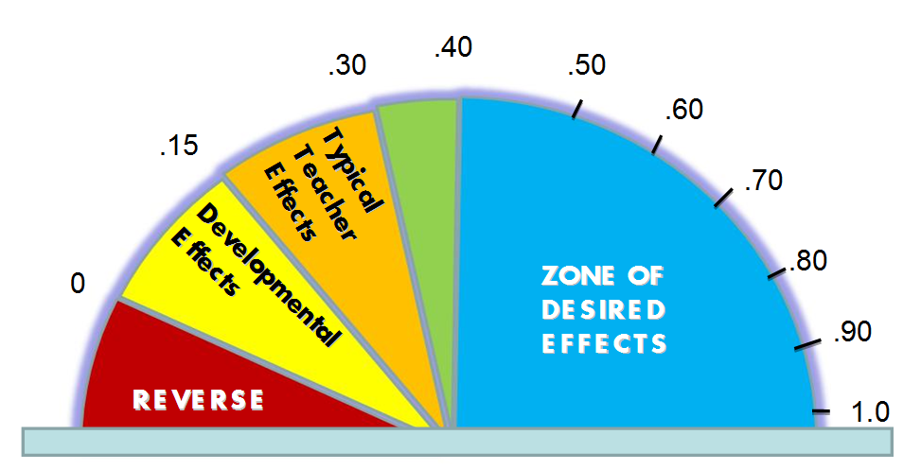
Research-Based Instruction
Notes:
-Effect size -.40=one year of academic growth -almost any effort will have some sort of effect, is it wise to choose and implement effectively those practices with high levels of return?

Slide 18
Which are the most effective?
Ability grouping
Acceleration
Feedback
Student-teacher relationships
Teaching study skills
Cooperative learning
Homework
Individualized instruction

Slide 19
Ability grouping (.12)
Acceleration (.88)
Feedback (.73)
Student-teacher relationships (.72)
Teaching study skills (.59)
Cooperative learning (.41)
Homework (.29)
Individualized instruction (.22)
Hattie (2009, 2012)
Notes:
-Effect size for each practice…

Slide 20
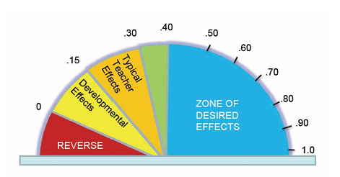
Relationship
Off the Charts!
Hattie, J. (2009). Visible Learning. New York: Routledge
Hattie, J. (2012). Visible Learning for Teaachers. New York: Routledge
Notes:
Off the Charts!
Put in notes

Slide 21
Feedback
Off the Charts!
Hattie, J. (2009). Visible Learning. New York: Routledge
Hattie, J. (2012). Visible Learning for Teaachers. New York: Routledge
Notes:
Off the Charts!
Put in notes

Slide 22
2011 Missouri Teacher Standards
9 Teacher Standards
and
36 Quality Indicators
Notes:
Activity _ Hand out yellow sheet with 9 standards and have them decides which ones were chosen to be the Highly Leverage Standards

Slide 23
36 Quality Indicators
Notes:
-Quality Indicator comparison visual -Call attention to Learning Growth and Development and Use of Student Data containing most Quality Indicators.
-Take a moment to reflect on the indicators within these two areas.

Slide 24
“High Leverage” Standards
High Leverage Standards and Quality Indicators were identified by threading across the research findings of John Hattie, Robert Marzano, Doug Lemov and findings gleaned from the Missouri pilot process

Slide 25
High Leverage Teacher Standards
Content Knowledge
Understanding and Encouraging Student Learning
Implementing the Curriculum
Teaching for Critical Thinking
Positive Classroom
Use of assessment data to analyze and modify
Notes:
Out of the 9 standards – 6 have been determined by the research to be High Leverage Standards
Content Knowledge, Understanding and encouraging student learning, implementing the curriculum , teaching for critical thinking , Positive Classroom, Use of assessment data to analyze and modify

Slide 26
Growth vs. Fixed Mindset
The growth mindset is based on the belief that your basic qualities are things that you can cultivate through your efforts. Everyone can change and grow through application and experience.
The New Psychology of Success
How We Can Learn to Fulfill our Potential
Carol Dweck, 2006

Slide 27
The Growth Model
Teacher demonstrates their own learning and progress for the standard they choose to work on .
Notes:
How do we know?
What would we see… what would the teacher be doing? What would the students be doing? Investing in ourselves.

Slide 28
Standard 5: Positive classroom Environment
The teacher uses an understanding of individual/group motivation and behavior to create a learning environment that encourages active engagement in leaning, positive social interaction, and self motivation
(SB 291 Section 161.380.2)
Notes:
What does the Ideal Classroom look like ? Activity

Slide 29
“The goal of effective classroom management is not creating “perfect” children, but providing the perfect environment for enhancing their growth , using research-based strategies that guide students toward increasingly responsible and motivated behavior”
Sprick, Knight, Reinke, & McKale, 2006
Notes:
We can’t make students learn or behave
We can create environments to increase the likelihood students learn and behave
Environments that increase the likelihood are guided by a core curriculum and implemented with consistency and fidelity

Slide 30
Proactive, Preventative
Designing your classroom for success
Notes:
Reflection activity – what worked well, what didn’t?

Slide 31
Design your own effective classroom using researched based strategies and the science of behavior proactively present problems from happening .

Slide 32
The Science of Behavior
A B C
Antecedent | Behavior | Consequence
Conditions or circumstances that alter the probability of a behavior occurring. | An observable act. What the student does. The actions or reactions to the antecedents. | The resulting event or outcome that occurs immediately following the behavior. Impacts future occurrence of the behavior.
Notes:
Before beginning to develop practices for encouraging behavior, it is important to revisit the A-B-C’s of behavior. Up to now our work has focused on altering antecedents. We now turn to look at consequences, making adult attention contingent on the performance of the expected behavior. The consequences of behavior affect future performance of that behavior. One effect is an increase in the likelihood the behavior will recur in the future, called reinforcement. .

Slide 33
Creating Environments:
Focus on socially important behaviors
Inviting atmosphere
Connections/relationships between:
Teacher and students
Students and students
Is your school a place where you would want your own child to attend?
Notes:
Effective classroom managers are known, not by what they do when misbehavior occurs, but by what they do to set their classroom up for academic success and prevent problems from occurring.

Slide 34
Create a culture
Create a culture of mutual respect where expectations , procedures and routines are intentionally taught, deliberately practiced, and consistently recognized with explicit feedback.

Slide 35
Climate
Examples & Non examples

Slide 36
Understanding the power of Adult Attention
Notes:
Read the Blue Handout titled “Understanding the Power of Adult Attention”- each person shares one statement. Sentence that was thought provoking, that resonated with them. How does it compare to their school?

Slide 37
Contingent v. Non-Contingent Attention
Notes:
There are two types of adult attention. – as a team create a Venn diagraph….. what is the difference between the two- what do they have in common?

Slide 38
Non-Contingent
Time and attention not tied to performance.
Fulfills need to be noticed and valued.
May decrease attention-seeking misbehavior.
Models positive social interactions.
Antecedents:
Sets stage for academic and social behaviors
Preps student to take correction
Notes:
“In the ABC’s of behavior, non-contingent attention serves as an antecedent. Given that some instances of inappropriate behavior are based on a desire for attention, providing sufficient non-contingent attention can result in reducing the frequency of problem behavior.”

Slide 39
The science of behavior has taught us:
Students are not born with bad behavior.
Students do not learn better ways of behaving when only given aversive consequences.
To learn better ways of behaving, student must be directly taught the expected behaviors.
To retain new behaviors, student must practice in a variety of settings where the behaviors should be used.
MO SW-PBS
Notes:
SW-PBS is based on the science of behavior…it is not what I believe or think works. It is a science. This is reflected in babies through adult hood. Go to page 112 for more information.

Slide 40
The Growth Model
Teacher demonstrates their own learning and progress for the standard they choose to work on .
Notes:
How do we know?
What would we see… what would the teacher be doing? What would the students be doing? Investing in ourselves.

Slide 41
Classroom Management Self-Assessment
Review-Reflect-Discuss
Read through the ten items items on the Classroom Management Self-Assessment . Reflect on your classroom; what is your current stautus: In place, partially in place , or not in place.
What do you need to focus on?
MO SW-PBS
326
Notes:
on.

Slide 42
Eight Effective Classroom Practices
Classroom Expectations
Classroom Procedures & Routines
Encouraging Expected Behavior
Discouraging Inappropriate Behavior
Active Supervision
Opportunities to Respond
Activity Sequencing & Choice
Task Difficulty
MO SW-PBS
Notes:
When you have clear expectations you depersonalize conflicts and protect teachers and administrators. The conflict is between the student and an expectation not the teacher or administrators

Slide 43
Investing in ourselves
How do we cite evidence of our Positive Classroom?
How to make it real for us?
How will we demonstrate growth for ourselves?

Slide 44
Resources for Effective Classroom Practices:
Missouri PBIS.org
Team Page
Margie Shean
sheanm@umkc.edu
margie@shean.com

