Slide 1
Using MO SW-PBS Podcasts and Video to Develop Staff Expertise with Effective Classroom Practices
Linda Bradley
Diane J. Feeley
Missouri Schoolwide Positive Behavior Support

Slide 2
Outcomes for Today
Become familiar with the Effective Classroom Practices
Become familiar with MO SW-PBS resources available to you to provide professional development for your staff on Effective Classroom Practices :
Content Acquisition Podcasts (CAPs)
Accompanying videos
Classroom Modules
Powerpoint, Activity Handouts & Teacher Tool
Tier 1 Workbook
Plan how the CAPs , videos and modules can be used by your schools as part of your professional development plan.
Notes:
Here are our outcomes for today

Slide 3
Why Focus on Effective Classroom Practices?
To Increase Academic Learning Time:
Instructional Time–the amount of the allocated time that actually results in teaching.
Engaged Time–the amount of instructional time students are actively engaged in learning.
Some Classroom Practices Are Best Predictors of Sustainability (Matthews, McIntosh, Frank & May, 2013)
Notes:
Here are a few reasons why MO SW-PBS has expended time and energy to develop materials to support your teachers in their implementation of ECPs:
Increased academic learning time—that’s what it is all about, right? If teachers set up a classroom environment they can increase instructional time and the time students are actually engaged in their instruction of academic material.
We also have some research findings that indicate that some classroom practices are best predictors of sustainability. These are:
Classroom rules aligned with schoolwide expectations and directly taught
Classroom procedures that are defined and taught
High rates of recognition for compliance with classroom rules and procedures
Academic tasks at students’ level (NOT WELL STATED)

Slide 4
Effective Classroom Practices Instructional and Engaged Time
Increase
Instructional Time
Classroom Expectations
Classroom Procedures & Routines
Encouraging Expected Behavior
Discouraging Inappropriate Behavior
Active Supervision
Opportunities to Respond
Activity Sequencing & Choice
Task Difficulty
Increase Engaged Time
Notes:
HIGHLIGHT Instructional time and Engaged Time
Note to presenter: The notes below are based on a school that has already addressed the first four effective classroom practices in non-classroom settings such as the hallway, cafeteria, etc. Edit the notes to be relevant to what your school has implemented at this point in time.
Here are the Effective Classroom Practices on which we’re going to focus.
The first four may be familiar to us because as a school we have implemented these in nonclassroom settings, like the cafeteria, halls, etc. We have determined our expectations (safe, respectful, responsible, etc) and we have taught procedures and routines in our cafeteria, hallways, etc. We have already set up a schoolwide system to encourage expected behavior (examples: Pride tickets, Bulldog Bucks). We have also worked on being consistent to discourage inappropriate behavior.
Effective Classroom Practices 5-8 are strategies we have not focused on as a whole school before.

Slide 5
Effective Classroom Practices Sustainability
Classroom Expectations
Classroom Procedures & Routines
Encouraging Expected Behavior
Task Difficulty
Notes:
Note to presenter: The notes below are based on a school that has already addressed the first four effective classroom practices in non-classroom settings such as the hallway, cafeteria, etc. Edit the notes to be relevant to what your school has implemented at this point in time.
Here are the Effective Classroom Practices on which we’re going to focus.
The first four may be familiar to us because as a school we have implemented these in nonclassroom settings, like the cafeteria, halls, etc. We have determined our expectations (safe, respectful, responsible, etc) and we have taught procedures and routines in our cafeteria, hallways, etc. We have already set up a schoolwide system to encourage expected behavior (examples: Pride tickets, Bulldog Bucks). We have also worked on being consistent to discourage inappropriate behavior.
Effective Classroom Practices 5-8 are strategies we have not focused on as a whole school before.

Slide 6
Three Levels of Implementation
A Continuum of Support for All
Academic Systems
Behavioral Systems
Tier Three
Individual Students
Assessment-based
High Intensity
Tier Three
Individual Students
Assessment-based
Intense, durable procedures
Tier Two
Some students (at-risk)
High efficiency
Rapid response
Tier Two
Some students (at-risk)
High efficiency
Rapid response
Tier One
All students
Preventive, proactive
Tier One
All settings, all students
Preventive, proactive
Notes:
We also want to remember that effective classroom practices are part of a solid Tier 1 system for all students. If teachers implement effective classroom practices with fidelity, we will know those students who truly at-risk and need additional support.

Slide 7
Outcomes for Today
Become familiar with the Effective Classroom Practices
Become familiar with MO SW-PBS resources available to you to provide professional development for your staff on Effective Classroom Practices :
Content Acquisition Podcasts (CAPs)
Accompanying videos
Classroom Modules
Powerpoint, Activity Handouts & Teacher Tool
Tier 1 Workbook
Plan how the CAPs, videos, and modules can be used by your schools as part of your professional development plan.
Notes:
Here are our outcomes for today

Slide 8
Resources
 | CAP | Video | Module | Workbook
1. Expectations | ✔ | ✔ | ✔ | Chpt 3, 4, & 8
2. Procedures | ✔ | ✔ | ✔ | Chpt 3, 4, & 8
3. Encourage | ✔ | ✔ | ✔ | Chpt 5 & 8
4. Discourage | ✔ | ✔ | ✔ | Chpt 6 & 8
5. Supervision |  |  | ✔ | Chpt 8
6. Opp. To Respond |  |  | ✔ | Chpt 8
7. Sequence/Choice |  |  | ✔ | Chpt 8
8. Task Diff. |  |  | ✔ | Chpt 8

Slide 9
Where to Find The Effective Classroom Practices on MO SW-PBS Website
Workbook:
http://pbismissouri.org/teams/t1_workbook
Modules:
http://pbismissouri.org/educators/effective-class-practice

Slide 10
Effective Classroom Practices
Classroom Expectations
Classroom Procedures & Routines
Encouraging Expected Behavior
Discouraging Inappropriate Behavior
Active Supervision
Opportunities to Respond
Activity Sequencing & Choice
Task Difficulty
Notes:
Today we are going to show you all the materials available to you to help all your teachers have classroom expectations aligned with your schoolwide expectations.

Slide 11
Content Acquisition Podcasts (CAP)
Videos that provide:
A definition of the effective classroom practices
What the research says
Some guidelines
A few examples
http://pbismissouri.org/archives/6095
Notes:
Describe the CAP then show the CAP on Classroom Expectations And Rules.

Slide 12
Videos
Short clips that show exemplary implementation of the effective classroom practice.
http://pbismissouri.org/archives/1243
Notes:
Describe what the videotapes are and show a clip.

Slide 13
Classroom Modules
Resources to provide staff development:
PowerPoint with notes
Activity Handouts
Teacher Tool
Summary of Effective Classroom Practice
Teacher Self-Assessment
Notes:
Describe then show

Slide 14
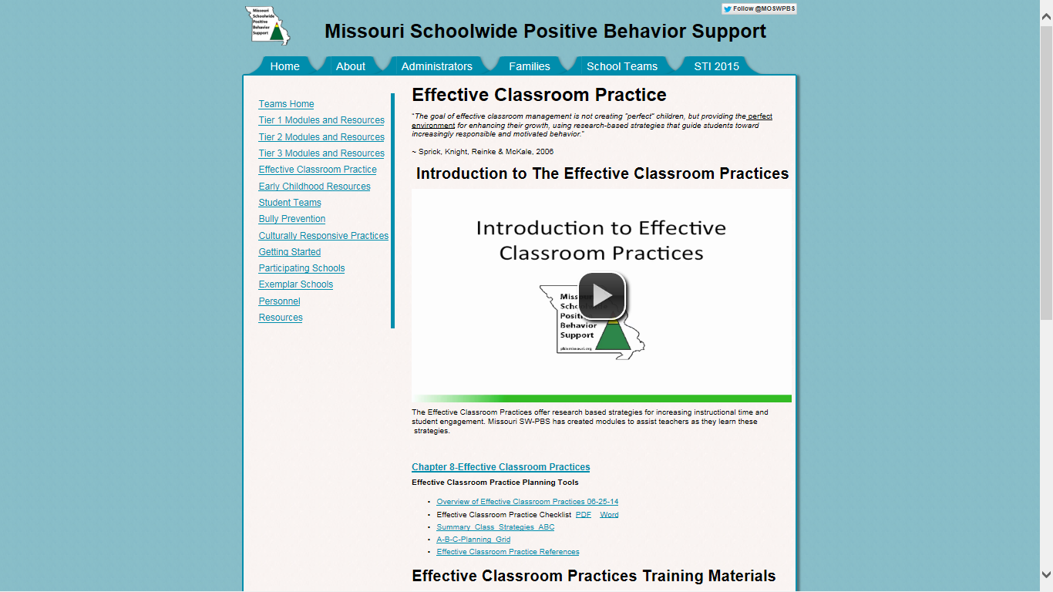
http://pbismissouri.org/educators/effective-class-practice

Slide 15
http://pbismissouri.org/archives/1243

Slide 16
Tier 1 Workbook
Workbook to teach school staff about Tier 1 implementation—content & forms
These effective classroom practices are embedded within chapters related to schoolwide implementation:
Classroom Expectations
Classroom Procedures & Routines
Encouraging Expected Behavior
Discouraging Inappropriate Behavior
These are addressed in Chapter 8: Classrooms
Active Supervision
Opportunities to Respond
Activity Sequencing & Choice
Task Difficulty
Notes:
Review and show. If they have attended Tier 1 training they will be familiar with the workbook

Slide 17
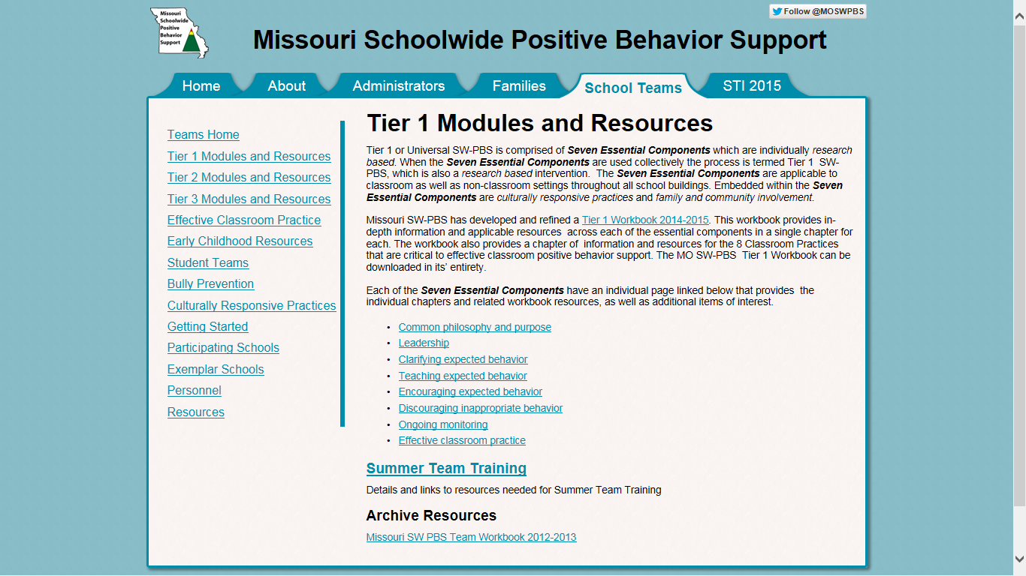
http://pbismissouri.org/teams/t1_workbook

Slide 18
Outcomes for Today
Become familiar with the Effective Classroom Practices
Become familiar with MO SW-PBS resources available to you to provide professional development for your staff on Effective Classroom Practices :
Content Acquisition Podcasts (CAPs)
Accompanying videos
Classroom Modules
Powerpoint, Activity Handouts & Teacher Tool
Tier 1 Workbook
Plan how the CAPs, videos, and modules can be used by your schools as part of your professional development plan.
Notes:
Here are our outcomes for today

Slide 19
Effective Professional Development
Research-based
Consistent, ongoing
Convenient
Relevant
Differentiated
Nobori, 2011
Notes:
Research-based – let research guide your strategies (SW-PBS is research-based, including the Tier 3 intervention that you will be implementing – FBA/BIP)
Consistent – create a long-term plan for PD and be consistent in the implementation across multiple years (The professional development you provide your staff will not be one-time at the beginning of the year before school starts. Staff development needs to be on-going, including new learning as well as “booster” sessions for review)
Convenient – schedule at a time that increases the likelihood of attendance (When will this be for your school? Your team will need to work closely with your administrator to ensure that professional development is a priority)
Relevant – focus PD on enhancing your school’s instructional model (Teachers will see a direct benefit in the improved behavior and positive relationships of the students participating in a Tier 3 intervention)
Differentiated – provide choices when possible. i.e. an instructional approach and a technology approach (Does all professional development in your school need to be face-to-face, large group? Is using technology such as podcasts and webinars an option? What are other possibilities?)

Slide 20
Quality Professional Development
Some characteristics:
Includes training, practice, feedback and coaching or other follow-up procedures/support
Provides opportunities for teachers to interact with peers
Ismat, 1996
Notes:
This is a partial list from the Eric Clearinghouse on Teaching and Teacher Education.
Did the teams identify a lot of the characteristics that were on these two slides?
You will see the impact of including training, practice, feedback, and coaching on the next slide.

Slide 21
Activity
Now is time for you to begin developing a strategic professional development plan to share with your team prior to the beginning of the school year.
Be specific - include names, dates, times and names of others who can make your plan to develop staff expertise happen!

Slide 22
Contact Information
Questions? Comments? Contact:
Linda Bradley, bradleyl@missouri.edu
Diane Feeley, feeleyd@missouri.edu

