Slide 1
Utilizing Effective Leadership To Sustain SW-PBS Practices: A Conversation from the frontline with Dr. Tim Roth
Tell us about little bit about Dr. Tim Roth and your initial experiences with PBS
Lessons from GBE, Blue Ribbon, and BIST

Slide 2
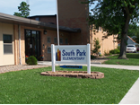
Tier I: The Early Years
South Park Elementary –the transition: Tell us a little about what PBS looked like at South Park when you took the helm.
In the beginning, there was a dream and only a dream without fidelity…Tier 1
Changing philosophies
Creating vision
Establishing Goals
Developing a leadership team
How did you do determine who would fit?
Building the system

Slide 3
Tier I: The First Full Year
You’ve talked about many systems that needed to developed…what were the biggest challenges that you faced during that first full year of implementation?
You want us to adopt what? Building commitment & securing buy-in…
The PBS Classroom walk throughs
Majors vs. Minors and everything in between
Punish vs. Reteach
Using the language of the Matrix

Slide 4
PBS Systems of Support
What systems have you determined are absolutely necessary to sustaining PBS in your building and how do you ensure that they are maintained?
Staff training
Recognition for students and STAFF
Assemblies and celebrations

Slide 5
Years 2 and 3: The Journey continues…
As you entered into Years 2 & 3, what changes did you notice in the building and how did it shape your thinking related to staff mobility?
Downward trend in referrals
Seeing success changes attitudes
A NEW culture emerges
Changes to the team and what “leaders” look like…what fits?

Slide 6
Tier 2
So managing one team of PBS building leaders is working, how challenging was it to develop another whole team and begin the process of thinking in a multi-tiered approach with behavior?
PLC, RTI and PBS

Slide 7
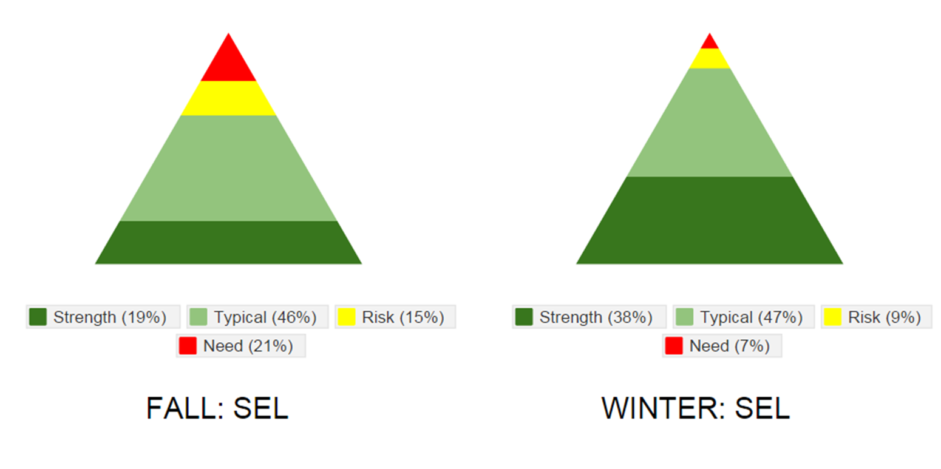
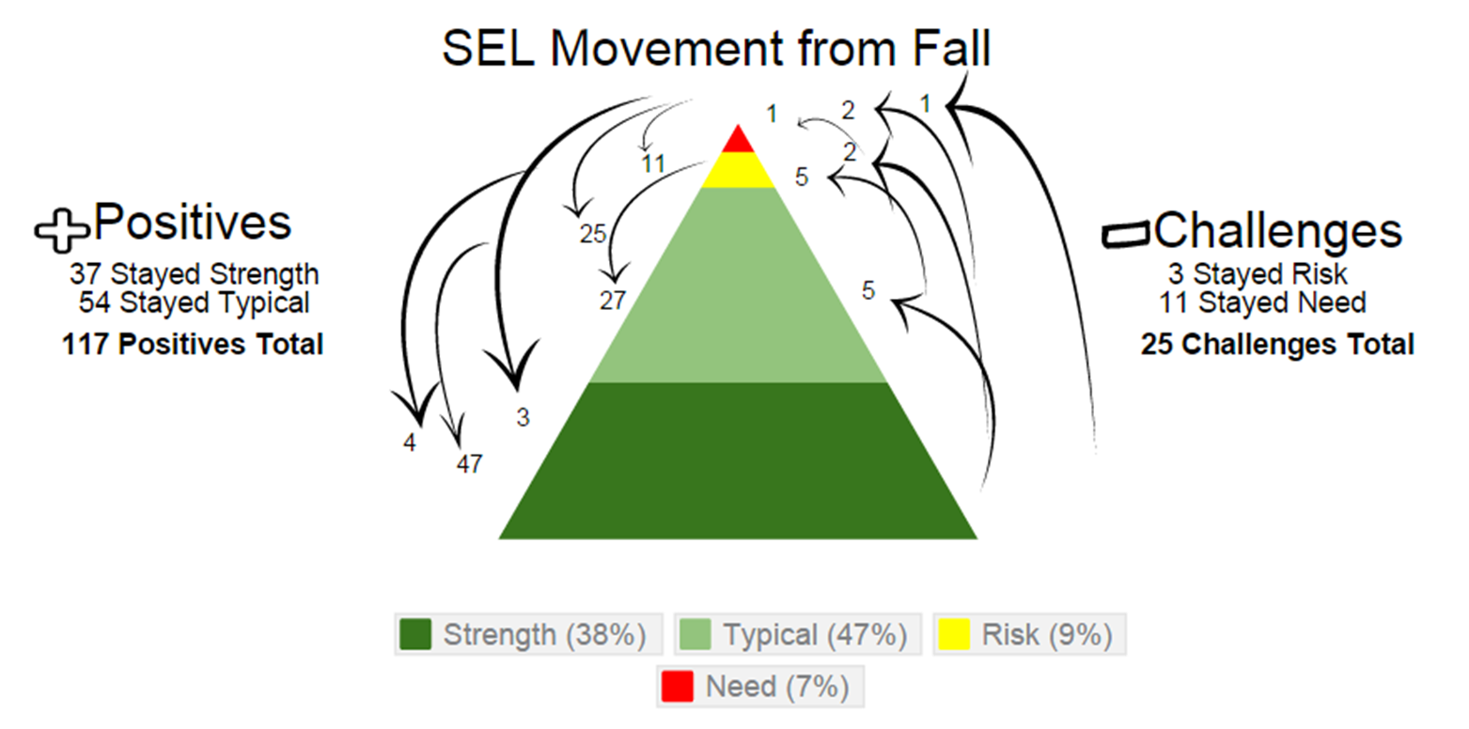
Triangle Graphs for Intervention Planning

Slide 8
3 Tiers and MORE! PBS, RTI, and Social Emotional Learning, oh my…
How did you as a leader help not only the PBS teams but the building level teams to embrace the multiple, simultaneous initiatives that ALL districts and buildings find co-existing?
Maintaining morale (encouraging the encouragers)
Revitalizing the PBS practices & encouraging creativity
Bucket filling and PBS

Slide 9
Bucket Filling Rap
Enjoy our PBS Leaders Show Their Talent

Slide 10
Greatest SW Impacts
What practices have you supported that you identify now as having made a significant impact on the building culture and student success?
Effective classroom practices and the PSF focus
The Social Emotional Research Project
Parent Involvement and support

Slide 11
Growing the Leader
What have you done personally and professionally to maintain the positive influence and style of leadership that supports your building culture?

