Slide 1
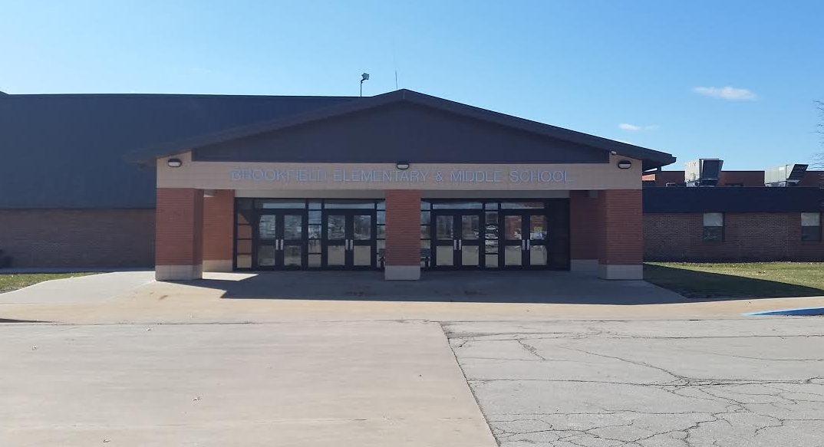
Ensuring the Presence and Fidelity of Effective Classroom Practices to Increase Positive Student Behavior
Notes:
Greeting
Introductions
Demographics of our school.

Slide 2
This presentation is an overview of the year long process the Brookfield Middle School Tier 1 PBS team used to determine whether effective classroom practices were used in all classrooms, and if they were being implemented with fidelity.
The outcome is to provide you with a beginning framework to use in your building to assist in looking at effective practices, determine fidelity, and to provide professional development.

Slide 3
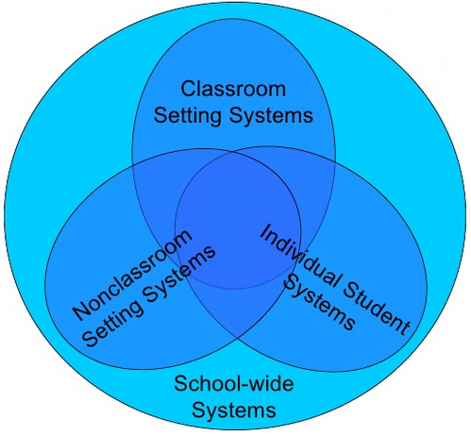
2013-2014 SAS Data
83% School-wide
87% Nonclassroom
76% Classroom
Notes:
At the end of last year, 2013-2014, we received our results from our SAS. We had made a lot of improvements especially in our non-classroom settings where we had put in a lot of work. What we noticed was that our Classroom systems were not quite where we wanted them to be and as a Tier 1 team and then entire staff decided we would focus on this for the 2014-2015 school year.

Slide 4
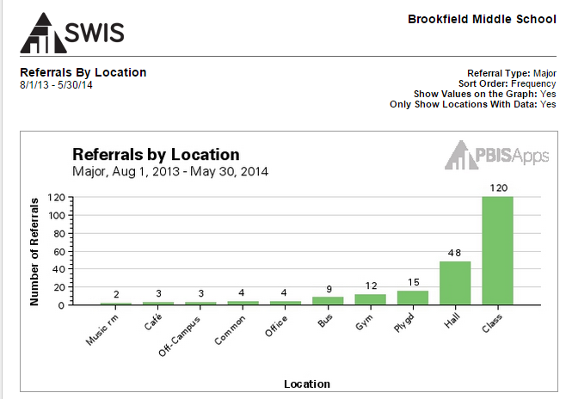

Slide 5
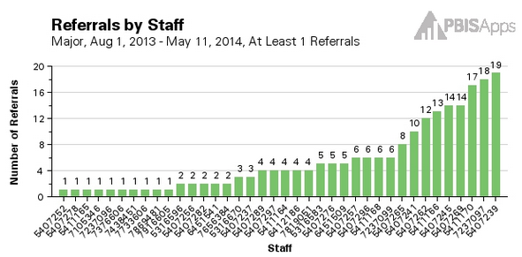
Notes:
This chart shows our referrals for the 2013-2014 school year. The bottom numbers represent our staff which equaled 29. The numbers resting on top of the bars represent the number of Office Discipline Referrals each teacher had. As you can see we ranged from 0-27. Our average was 7.5 per teacher, which is almost 2 per quarter. That doesn’t sound too terrible, but for the person who had 27 that is 7 per quarter. The team hoped that working on the classroom systems would help decrease ODRs.

Slide 6
Active Supervision
Classroom Expectations
Encouraging Expected Behavior
Classroom Procedures & Routines
Discouraging Inappropriate Behavior
Activity Sequencing & Choice
Opportunities to Respond
Task Difficulty
Notes:
Front Loading Prior to the 2014-2015 School Year:
Initial Training in Year 1 2012-2013
Year 2:
Brief Overview of all 8 practices at weekly faculty meetings
More in depth training on 4 of the 8 practices

Slide 7
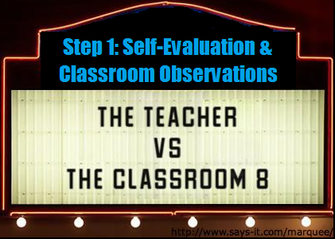
Notes:
Our Tier 1 team decreased the amount of time we were meeting this school year from bi-monthly to only once a month. Partially due to this change we started this adventure much later than intended.
The first part of our journey focused on the teacher and their practices.

Slide 8
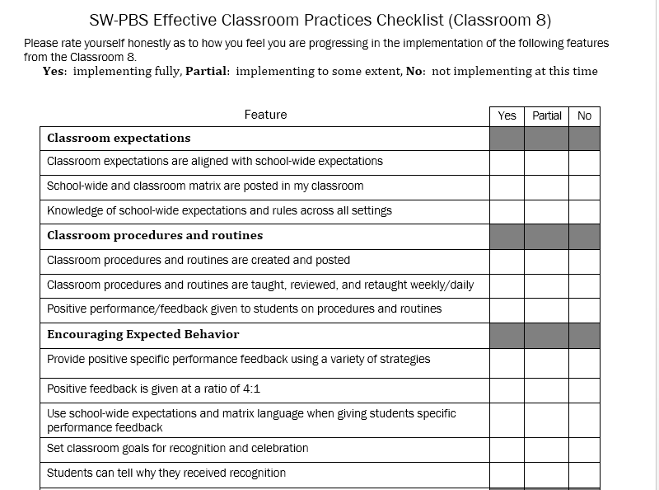
Effective Classroom Practices Checklist
Notes:
We started with the Missouri School-wide Positive Behavior Support Effective Classroom Practices Checklist that is provided in training. We wanted more information, so we scoured other PBIS sites and found others with additional items for reflection and then created one that best fit our needs.
Teachers filled out the checklist and the data was compiled and disseminated by the Tier 1 team.

Slide 9
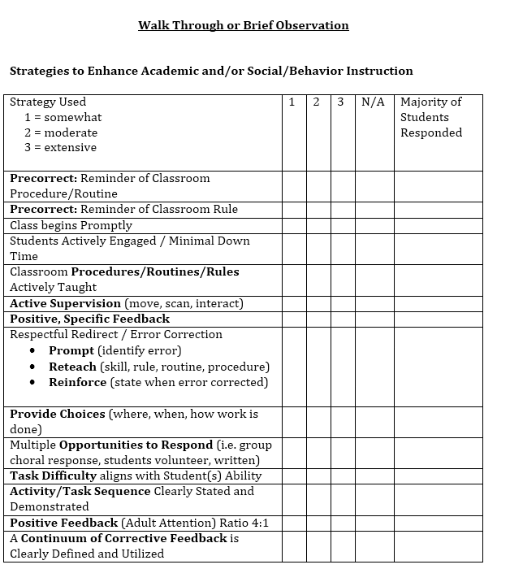
Walk Through or Brief Observation
Notes:
This document came directly from MO PIBS. Our Tier 1 team split up our staff and did a 15-20 minute observation during their plan time.
Team members filled out the checklist and the data was compiled and disseminated by the Tier 1 team.
This is one area that I would improve upon for next year. We did not do a good enough job of previewing each of the items on the survey so the team had a clear understanding of what they were looking for. This came up in conversation when we disseminated the information.

Slide 10
When Giving the Survey & Observing
Make sure the staff knows it is NOT an evaluative tool
Encourage honest evaluation of individual practices
Preview each of the items on the survey so staff have a clear understanding
Explain how the data will be used to target specific needs for staff development

Slide 12
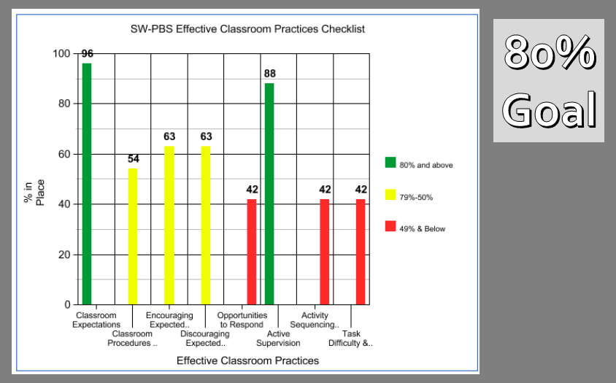
Notes:
Here are the results of the teacher self-reflection. We were not surprised that Activity Sequencing & Choice and Task Difficulty were lower because we did not get to that in depth training until this year and teachers were just beginning to focus on it. The biggest surprise was the Opportunities to Respond. There had been multiple trainings offered over the past 3 years on this topic.
The team noted the following:
Classroom procedures are usually taught at the beginning of the year but in the MS they don’t consistently review them
Encouraging expected behavior was also lower than expected but the team noted that our Positive Specific Praise 4:1 really brought the score down
Discouraging was also low and the team noted that teachers were not utilizing the continuum they had been given, were unsure about minors (we just started this year), and felt that they were not getting a good breakdown of our SWIS data monthly
Our active supervision was high which was not surprising since it was the big focus of the previous year
Our 3 expectations are in good shape

Slide 13
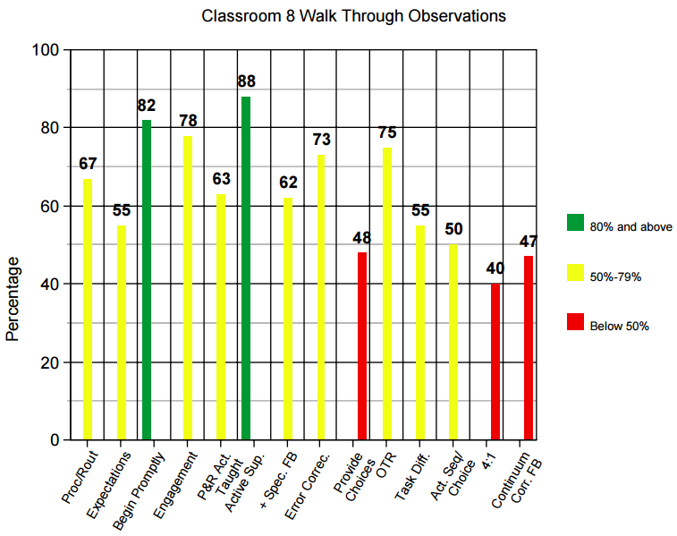
Notes:
Here are the results of our classroom walk-through observations.
The team noted the following:
Active Supervision was once again high
Class beings promptly
Our scores were also low in Task Difficulty & Activity Sequencing & Choice
We weren’t going over our expectations/procedures/routines similar to the other data
Classroom procedures are usually taught at the beginning of the year but in the MS they don’t consistently review them
Positive Specific Praise 4:1 was one of our bottom 3 similar to checklist data
Continuum of Corrective Feedback was one of our bottom 3 similar to the checklist data
Provide Choice was also one of our bottom 3

Slide 14
Present Data to Staff
Show:
Strengths
Areas to develop
How the team is using the data to guide professional development
What are the next steps?
Notes:
The data for both was presented to the staff quickly after being disseminated and was placed in the staff newsletter so they could see visuals.
One thing the team will need to look at for next year is the space between the checklist/observation being done and when the data is shared with staff. We did a pretty good job, but only meeting once a month puts restrictions on how quickly we can get together to disseminate.

Slide 15
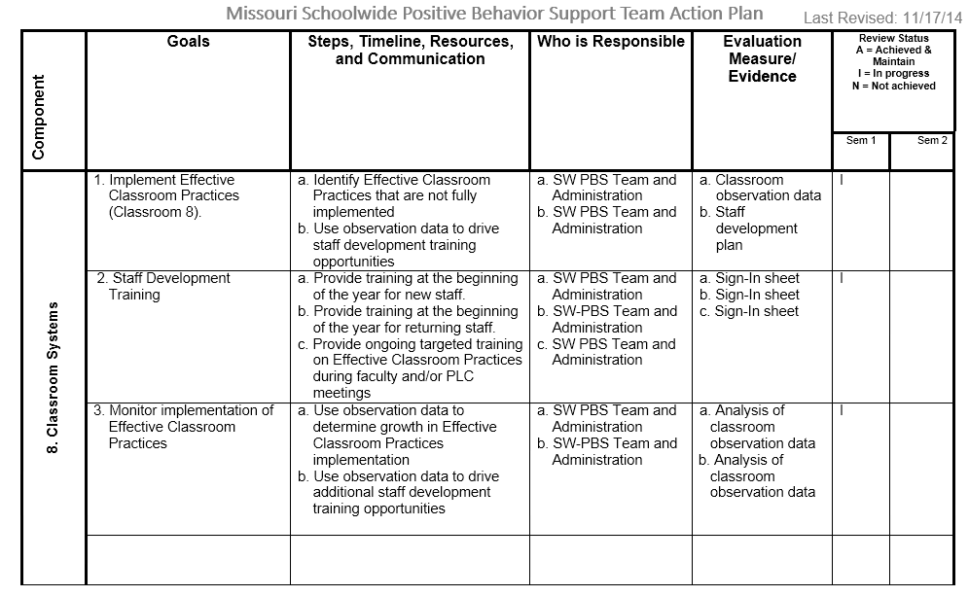
Utilize the Action Plan
Notes:
We reviewed our Action Plan at the beginning of this last school year and realized that we had not sufficiently addressed our Classroom Systems. That could be one reason why we had not made much progress in this area. We revamped it in hopes that having a better structured system would help us move in the right direction.

Slide 16
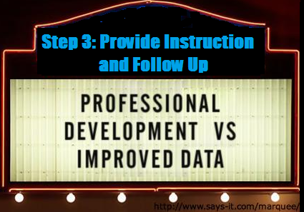
Notes:
Now that the data had been discussed it was time to provide some professional development.

Slide 17
Professional Development
Year 3:
Looked back at the 4 practices we trained on from the previous year
Provided more in depth training on the remaining 4 practices
Active Supervision
Opportunities to Respond
Activity Sequencing & Choice
Task Difficulty
Provided PBS Work Sessions
Positive Specific Feedback 4:1
Continuum of Corrective Feedback
Providing Choice
Open Forum
Notes:
What had been previously provided:
Student Engagement Seminar (included Opportunities to Respond)
Let’s Move (Classroom Procedures/Routines)
Cooperative Learning
Quick overviews of the 8 Effective Classroom Strategies
Quick overviews of the Guiding Hand
It was determined in the spring of 2014 that teachers appreciated a more laid back approach to PD, so PBS Work Sessions were developed. These sessions still had a focus to drive the group, but also allowed for a lot of conversation and support.

Slide 18
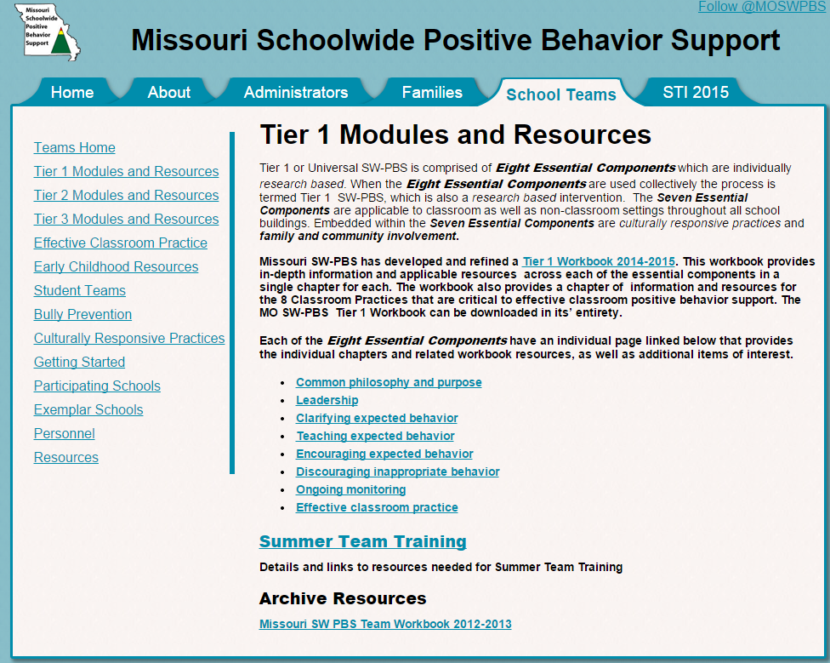
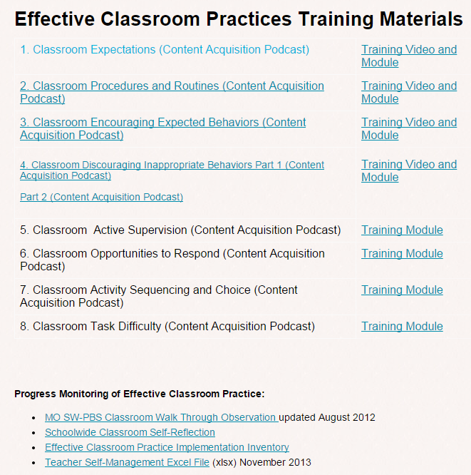
Professional Development Tools
pbismissouri.org
Notes:
The tools that were used for PD were found at pbismissouri.org.

Slide 19
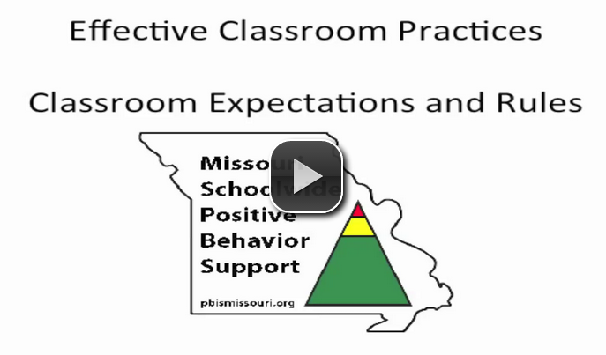
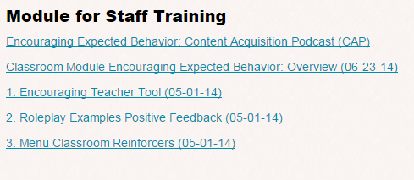
Professional Development Tools
pbismissouri.org
Notes:
They now have videos and podcasts for some of the effective strategies to help support teams and staff. There are also many tools provided to help you lead your team/staff through your PD. One of the best tools is the “Teacher Tool” found in each module.

Slide 20
What Makes PD Successful?
Know your staff
Build on the existing PBS system in the building
Utilize the SWPBS team
Use data to justify
Adopt evidence based practices
Provide follow up to ensure fidelity (Instructional Coach/Peers/Grade Level Teams)
Review and monitor
Acknowledge improvement and success
Notes:
Having an Instructional Coach helps because they have the flexibility to be in rooms to help support best practice.

Slide 21
Link PD to Teacher Evaluation
The Classroom 8 and the Marzano Model
Expectations & Rules:
#4: Establishing Classroom Routines
Procedures & Routines:
#4: Establishing Classroom Routines
#5: Organizing the Physical Layout of the Classroom
Continuum of Strategies to Acknowledge Appropriate Behavior:
#33: Demonstrating “Withitness”
#35: Acknowledging Adherence to Rules & Procedures
#37: Using Verbal & Nonverbal Behaviors that Indicate Affection for Students
# 38: Displaying Objectivity & Control
Continuum of Strategies to Acknowledge Inappropriate Behavior:
#33: Demonstrating “Withitness”
#34: Applying Consequences for Lack of Adherence to Rules & Procedures
# 38: Displaying Objectivity & Control
Active Supervision:
#5: Organizing the Physical Layout of the Classroom
#24: Noticing When Students are not Engaged
#33: Demonstrating “Withitness”
#34: Applying Consequences for Lack of Adherence to Rules & Procedures
#35: Acknowledging Adherence to Rules & Procedures
Multiple Opportunities to Respond:
#25: Using Academic Games
#26: Managing Response Rates
#40: Asking Questions of Low Expectancy Students
Activity Sequence & Offering Choice:
#24: Noticing When Students are not Engaged
Task Difficulty
Lesson Segment: Addressing Content
Notes:
Our district adopted the Marzano teacher evaluation model. Pairing PBS with this model helped teachers see that they were not two different things. When you were working on Marzano you were actually working on PBS. This was a nice connection that helped the staff feel that they were making progress with PBS.

Slide 22
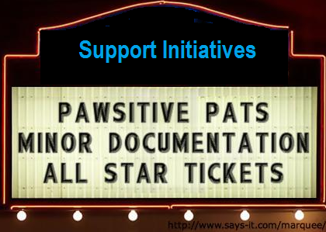
Notes:
These three initiatives help support our advances in our Tier 1 systems.

Slide 23
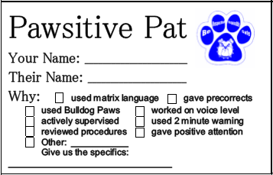
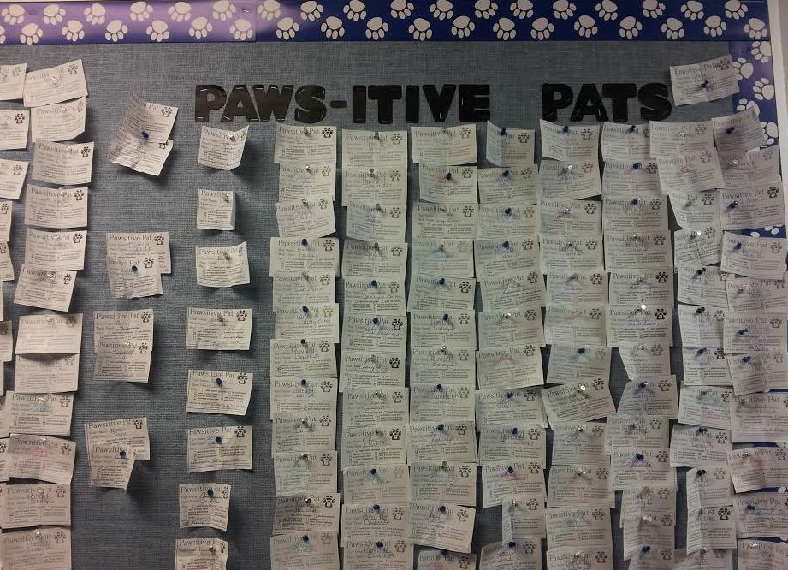
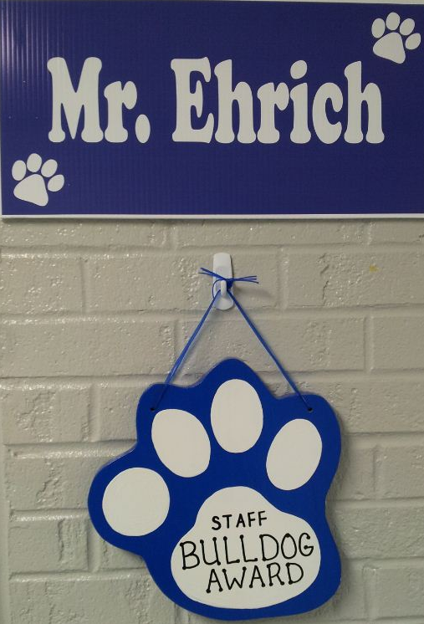
Pawsitive Pats
We use this recognition for our staff when they exhibit PBS procedures, strategies, and interventions. When a teacher sees a teammate “Being a Bulldog” from the teacher standpoint they complete the form and hand it in. Each week at the faculty meeting one “pat” is drawn. The person who wrote the pat and the person recognized get to park in the front two spots in the lot! A paw is also hung outside their doors for everyone to see! When we reach 500 tickets as a staff everyone receives a small recognition.
Notes:
This was the first year we had the parking spot and it has been a huge hit, especially when it was cold! It had been suggested many times but it took a little time to get the logistics figured out. Adding this helped make the teachers feel that their voice was heard.

Slide 24
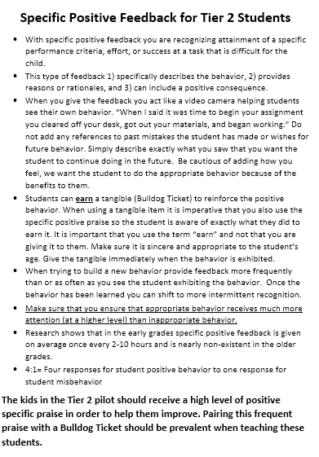
Minor Documentation
The middle school team piloted the CICO intervention. Through this pilot there was additional work with Positive Specific Feedback 4:1 and the Continuum of Corrective Feedback.
Notes:
These two specific items are really key in changing student behavior. Our first pilot there was not a large focus on this, but in our second pilot there were more prominent behaviors and it was decided that this would be an addition to our teacher training.

Slide 25
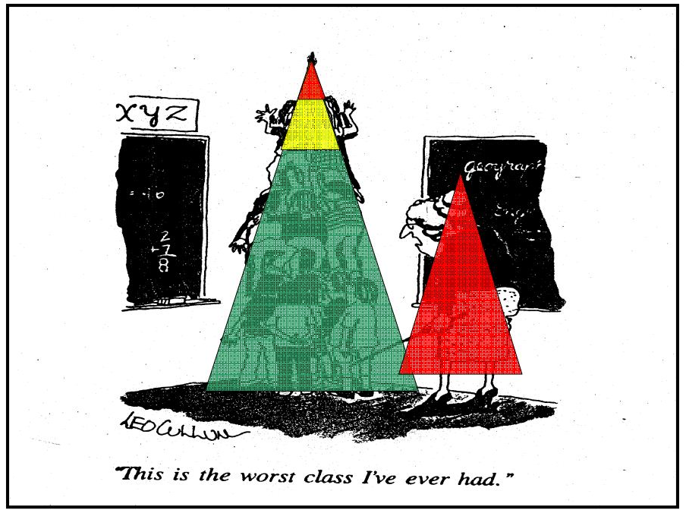
All Star Tickets
The 4th quarter is a difficult time for both teachers and students. To bring awareness to recognizing expected behaviors teachers were given a challenge. Each week they were to set a goal for each class, work on recognizing students to meet the goal, and then sign the recognition poster at the weekly faculty meeting. Teachers received a small tangible and their names were announced on the intercom.
Notes:
The first week we only had a handful of teachers who met the challenge. The second week we had a dozen.

Slide 27
2013-2014 SAS Data
83% School-wide
87% Nonclassroom
76% Classroom
2014-2015 SAS Data
90% School-wide
95% Nonclassroom
81% Classroom

Slide 28
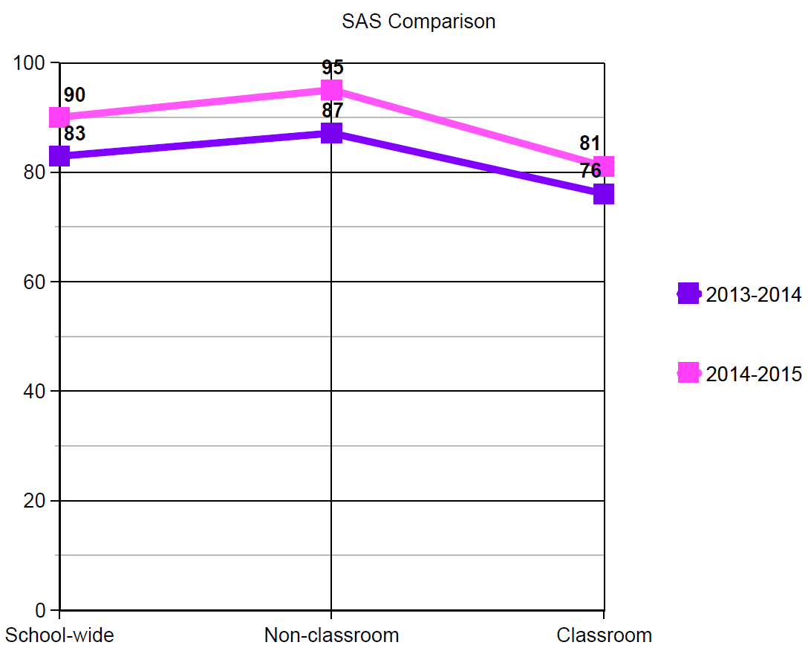

Slide 29
SAS Summary
Schoolwide
Notes:
The first week we only had a handful of teachers who met the challenge. The second week we had a dozen.

Slide 30
SAS Summary
Non-classroom
Notes:
The first week we only had a handful of teachers who met the challenge. The second week we had a dozen.

Slide 31
SAS Summary
Classroom
Notes:
The first week we only had a handful of teachers who met the challenge. The second week we had a dozen.

Slide 32
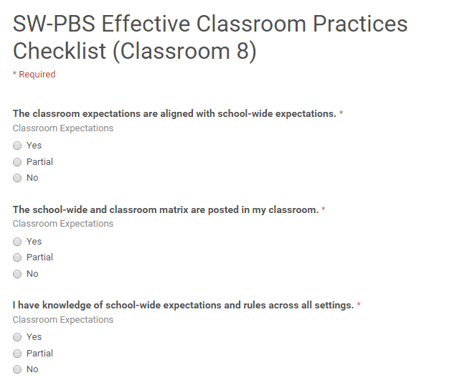
Effective Classroom Practices Checklist
We turned it into a
Google Form!
Notes:
We started with the Missouri School-wide Positive Behavior Support Effective Classroom Practices Checklist that is provided in training. We wanted more information, so we scoured other PBIS sites and found others with additional items for reflection and then created one that best fit our needs.
Teachers filled out the checklist and the data was compiled and disseminated by the Tier 1 team.

Slide 33
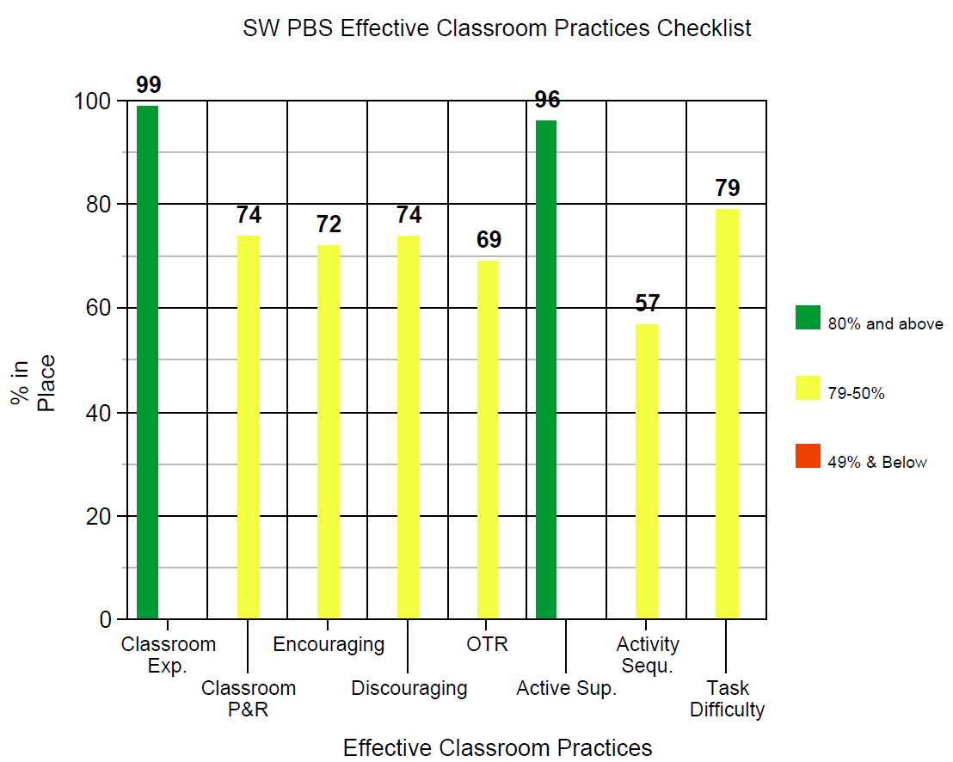

Slide 34
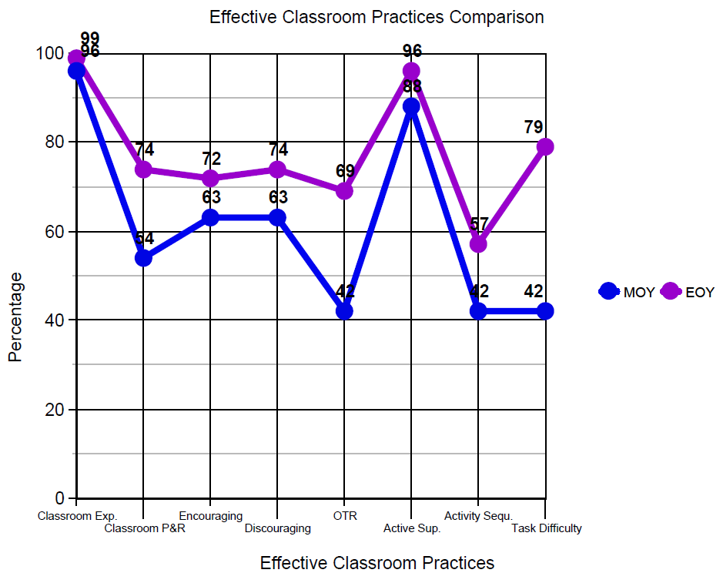
-Yes

Slide 35
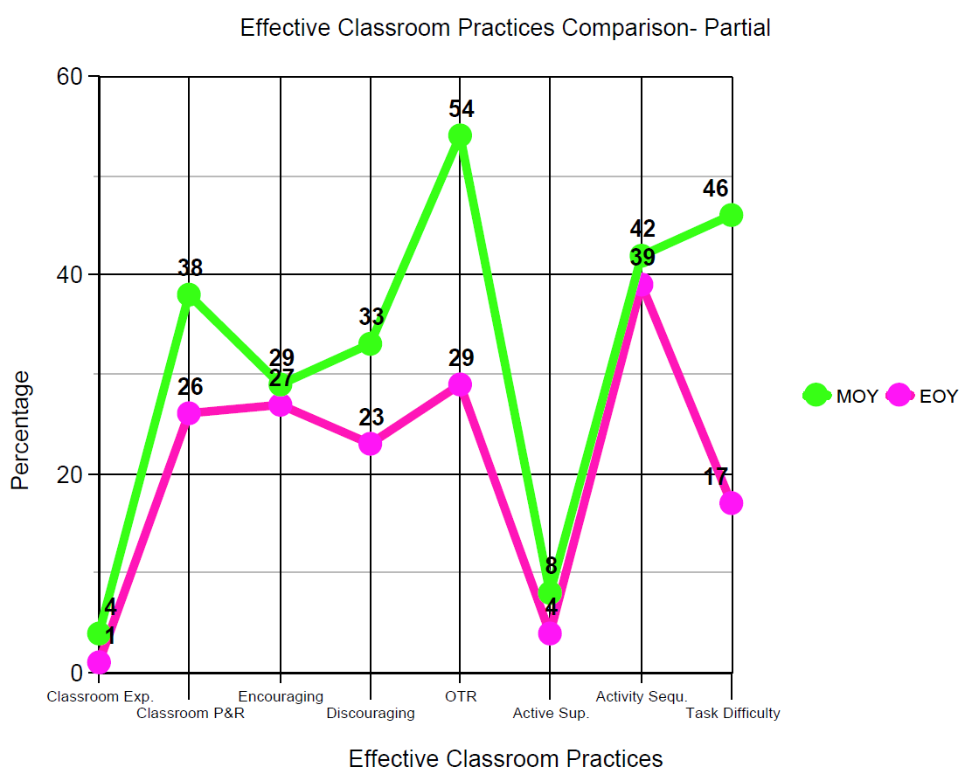

Slide 36
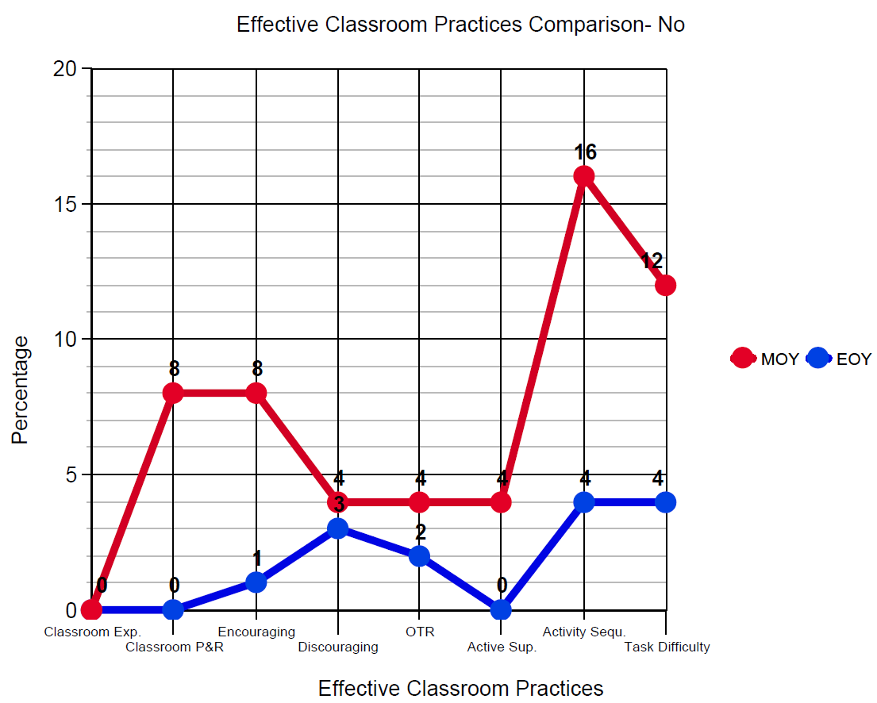

Slide 37
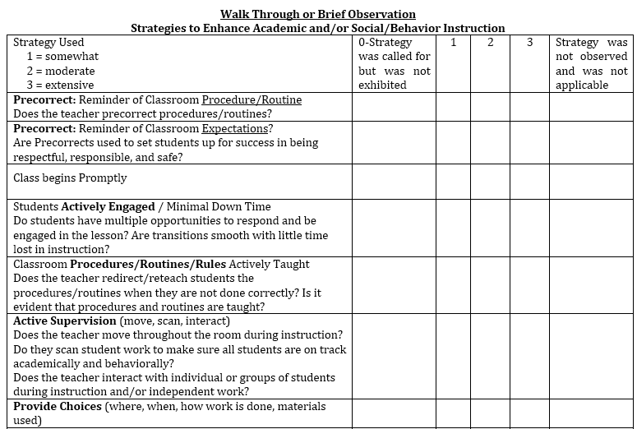
Walk Through or Brief Observation
We made it
more specific!
Notes:
This document came directly from MO PIBS. Our Tier 1 team split up our staff and did a 15-20 minute observation during their plan time.
Team members filled out the checklist and the data was compiled and disseminated by the Tier 1 team.
This is one area that I would improve upon for next year. We did not do a good enough job of previewing each of the items on the survey so the team had a clear understanding of what they were looking for. This came up in conversation when we disseminated the information.

Slide 38
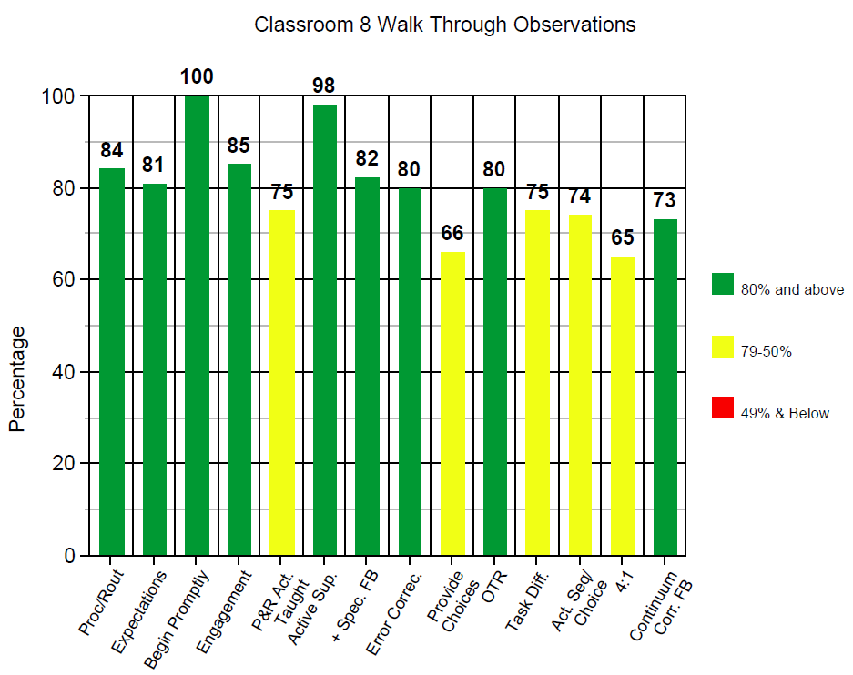

Slide 39
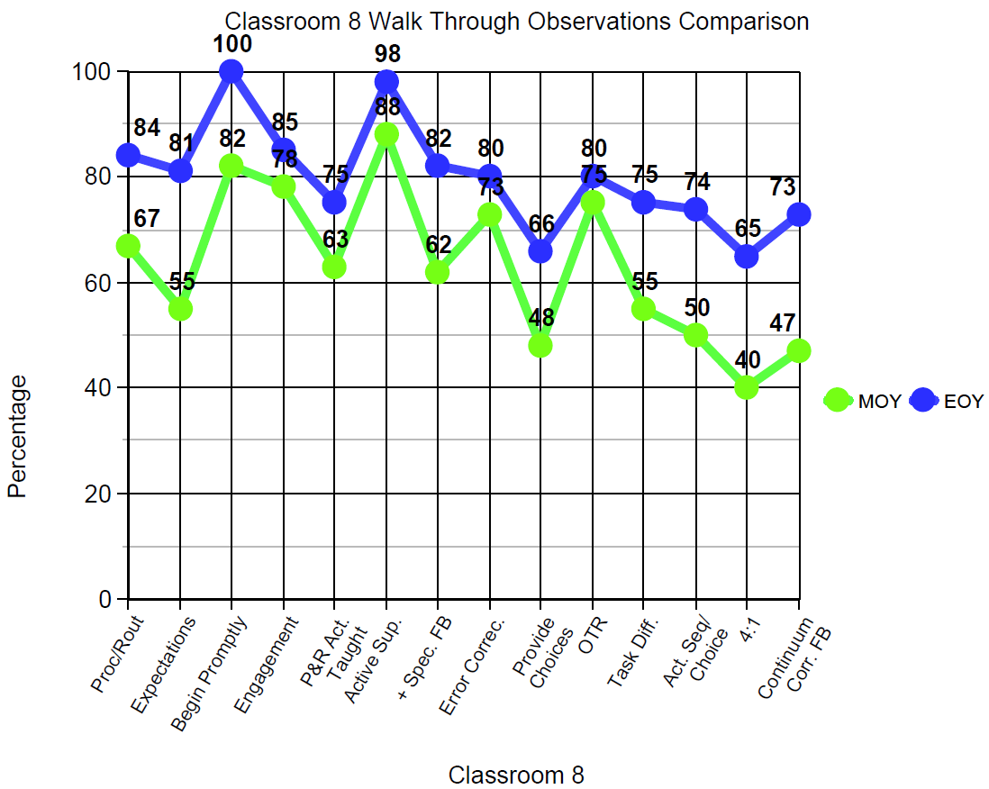

Slide 40
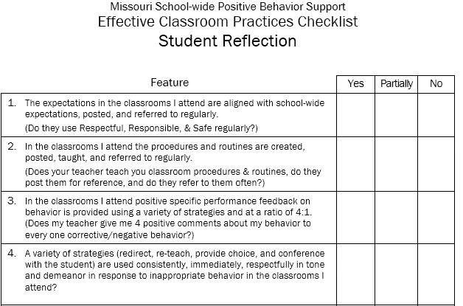
Student Reflection

Slide 41
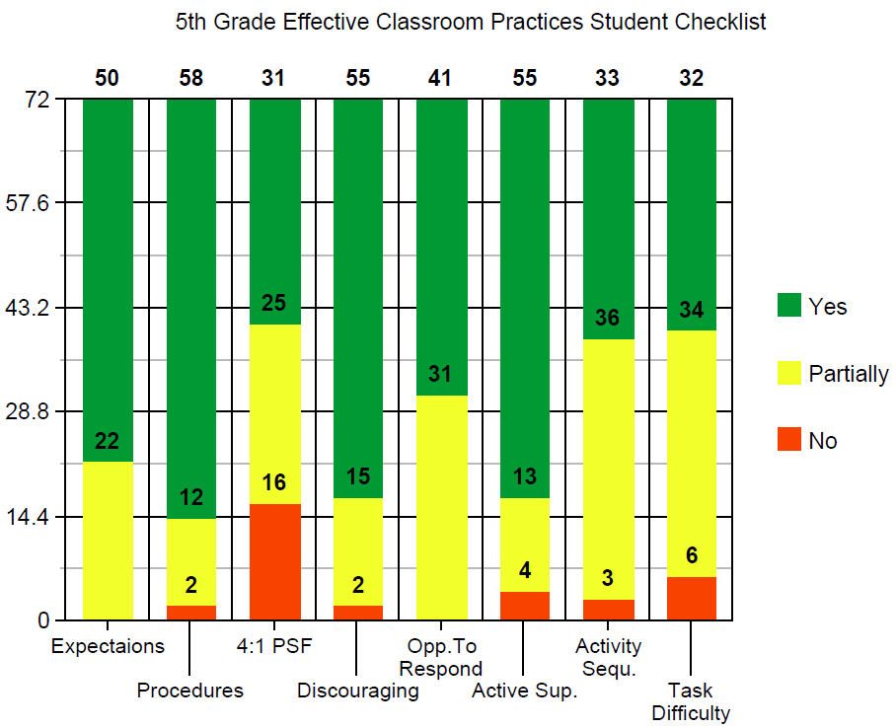
Student Reflection

Slide 42
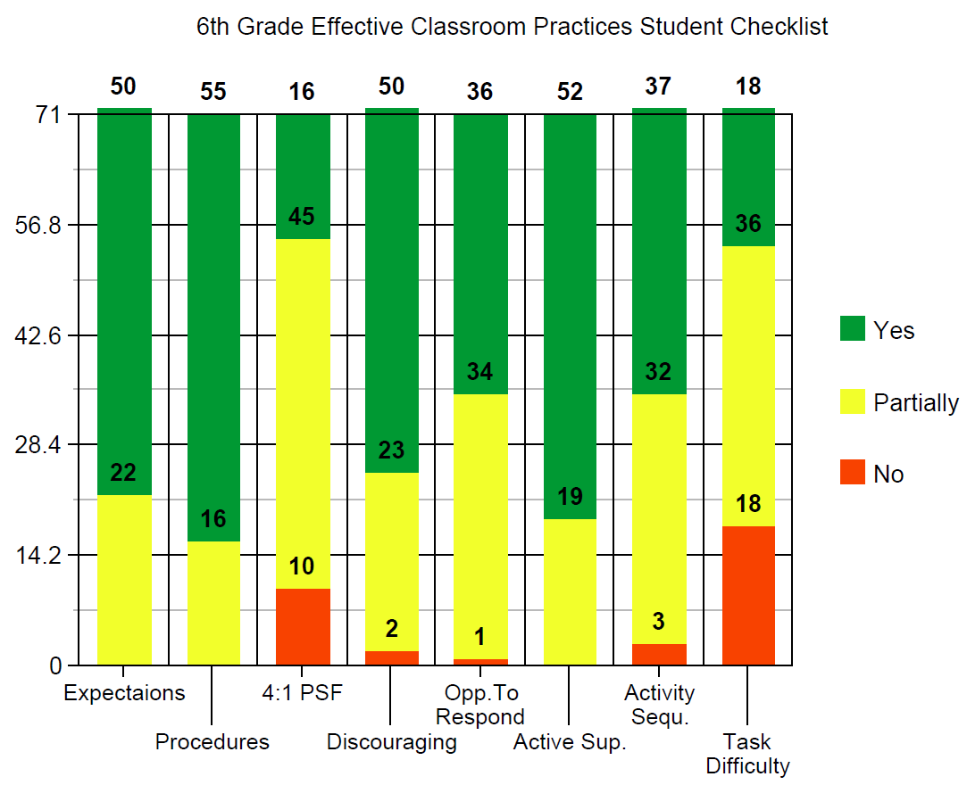
Student Reflection

Slide 43
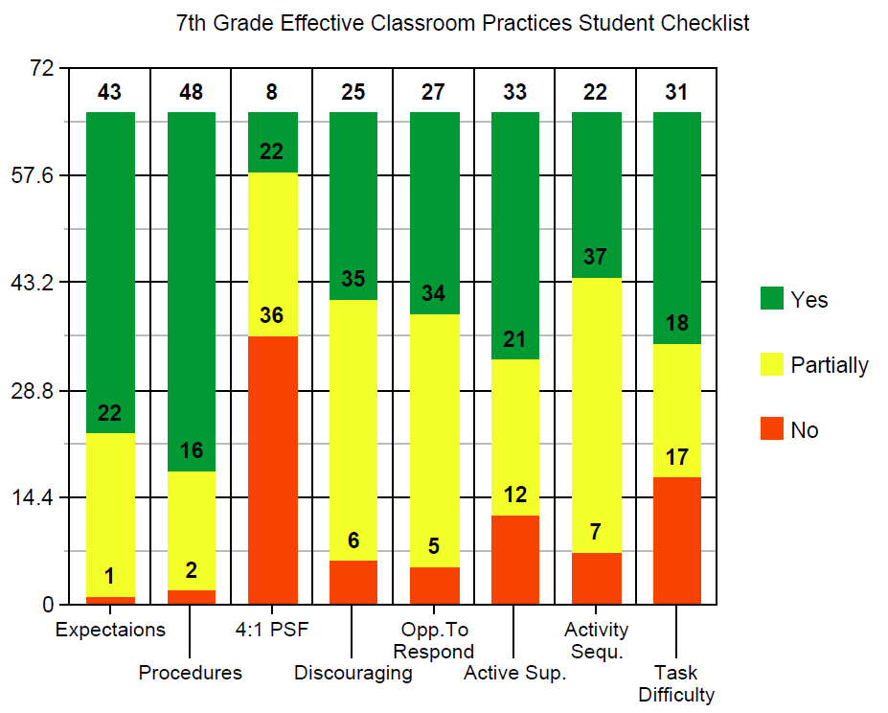
Student Reflection

Slide 44
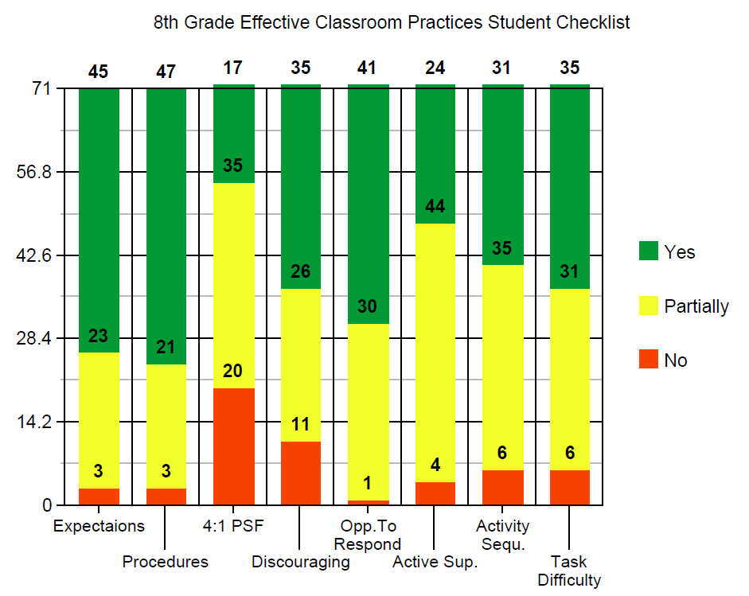
Student Reflection

Slide 45
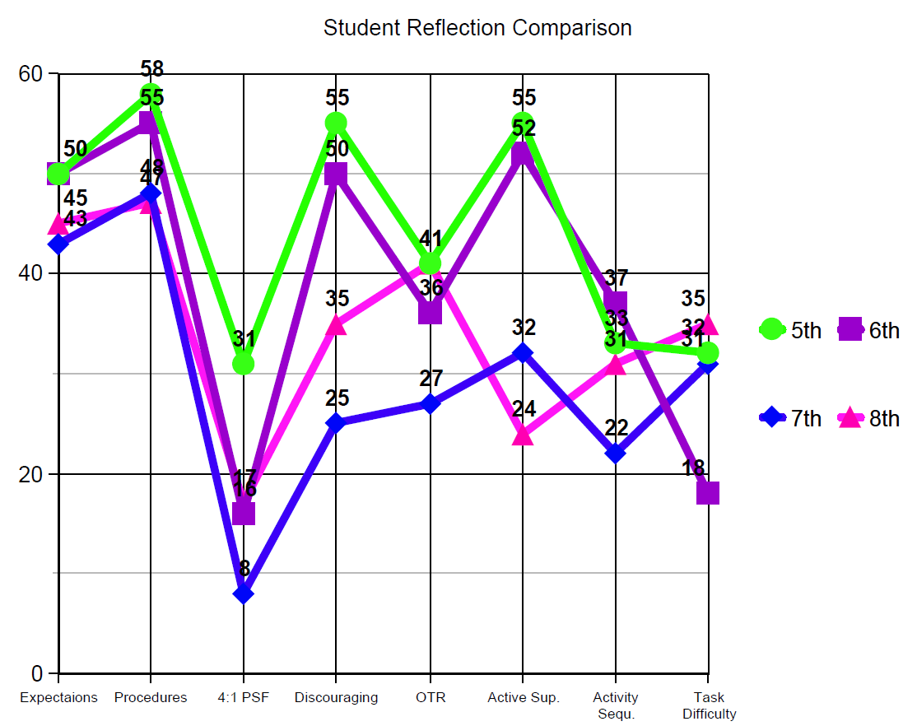

Slide 46
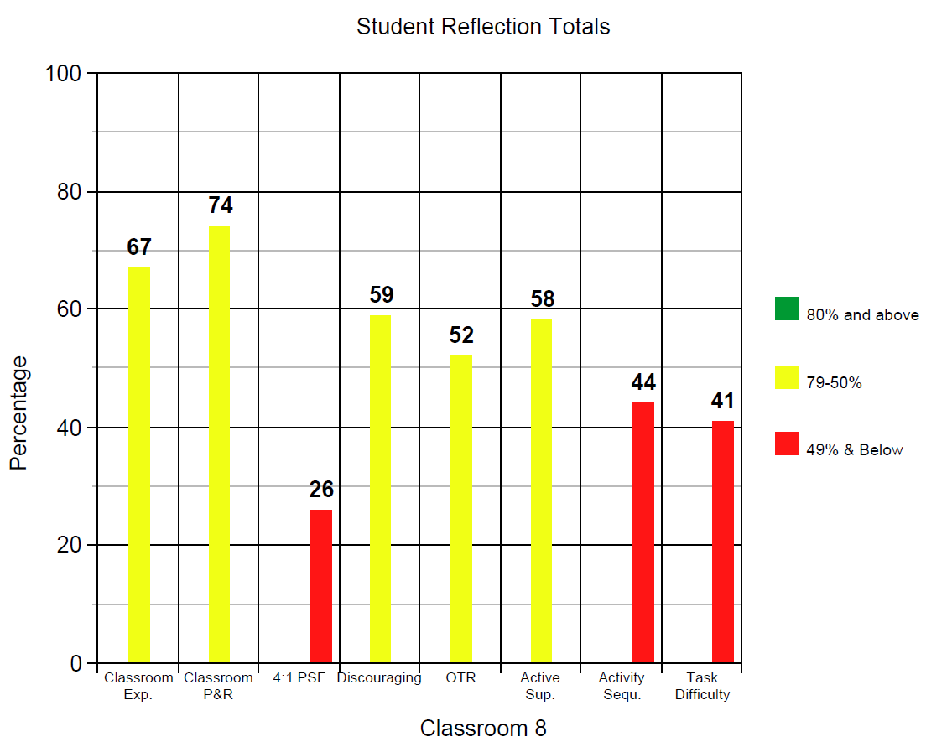
Overall Percentage Per Grade
5th: 62%
6th: 55%
7th: 45%
8th: 48%

Slide 47
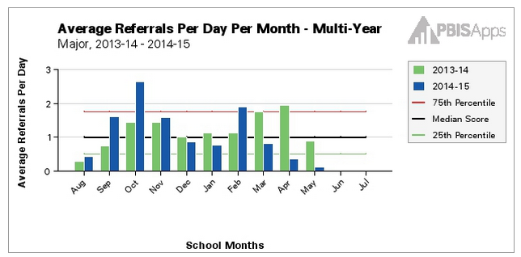

Slide 48
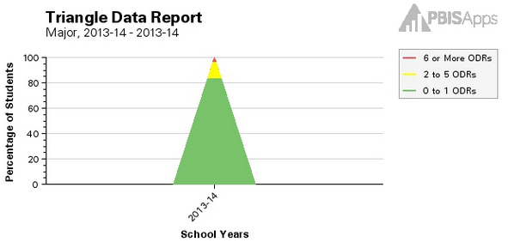
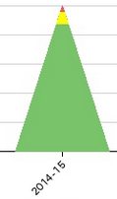

Slide 49
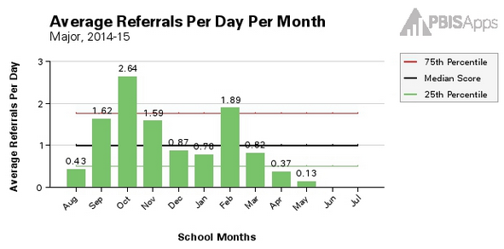
Notes:
1st Semester an average of 1.43 referrals per day
2nd Semester an average of .798 referrals per day (incomplete for May)

Slide 50
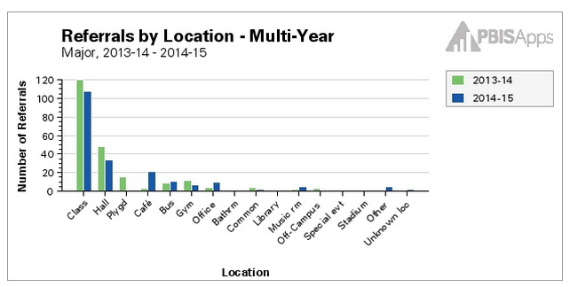

Slide 51
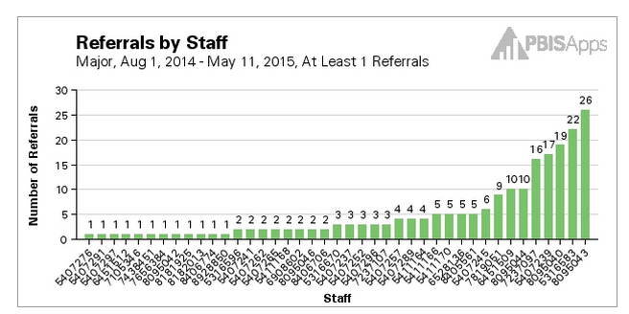

Slide 52
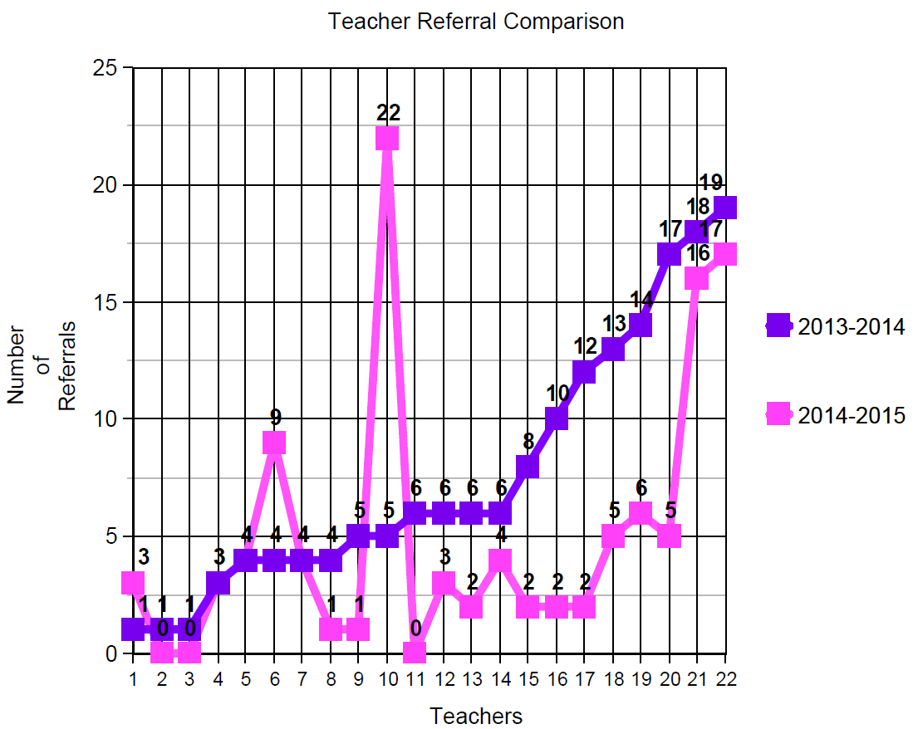

Slide 53
What Went Well
The staff became more aware of the effective classroom practices
Professional development was provided based on data
The Tier 1 team had great discussions about the practices after
doing observations
Forms were modified to make sure everyone was on the same page
and getting more accurate data
Data improved

Slide 54
Improvements for Next Year
Timeline of the process- start earlier in the year
Look at the observation tool, self-reflection, and student reflection
to make adjustments/improvements
Plan end of year observations earlier so we stay away from testing
Plan professional development each quarter and get teachers a
calendar
Make more time available for support and follow up
Give the students more information on the Classroom 8

Slide 55
You can find the this Powerpoint and the documents we used at this site:
https://sites.google.com/site/brookfieldriiimiddleschoolpbs/home
Respectful
Safe
Be A Bulldog
Responsible
For further support you can contact:
Katie Andreasen, Middle School Instructional Coach and PBS Tier 1 Coach
kandreasen@brookfield.k12.mo.us
(660)258-2159

