Slide 1
Your Turn

Slide 2
Step 1: Choose a desired outcome

Slide 3
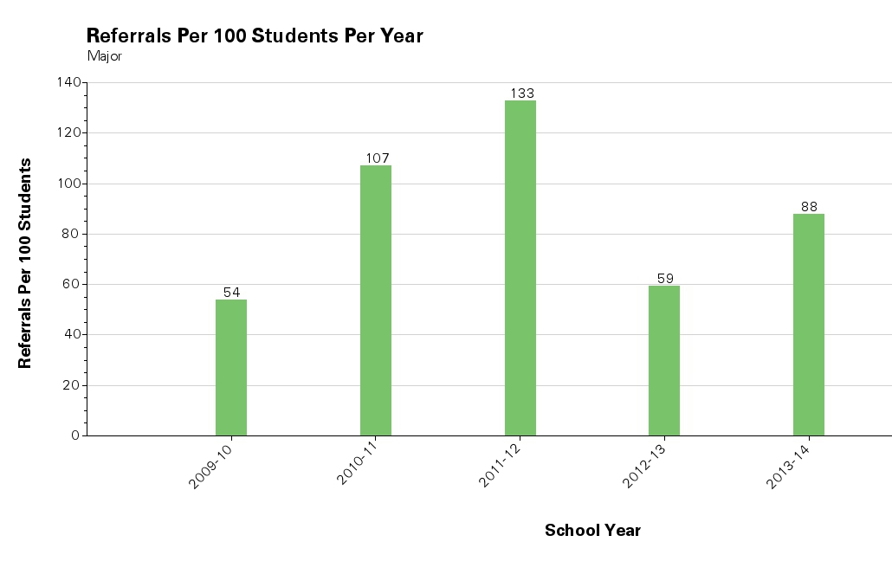

Slide 5
Step 2: Identify Current Status

Slide 6
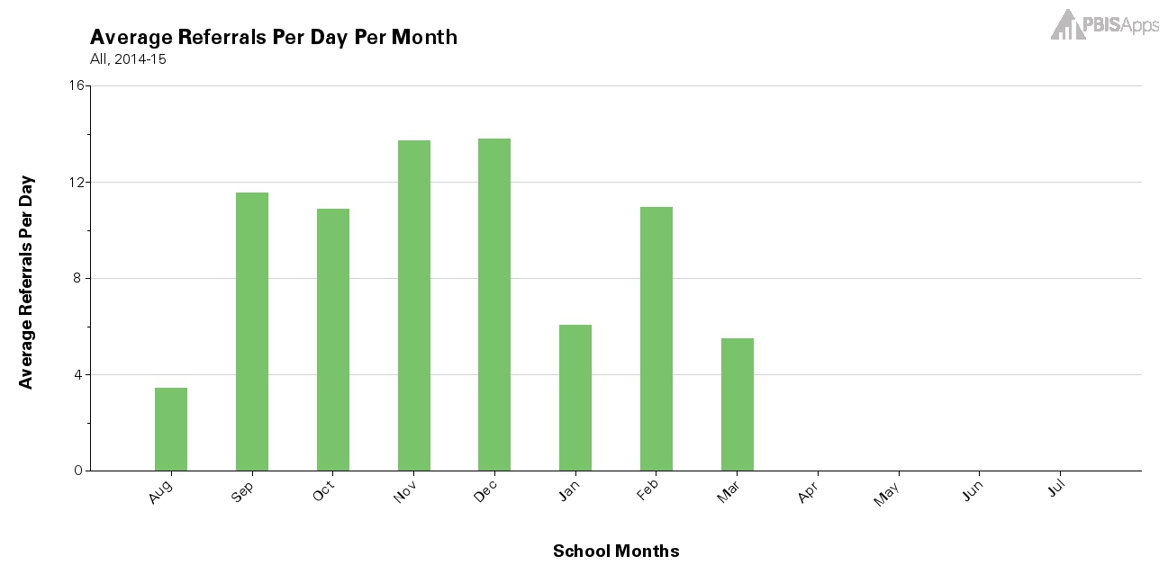

Slide 7
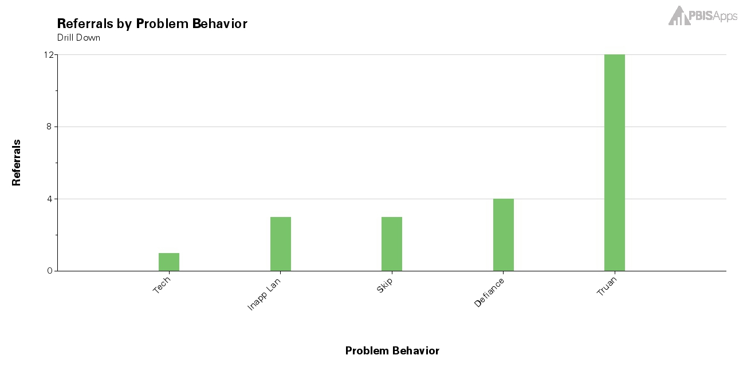

Slide 8
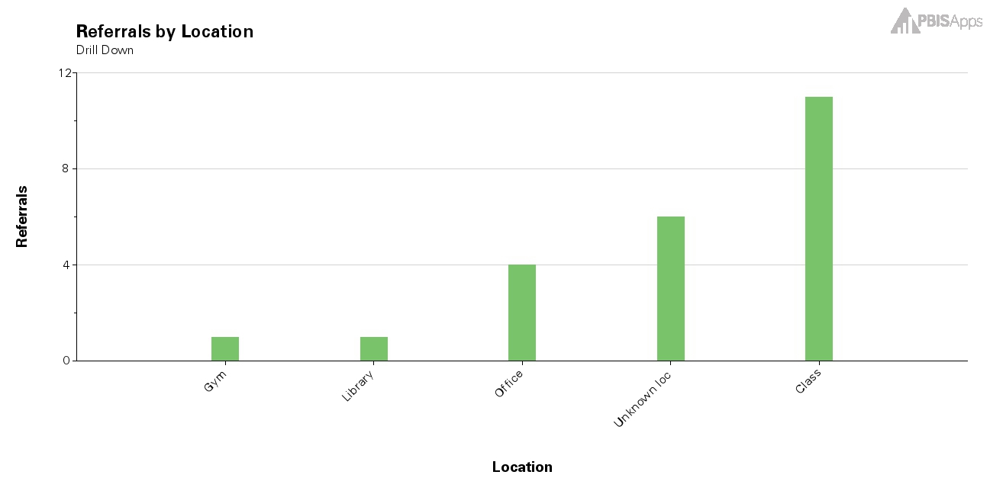

Slide 9
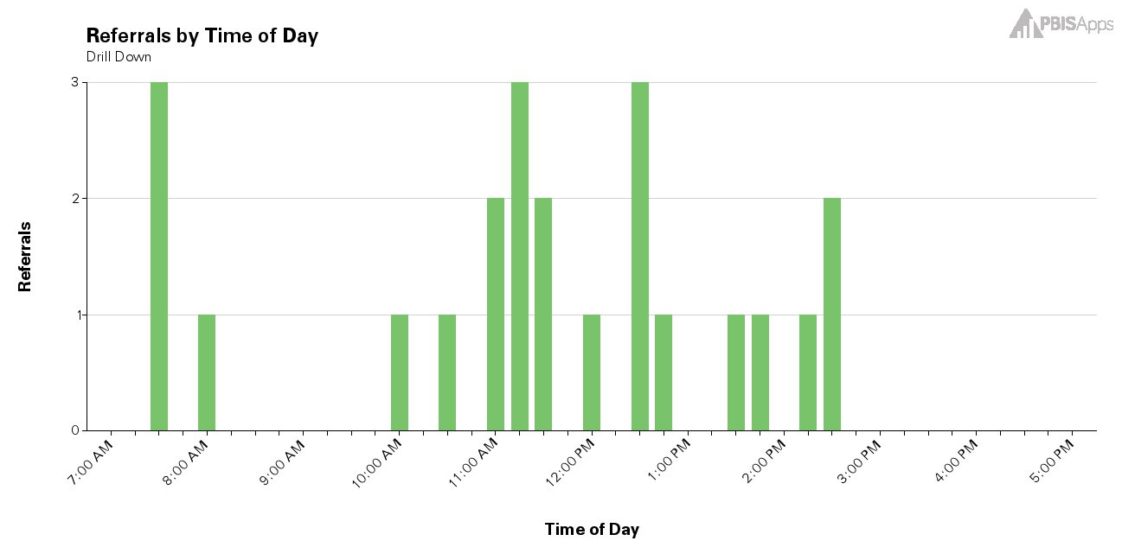

Slide 10
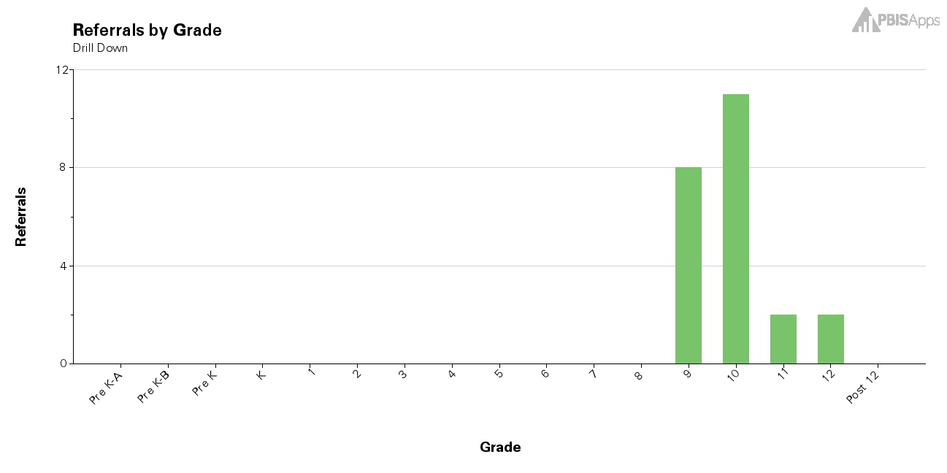

Slide 11
Step 3: Analyze

Slide 12
Truency

Slide 13
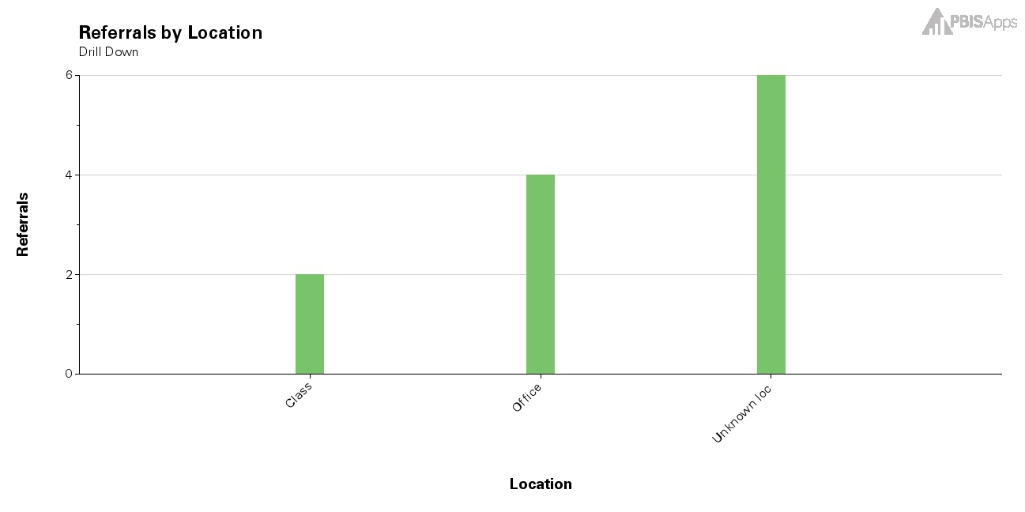

Slide 14
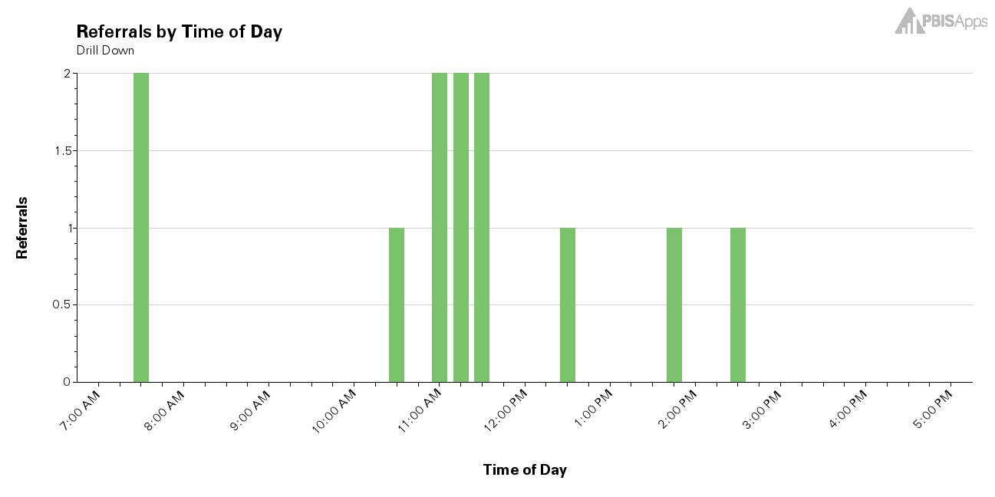

Slide 15
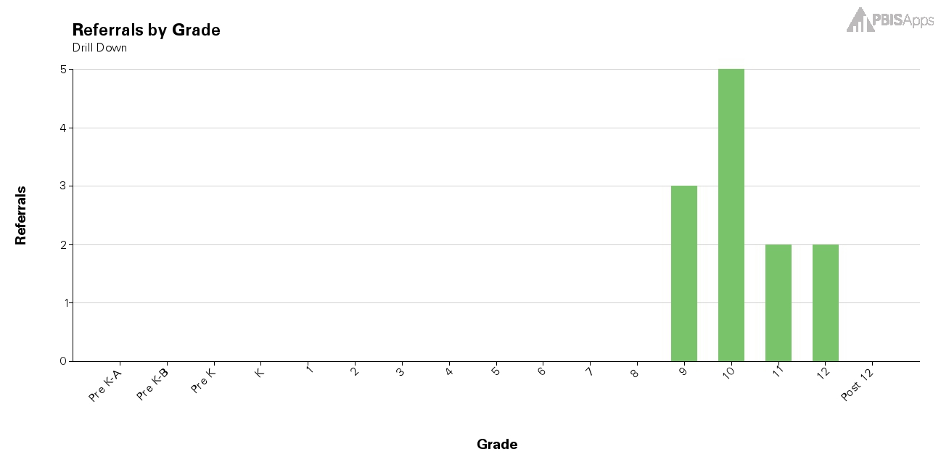

Slide 16
Classroom

Slide 17
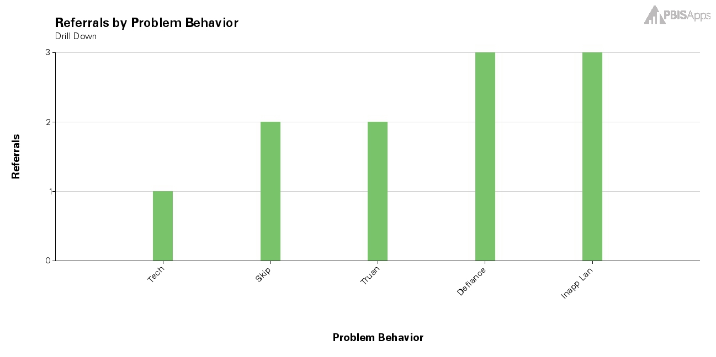

Slide 18
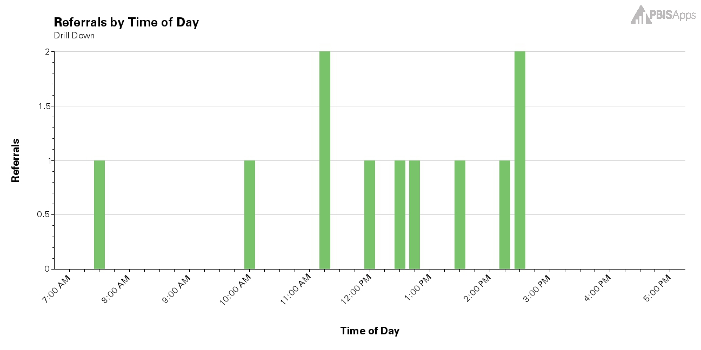

Slide 19
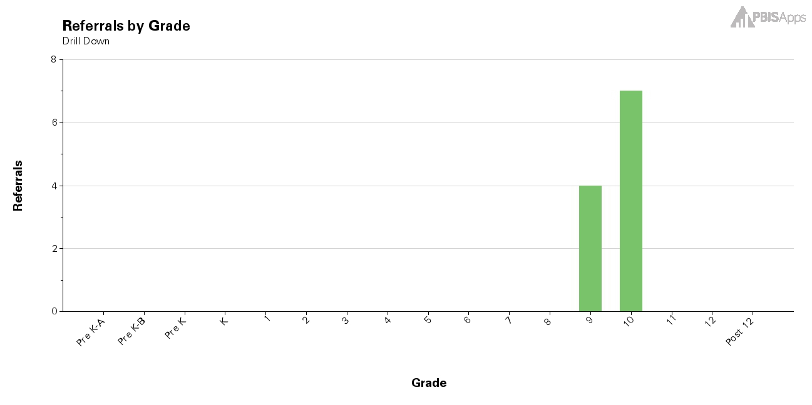

Slide 20
7:30

Slide 21
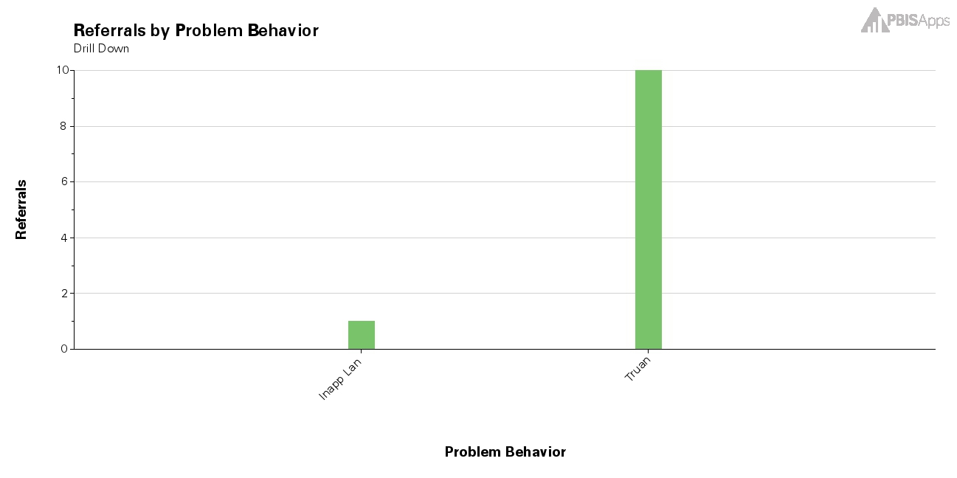

Slide 24
10th Grade

Slide 25
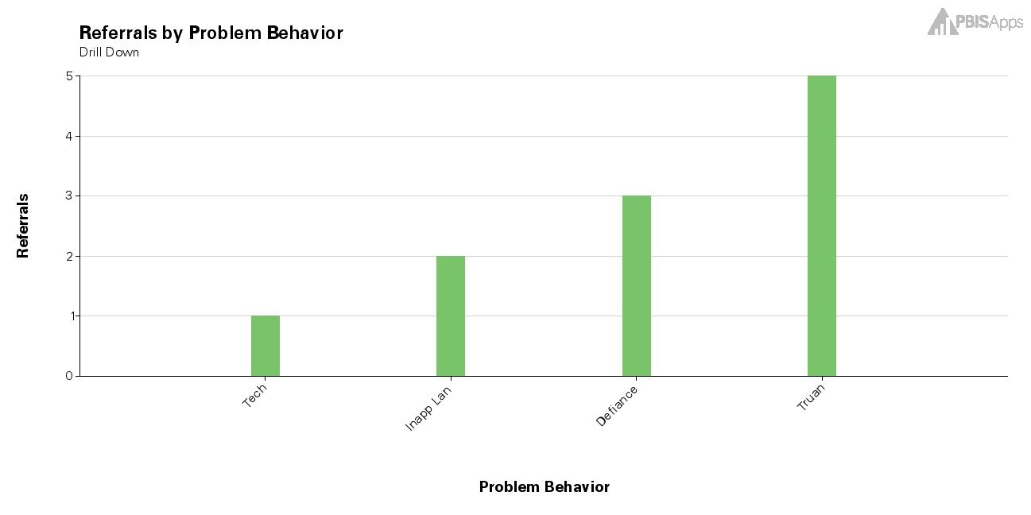

Slide 26
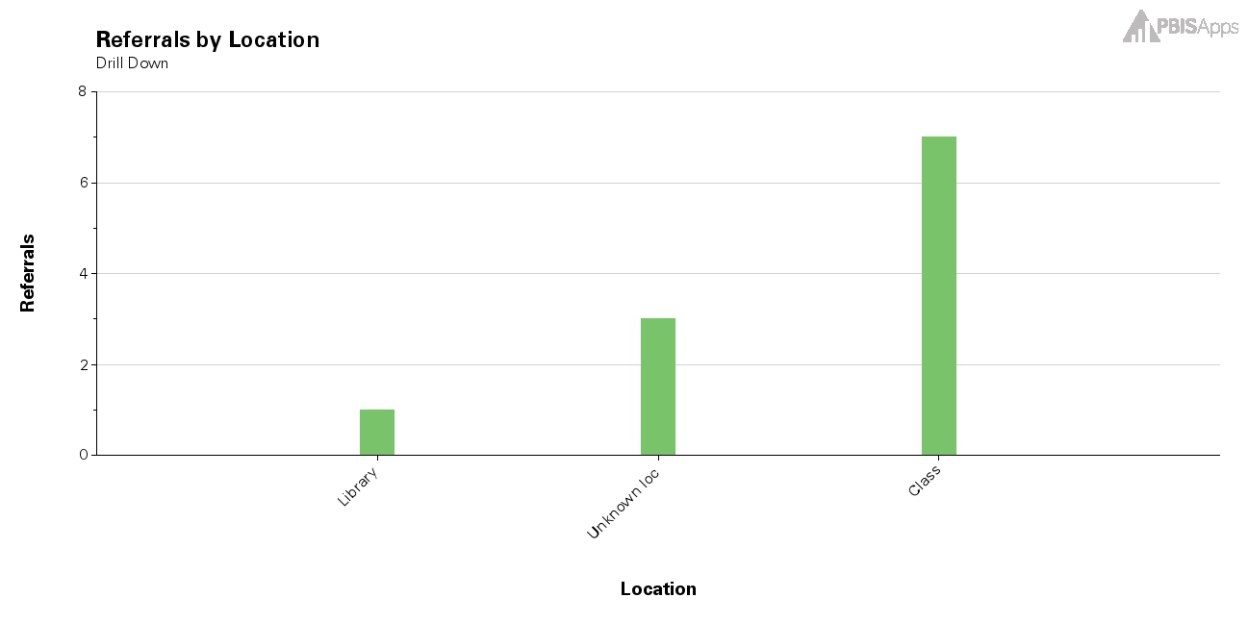

Slide 27
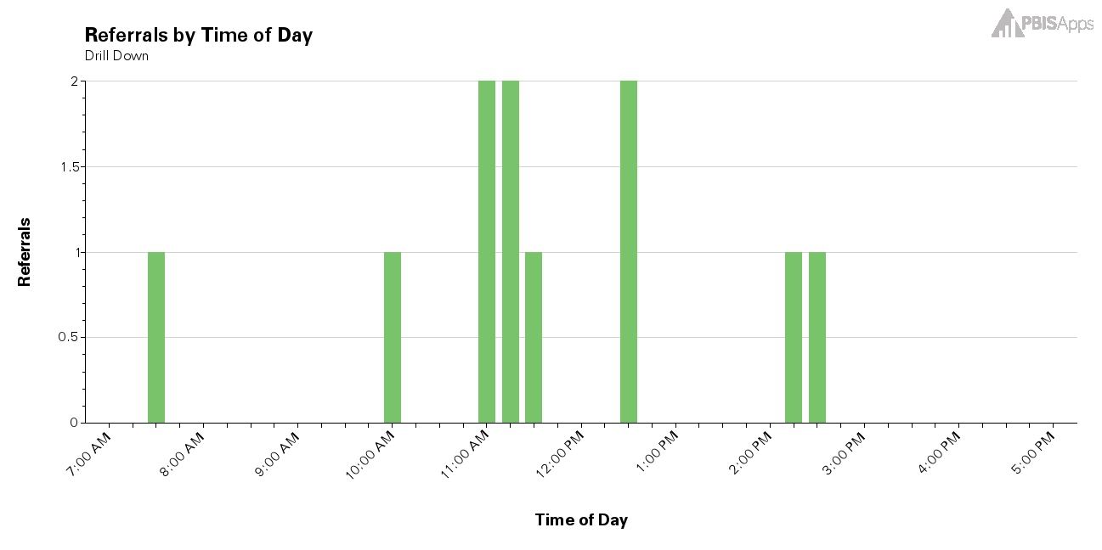

Slide 28
Step 4: Develop a Plan

Slide 29
Step 5: Implement Plan

Slide 30
Step 6: Evaluate Plan

