Slide 1
KCPS SUCCESS ACADEMY at ANDERSON

Slide 2
What happens when you have one firecracker in a building?
Notes:
Sarah

Slide 3
Now what happens when you have a hundred firecrackers in a building?
Notes:
Brad

Slide 4
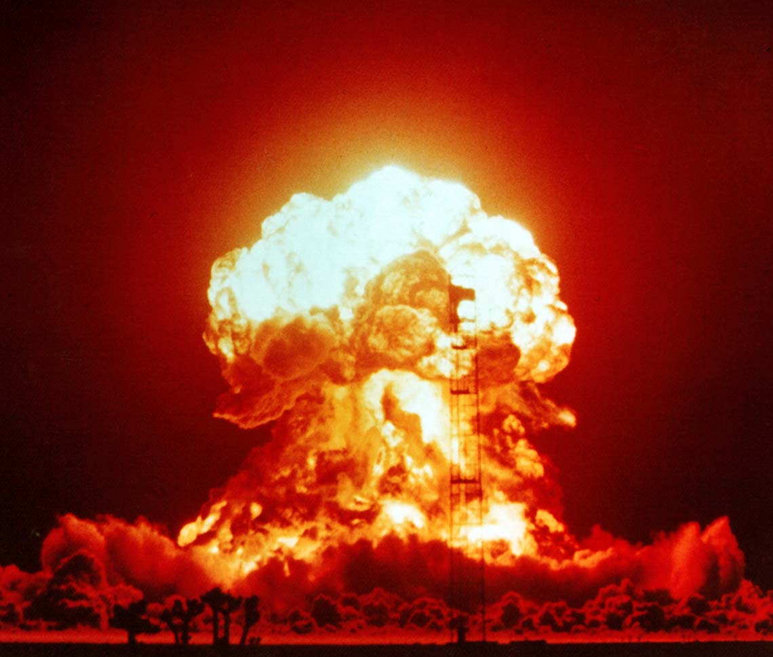

Slide 5
But not at Success Academy
It is where Success is our name!
And PBIS is our game!
With two scoops of HOOAH!!!!!!

Slide 6
The History and the Dream of Success Academy
How Success Academy was established
Why the Phoenix
Demographics
The school board’s release policy

Slide 7
Our School Before PBIS

Slide 8
We are Driven by Our Data

Slide 9
Our Data
Reasons our students are at our school
Per day Per month
Event Type
Location
Time
Number of referrals per student
Minor Referral Logs
Positive Behavior Logs

Slide 10
Why Students Were Sent To Our School
Reason | #
Arson | 5
Weapons | 10
Assault on Students and Personnel | 45
Threatening Students and Personnel | 25
Fighting | 10
Drugs | 16
Gang Fight | 3
Released from Juvenile | 16
Theft | 14

Slide 11
Office Referrals Per Day Per Month

Slide 12
Event Type
Type | Dis. | Dang. | DOA | C.M.
12/13 | 285 | 26 | 116 | 221
13/14 | 85 | 1 | 45 | 73

Slide 13
Events By Time of Day
Time | 7:30 AM | 8:00 AM | 8:30 AM | 9:00 AM | 9:30 AM | 10:00 AM | 10:30 AM | 11:00 AM | 11:30 AM | 12:00 PM | 12:30 PM | 1:00 PM | 1:30 PM | 2:00 PM | 2:30 PM | 3:00 PM | 3:30 PM | 4:00 PM | 4:30 PM | 5:00 PM | Total Events
12/13 | 2 | 2 | 7 | 5 | 56 | 80 | 81 | 79 | 57 | 43 | 1 | 53 | 97 | 95 | 82 | 72 | 108 | 65 | 17 | 17 | 1173
13/14 | 8 | 21 | 21 | 12 | 15 | 16 | 19 | 19 | 25 | 35 | 0 | 37 | 35 | 71 | 14 | 10 | 3 | 13 | 7 | 4 | 411

Slide 14
Total Suspension
School | # of Suspensions | Male | Female | Asian | Black | Hispanic | White | Days Missed
SA@A 12/13 | 317 | 208 | 109 | 0 | 288 | 22 | 7 | 1592
SA@A 13/14 | 188 | 153 | 35 | 2 | 173 | 13 | 2 | 731

Slide 15
Events By Location
Location | 2012/2013 | 2013/2014
Auditorium | 1 | 0
Cafeteria | 29 | 18
Classroom | 962 | 252
Community | 2 | 0
Grounds | 27 | 53
Gym | 21 | 12
Halls | 74 | 44
ISS Room | 8 | 1
Lavatory | 6 | 4
Loc/Bus | 8 | 0
Office | 6 | 1
Other | 17 | 4
School Bus | 12 | 13

Slide 16
Minor Behaviors
Low Metacognition
Metacognition: Higher order thinking that enables understanding, analysis, and control of one’s cognitive processes, especially when engaged in learning.
Classifying minor behavior
Staff buy-in
Minor Behavior Sheet
Re-teaching Minor Behaviors
Notes:
Inner-city schools are ravaged by a plague of problems: poverty, crime, drugs, gang violence, broken families, child abuse, children having children, joblessness, racism, and the "soft bigotry of low expectations." The list can be substantially lengthened by anyone who has lived or otherwise spent time there. These problems overflow from the community into the school, and make life and teaching in the inner-city school tough.

Slide 17
Minor Behavior Log
STUDENT’S NAME | MINOR EVENT LOG | DATE

Slide 18
Positive Behavior
Building Metacognition
What does Positive Behavior Look Like?
Positive Behavior Sheet
Celebrating Positive Behavior

Slide 19
Positive Behavior Log
STUDENT’S NAME | POSITIVE BEHAVIOR SHEET | DATE

Slide 20
Our Phoenix Incentive Program
This incentive program was implemented for students to earn rewards by improving their attendance, behavior and grades.
Since our school has a revolving door, our incentive program is constantly changing.
We used our data to set criteria for our students to earn incentives quarterly.

Slide 21
Phoenix Ambassador Program
Three students were selected as building leaders.
Criteria of selection
Major turn-around at Success
No major issues at Success
Above average grades and candidates for release from Anderson.
These students were given an overview of the program expectations.
They would share their individual story with their little buddy.
They had to design behavior goals, conduct tutoring, and design lesson follow up charts for their little buddies.
If their little buddy was on point – they earned minutes of gym time.

Slide 22
Phoenix Feather Program
This program is designed to improve students academic success.
Students earn Phoenix Feathers by:
An “A” on an assignment earns two phoenix feathers while a “B” on an assignment earns one.
An “A” on a test earns five, a “B” on a test earns three.
All Phoenix Feathers are logged in to a computer program and stored in the Success Bank Vault.

Slide 23
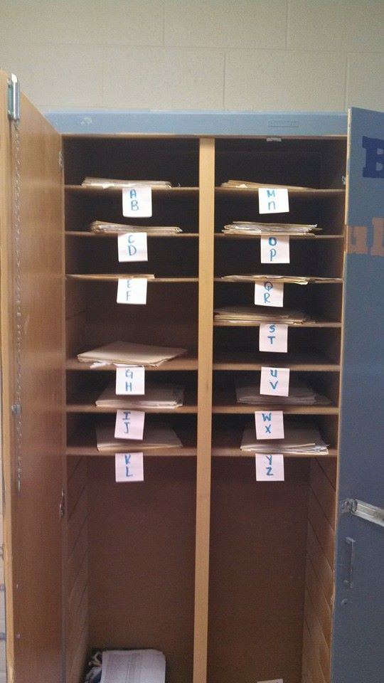
Success Bank Vault

Slide 24
Incentive List
Some of our most popular incentives include:
Being able to buy snacks at our school concession stand
Lunch with a teacher
Fun Friday
Computer time
Our incentive list is constantly changing.
We get student input on what THEY would like twice a semester.

Slide 25
Fun Fridays Expectations
Expectations to EARN Fun Friday.
Zero major write-ups
Maximum of one day absence in a week.
If a student receives one minor referral, the student did not earn the privilege to dress down; two minor referrals and student did not earn dress down or gym.
Students can earn Fun Friday back with three positives on our positive behavior matrix

Slide 26
Fun Friday

Slide 27
Our Testimonies
Johniese Doss
Tyler Williams
DeMarcus Rivers
Ms. Campbell (DeMarcus’s Mother)

Slide 28
SUCCESS ACADEMY

Slide 29
Student Transitions
Seniors
Students that return to their neighborhood schools
Students that meet the requirements to return to their neighborhood schools, but appeal to stay at Success Academy

Slide 30
Questions ???

Slide 31
Contact Information
Sarah Buesteton
sbuestet@kcpublicschools.org

