Slide 1
Checking in on Check In/Check Out
Debora lintner
MO SW-PBS Tier 2/3 Consultant
Susan Long
Assistant Principal Sikeston 5-6 Grade Center

Slide 2
Social Competence &
Academic Achievement
OUTCOMES
Supporting
Data
Decision
Making
Supporting
Staff
Behavior
SYSTEMS
DATA
PRACTICES
Supporting Student Behavior

Slide 3
Three Levels of Implementation
A Continuum of Support for All
Academic Systems
Behavioral Systems
Tier Three
Individual Students
Assessment-based
High Intensity
Tier Three
Individual Students
Assessment-based
Intense, durable procedures
Tier Two
Some students (at-risk)
High efficiency
Rapid response
Tier Two
Some students (at-risk)
High efficiency
Rapid response
Tier One
All students
Preventive, proactive
Tier One
All settings, all students
Preventive, proactive

Slide 4
What is the benefit CICO?
Research supported practice
Schools can successfully implement
Decreases problem behavior
Effective for 60-75% of second tier, at-risk students
Less effective for students who do not find adult attention reinforcing
Use of Functional Behavior Assessment can enhance success
(Crone, Horner, & Hawken, 2004, pp. 9-10)

Slide 5
Intervention Overview
Small group intervention to provide…
Daily organization and behavioral support
Systematic performance feedback
High rates of adult attention
Mechanism for making data-based decisions
Communication link between school and home

Slide 6
Why does CICO Work?
Improved structure
Student is “set up for success”
Increase in specific feedback
-

Slide 7
Why Does CICO Work?
Program can be applied in all school locations
Links school support and home
Organized to fade into a self-management system

Slide 8
Check-In/Check-Out
Basic Cycle
Morning check-in (Get Daily Progress Report)
Regular teacher feedback throughout day
End of day check-out
Tally and record points
Receive recognition
Data collection & progress monitoring
Take DPR home & return signed copy

Slide 9
Student Recommended for CICO
CICO Implemented
Morning
Check-in
CICO Coordinator
Summarizes Data
For Decision Making
Parent
Feedback
Regular Teacher
Feedback
Bi-weekly CICO Meeting
to Assess Student
Progress
Afternoon
Check-out
Revise
Program
Exit
Program

Slide 10
Implementation Example
Morning Check-in
Consistent location
Begin with positive greeting
Prompt for picking up daily progress report (DPR)
Prepare for day (breakfast, pencil, paper, planner)
Reminder of expectations
Provides access to positive adult attention, precorrect for behavioral and academic expectations and organizes student materials

Slide 11
Implementation Example
Throughout the Day
Student carries a daily progress report (DPR)
Teacher greets and pre-corrects
Established criteria for pre-corrects and points
Teacher provides feedback and awards points
Provides high rates of adult attention and specific performance feedback

Slide 12
Implementation Example
End of Day Check-out
Consistent Location
Adult positive greeting
Total points, calculate percentage, and enter data
Daily and/or weekly reinforcement for meeting goals
Quick debrief with student
Provide parent communication
Provides positive adult attention, specific performance feedback and progress monitoring.

Slide 13
Who Benefits?
CICO is for students who:
Continue to display problems after PBS Universal/Tier 1 supports in place
Demonstrate behavior patterns that are functionally related to obtaining attention
Need increased levels of structure, routine and feedback
121

Slide 14
Who Benefits?
Students in the 2-5 office referral range
Low level disruptions
-Talk out
-Unprepared
-Talk back
-Non-compliant
Data indicating attention maintained behavior
Student willingness to participate
*Students with more intense problems may benefit, but will need additional supports!

Slide 15
Crone, D. A., Hawken, L. S. & Horner, R. H. (2010). Responding to Problem Behavior in Schools: The Behavior Education Program. New York: Guilford Press.

Slide 16
Resources Needed
123

Slide 17
Steps to Implementation
Consider program design for your school
Develop a daily progress report (DPR)
Design a reinforcement system
Select a system for managing daily data
Establish plans for fading
Create staff training materials and time
Provide information for students and parents

Slide 18
Sikeston 5-6 Grade Center-Our Journey

Slide 19
Who We Are
532 fabulous students
58% FRL
10% SPED
0 ELL
2% Homeless

Slide 20
1. Program Design
Team
Student Identification
Teacher nomination
Data Collection-ODRs
Family Notification/Permission
Introducing the Program
Teachers
Family
Students

Slide 21
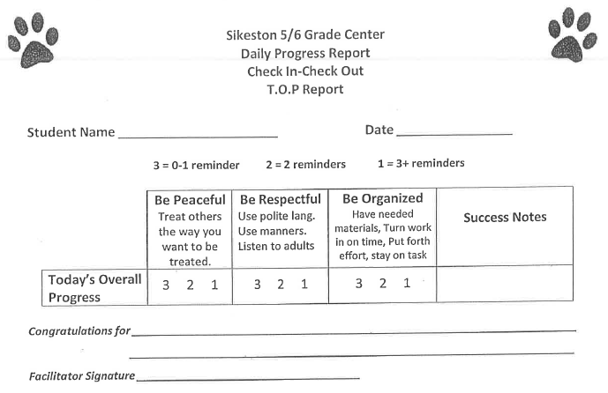
2. Daily Progress Report (DPR)
Notes:
Explain the importance of the DPR

Slide 22
3. Reinforcement System
The primary reinforcer is personal connection with CICO adult.
-Checking in
-Checking out
-Meeting daily and/or weekly point goal
Students who participate in the CICO Intervention still participate in the schoolwide system of encouraging appropriate behavior and discouraging inappropriate behavior.

Slide 23
4. Data Management
Team process for monitoring progress and making decisions
-Regularly scheduled meetings
-Standard meeting format
-Team roles
Easy access to additional information
-Attendance, Grades, ODR, Minors
Informed choices/Evaluate based on goal
-Continue or Fade; Modify or Intensify

Slide 24
Data Management
What Data?
Collection of Data
What to do with the data?
Poor Response
Questionable Response
Positive Response
With whom is the data shared?
“TEAM”
Are we implementing with fidelity?

Slide 25
5. Plans for Fading
Train student for self-management
Celebration of “graduation” from the program
Support for student after the program ends
Notes:
.

Slide 26
Fading Process

Slide 27
Celebration Time!

Slide 28
6. Staff Training
Who should be trained?
Teachers
Facilitators
When should training occur?
Initial training should include:
What CICO is.
What CICO is not.

Slide 29
7. Student/Parent Training
Get parents and students excited about this “opportunity”
CICO is an intervention to work towards self monitoring
It’s not a life sentence for student

Slide 30
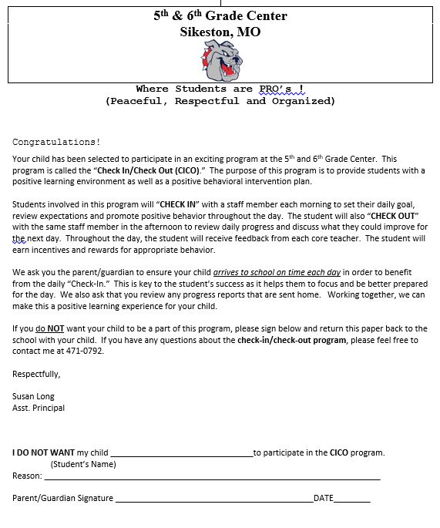

Slide 31
Student Outcome Data

Slide 32
Questions ??

Slide 33
Contact Information
Susan Long, Assistant Principal
Sikeston 5th 6th grade center
slong@Sikeston.k12..mo.us
Debora Lintner, Tier 2/3 Consultant
University of Missouri
lintnerdr@Missouri.edu

