Slide 1
Braymer C-4 High School
High Expectations in High School
Notes:
• 3 Slides introducing your school, demographics
• Name of school (Pictures are nice!)
• Location
• Demographic data – diversity data, free/reduced, SPED

Slide 2
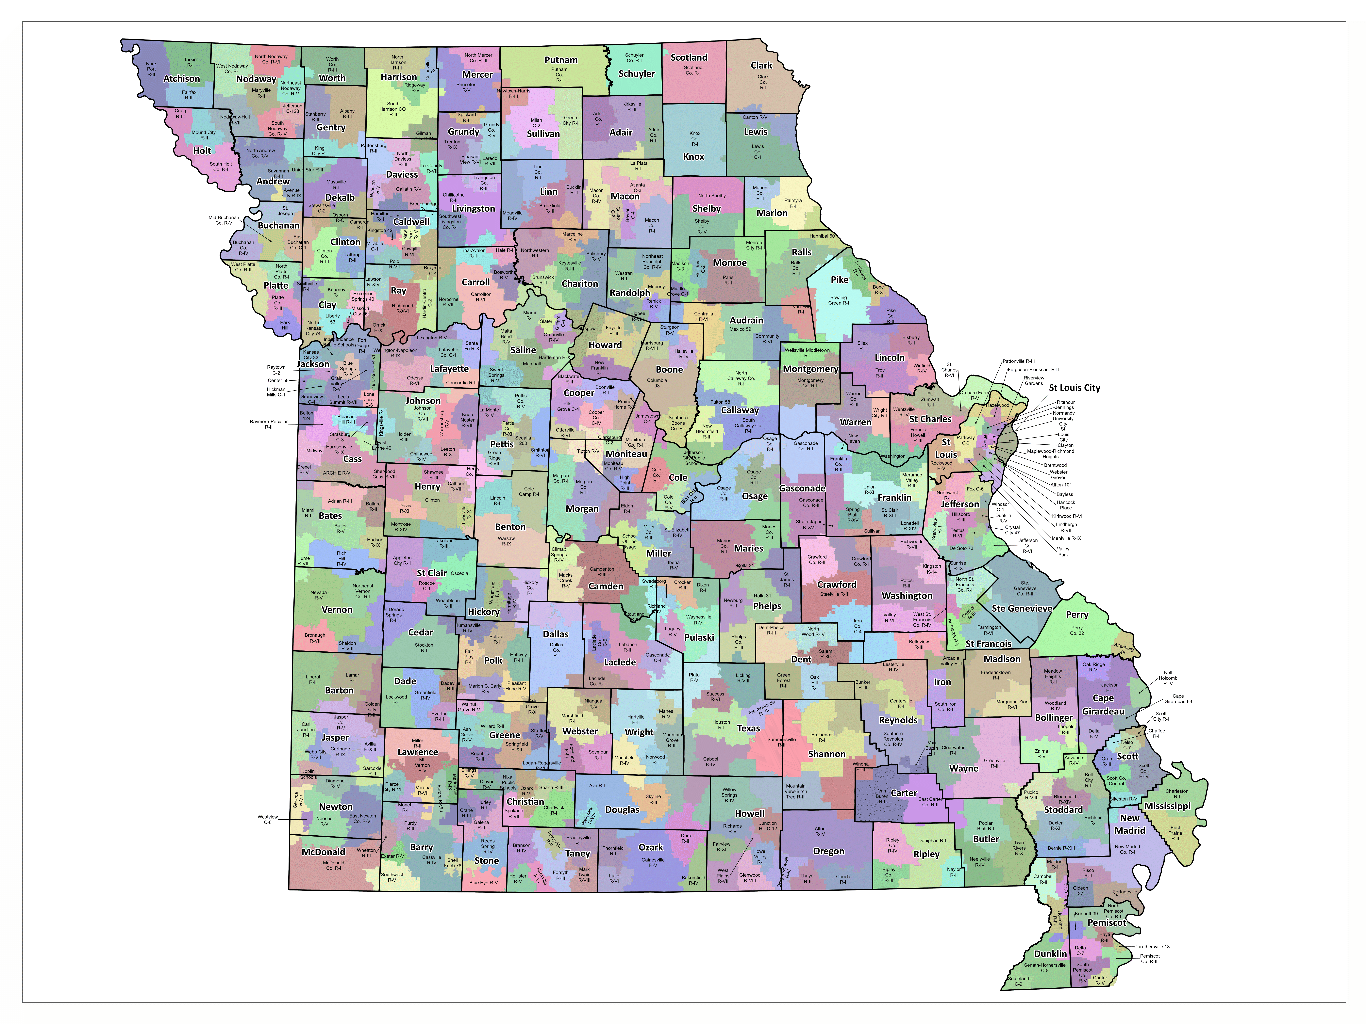
Braymer, MO
Notes:
• 3 Slides introducing your school, demographics
• Name of school (Pictures are nice!)
• Location
• Demographic data – diversity data, free/reduced, SPED

Slide 3
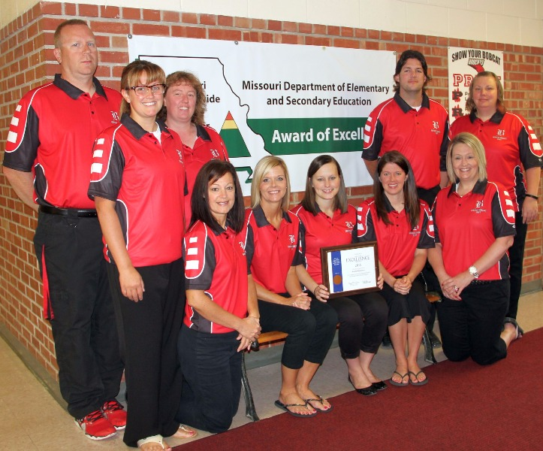
Tier 1
2012 – 2013
Bronze Award
2014 – 2015
Tier 2
2018 – 2019
Notes:
Then we go into digital bucks and things like that which make us higher working vs elementary

Slide 4
Braymer C-4 High School
2016-2017 School Year
Total Enrollment: 129 Students
Eligible for Free or Reduced-Price Lunch: 44.7%
Enrollment: 93% White
Students with IEPs: 10%
Notes:
3 Slides introducing your school, demographics
• Name of school (Pictures are nice!)
• Location
• Demographic data – diversity data, free/reduced, SPED

Slide 5
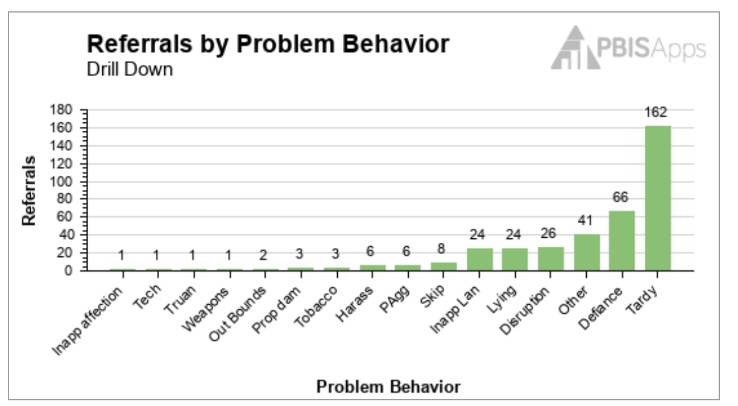
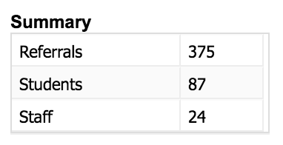
Data – Year 1

Slide 6
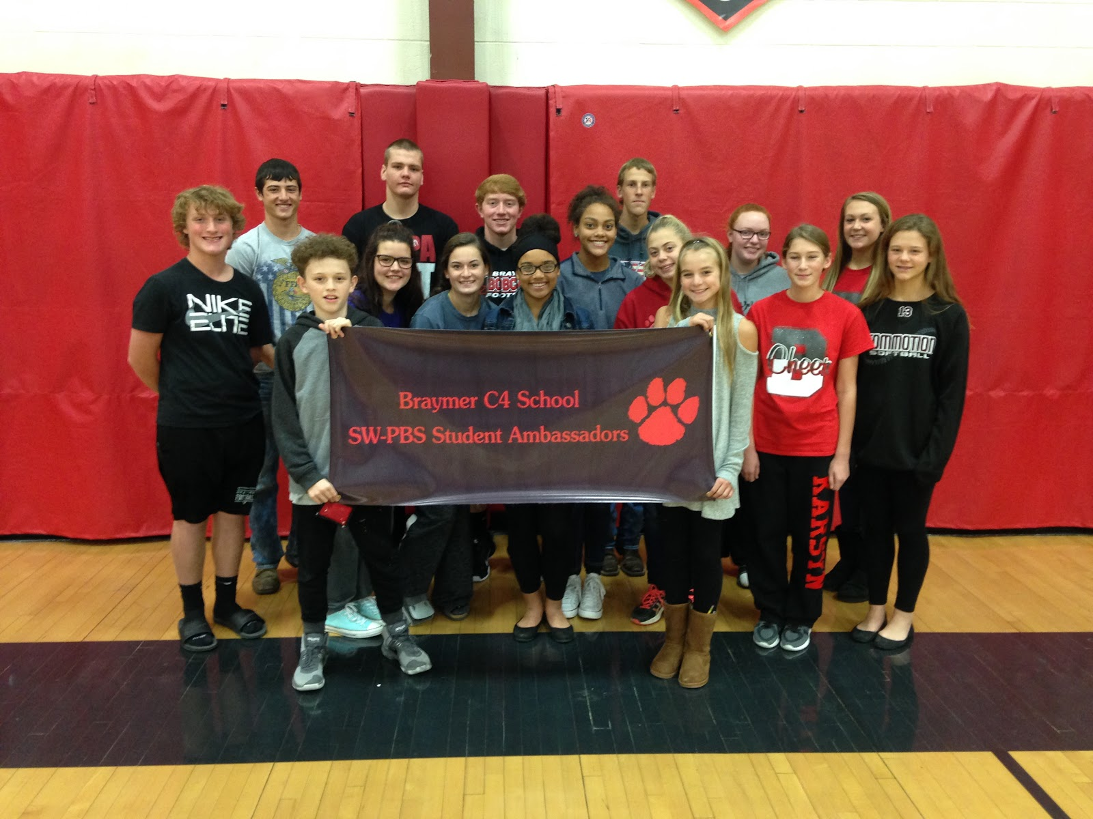
Student Ambassadors
Notes:
Slides 4-6 should be Ambassadors, not program name, then talk about monthly assemblies with class competitions, winter dance, store.

Slide 7
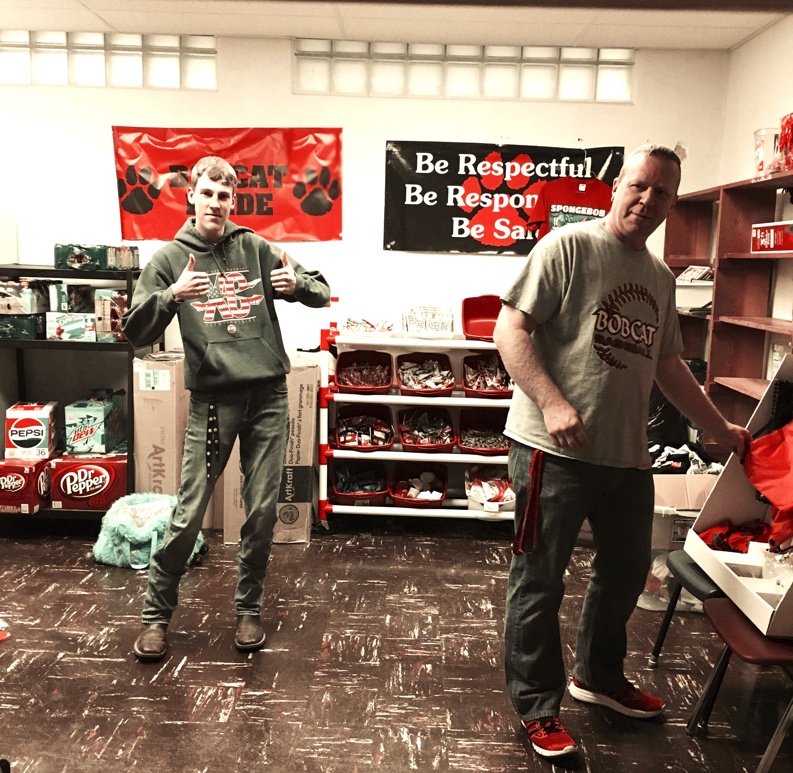
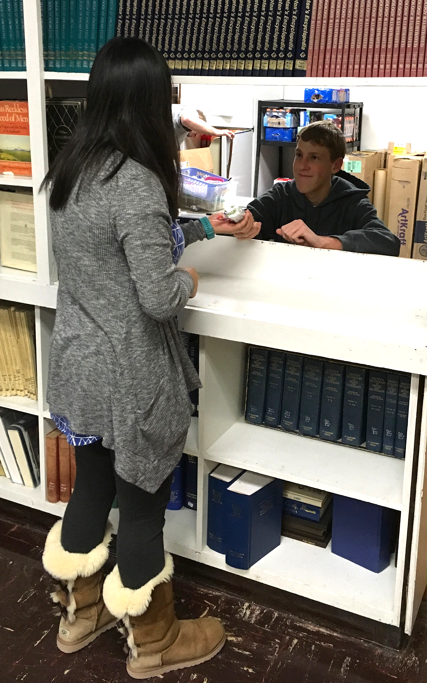
Bobcat Store

Slide 8
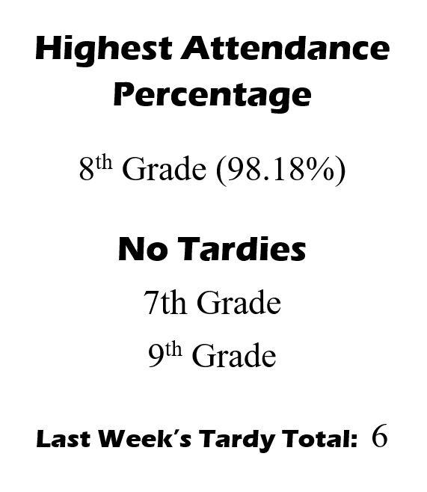
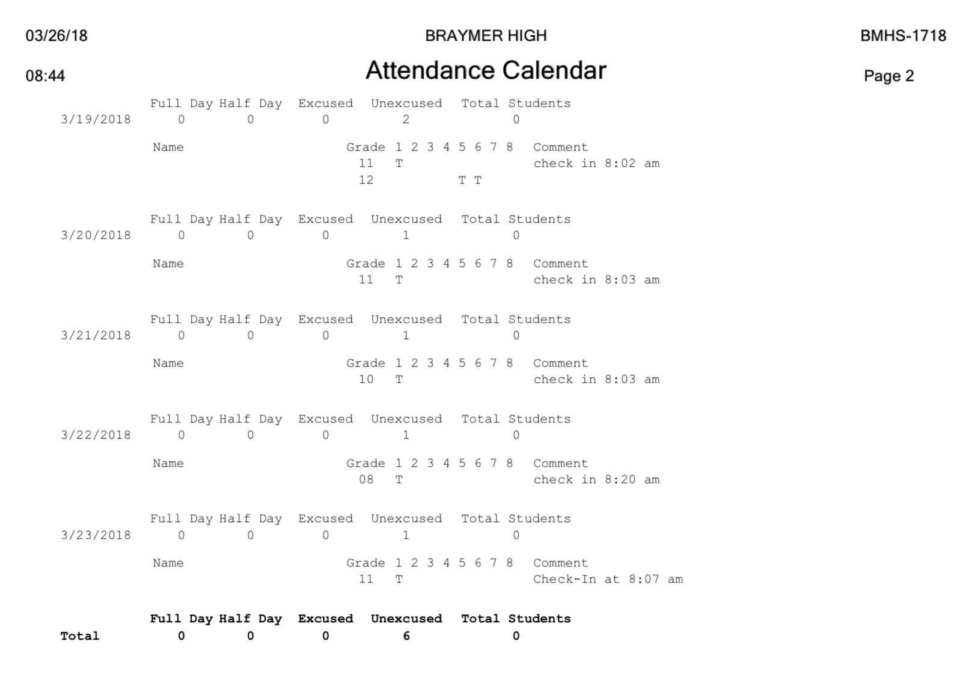
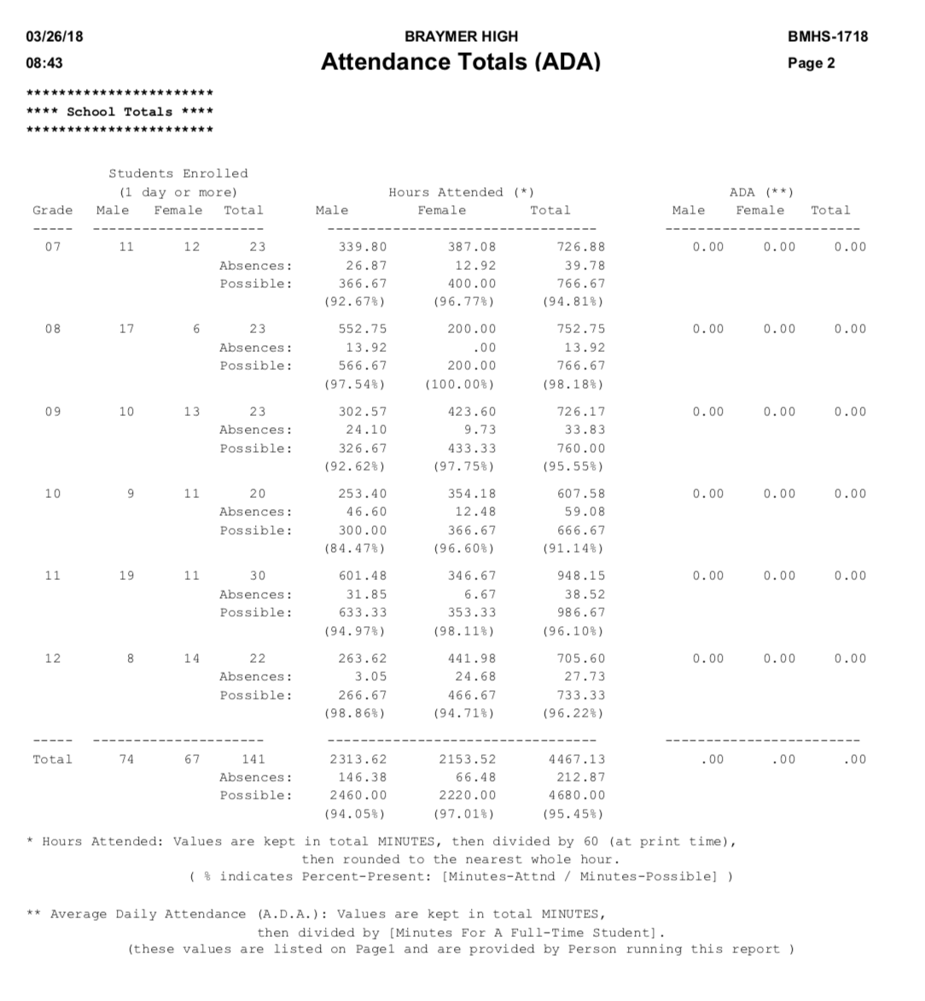
SW-PBS Mondays

Slide 9
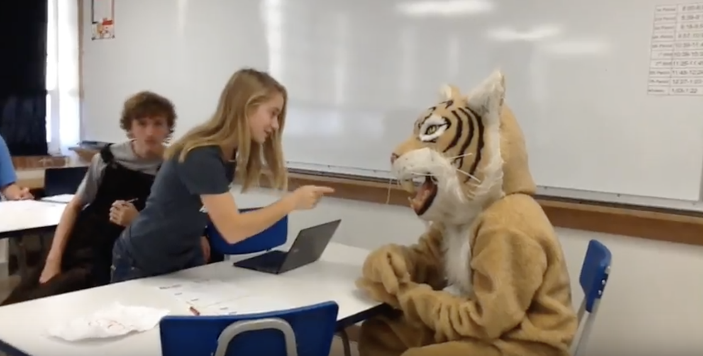
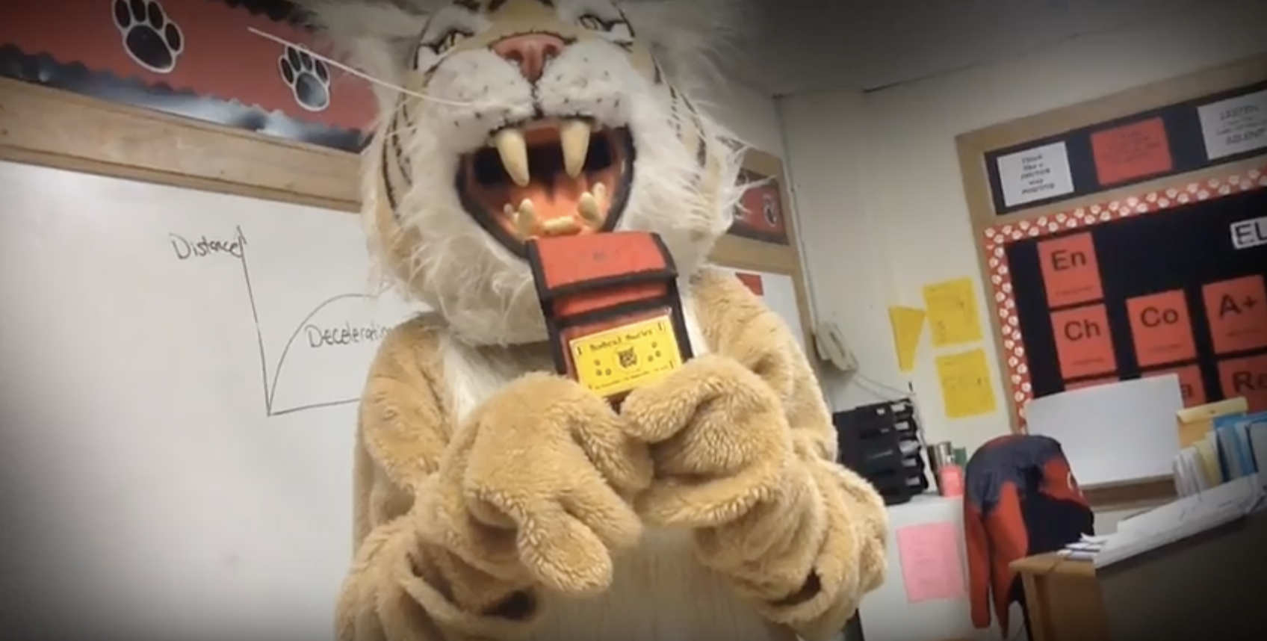
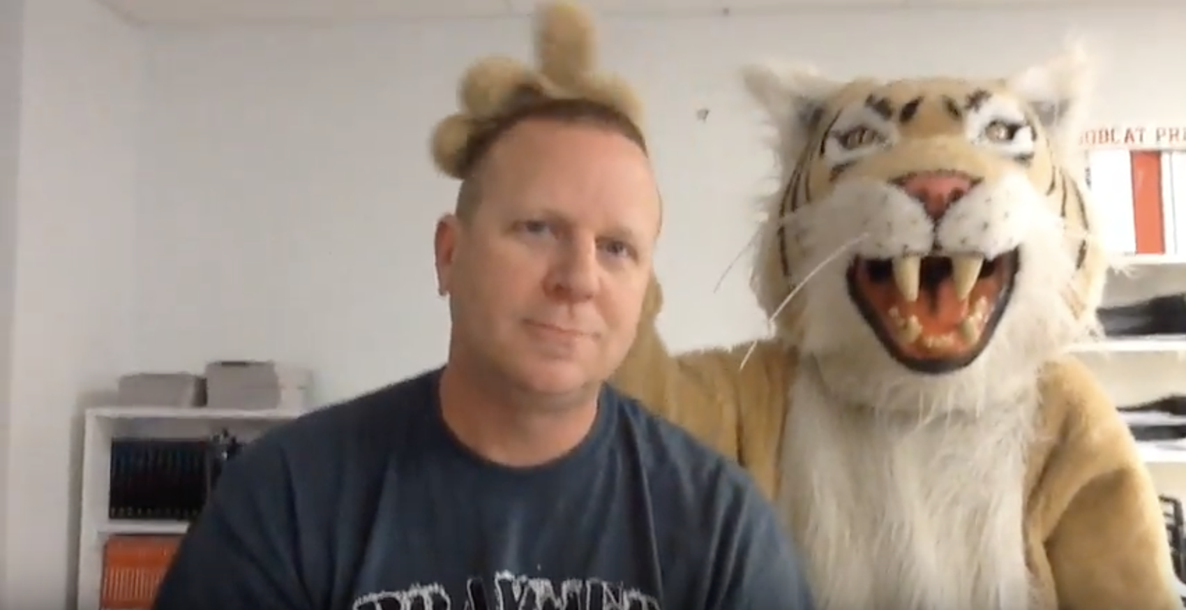
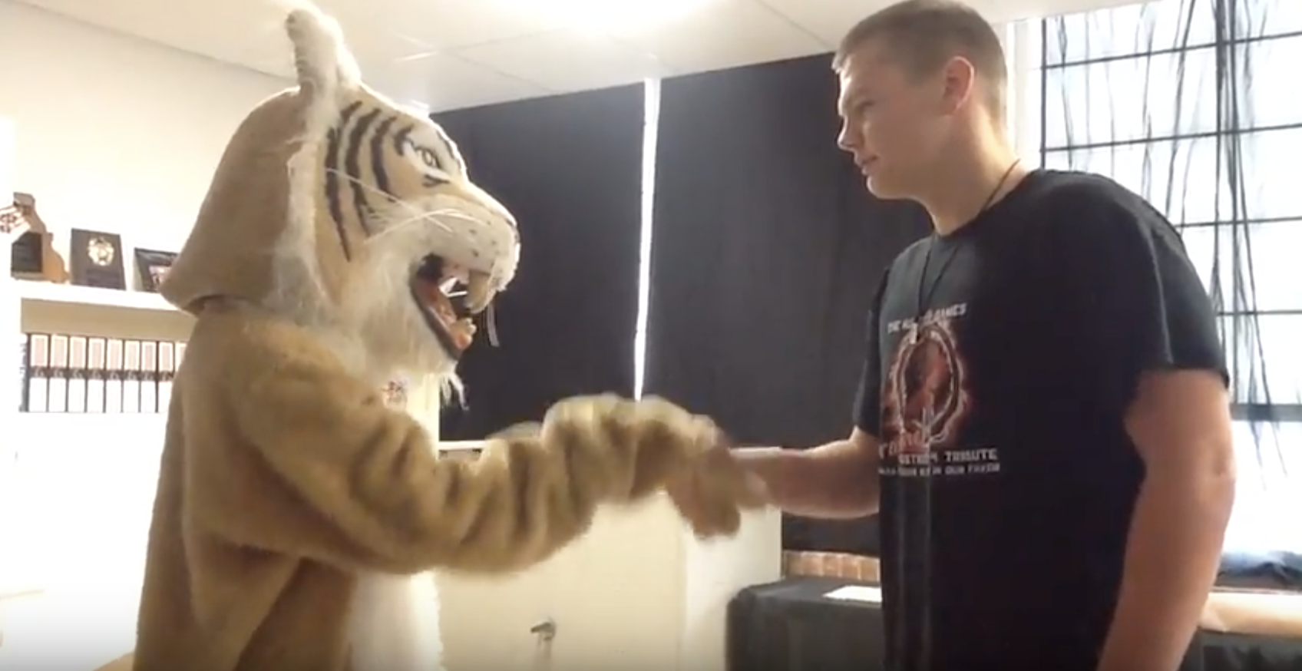
Ambassador Video Lessons

Slide 10
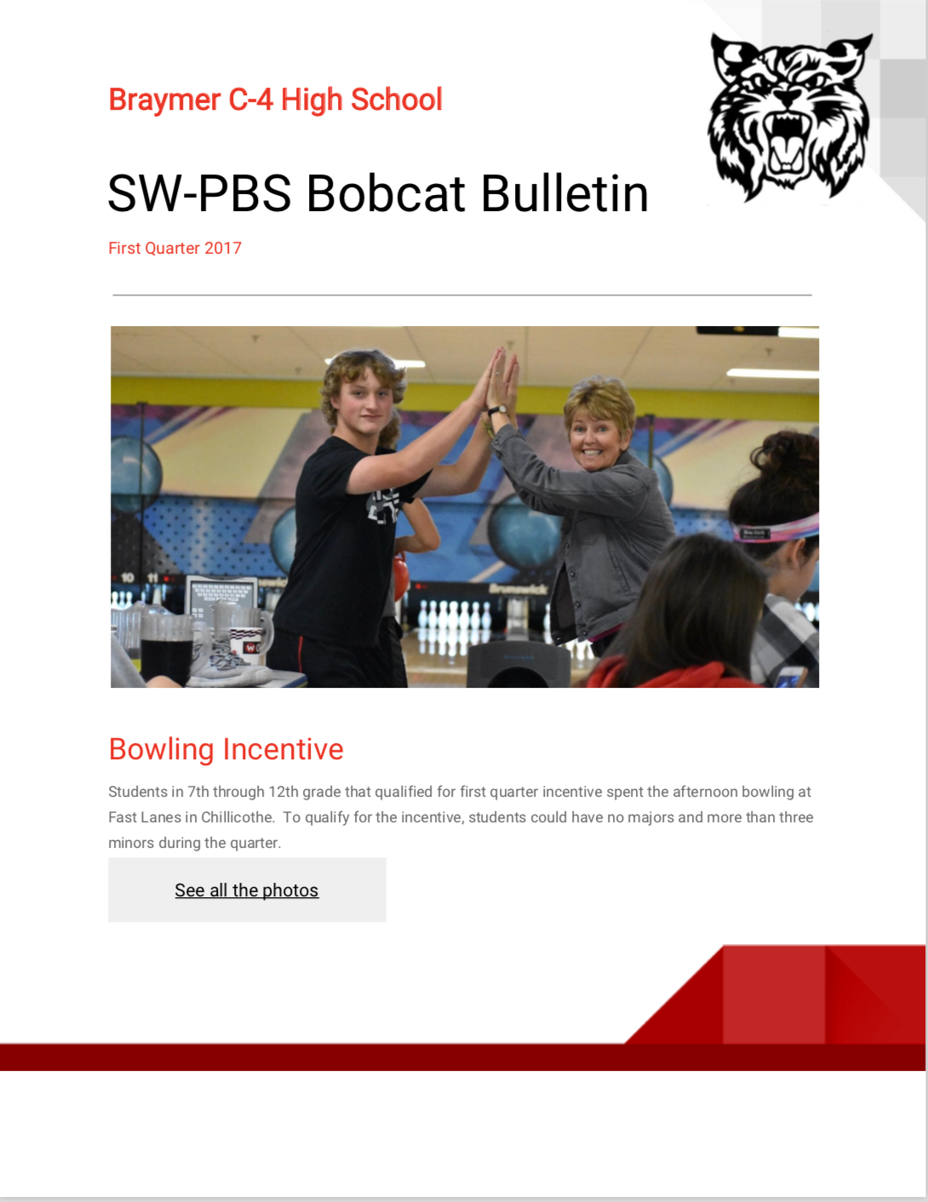
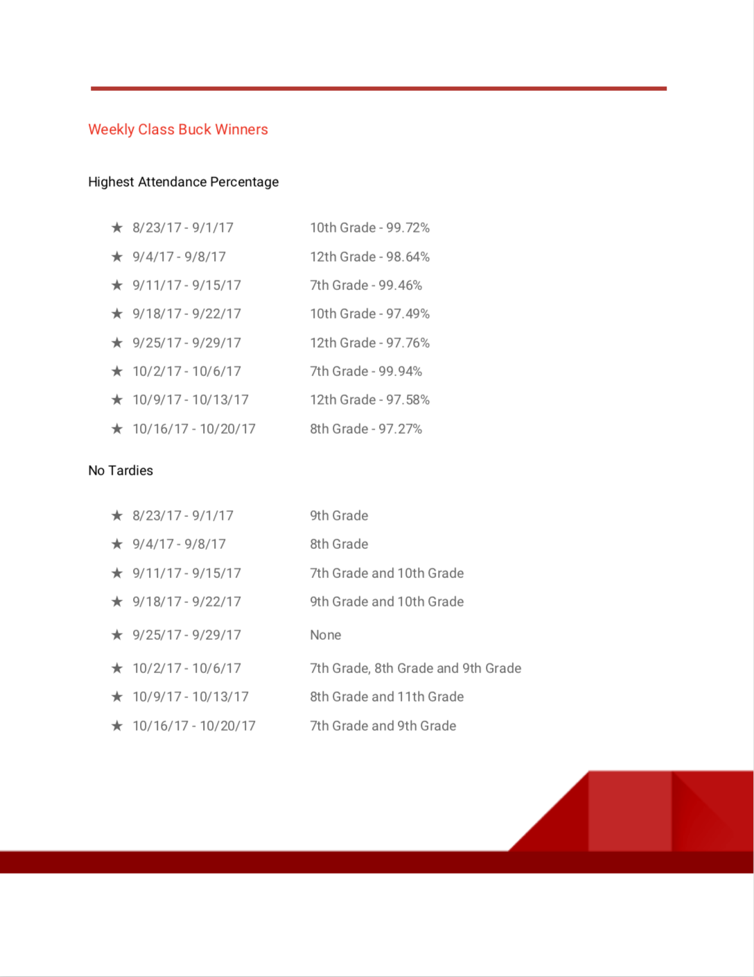
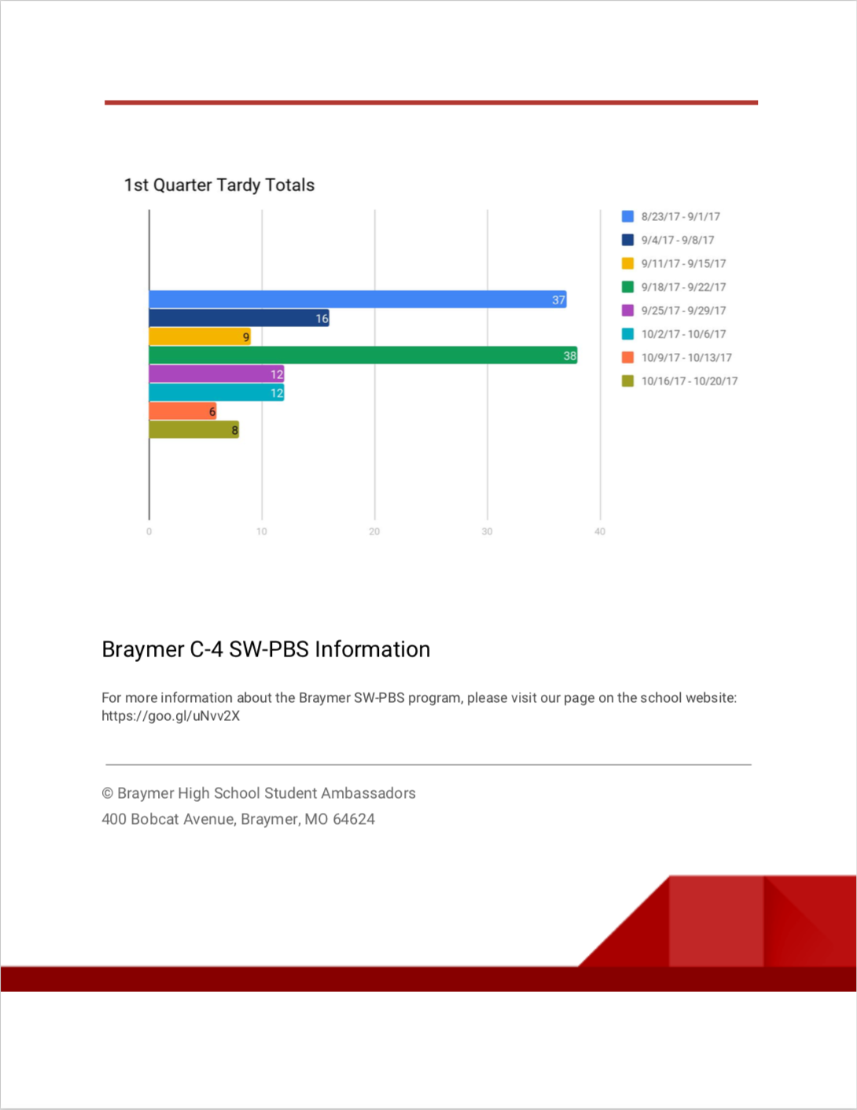
Ambassador Newsletter

Slide 11
Semi-Formal Winter Dance
Notes:
Slides 4-6 should be Ambassadors, not program name, then talk about monthly assemblies with class competitions, winter dance, store.

Slide 12
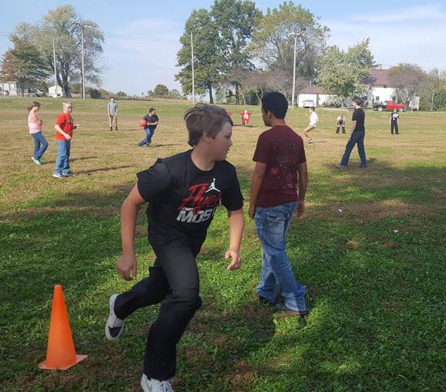
Tardy-Free Tuesdays

Slide 13
The Tardy Battle
On-Time
All The Time Awards
Free Casey’s
Food Coupons
at Breakfast
Weekly
Tardy-Free
Class Bucks
Tardy-Free Tuesdays
Individual
Tardy-Free
Bucks
Affordable
Tardy Passes
in the
Bobcat Store
Morning Greetings at the
Front Door
with Snacks

Slide 14
Monthly Be a Bobcat Awards

Slide 15
Monthly Class Competitions

Slide 16
Quarterly Incentives
Notes:
Slides 4-6 should be Ambassadors, not program name, then talk about monthly assemblies with class competitions, winter dance, store.

Slide 17
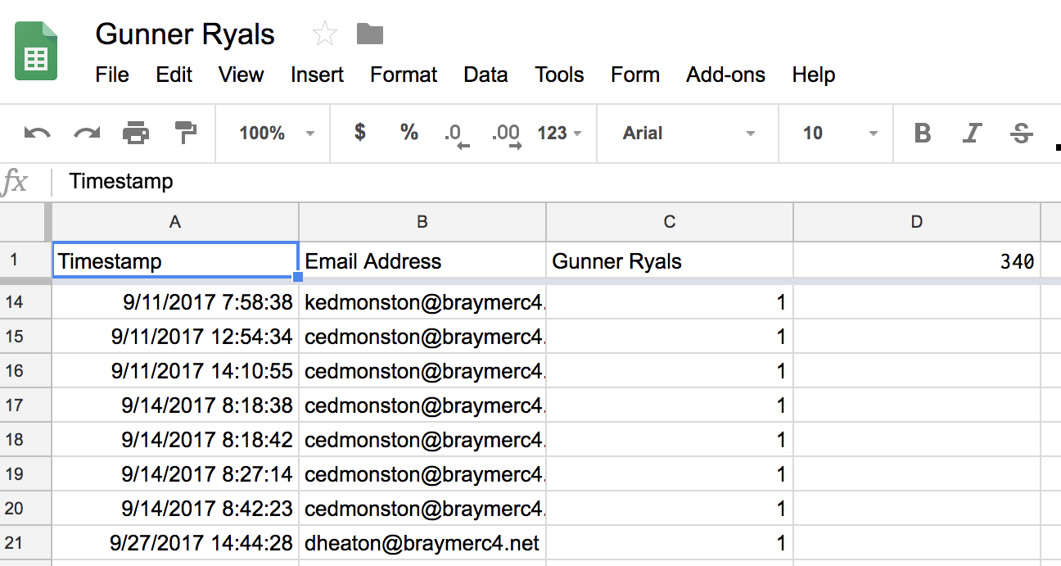
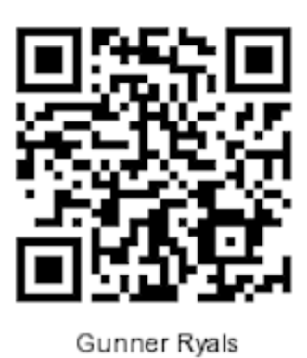
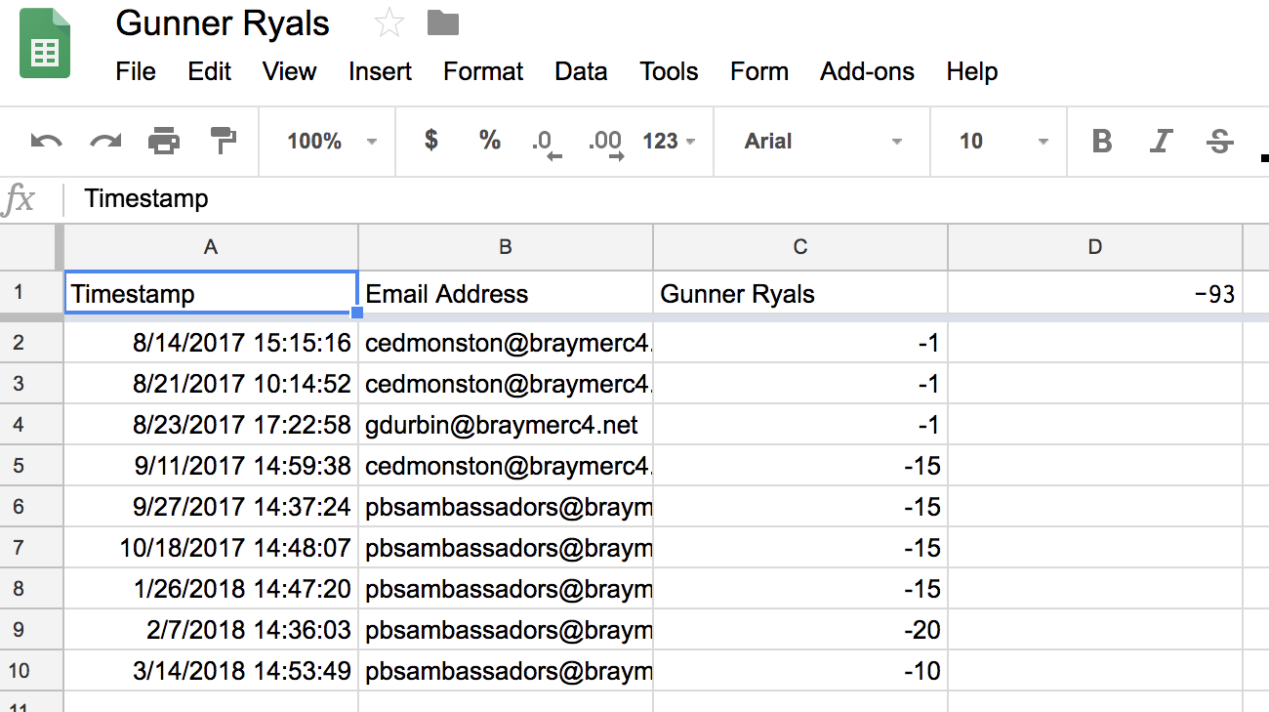
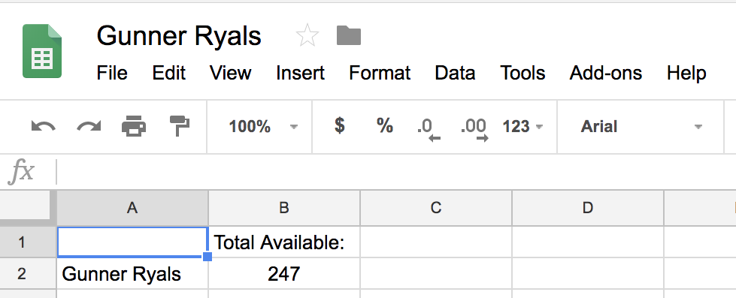
Digital Bobcat Bucks

Slide 18
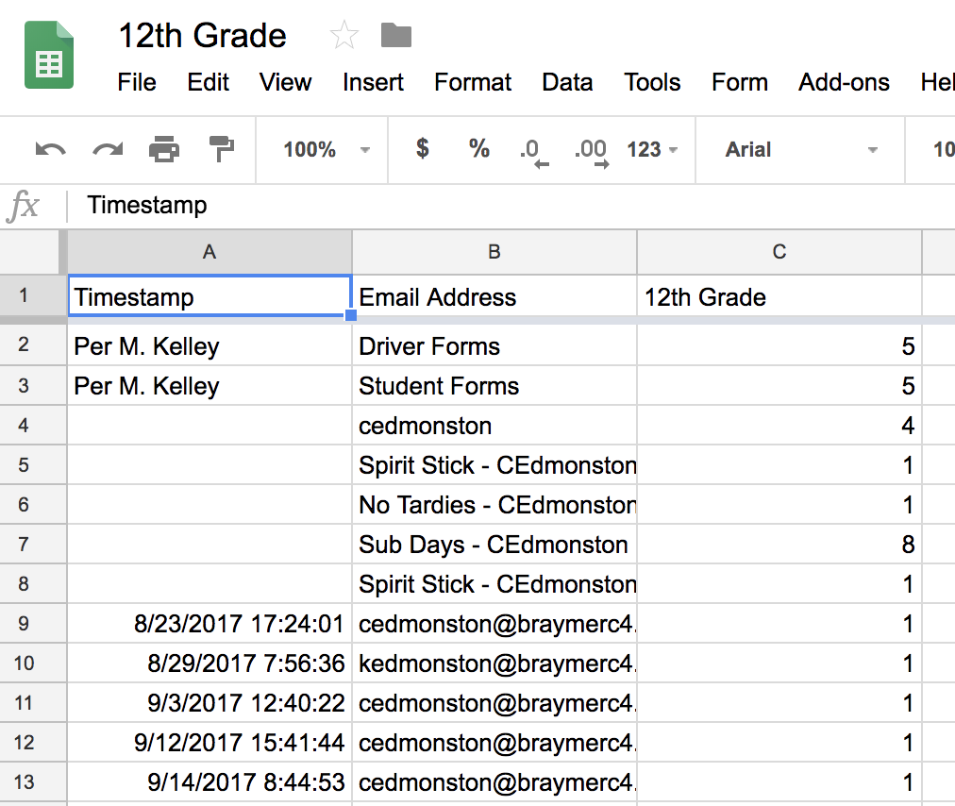
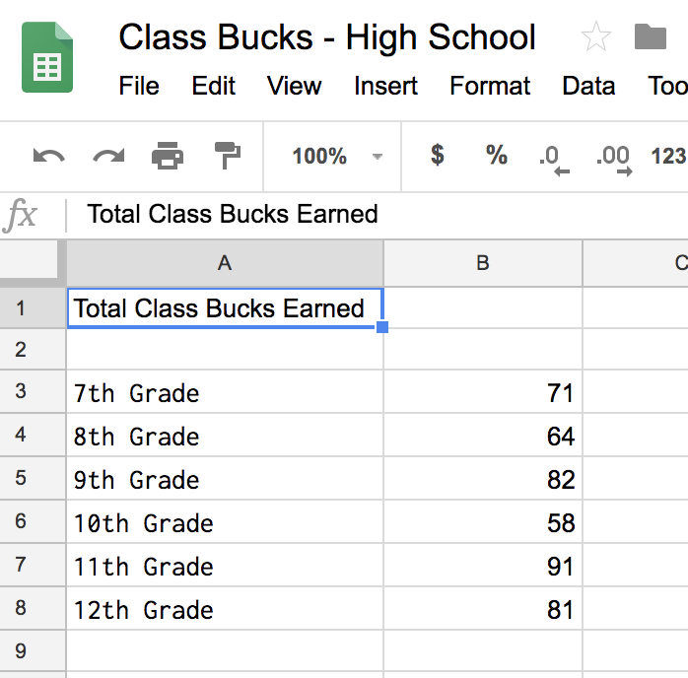
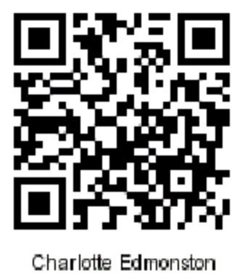
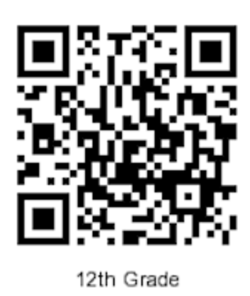
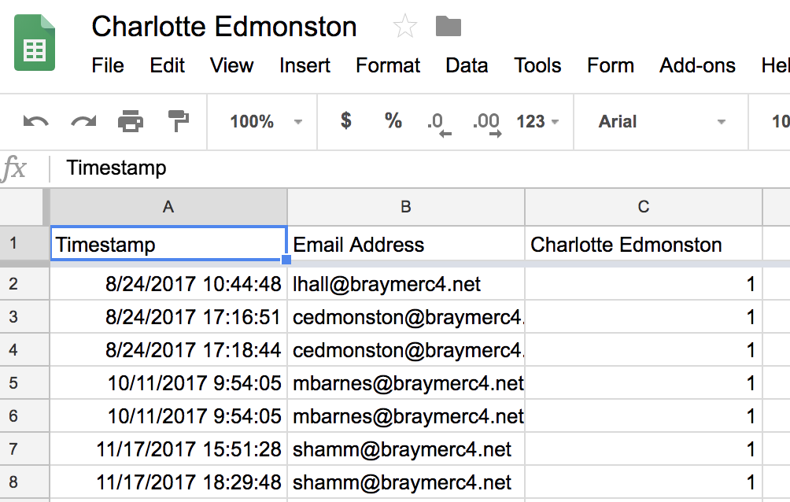
Digital Class & Teacher Bucks

Slide 19
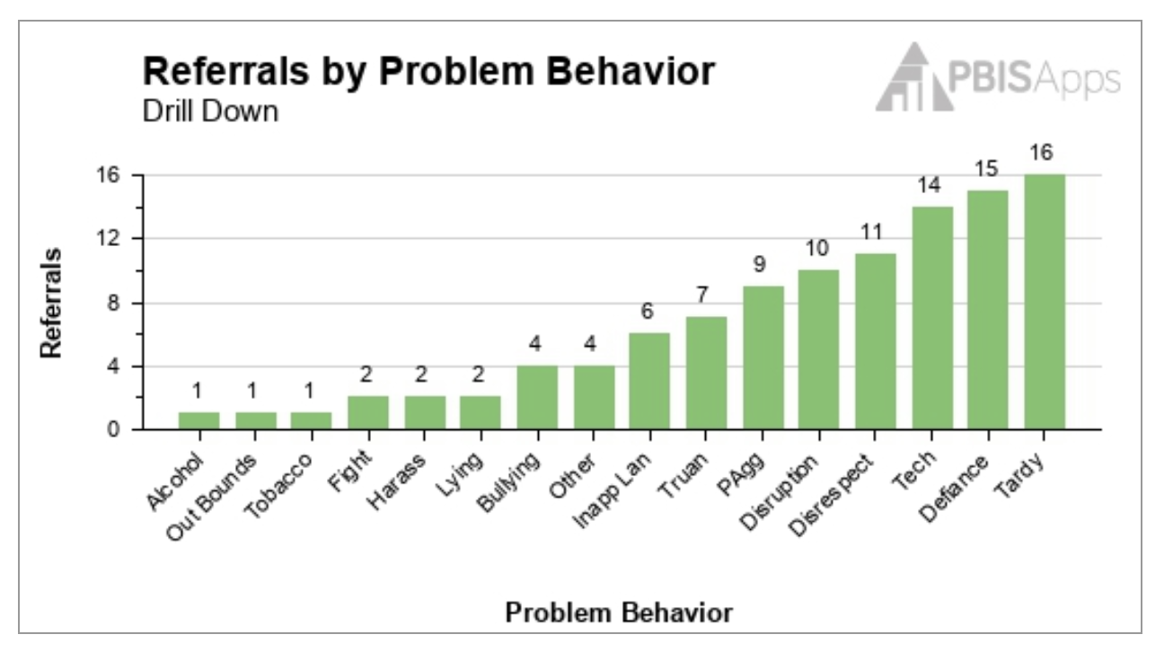
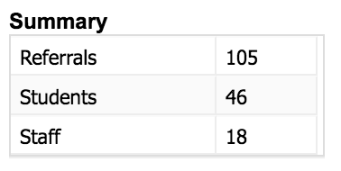
Data – Year 6

Slide 20
Braymer C-4 High School
Higher Expectations in High School
Charlotte Edmonston
cedmonston@braymerc4.net
High School Math Teacher
District SW-PBS Coordinator
Keith Edmonston
kedmonston@braymerc4.net
High School English Teacher
High School Tier 1 Chairperson

