Slide 1
Students Engaging Students Spartan Shield
Saeger Middle School’s Student Leadership Team

Slide 2
Our Vision
Empower student leaders to have an active part in the decision making process.
Gather feedback from students through honest conversations with kids!

Slide 3
Our Vision
Generate new ideas for leadership videos and character lessons; organize these videos digitally.
Utilize students’ technology skills and abilities.
Incorporate student ideas into building wide decisions.

Slide 4
Getting Started
We began by asking teachers for student recommendations.
Used that list to send out personal invitations.

Slide 5
Getting Started
Our goal was to begin with a group of 10-20 students.
Once the group was established, members were allowed to ask friends to join.

Slide 6
Once we had our group…
We asked students to reflect on:
--what do they LOVE about SMS?
--what do they want to see CHANGED at SMS?
--what would help other students LOVE SMS?

Slide 7
Working with the Students
Student group met weekly after school for one hour.
Teacher-sponsor would lead a discussion about the discipline focus for the month. For example, pedestrian safety in August.

Slide 8
Working with the Students
Teacher-sponsor would lead brainstorming session to develop ways to reach out to the student body.
Student team would assign roles and jobs, set deadlines and dates for recording.

Slide 9
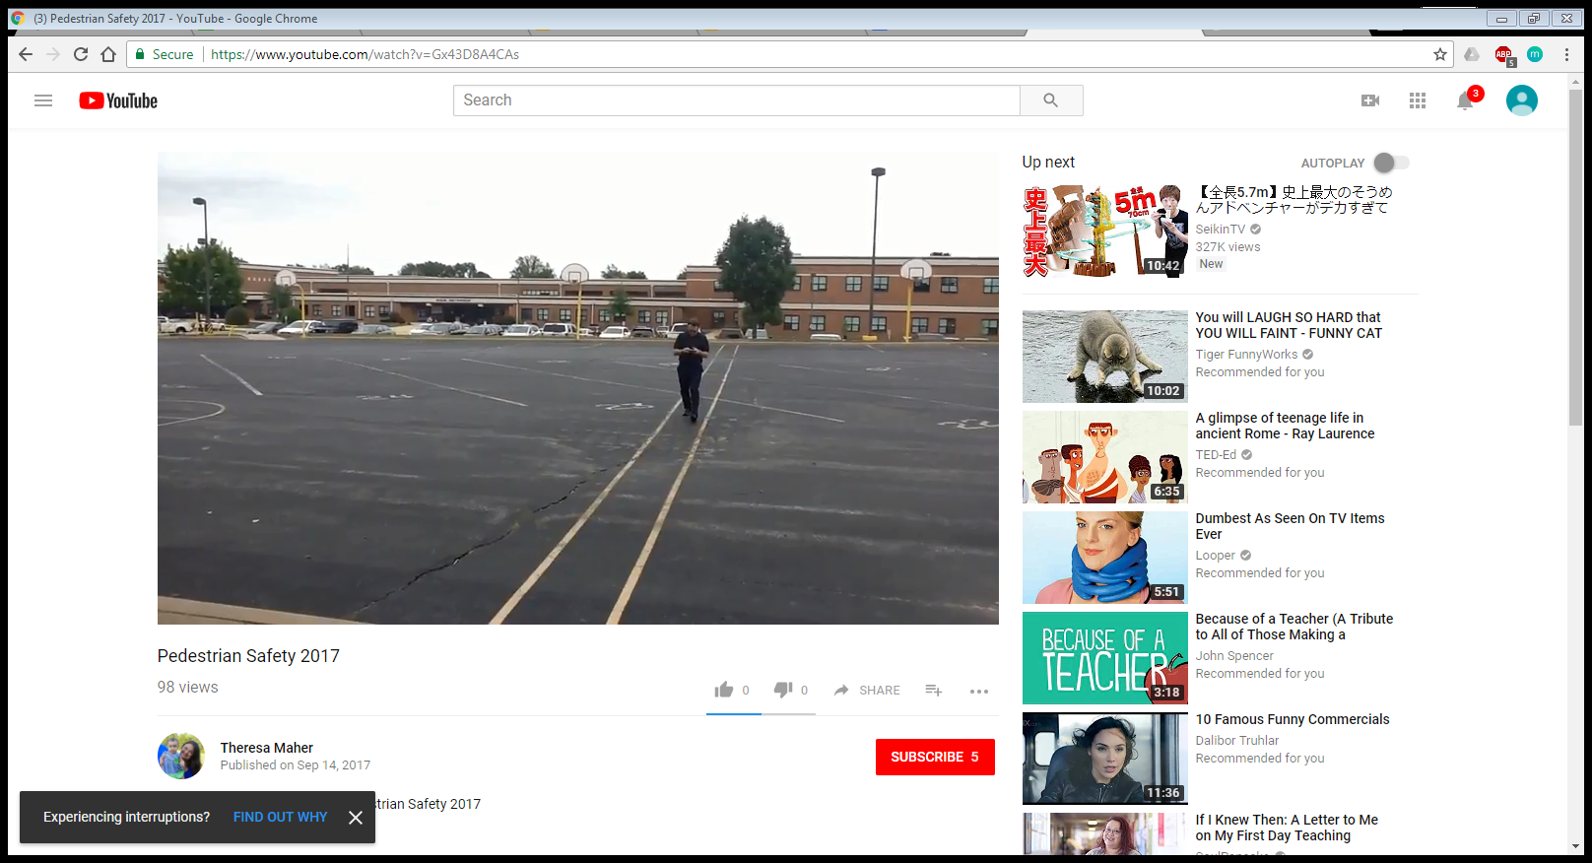

Slide 10
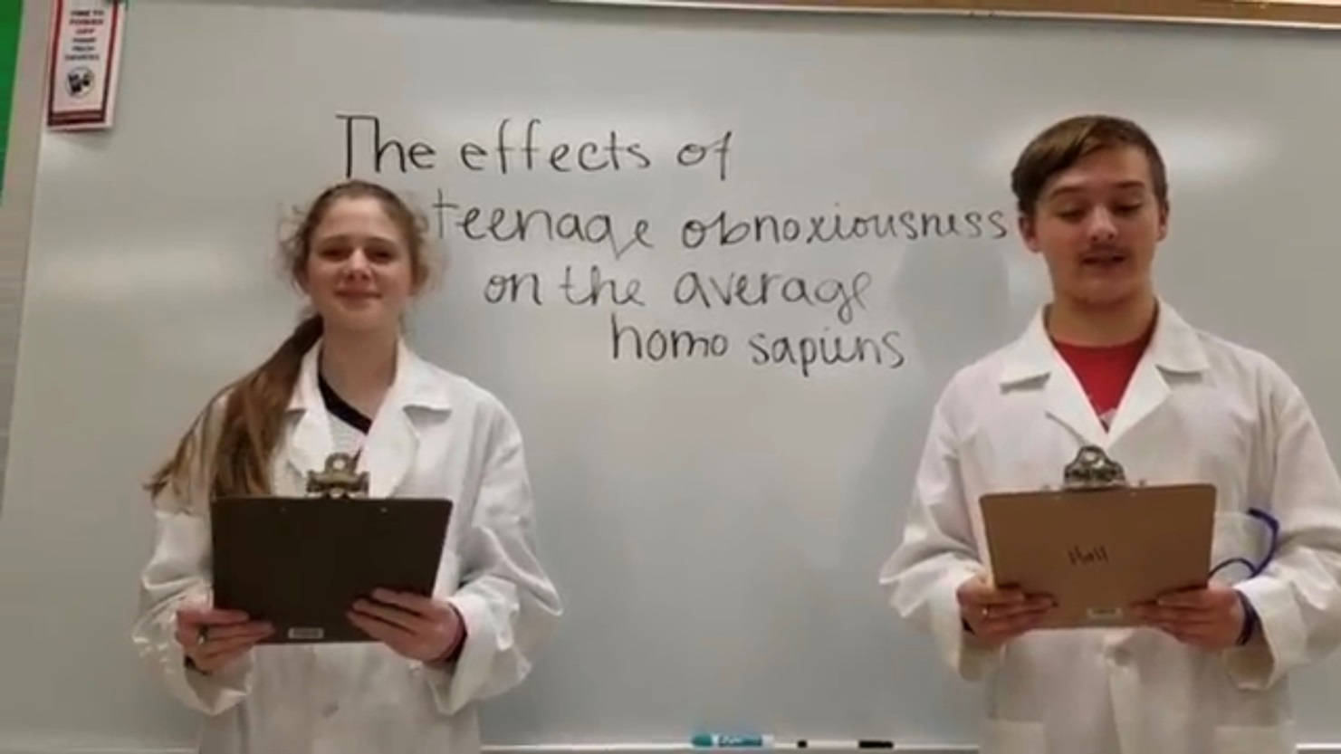
Student videos were posted on our online blog!
www.smspbs.blogspot.com
A resourceful and easy way to organize our videos.

Slide 12
The Biggest Impact
Students brainstormed ways to change our current positive recognition program (our CAUGHT-CHA system) and the Caught-cha store was born!

Slide 13
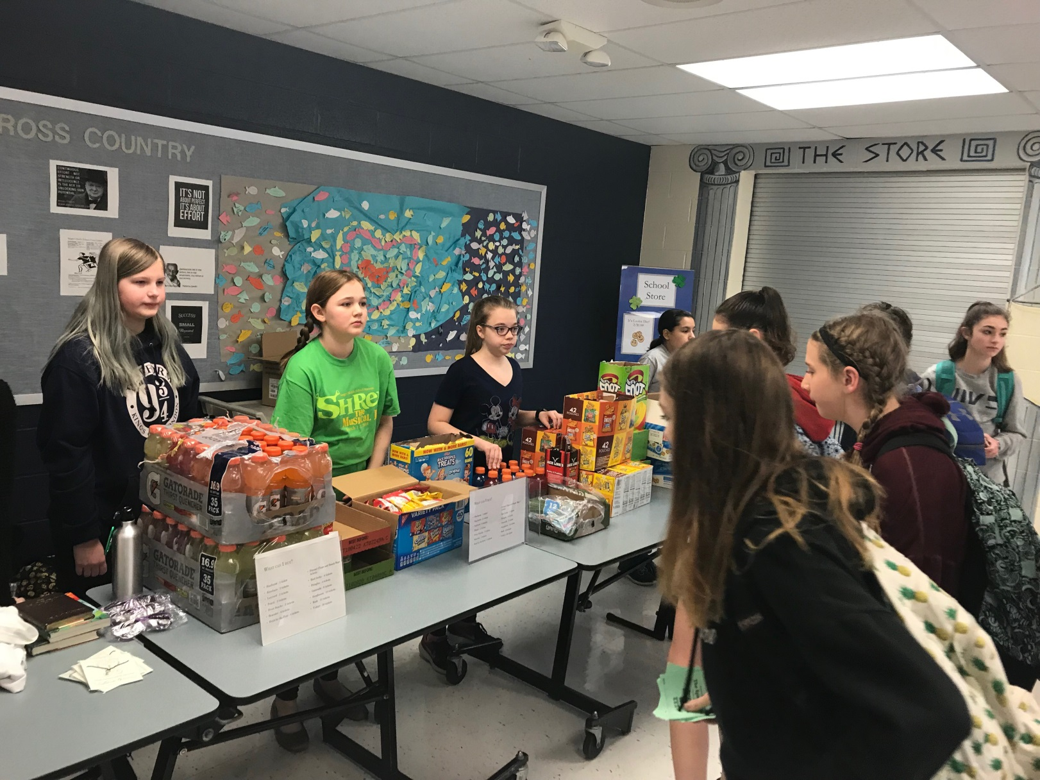

Slide 14
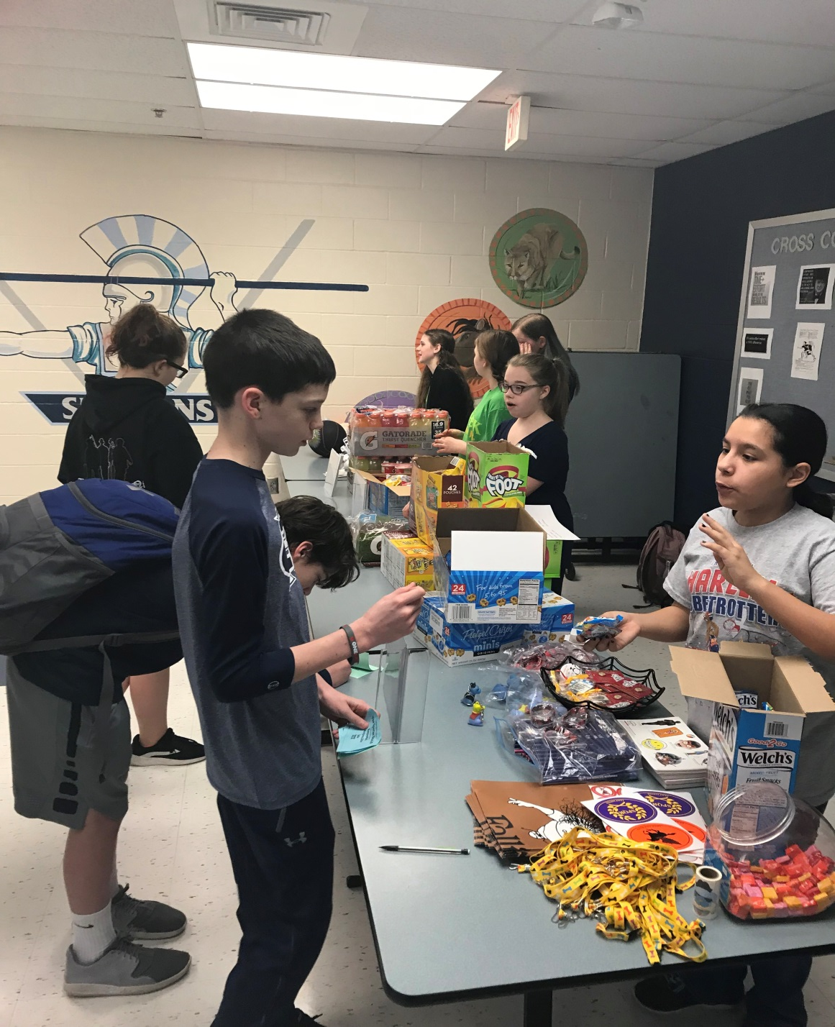
The Caught-cha Store was planned and managed by students!

Slide 15
Events & Other Changes
Student led Valentine’s Day fundraiser.
Students created positive attitude bulletin boards.

Slide 16
Pleasant Surprises!
Students were VERY invested! They loved having their voice heard!
Natural leadership emerged!
Fresh ideas and videos for the school community to see!

Slide 17
Challenges
Letting the staff know who we are!
The kids were so excited—how could we incorporate all of their great ideas?!

Slide 18
Plans for Next Year?
More videos!
A fall and spring fundraiser.
Dates of Caught-cha Store established in advance.

Slide 19
Plans for Next Year
Collaboration with Student Council to recognize teachers and increase student participation and involvement.
Plan and implement School wide incentive each semester for students (spirit weeks, school assemblies, etc…)

Slide 20
Recommendations
Start small—set a few goals.
Have a clear, shared vision between students and teacher-leader.
Trust the kids! Our students produced great things!
Let it take the shape that best fits your school’s needs.

