Slide 1
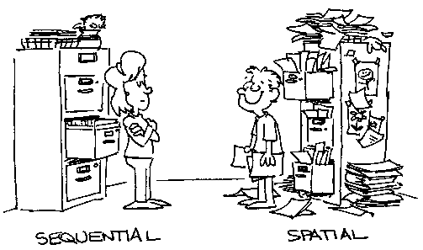
Organizational Skills
Getting your room and your students in shape
K
Notes:
Just as we ask you to teach universally applied behavioral expectations for all students in your building, so we are also asking you to help all students become more organized by modeling a well organized classroom. You should then teach organizational skills to all students and require them to practice these skills until they become fluent.

Slide 2

Outcomes
As a result of this session you will have gained knowledge about the following strategies:
Organizing your classroom
Teaching organization skills to your students
Creating an Organizational Skills Tier 2 intervention
Adding organizational skills to current Tier 2 interventions
Notes:
May or \may not have noticed that there are 2 parts to this presentation. Part one is going to be covering some general
Organizational strategies that are beneficial for all students. Including room organization starting and ending on time, classroom procedures and visual schedules. Most of the things you will hear will be things you can do with whole class. We will also introduce more individual plans that you will be able to utilize to help some of your students who continue to struggle with organization. If you have exhausted many of these then you will need to consider a tier 2 which will be covered in part 2 tomorrow.

Slide 3
Design the Environment to Encourage Appropriate Behavior
Arrange furniture to allow easy traffic flow.
Designate staff & student areas.
Ensure adequate supervision of all areas—proximity and mobility.
Visual access
    Teacher access to students at all times
    Student access to relevant instructional materials
Notes:
The first step is to design an environment that is conducive to learning. In thinking about the arrangement of your classroom these are some key things to keep in mind to develop an environment more conducive to learning.(reference steps on slide)

Slide 4
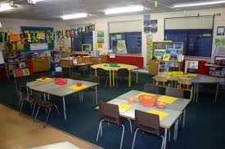
Design a Functional Physical Layout for the Classroom
  Creating Spaces:
  Resource area
  Computer area
  Free time
  Reading area
  Group learning
  Different areas of classroom defined for different activities:
  Groups versus separate work stations
  Independent work
  Break or Chill out area
Notes:
Set up room with chart posters for group work, independent work procedures, chill out poster and fidgets and scrap paper and think sheet. 1st step is designing the classroom. You also need to take into consideration what takes place in the different areas of the classroom. For instance: Where will your cooperative learning groups take place? Where will students be expected to do their independent work or how will you set up work stations? It might be helpful to have a chill out area in your classroom for students who need to have a private place to deal with their frustrations. If you designate an area for this you need to be sure to teach the procedure for it. It is important that you take into considerations what will take place where and design your room so you can effectively supervise those areas. YOU MUST ALSO TEACH THE PROCEDURES FOR THESE TO YOUR STUDENTS. For example in group work we will use voice level 1 that sounds like this. If you need assistance you will put up a red cup. All voices will be heard equally. Assign roles: One person will be the resource person to gather needed materials prior to beginning the assigned task. One person will be the task manager keep the group focused and a secretary to record notes. Reporter who will report out to the group. Facilitator to begin the task. You will move your desk into pods when signal is given. Break area who can use it, when and how. What should it look like? Stand up desk or sit down with fidgets, thinks sheets, scrap paper.

Slide 5
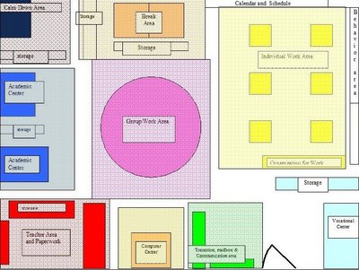
Picture of Room Arrangements

Slide 6

Discussion Activity
Share with an elbow partner what spaces you have allotted in your room. How might it be improved?

Slide 7
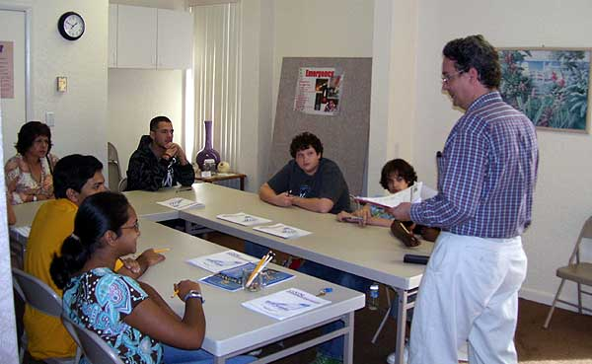
Consider Seating Arrangements
  Arrange desks to optimize the most frequent style of teaching
  Consider traffic areas and supervision
Notes:
Thinking about the physical lay out of the room and how it should match your teaching style is important. You will also need to consider where student materials will be placed for easy access and the least amount of distractibility. As well as how you will be able to actively supervise the entire class at all times. (EYES in the back of your head) Earlier I discussed the importance of having a procedure for group time. It is important that this procedure is taught and practiced. ( Demonstrate how to move from instructional to cooperative groups)

Slide 8
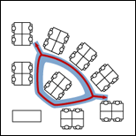
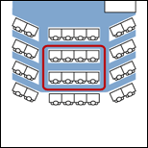
Suggested Seating Arrangements
An interior loop allows you to work
the crowd with the fewest steps.
(Fred Jones)
Notes:
Here are 2 suggested ways to arrange the classroom which allows the teacher to access all students.

Slide 9

Teach Students
How to quickly move seats into cooperative learning groups
How to utilize the break or chill out area
Procedures for independent vs group work
D&K
Notes:
We need to model this and have procedures written for both. Deb Demonstrate moving desks from rows to groups of 3 or 4. Karen move to chill out area where she will have chill out cards, anger putty, squish balls. Deb show independent vs group work procedures with CHAMP cards

Slide 10
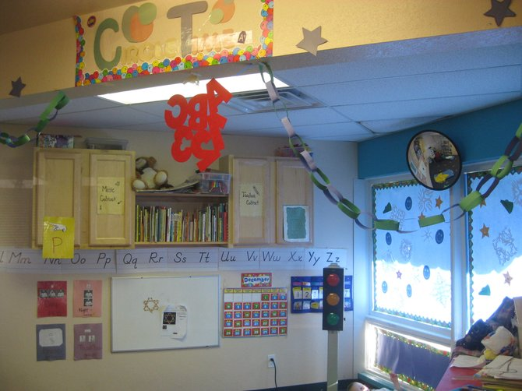
Creating an Organized Classroom
Organizing wall space – keep like items together
  Rules and Procedures
  Examples of student work
  Academic directions or reminders
  Don’t have too much on the walls. Take down and put up items relevant to academic objectives
Notes:
Teaching order of operations take it down when you begin teaching geometry don’t add too. SENSORY OVERLOAD

Slide 11

Creating an Organized Classroom
What goes on the board?
  Homework
  Objectives
  Assignments
  Bell Ringer
  Schedule
D
Notes:
writing on the board should be done before or after school or for student practice. Don’t turn your back to the class – use an overhead for writing during instruction. Put DOL in container at door

Slide 12
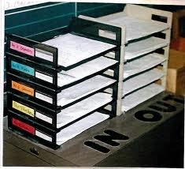
Creating an Organized Classroom
Organizing papers
  Location for homework
  Location for in class assignments
  Notes home
  Graded assignments that go back to students
Notes:
Look for pictures that reflect these items. Props in/out baskets Have a location for placing make-up work. This could be in a student mailbox or folder – do not have the student get it directly from you. Assign each student a buddy helper or make it a job assignment (this is the ‘go to’ person for explanation of make-up work) Teach students to ask peer for instructions on make-up work before they come to you. Karen reference baskets

Slide 13
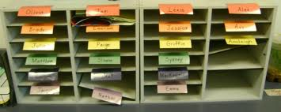
Dealing with Absences
Create a system and location for make up work:
Student mailbox or folder
Assign student buddy helper
Student job assignment
Notes:
Have. a location for placing make-up work. This could be in a student mailbox or folder – do not have the student get it directly from you. When distributing worksheets for the day, place copies in folders for absent student. At the end of the day label the folder with the absent students’ name and missed work is ready for the students’ return. (Education World” Teachers, Start Your Engines” www.educationworld.com10/04/2005)
Assign each student a buddy helper or make it a job assignment (this is the ‘go to’ person for explanation of make-up work) Teach students to ask peer for instructions on make-up work before they come to you

Slide 14

Reflection Question: Room Design
What adjustments might you make to your current classroom design to create an environment more conducive to learning ?
Notes:
Take a moment to reflect on some changes you might want to make in your classroom. Jot down your thoughts on Organization Star Ideas handout provided. Turn to a partner and share the adjustments you plan to make.

Slide 15

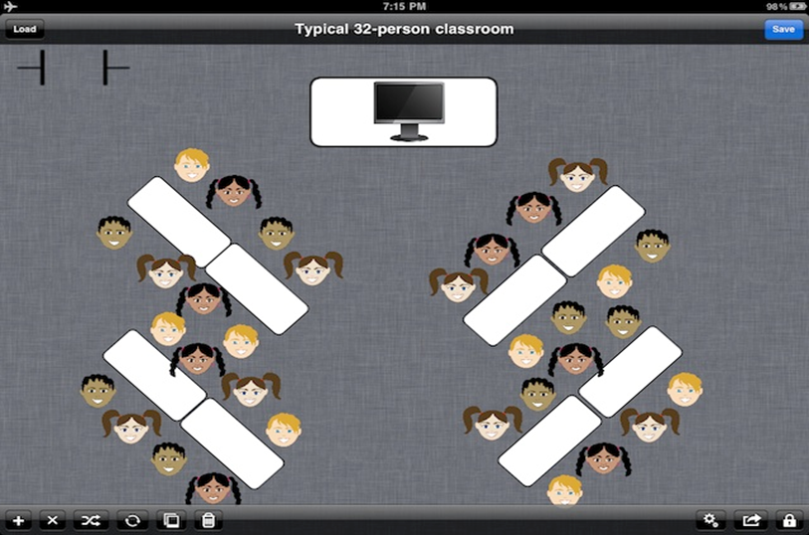
Set the Stage for Learning
Greet Students at the Door
Post a Visual Schedule
Visual Seating Chart
Visual Schedule Examples
K
Notes:
Deb and I need to greet people as they come in to the presentation. Show visual schedules. . Karen discuss different types of schedules and importance of having them on the same spot on the board. Deb show posters of these items that are placed on wall and why each is important Greeting students at door using their names until bell rings. Have a visual schedule posted. Greeting students at door using their names and possibly a handshake or high five. Their responses can tell you a lot about how they are feeling that day.
It may be helpful to have classical music playing or the lights down low.
Increase flexibility in seat assignments and make life easier for substitutes by creating a visual seating chart. Use the small pictures you get from picture day or take a digital photo. Attach a 2 sided tape or a velcor dot to the back and attach to a laminated poster of your classroom seating arrangement. The velcro allows for easy movement of the students and substitutes love being able to easily identify students.( Education World” Teachers, Start Your Engines” www.educationworld.com10/04/2005)

Slide 16
Teach Procedures
Entering Classroom
Turning in Homework
Getting Needed Materials
  Rent a Car
  FORGET-ME-NOT Flowers
  Start off on the right foot
Do Now or Bell Ringer
Notes:
Karen Reference getting materials. Using a basket for DOL Teachers spend an average of $400 dollars out of pocket for school supplies every year so holding on to supplies is a priority. One South Dakota teacher uses floral tape to tape silk flowers around her loaner pencils and that way she can ensure that they will be returned. Another teacher had students give her a shoe for a pencil and when returned the borrowed materials she gave them their shoe back.
Having a DO NOW activity written on the board every morning so students know exactly what is expected of them each morning is an effective procedure to ensure students start their day off on the right track

Slide 17



Send them out ready
At end of class
  Teacher ends the class – not the bell
  Allow time for writing assignments and homework in planner
  Teach a ‘clean-up’ procedure
  Have students carry a homework folder which contains all papers needed to complete homework assignments
Notes:
Model have Deb copy homework from board into planner and stack all books up for home with planner open. I can do a quick check or have a buddy check. Then put in book bag.

Slide 18
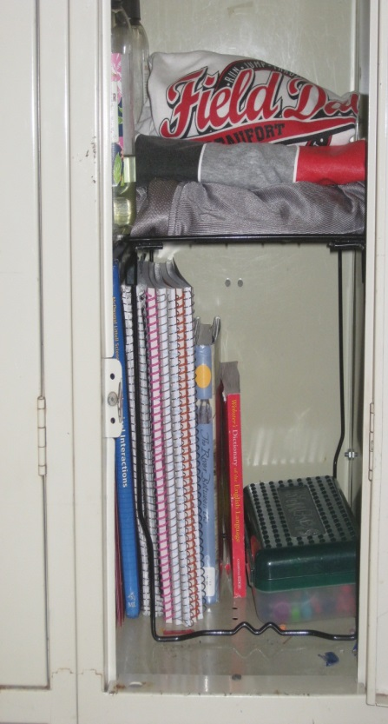
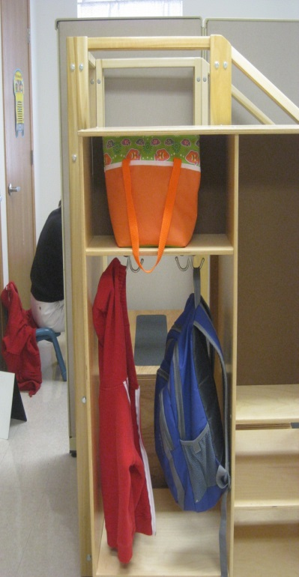
But I still have Students who are DISORGANIZED!
Try pairing them with an organized peer for additional practice
Teach and post arrival and departure procedures inside cubby or locker
D
Notes:
After all this you still have kids struggling with organization. How can I meet the needs of these individuals?

Slide 19
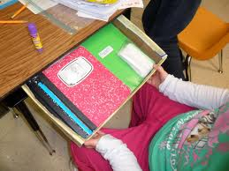
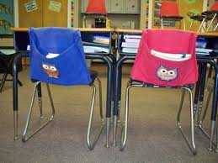
Teach and Provide Visuals for
Student Desk Organization
Desk Organization Picture
Notes:
Allow student to have an additional desk and/or have a desk organizer picture and share with them what the expectations are and do periodic checks.

Slide 20


Additional Ideas
Sticky labels: Type or write assignments on labels and place in planner if assignment is missing
Color coding folders
Accordion folder
String bags in place of backpack
Notes:
Show these additional ideas.

Slide 21
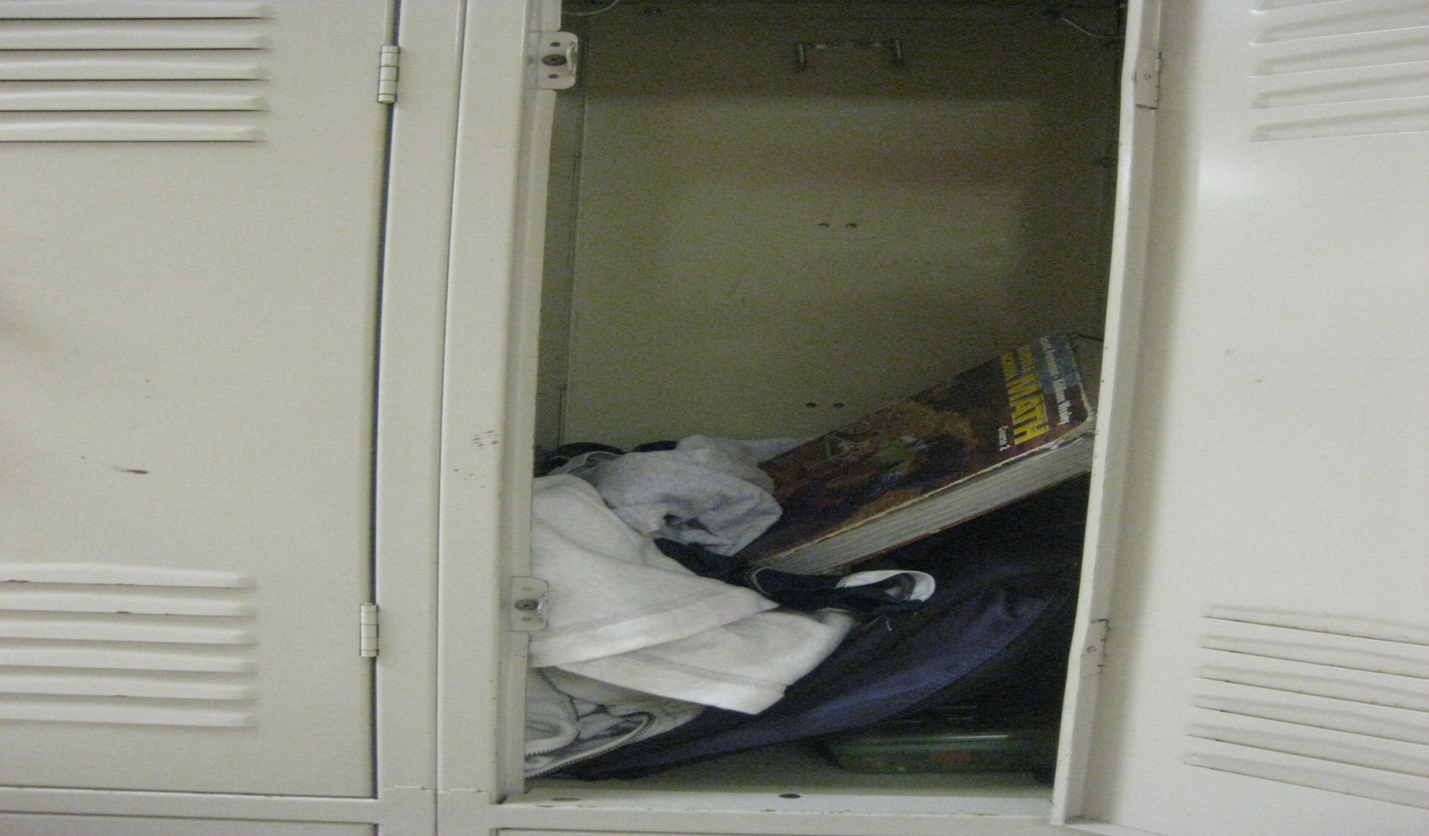
Even with additional strategies you still have students who are disorganized?
Do you still do more?????
Notes:
Here is a picture of a student locker.

Slide 22
Is There a Need?
It is a diagnostic criteria for ADHD(American Psychiatric Association, 2000)
Disorganization manifests itself in poor grades (Evans, Schultz, White, Brady, Sibley, & Van Eck, 2009)
67% of HS teachers view organizational skills as crucial for student success. (Kerr & Zigmond, 1986)
Notes:
Which means if you have any students with ADHD, disorganization comes with the label

Slide 23


Organizational Skills Intervention
Tier 2 intervention designed to facilitate student organization and promote student ability to sort and store paperwork, identify assigned homework, and turn in completed assignments when they are due.

Slide 24

Organizational Skill Intervention
For students who can’t find homework, don’t bring needed supplies to class, have missing assignments when you know they completed them. AND this is affecting their grades

Slide 25
Steps to Implementation
Consider Program Design for your school
Identify/select students in need
Develop an Organizational Checklist
Design a Reinforcement System
Select a system for Data Management
Plans for Fading
Staff Training ( Organizational Checkers)
Student and Parent Training
Organizational Skills System Summary
Notes:
Prior to addressing the steps to implementation you must have an established tier 2 team. Along with a criteria for identifying students who are in need of a tier 2 intervention. A system for gathering additional information. We will be following along with this organizational summary sheet.

Slide 26

Step 1: Program Design
(addressed in tier 2 meetings)
An intervention coordinator is identified that will keep track of student data and match incoming students with an organizational checker
Organizational checkers are identified and trained
Develop a communication system to be utilized between organizational checker and students’ teachers/parents
Notes:
During the tier 2 meeting you have determined who the Coordinator and Checker may be. It could potentially be the same person but does not need to be.
Consider a first or last hour teacher for Checker if in a secondary school. Is regular teacher willing to be the Checker if an elementary building?
The coordinator is in charge of training checkers, matching student to checker as well as compiling data to determine if the student meets the established criteria.

Slide 27
Step 2: Identify/Select Students in Need
Establish data decision criteria to identify/select students at risk and in need of organizational support based on:
  Example:
  Students that turn in homework assignments and projects less than 80% of the time across classes.
  Students whose grades are significantly affected by missing or lost assignments.
Teacher nomination form
Notes:
Will you find this information on your current data decision rules for students to enter any tier 2 intervention? Will your teacher nomination form have identifying information that would allow your tier 2 team to conclude the need for this intervention?

Slide 28

Activity
Thinking back to the previous slides
Choose one student who may be exhibiting one or more of these organizational deficits
Using the Organizational Skills Checklist write the student’s name and list skill deficits.
Organizational Skills Checklist template
Notes:
Note: Print this template in a color so they will have it to give it to them to complete on their student

Slide 29
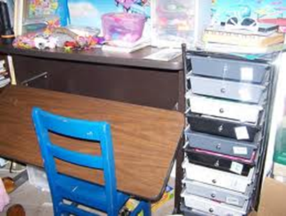

Step 3: Develop an Organizational Checklist
Include a place to document the student’s goal
Include a place to check each criteria for each item with a place for totals
Items that may be included on list:
  Homework or Assignment folder/planner
  Folders or binders for individual classes
  Desk/locker
  Book bag
Notes:
The checklist should reflect your schools expectation for an organized student using any existing systems that have been developed by teachers. See examples of these items A different checklist may need to be developed for different grade levels.

Slide 30
Organizational Checklist Sample
Notes:
Deb will remake to reflect hourly checks

Slide 31

Step 4: Reinforcement System
Design a reinforcement system:
Use the first organizational check to establish baseline to determine initial goal. Increase goal regularly.
Use verbal praise.
Use current school wide recognition system or tangibles as needed.
  Meeting daily/weekly goals
  Other function based reinforcers
Notes:
Verbal praise is used for those who are motivated by adult attention. If student has other motivators (such as peer attention or escape), reinforcers may need to be adjusted. Show mystery motivators, license of control and ice cream or pizza.

Slide 32
Activity Time
Refine Student Organizational Checklist to meet your school/student’s need
Establish a student goal
Determine type and a schedule of reinforcement to support student

Slide 33

Step 5: Data Management
Select a System for Managing Data
Convert organizational checklist to percentage
Chart percentage on graph for visual display
Use excel spreadsheet or Advanced Tier Spreadsheet to collect data for periodic review by tier 2 team.
pbismissouri.org
Notes:
Will student be checked daily or weekly? Show advanced tier spread sheet- have an example of the spread sheet

Slide 34

Step 6: Plans for Fading
Establish Data Decision rule:
How long will student be required to be near 100% before fading intervention?
  Teach student to self monitor paired with periodic checks by organizational checker
  Reduce the number of times student is checked by organizational checker until it is done monthly
Notes:
Criteria for organization needs to be higher due to the nature of the beast. Every missing assignment has the potential to lower the overall grade by considerable (only 1 missing assignment out of 10 lowers the average by 1 letter grade)

Slide 35

Step 7: Staff Training
Train Organizational Checkers
Checker should meet with student in a consistent time and location
Beginning and/or end of the day most ideal
Plan on spending time the first meeting to help organize target areas to criteria
Samples or pictures should be kept on site for student to compare
When student does not meet full criteria, the student should be instructed to correct the problem (prompts may be needed)
Notes:
Stress that there is no punishment for not meeting full criteria. Student is simply required to correct the problem in front of the checker with prompts if needed. Student may not earn goal and therefore the reinforcer would be withheld.

Slide 36
Step 8: Teaching Students and Involving Parents
Consider creating a manual to describe interventions
Teach the program to the student and demonstrate expected behaviors as listed on the checklist (model expected behavior)
Explain program expectations to parent include a contract for them to sign agreeing to sign off on their daily homework
Provide regular updates on student performance to parents
Parent Admission Form
Notes:
You could share with the parents the impact of missing assignments . One missing assignment lowers your grade by one letter. We might want to model a conversation with a student and a parent or show a progress report from STARS SHOW EXAMPLE OF STARS PROGRESS REPORT LAMINATED

Slide 37

Activity Time
Is this Tier 2 intervention needed in your building?
How and when will you present it staff to determine buy in?
Who would be the coordinator?
Who would be checkers?

Slide 38

Organizational Checklist as part of
CICO or Mentoring
CICO facilitator adds the checklist to the morning and/or afternoon check-in check-out procedures
Mentor uses organizational checklist each time they meet with mentee

Slide 39

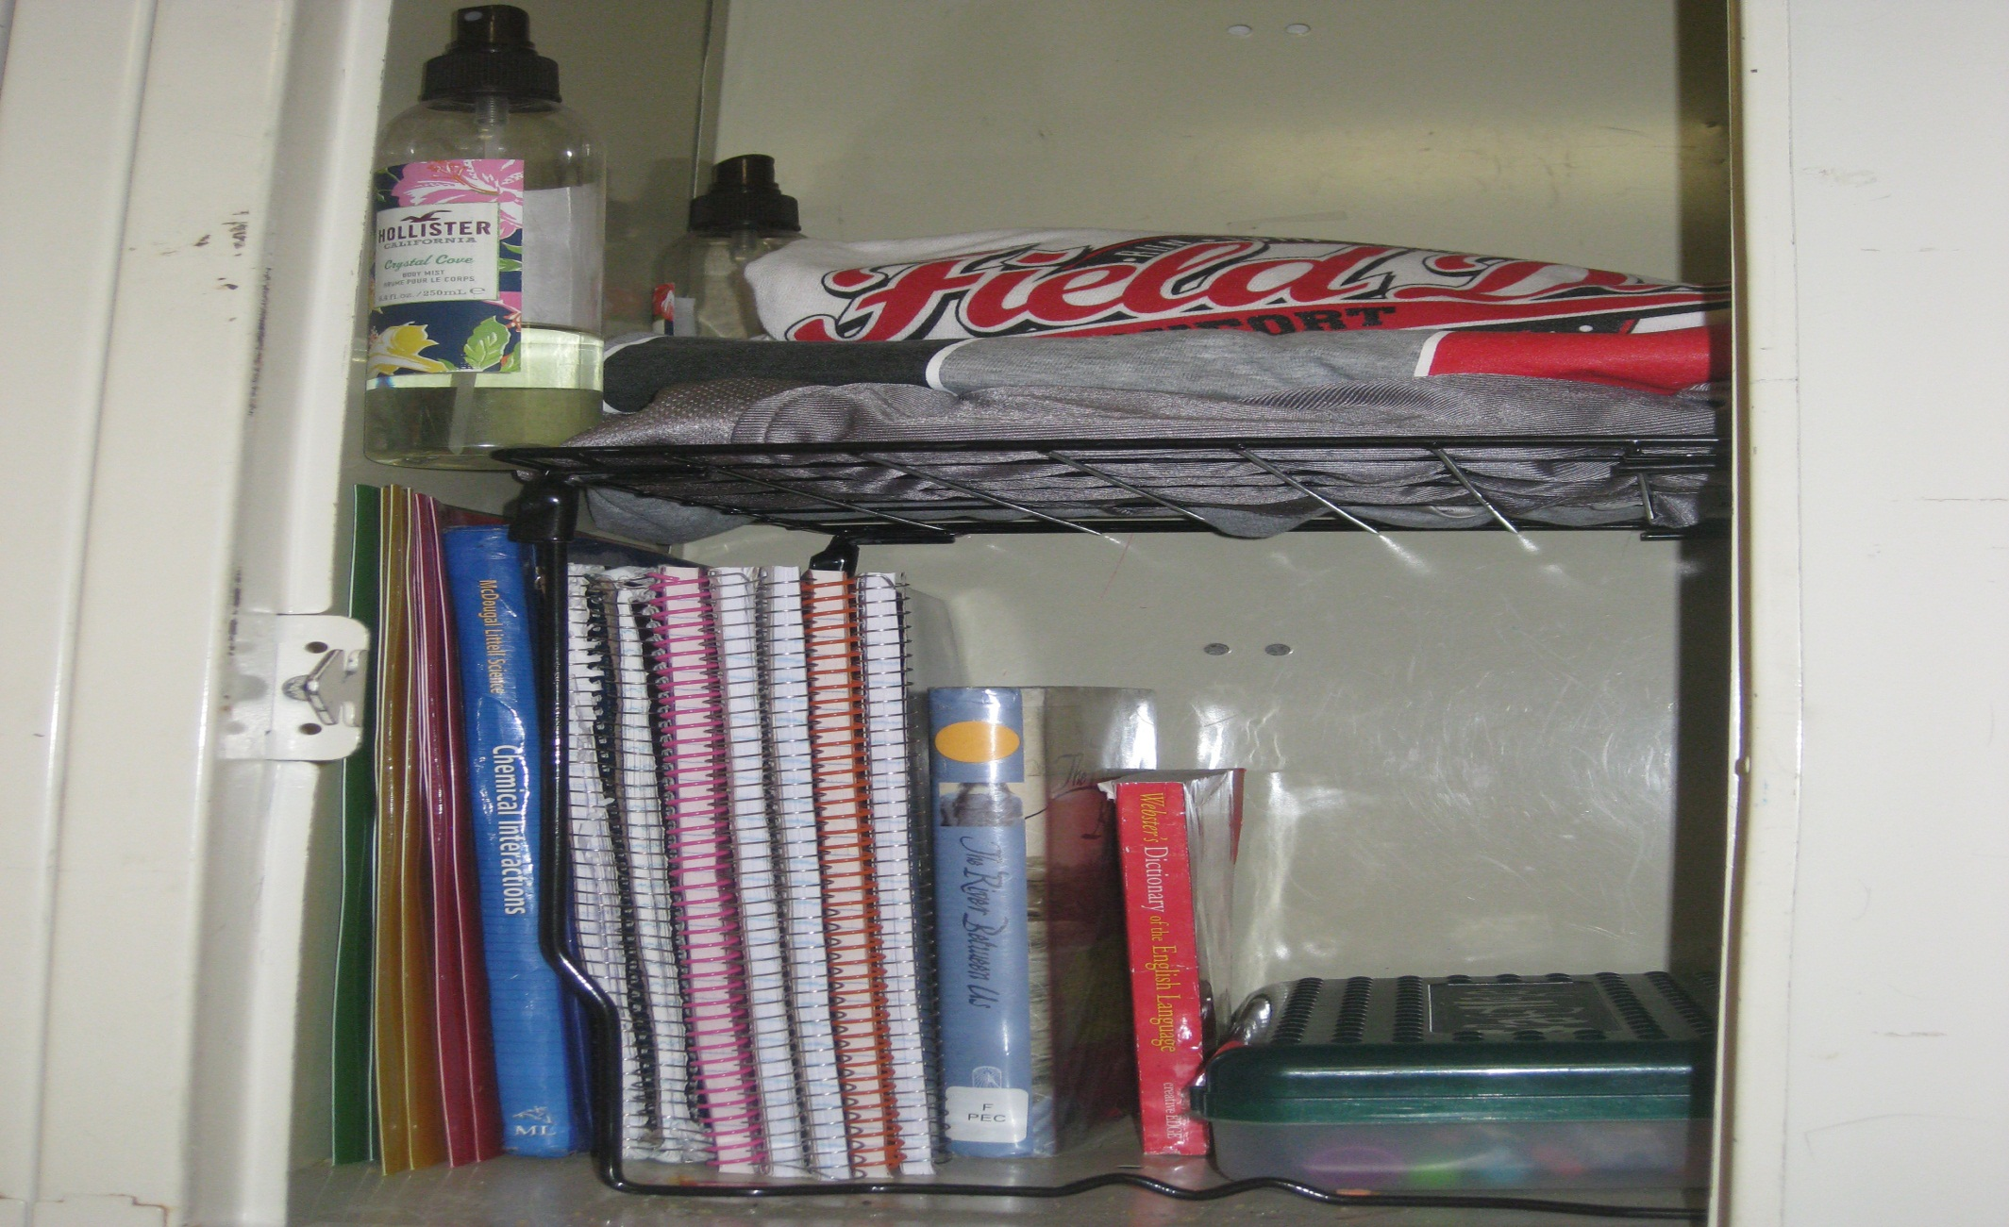

Slide 40
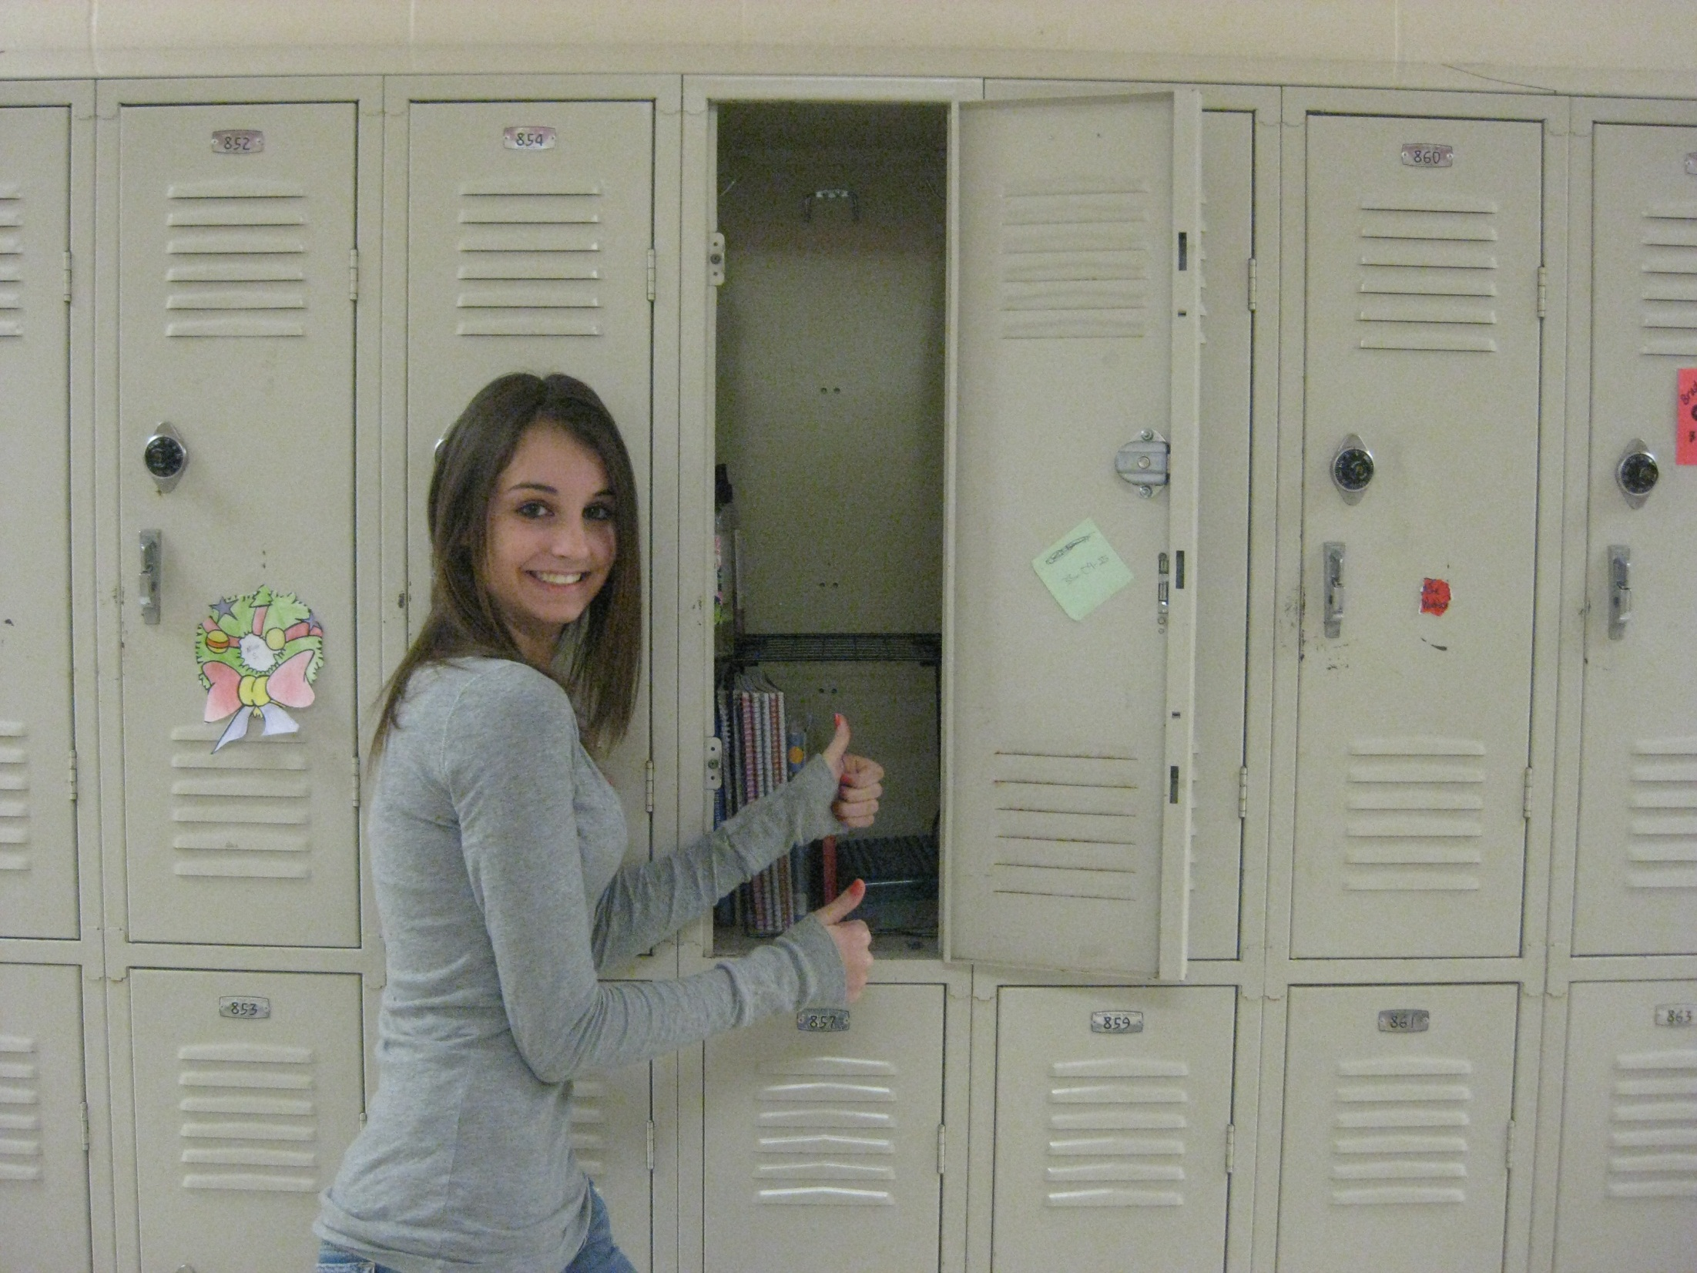

Slide 41

As a Result of Today’s Training
What is….
One thing you will stop doing
One thing you will continue to do
One thing you will start doing
Notes:
Have them fill out the GOTS and Wants handout and leave them on the table so we can review them and try to incorporate the answers in tomorrows information.

Slide 42
Contact Information
Karen Westhoff – Tier 1 Consultant kwesthoff@csd.org
314-692-1252
Deb Childs Ph.D. – Tier 2/3 Consultant
childsde@missouri.edu

