Slide 1
PATH
FOLLOWING A
CURVED
WITH A
STRAIGHT FOCUS
A Look into the Lebanon High School PBIS World

Slide 2
Presented by . . .
Lebanon High School
Bob Matthews- PBIS HS Administrator
Dan Pitts- Counselor- Tier II and Tier III Liaison
Amanda Goodwin- PBIS Team Member
Justin Slye- PBIS HS Coach

Slide 3
Lebanon High School
Student Body | 1,435
Faculty | 95
Administrators | 5
Support Staff | 45
Free & Reduced Lunches | 46%
Minorities | 6%

Slide 4
Where To Start. . .
Researching for Consensus
Universal Expectations
The Matrix
Staff In-service
Follow-up

Slide 5
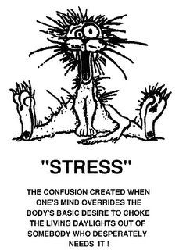
Then and Now

Slide 6
Then and Now
Here is How!
Classrooms Isolated
Teachers Not Clear on What Behavior to Send to the Office
Teacher Morale (Low)
Student Behavior (misunderstood)
Tardies (unorganized and random)
Attendance (below expectations)
Data (not organized or monitored)
Teachers Unaware of Behavioral Data
“At Risk Students” Falling through the cracks
Universal Expectations
Teachers Aware of Office vs. Classroom Managed Behaviors
Teacher Morale (High)
Student Behavior (can discover reason)
Tardies (organized and monitored)
Attendance (at or exceeding expectations)
Data (constantly monitored to make informed decisions)
Teachers Receive Monthly Updates of Behavioral Data
Multiple interventions in Place for “At Risk Students” at all tiers

Slide 7
What Does PBIS Look Like at Lebanon High School?

Slide 8
Overview
Lebanon High School Composition
Initiating PBIS
The PBIS Team
Faculty Involvement
The PBIS Matrix
Recognition Programs
PBS Building-Wide Initiatives
Secondary and Tertiary Interventions
Lebanon High School PBS Data

Slide 9
Team
Representative of Building Composition
Action Plan: Setting Clear Goals
Meetings & Agendas
Subcommittees
Recognition Programs
Student Panel
Data Collection & Analysis
Tier Two & Three Interventions
Communication with Students and Faculty

Slide 10
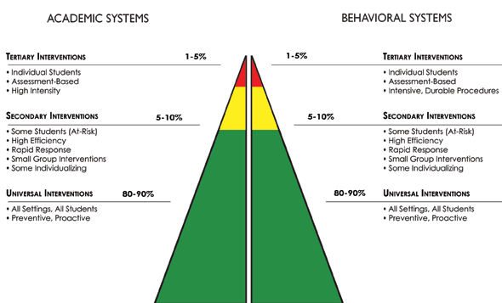
The PBIS Pyramid at LHS
⧫ Special Education
⧫ 504
⧫ Alternative School
⧫ Missouri Options
⧫ Privilege Time
⧫ Out of School Suspension
⧫ Social Worker Referral
⧫ Juvenile Justice Referral
⧫ Mental Health Counseling
⧫ Self-Management Center (Long Term)
⧫ FBA & BIP Privilege Time
Night School  Required Summer School
⧫ Attendance Recovery (Seniors Only)  Credit Recovery
⧫ SAT (Student Assistance Team) Referral  SOS (Save One Student)
⧫ Counselor Watch  P.A.L.S.
⧫ Academic Advisory Lab  RIB (Resource in Basics)
⧫ Tutoring Before/After School (At Risk)  Check and Connect
⧫ Required Tutoring (Administrative Referral)
⧫ ARC (Academic Resource Center) Privilege Time
⧫ Alternative Suspension Center
⧫ In School Suspension ‘Block of ISS / Detention
⧫ Self-Management Center (Short Term)
⧫ SAT (Student Assistance Team) Referral
⧫ SOS (Save One Student)
Buzz Time (Check-in Check-out)
⧫ P.A.L.S.
⧫ Tardy Sweep  PBS Team Services
Privilege Time
⧫ Preferred Seating
⧫ Altered Assignments
⧫ Student Conferences
⧫ Teacher Proxemics
⧫ A+ Peer Tutoring
Bridges Mentors (Freshmen Only)
General Advisory Monitor
Yellow Jacket Code
PBS Matrix
Privilege Time
⧫ Preferred Seating
⧫ Altered Assignments
⧫ Student Conferences
⧫ Teacher Proxemics
⧫ A+ Peer Tutoring
Bridges Mentors (Freshmen Only)
General Advisory Monitor
Yellow Jacket Code
PBS Matrix
PBS Recognition Programs
Privilege Time

Slide 11
The Yellowjacket Code
As a Student at LHS, I will be . . .
Safe
Responsible
Respectful
A Learner

Slide 12
Posting Expectations
Posters in Classrooms
Posters in All Common Areas
Large Framed Posters in Some Common Areas
Banners in All Common Areas
Banners at Major Activities
Sign Outside of Main Entrance

Slide 13
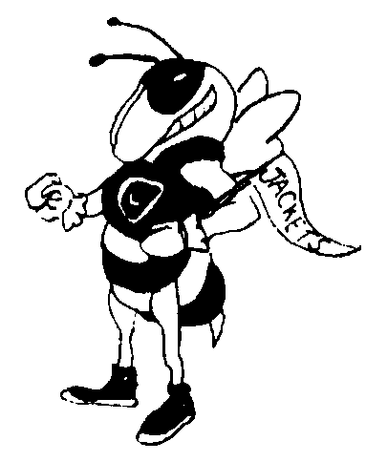
Student Handbook
Positive Behavior Support (PBIS)
Yellowjacket Code
Lebanon High School promotes and emphasizes PBIS. The school-wide expectations for all students are
As a student at Lebanon High School:
I am Respectful
I am Responsible
I am Safe
I am a Learner
Lebanon High School
Lebanon Technology & Career Center
Student Handbook and Planner
2014-2015
“Buzz”
Home of the Yellowjackets
Lebanon High School
777 Brice
Lebanon, Missouri
(417) 532-9144
Dr. Duane Widhalm, Superintendent
Mr. Kevin Lowery, Principal
Mr. Rick Talbott, Assistant Principal
Mr. Bob Matthews, Assistant Principal
Mrs. Kim Lloyd, Assistant Principal

Slide 14
Tardy Sweep
Initiated by Administration
Voted on by Teachers
Established Universal Expectation
Upheld Procedure
Tardy Bell Rings
Teachers “Sweep” Students to Cafeteria/Library
Students Complete Tardy Form
Teachers Escort Students to Class
Office Enters All Tardies into Attendance Program
Office Administers All Detentions, Etc.
Tabulated Results: Data, Data, Data!

Slide 15
Tier III Interventions
Functional Behavior Assessments
and Behavior Improvement Plans
Overview
Team Members
Student Selection
Data Collection

Slide 16
Tier II Interventions
Academic Lab(Check-and-Connect)
Academic Lab Teacher mentors struggling students
Makes Contact with PBIS team member for additional support
Data Collection

Slide 17
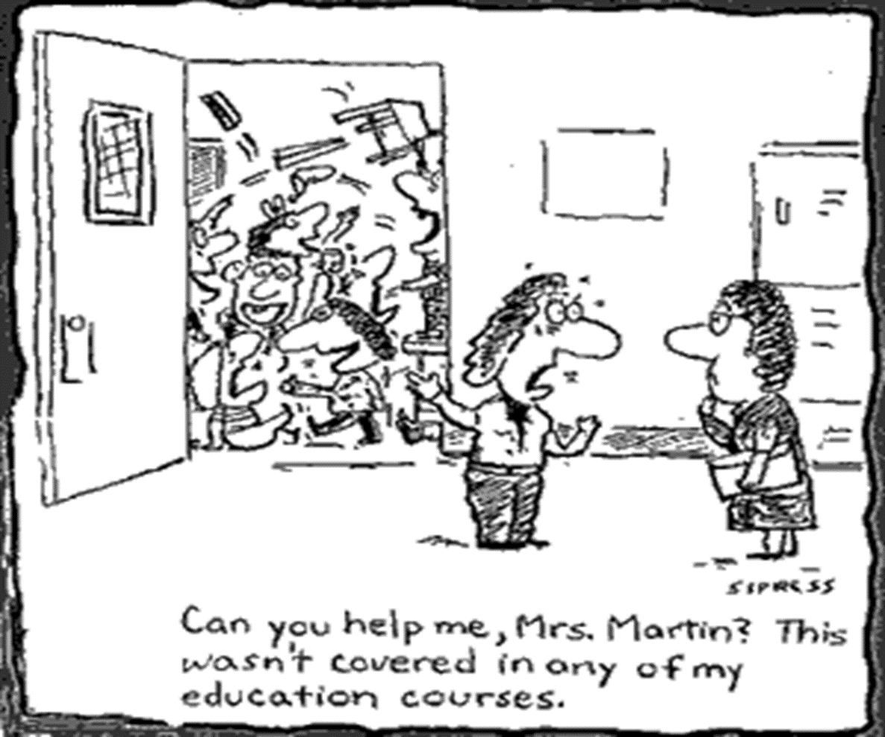

Slide 18
Jacket Success Center
Jacket Success Center Procedure
Students must come to JSC with the appropriate referral filled out.
( Forms are in Tier II Support folder on S Drive)
Send student(s) down with work/tests and the JSC referral form completely filled out

Slide 19
What JSC is and What It Is not!
What it is
It is open all blocks
It is for students who may need an alternate environment to be successful
It is a center for make-up tests
What it is not
JSC is NOT an alternative to ISS, Detention, timeouts, or a place to send students when you need a break from them.
JSC is not a place for punishment, it is a place for support

Slide 20
Student Recognition
Jacket Grams
Buzz Bucks
STAR
Jacket Time
Student of the Week

Slide 21
Jacket Grams
Postcard Recognition
Written by Teachers
Sent Home via Mail
Presented in Class
Team Sends at Least Four Each Month to Faculty

Slide 22
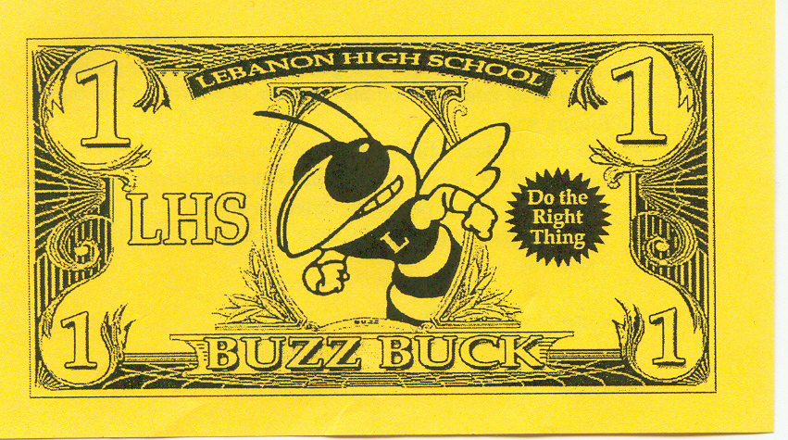
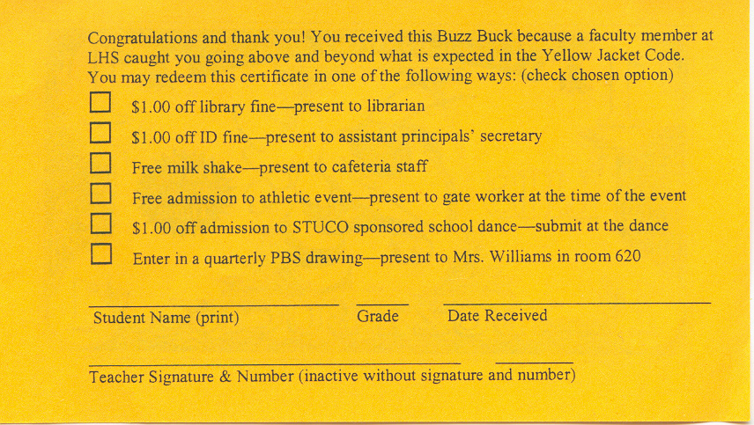
Buzz Bucks
Given by Teachers and Administrators
Received by Students for . . .
Meeting Expectations Consistently
Exceeding Expectations
Showing Vast Improvement
Updated Yearly

Slide 23
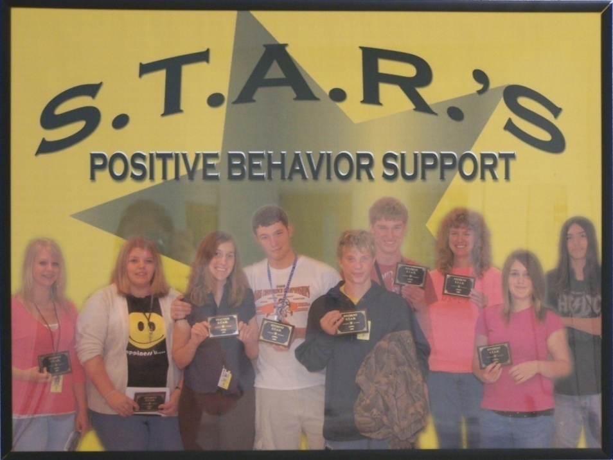
STAR
Nominations by Teachers
Students
Teacher
Support Staff
Selection by PBS Team
Monthly Banquet
Picture & Plaque Ceremony
Recognition Gifts

Slide 24
Teacher PBIS Handbook
Positive Behavior Supports Defined
Lebanon High School Expectations and Goals
Positive Behavior Supports Program Overview
Positive Behavior Supports Teacher Responsibilities Guide
Positive Behavior Supports Implementation Schedule
Behavioral Expectations Matrix for Building Areas
General Lesson Template for Teaching School Behavioral Expectations
Sample Lesson Plan for “Be Safe”
Sample Lesson Plan for “Be Responsible”
Sample Lesson Plan for “Be Respectful”
Sample Lesson Plan for “Be a Learner”
Suggested Application Activities
Positive Behavior Supports Teacher Tool Kit
Recognizing Individuals Who Achieve Behavioral Expectations
Procedures for Handling Infractions of Behavioral Expectations
Office Managed Behaviors
Classroom Managed Behaviors
Instructional Procedure for Dealing with Problem Behaviors
Pyramid of Interventions
Behavior Reporting Form
Request for PBIS Team Services
PBS Individualized Student Support Process
Evaluation and Monitoring of Positive Behavior Supports
Lebanon High School
Positive Behavior Supports and Interventions
Teacher Handbook
2014-2015 School Year

Slide 25
Office vs. Classroom
Managing Student Behaviors
Alcohol
Assault: Physical or Verbal
Bus Referrals
Chronic Classroom Infractions
Classroom Disruption: Major
Dishonesty (Major): Plagiarism
Dress Code (Failure to Comply)
Drugs
Fighting
Gambling
Harassment (of Students or Teachers)
Inappropriate Behaviors in the Hallway
Language: Aggressive and Excessive
Lateness/Tardiness/Skipping Class
Smoking
Threats: Verbal or Physical
Truancy
Vandalism (Significant)
Walking out of Class
Weapons
Attitude/Tone
Calling Out in Class
Classroom Disruption: Minor
Dishonesty (Minor): Lying, Cheating (First Offense)
Dress Code (Initial Warning)
Dressing Out (Physical Education Classes)
Electronic Devices (Universal Expectations)
Food or Drink (Universal Expectations)
Inappropriate Comments
Language (Between Students)
Noncompliance
Non-preparedness
Put Downs
Refusal to Work
Sleeping
Tardiness (Tardy Sweep)
Throwing Small Objects
Touching Others or Objects (Minor Offense)

Slide 26
LHS PBIS Matrix In All Syllabi
Be . . . | Safe | Responsible | Respectful | a Learner
Classroom | Obey Classroom Rules Obey Teacher Directives Display Appropriate Classroom Behaviors | Be on Time Be Prepared Turn in Assignments | Be Attentive Appropriately Respond When Asked Engage in Class Activities Use Appropriate Language Keep Hands and Feet to Self Respect Self and Others | Do personal best by AREA Active Respond Engage Appropriate Study for Assessments Complete Assignments on Time
Hallways | Keep to the Right Keep Moving Keep Hands and Feet to Self | Be in Assigned Area Be Timely | Keep to the Right Keep Moving Use Only Acceptable PDA Use Appropriate Language | Allow Others to Learn Be Timely Be Prompt
Cafeteria | Wait in Line Keep Hands and Feet to Self Treat Food as Food | Put Away Tray Clear Table Pick up after Self | Wait in Line Use Appropriate Vocal Tone Keep Hands and Feet to Self Use Only Acceptable PDA | Be Healthy
Activities/ Assemblies | Obey Safety Rules Stay Seated | Be in Assigned Area Participate in a Positive Manner Take Own Belongings When Leaving | Show School Spirit Display Sportsmanship Give Speaker(s) Undivided Attention Respond Appropriately | Participate Appropriately Pay Attention to Presenter(s) Demonstrate Sportsmanship

Slide 27
Teaching Expectations
Lesson Template for Teaching Behavioral Expectations
When introducing school and/or classroom
expectations, follow three basic steps.
Step 1: Introduce the Expectation
A. Briefly outline what the focus of the lesson will be, what activities will be engaged in, and what your expectations are for the lesson.
B. Check for understanding by asking students to tell you what they will be working on and doing during the lesson.
C. State the expectation and its definition.
Step 2: Demonstrate the Expectation
A. Model at least two positive and negative examples of the expectation; emphasize the positive.
1. Use another adult or a student to demonstrate these examples.
2. Give students observation tasks, such as:
a. ”List all the things that I/he/she did that were ‘safe’”
b. ”List all the things that I/he/she did that were ‘not safe’”
B. Conduct a role-play: choose one to three students to participate.
C. Require one student to demonstrate the skill in response to an example.
D. Coach students on key expectation (skills) as needed.
E. Refer to the expectation and the definition when giving feedback.
Step 3: Provide Monitoring and Feedback
A. Discuss the role-play, focusing on the targeted skill for the lesson.
1. Use key words when discussing the role-play.
Example: “That’s right, she walked facing forward; this action was safe.”
2. Provide specific feedback to students during the discussion.
B. Use real situations throughout the day/class/quarter/year as needed for further examples to discuss and use for review.
Teacher Handbook
Part of Course Syllabus
Lesson Plans
Advisory
Review in January
Teachers are Encouraged to Review Each Time an Infraction Occurs

Slide 28
Yearly Staff Updates & Training
New Staff Orientation
PBS Defined
Universal Expectations & Matrix
Building-wide Recognition Programs
PBS Initiatives
Classroom Management
All Staff Review & Update
Review of PBS Practices
Data from Previous Year(s)
Teacher Handbook
PBS Team & Goals

Slide 29
Teacher Recognition
Jacket Grams
Lowery Loot
STAR
Run for the Roses
Teacher of the Week

Slide 30
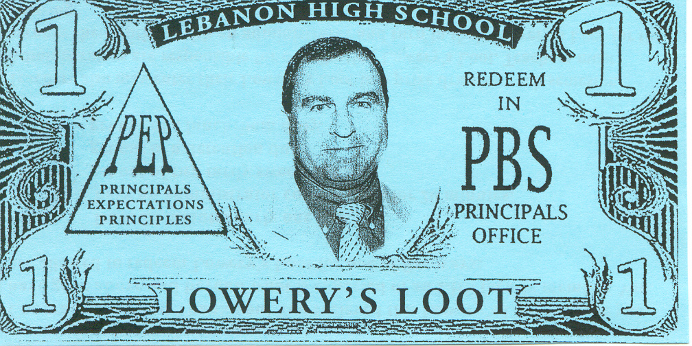
Lowery Loot
Given by Administrators
Announced in Newsletter
Teacher Options
Semester Drawing
Lowery Loot are entered into a drawing to be held at the end of each semester. They may also be redeemed for one of the options below:
leave 20 minutes early one day
have administration cover a class for 20 minutes one day
get out of two tardy sweeps
get out of one detention duty
get out of one lunchroom supervision

Slide 31
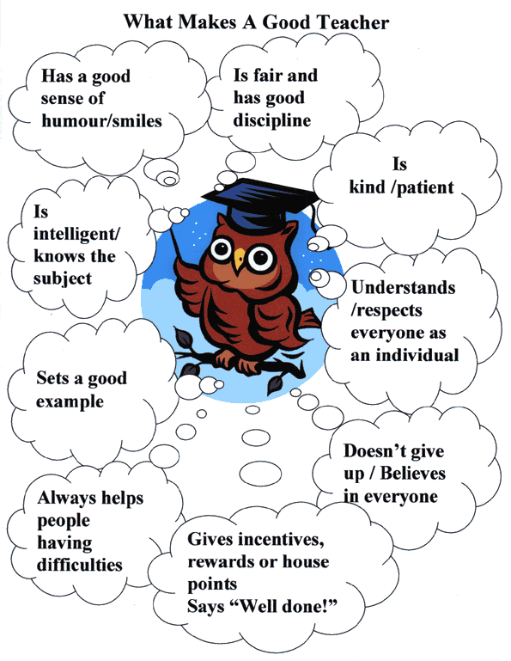
Teacher of the week
Teacher of the Week is voted for by students
Random students are selected each week to vote
Voting also takes place in a ballot box in the cafeteria
Teacher with the most votes becomes Teacher of the Week

Slide 32
Data Analysis
Monthly Reports
Reported to Faculty
Results of Current Data
SIS Discipline Data
SWIS “Big 5” Data
Changes for Reports Next Year

Slide 33
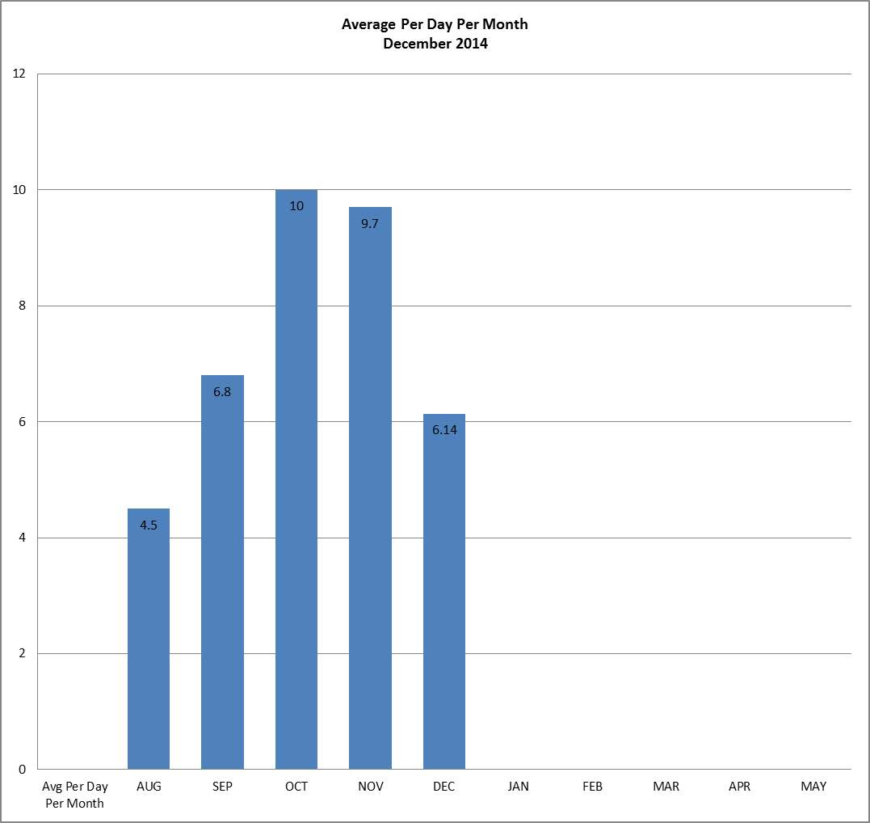

Slide 34
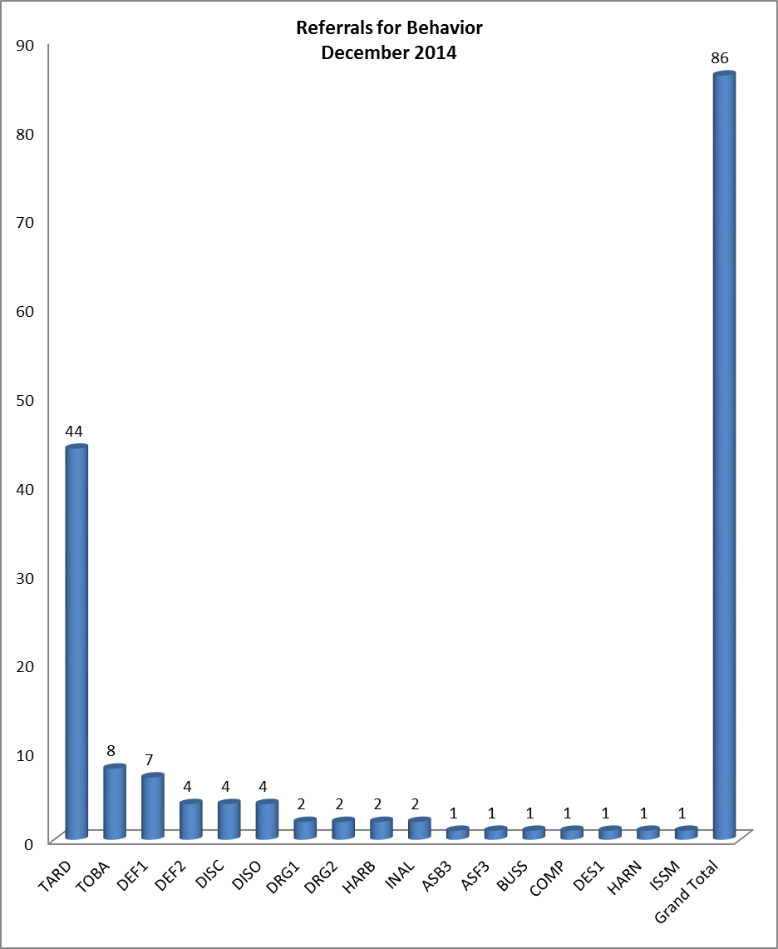

Slide 35
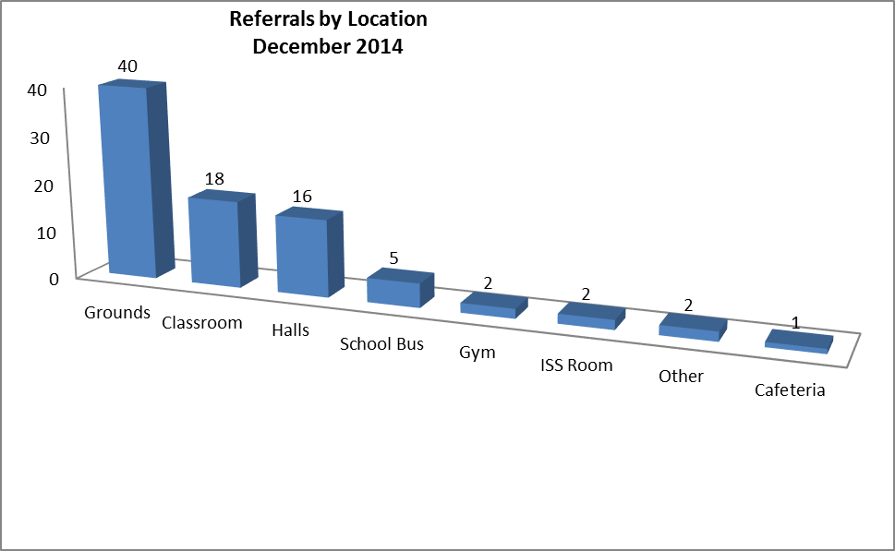

Slide 36
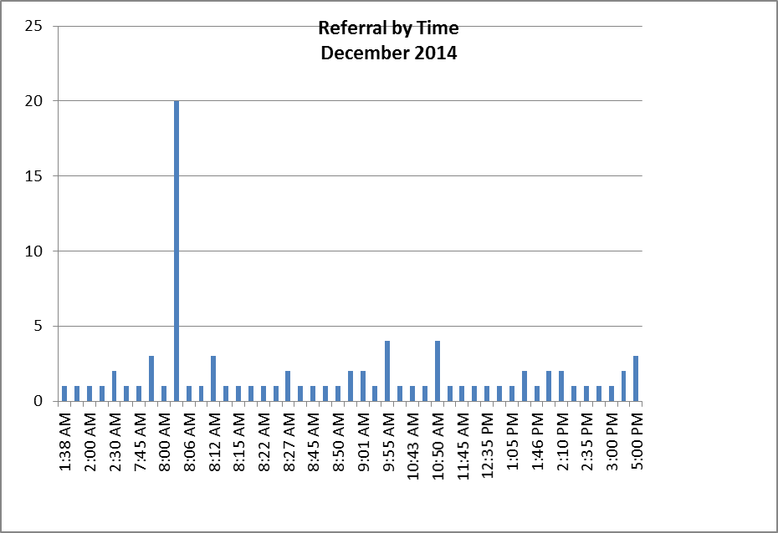

Slide 37
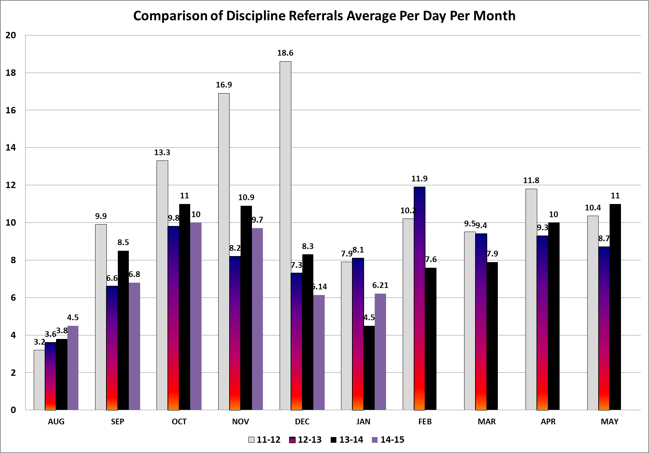

Slide 38
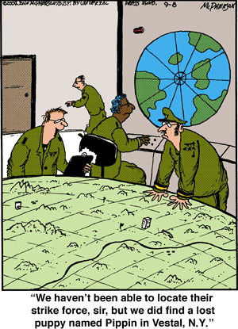
Sometimes You Find What You Are Not Looking For!

Slide 39
Questions??
jslye@lebanon.k12.mo.us - Justin Slye-HS Building Coach
bmatthews@lebanon.k12.mo.us – Bob Matthews-PBIS Building Administrator

