Slide 1
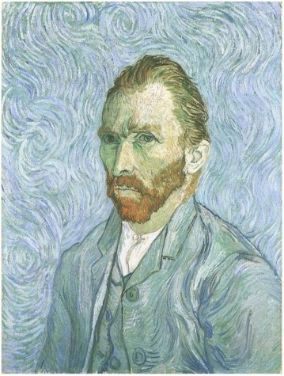
Marzano to “Gogh”
Breaking Down Strategies to Make You More Successful in the Classroom

Slide 2

About Me . . .
Travis Dimmitt
Married to Elizabeth
Daughter Mattie (almost 4)
Son Charlie (19 months)
From Iowa, live in Maryville
7-12 social studies
PBS/RPDC consultant
13 years of experience
Now 6-12 principal
E and I in Florida, 2007.

Slide 3
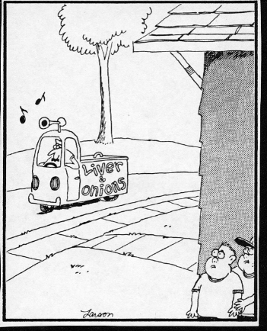

Slide 4
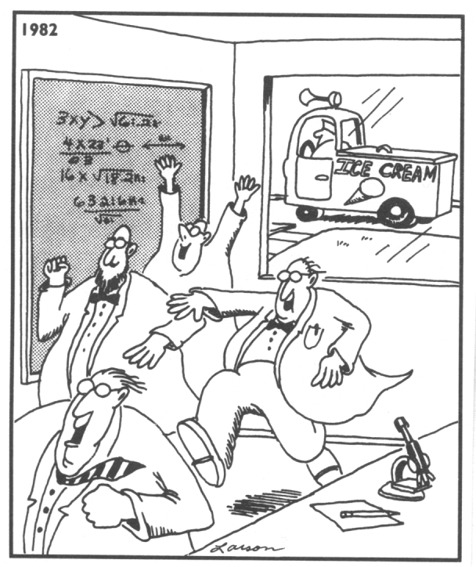

Slide 5
About YOU . . .
Turn to the people around you
Name
Where are you from?
Where do you live now?
Where do you teach? (Where DID you teach?)
What grades/subjects? (Back in the day…)
How many years have you taught?
Complete the Marzano strategies continuum

Slide 6
Marzano Strategies Continuum
No
knowledge
Expert
knowledge
0%
100%
Where do you fit?
(We’ll come back to this in a few minutes.)

Slide 7
Opener – “Talk a Mile a Minute”
Partner up – giver and receiver
Kind of like “Password” or “Pyramid”
Both see the category
A set of terms will appear based on the category – giver gives clues, while receiver tries to guess the terms
Receiver must turn his/her back
First group done shout out
Questions?

Slide 8
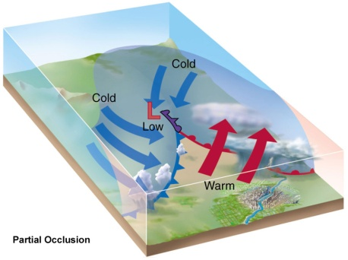
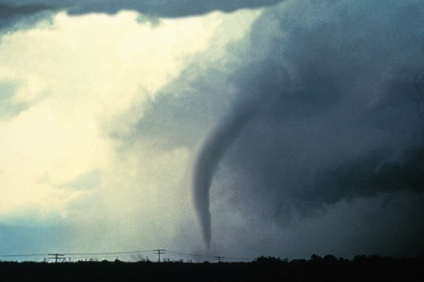
Things associated with weather
Tornado
Hurricane
Cold front
Cumulus clouds
Sleet
Barometer
El Nino

Slide 10
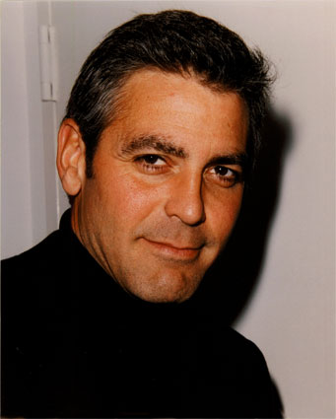
Things associated with oceans
Waves
Moon
Algae
Pacific
Ships
Tropical fish
George Clooney

Slide 12

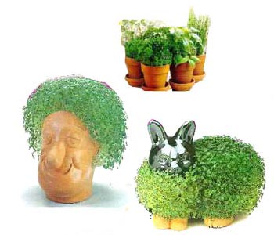
Things associated with plants
Photosynthesis
Foliage
Stems
Fertilizer
Chlorophyll
Pollinate
Chia pets

Slide 14
U.S. Presidents
Abraham Lincoln
George Washington
Franklin Roosevelt
Harry Truman
Richard Nixon
Bill Clinton
Dwight Eisenhower

Slide 16
3
1
2
6
4
5
States
7

Slide 18
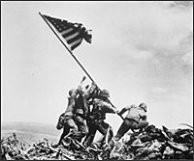
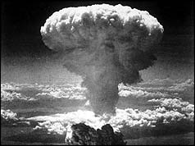
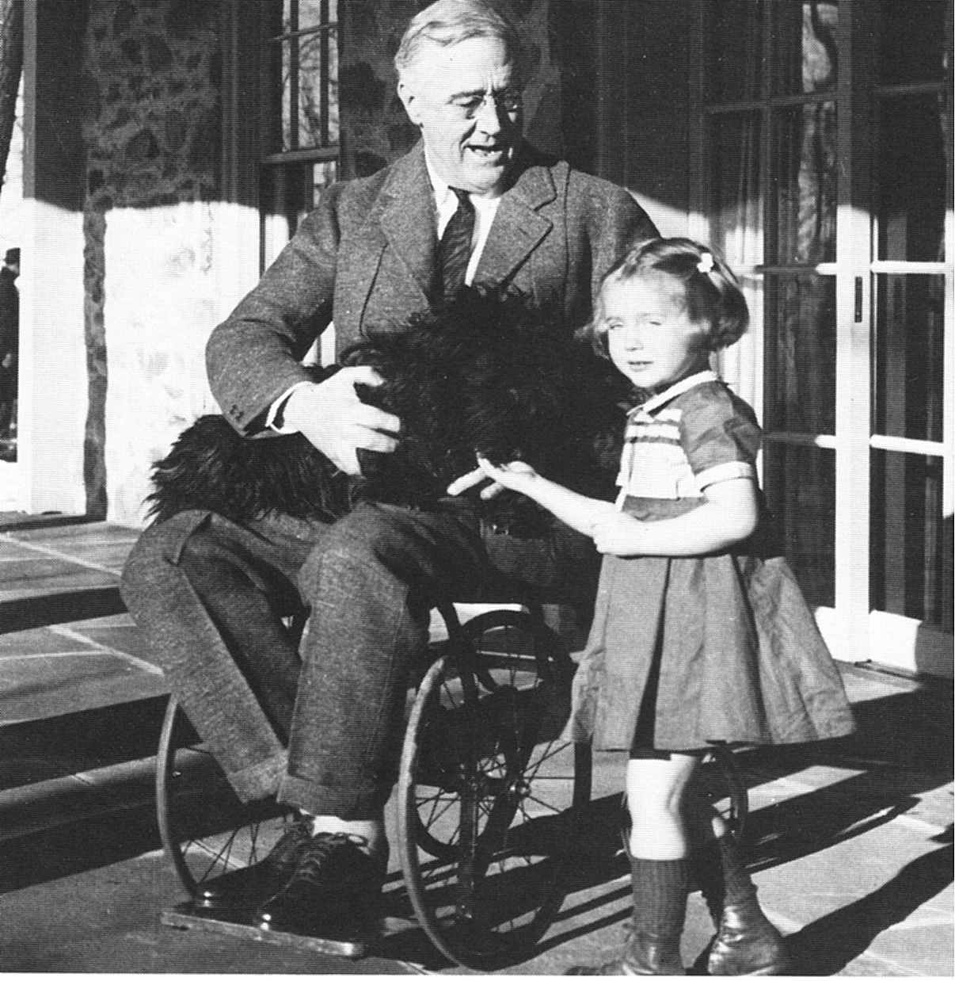

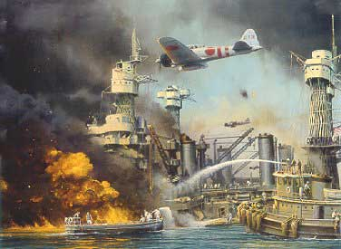
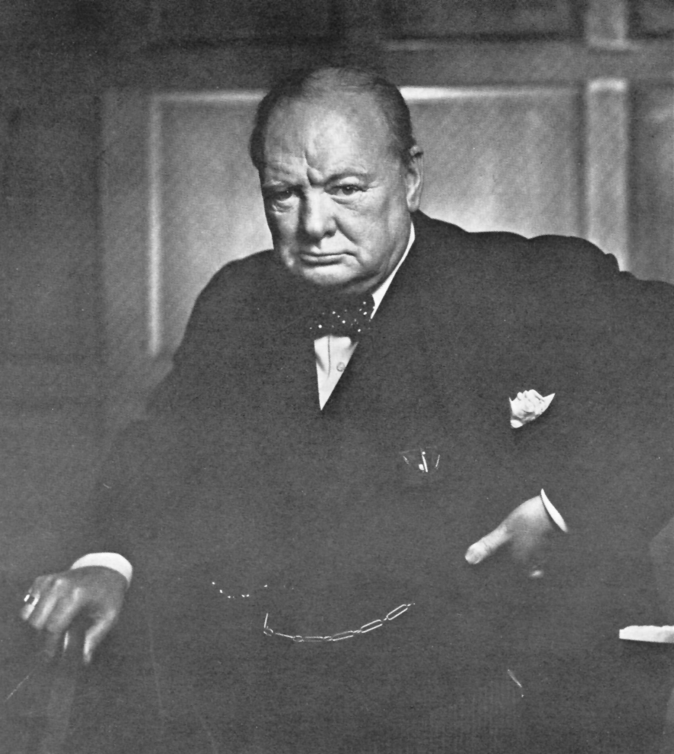

2
1
3
4
6
5
World War 2
7

Slide 20


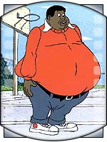

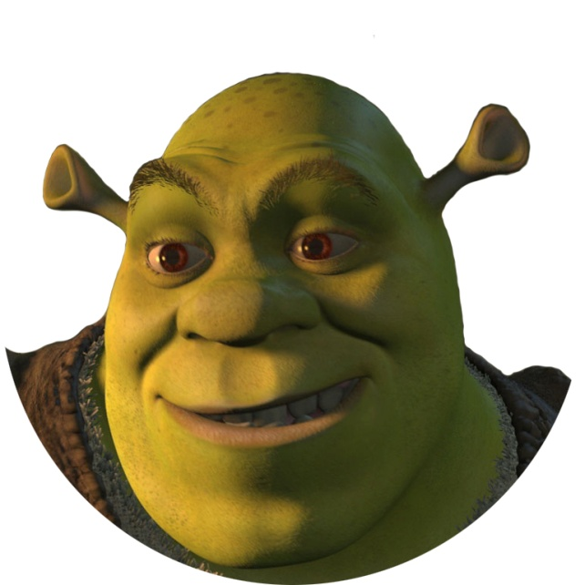


Cartoon Characters
1
4
2
3
5
6
7

Slide 21
As a giver, how did you get your receiver to figure out the terms?
As a receiver, what mental process did you follow in order to figure out each term correctly?
Using info in your packet, what Marzano strategy did we just use?
We’ll come back to this in a few minutes . . .

Slide 22

PRESENTATION GOALS
Put more tools in your “teacher toolbox”
Present information to enhance teaching through use of Marzano strategies
Model effective strategies through in-workshop activities
Enhance ability to provide students “multiple opportunities to respond”

Slide 23
PRESENTATION GOALS
Put more tools in your “teacher toolbox”
Present information to enhance teaching social studies through Marzano strategies
Model effective strategies through in-workshop activities
Provide in-workshop time to process new learning and design lessons intentionally using strategies

Slide 24

Today’s Norms
Active Learning
Participation
Equity of Opinions
Take Care of YOU
Quiet Signal

Slide 25
Today’s Format
Student Mode/Teacher Mode (We’ll switch back and forth)
Instruction
Practice
“Assessment”

Slide 26

Why Provide Multiple
Opportunities to Respond?
Behavioral Outcomes:
Increases student engagement with instruction
Allows for high rates of positive, specific feedback
Limits student time for engaging in inappropriate behavior
Is an efficient use of instructional time
(Heward, 1994)
Notes:
Here are a few reasons why providing opportunities to respond is recommended. Opportunities to respond are associated with:
Students who are more engaged in instruction.
The more we ask students to respond, the more likely they are to be engaged in the academic material presented.
High rates of feedback.
If the teacher sets up the prompts or questions well, the students will respond with the correct answer. When students respond accurately the teacher can then give specific, positive feedback.
Decreases in problem behavior.
When students are engaged in academic responding, they have fewer opportunities to misbehave. Providing many opportunities for students to respond correctly sets a brisk pace during teacher led instruction and decreases time for problems to occur .
Finally, allowing multiple opportunities for student response is an efficient use of instructional time.
Setting up group or whole class responses allows more students to be involved compared with the traditional method of the teacher asking a question and allowing one student to respond.

Slide 27
Marzano Strategies Continuum
No
knowledge
Expert
knowledge
0%
100%
Where do you fit?

Slide 28
As a giver, how did you get your receiver to figure out the terms?
As a receiver, what mental process did you follow in order to figure out each term correctly?

Slide 29
The Marzano Strategies from Classroom Instruction that Works
1. Identifying Similarities and Differences
2. Summarizing and Note Taking
3. Reinforcing Effort and Providing Recognition
4. Homework and Practice
5. Nonlinguistic Representations
6. Cooperative Learning
7. Setting Objectives and Providing Feedback
8. Generating and Testing Hypotheses
9. Questions, Cues and Advance Organizers

Slide 30
The Montillation of Traxoline
Judy Lanier
It is very important that you learn about traxoline. Traxoline is a new form of zionter. It is montilled in Ceristanna. The Ceristannians gristeriate large amounts of fevon and then bracter it to quasel traxoline. Traxoline may well be one of our most lukized snezlaus in the future because of our zionter lescelidge.
Traxoline is a new form of what?
Where is traxoline montilled?
What must be bractered to quasel traxoline?
Why might traxoline be one of our most lukized snezlaus in the future?
DID YOU GET ALL THE ANSWERS CORRECT?
DID YOU LEARN ANYTHING?

Slide 31
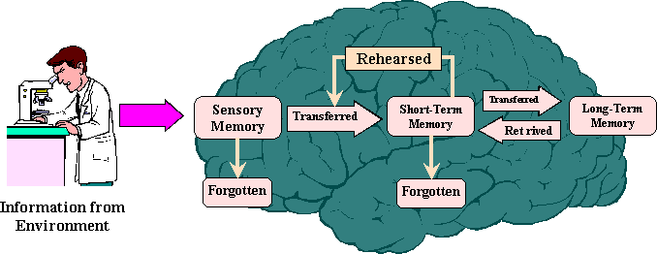
Information Processing Model

Slide 32



Background Knowledge
Permanent
Memory
Working
Memory
Sensory
Memory
New
Information

Slide 33
Permanent
Memory
Background Knowledge
Background
Knowledge
Background
Knowledge
Working
Memory
New
Information
Sensory
Memory

Slide 34
Using info in your packet, what Marzano strategy did we use in our opener?
Identifying Similarities and Differences
What other strategies have we already used?

Slide 35

High-Order Thinking to Gogh
Using Marzano Strategies
(and a special guest)
to Build High-Order Thinking Skills and Provide Multiple Opportunities to Respond

Slide 36
Get Into Teams . . .
LINEUP!

Slide 37
The Marzano Strategies from Classroom Instruction that Works
1. Identifying Similarities and Differences
2. Summarizing and Note Taking
3. Reinforcing Effort and Providing Recognition
4. Homework and Practice
5. Nonlinguistic Representations
6. Cooperative Learning
7. Setting Objectives and Providing Feedback
8. Generating and Testing Hypotheses
9. Questions, Cues and Advance Organizers

Slide 38
Best Practice #1
Finding Similarities and Differences
The brain seeks patterns, connections, and relationships between and among prior and new learning. (BACKGROUND KNOWLEDGE)
The ability to break a concept into its similar and dissimilar characteristics allows students to understand and often solve complex problems by analyzing them in a more simple way.
45%

Slide 39
Finding similarities and differences can increase student achievement by 45%
Compare
Classify
Create metaphors and analogies

Slide 40
Best Practice #6
Generating Nonlinguistic Representations increases student achievement by 27%
Research says that knowledge is stored in two forms: linguistic (in ways associated with words) and nonlinguistic (mental pictures or even physical sensations like smell, touch, kinesthetic association or sound).
The more we can use nonlinguistic representations while learning, the better we can think about and recall our knowledge.

Slide 41
Best Practice #8
Generating and Testing Hypotheses increases student achievement by 23%
“Knowing what to do when you don’t know what to do” is how Piaget defined intelligent behavior. When students generate and test hypotheses they are applying knowledge.
Teachers can keep kids engaged with problems, puzzles, and riddles by using open ended examples. By considering several courses of action, the mind is exercised and the learner engaged.

Slide 42
Best Practice #5
Cooperative Learning Increases Student Achievement by 27%
Research shows that organizing students into cooperative groups yields a positive effect on overall learning.
Round Robin
Stand Up, Hand Up, Pair Up
Kagan!
PIES – positive interdependence, individual accountability, equal participation, simultaneous interaction

Slide 43
Talk a mile a minute . . .
Assessing Initial Background Knowledge

Slide 44

Things associated with
Vincent van Gogh
Artist
“Starry Night”
Absinthe
Missing Ear
Bipolar
Flowers
Shades of Yellow

Slide 45
Assignment
Listen to the song “Starry, Starry Night” while viewing some of Vincent van Gogh’s paintings.
We will be generating and testing a hypothesis, as well as drawing a picture at the song’s conclusion.
Feel free to jot down any ideas or emotions as you are listening and watching you think might help.
(Packet p. 5)

Slide 46
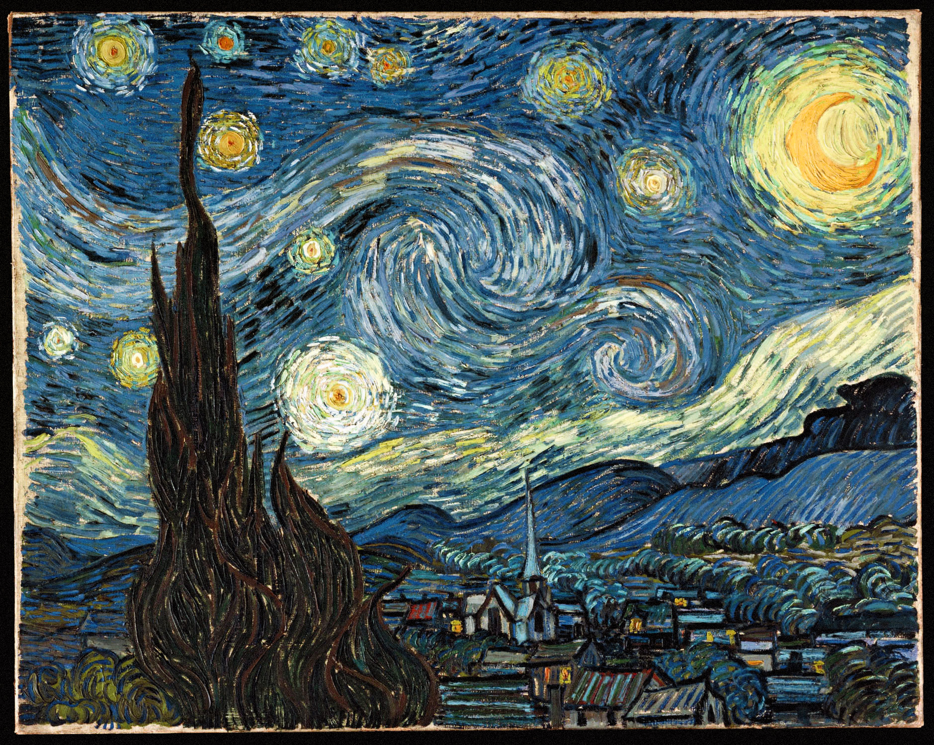

Slide 47
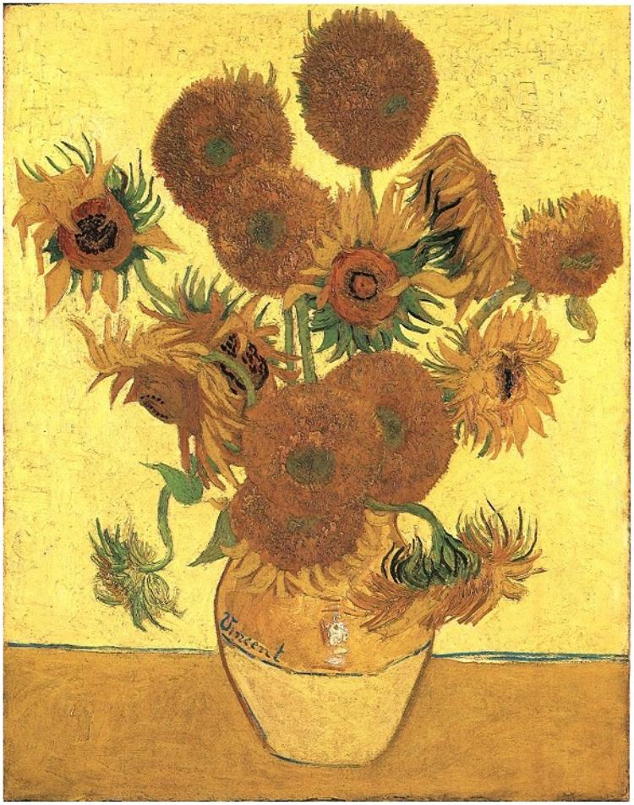

Slide 48
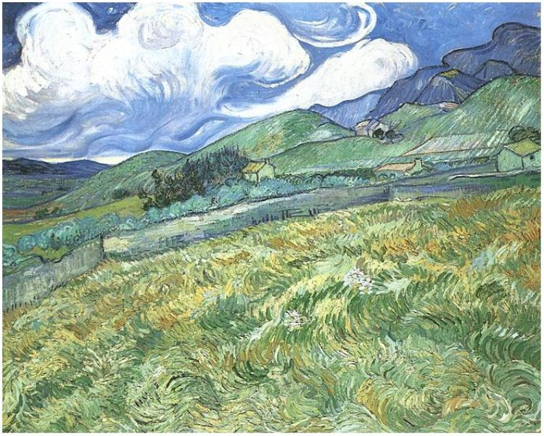

Slide 50
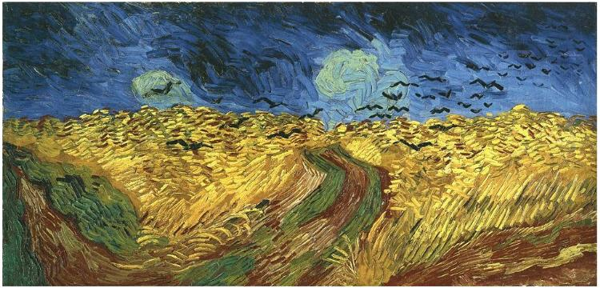

Slide 51
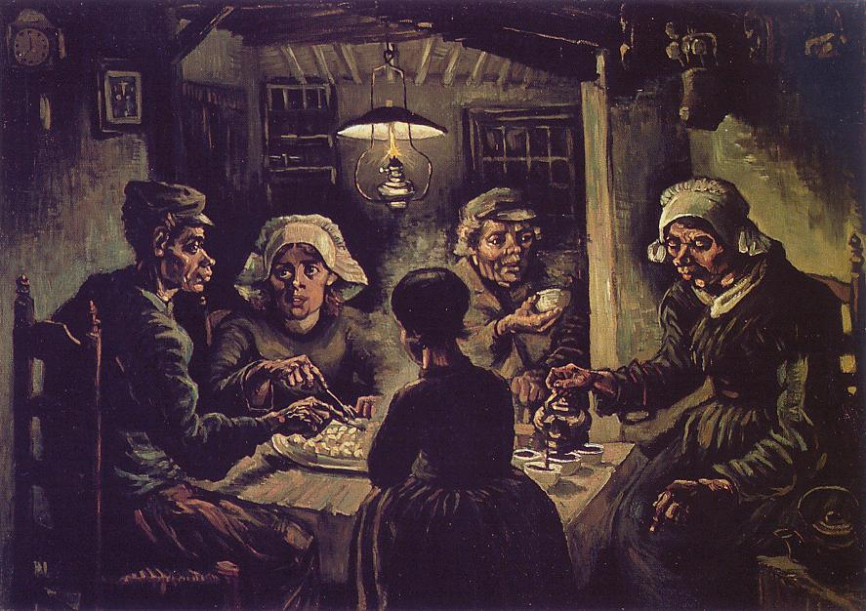

Slide 52
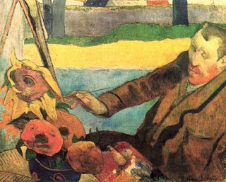

Slide 54
The Paintings
Starry Night (1889)
Vase With Fifteen Flowers (1888)
Mountainous Landscape Behind Saint-Paul Hospital (1889)
Self-Portrait (1889)
Wheat Field With Crows (1890)
The Potato Eaters (1885)
Van Gogh Painting Sunflowers** (1888)
  ** by Paul Gauguin

Slide 55
Time To Hypothesize . . .
Based on what you just heard and saw, what kind of life do you believe Vincent van Gogh led? Why?
Draw a picture that illustrates what you believe to have been Vincent’s single overwhelming emotion throughout his life.
5 minutes

Slide 56
Read Vincent’s Biography
Underline anything in the reading that supports your hypotheses (both written and drawn)
Circle anything in the reading that directly contradicts your hypotheses
In your opinion, do your hypotheses concerning Vincent van Gogh seem correct? Why?
Stand Up, Hand Up, Pair Up
Assess: You in comparison to others

Slide 57
PROCESS TIME
Which four Marzano strategies were used with the previous assignment? Give examples.
Shoulder Partner
Process as a whole
Pages 11-12 in packet
Simple way to incorporate non-linguistic representation into classrooms

Slide 58
Best Practice #9
Cues, Questions, and Advance Organizers increases student achievement by 22%
Cues, questions, and advance organizers help students use what they already know about a topic to enhance further learning.
These tools should be analytical, focus on what is important, and are most effective before a learning experience.

Slide 59
PROCESS TIME
What have I done today that could be considered an advance organizer?
Discuss things you have done in class to cue students in to what they were about to learn.
1 minute each
Shoulder Partner
Process as a whole

Slide 60


Lecture . . .

Slide 61
Best Practice #2
Summarizing and Note Taking increases student achievement by 34%
These skills promote greater comprehension by asking students to analyze a subject to expose what’s essential and then put it into their own words.
Research shows that taking more notes is better than fewer notes, though verbatim note taking is ineffective because it does not allow time for processing the information.

Slide 62
Summarizing and Note Taking
To effectively summarize, students must delete some information, substitute some information, and keep some information.
To effectively delete, substitute, and keep information, students must analyze the information thoroughly.

Slide 63
A Note-Taking Technique . . .
1. Cornell 2-Column Notes (packet page 8)
2. Watch and listen
3. With partner, summarize what you remember
4. Return to the PowerPoint
5. Fill in the “blanks” (NOT word for word)
6. Write at least one question about the material in the margin
7. Write a summary sentence describing the material learned
8. Variations?

Slide 64
Vincent van Gogh’s Possible Illnesses
Temporal Lobe Epilepsy
  Suffered from seizures
  Born with a brain lesion that was made worse by use of absinthe
  Epilepsy treated with digitalis, which causes patients to see yellow spots
  Vincent often used the color yellow in his paintings
Bipolar Disorder
  Extreme enthusiasm and dedication to religion and, later, art
  Art created at feverish (manic) pace (900 paintings in 9 years)
  Frantic pace always followed by exhaustion, depression and, ultimately, suicide
Thujone Poisoning
  Thujone is in absinthe and is toxic
  Can aggravate depression and mania
  Can also cause users to see objects in yellow

Slide 65

With a partner: summarize what you just saw and heard.
Process: What do you think of this technique? How could it be used in your classroom?
Discuss variations . . .

Slide 66
One-Word Summary
Read the selection
Summarize your reading in no more than one word
Packet p.10
Weed out the chaff

Slide 67
The Chaff . . .
What Else?
Cool
Neat
INTERESTING
Good

Slide 68
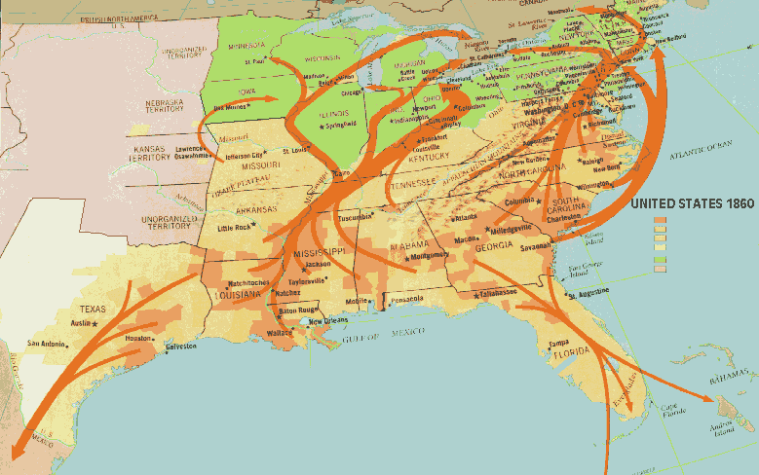
Underground Railroad Letter

Slide 69
Of all the words you’ve heard, which is your favorite? Why?
What word did you choose to summarize the story? Why?

Slide 70
Process Time
Stand Up, Hand Up, Pair Up
Explain your one-word summary to as many people as you can
Tallest person talks first
Process as a group
NOT JUST TEXT!

Slide 71
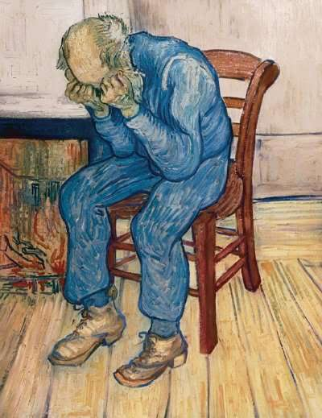

Slide 72
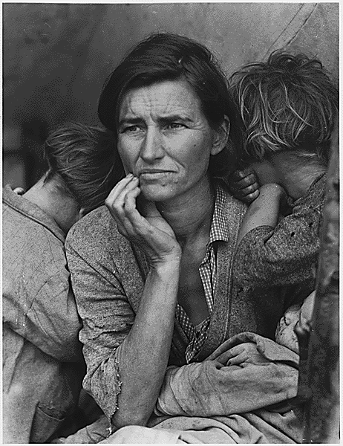

Slide 73
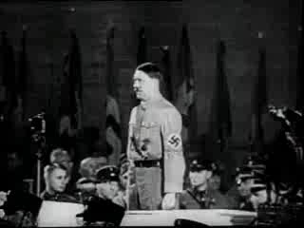

Slide 74
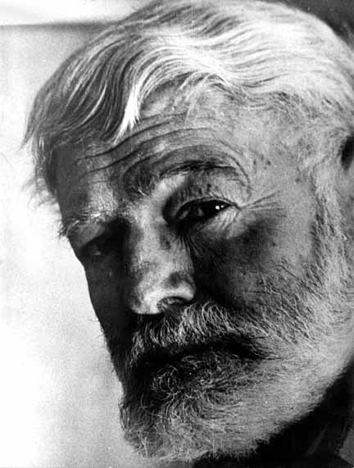
Hemingway’s Six-Word Novel
Challenged to create a story in just six words
Thought it was the best prose he ever wrote
For sale: baby shoes. Never worn.
Though not Hemingway’s intent, today is often used as a form of synthesis

Slide 75
Application Time!
Create a six-word essay that synthesizes the life and times of Vincent van Gogh.
In little time, he created much.
SUHUPU (Depending on time)
Process as a whole
Share your own
Which 6WE did you like best besides your own? Why?

Slide 76
Finish The Analogy . . .
Vincent van Gogh is to “Starry Night” as __________ is to __________.
Round Robin Comment then Share + Group Process
Vincent van Gogh is to “Starry, Starry Night” as Marilyn Monroe is to __________.
Round Robin Comment then Share + Group Process
Create your own analogy using your content area.
Stand Up, Hand Up, Pair Up Comment and Share + Group Process (BUT NOT YET)

Slide 77
Metaphors
Vincent van Gogh was a candle burning at both ends.
Why would I say this?
Shoulder Partner + Group Process
Create your own Vincent van Gogh metaphor.
Stand Up, Hand Up, Pair Up Comment and Share + Group Process (BUT NOT YET)
Create a metaphor using your own class content.
Stand Up, Hand Up, Pair Up Comment and Share + Group Process (OKAY, NOW!)

Slide 78
The Marzano Strategies from Classroom Instruction that Works
1. Identifying Similarities and Differences
2. Summarizing and Note Taking
3. Reinforcing Effort and Providing Recognition
4. Homework and Practice
5. Nonlinguistic Representations
6. Cooperative Learning
7. Setting Objectives and Providing Feedback
8. Generating and Testing Hypotheses
9. Questions, Cues and Advance Organizers

Slide 79
Marzano Strategies Continuum
No
knowledge
Expert
knowledge
0%
100%
Where do you fit?

Slide 80
I am going to try…..
because…..
I think I will see/find/discover/learn
Notes:
Effect on me…
Effect on students…

Slide 81


Slide 82
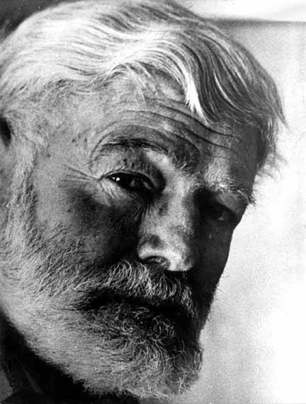


Thanks!
Travis Dimmitt
North Nodaway R-VI Schools
tdimmitt@nnr6.org
660-254-3354
Mrdimmitt.moodlehub.com

Slide 83

MARY POPPINS AND BEHAVIORAL INFLUENCE

Slide 84
Mary Poppins #1

Slide 85


Slide 86
Question Time
What are words you would use to describe how you felt during the previous trailer?
Watch the second Mary Poppins trailer.

Slide 87
Mary Poppins #2

Slide 88


Slide 89
Question Time
How did your feelings differ from the first trailer?
What are some words you would use to describe the overall feelings evoked by the second trailer?
What most affected the overall mood from one trailer to the next?
Now, let’s use the knowledge there are ways people can affect our behavior…

Slide 90
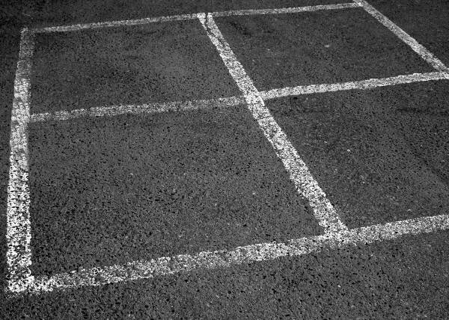
STRUCTURE/STRATEGY
Four Square

Slide 91
Four Square Summary
Topic: 1984 by George Orwell | An excerpt of 1984 can be found on page 34 of your handout.
1. 1984 has been called a “dystopian” novel. Based on your reading of the initial pages, what does “dystopian” mean?(1 minute) | 2. Now, write the actual definition of dystopian in this square. How close was your definition to the actual? Talk about it in exactly one sentence. (2 minutes)
3. Write five words or phrases that Orwell uses to reinforce the idea of a dystopian society in 1984. (3 minutes) | 4. SUM UP – Draw a picture of a dystopian society. Be prepared to describe what you draw. (3 minutes)

Slide 92
Process as Students
Small group process through Round Robin*
One minute each
1. What was my prediction of dystopia?
2. What was the actual definition?
3. How close was I?
4. Discuss your picture.
Class process (Wheel of Destiny)
* Cooperative Learning = 27% achievement increase

Slide 93
Four Square Information
Graphic organizer (27% achievement increase)
Can be used to gather and store information
Can be used to analyze findings
Can be used to compare similarities and differences (45% achievement increase)
Can be used to summarize and synthesize information that has been learned (34% achievement increase)
Can be used to inform and record predictions (23% achievement increase)
Our sample activity will use it to do all these things (I think)

Slide 94
Process as Teachers
With your shoulder partner:
  What is at least one way you can adapt the four square tool for use in your classroom?

Slide 95

QUESTIONS?

Slide 96
STRUCTURE/STRATEGY
Non-Linguistic Worksheets

Slide 97
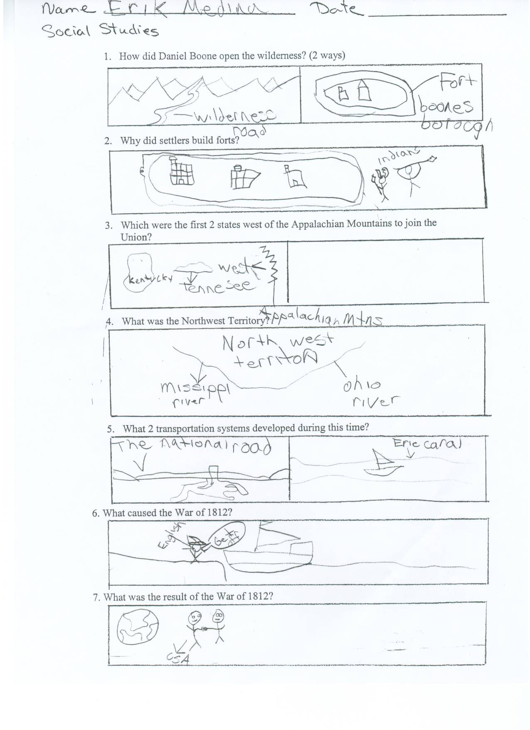

Slide 98
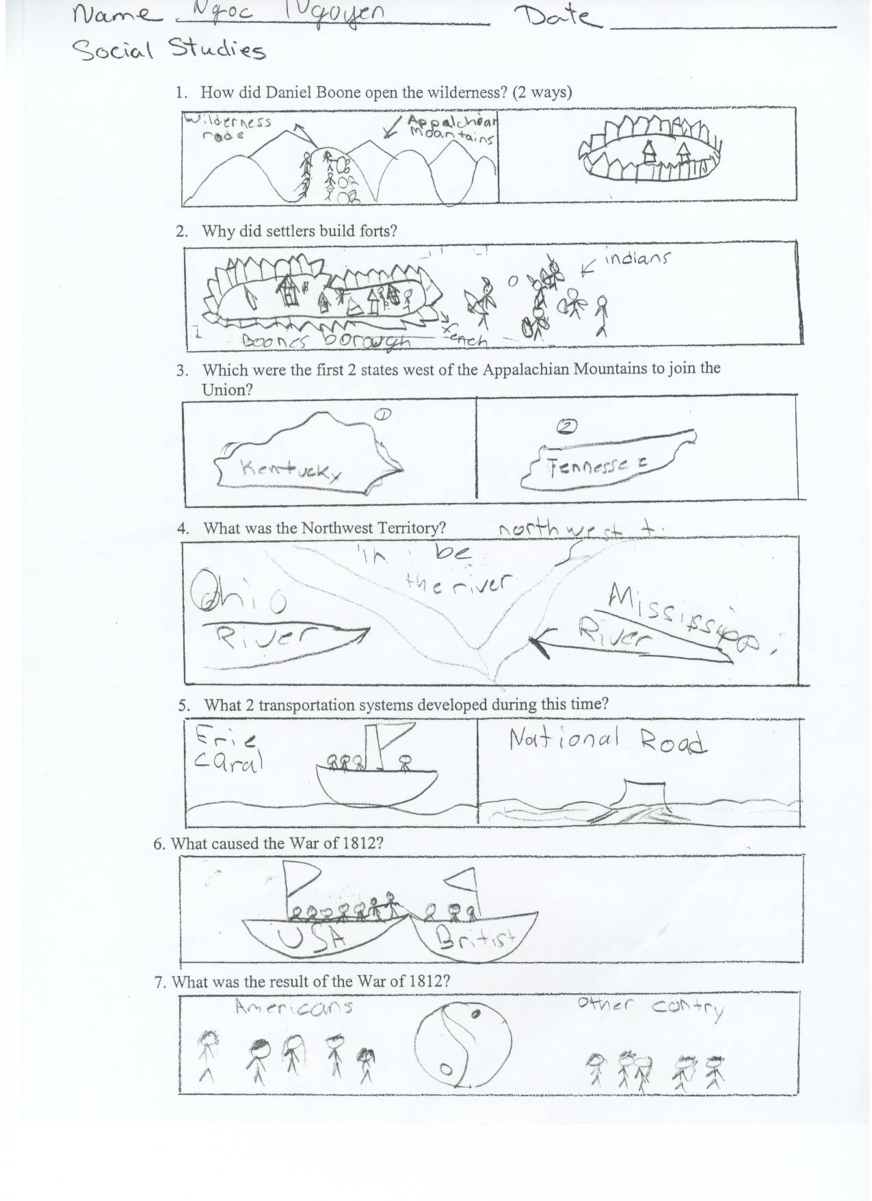

Slide 100
Non-Linguistic Worksheet Information
Graphic organizer (27% achievement increase)
What else?

Slide 101
Process as Teachers
With your shoulder partner:
  What is at least one way you can adapt the non-linguistic worksheet for use in your classroom?

Slide 102
Vocabulary Template Page
Packet Page 25
The idea of “academic vocabulary”
Vocabulary Term: DEMOCRACY
Thoughts?
Marzano Strategies?
How can you use this in your classroom?

Slide 103
Lined Venn Diagram
Packet Page 14, 15, 16
A more focused Venn
“Forced comparison” rather than “freestyle”
If used a lot, students will “self-police”
Textbook Comparison
  Content, Design, Language
Poetry Comparison
  Subject, Symbolism, Outcome

Slide 104
TOPICS What am I looking at or reading about?
O Captain! My Captain!
Goliath and David
ATTRIBUTES
What am I comparing?
Subject of poems
A
A
A
Symbolism in Poems
A
A
A
A
Outcome of Poems
A
A
John Antonetti’s Lined Venn Diagram

Slide 105
TOPICS What am I looking at or reading about?
Old Textbook
New Textbook
ATTRIBUTES
What am I comparing?
Content in Books
A
A
A
Design/
Layout
A
A
A
A
Use of Language
A
A
John Antonetti’s Lined Venn Diagram

Slide 106
Lined Venn Diagram
Thoughts?
Marzano Strategies?
How can you use the lined Venn in your classroom?

Slide 107
Identifying Similarities and Differences
Initial Assessment
What percentage gain have students averaged through use of this strategy?
Can I give specific examples of this strategy in action?
Have I ever used this strategy in my classroom?
Was the use of this strategy INTENTIONAL?
What else do I already know about this strategy?

Slide 108
Best Practice #1
Finding Similarities and Differences
The brain seeks patterns, connections, and relationships between and among prior and new learning. (BACKGROUND KNOWLEDGE)
The ability to break a concept into its similar and dissimilar characteristics allows students to understand and often solve complex problems by analyzing them in a more simple way.
45%

Slide 109
c
Comparing

Slide 110
Explicitly teaching the thinking higher level tasks demand
Comparing
Sentence Stems
Graphic organizers

Slide 111
A and B are similar because they both
________________
________________
________________
A and B are different because
A is __________, but B is ___________.
A is __________, but B is ___________.
A is __________, but B is ___________.

Slide 112
Fun and Enjoyment are similar because they both
________________.
________________.
________________.
Fun and Enjoyment are different because
Fun is ___, but Enjoyment is ___________.
Fun is____, but Enjoyment is ___________.
Fun is ____, but Enjoyment is ___________.

Slide 113
A win and a victory are similar because they both
________________.
________________.
________________.
A win and a victory are different because
Win is ___, but Victory is __________.
Win is ___,but Victory is ________.
Win is ___,but Victory is ________.

Slide 114
Fractions and Decimals are similar because they both ________________. ________________. ________________.
Fractions and Decimals are different because
Fractions __, but Decimals __.
Fractions __, but Decimals __.
Fractions __, but Decimals __.

Slide 115
Blogs and Wikis are similar because they both ________________. ________________. ________________.
Blogs and Wikis are different because
Blogs __, but Wikis __.
Blogs __, but Wikis __.
Blogs __, but Wikis __.

Slide 116
Comparing
Identify what you are comparing and decide on a format to organize your information and guide your thinking.
Examine the items and decide what characteristics would lead to an interesting comparison.
For each characteristic, explain how the items are similar and different.
4. Re-examine your information, and state what you learned or thought about by doing this comparison.

Slide 117
 | Item 1 | Item 2 | Item 3
Characteristic 1 |  |  |  | Similarities and Differences
Characteristic 2 |  |  |  | Similarities and Differences
Characteristic 3 |  |  |  | Similarities and Differences
Characteristic 4 |  |  |  | Similarities and Differences

Slide 118
Characteristic 1:Similarities and Differences.
For characteristics 1, Item 1 and Item 2 and are mainly similar. They both……
Characteristic 2:Similarities and Differences.
Characteristic 3:Similarities and Differences.
Characteristic 4:Similarities and Differences.

Slide 119
 | Food eaten Frontier Days | Food eaten today | Item 3
Characteristic 1 |  |  |  | Similarities and Differences
Characteristic 2 |  |  |  | Similarities and Differences
Characteristic 3 |  |  |  | Similarities and Differences
Characteristic 4 |  |  |  | Similarities and Differences

Slide 120
Belle in “Beauty & the Beast”
Jasmine in “Aladdin”
Ariel in “Little Mermaid”
Family Background
Poor; daughter of inventor; no mother in story
Rich, daughter of ruler; no mother in story”
Rich, daughter of king; no mother in story”
Loved to read & stay home; strong opinions. Obeyed father
Loved to have adventures; strong opinions; disobeyed father
Loved to have adventures; strong opinions; disobeyed father
Personality Traits
How she ended up
Marries prince; father lives with her
Marries prince; lives in palace with father
Marries prince; leaves father to live with prince
Garcon—man who wanted to marry her
Evil sorcerer—man who wanted to marry her.
Sea witch—woman who wanted to destroy her father
Her enemy

Slide 121
Characteristic 1:Similarities and Differences.
All similar in that there is no mother in story; Jasmine and Ariel were similar because they were rich with father as ruler; Belle was different from them -- was poor and father was inventor
Characteristic 2:Similarities and Differences.
Characteristic 3:Similarities and Differences.
Characteristic 4:Similarities and Differences.

Slide 122
TOPICS What am I looking at or reading about?
O Captain! My Captain!
Goliath and David
ATTRIBUTES
What am I comparing?
Style and Tone of Poems
A
A
A
Symbolism in Poems
A
A
A
A
Outcome of Poems
A
A
John Antonetti’s Lined Venn Diagram

Slide 123
Handy Websites
For an online comparison matrix:
http://www.tltguide.ccsd.k12.co.us/instructional_tools/Strategies/Sim_Differences/Sim_Diff.html
A website to practice analogies:
http://www.sadlier-oxford.com/phonics/analogies/analogiesx.htm

Slide 124
Identifying Similarities and Differences
Summative Assessment
What percentage gain have students averaged through use of this strategy?
Can I give specific examples of this strategy in action?
How can I INTENTIONALLY use this strategy in my classroom?
Were any other Marzano strategies demonstrated in conjunction with this strategy? If so, which ones?
What are some other things I would like to know about this strategy?
Create a six-word essay concerning this strategy.

Slide 125
Summarizing and Note Taking
Initial Assessment
What percentage gain have students averaged through use of this strategy?
Can I give specific examples of this strategy in action?
Have I ever used this strategy in my classroom?
Was the use of this strategy INTENTIONAL?
What else do I already know about this strategy?

Slide 126
Best Practice #2
Summarizing and Note Taking increases student achievement by 34%
These skills promote greater comprehension by asking students to analyze a subject to expose what’s essential and then put it into their own words.
Research shows that taking more notes is better than fewer notes, though verbatim note taking is ineffective because it does not allow time for processing the information.

Slide 127

STRUCTURE/STRATEGY
One-Word Summary

Slide 128
Modeling the One-Word Summary Strategy
Read the selection
Summarize your reading in no more than one word

Slide 129
Underground Railroad Letter

Slide 130
ONE-WORD SUMMARY INFORMATION
Active learning because it puts burden of learning on students
Useful because of relationship to other active learning structures
Builds reading in the content area
Builds high-order thinking skills (HOTS)
Weed out the “chaff”

Slide 131
The Chaff . . .
What Else?
Cool
Neat
INTERESTING
Good

Slide 132
Share Your One-Word Summary
What word did you choose to summarize the story? Why?

Slide 133
Of all the words you’ve heard, which is your favorite? Why?
What word did you choose to summarize the story? Why?

Slide 134
QUESTIONS?

Slide 135
Examples: Reflection with Two-column/Cornell Notes
Name_____________________ Subject:______________________
Date: Topic:_______________________
Reflecting/Processing
Questions– literal and inferential
Nonlinguistic representations
Cues
Reminders/Cautions
Notes

Slide 136
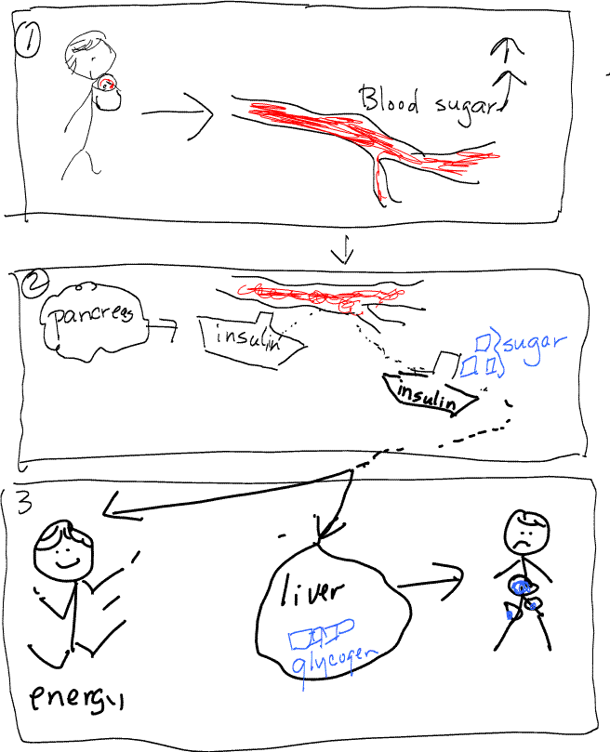
Carbohydrate
eat carbs—blood sugar goes up and pancreas releases insulin
in Islets of Langehans in pancreas, insulin produced to carry glucose to cells
once in cells, 3 things can happen
  a) energy
  b) convert to glycogen and goes to liver and muscles for later
  c) or liver can store as fat
Insulin—fat producing hormone
What do carbs do to blood?
What is role of pancreas?
What does insulin carry to cells?
What does insulin carry to cells?
Effects on body?
Summary:

Slide 137
Plant Reproduction
Plants and animals have life cycles—growth, reproduction, and death.
Reproduction can happen with seeds or without; when there are no seeds,there are spores. With seeds—conifers, and flowering plants.
Conifers have 2 cones, male contains pollen; female has ovules. When the pollen fertilizes the ovules, they become seeds.
Seeds have a new plant embryo.
Growth
Circle of Life
Life Cycles- Birth Growth Reproduction Death
Death
Reproduction
Plant Reproduction
w/o seeds = spores
w/ seeds= male-pollen
Female-ovules
With seeds
Without seeds; with spores
Conifers
Flowering plants
pollen
pollen
ovule
Male Cone
Female Cone
seed
Summary:

Slide 138
Thunderstorms
Thunderstorms
Warm moist air is sitting beneath cold dry air,
An updraft can push the warm air up so :
What air masses collide to form thunderstorms?
Cold, dry air
Warm, moist air
Updraft
Updraft
Summary:

Slide 139
Topic – List your Questions Cite your Resource | Information / Details Collected What this text is about? | What this means to me. What this makes me think about?
3-column notes

Slide 140
Your topic
Concepts / facts
Nonlinguistic Representations
1.
2.
3.
4.
5.
Type your topic sentence or summary here.

Slide 141
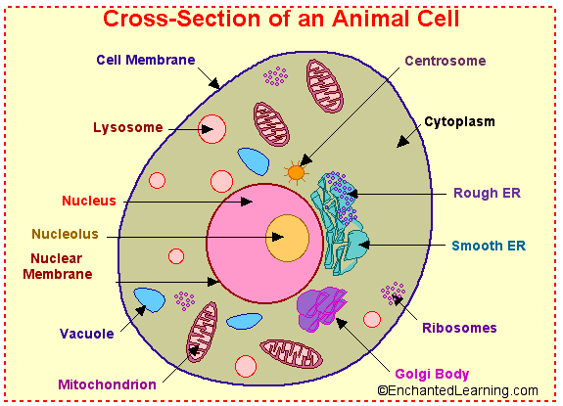
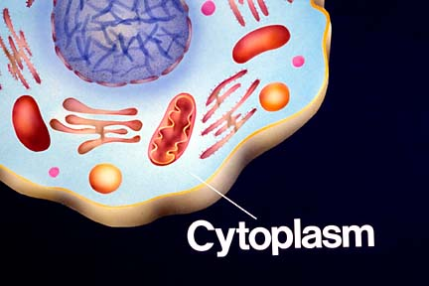



Cells
All living cells have:
- a nucleus
houses organelles “little organs”
a cell membrane
a thin layer of protein and fat, like skin
- cytoplasm
a jelly like material outside the nucleus
- Ribosomes
makes protein synthesis
Mitochondria
are often referred to as the power plants, converts energy
- Chromosomes, our DNA
46
78
Cells are the smallest but the most important units of life. Each part of the cell has an important job to keep us healthy and alive.

Slide 142
Summarizing and Note Taking
Summative Assessment
What percentage gain have students averaged through use of this strategy?
Can I give specific examples of this strategy in action?
How can I INTENTIONALLY use this strategy in my classroom?
Were any other Marzano strategies demonstrated in conjunction with this strategy? If so, which ones?
What are some other things I would like to know about this strategy?
Create a six-word essay concerning this strategy.

Slide 143
Reinforcing Effort and Providing Recognition
Initial Assessment
What percentage gain have students averaged through use of this strategy?
Can I give specific examples of this strategy in action?
Have I ever used this strategy in my classroom?
Was the use of this strategy INTENTIONAL?
What else do I already know about this strategy?

Slide 144
Best Practice #3
Reinforcing Effort and Providing Recognition increases student achievement by 29%
Not all students realize the importance of believing in effort.
Students can learn to change their beliefs to an emphasis on effort with teacher help.
Recognition does not necessarily imply praise or rewards. Rather, it means helping students recognize success to build intrinsic motivation toward a particular subject or activity.

Slide 145
Older Student Achievement Rubric | Younger Student Achievement Rubric
4 – The student exceeded the objectives of the task or lesson 3 – The student met the objectives of the task or lesson 2 – The student met a few of the objectives of the task or lesson, but did not meet others 1 – The student did not meet the objectives of the task or lesson 0 – The student did not do the task or lesson | 4 – The student did more than the task asked 3 – The student did everything the task asked 2 – The student did some of the things the tasked asked him to do, but the student did not do all of the things the task asked 1 – The student did not do what the task asked 0 – The student did not do the task
Older Student Effort Rubric | Younger Student Effort Rubric
4 – The student works on tasks until completed and continues working on the task even when difficulties arise or a solution is not immediately evident. The student views difficulties that arise as opportunities to strengthen understanding. 3 – The student works on tasks until completed and continues working on the task even when difficulties arise or a solution is not immediately evident. 2 – The student puts some effort into the task but stops working when difficulties arise. 1 – The student puts very little effort into the task. 0 – Not enough information to make a judgment. | 4 – The student works on the task until she finishes it. The student keeps working even when she has trouble and cannot find an answer at first. The student uses problems as chances to learn more. 3 – The student works on the task until she finishes it. The student keeps working even when she has trouble and cannot find an answer at first. 2 – The student tries to do the task but stops working when she has problems. 1 – The student does not try very hard. 0 – The student does not try at all.

Slide 146
Effort and Achievement Chart
Name: Travis Dimmitt Date: | Assignment | Effort | Achievement
Fri., Oct. 20 | Homework: Practice solving linear functions | 2 | 1
Wed., Oct. 25 | Quiz: Graphs of linear functions | 4 | 2
Thur., Oct. 26 | In-class practice: Solving linear equations | 4 | 3
Tues., Oct. 31 | Quiz: Solving linear equations | 4 | 4
Wed., Nov. 1 | Homework: Properties of linear equations | 3 | 2
Fri., Nov. 3 | In-class assignment: Properties of linear equations | 2 | 2
Tues., Nov. 7 | Homework: Solving linear equations | 2 | 2

Slide 147
Effort vs. Achievement Graph

Slide 148
Handy Websites
A website that encourages kids to create their own books and submit them for prizes:
http://www.scholastic.com/bookfairs/contest/kaa_about.asp
An online award certificate maker:
http://www.teach-nology.com/web_tools/certificates/

Slide 149
Reinforcing Effort and Providing Recognition
Summative Assessment
What percentage gain have students averaged through use of this strategy?
Can I give specific examples of this strategy in action?
How can I INTENTIONALLY use this strategy in my classroom?
Were any other Marzano strategies demonstrated in conjunction with this strategy? If so, which ones?
What are some other things I would like to know about this strategy?
Create a six-word essay concerning this strategy.

Slide 150
Homework and Practice
Initial Assessment
What percentage gain have students averaged through use of this strategy?
Can I give specific examples of this strategy in action?
Have I ever used this strategy in my classroom?
Was the use of this strategy INTENTIONAL?
What else do I already know about this strategy?

Slide 151
Best Practice #4
Homework and Practice increases student achievement by 28%
In order to be effective, the purpose and desired outcome of homework should be clearly communicated.
Just because a homework assignment is time consuming does not necessarily make it beneficial.

Slide 152
Homework Policies Issue: Purpose
A
You can expect homework each evening, Monday through Thursday. It is your responsibility to complete the assignments to be prepared for class the next day.
B
There often is just not enough time in class for each of you to study and practice what you are learning. When it seems that there is a clear need for further individual work beyond what we do in class, you will have homework.
For some learning goals, frequent homework might be assigned; for others, there might be no need for homework. When there is homework, it is your responsibility to complete the work and be prepared for class the next day.
Which do you prefer? Why?
What is most common? Why

Slide 153
Purpose
1. Avoid assigning homework simply as a matter of routine.
“Expert teachers…do not report rigidly adhering to regular homework schedules so much as flexible use of what they view as a means for furthering collectively defined curricular goals.
…[they] see policies requiring rigid homework schedules as undermining their ultimate curricular goals…”
(as reported in “Homework is a Complicated Thing”, Lyn Corno)

Slide 154
Purpose
1. Avoid assigning homework simply as a matter of routine.
2. Make sure students understand the purpose of the homework

Slide 155
Clear Learning Goals?
Examples (adaptations) from The Case Against Homework:
Read Chapter 5 and
identify who said the following quotes
find these vocabulary works, circle them, write a definition
make a timeline of events
Read pages 62-66 in your textbook, and answer the questions at the end.
Read chapters 6-10 in To Kill a Mockingbird.
On a 12 x 12 piece of plywood, nail one-hundred nails (size shown in diagram) at precise intervals at the same depth. Take six difference colors of embroidery thread and weave it between the nails in geometric pattern.
Circle all the words on this page that begin with the letter A. Then write them out
Solve the fifty math problems on page 100.

Slide 156
Assignment Notebook
Language Arts | Assignment: Due: Learning Goal: As a result of doing this assignment, I should:
Math | Assignment: Due: Learning Goal: As a result of doing this assignment, I should:
Science | Assignment: Due: Learning Goal: As a result of doing this assignment, I should:
Social Studies | Assignment: Due: Learning Goal: As a result of doing this assignment, I should:
Assignment:
Due:
Learning Goal: As a result of doing this assignment, I should
Know more about..? Understand better..? Be more skilled..?
Assignment:
Even numbered problems on page 101
Due: Tomorrow Thursday
Assignment:
Even numbered problems on page 101
Due: Tomorrow Thursday
Learning Goal: As a result of doing this assignment, I should:
Be more skilled at finding the area of a parallelogram

Slide 157
Purpose
1. Avoid assigning homework simply as a matter of routine.
2. Make sure students understand the purpose of the homework
Narrowing the focus:
Clear instructional goals …. have shown to help students focus more on the relevant information and give less attention to information not related to the goal.
(as reported in Classroom Instruction That Works, Marzano, et.al., 2001)

Slide 158
Purpose
1. Avoid assigning homework simply as a matter of routine.
2. Make sure students understand the purpose of the homework.
3.The purpose should be appropriate for the type of knowledge and the learning goal.
Paraphrase of Alfie Kohn:
Homework does not work because those assigning it don’t understand that practice does not increase understanding.

Slide 159
3.The purpose of homework should be identified and articulated.
Appropriate purposes for homework
Skills and Processes | Practice to increase accuracy, fluency, and, if appropriate, speed
Information and Ideas | Preparation for new learning or Elaboration to increase understanding

Slide 160
Formats for homework that clarify purpose:
Assignment Notebook
Language Arts | Assignment: Due: Learning Goal: As a result of doing this assignment, I should:
Math | Assignment: Due: Learning Goal: As a result of doing this assignment, I should:
Science | Assignment: Due: Learning Goal: As a result of doing this assignment, I should:
Social Studies | Assignment: Due: Learning Goal: As a result of doing this assignment, I should:
Assignment:
Due:
Learning Goal: As a result of doing this assignment, I should
Know more about…? Understand better…? Be more skilled at…?

Slide 161
Parent Involvement

Slide 162
Parent Involvement
1. Parents can help students develop “responsibility,” but don’t depend on it.

Slide 163
Parent Involvement
1. Parents can help students develop “responsibility,” but don’t depend on it.
2. Parent involvement should be kept to a minimum, and should focus on showing support for, and interest in, the student learning.

Slide 164
..from Classroom Instruction That Works.
“While it is certainly legitimate to inform parents of the homework assigned to their children, it does not seem advisable to have parents help their children with homework.”
“Specifically, many studies show minimal and even negative effects when parents are asked to help students with homework.

Slide 165
Direction for parents:
When your child has worked hard but cannot complete the assignment in a reasonable time, and you are thinking about sitting down and helping her…….STOP. Get out a piece of paper and write the teacher a note….
Dear Ms. Curie,
Sally has worked hard for one hour on this assignment and cannot complete it. I told her to stop and assured her that she had completed her homework for tonight. She doesn’t really understand how to read bar graphs yet so she can’t go on. Please let her know if there will be more instruction in class or if she needs to come in for extra help.

Slide 166
Feedback

Slide 167
Feedback
Feedback should help students understand if their work contributed to their achievement of learning goals.
2. Feedback should be timely.

Slide 168
FEEDBACK
Whole class
Small group
One-on-one
Correct answers
Sample answers
Criteria to apply
Oral
Written

Slide 169
Homework Assignments Issue: Feedback
A
You will receive a homework packet on Monday; it will be due on Friday. Schedule your time carefully so that you do not have too much to complete on any single evening.
B
You will receive a homework packet on Monday with homework assignments designated for each day of the week. Each morning, you will work in groups to go over the assignment due that day and clarify any confusions.
I will monitor the groups to record who completed the homework. You have the entire week’s assignments so that you can schedule your time and work ahead if you know that a specific evening is already busy for you.
Pros and Cons?

Slide 170
Time

Slide 171
Homework Assignments Issue: Time
Learning Goal: Increase competency when multiplying 3 digits time 3 digits.
A
Assignment:
Do all of the even numbered problems on page 100-101. Bring your work to class with you tomorrow morning.
B
Practice this skill tonight by using the problems on page 100-101. Do as many as you can accurately in 15 minutes tonight. Bring with you those you were able to do in the 15 minutes.
Pros and Cons?

Slide 172
Time
Time constraints should be identified when assigning homework.
2. If students cannot complete the assigned work within time constraints, they may need the opportunity to complete the work in class.

Slide 173
Accountability
and
Grading

Slide 174
Homework Policies Issue: Accountability and Grading
 | Consequences related to time…
A
 | Consequences related to grading…
B
 | Consequences related to possible influence on performance…
C
If you do not do your homework, you will (not be allowed to go to recess) OR (you will have “homework club” after school the next day). You will work until the assignment is completed.
Missing homework will influence your grade as follows:
Each missing assignment will be recorded as “0” an averaged in… or…
A “homework completion” grade will be included as _% of your grade.
You, and I, will keep track of whether you complete your homework. If your assessments indicate you are not progressing toward the learning goals, we will have a conference to determine why. If we decide one reason is that you have not been completing homework, we (and perhaps your parents) will figure out how to help you to complete your homework.
What are the pro’s and con’s of each approach?

Slide 175
Issues related to accountability
All students should have scheduled breaks (recess, lunch, free period) during every school day—whether they have completed their homework or not.
Homework should not be considered a reliable assessment of students’ learning.

Slide 176
Accountability and grading
If homework completion is to be a factor in students’ overall grade for a subject or course, the weight of that factor should be
  consistently applied,
  clearly reported, and
  aligned with the school’s mission.

Slide 177
Homework
You know homework is causing stress at home when you hear YOUR CHILD say…
“I am sorry I can’t come out and play right now. I have to help my dad with my homework.”
Or when you hear YOURSELF say..
“Please stop your crying. This is how we did it when I was in school. It will be fine.”

Slide 178
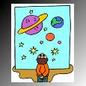
School
Projects
  You know School Project Homework might be contributing to the stress at home when you hear YOUR CHILD say,
“Mom, you got an A!”
Or, when you hear YOURSELF say,
“Hello. JoAnn’s Craft’s? Do you have Styrofoam balls in the shapes and sizes of all the planets? How late are you open?”
“Here is my volcano, son. It was your grandfather’s, too. He would be proud—and it is a guaranteed “A.”

Slide 179
To what extent do you work with colleagues to foster and support the following:
      Assigning homework in a way that enhances learning

Slide 180
Homework and Practice
Summative Assessment
What percentage gain have students averaged through use of this strategy?
Can I give specific examples of this strategy in action?
How can I INTENTIONALLY use this strategy in my classroom?
Were any other Marzano strategies demonstrated in conjunction with this strategy? If so, which ones?
What are some other things I would like to know about this strategy?
Create a six-word essay concerning this strategy.

Slide 181
Nonlinguistic Representations
Initial Assessment
What percentage gain have students averaged through use of this strategy?
Can I give specific examples of this strategy in action?
Have I ever used this strategy in my classroom?
Was the use of this strategy INTENTIONAL?
What else do I already know about this strategy?

Slide 182
Best Practice #5
Generating Nonlinguistic Representations increases student achievement by 27%
Research says that knowledge is stored in two forms: linguistic (in ways associated with words) and nonlinguistic (mental pictures or even physical sensations like smell, touch, kinesthetic association or sound).
The more we can use nonlinguistic representations while learning, the better we can think about and recall our knowledge.

Slide 183
Nonlinguistic Examples . . .
How is the DOK level of the assignment affected by the use of nonlinguistic representations?
Shoulder partner discussion
“Wheel of Destiny”

Slide 187
Vocabulary Template Page

Slide 188
4th Grade Science GLE
Strand 2, Concept D, Part C
Predict how the change in speed of an object (i.e., faster/slower/remains the same) is affected by the amount of force applied to an object and the mass of the object
Assessed at DOK Level 2

Slide 189
Build on Background Knowledge
FORCE
Using only background knowledge, draw a picture that represents this term
(1 min.)

Slide 190
FORCE
You have to use a force to make things start moving.
In the news, when people talk about "using force," they mean violence.
To a scientist, however, blowing on something is using a force, and so is patting somebody on the back, and so is friction.
A force is any push or a pull on an object caused by another object.

Slide 191
FORCE
FORCE can:
  make an object start moving
  make an object stop moving
  make an object go faster
  make an object go slower
  make an object change directions

Slide 192
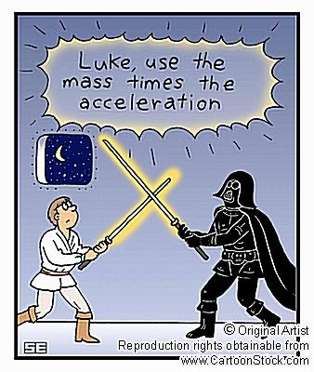
Build on Background Knowledge
FORCE
Now, with the actual definition in mind, draw a new picture (2 min.)
What was the same? Different?

Slide 193
Build on Background Knowledge
MASS
Using only background knowledge, draw a picture that represents this term
(1 min.)

Slide 194


Mass
A basketball and a bowling ball take up the same amount of space.
Which would you rather drop on your foot?
Mass is the amount of matter in something.
Which has more mass?
NOT the same as weight – how hard gravity pulls on you.
vs.

Slide 195

Build on Background Knowledge
MASS
Now, with the actual definition in mind, draw a new picture (2 min.)
What was the same? Different?

Slide 196
Predict
Draw a picture of what would happen if, on a flat surface, I pushed a bowling ball and a basketball with equal force at exactly the same time.
vs.

Slide 197
Process Time
Did the lesson meet the GLE?
Was the lesson grade-level appropriate?
Did the lesson match or exceed the DOK assessment level?

Slide 198
Nonlinguistic Representation
Summative Assessment
What percentage gain have students averaged through use of this strategy?
Can I give specific examples of this strategy in action?
How can I INTENTIONALLY use this strategy in my classroom?
Were any other Marzano strategies demonstrated in conjunction with this strategy? If so, which ones?
What are some other things I would like to know about this strategy?
Create a six-word essay concerning this strategy.

Slide 199
Cooperative Learning
Initial Assessment
What percentage gain have students averaged through use of this strategy?
Can I give specific examples of this strategy in action?
Have I ever used this strategy in my classroom?
Was the use of this strategy INTENTIONAL?
What else do I already know about this strategy?

Slide 200
Best Practice #6
Cooperative Learning increases student achievement by 27%
Do not group for grouping’s sake.
Positive Interdependence
Individual and Group Accountability
Equal Participation
Simultaneous Interaction
Marzano mentions these coop learning necessities, but describes them in a different manner

Slide 201
Cooperative Learning
What structures have we already used?
Find Someone Who
Quiz, Quiz, Trade
Find The Fiction
Which of these have you found the most useful?
Many, many, many others . . .
Kagan Conference Plug Now

Slide 202
Cooperative Learning
Summative Assessment
What percentage gain have students averaged through use of this strategy?
Can I give specific examples of this strategy in action?
How can I INTENTIONALLY use this strategy in my classroom?
Were any other Marzano strategies demonstrated in conjunction with this strategy? If so, which ones?
What are some other things I would like to know about this strategy?
Create a six-word essay concerning this strategy.

Slide 203
Setting Objectives and Providing Feedback
Initial Assessment
What percentage gain have students averaged through use of this strategy?
Can I give specific examples of this strategy in action?
Have I ever used this strategy in my classroom?
Was the use of this strategy INTENTIONAL?
What else do I already know about this strategy?

Slide 204
Best Practice #7
Setting Objectives and Providing Feedback increases student achievement by 23%
If students know what they are supposed to learn and why, they will likely be more successful in accomplishing what their teacher desires.
If regular feedback comes, informing students of their progress in accomplishing goals, students will use this formative assessment to become better.

Slide 205
A Question
How do we let our students know what it is we want them to learn?
Do we hold students accountable for these learning goals in any other way than end of unit tests?

Slide 206
Three Commitments to Students
Commitment:
Provide Feedback Through Classroom Formative Assessment and Grading
Commitment #1: Provide Feedback Through Classroom Formative Assessment and Grading
Commitment #2: Foster and Support Effective Teaching in Every Classroom

Slide 207
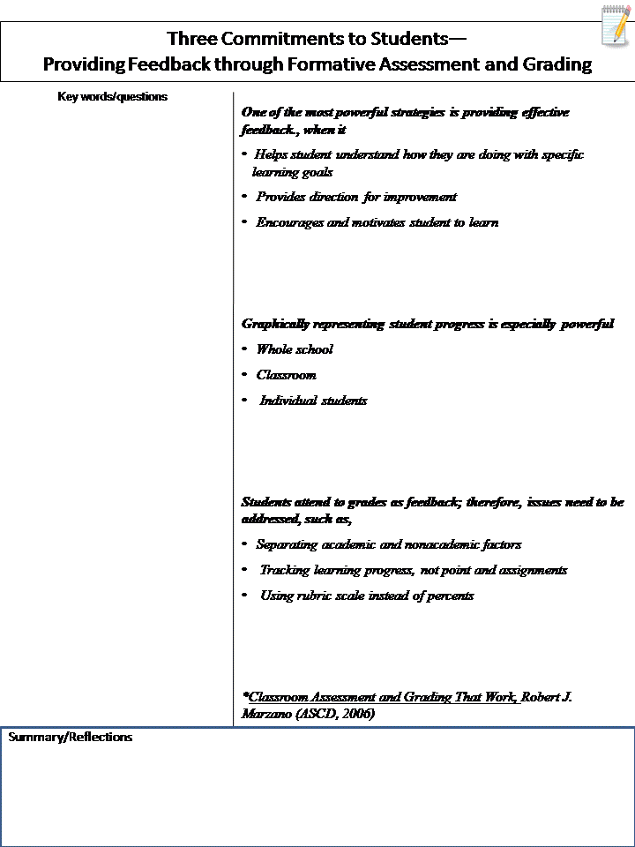

Slide 208
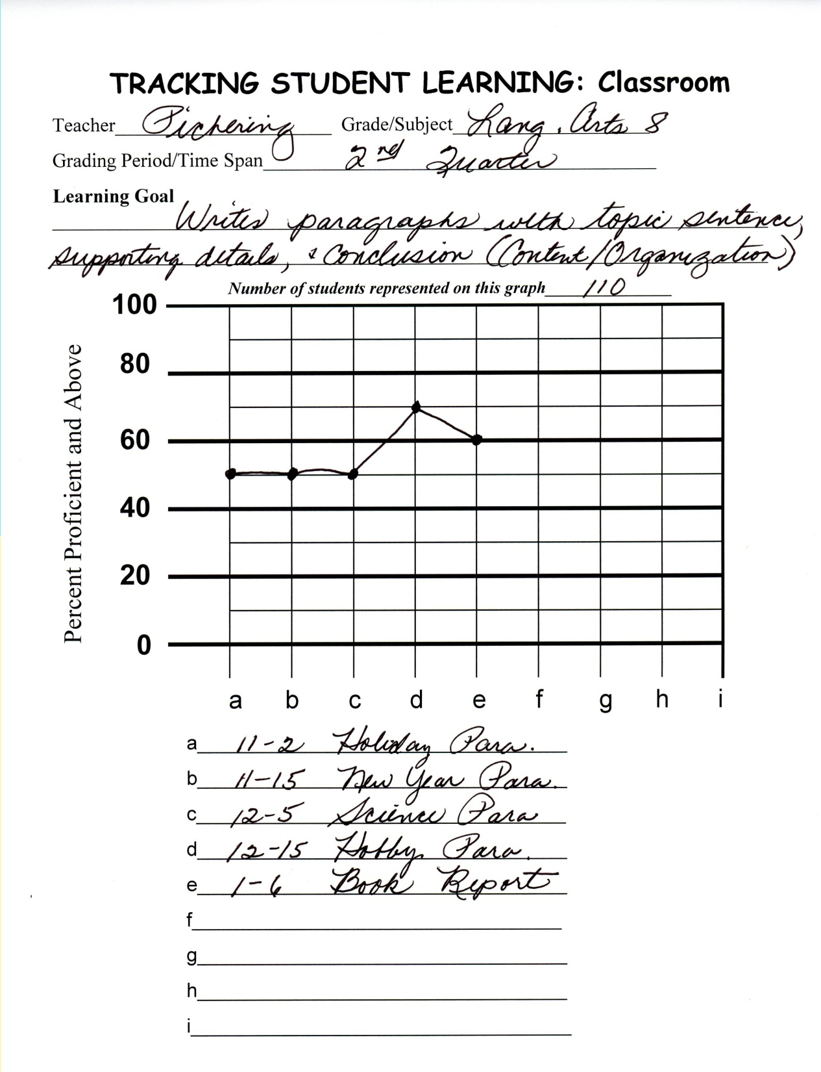

Slide 209
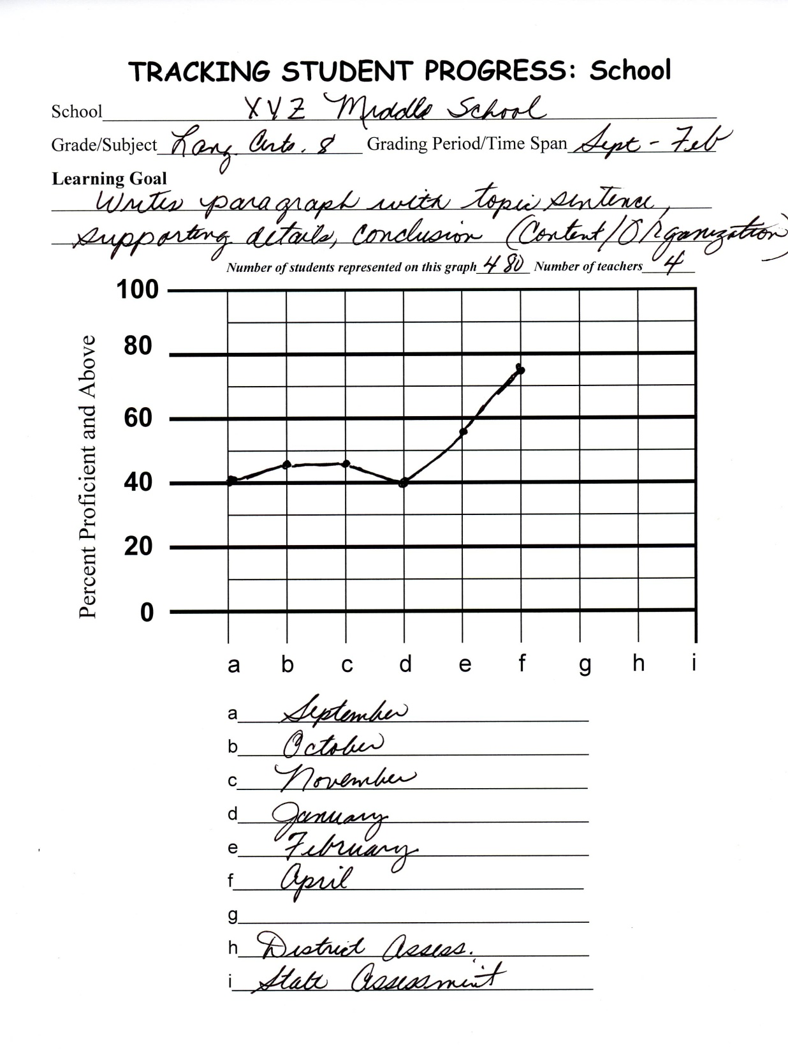

Slide 210
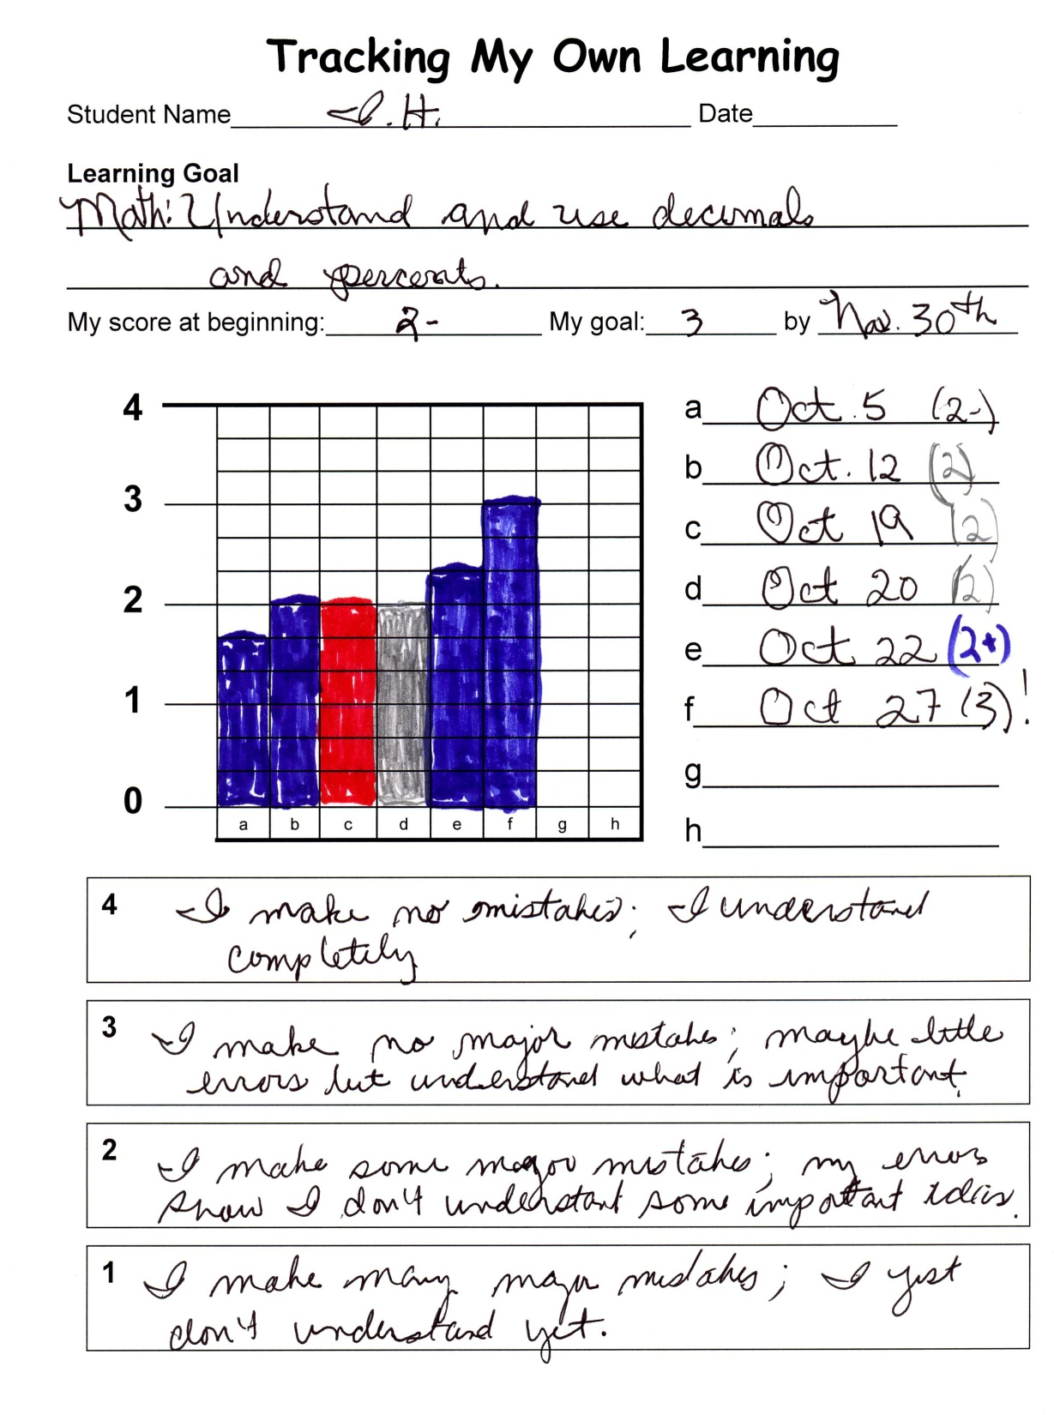

Slide 211
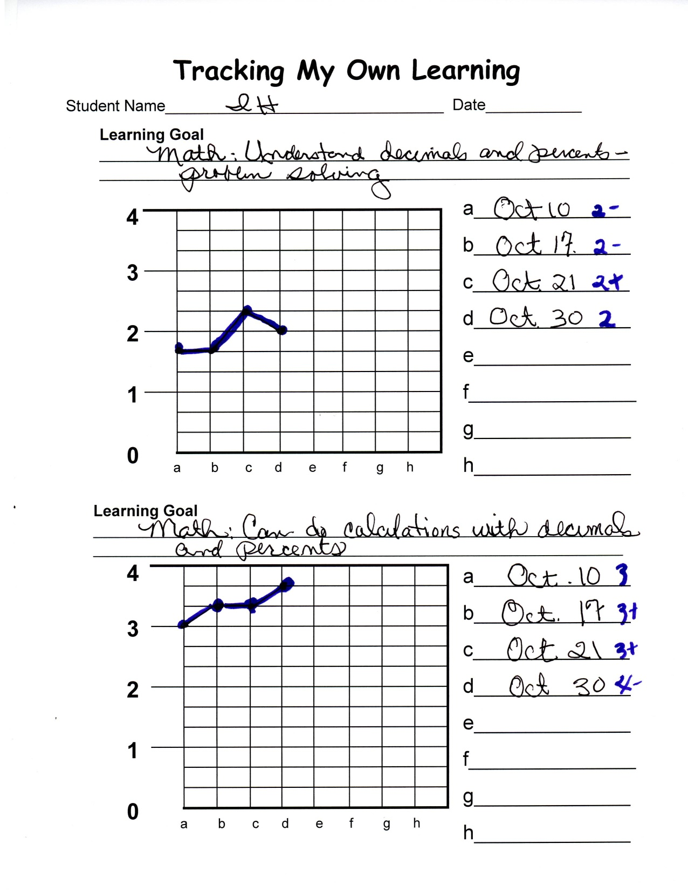

Slide 212
Setting Objectives and Providing Feedback
Summative Assessment
What percentage gain have students averaged through use of this strategy?
Can I give specific examples of this strategy in action?
How can I INTENTIONALLY use this strategy in my classroom?
Were any other Marzano strategies demonstrated in conjunction with this strategy? If so, which ones?
What are some other things I would like to know about this strategy?
Create a six-word essay concerning this strategy.

Slide 213
Generating and Testing Hypotheses
Initial Assessment
What percentage gain have students averaged through use of this strategy?
Can I give specific examples of this strategy in action?
Have I ever used this strategy in my classroom?
Was the use of this strategy INTENTIONAL?
What else do I already know about this strategy?

Slide 214
Best Practice #8
Generating and Testing Hypotheses increases student achievement by 23%
“Knowing what to do when you don’t know what to do” is how Piaget defined intelligent behavior. When students generate and test hypotheses they are applying knowledge.
Teachers can keep student engaged with problems, puzzles, and riddles by using open ended examples. By considering several courses of action, the mind is exercised and the learner engaged.

Slide 215
Bleak House Example
When students create hypotheses, stress to them that it doesn’t matter whether they are right or wrong.
Learning comes from the analysis of the event result in comparison to what they thought the result would be.

Slide 216
STRUCTURE/STRATEGY
Four Square

Slide 217
Four Square Information
Notes on page 11
Graphic organizer (27% achievement increase)
Can be used to gather and store information
Can be used to analyze findings
Can be used to compare similarities and differences (45% achievement increase)
Can be used to summarize and synthesize information that has been learned (34% achievement increase)
Can be used to inform and record predictions (23% achievement increase)
Our sample activity will use it to do all these things (I think)

Slide 218
Let’s Talk About Mood!
In a story, what is “mood”?
In what ways can an author create mood in a story?
Watch the first Mary Poppins trailer.

Slide 219
Mary Poppins #1

Slide 221
Question Time
What are words you would use to describe the mood of the previous trailer?
Watch the second Mary Poppins trailer.

Slide 222
Mary Poppins #2

Slide 223


Slide 224
Question Time
How did the mood differ from the first trailer?
What are some words you would use to describe the overall mood of the second trailer?
What most affected the overall mood from one trailer to the next?
Now, let’s use our knowledge of mood . . .

Slide 225
Four Square Summary
Topic: BLEAK HOUSE by Charles Dickens | An excerpt of Bleak House can be found on page 6 of your handout.
1. Predict the overall mood of Bleak House. (1 minute) | 2. What are ten words you expect to see in the story that will help create that mood? (2 minutes)
3. Write ten words or phrases that are used in the story to create mood (3 minutes) | 4. SUM UP – How close were your words to the story’s words? Were any similar or the same? Was your mood prediction correct? Why? (4 minutes)

Slide 226
Process as Students
Small group process through Round Robin*
One minute each
1. What was my prediction?
2. What words did I expect to see?
3. What words did I actually see?
4. Were the words similar or the same?
Overall, was your prediction correct?
Class process (Wheel of Destiny)
* Cooperative Learning = 27% achievement increase

Slide 227
Process as Teachers
With your shoulder partner:
  What GLEs/CLEs match this assignment?
  Pages 3-4
  What is at least one way you can adapt the four square tool for use in your classroom?

Slide 228
QUESTIONS?

Slide 229
Generating and Testing Hypotheses
Summative Assessment
What percentage gain have students averaged through use of this strategy?
Can I give specific examples of this strategy in action?
How can I INTENTIONALLY use this strategy in my classroom?
Were any other Marzano strategies demonstrated in conjunction with this strategy? If so, which ones?
What are some other things I would like to know about this strategy?
Create a six-word essay concerning this strategy.

Slide 230
Questions, Cues and Advance Organizers
Initial Assessment
What percentage gain have students averaged through use of this strategy?
Can I give specific examples of this strategy in action?
Have I ever used this strategy in my classroom?
Was the use of this strategy INTENTIONAL?
What else do I already know about this strategy?

Slide 231
Best Practice #9
Cues, Questions, and Advance Organizers increases student achievement by 22%
Cues, questions, and advance organizers help students use what they already know about a topic to enhance further learning.
These tools should be analytical, focus on what is important, and are most effective before a learning experience.

Slide 232
Questions
What have we done over the past few hours that could fall under the category of cues, questions and advance organizers?
How do you use cues, questions or advance organizers in your classroom?

Slide 233
Questions, Cues and Advance Organizers
Summative Assessment
What percentage gain have students averaged through use of this strategy?
Can I give specific examples of this strategy in action?
How can I INTENTIONALLY use this strategy in my classroom?
Were any other Marzano strategies demonstrated in conjunction with this strategy? If so, which ones?
What are some other things I would like to know about this strategy?
Create a six-word essay concerning this strategy.

Slide 234
Marzano Strategies Continuum
No
knowledge
Expert
knowledge
0%
100%
Where do you fit?

Slide 235
I am going to try…..
because…..
I think I will see/find/discover/learn
Notes:
Effect on me…
Effect on students…

