Slide 1
Staying on Course: Progress Monitoring to Insure Success
Tim Lewis, Ph.D.
University of Missouri
Center on Positive
Behavioral Intervention & Supports
pbis.org

Slide 2
Data Purposes
Fidelity
System
Practice
Student Progress Monitoring
School-wide
Classroom
Students
Summative Evaluation
Systems (Fidelity / Cost –Benefit)
Student outcomes

Slide 3
System Fidelity Tools
Tier I (systems & practices)
Team Implementation Checklist
Benchmarks of Quality
School-wide Evaluation Tool
School Assessment Survey
SWIS
Tier II/III
Benchmark for Advance Tiers (BAT)
Individual Student Systems Evaluation Tool (ISSET)

Slide 4
Tier II Practices Fidelity
Self-management
CICO
Check & Connect
Social Skills
Tell / Show / Practice
Academic
Tell / Show / Practice

Slide 5
Tier III Practices Fidelity
Functional Behavior Assessment
Behavior Intervention Plan

Slide 6
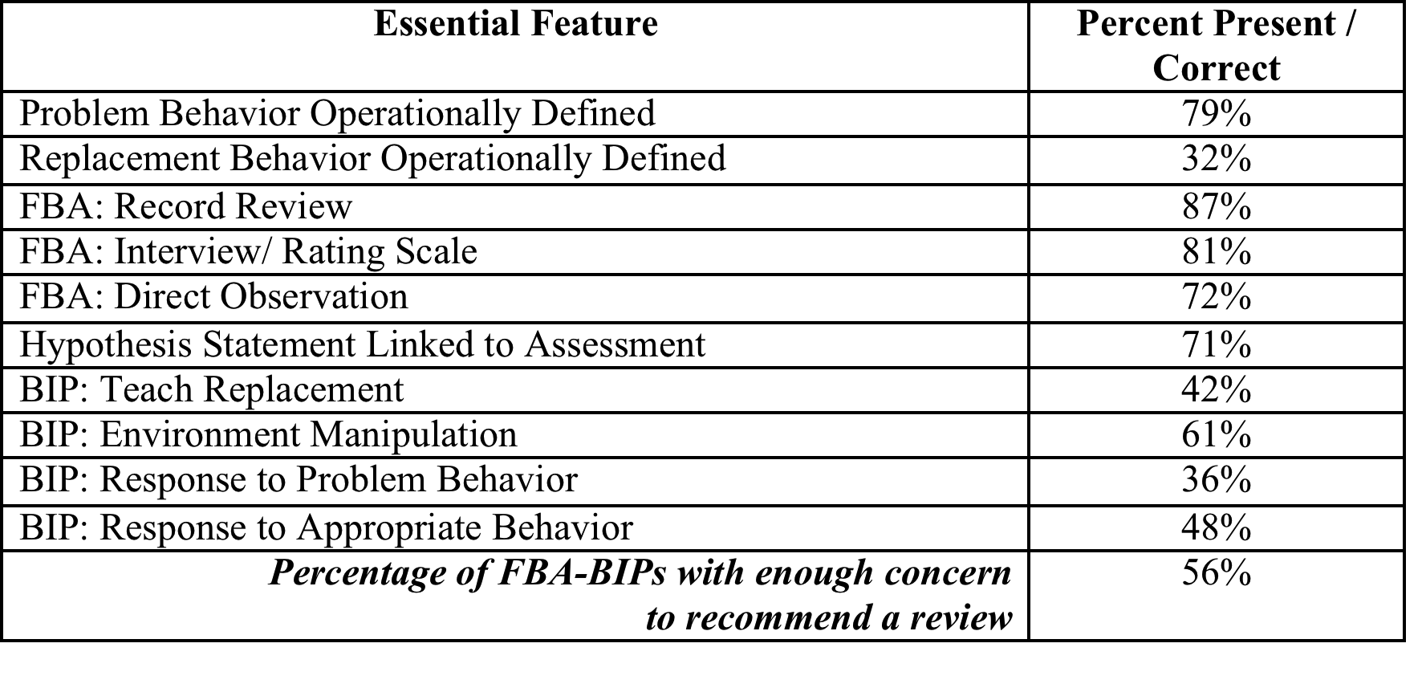

Slide 7
Key Points Across the Review
Therapy is not an FBA-based intervention.
Response to appropriate/replacement behavior must lead to the same functional outcome as the problem behavior (i.e., get/avoid).
Response to problem behavior must be the opposite of the current function (e.g., avoid adult attention if problem behavior functions to access adult attention).
Hypotheses should only include “get what student finds reinforcing” and/or “avoid what student finds aversive.” Power, control, emotion expression are not observable/manipulable functions.

Slide 8
Key Points Across the Review
Teaching replacement behavior should focus on how to build student fluency with replacement behavior, not what the adults will do or what incentives will be built into the system.
Environment manipulations should focus on prompting replacement behavior and altering antecedent conditions to lessen likelihood of problem behavior occurring.
Training and technical assistance should focus on a range of strategies for escape-motivated students.

Slide 9
Tier III Practices Fidelity
Functional Behavior Assessment
Behavior Intervention Plan

Slide 10
Progress Monitoring: Universals
Office Discipline Referrals
Suspensions / Expulsions
Attendance
Academic Outcomes

Slide 11
Progress Monitoring: Tier II
CICO / Check & Connect
Social Skills
Academic
Accuracy
Percent Completed
Academic Engaged Time (reduction in loss of instruction)

Slide 12
CICO Record
Name: ____________________________ Date: ______________
0 = Need work, 1 = “OK” 2 = Nice Job
 | Safe | Responsible | Respectful
Check In | 0 1 2 | 0 1 2 | 0 1 2
Before Recess | 0 1 2 | 0 1 2 | 0 1 2
Before Lunch | 0 1 2 | 0 1 2 | 0 1 2
After Recess | 0 1 2 | 0 1 2 | 0 1 2
Check Out | 0 1 2 | 0 1 2 | 0 1 2
Today’s goal |  | Today’s total points
Comments:

Slide 13
HAWK Report
Date ________ Student _______________Teacher___________________
0 = Not Yet 1= Good 2= Excellent | Be Safe | Be Respectful | Be Your Personal Best |  | Teacher initials
 | Keep hands, feet, and objects to self | Use kind words and actions | Follow directions | Working in class
Class | 0 1 2 | 0 1 2 | 0 1 2 | 0 1 2
Recess | 0 1 2 | 0 1 2 | 0 1 2
Class | 0 1 2 | 0 1 2 | 0 1 2 | 0 1 2
Lunch | 0 1 2 | 0 1 2 | 0 1 2
Class | 0 1 2 | 0 1 2 | 0 1 2 | 0 1 2
Recess | 0 1 2 | 0 1 2 | 0 1 2
Class | 0 1 2 | 0 1 2 | 0 1 2 | 0 1 2
Total Points = Points Possible = 50 |  | Today ______________% |  | Goal ______________%

Slide 14
CHECK | M | Tu | W | Th | F | M | Tu | W | Th | F | M | Tu | W | Th | F | M | Tu | W | Th | F | M | Tu | W | Th | F
Tardy
Skip
Absent
Behavior referral
Detention
In-school suspension
Out-of-school suspension
Failing classes/Behind in credits | _____ D’s _____ F’s _____ Classes passed out of _____ total ____Credits earned out of _____ total
 |  |  |  |  |  |  |  |  |  |  |  |  |  |  |  |  |  |  |  |  |  |  |  |  |  | < High risk for month
CONNECT
BASIC
Shared general information
Provided regular feedback
Discussed staying in school
Problem-solved about risk
INTENSIVE
Arranged for alternative to suspension
Contracted for behavior or grades
Communicated with parents
Made special accommodations
Participated in community service
Participated in social skills group
Worked with tutor or mentor
Other_____________________

Slide 15
Social Skills
Student can state the rule for skill use
Student can demonstrate skill during an untrained role play
Student displays skill in generalized setting

Slide 16
Daily Progress Report
Notes:
Periods (block schedule) along the top
Goals (along the side) are the school-wide expectations (may need to be individualized for some students)
Rankings – 2 = followed expectation, 1 = so- so, 0 = did not meet expectation

Slide 17
Progress Monitoring: Individual Students

Slide 18
Describe Behaviors Using Operational Definitions
Describe behavior such that it is observable and measurable via the following dimensions
Topography
Force or intensity
Locus
Frequency
Duration
Latency

Slide 19
Two General Methods
EVENT BASED = Record when behavior occurs
TIME BASED = Record after a set passage of time

Slide 20
With all instruments...
1 Accurate operational definition of behavior
2 Clearly defined setting
3 Define observation period
4 Define interval size (time based)
5 Name/ I.D. measurement system
6 Convert raw data into standard METRIC

Slide 21
Event Recording
Method
Record time
Count behavior
Metric = Rate per minute
Appropriate for low frequency, equal duration behaviors

Slide 22
Duration Recording
measure duration of each occurrence of behavior
sum measures
useful for behaviors that are continuous and when total amount of time engaged is important
metric =
Percent of Time
Amount of Time
Useful in measuring high frequency and or behaviors of unequal duration

Slide 23
Time Based Measurement
Interval recording
Gives approximation or estimate of number of times a behavior occurs
Record at end of interval
Metric = Percent of Intervals
-
-
+
+
+

Slide 24
Partial Interval
Method
specify observation period
divide observation time into intervals
{intervals should be no longer than average length of behavior}
record if behavior occurs at any time during the interval

Slide 25
Whole Interval
Method
specify observation period
divide observation time into intervals
{intervals should be no longer than average length of behavior}
record if behavior occurs throughout the interval

Slide 26
Momentary Time Sampling
Method
specify observation period
divide observation time into intervals
{intervals should be no longer than average length of behavior}
record if behavior occurs at end of interval

Slide 27
Graphing Data
Rationale
show performance MONITOR / DECISION MAKING
EVALUATE effectiveness of instruction

Slide 28
Graph Components
Abscissa (horizontal) = Time
Ordinate (vertical) = Behavior
Title (Student Name & Intervention)
Data points
Phase Lines

Slide 29
Title = Student Name & Intervention
Baseline
Intervention
Behavior
Time

Slide 30
Lines of Progress
Used to assist in Decision Making
Trend Lines
Aim Lines

Slide 31
Aim Line
Indicates desired progress
Criteria from objective/goal
Date of desired mastery
Data Decision Rules created relative to the Aim Line (determined prior to start of intervention)
If data fall below the aim line for three consecutive days, begin alternative intervention

Slide 32
Aim Line
Place “aim star” at objective criteria and time point
Using ONLY the last three days of baseline data, calculate the mid-date and mid-rate
Connect intersection to aim star

Slide 33
Place the Aim Star
Criteria from Obj.
Baseline
Intervention
*
Behavior
Desired time line
Time

Slide 34
Mid-Date & Mid-Rate Last 3 Points
Baseline
Intervention
*
Behavior
Time

Slide 35
Draw the Aim Line
Baseline
Intervention
*
Behavior
Time

Slide 36
Data Decisions

Slide 37
Data Decisions
Intervention data patterns
Make no change
Change goal date
Step back - teach pre-requisites of task
Move to new instructional procedure
Move to new skill / new phase of learning

Slide 38
Data Decisions Example 1
Baseline
Intervention
*
Behavior
Keep Intervention in Place
Time

Slide 39
Data Decisions Example 2
Baseline
Intervention
*
*
Behavior
Change Timeline
Time

Slide 40
Data Decisions Example 3
Baseline
Intervention
*
Behavior
Move to next objective
Time

Slide 41
Data Decisions Example 4
Baseline
Intervention
*
Behavior
“Step back”
Teach Pre-requisite or
Easier version of Skill
Time

Slide 42
Data Patterns (within and across phases)
VARIABILITY
more stable more predictive
look for cyclical patterns
LEVEL CHANGES
indication of possible change in functional relationships or influencing factors
TREND DIRECTIONS
Downward
Upward
Flat

Slide 43
Evaluating Outcomes
Baseline
Intervention
*
Behavior
Trend &
Level Change
Time

Slide 44
Evaluating Outcomes
Baseline
Intervention
*
Behavior
Trend & Level Change
Time

Slide 45
Evaluating Outcomes
Baseline
Intervention
*
Behavior
Level Change
Time

Slide 46
Data Purposes
Fidelity
System
Practice
Student Progress Monitoring
School-wide
Classroom
Students
Summative Evaluation
Systems (Fidelity / Cost –Benefit)
Student outcomes

Slide 47
Staying on Course: Progress Monitoring to Insure Success
Tim Lewis, Ph.D.
University of Missouri
Center on Positive
Behavioral Intervention & Supports
pbis.org

