Slide 1

EPA
Environmental Protection Adaptations
Changing the Environment to Support our Students
Notes:
Introduction: Environmental Protection Adaptations – How do we guarantee success for all students? This session will focus on implementing adaptations to create a student centered environment.

Slide 2


Like Me
© CAS
Notes:
First We are going to do an inclusion activity called like me to get to know you a little better.
Directions: Move your chair a few feet away from the table so you can stand up without hitting the table. When you hear a description that reflects you in some capacity please stand up.
Stand up if you have ever encountered an angry student. Stay standing if you may have contributed to making that student angry. Stand up Stand up if you were ever directly involved with de-ecalating a student. Stand up if you know someone who has done a stellar job at DE-ESCALATING a student. Stay standing if you were that person. Stand up if you know someone who has ESCALATED a student> Stand standing if you were one of those people at one point in time. Thank you. Please sit back down.
How many know
“. . . the number one reason that teachers do not deal with or overlook problem behavior? It is because they are uncertainty of WHAT to do. Many of the techniques used by teachers–including reprimands, raised voices, threats, or even ignoring the behavior–actually may, inadvertently, be strengthening the problem behavior.”
“We’ll first focus on what we can do to PREVENT defiant and noncompliant behavior.”

Slide 3

Important Insights
“When teachers know and use positive and preventative management strategies, many of the commonly reported minor classroom behaviors can be avoided.”
Scheuermann & Hall
“Effective classroom management is a key component of effective instruction, regardless of grade level, subject, pedagogy or curriculum.”
Sprick, et. al
Notes:
Our goal is to give you some tools to fill up your tool box so you can be more proactive since as you can see by these quotes
The first one reminds us that the effective classroom practices are positive and preventative which help us avoid many minor classroom behaviors.
In the second quote. Sprick tells us effective classroom management is an important component of effective instruction for all teachers, regardless of grade level, subject, pedagogy or curriculum. Unfortunately many of our college classes did not prepare us in effective classroom practices.

Slide 4
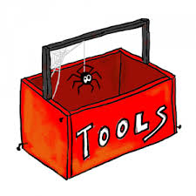

Unfortunately, most of the practical techniques used by teachers to respond to acting-out children are only of limited effectiveness and some, such as reprimands, arguing, and escalated hostile interactions, can actually strengthen the behaviors they are intended to suppress or terminate.”
Hill Walker, 1995
The Acting-Out Child: Coping With Classroom Disruption
Notes:
This is a Hill Walker quote about the ineffective strategies that many adults defer to when they do not have the right tools in their tool boxes or their tool boxes are empty. to help them be more proactive. We are going to give you some supports to put in place that will help to meet the needs of some of your challenging students.

Slide 5
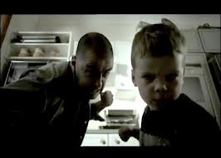
Why Do People Behave?
Modeling?
Accident?
Instinct?
Condition?
Why Do People Continue Behaving?
IT WORKS!
(ABC Training Curriculum, Borgmeier)
Notes:
Attention grabber: Video options (Children See Children DO? Or I’ve Been Watching You)
But First we need to know why a person behaves the way they do. “A person continues exhibiting a specific behavior because the behavior serves a communicative purpose. In other words, the behavior is communicating a need. Our job is to “decipher” the need that is being communicated.”
(ABC Training Curriculum, Borgmeier)

Slide 6

Understanding Chronic Problem Behavior
Behavior is a form of communication, unfortunately some students learn that problem behavior is the most efficient way for them to communicate their needs.
If a student repeatedly engages in a problem behavior, he/she is doing it because it is effectively meeting his/her needs.
Notes:
The behavior is functional or serves a purpose
“One example of a student exhibiting problem behavior to effectively meet her need is the student who ‘blurts out responses’ during class discussions. The teacher responds to the student by saying, ‘Remember to raise your hand and wait to be called on before answering.’ The teacher continues the discussion by asking a question. The student raises her hand and the teacher calls on another student. The next time the teacher asks a question, the student blurts out the answer.”
“If we want students to effectively meet needs by engaging in appropriate behavior, we must look for and find the ABC pattern of problem behavior. Then we build a hypothesis about why the problem behaviors are occurring and implement strategies to prevent the problem behavior and to teach appropriate behavior.”

Slide 7
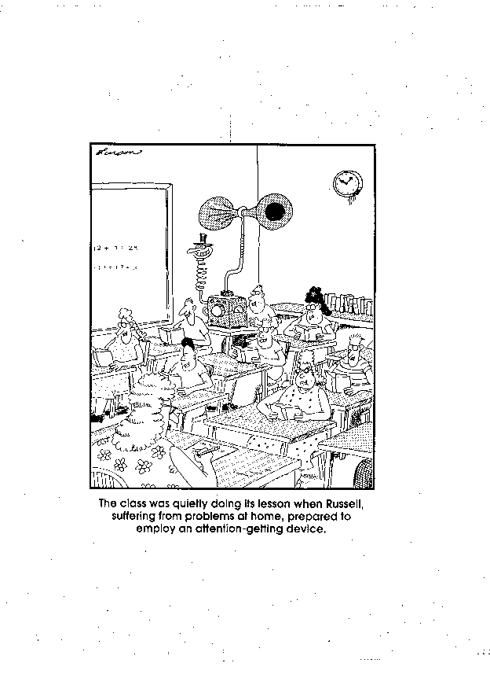
What is Russell trying to Communicate?
Notes:
For instance Russell is desperately seeking attention.

Slide 8
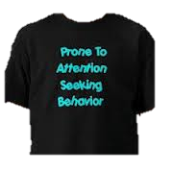
Think Function, not Behavior
Reflection Questions:
What is the student trying to communicate?
How can we help the student meet their needs?
Notes:
You need to focus your attention on the function not the behavior itself. Unfortunately our students do not wear t-shirts identifying what they are trying to communicate, so when a student is engaging in problem behavior more frequently than other students you need to ask yourself these questions:
What is the child trying to communicate?
What is the child trying to gain or avoid?
What can we do to change the behavior? In other words, how can we help meet the child’s need?”
“Discussions should focus on the function rather than the type of behavior because intervention is based on meeting the function.
Example: A child runs when certain types of writing tasks are assigned because she will be sent to the office. Intervention would not be focused on ‘stopping the running’, rather, the intervention would be focused on coping with difficult writing tasks.”

Slide 9
Functions of Behavior
Behavior
1
2
Obtain/Get
Something
Avoid/Escape Something
Stimulation/
Sensory
Social
Tangible/
Activity
Adult
Peer
Notes:
There are 2 main functions of behavior Avoid or Obtain.
“Humans engage in behavior to obtain something or to avoid/escape something. What is that we are attempting to obtain or avoid? We may be attempting to obtain sensory input, social interaction (otherwise known as attention), an object or an activity. We may be attempting to avoid/escape those same things.”
“Have you ever attempted to avoid completing paper work by cleaning out your work area? Have you ever attempted to get someone who was working on another task to talk to you by walking close to the person and smiling? Think of some times this week when you attempted to obtain or avoid something.”

Slide 10
The Science of Behavior
A B C
Antecedent | Behavior | Consequence
Conditions or circumstances that increase the probability of a behavior occurring. Examining the ABC’s of a specific Behavior can help clarify the FUNCTION of that behavior | An observable act. What the student does. The actions or reactions to the antecedents. . | The resulting event or outcome that occurs immediately following the behavior. Impacts future occurrence of the behavior.
Notes:
Walking through the ABC’s may help us to identify what is triggering a behavior otherwise known as the antecedent and then we can change the antecedent which may change the outcome of the behavior.
“Antecedents are the actions/events that occur before the behavior, anything in the students’ environment that sets the stage or triggers the behavior. Antecedents include the physical setting, the activities of the day, the materials, person or people present, as well as how and what directions are given.”
“Behavior is any observable act that the student does–the actions or reactions of the student to the environment or antecedents.”
“Consequences are the results, actions or events that directly follow the behavior. Consequences either increase (reinforce) or decrease (punish) the probability that the behavior will occur again in the future (Alberto & Troutman, 2012).” So if we can change the antecedent we can change the behavior.

Slide 11
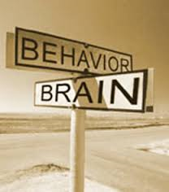

The Principals of Human Behavior
Human behavior is Functional
  Behavior serves a purpose
  Results/consequences of a behavior affect
  future occurrences of that behavior
Human behavior is Predictable
  Environmental conditions can set up, set off, or maintain appropriate or inappropriate behavior
Human behavior is Changeable
  Understanding the predictors, consequences and function of problem behavior is key for designing effective interventions.
Notes:
Human behavior is functional- it serves a purpose
Predictable- Occur in patterns
Changeable – By changing the environment Antecedents and consequences you can change the behavior
“Consequences of a behavior teach the student which strategies are most effective. All of us use effective strategies more often than ineffective strategies to get our needs met.”
“Because we can predict which conditions set up and maintain appropriate behavior and inappropriate behavior, we can design effective routines that increase the likelihood students will behave appropriately.”

Slide 12
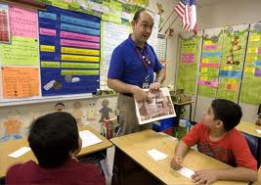
Creating Positive Environments to
Manage Classroom Behavior
Identify Academic & Behavioral goals or outcomes
Maximize Structure
Develop & Teach Procedures
Provide Specific Positive Feedback (4:1)
Consistently Respond to Errors.
Notes:
So first step is to evaluate your current environment to ensure that you have a created a positive environment conducive to learning.
Managing classroom behavior begins by
Clarifying or specifying the goals each child is working to accomplish.
Maximizing the structure by arranging the physical space, identify and teach procedures.
Developing and teaching the rules & procedures that will provide structure for the children to accomplish the goals. Teach rules that will provide very clear parameters for how the children will interact with each other and how they will interact with the adults.
A system for effectively providing specific positive feedback to students when they are following the expectations.
Consistently responding to their errors by using the continuum of discouragement strategies.

Slide 13
Identify Academic Goals or Outcomes
What do you expect the students to be able to do at the end of a lesson?
What will the students have to produce to show you they can do it?
Student Goal Sheet
Notes:
Beginning with Identifying academic goals. Children who do not understand the purpose of the work they’re assigned to do are much less likely to persist to the completion of the task.
The goal of the task must be very clear. The child must be able to know what he or she will be able to do as a result of completing the work.
For example, the teacher directs the child to paste pictures of things that start with the letter “b”. The child must understand that they are learning the letter “b” so that they can read words like “bat”, “box”, “bug”. The child should have the letter “b” in front of them. They should also have the printed words that start with “b” in front of them.
The child must also understand when a task is finished. If you’ve directed the students to find pictures of objects that start with the letter, “b”, you must tell them what they must do to be done. For example, the students could be told, “You’ll be finished when you find five pictures that start with the letter ‘b’. ” You could direct the children to find as many pictures as they can within 5 minutes (set a visual timer so the children can see the minutes passing.)
Clarifying the outcome by stating what the kids will be able to do and what each child must produce will provide the rationale for staying in the assigned area and completing the work.
Disseminate a copy of the Student Goal Sheet. Proceed to the next slide to provide a sample of a student goal sheet.

Slide 14
Identify Academic Goals or Outcomes
Do students know their goals and do they keep a record of their progress toward their goals?
Goal | My Progress
Elmo will read the 40 words on the Dolch preprimer list at 80% | On September 12 I can read 10 of my words.
Elmo will point to each object as he counts 1 to 30 at 80% | On September 12 I can count up to 10 things.
Elmo will be able to draw horizontal lines, copy a circle and a square 8 of 10 times | On September 12 I can draw horizontal lines 10 of 10 times. I can copy a circle 3 of 10 times. I can copy a square 5 of 10 times.
Notes:
Do you often hear students say, “Why do I have to do this work?!” How do you respond?
The most effective response is one that involves eliciting goals from the student and family and focusing all work on attaining those goals.

Slide 15
Identify Behavioral Goals or Outcomes
The same questions must be asked about the outcomes for behavior:
What do you expect the students to be able to do at the end of a lesson?
What will the students have to produce to show you they can do it?
Notes:
Students who have challenges with behavior have learned to meet their needs by following a set of “rules” that do not match the rules of the children who do not have challenges with behavior. For example, the child who “calls out” during class has learned that calling out gets the attention of the teacher MUCH more efficiently than raising his or her hand and waiting. Raising his or her hand may not result in getting the teacher’s attention, but “calling out” works almost every time.
A child who has trouble reading may say, “I’m not going to do this stupid work” so he or she will be punished and will not have to remain in the group to read. We have to clarify the goals or rules so children will know that all the adults in the school have the same rules. These rules are in place to make sure all the students will learn to read and write and get their work done. School is the “job” of each student and the rules are in place to make sure each student can do his or her job.

Slide 16
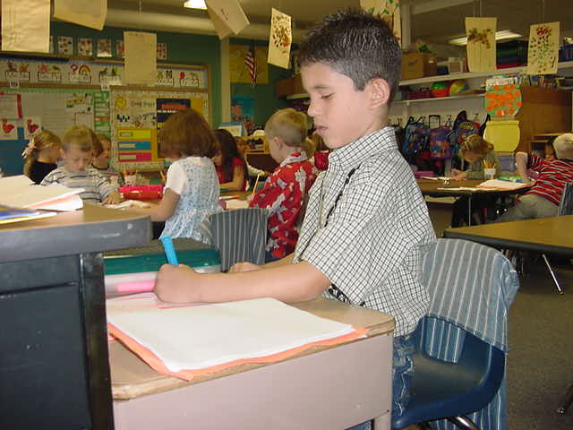
Identify Goals or Outcomes for Behavior
Expectations & Rules Sample
Expectations | Classroom Rules
Safe | Keep hands, feet & objects to yourself Stay in work/play space
Respectful | Use good words Actively Listen
Responsible | Follow Directions* Do your work
Notes:
Expectations describe how we’d like our students to act.
Rules describe the specific behaviors the students will exhibit.
Here is an example of the rules you might use with your students.
They are stated with few words and describe exactly what you want each child to do. These rules are called “keystone” rules because they are comprehensive. In other words, these rules provide behavioral guidelines for any circumstance or interaction a person may have throughout the day..
You will have to describe exactly what following each rule looks like by developing a lesson plan to teach each rule. For example, you’ll have to create a lesson plan to teach the rule, “Use good words.” You will define what you mean by “good” words. For older students, you would most likely word this rule as, “Use appropriate language.”
*A sample lesson plan is included to demonstrate how to create lessons to teach rules.

Slide 17
Creating Positive Environments to
Manage Classroom Behavior
Identify Academic & Behavioral goals or outcomes.
Maximize Structure.
Develop & Teach Procedures
Provide Specific Positive Feedback (4:1)
Consistently Respond to Errors.
Notes:
The next critical piece to creating a positive environment is to Maximize structure by arranging the physical space to make it more conducive to learning.

Slide 18
Physical Arrangement of the Environment:
Minimize Crowding and Distractions
Design the environment to elicit appropriate behavior.
  Arrange furniture to allow easy traffic flow.
  Designate staff & student areas.
  Arrange Seating to facilitate completion of tasks
Notes:
The goal is to arrange seating to facilitate completion of tasks (group work, individual work). The furniture should be arranged to allow you to move around the room so that you can constantly be interacting with your students. Students should know where they can easily access materials so they do not need to interrupt instruction if they need a pencil ect.

Slide 19
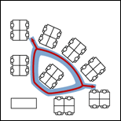
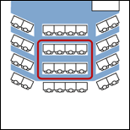
Suggested Seating Arrangements
An interior loop allows you to work
the crowd with the fewest steps.
(Fred Jones)
The following web site provides design instructions: classroomdeskarrangement.com
Notes:
Here are 2 suggested ways to arrange the classroom which allows the teacher to access all students. Placement of students is also key. If a student requires more attention make sure they are strategically placed so that you can interact with them on a more frequent basis. Students who are highly distracted should be away from the doors and windows to decrease distractions.

Slide 20
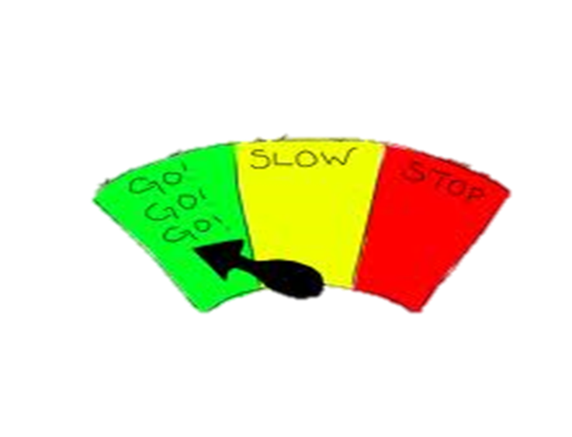

Design the Environment to Encourage Appropriate Behavior
Ensure adequate supervision of all areas proximity and mobility
  Move (Green, Yellow, Red Zones)
  Scan
  Interact
  Positively Acknowledge
Visual Access
    Teacher access to students at all times
    Student access to relevant instructional materials
Notes:
The first step is to design an environment that is conducive to learning. In thinking about the arrangement of your classroom these are some key things to keep in mind to develop an environment more conducive to learning.(reference steps on slide)

Slide 21

Room Design Self Reflection:
What adjustments might you make to your current classroom design to create an environment more conducive to learning ?
Notes:
Take a moment to reflect on some changes you might want to make in your classroom. Turn to a partner and share the adjustments you plan to make.

Slide 22
Creating Positive Environments to
Manage Classroom Behavior
Identify Academic & Behavioral goals or outcomes.
Maximize structure.
Develop & Teach Procedures
Provide Specific Positive Feedback (4:1)
Consistently Respond to Errors.
Notes:
How do you get the children in my class to achieve academic and social/behaviors? You must identify and teach procedures to help make the most effective and efficient use of your time.

Slide 23

Typical School Day
17% Direct Instruction
33% Seatwork
20% Transitions
30% Discipline & Other
Non-Instructional
Activities
Cotton, 1995; Walberg, 1988
Notes:
When the amount of time spent in various classroom activities was researched only 17% was spent in instruction and 33% in seatwork.
Transitions take 20% of the school day. The typical elementary classroom loses 7-10 minutes each transition from one subject to another; with a typical day including at least 10 transitions, 70 minutes are lost each day; almost one day per week lost to transitions alone.
Unfortunately discipline and other non-instructional activities such as taking attendance, announcements, etc, accounted for 30% of the school day.
Think about your typical day and the time you spend in various activities. How does it compare to these statistics?
Why is this information relevant to us? (discipline takes away from time to teach academic curriculum)
Conclusion: We want to implement effective classroom practices to prevent and decrease interruptions caused by discipline problems and increase the amount of time we have to teach.

Slide 24
Clear procedures, taught and consistently enforced, are the most critical tool to create a functional and productive learning environment.
Good & Brophy, 2013
As students become more familiar with classroom routines and procedures, additional instructional formats and more challenging work can be incorporated.
Evertson, Emmer & Worsham, 2003; Good & Brophy, 2003
Notes:
We know that instructional time is lost due to unclear procedures, ineffective transitions, which can lead to disruptive behavior requiring a corrective response
“When students can predict the events throughout their school day, they are more likely to be engaged and less likely to display problem behavior. One way to increase predictability in a classroom is to establish routines, particularly early in the school year.” (Kern & Clemens, 2007, p. 67)

Slide 25
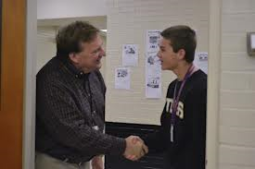
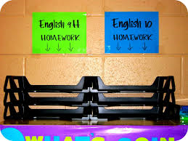
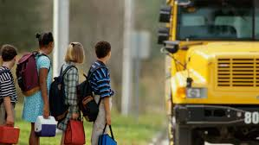
Teacher Procedures
Greeting students
Seating Chart
Attention signal
Attendance
Giving directions
Preparing for transitions
Assigning class work and homework
Providing feedback
Providing correction
Escorting students to bus, cafeteria, etc.
Collecting student work
Keeping records
Notes:
Having clearly defined procedures will allow you to plan and work efficiently with your students. Here is a list of some the procedures you need to have developed to make your day run more effectively and efficiently.

Slide 26

Prepare for Transitions
Provide Pre-corrects signaling the end of an activity
Communicate Clearly upcoming transition
Check for Understanding
Use Verbal or Non-Verbal Signal
Provide Positive Feedback for smooth Transitions
Transition Handout
Notes:
As we mentioned earlier transitions eat up about 20% of your time so it is important that you have procedures in place to help transitions run smoothly so here are some strategies that you may want to consider.

Slide 27
Student Procedures
Entering the room
Beginning the school day with necessary materials
Sharpening pencils
Requesting assistance (and how to “help myself” until someone can help me if the teacher is busy)
Independent work
Putting things away
Making up missed work
Ending the school day
Notes:
You also need to have common classroom procedures for students. So think of the challenging times that occur in your classroom that steal away instructional time. Do you have a procedure in place? If you do is it working?

Slide 28
Current Status of Classroom Procedural Routines
Consider Problematic Areas and Times
Do you have a Procedural Routine?
Have you taught it?
Is it working effectively?
Do you need to tweak or develop a new procedure?
Procedure Checklist
Notes:
Consider your current status and ask yourselves these questions.

Slide 29
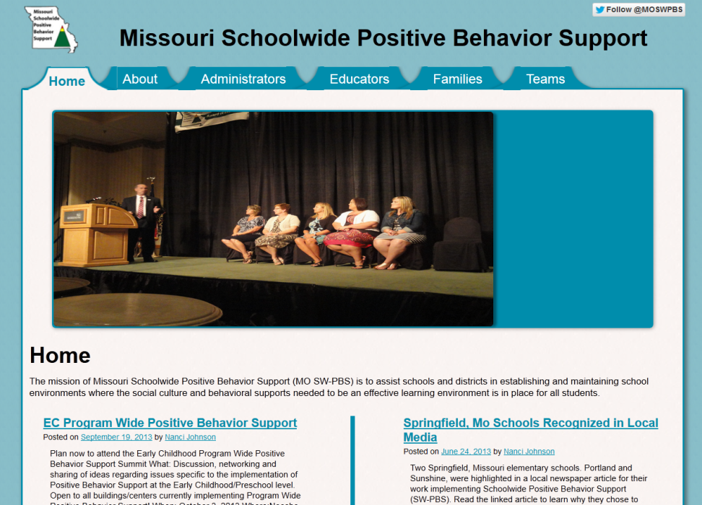
Eight Effective Classroom Practices Resources
Power Point
Handouts
Teacher Tools
http://pbismissouri.org
Notes:
If you need some additional supports you can access the classroom module on procedures and routines on our website. It will provide you with further information about developing your classroom procedures.

Slide 30
Creating Positive Environments to
Manage Classroom Behavior
Identify Academic & Behavioral goals or outcomes.
Maximize structure.
Develop & Teach Procedures
Provide Specific Positive Feedback(4:1)
Consistently Respond to Errors.
Notes:
How do I get the children in my class to achieve academic and social/behavioral goals? Provide specific feedback.

Slide 31


You Get What You Recognize
Provide Specific Positive Feedback ( SPF) to the Students for meeting Expectations.
Use specific, positive feedback when students display the expected behavior to increase the likelihood students will display the desired behavior again in the future.
Notes:
Most teachers agree on giving descriptive feedback about academic work. Most teachers know giving descriptive feedback on what the student did well and what the student needs to improve will help them learn reading, math and other academics. Giving positive performance feedback is equally important to learn social behavior skills.
There is no one universal reinforcer to increase likelihood of a social skill, although adult attention is reinforcing for most students.

Slide 32

Benefits of Specific Positive Feedback
“When we focus our praise on positive actions, we support a sense of competence and autonomy that helps students
develop real self-esteem.” Davis, 2007
The most powerful behavior change tool teachers have in their repertoire:
Helps adults and students focus on positive social behaviors and actions.
Increases likelihood students will use the recognized behaviors and skills in the future.
Increases on-task behavior
Decreases inappropriate behavior, and reduces the need for correction.
Enhances self-esteem and helps build internal locus of control.
A minimum of a 4 positives for every negative/correction (4:1) creates an optimal learning environment.
Notes:
As teacher praise to reprimand ratios improved, student on-task levels increased for all classrooms.
After withdrawing praise from a classroom, off-task behavior increased from 8.7% to 25.5%
When the rate of criticism was increased, off-task behavior increased from 25.5% to 31.2% with over 50% off-task behavior on some days

Slide 33
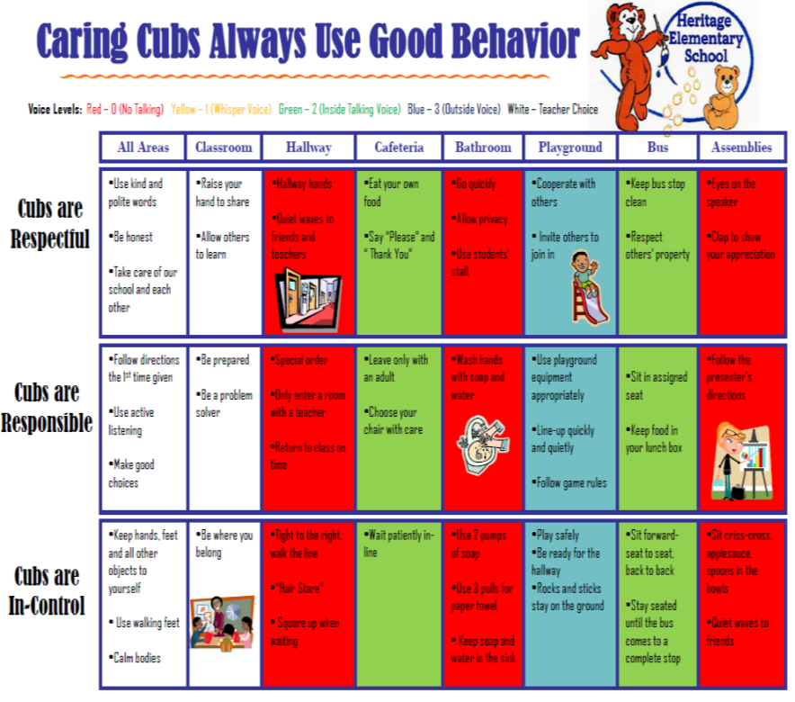
What Should be Recognize
Recognize students for following the Expectations and Rules that have been identified for all students.
Recognize students for exhibiting specific rules they have difficulty following.
Notes:
Each person in the school must recognize the students for following school rules.
Some students have more difficulty following some rules. Focus the recognition for those children on the specific rules they have difficulty following (e.g. A student who hits, must be recognized at a HIGHER rate for using good words and keeping hands to self.)

Slide 34
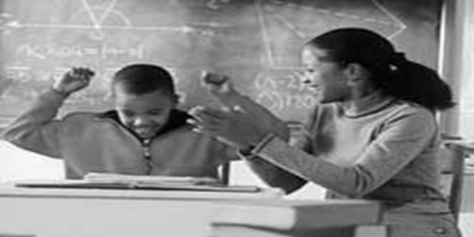
How to Provide Effective Specific Positive Feedback
State the Expectation
Specifically Describe the Behavior
Include a Positive Consequence( optional)
“Carl thanks for using materials appropriately by putting them away at the end of the project. That shows respect for our classroom. You earned a Bee ticket!”

Slide 35
Creating Positive Environments to
Manage Classroom Behavior
Identify Academic & Behavioral goals or outcomes.
Maximize structure.
Develop & Teach Procedures
Provide Specific Positive Feedback ( 4:1)
Consistently Respond to Errors.
Notes:
How do I get the children in my class to achieve academic and social/behavioral goals? Consistently respond to errors so they have a clear understanding of the expectations in our classroom.

Slide 36
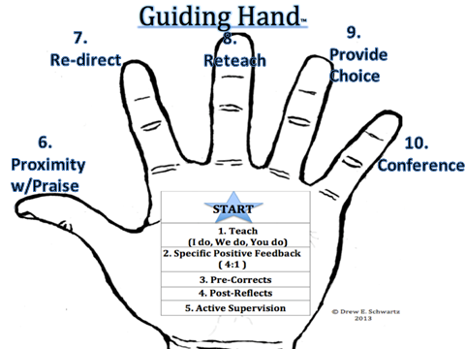
Respond Consistently to Errors
Notes:
When students are not following the expectations and rules then your staff needs to consistently respond to the errors by following these steps. First have you taught the expectations, provided spf, utilized precorrects, given the students time to self reflect and have you provided Active supervision? If you have then you move to the continuum starting with the less intrusive which is using proximal control and or proximal praise. If the student’s behavior continues move to redirect, reteach, providing choice and then conference.

Slide 37
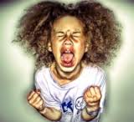

But What If….
Notes:
But when the students still drive you crazy and you are ready to pull your hair out. What can you do? We have to provide additional supports to meet the needs of their behaviors.

Slide 38
Providing Additional Environmental Strategies to Support your Students
Environmental Supports Handout
Notes:
Environmental Protection Adaptations – How do we guarantee success for all students? This part of the presentation will focus on implementing adaptations to create a student centered environment, so please take out the Environmental supports handout. Think of a few students who have been struggling. Keep in mind their strengths but what our some additional supports you might be able to use with them to equip them so they can be successful?

Slide 39
Attention Seeking
Using excessive or inappropriate behaviors in order to gain attention
Behaviors
Dangers
Provocative Dress
Superficial Cutters
Lying
Munchausen
Bullying
Excessive Bragging
Talking out
Aggravating others
Martyr/Victim
Drama Queen
Rescuers
Willing to put their own health in danger.
Difficult to develop lasting and meaningful relationships.
Bullying and Munchausen can be very damaging to other people.
Deliberately stirs up conflict among other people.
Perceived as untrustworthy
Notes:
It is important to know the characteristics to help determine the function of the students behaviors and provide the correct intervention.
So, Attention Seeking students may…….
Bragging about achievements and personal skills.
* Bullying other people either physically or emotionally.
* The individual can abuse their authority and power in order to show people how important they are.
* This need to sort out other people’s problems. When the individual takes on the role of a rescuer it means that the spotlight is on them.
* Becoming a drama queen. This means that the individual turns everything into a deal where they at the center of things.
* It can involve manipulating loved ones to deliberately create problems. This could involve things like spreading lies about one of their friends to get them into trouble with other friends.
* The individual may complain about nonexistent health problems in order to get attention. This is usually referred to as Munchausen Syndrome
* Munchausen by Proxy is where the individual creates health problems for their dependents in order to gain attention. In extreme cases a parent my even poison their child or cause other damage.
* Munchausen by Internet is where people go to online forums or chat rooms and pretend to have serious illnesses. This type of attention seeking behavior is becoming increasingly common because it is so easy to deceive people this way.
* Another type of attention seeking behavior is false confessions. This can include people who go to the police to admit to crimes they have not committed.
* Some people try to gain attention by being the busy bee. In work they will always want other people to view them as the hardest worker – they can act like a martyr because of this.
* Some people will resort to poisoning the minds of other people in order to cause drama that they can be involved in.
* The individual may falsely claim to be a victim of sexual or physical abuse in order to gain attention.
* They may manipulate other people into attacking them so that they can claim victimhood.
* Dominating conversations.
* Wearing clothes that are highly unusual or noticeable in an attempt to seek attention. This may include sexy clothing or even clothes that are highly unflattering.
Dangers Poor relationships Other people will find them to be too demanding and hard to be around.

Slide 40
Classroom Practices provide a
Menu of Interventions for:
Attention Seeking Behaviors
Increase Positive Recognition
  Increase recognition to the student when he/she is exhibiting appropriate behavior
  Give student leadership responsibility or a class “job” that requires the student to interact with staff
  Increase positive home/school communication
Increase Opportunities to Respond
Increase Active Supervision – Schedule more frequent interactions
Notes:
For attention-seeking behavior, classroom practices that provide more frequent opportunities for appropriate interaction will be most effective.

Slide 41

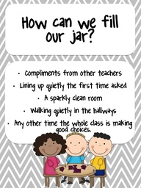
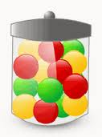
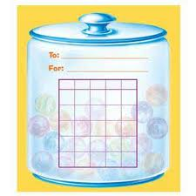
Change the Environment by utilizing Strategies for
Increasing Positive Attention
Notes:
If a student is seeking attention you can increase positive attention by providing more frequent positive feedback on an individual sheet that ties to the whole class incentive.

Slide 42

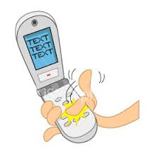


Increase Peer to Peer Positive Attention
(SPF)
C-MAIL Wednesday
Text IT
Tim
Joan
Larry
Fred
Lucy
TOOTLING!
Notes:
You can teach students how to provide specific positive feedback to each other, have them practice it and then provide them the opportunity to continue to use it to help them to internalize it. Each student takes a card and writes a specific positive feed back to the person and gives them the card at the end of the class.

Slide 43
Escape Behaviors
Performing an operant response that gets you away from an ongoing punishing stimulus.
Escape Behaviors
Dangers
Sleeping in class
Acting Out
Class Clown
Withdrawn
Low Attendance
Frequent Nurse visits
Frequent Counselor visits
Failure
Drop out
Delinquency
Notes:
Students who are trying to escape may…..

Slide 44
Classroom Practices provide a
Menu of Interventions for :
Escape/Avoid Task
Teach Procedures
  Asking for help
  Individualize procedure for use of resources (e.g. help bucket; peer support)
  Check to see if student has needed materials and if not, provide them before they are needed.
Address Task Difficulty
  Design assignments to meet student instructional/skill level.
  Pre-teach content.
  Modify amount or type of activity.
  Provide extra help/checks for understanding.
Provide Choice
  Provide choices such as what to do first or what tools to use.
  Provide an opportunity to engage in a preferred activity first.
Sequence Tasks
  Use behavioral momentum/task dispersion
Notes:
For escape-maintained behavior, classroom practices that provide more assistance with difficult tasks or social interactions, more choices regarding how to complete tasks or specialized procedures for use of resources will be most effective.

Slide 45
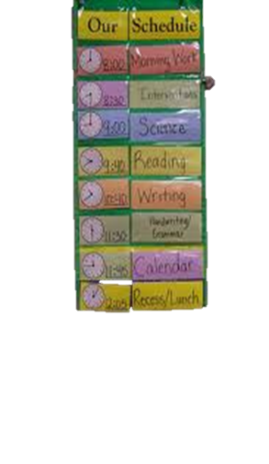
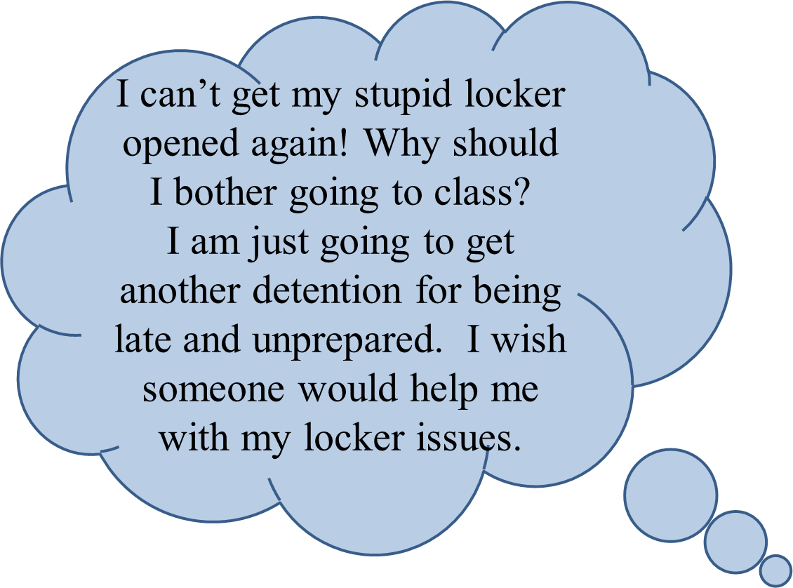
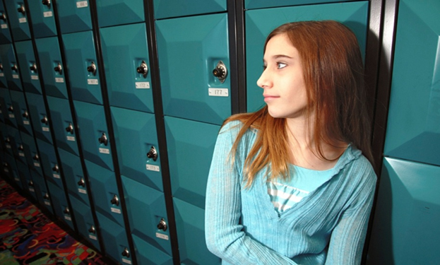
Environmental Supports to Decrease Frustrations in Students who lack Organizational Skills
  Visual Schedules
  Visual Reminders
    Morning/Dismissal Routines
    Reminder Sticky Notes
    Pre-correct Cards
  Student “Schedule” supports
Notes:
Some additional supports that you may need to provided in order to support your students might be to provide additional organizational tools. These tools can be an environmental change that can help students to be more successful. Sticky notes with short reminder statements
Can you think of a student or person , maybe yourself( me) that they just don’t seem to be able to make it anywhere on time. Poor time management? Lack skills. Show Visual Resources: Visual schedules, checklist of morning and dismissal routines, COLE’s student schedules with * when to go to lockers and when to bring what books
Some students may need supports to eliminate tardies or skipping class all together. So walk them through their schedule to help them determine which books they need to bring with them and what transition periods they can go to their lockers. Provide ample practice to unlock their lockers.
Antecedent: Students can predict the outcome of the behavior when the cue is present.

Slide 46
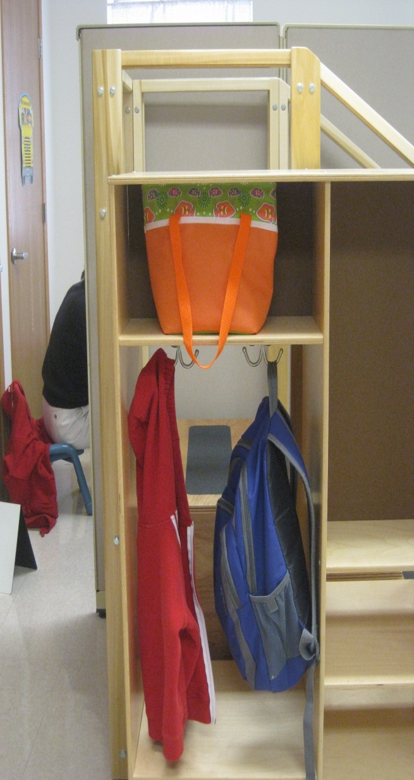
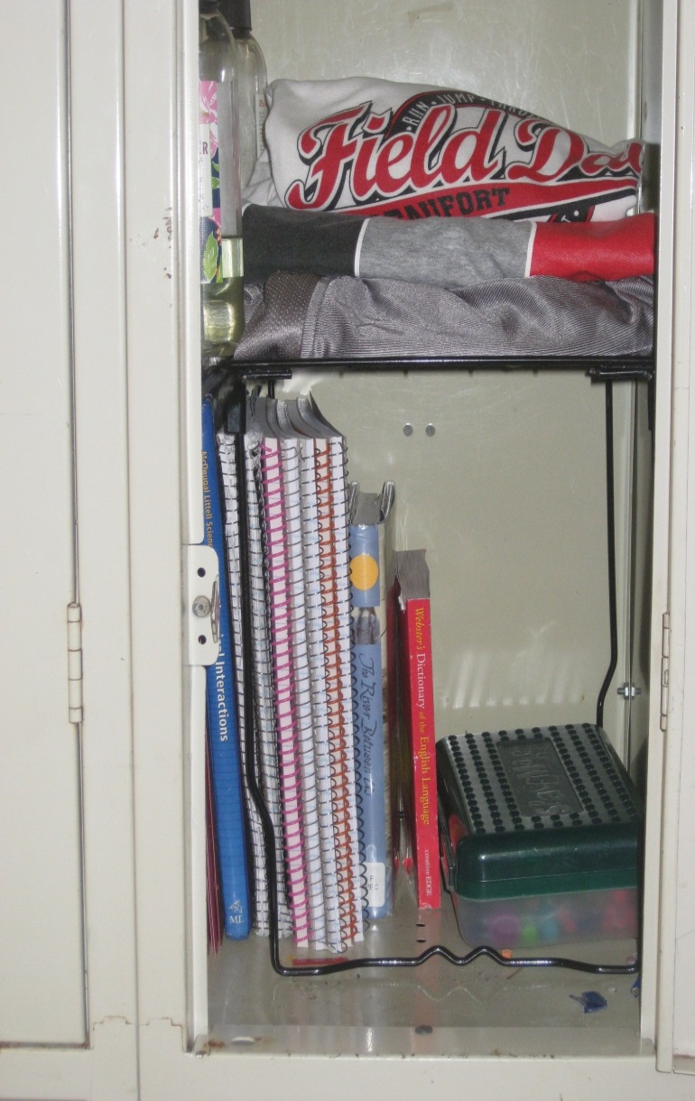
Visual Reminders
Teach and Post Arrival and Dismissal Procedures inside Locker or Cubby
Arrival Procedures
Dismissal Procedures
Notes:
Show posters of arrival and dismissal procedures. Visual reminders of the arrival dismissal procedures or how their cubbies or locker should look can set the student off on the right foot each day and help them to leave more prepared.

Slide 47
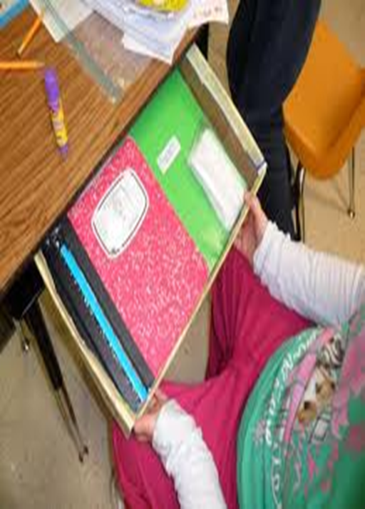
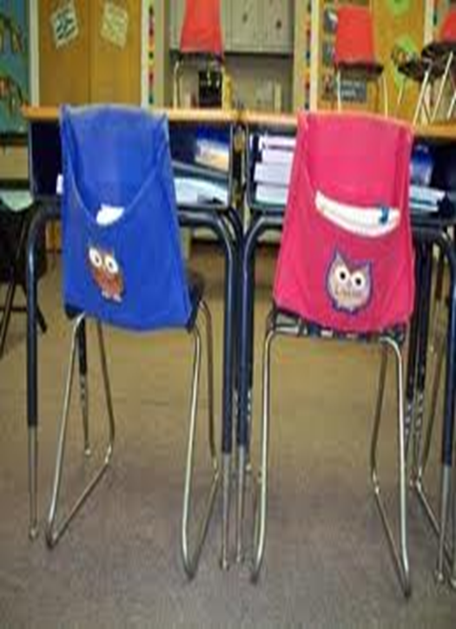
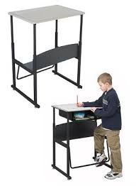
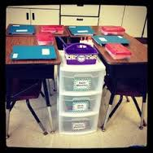
Teach and Provide Visuals for
Student Desk Organization
Desk
Organizers
Extra Storage
Stand Up Desk
Notes:
Desk organizers can help them to locate their materials and assignments which cuts down on frustration by saving time.

Slide 48
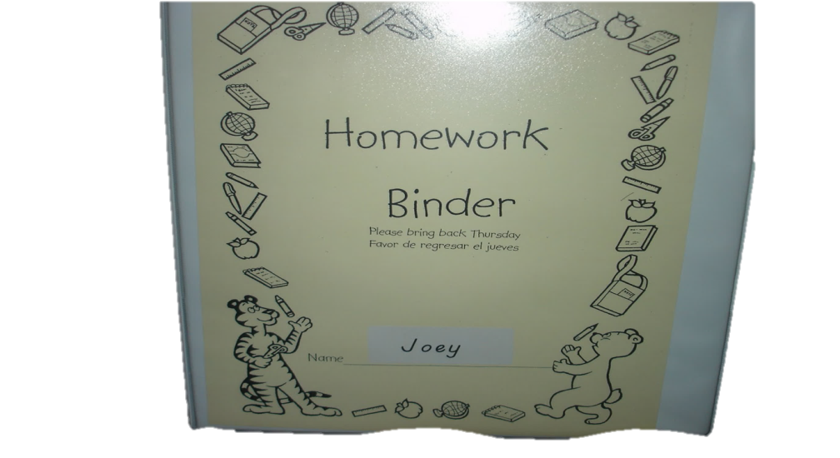


Organizational Folders
Custom planner/Assignment Sheet
Homework Binders
Color coded folders
Accordion folder
Assignment Labels
Copy of Class Notes
Notes:
Items for organization of homework. Providing strategies and tools to help them organize their homework materials can also help them to be more prepared. This can also impact their grades.

Slide 49

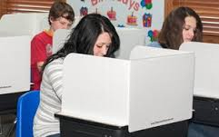


Environmental Supports to Increase Focus On-Task Behavior
Pen lights
Study Carrel
Pastel Backgrounds
Read by Color
SenseAble Strategies
Annie M. Beninghof, ( 1998)
Notes:
Using strategies to help kids focus can be an environmental change to help them be successful by decreasing off task behaviors.

Slide 50
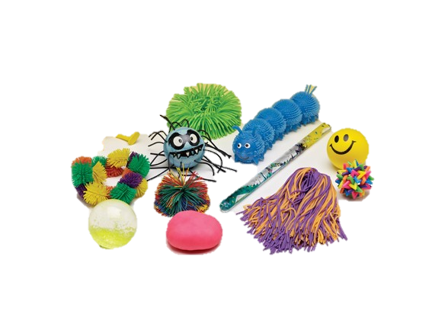
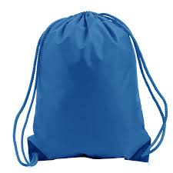
Environmental Supports to Decrease Anxiety in Students who have Low Tolerance Thresholds
  Fidgets
  Head phones
  Proprioceptive Input
    Wrist bands
    Jacket or Hoodie
    Weighted back pack or draw string bag
    Leg weights
    Heavy book on lap
Notes:
Seeking input provide them with fidgets or wrist bands. If on sensory overload proprioceptive input can help to calm them. Keep in mind what your classroom looks like is it putting the kids on sensory overload?

Slide 51

Teach Strategies for Relaxation
Relaxation Exercises (Ready, Set, Relax)
Meditation Apps
Breathing Exercises
Self-Talk Cards
Notes:
Relaxation techniques. Reminder cards, bracelet. In order to change perceptions and feeling we must tap into the students self- talk. By learning these techniques they will hopefully utilize one strategies when someone or something pushes their buttons instead of losing control.

Slide 52
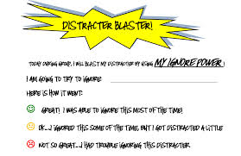
Self Monitoring Tools
On task behavior
In Seat
Raising Hand before speaking
Notes:
Helping them to self monitor their behavior can bring about an awareness of when they are following the rules and in which situations they are struggling. Sometimes just being conscious of their behavior decreases the frequency of the inappropriate behavior. You may need to provide some extra incentive for following the rules.

Slide 53

Provide Time and Space to
Self Regulate
Chill Out Zone
  Journaling
  Anger Ball
  Shredding Paper
  Proprioceptive Input
    Thinking Putty
    Wrist Exerciser
    Stop, Think, Plan
Notes:
Develop and Teach Chill Out Zone Procedures. Provide a place in the room where a student can go to calm down and refocus. You may want to have journals that they can write in, theraputty or self talk cards for them. You will need to have procedures for this area and teach them to the whole class. This is not a punishment is an opportunity for them to remove themselves from the current situation so they can calm down and make a better choice.

Slide 54
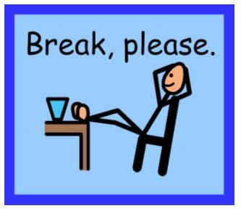
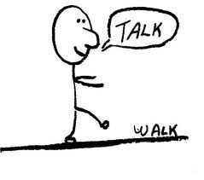
The Environment May Need to Change Completely
Break Cards/Signal
Walk and Talk
Notes:
If they cannot focus or their frustration level is too high in the room then have a plan for a break so they can calm down and refocus.

Slide 55


What are two primary reasons some students fail to use expected behaviors?
Notes:
As you are planning to develop a support plan for some of your more challenging students you need to keep in mind the answer to this important question.

Slide 56
Reasons for Inappropriate Behavior:
Skill Deficit–absent skill levels or insufficient opportunity to learn and practice the expected behavior
Performance Deficit– a lack of motivation to perform the preferred behavior due to inefficient or ineffective reinforcement of correct performance of the behavior
*
Notes:
These are the primary reasons some students fail to use expected behaviors. These are the reasons for problems, the solution is to provide more teaching.

Slide 57
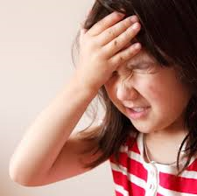
Misbehavior = Learning Error
EDUCATE
Students learn appropriate behavior in the same way they learn to read – through
instruction,
practice,
feedback,
and encouragement.
Notes:
The Key is that the behaviors must be taught.
Either problem–absent skill or lack of motivation–requires more teaching and practice to resolve so when you develop the plan you must ensure that you have provided ample time to teach the skills and time for the student to practice the skill. When they demonstrate the skill correctly you need to provide SPF.
I stress the practicing part because a lot of teachers teach it one time and expect the student to remember and use it from then on. When we teach them how to decode it doesn’t mean they can decode every word they encounter from that moment on same holds true for behavior no matter what the age.

Slide 58

Plan for Future Success
  How will you change the environment to help your students to be successful?

Slide 59


Review, Clarify, Commit to Support
Student Success
Reflect on the strategies
Choose at least 2 that you will commit to trying with a student
Explain to a partner what, why and how you might apply them
Environmental Strategies Handout
Notes:
Think of a student review the strategies, ask for clarification as needed circle at least 2 strategies that you are willing to commit to trying with one of your challenging students.

Slide 60


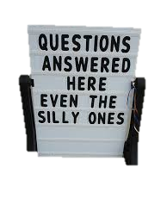

Questions
Notes:
Don’t leave with a question that is boggling you please ask. That is what I am here for.

Slide 61



