Slide 1
Small Group Social Skills
Becky-David Elementary
Kelly Pezzani and Rainah Pray

Slide 2
Presentation Outline
About Becky-David
Group Facilitators
Finding Time for Group
Teacher Identification
Assessment
Forming Groups
Group Guidelines
Types of Groups
Curriculum and Examples
Group Session Outline
Group Expectations
Homework
Progress Monitoring
Reinforcement
Additional Tips

Slide 3
About Becky-David
We just completed our 5th full year of implementing PBS. We are in our second year of Tier 2 and first year of Tier 3.
Current enrollment, as of May 2, is 933
4% Hispanic, 6% Asian, 7% Black or African American, 5% Two or More Races and 78% White
16.5% of students are on free or reduced lunch
87/933 students are on an IEP
3 principals
2.5 school counselors and 1 part-time Educational Support Counselor

Slide 4
Who does the groups?
Our groups are facilitated by our counselors. We typically do the groups for the grade levels that we are assigned.

Slide 5
Finding Time in the Day for Groups
Groups are done during school-wide intervention time first thing in the morning.
Groups are also done during the school day at an agreed upon time with the teacher and the counselor.
Some groups are done as a “lunch bunch” format or during recess time.

Slide 6
Teacher Identification
Kid Talk during PLC once a week
Discipline referrals- copies are given to the counselors

Slide 7
Assessment
Lagging skills form- based on Dr. Ross Greene’s Assessment of Lagging Skills and Unsolved Problems.

Slide 8
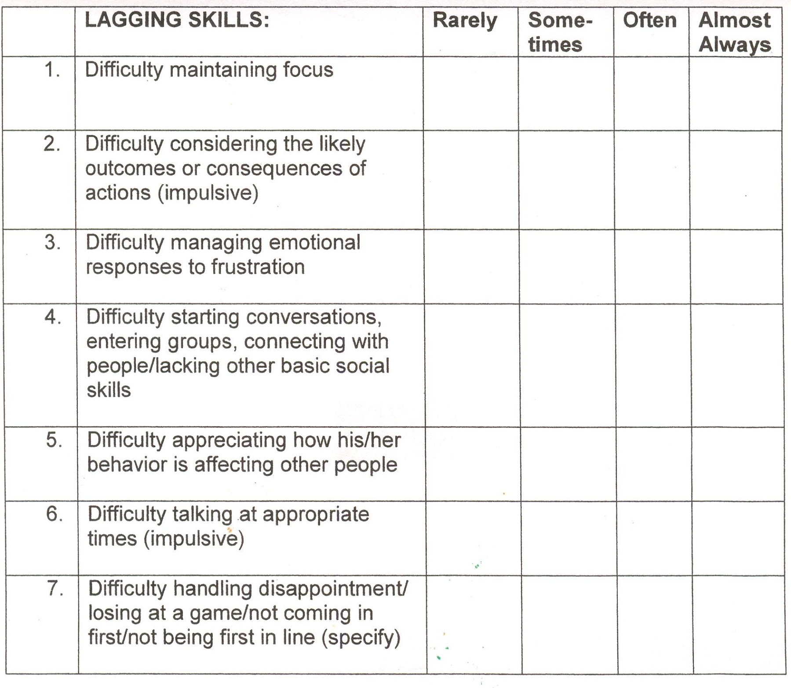

Slide 9
Forming Groups from Assessment
It’s important to focus on one to two common skills during group.
We use the lagging skills forms to form the groups.

Slide 10
Group Guidelines
We have all different types of groups with 3 different facilitators, but these are the norms for all of the groups.
Maximum of 8 students
6-8 sessions
Letters home to parents one week prior to the start of group
Group log is kept with lessons and students in attendance
End of session letter with evaluation sent to parents

Slide 11
Different Types of Groups
Focus Group
Choices and Consequences (impulsive)
Managing Emotions
Basic Social Skills
Friendship skills
Social Detective- appreciating how our behavior affects others
Girls Group

Slide 12
What Curriculum
Focus Group- Brain Gym
Managing Emotions- The Superflex Curriculum and The Zones of Regulation
Basic Social Skills- SSIS and My School Day or The Social Detective
Girls Group- Circle of F.R.I.E.N.D.S

Slide 13
Brain Gym * some exercises are also good for self-regulation or calming.

Slide 14
Room Setup for Brain Gym

Slide 15
Superflex Curriculum

Slide 16
Session Outline
Review
Talk about homework
Lesson
Homework

Slide 17
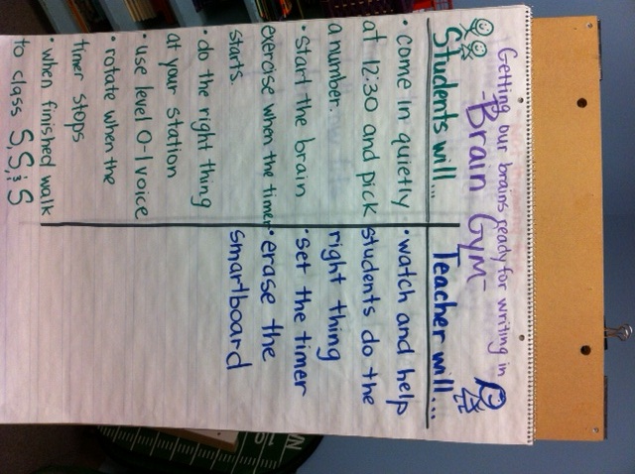
Session Expectations

Slide 18
Example of Homework

Slide 19
Progress monitoring

Slide 20
Reinforcement

Slide 21
Additional Tips

Slide 22
Resources
Dennison, G. & Dennison, P. (1994). Brain Gym: Teacher's edition revised. Ventura, CA: Edu-Kinesthetics, Inc.
Elliott, S.N. & Gresham, F.M. (2008). Social Skills Improvement System- An intervention guide. Minneapolis, MN: Pearson Assessments.
Fee, S. (2008). Circle of f.r.i.e.n.d.s.: Facilitator’s Guide. Bothell, WA: Book Publishers Network.
Greene, R.W. (2008). Lost at school: Why our kids with behavioral challenges are falling through the cracks and how we can help them. New York: Scribner.
Kuypers, L. (2011). The zones of regulation. San Jose, CA: Social Thinking Publishing.
Madrigal, S. & Garcia Winner, M. (2008). Superflex: A superhero social thinking curriculum. San Jose, CA: Social Thinking Publishing.
You are a Social Detective! CD Rom- The Social Skill Builder, Inc.
My School Day CD Rom- The Social Skill Builder, Inc.
Brain Gym Activities for the Classroom Website: http://www.livebinders.com/play/play_or_edit?id=138907

