Slide 1
Wood Elementary
Fort Leonard Wood, MO
Presenters:
Brittany Noroian
Crystal Reiner
Jennifer Schaub
Darlene Starner

Slide 2

Wood Environment
Located on Fort Leonard Wood Military Installation
Very Diverse K-5 School
Population around 460 students
Character Education Award Recipient
Nearly 40% transition rate during school year
SPED Programs
  ED
  ID
  LD
  Autism
  SPEECH/LANGUAGE
  ELL

Slide 3
Wood Motto:
“Where Learning Happens!”
Wood Vision
  Working Together To Ensure the Total Success of Everyone, Everyday.
Wood Universals
  Be Respectful
  Be Responsible
  Be Safe

Slide 4
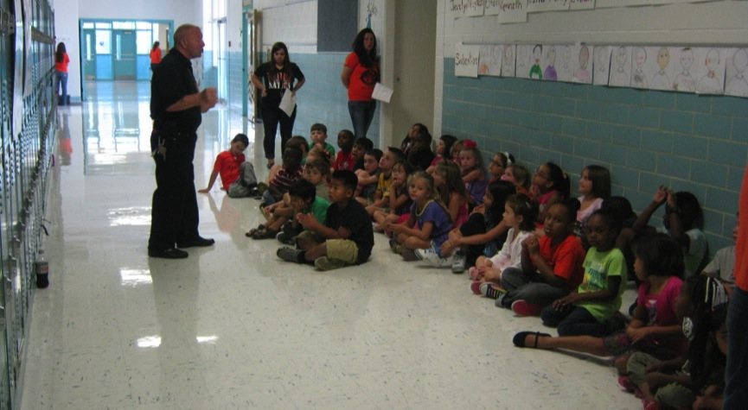
Wood Elem. Safari Days
PBIS Procedural Days

Slide 5
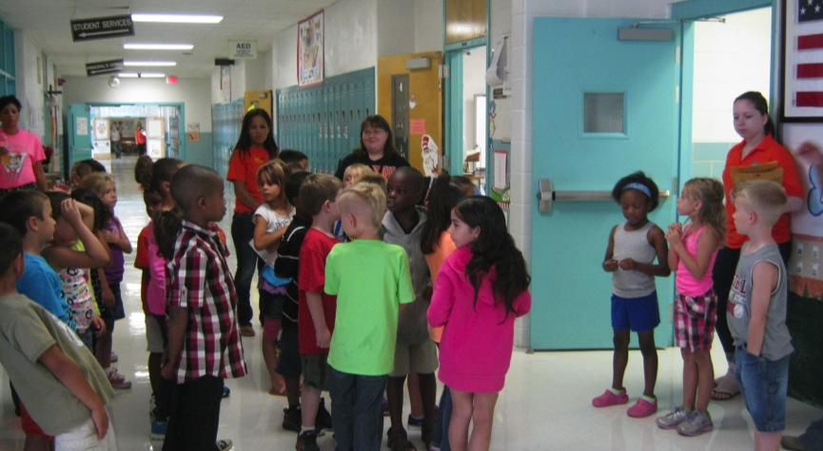
Being a Safe Wood Tiger
Safari Days

Slide 6
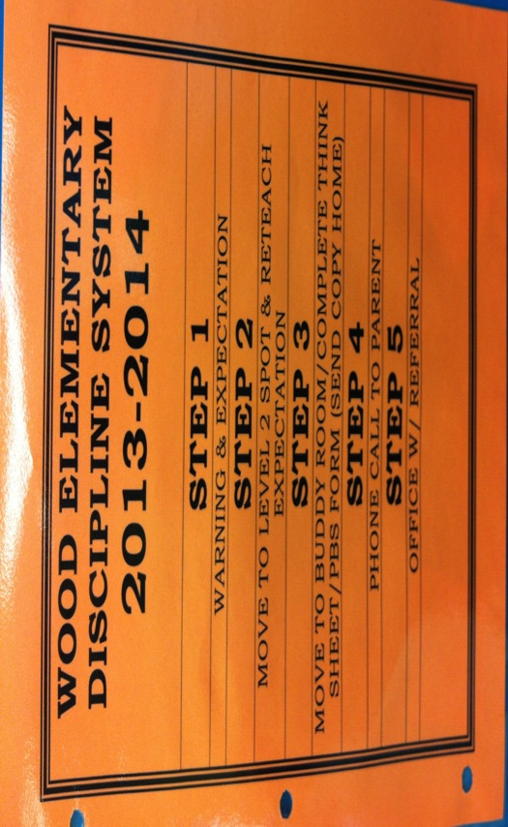
Rules/Expectations

Slide 7
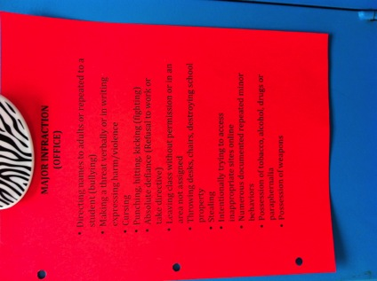
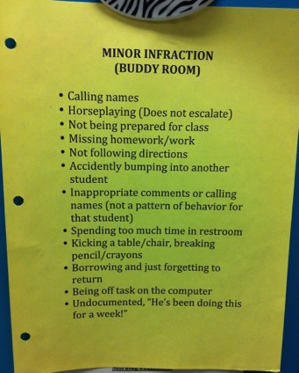
Major and Minor Infractions

Slide 8
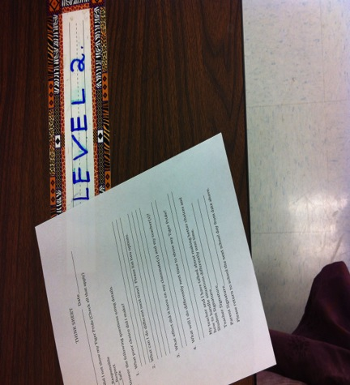
Buddy Room/Level 2 Spot

Slide 9
Discipline Referral
2012-2013 = 315 Office Referrals
2013-2014 = 64 Office Referrals
New Referral Policy in Place
Clear Expectations
Positive Behavior Awarded

Slide 10
Being a RESPECTFUL
Wood Tiger

Slide 11
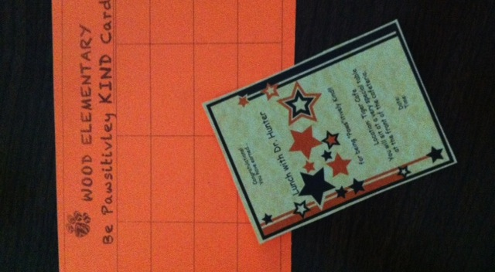
Be Kind Cards
Celebration Lunch w/ Principal

Slide 12
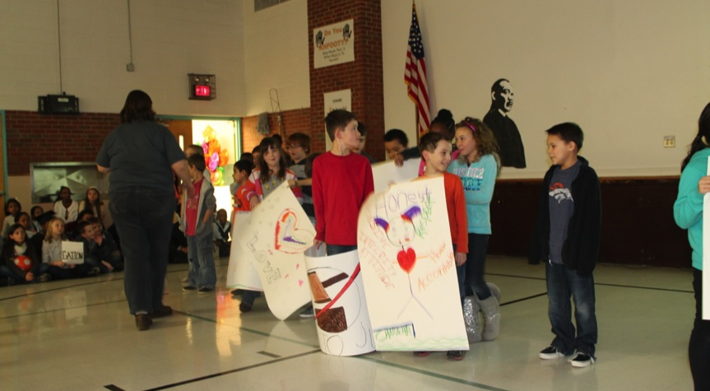
Martin Luther King Assembly

Slide 13
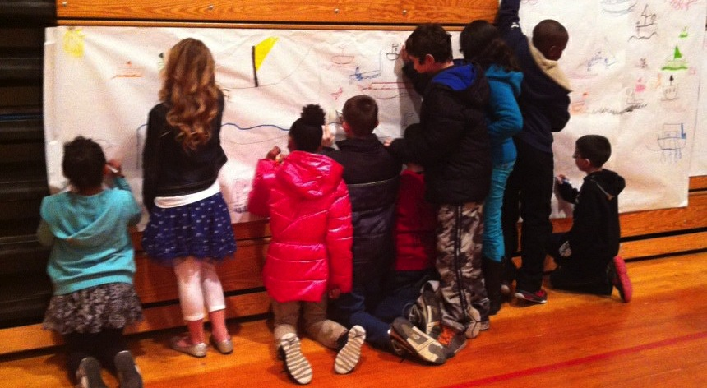
Black History Month

Slide 14
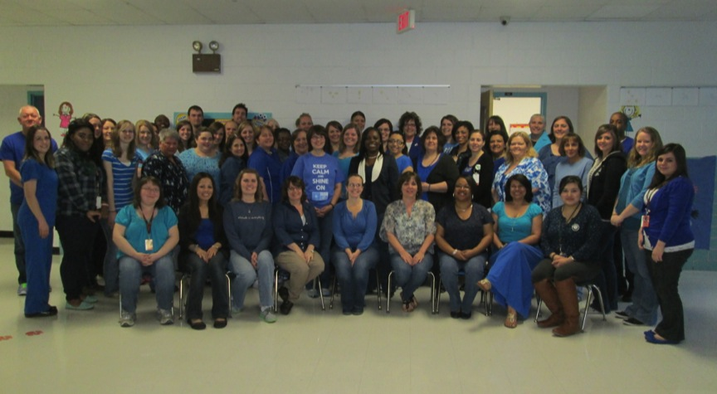
Paint it Blue—Autism Awareness

Slide 15
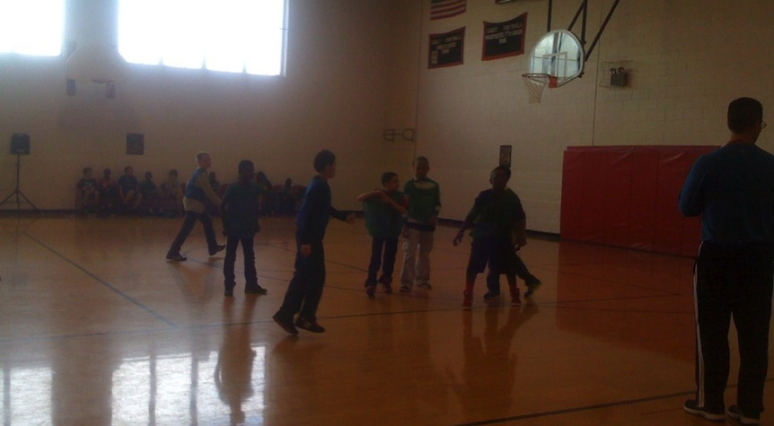
Fundraiser for
Autism Awareness

Slide 16
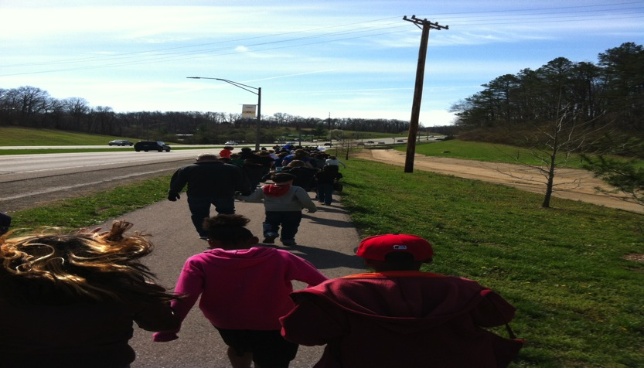
Walk-a-Thon for
Autism Awareness

Slide 17
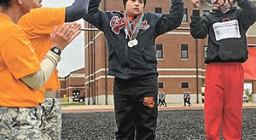
Special Olympics

Slide 18
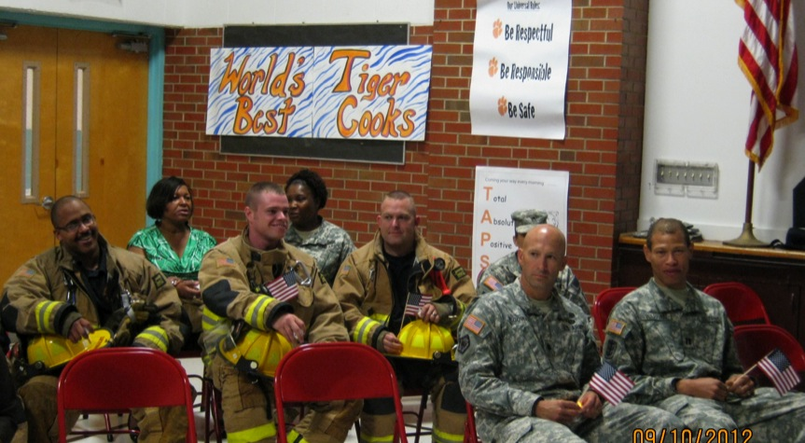
Honoring our Heroes
9/11 Assembly

Slide 19
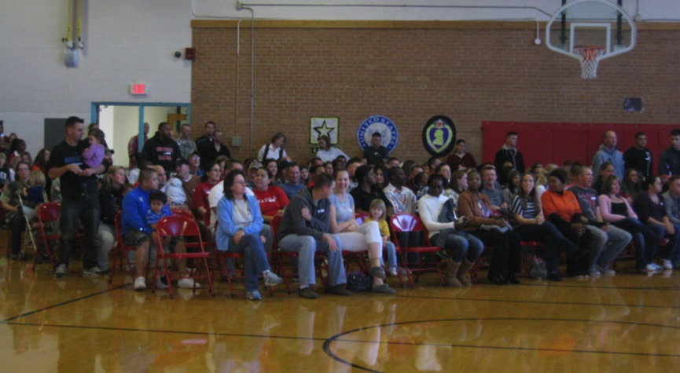
Veterans Assembly/Program

Slide 20
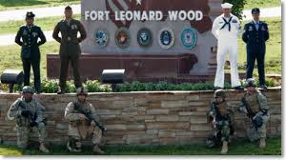
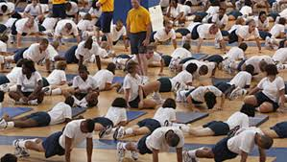
Sharing School Facilities with Military Community

Slide 21
Being a RESPONSIBLE
Wood Tiger

Slide 22
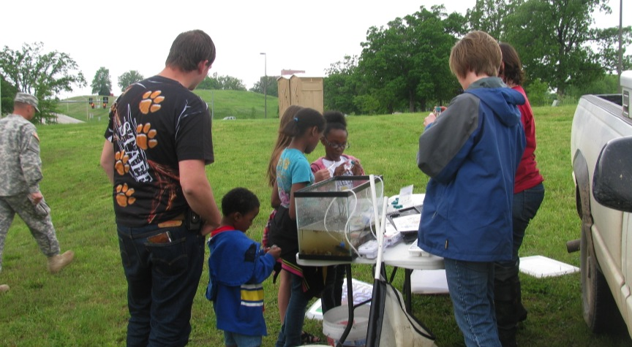
Science Unleashed (Mo Conservation)/Drury University Science Nights 1st-5th

Slide 23
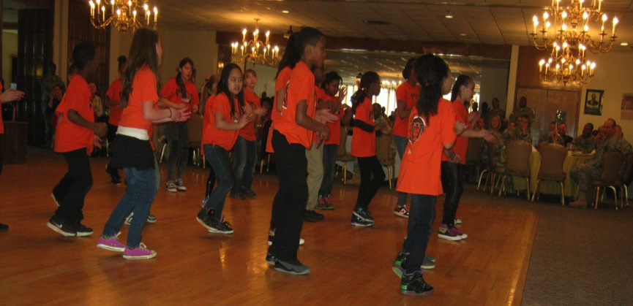
Wood Step Team
3RD-5TH GRADERS

Slide 24
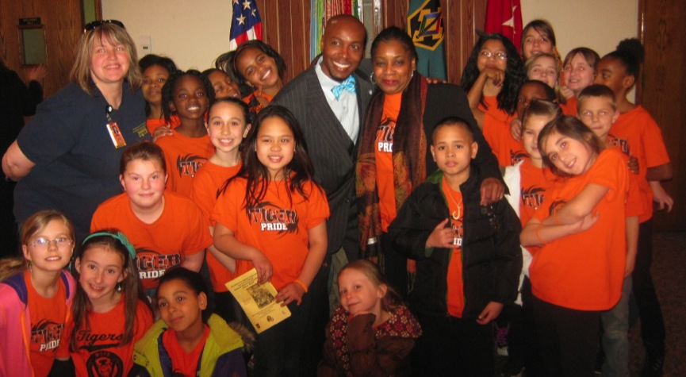
Awards and Honors
Wood Steppers

Slide 25
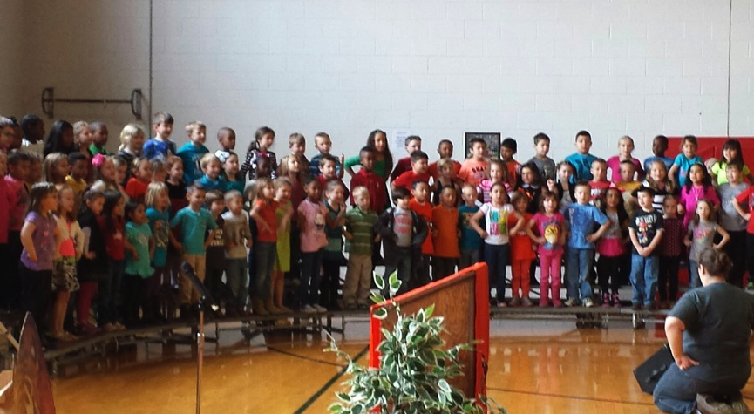
Concerts

Slide 26
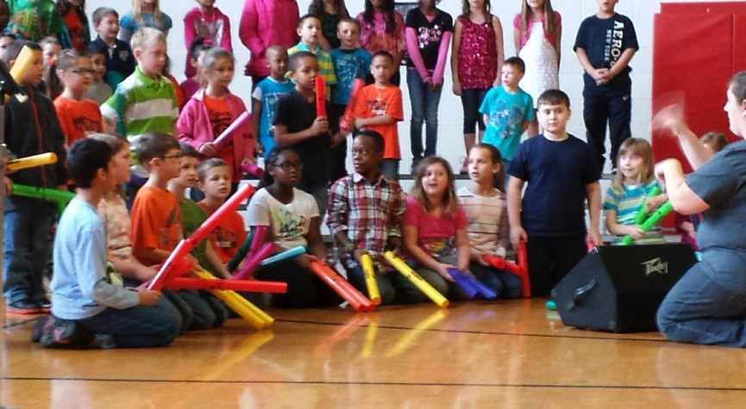
Presenting to our Community

Slide 27
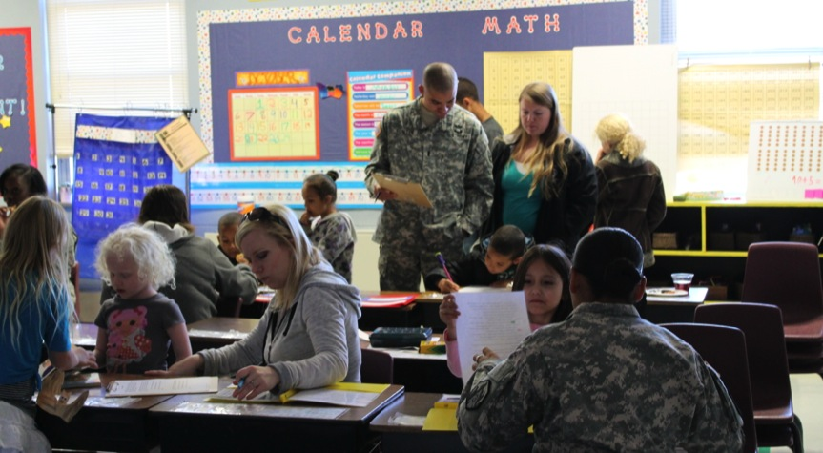
We are responsible to our Parents
Parent Math Night

Slide 28
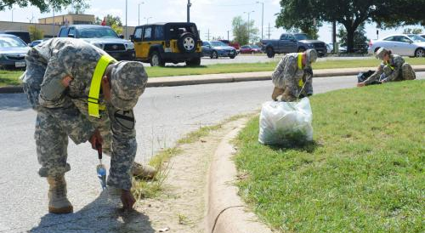
Community Responsibility
Military PIE
(Partners In Education)

Slide 29
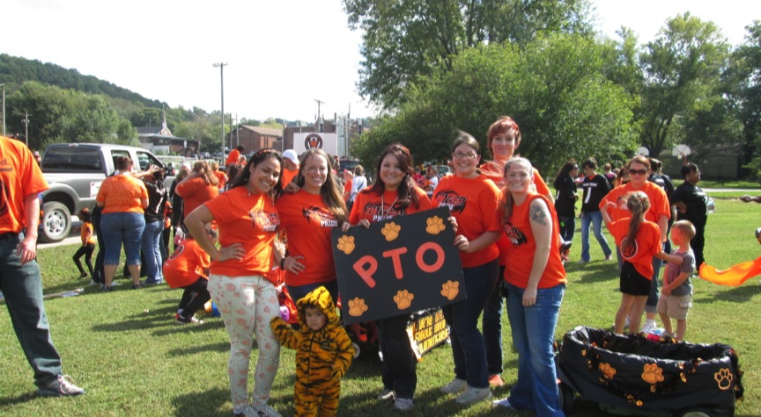
Partnering with our PTO

Slide 30
PTO
Meetings arranged so all can attend
Strong team members delegate responsibilities
Many Activities to Support Community
Popcorn Fridays
Teachers Involved

Slide 31
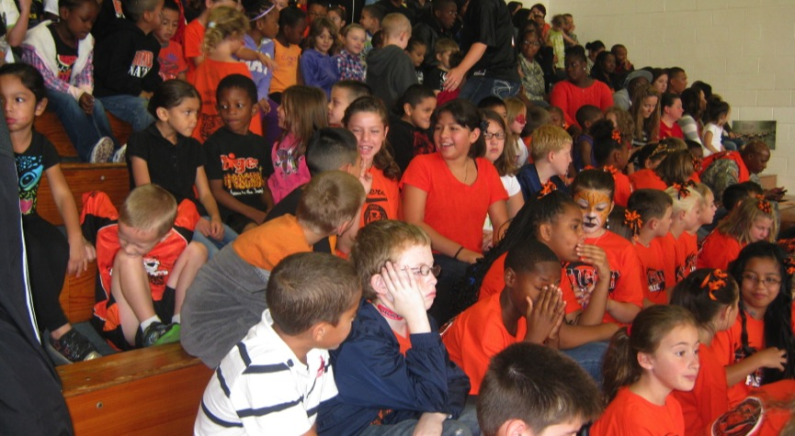
Tiger Pride!!!!
Assembly for Homecoming

Slide 32
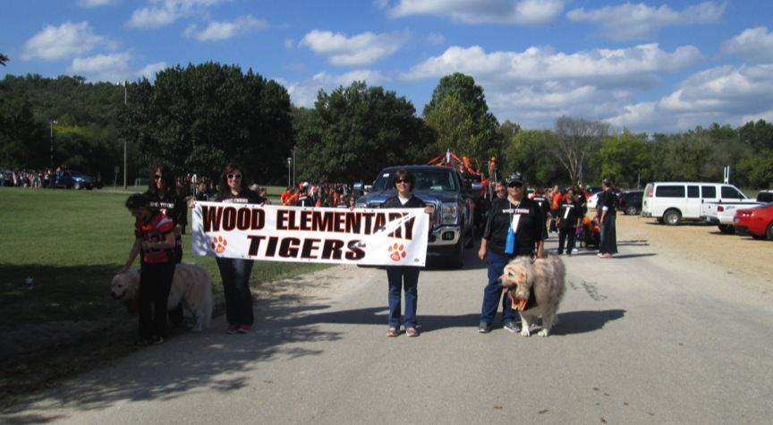
Homecoming Float

Slide 33
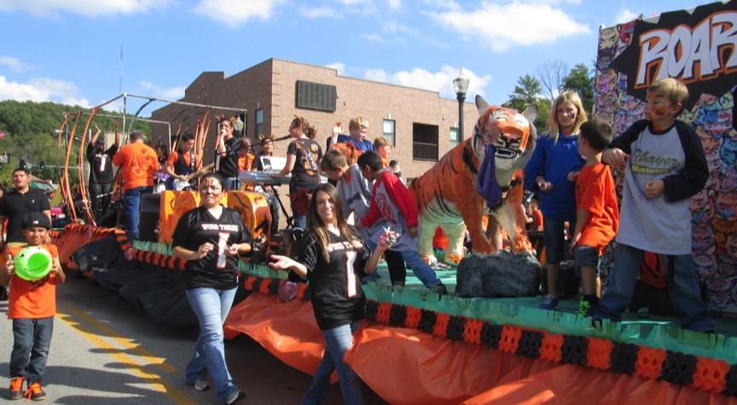
Homecoming Parade
99% Participation Rate

Slide 34
Being a Safe
Wood Tiger

Slide 35
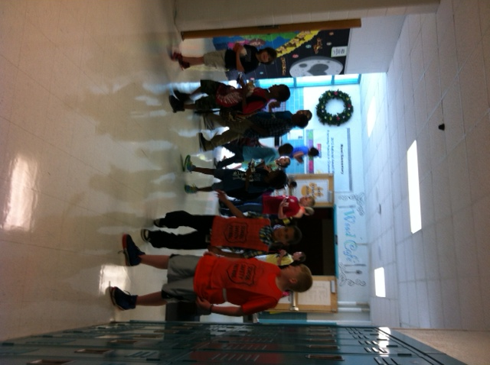
Tiger Patrol

Slide 36
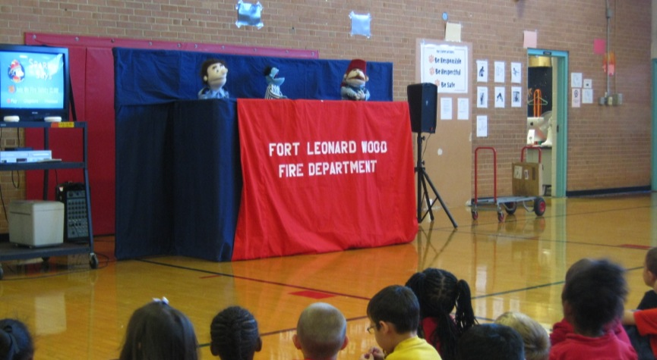
Fire Prevention
Ft. Leonard Wood Fire Department

Slide 37

Rewarding the Positives
Awards/Celebrations

Slide 38
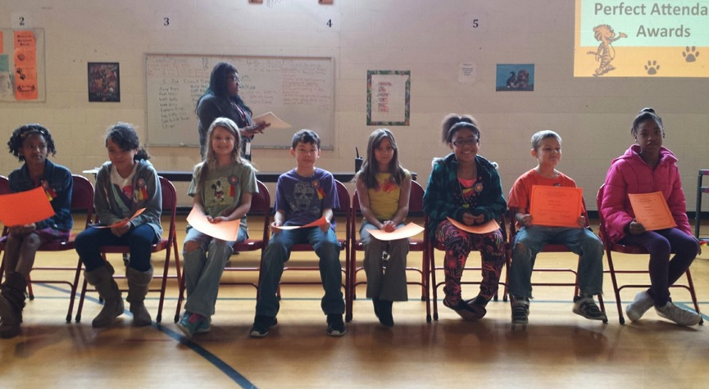
Quarterly Awards Day
Student of the Quarter

Slide 39
Opportunities for Student Recognition
Most Improved
Perfect Attendance
Music Awards
Art Awards
Physical Education Awards
Achievement Awards
Reading Awards
Character Awards

Slide 40
Be Kind Lunch “Character”

Slide 41
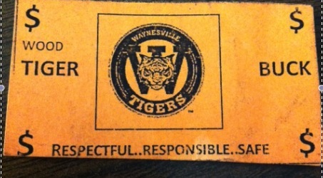
Tiger Bucks

Slide 42
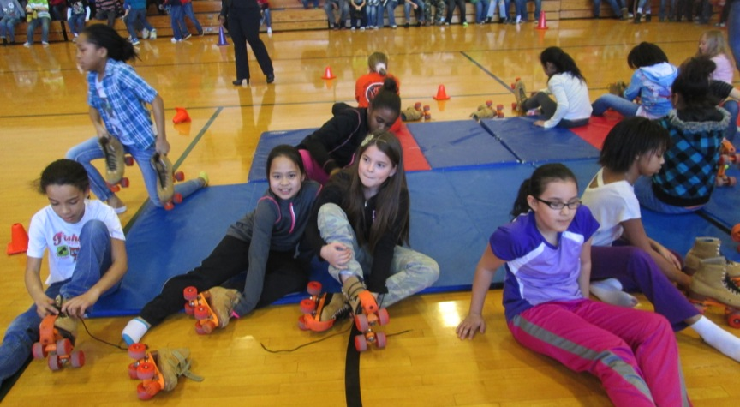
Quarterly Achievement Celebrations
Skate Parties

Slide 43
Special Events

Slide 44
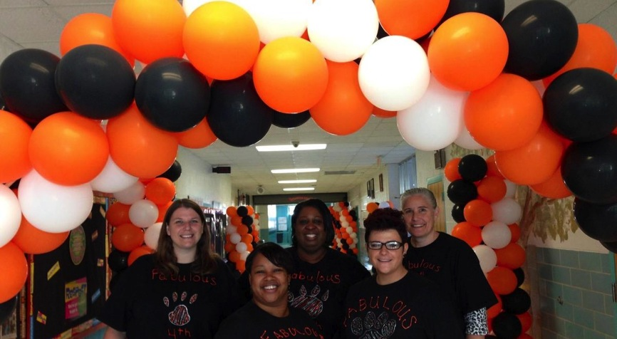
Open House for All Parents

Slide 45
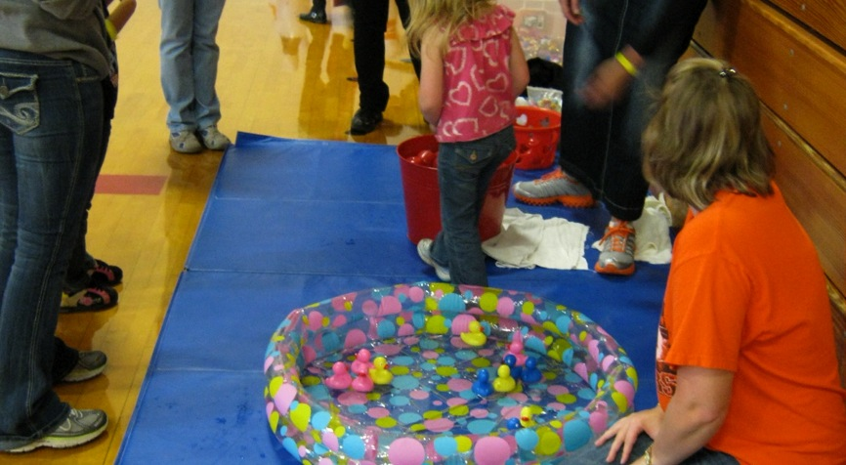
Fall and Spring Carnivals/Festivals

Slide 46

Future for Wood Elementary
Implement Tier 3
Strong Tiers

